Slide 1
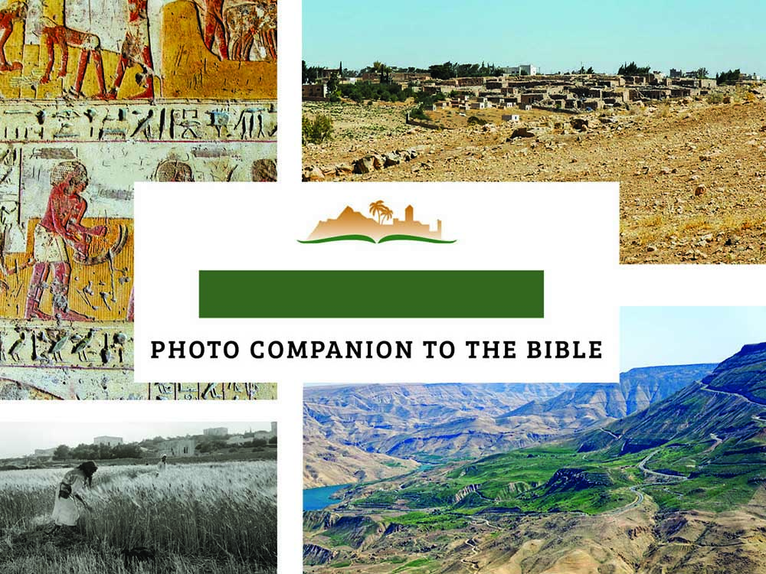
RUTH 2
Notes:
This is a free sample of the initial verses of the Ruth 2 presentation from the Photo Companion to the Bible. The complete Ruth 2 presentation includes more than 100 slides, and the Ruth volume includes more than 350 slides. To purchase the full volume, visit https://www.bibleplaces.com/ruth/
The Photo Companion to the Bible is an image-rich resource for Bible students, teachers, and researchers. Just as a librarian stocks the shelves with as many relevant materials as possible, so we have tried to provide a broad selection of images. We do not expect many situations where someone will need, desire, or even approve of every image, but our goal is that you will find in this “library” whatever it is you are looking for.
Credits: The primary creators of this presentation are Todd Bolen, Steven D. Anderson, Chris McKinny, and A.D. Riddle. The photographs have an individual file code which usually includes the initials of the photographer. Other images have additional credit or source information.
Updates: We plan to update this collection as we are able. We welcome your suggestions for improving this resource (photocompanion@bibleplaces.com). Purchasers of the Ruth volume are provided free, lifetime updates to the volume.
Copyright: This photo collection is protected by copyright law and may not be distributed without written permission from BiblePlaces.com. Slide notes should be treated as any other copyrighted written material, with credit given when quoting from these notes.
For more information, see our complete “Introduction to the Photo Companion to the Bible” online at http://www.BiblePlaces.com/Intro-Photo-Companion-Bible/. Here you will find more information about photo selection, explanatory notes, Bible translation, credit information, and copyright allowances.

Slide 2
RUTH 2
This is a free sample of the initial verses of the Ruth 2 presentation from the Photo Companion to the Bible. To purchase the full volume, visit https://www.bibleplaces.com/ruth/
The Photo Companion to the Bible is an image-rich resource for Bible students, teachers, and researchers. Just as a librarian stocks the shelves with as many relevant materials as possible, so we have tried to provide a broad selection of images. Our goal is that you will find in this “library” whatever it is you are looking for.
For more details (for this and every slide), see the Notes section below.
Notes:
This is a free sample of the initial verses of the Ruth 2 presentation from the Photo Companion to the Bible. The complete Ruth 2 presentation includes more than 100 slides, and the Ruth volume includes more than 350 slides. To purchase the full volume, visit https://www.bibleplaces.com/ruth/
The Photo Companion to the Bible is an image-rich resource for Bible students, teachers, and researchers. Just as a librarian stocks the shelves with as many relevant materials as possible, so we have tried to provide a broad selection of images. We do not expect many situations where someone will need, desire, or even approve of every image, but our goal is that you will find in this “library” whatever it is you are looking for.
Credits: The primary creators of this presentation are Todd Bolen, Steven D. Anderson, Chris McKinny, and A.D. Riddle. The photographs have an individual file code which usually includes the initials of the photographer. Other images have additional credit or source information.
Updates: We plan to update this collection as we are able. We welcome your suggestions for improving this resource (photocompanion@bibleplaces.com). Purchasers of the Ruth volume are provided free, lifetime updates to the volume.
Copyright: This photo collection is protected by copyright law and may not be distributed without written permission from BiblePlaces.com. Slide notes should be treated as any other copyrighted written material, with credit given when quoting from these notes.
For more information, see our complete “Introduction to the Photo Companion to the Bible” online at http://www.BiblePlaces.com/Intro-Photo-Companion-Bible/. Here you will find more information about photo selection, explanatory notes, Bible translation, credit information, and copyright allowances.

Slide 3
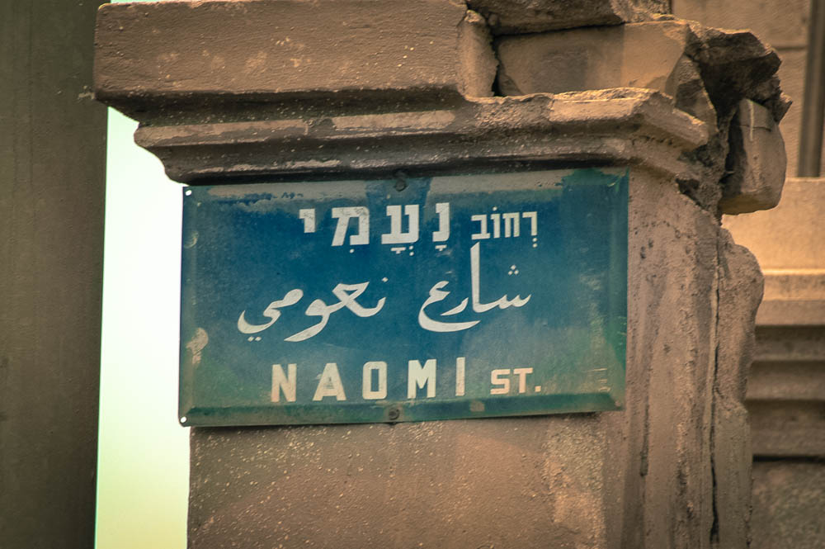
Naomi had a relative of her husband, a man of great wealth . . . whose name was Boaz
“Naomi Street” sign in Jerusalem
2:1
Notes:
Naomi is remembered in the name of a street in Jerusalem, south of the Old City in Abu Tor.
tb07240483e

Slide 4
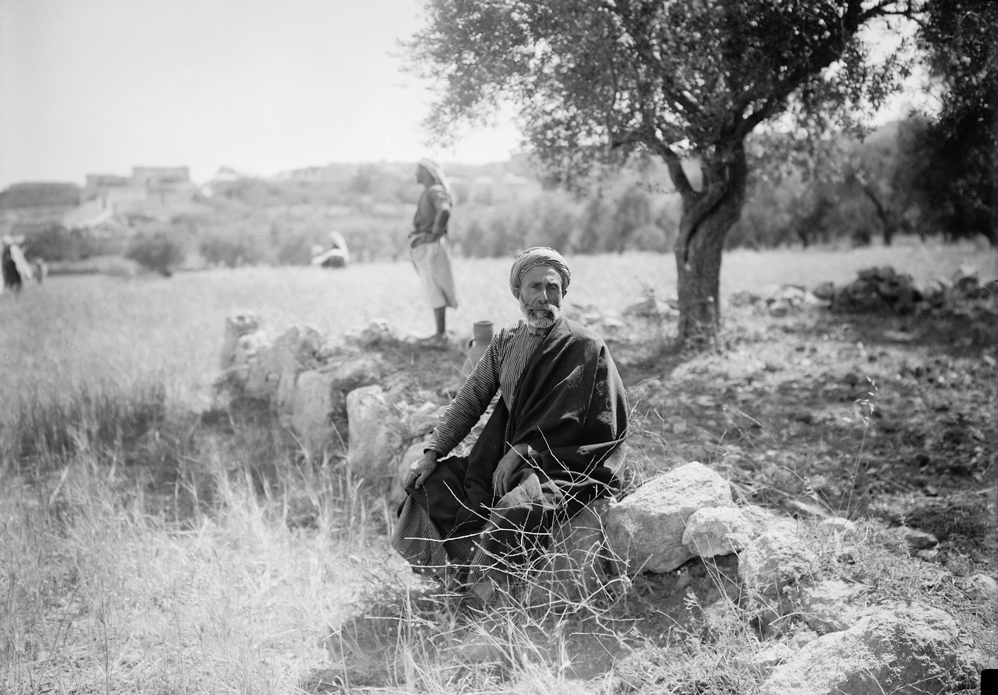
Naomi had a relative of her husband, a man of great wealth . . . whose name was Boaz
“Boaz” seated in a reenactment of the story of Ruth
2:1
Notes:
Boaz’s wealth was likely measured in his land holdings, which produced abundant quantities of food with which he could provide for a large household with many servants. The Hebrew words translated here as “a man of great wealth” are gibbôr ḥayil, which corresponds to the description of Ruth as “a woman of ḥayil [noble character]” in 3:11). This American Colony photograph was taken between 1898 and 1946.
mat10151

Slide 5
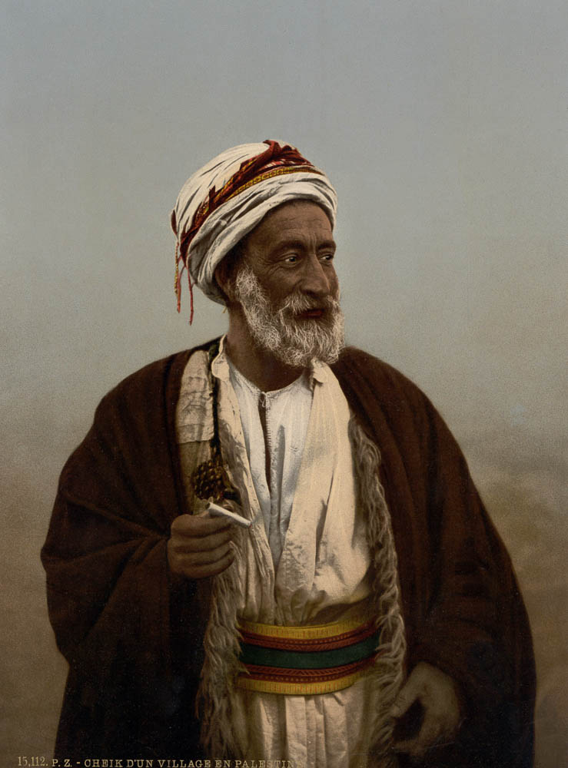
Naomi had a relative of her husband, a man of great wealth . . . whose name was Boaz
Sheikh of a village
2:1
Notes:
This photochrom image was taken in the 1890s.
pcm02753

Slide 6
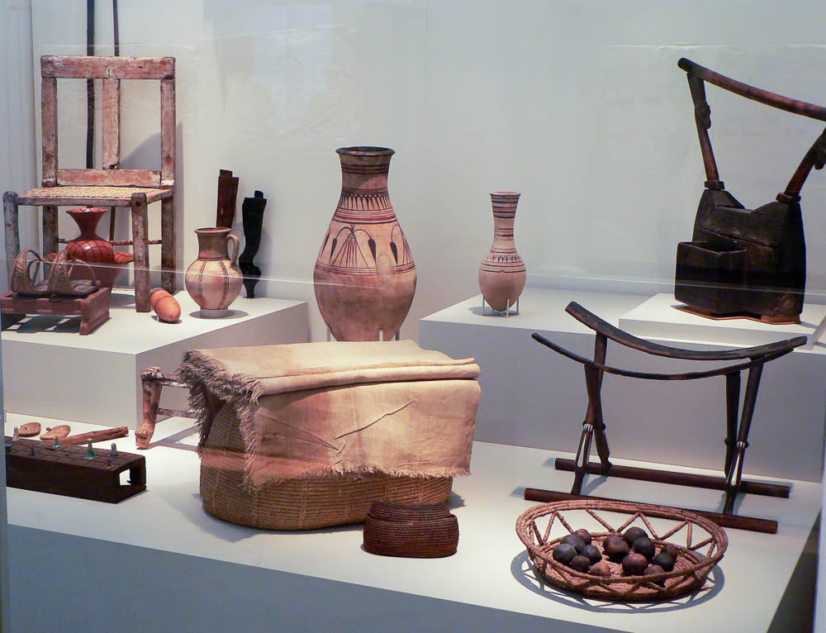
Naomi had a relative of her husband, a man of great wealth . . . whose name was Boaz
Interior furnishings of a distinguished family, 18th–20th dynasties
2:1
Notes:
This image shows items that belonged to a wealthy family in Egypt. This display was photographed at the Egyptian Museum and Papyrus Collection in Berlin.
adr070511619

Slide 7
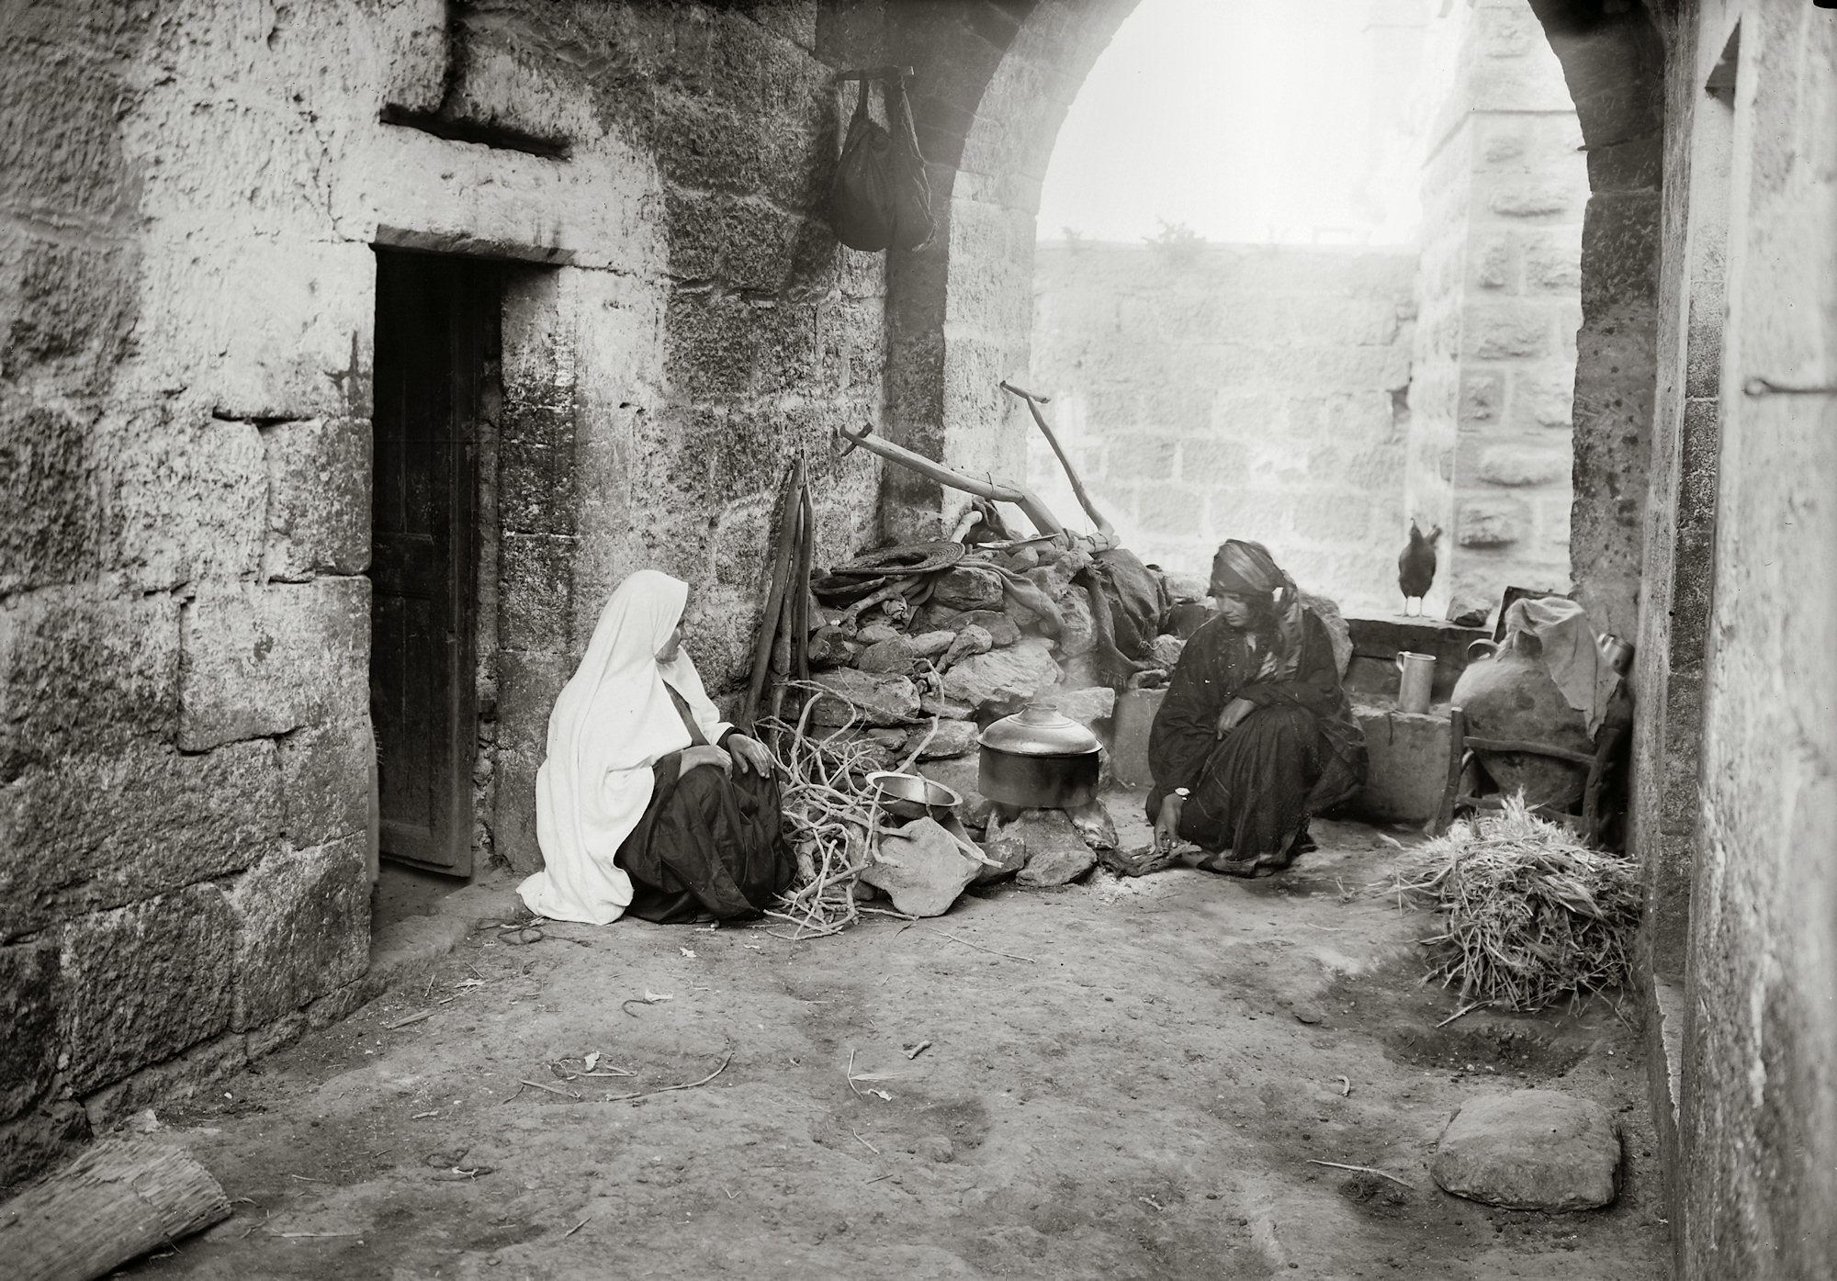
Ruth . . . said to Naomi, “Let me now go to the field and glean among the ears of grain”
Two women in the courtyard of an old house, from a reenactment of the story of Ruth
2:2
Notes:
This American Colony photograph was taken between 1898 and 1946.
mat10186

Slide 8
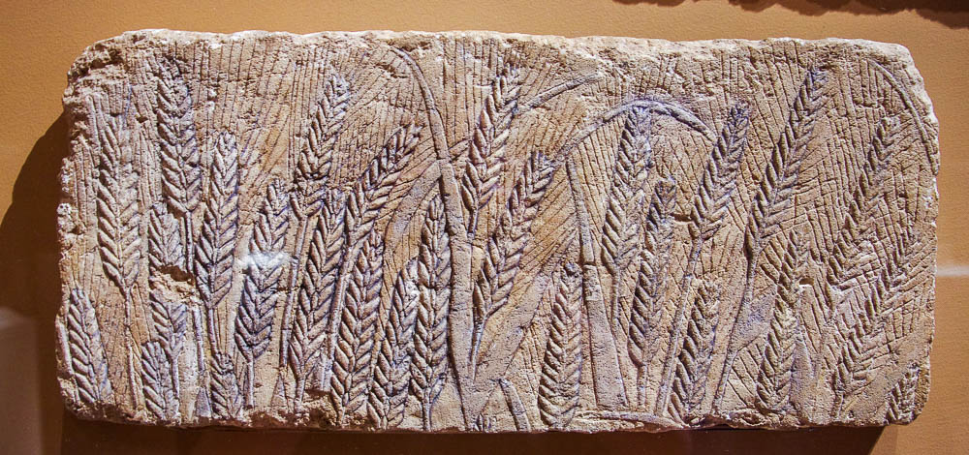
Ruth . . . said to Naomi, “Let me now go to the field and glean among the ears of grain”
Ripe barley depicted on a relief from Tell el-Amarna, reign of Akhenaten, 18th dynasty
2:2
Notes:
This relief was photographed at the Metropolitan Museum of Art in New York City.
adr1605232252

Slide 9
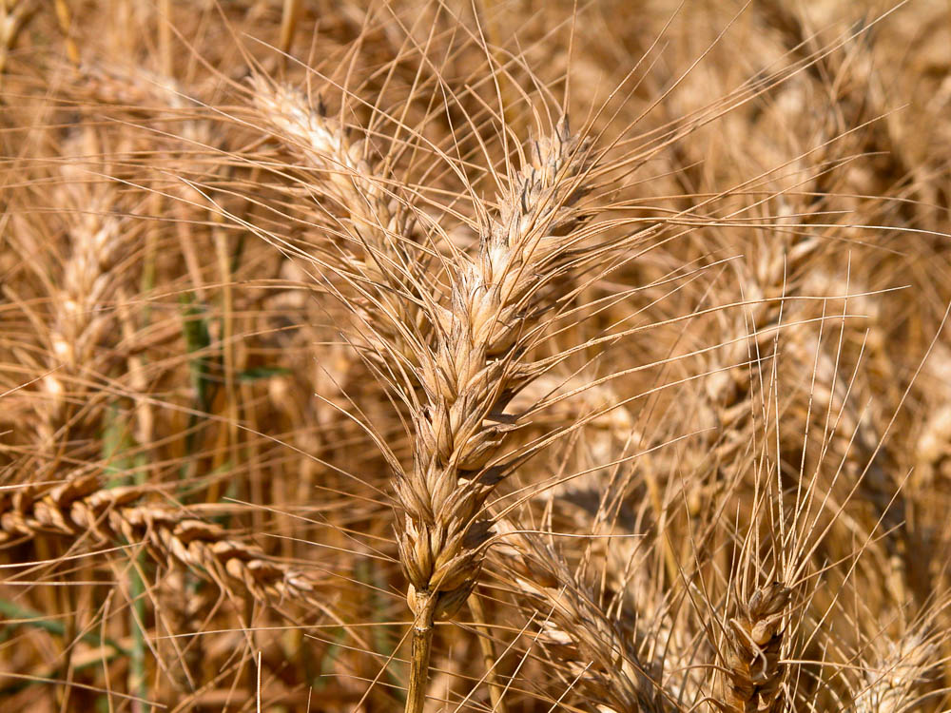
Ruth . . . said to Naomi, “Let me now go to the field and glean among the ears of grain”
Barley field near Kiriath Gat
2:2
Notes:
Kiriath Gath is located on the southern coastal plain of Israel about 25 miles (40 km) southwest of Bethlehem.
tb052203320

Slide 10
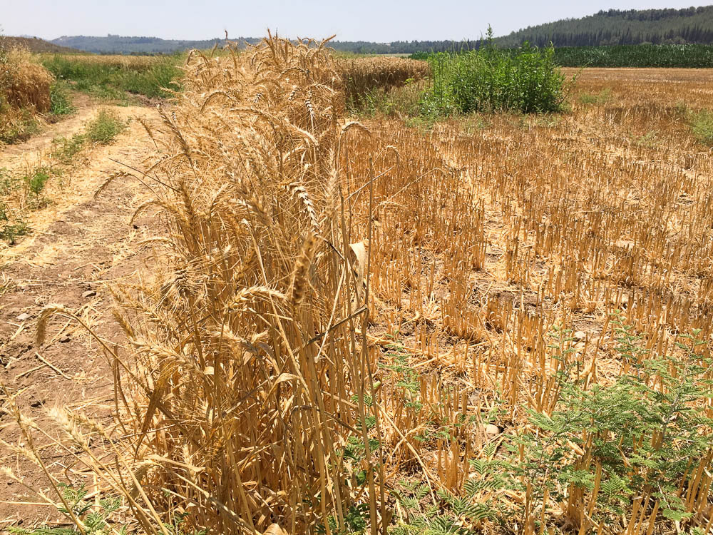
Ruth . . . said to Naomi, “Let me now go to the field and glean among the ears of grain”
Wheat left on edge of field in Sorek Valley near Timnah
2:2
Notes:
The Lord commanded his people that when they harvested the grain they were not to reap to the very edges, but they were to leave behind gleanings for the poor and foreigner (Lev 19:9-10). The field shown above is in the Shephelah, about 20 miles (32 km) west of Bethlehem.
ws061217782

Slide 11
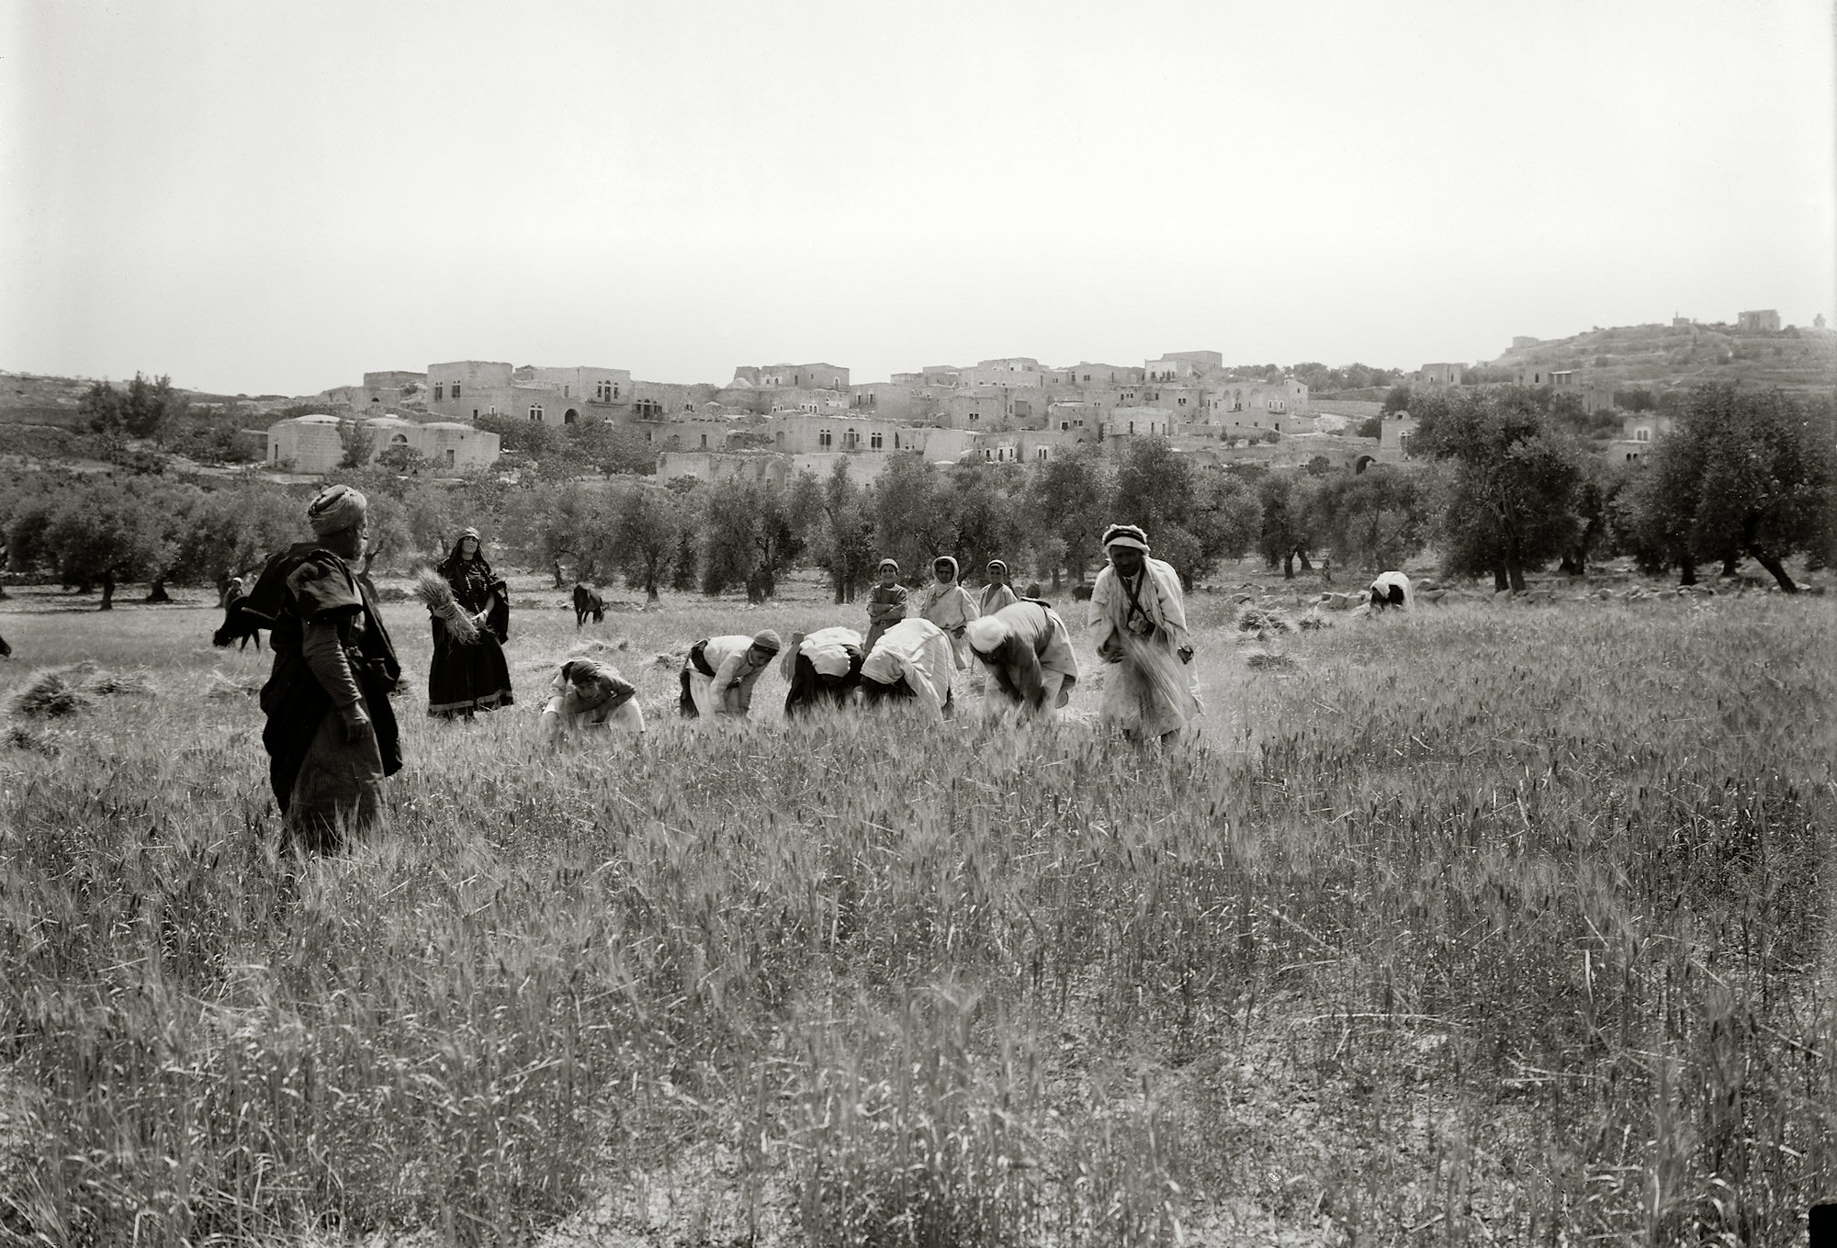
So she departed and went and gleaned in the field behind the reapers
Reapers and gleaners, from a reenactment of the story of Ruth
2:3
Notes:
This American Colony photograph was taken between 1898 and 1946, probably on the outskirts of Bethlehem.
mat10135

Slide 12
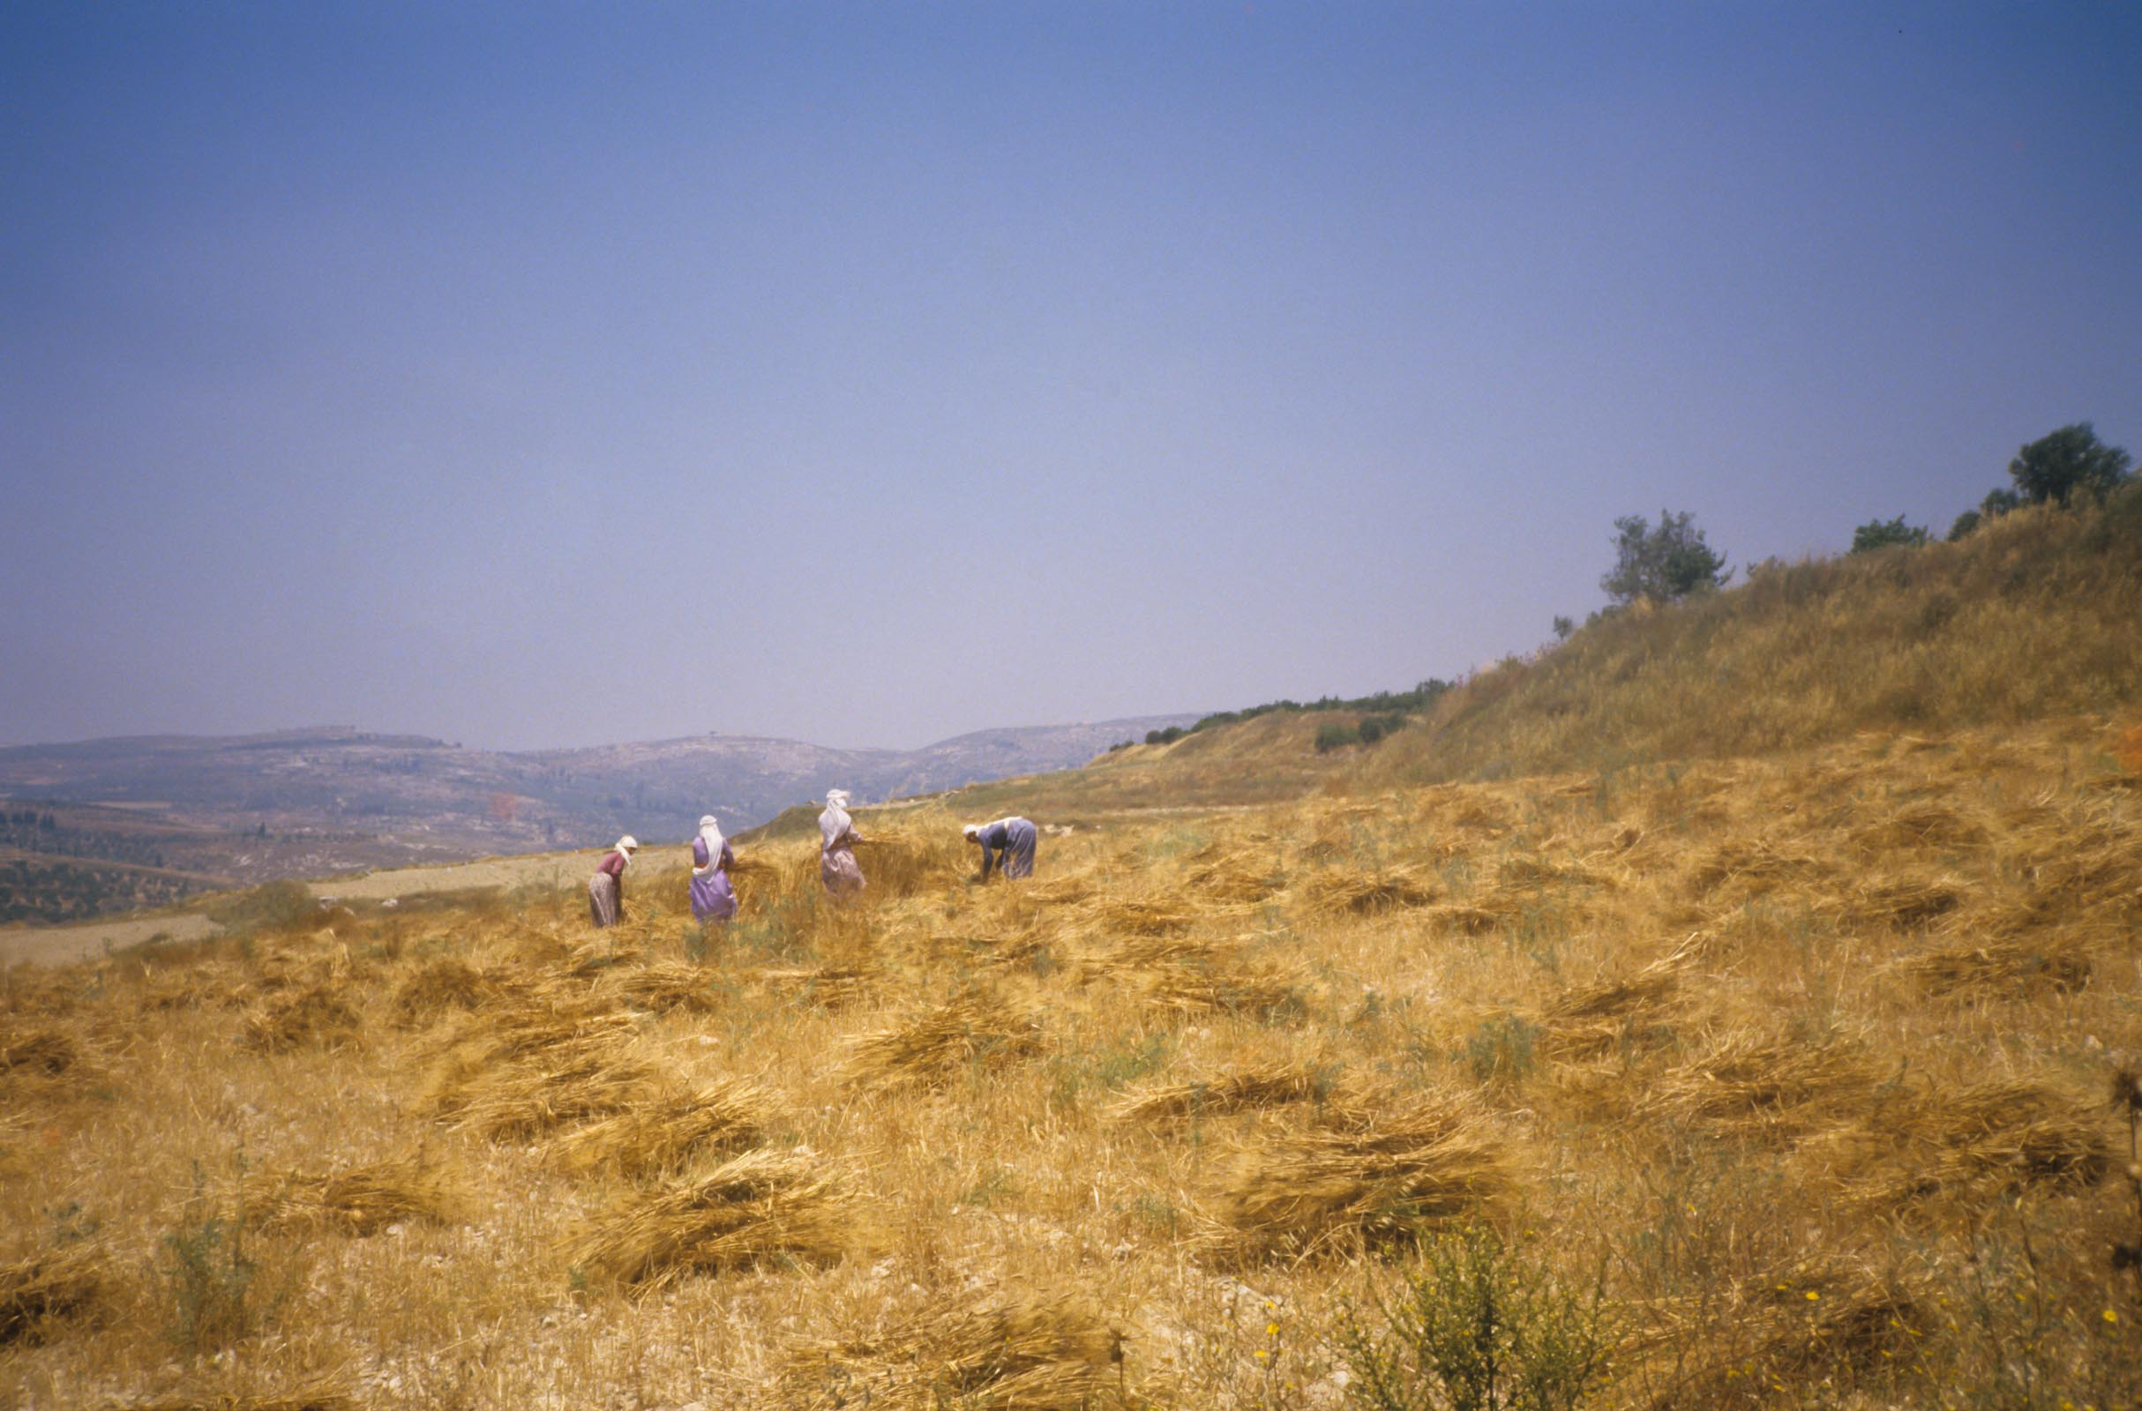
So she departed and went and gleaned in the field behind the reapers
Women harvesting wheat near Bethlehem
2:3
Notes:
This photograph was taken on the outskirts of Bethlehem in 1987.
cd060087010

Slide 13
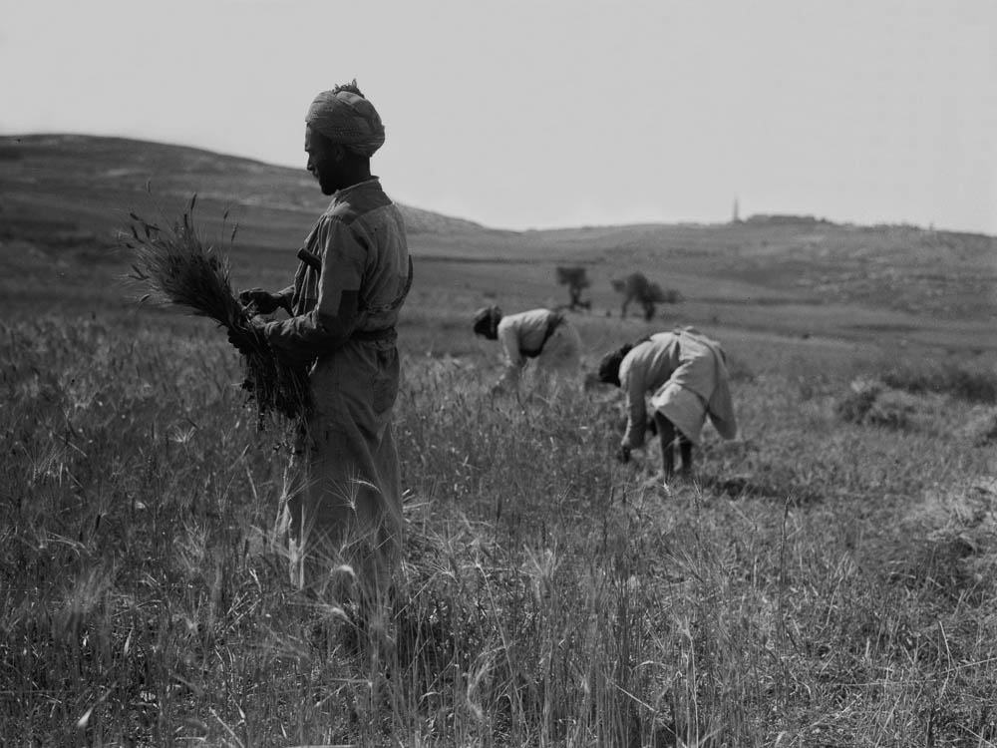
So she departed and went and gleaned in the field behind the reapers
Arab peasants reaping in grain field
2:3
Notes:
This American Colony photograph was taken between 1898 and 1946. It appears to have been taken on the eastern side of the Mount of Olives.
mat07433

Slide 14
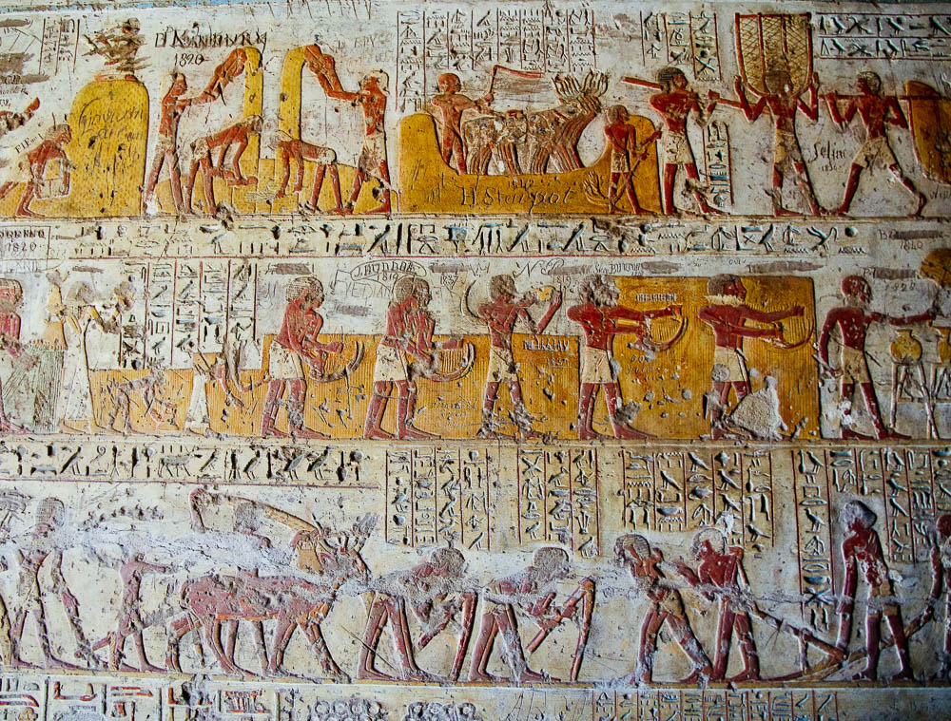
So she departed and went and gleaned in the field behind the reapers
Depiction of plowing, hoeing, reaping, threshing, and winnowing from tomb of Paheri in El-Kab
2:3
Notes:
Different field activities are documented in this tomb in Upper Egypt that dates to the time of the 18th dynasty. See the next slide for labels.
adr1603226673

Slide 15
So she departed and went and gleaned in the field behind the reapers
scribe atop
grain pile
carrying baskets
of grain to threshing
sacking grain
for granary
winnowing with
hand shovels
threshing with cattle
stopping to drink for work is hot
woman and child
gleaning behind
reapers
reaping with sickles
fanning jars to
keep contents cool
sowing seed
by hand
bag of seed
plowing with
hoes
plowing with team of men
plowing with team of cattle
Depiction of plowing, hoeing, reaping, threshing, and winnowing from tomb of Paheri in El-Kab
2:3
Notes:
Different field activities are documented in this tomb in Upper Egypt that dates to the time of the 18th dynasty.
adr1603226673

Slide 16
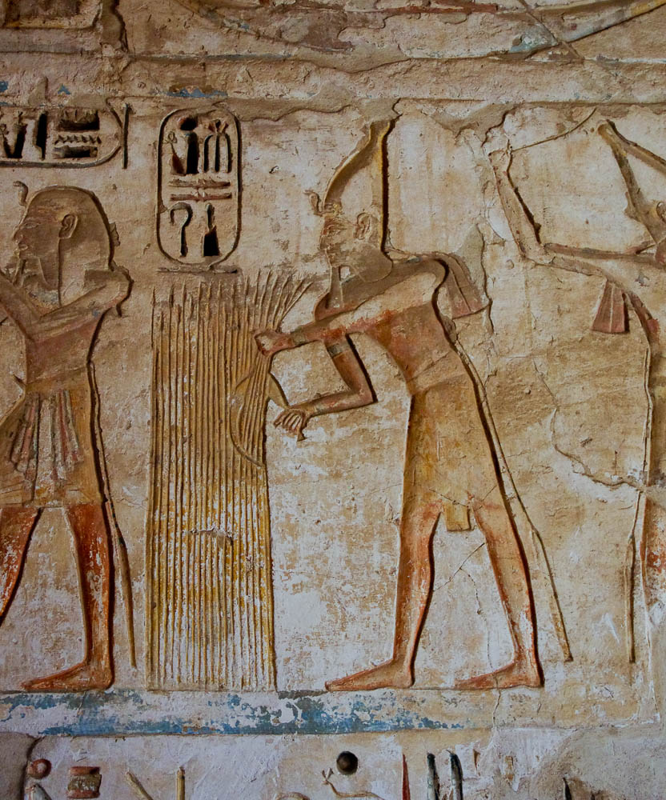
So she departed and went and gleaned in the field behind the reapers
Depiction of Ramesses III reaping, from the Mortuary Temple at Medinet Habu
2:3
Notes:
Ramesses III ruled during the 12th century BC, making him roughly contemporary with the time of Ruth.
adr1603143109

Slide 17
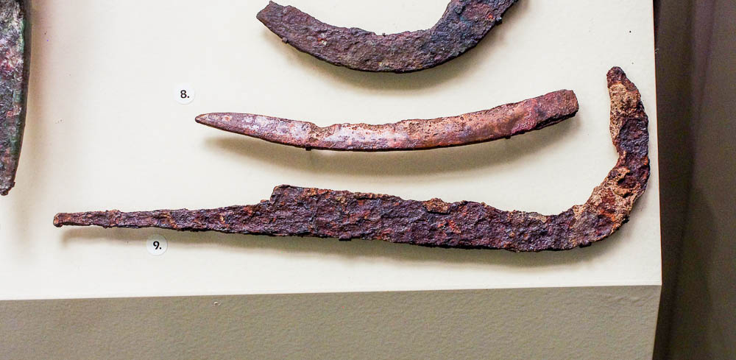
So she departed and went and gleaned in the field behind the reapers
Iron scythe (or sickle) from Beth Shemesh, 701–586 BC
2:3
Notes:
This artifact was photographed in the University of Pennsylvania Museum of Archaeology and Anthropology. Beth Shemesh is located 13 miles (21 km) west of Bethlehem. These artifacts date to many hundreds of years after the time of Ruth.
adr1605266786

Slide 18
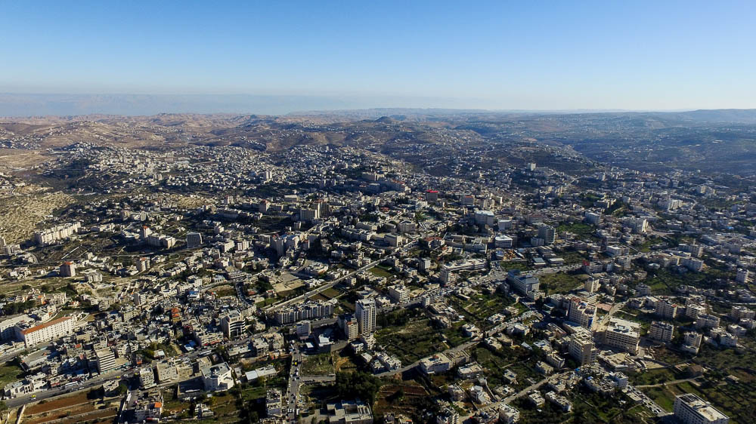
She happened to come to the part of the field that belonged to Boaz . . . of the clan of Elimelech
Environs of Bethlehem (aerial view from the northwest)
2:3
Notes:
This aerial photograph shows the greater Bethlehem area, with the Church of the Nativity (labeled on the next slide) marking the location of the ancient village. This perspective provides some idea for the many possible fields where Ruth might have gone to gather grain. In God’s providence, she “happened” to choose the field owned by Naomi’s relative, the righteous Boaz.
ws120915354

Slide 19
She happened to come to the part of the field that belonged to Boaz . . . of the clan of Elimelech
Church of the Nativity
Environs of Bethlehem (aerial view from the northwest)
2:3
Notes:
This aerial photograph shows the greater Bethlehem area, with the Church of the Nativity marking the location of the ancient village. This perspective provides some idea for the many possible fields where Ruth might have gone to gather grain. In God’s providence, she “happened” to choose the field owned by Naomi’s relative, the righteous Boaz.
ws120915354

Slide 20
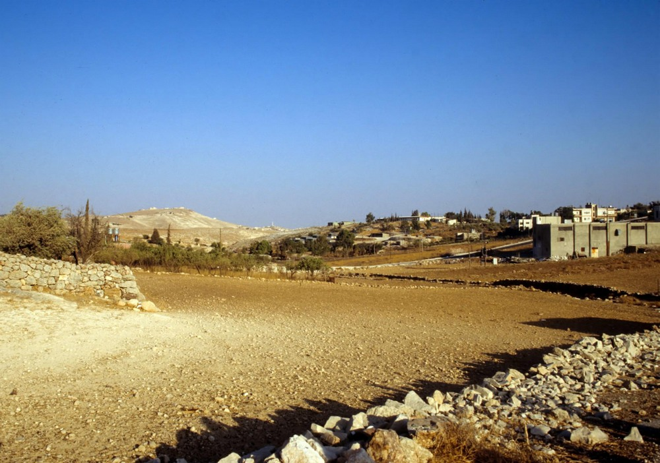
She happened to come to the part of the field that belonged to Boaz . . . of the clan of Elimelech
Fields west of Bethlehem with stone walls
2:3
Notes:
Boundaries between fields were often created by removing stones from the field itself and placing the stones in a line, as can be seen until today throughout the West Bank.
tbs43289009

Slide 21
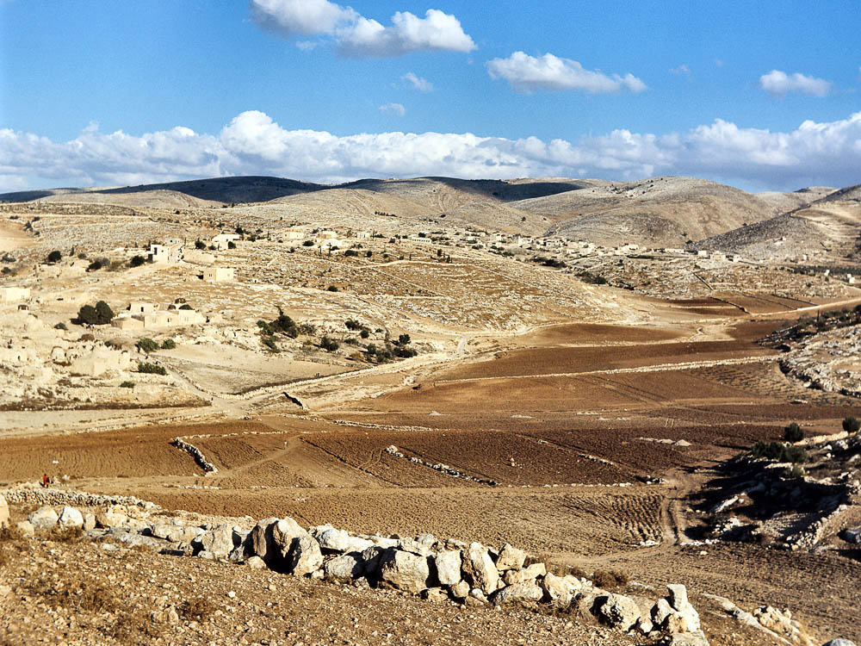
She happened to come to the part of the field that belonged to Boaz . . . of the clan of Elimelech
Plowed fields with stone walls near Simiya and Deir Samit (from the west)
2:3
Notes:
This photo, taken by David Bivin in southern Judah in 1968, shows fields that were separated by stone walls.
db6811166003

Slide 22
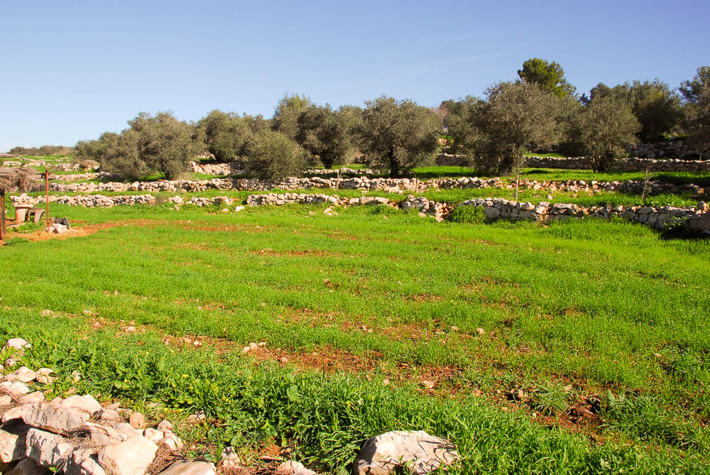
She happened to come to the part of the field that belonged to Boaz . . . of the clan of Elimelech
Newly planted wheat field at Neot Kedumim
2:3
Notes:
Neot Kedumim Biblical Landscape Reserve is located 20 miles (32 km) northwest of Bethlehem.
tb011010376

Slide 23
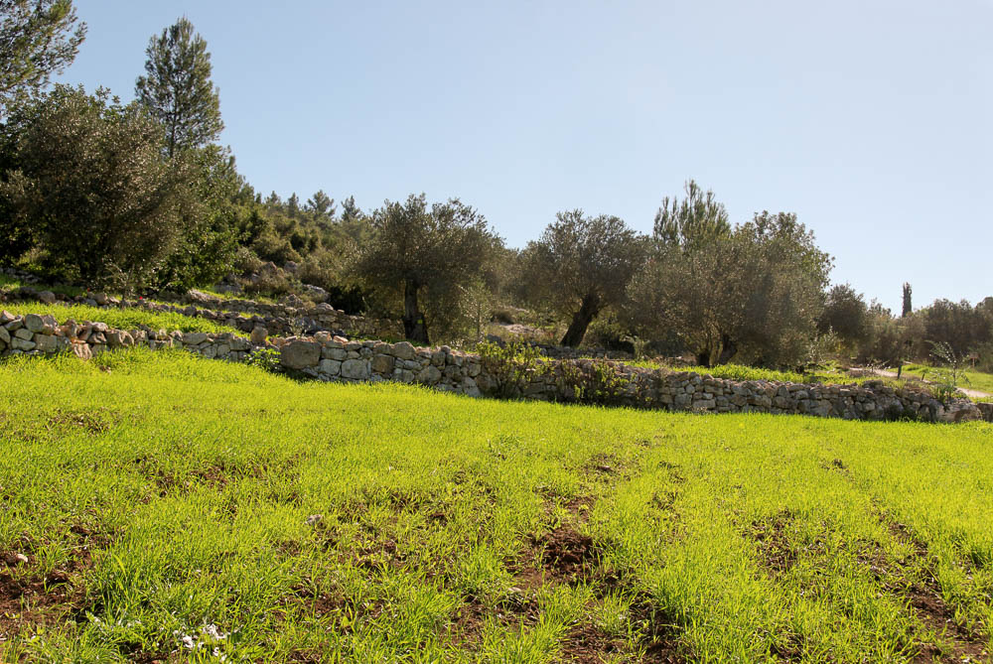
She happened to come to the part of the field that belonged to Boaz . . . of the clan of Elimelech
Newly planted wheat field at Neot Kedumim
2:3
Notes:
This photograph and the preceding one were taken in January, shortly after the wheat had sprouted. Ruth arrived in Boaz’s field at harvest time when the grain was mature. This photo is provided to illustrate fields and “the part of the field” that belonged to Boaz.
tb011010381

Slide 24
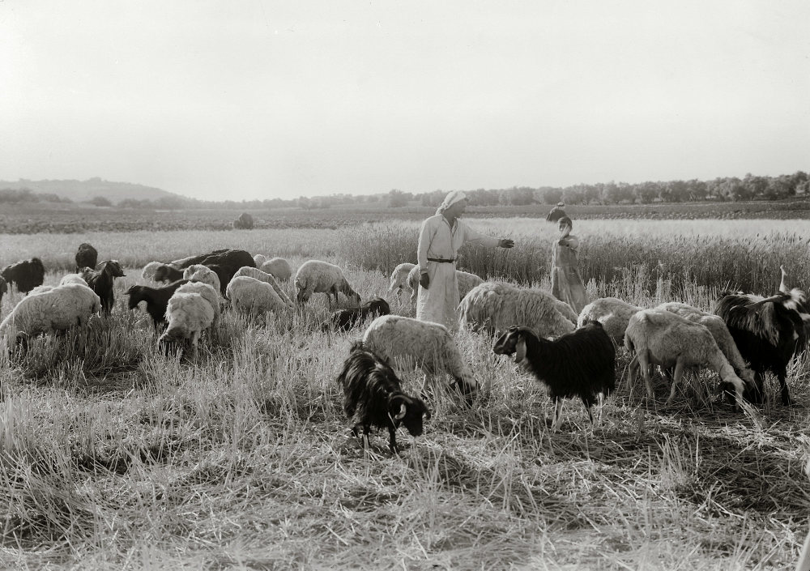
She happened to come to the part of the field that belonged to Boaz . . . of the clan of Elimelech
Sheep in harvested fields near Bethlehem
2:3
Notes:
This photo is included here to show a field that has been partly harvested, but it also shows another reality: flocks and fields are not compatible until after harvest time. Because sheep and goats will eat the crop, farmers don’t want the shepherd bringing his flock around until after the harvest. Then the animals are welcomed, as they will eat only what remains and provide fertilizer with their droppings. This American Colony photograph was taken between 1920 and 1933.
mat02612

Slide 25
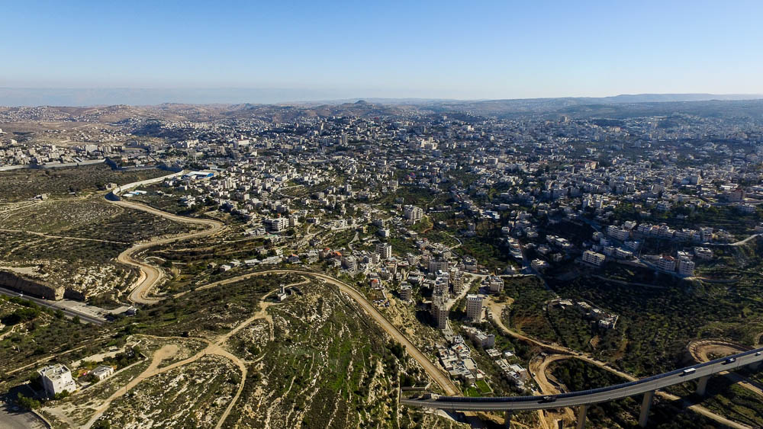
Boaz came from Bethlehem and said to the reapers, “Yahweh be with you”
Bethlehem (aerial view from the northwest)
2:4
Notes:
The ancient tell of Bethlehem is located to the south and east of the Church of the Nativity. Remains from the Iron I–II periods (circa 1200–586 BC) were uncovered at the tell. See the next slide for a label for the location of the Church of the Nativity.
ws120915337

Slide 26
Boaz came from Bethlehem and said to the reapers, “Yahweh be with you”
Bethlehem Church of Nativity
Bethlehem (aerial view from the northwest)
2:4
Notes:
The ancient tell of Bethlehem is located to the south and east of the Church of the Nativity. Remains from the Iron I–II periods (circa 1200–586 BC) were uncovered at the tell.
ws120915337

Slide 27
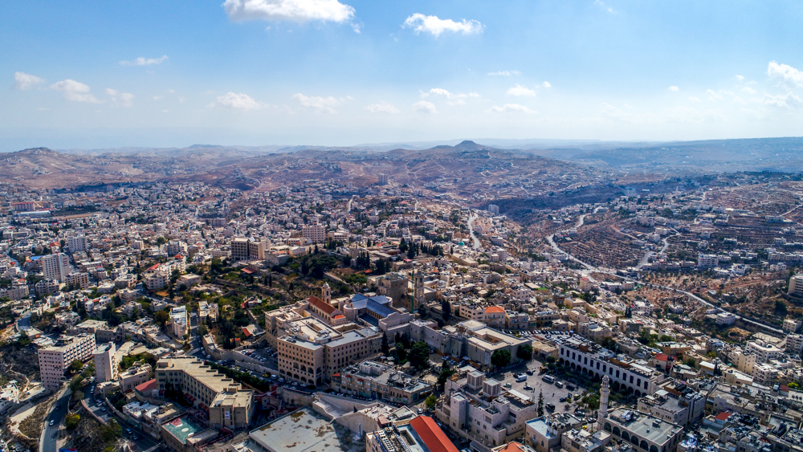
Boaz came from Bethlehem and said to the reapers, “Yahweh be with you”
Bethlehem (aerial view from the northwest)
2:4
Notes:
This photo shows the area of ancient Bethlehem. The site was surrounded by fields which have been covered with modern construction in recent decades. See the next slide for labels.
ws110117673

Slide 28
Boaz came from Bethlehem and said to the reapers, “Yahweh be with you”
approximate area of
Iron Age village
Church of Nativity
Bethlehem (aerial view from the northwest)
2:4
Notes:
This photo shows the area of ancient Bethlehem. The site was surrounded by fields which have been covered with modern construction in recent decades. The Church of the Nativity is labeled as a point of reference.
ws110117673

Slide 29
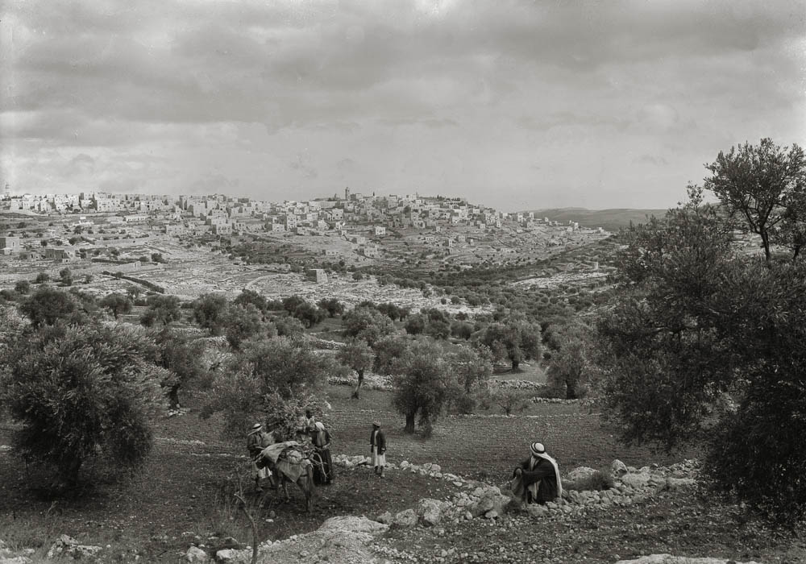
Boaz came from Bethlehem and said to the reapers, “Yahweh be with you”
Bethlehem (from the southwest)
2:4
Notes:
This American Colony photograph, taken between 1934 and 1939, shows the relation between the fields around Bethlehem and the area of the ancient village, located east of the Church of the Nativity. See the next slide for labels.
mat04038

Slide 30
Boaz came from Bethlehem and said to the reapers, “Yahweh be with you”
Church of Nativity
Iron Age village
Bethlehem (from the southwest)
2:4
Notes:
This American Colony photograph, taken between 1934 and 1939, shows the relation between the fields around Bethlehem and the area of the ancient village, located east of the Church of the Nativity.
mat04038

Slide 31
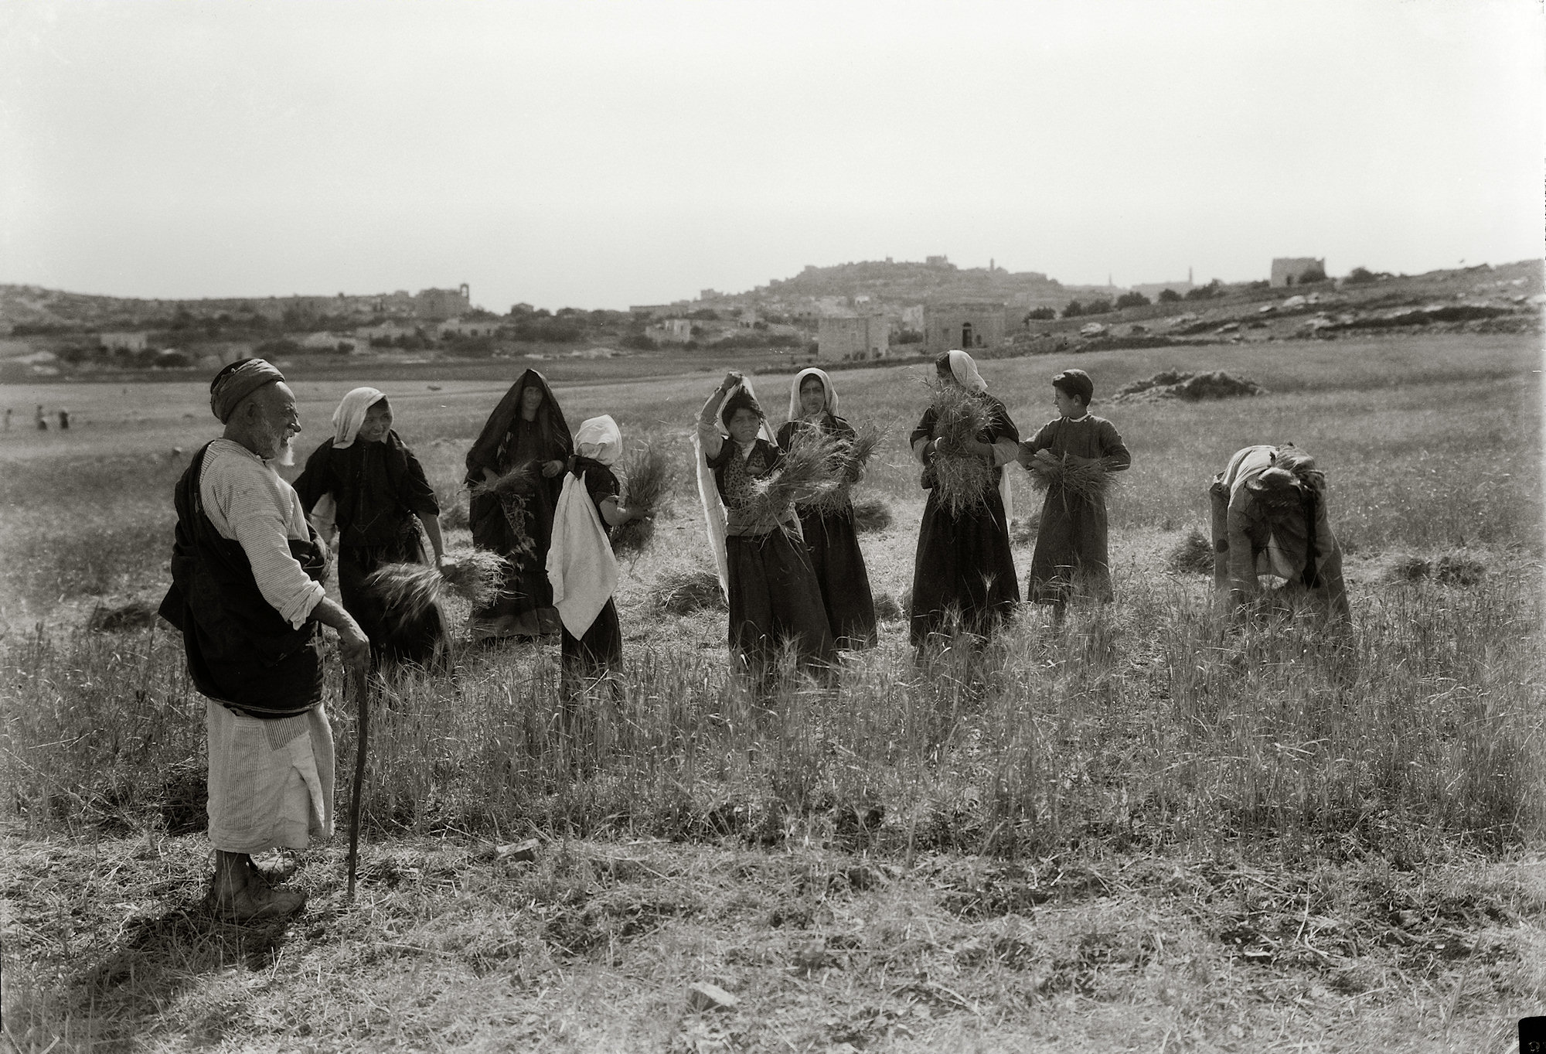
Boaz came from Bethlehem and said to the reapers, “Yahweh be with you”
Man greeting harvesters, from a reenactment of the story of Ruth
2:4
Notes:
This American Colony photograph was taken between 1925 and 1946.
mat14347

Slide 32
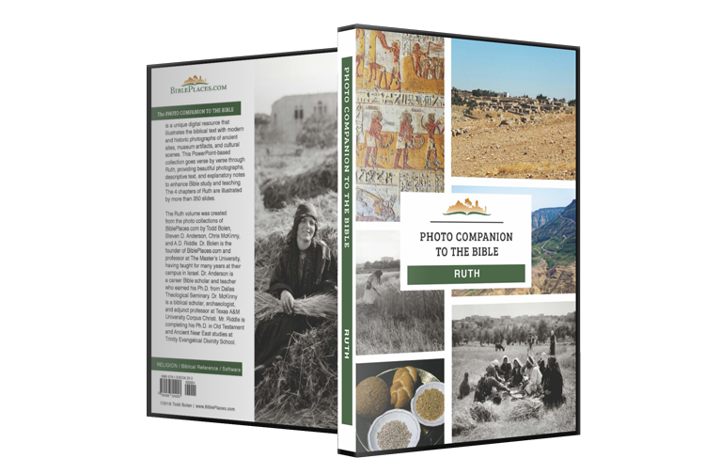
More than 350 slides in PowerPoint format. Available now from BiblePlaces.com.
Notes:
This is a free sample of the initial verses of the Ruth 2 presentation from the Photo Companion to the Bible. The complete Ruth 2 presentation includes more than 100 slides, and the Ruth volume includes more than 350 slides. To purchase the full volume, visit https://www.bibleplaces.com/ruth/
The Photo Companion to the Bible is an image-rich resource for Bible students, teachers, and researchers. Just as a librarian stocks the shelves with as many relevant materials as possible, so we have tried to provide a broad selection of images. Our goal is that you will find in this “library” whatever it is you are looking for.
Credits: The primary creators of this presentation are Steven D. Anderson, A.D. Riddle, Christian Locatell, Kris Udd, and Todd Bolen. The photographs have an individual file code which usually includes the initials of the photographer. Other images have additional credit or source information.
Updates: We plan to update this collection as we are able. We welcome your suggestions for improving this resource (photocompanion@bibleplaces.com). Purchasers of the Ruth volume are provided free, lifetime updates to the volume.
Copyright: This photo collection is protected by copyright law and may not be distributed without written permission from BiblePlaces.com. Slide notes should be treated as any other copyrighted written material, with credit given when quoting from these notes.
For more information, see our complete “Introduction to the Photo Companion to the Bible” online at http://www.BiblePlaces.com/Intro-Photo-Companion-Bible/. Here you will find more information about photo selection, explanatory notes, Bible translation, credit information, and copyright allowances.

