Slide 1
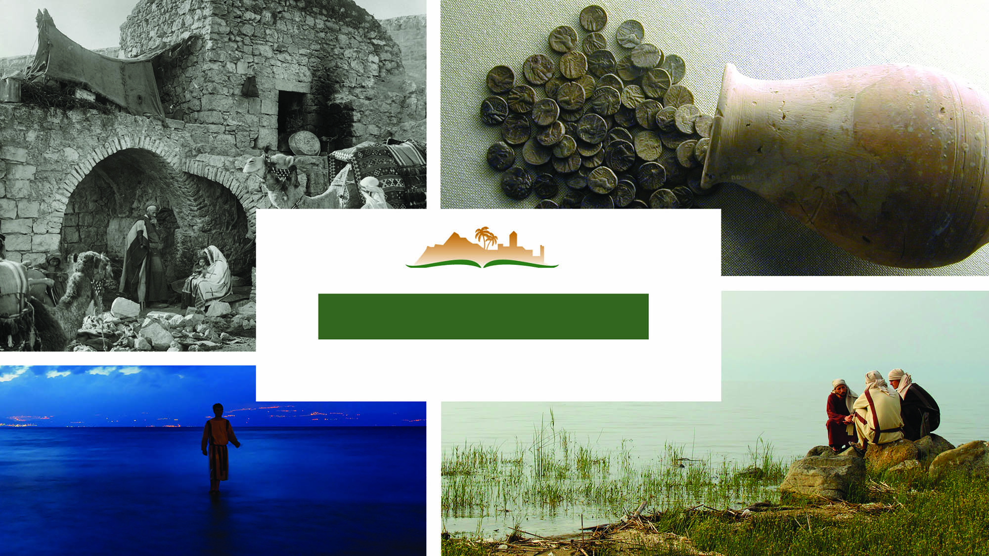
MATTHEW 4
Notes:
This is a free sample of the Matthew 4 presentation from the Photo Companion to the Bible. To purchase the full volume, visit https://www.bibleplaces.com/matthew/
The Photo Companion to the Bible is an image-rich resource for Bible students, teachers, and researchers. Just as a librarian stocks the shelves with as many relevant materials as possible, so we have tried to provide a broad selection of images. Our goal is that you will find in this “library” whatever it is you are looking for.
Credits: The primary creators of this presentation are Steven D. Anderson, A.D. Riddle, and Todd Bolen. The photographs have an individual file code which usually includes the initials of the photographer. Other images have additional credit or source information.
Updates: We plan to update this collection as we are able. We welcome your suggestions for improving this resource (photocompanion@bibleplaces.com). Purchasers of the Matthew volume are provided free, lifetime updates to the volume.
Copyright: This photo collection is protected by copyright law and may not be distributed without written permission from BiblePlaces.com. Slide notes should be treated as any other copyrighted written material, with credit given when quoting from these notes.
For more information, see our complete “Introduction to the Photo Companion to the Bible” online at http://www.BiblePlaces.com/Intro-Photo-Companion-Bible/. Here you will find more information about photo selection, explanatory notes, Bible translation, credit information, and copyright allowances.

Slide 2
MATTHEW 4
This is a free sample of the Matthew 4 presentation from the Photo Companion to the Bible. To purchase the full volume, visit https://www.bibleplaces.com/matthew/
The Photo Companion to the Bible is an image-rich resource for Bible students, teachers, and researchers. Just as a librarian stocks the shelves with as many relevant materials as possible, so we have tried to provide a broad selection of images. Our goal is that you will find in this “library” whatever it is you are looking for.
For more details (for this and every slide), see the Notes section below.
Notes:
This is a free sample of the Matthew 4 presentation from the Photo Companion to the Bible. To purchase the full volume, visit https://www.bibleplaces.com/matthew/
The Photo Companion to the Bible is an image-rich resource for Bible students, teachers, and researchers. Just as a librarian stocks the shelves with as many relevant materials as possible, so we have tried to provide a broad selection of images. Our goal is that you will find in this “library” whatever it is you are looking for.
Credits: The primary creators of this presentation are Steven D. Anderson, A.D. Riddle, and Todd Bolen. The photographs have an individual file code which usually includes the initials of the photographer. Other images have additional credit or source information.
Updates: We plan to update this collection as we are able. We welcome your suggestions for improving this resource (photocompanion@bibleplaces.com). Purchasers of the Matthew volume are provided free, lifetime updates to the volume.
Copyright: This photo collection is protected by copyright law and may not be distributed without written permission from BiblePlaces.com. Slide notes should be treated as any other copyrighted written material, with credit given when quoting from these notes.
For more information, see our complete “Introduction to the Photo Companion to the Bible” online at http://www.BiblePlaces.com/Intro-Photo-Companion-Bible/. Here you will find more information about photo selection, explanatory notes, Bible translation, credit information, and copyright allowances.

Slide 3
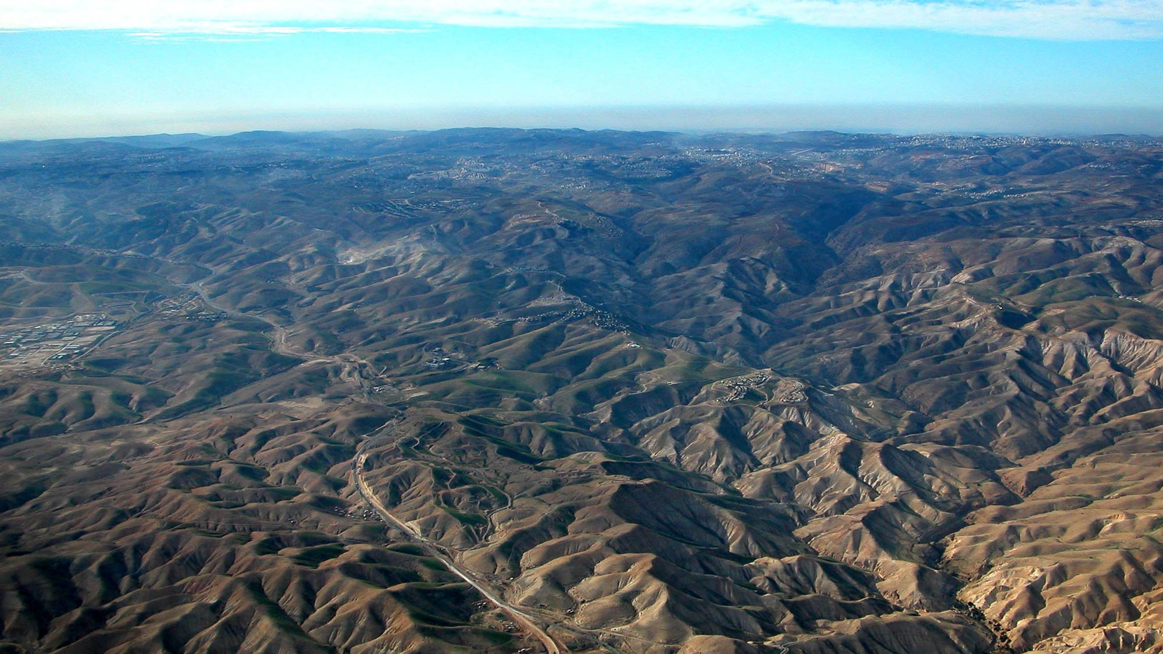
Jesus was led by the Spirit into the wilderness
Judean wilderness west of Jericho (aerial view from the east)
4:1
Notes:
Because of its lack of water and good routes, the Judean wilderness has been (mostly) uninhabited throughout history. Consequently it was an ideal place for those seeking refuge from enemies or retreat from the world. John the Baptist preached here, and it seems likely that this was the wilderness where Jesus was tempted.
tb010703286h

Slide 4
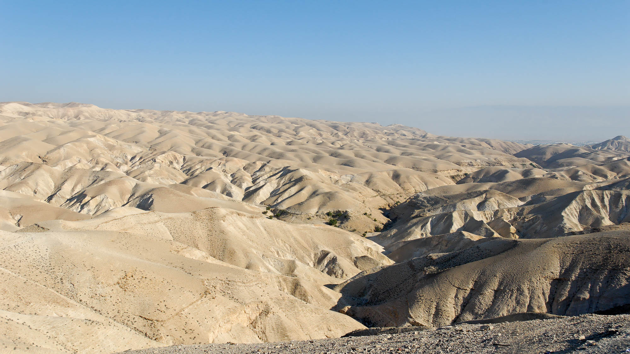
Jesus was led by the Spirit into the wilderness
Judean wilderness
4:1
Notes:
This photo shows the wilderness west of Jericho. This area is a possible area for the temptation because it is in closer proximity to the Jordan River where Jesus was baptized.
tb113006600

Slide 5
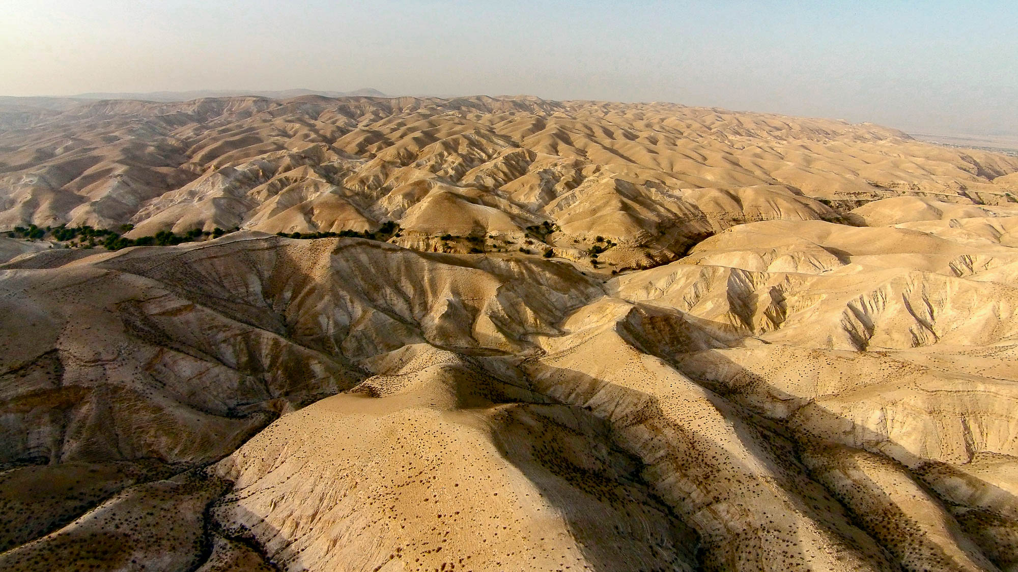
Jesus was led by the Spirit into the wilderness
Judean wilderness near the Wadi Qilt (aerial view from the south)
4:1
Notes:
If Jesus was tempted in the wilderness near Jericho, he could well have been in the area shown in this photograph. The Wadi Qilt is the canyon with trees running through the center of the photo. Jericho is just out of view on the right side.
ws092414442h

Slide 6
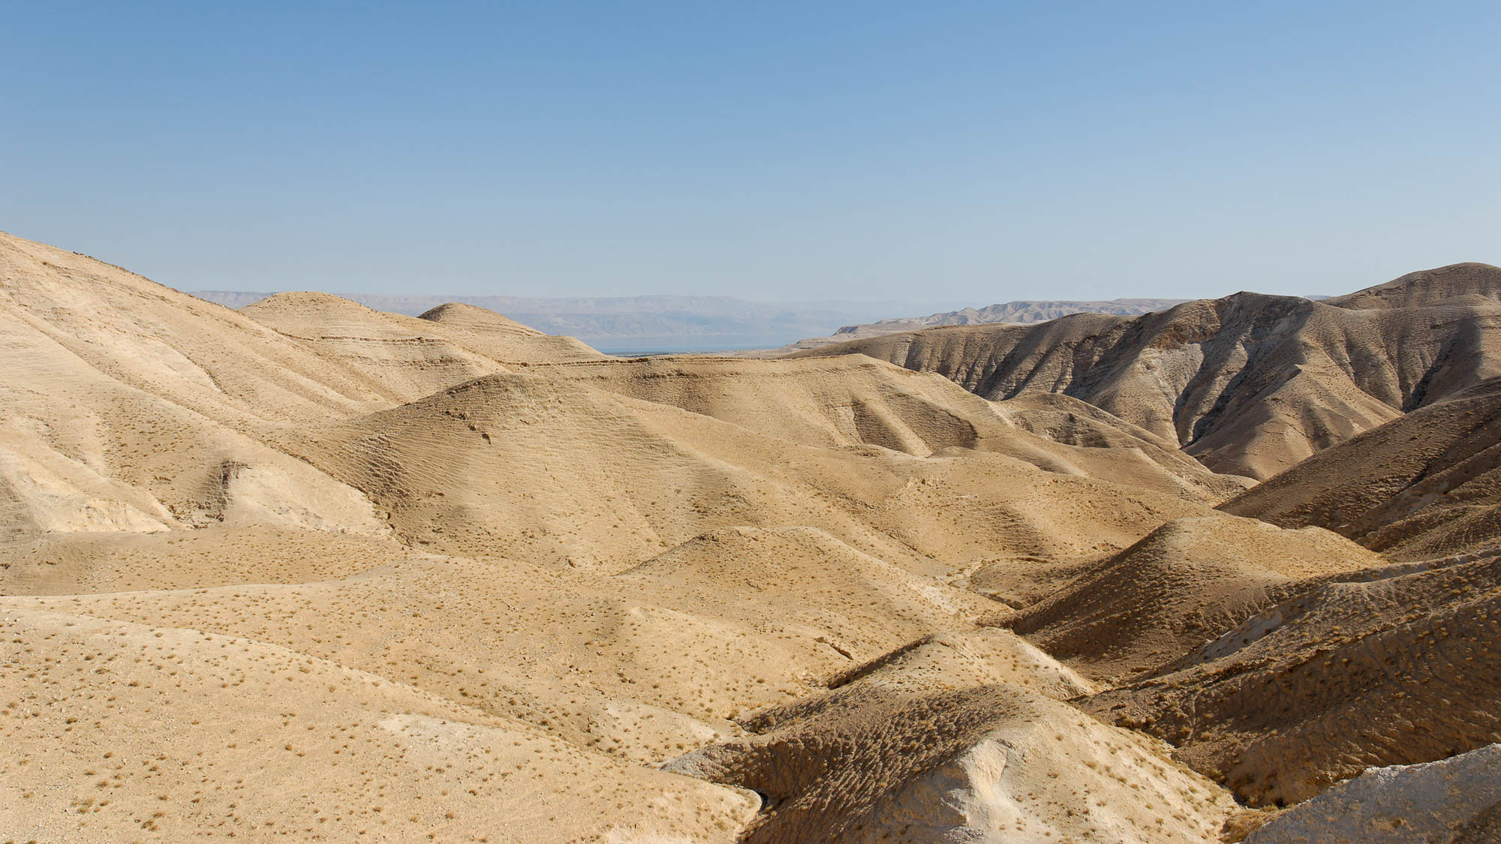
Jesus was led by the Spirit into the wilderness
Judean wilderness and the Dead Sea
4:1
Notes:
This photograph shows the wilderness area to the southwest of Jericho and the Jordan River. Jesus may have traveled southwestward in an attempt to avoid people traveling along the road from Jericho to Jerusalem.
tb092706221

Slide 7
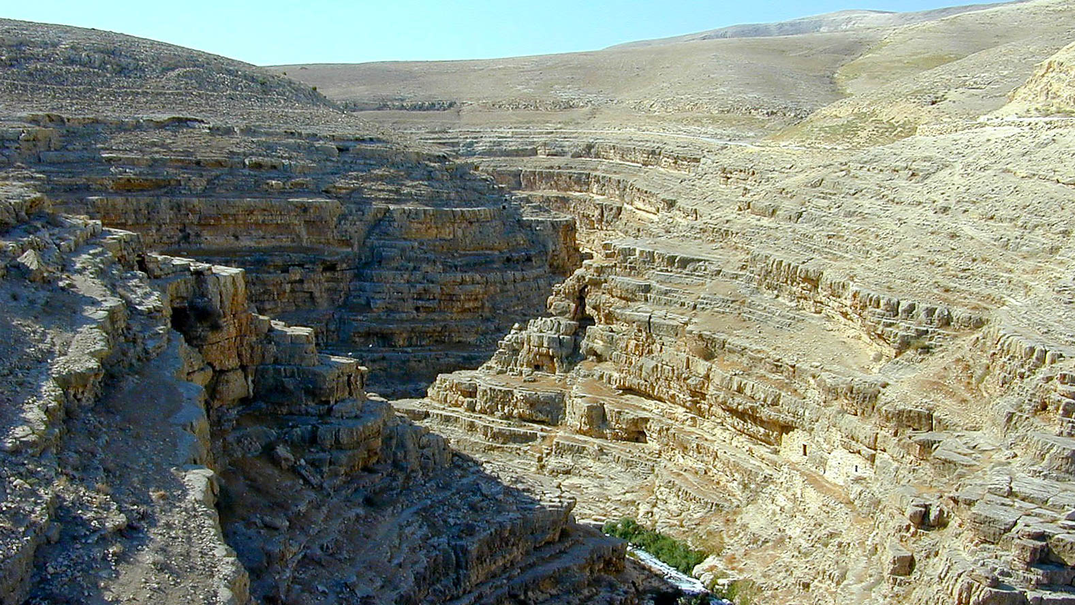
Jesus was led by the Spirit into the wilderness
Judean wilderness near Mar Saba
4:1
Notes:
This photo shows the Nahal Kidron which runs from Jerusalem to the Dead Sea. The Mar Saba Monastery was built overlooking this canyon.
tb100200296h

Slide 8
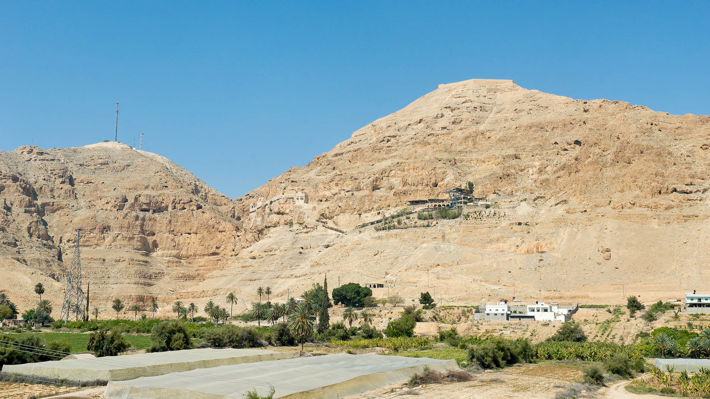
Jesus was led by the Spirit into the wilderness
Traditional Mount of Temptation near Jericho (from the east)
4:1
Notes:
The traditional Mount of Temptation is conveniently located near Jericho, providing easy access for tourists. It seems likely that Jesus was tempted in a more remote part of the wilderness. See the next slide for a label.
tb051106850h

Slide 9
Jesus was led by the Spirit into the wilderness
Monastery of the Temptation
Traditional Mount of Temptation near Jericho (from the east)
4:1
Notes:
The traditional Mount of Temptation is conveniently located near Jericho, providing easy access for tourists. It seems likely that Jesus was tempted in a more remote part of the wilderness.
tb051106850h

Slide 10
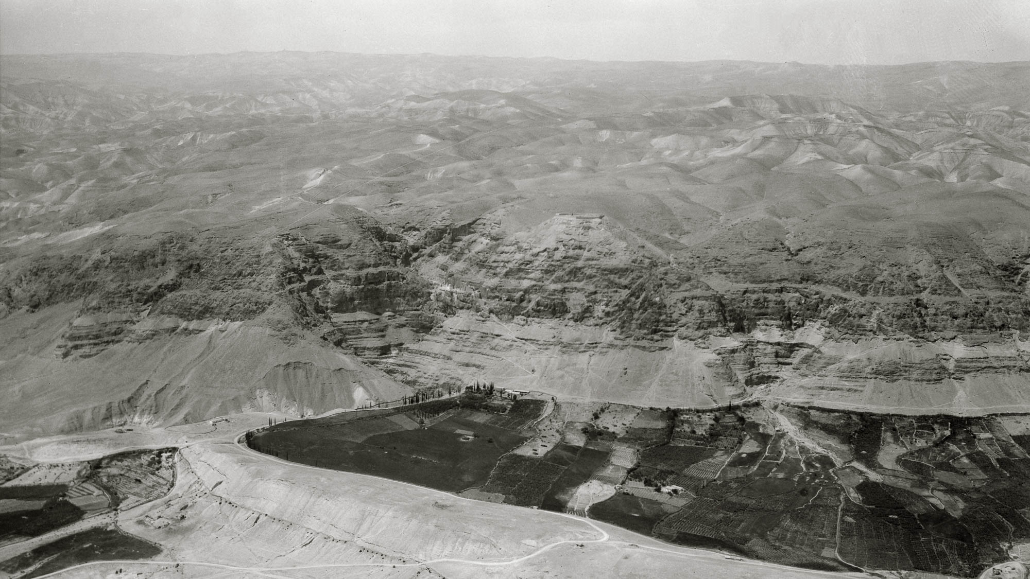
Jesus was led by the Spirit into the wilderness
Wilderness of Judea and the traditional Mount of Temptation (from the east)
4:1
Notes:
The traditional Mount of Temptation is in the center of this aerial photo taken by the American Colony photographers in the 1930s. See the next slide for labels.
mat14208h

Slide 11
Jesus was led by the Spirit into the wilderness
Wilderness of Judea
Monastery of the Temptation
Jericho
Wilderness of Judea and the traditional Mount of Temptation (from the east)
4:1
Notes:
The traditional Mount of Temptation is in the center of this aerial photo taken by the American Colony photographers in the 1930s.
mat14208h

Slide 12
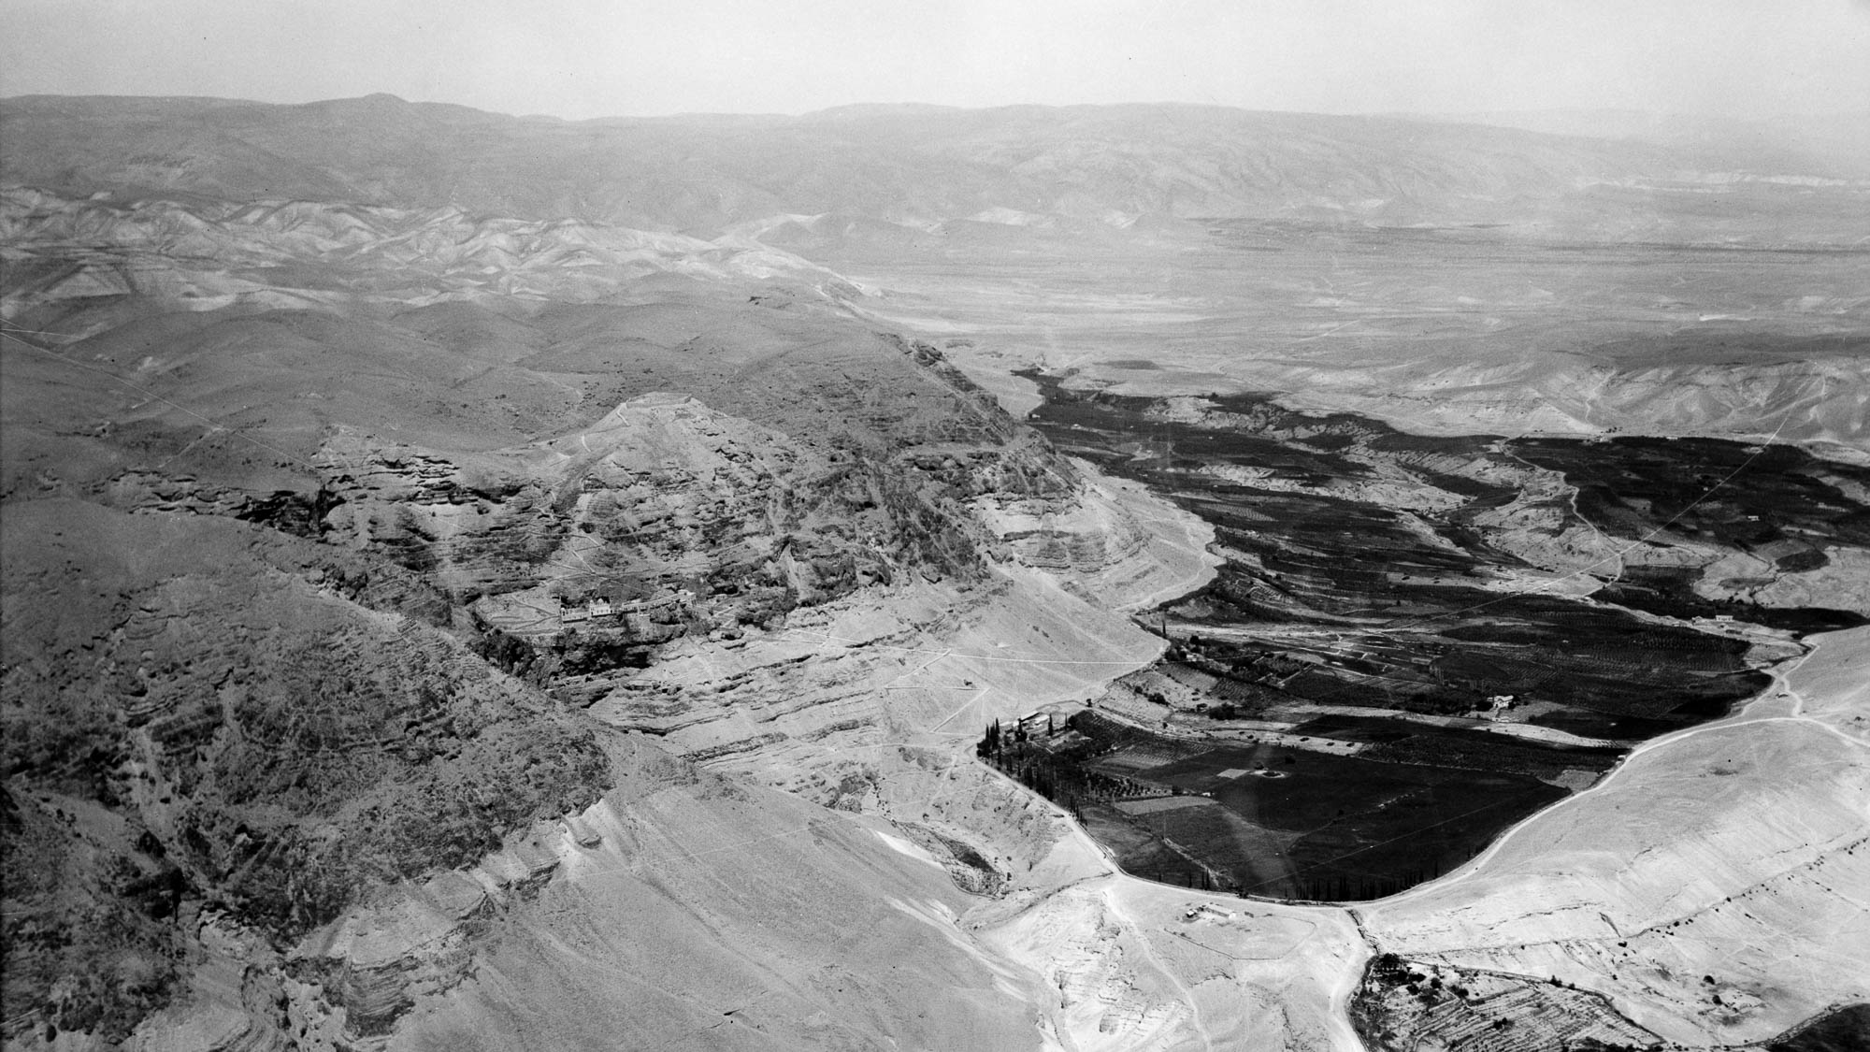
Jesus was led by the Spirit into the wilderness
Traditional Mount of Temptation near Jericho (aerial view from the south)
4:1
Notes:
This American Colony photograph was taken in 1931. The Monastery of the Temptation is circled.
mat22118h

Slide 13
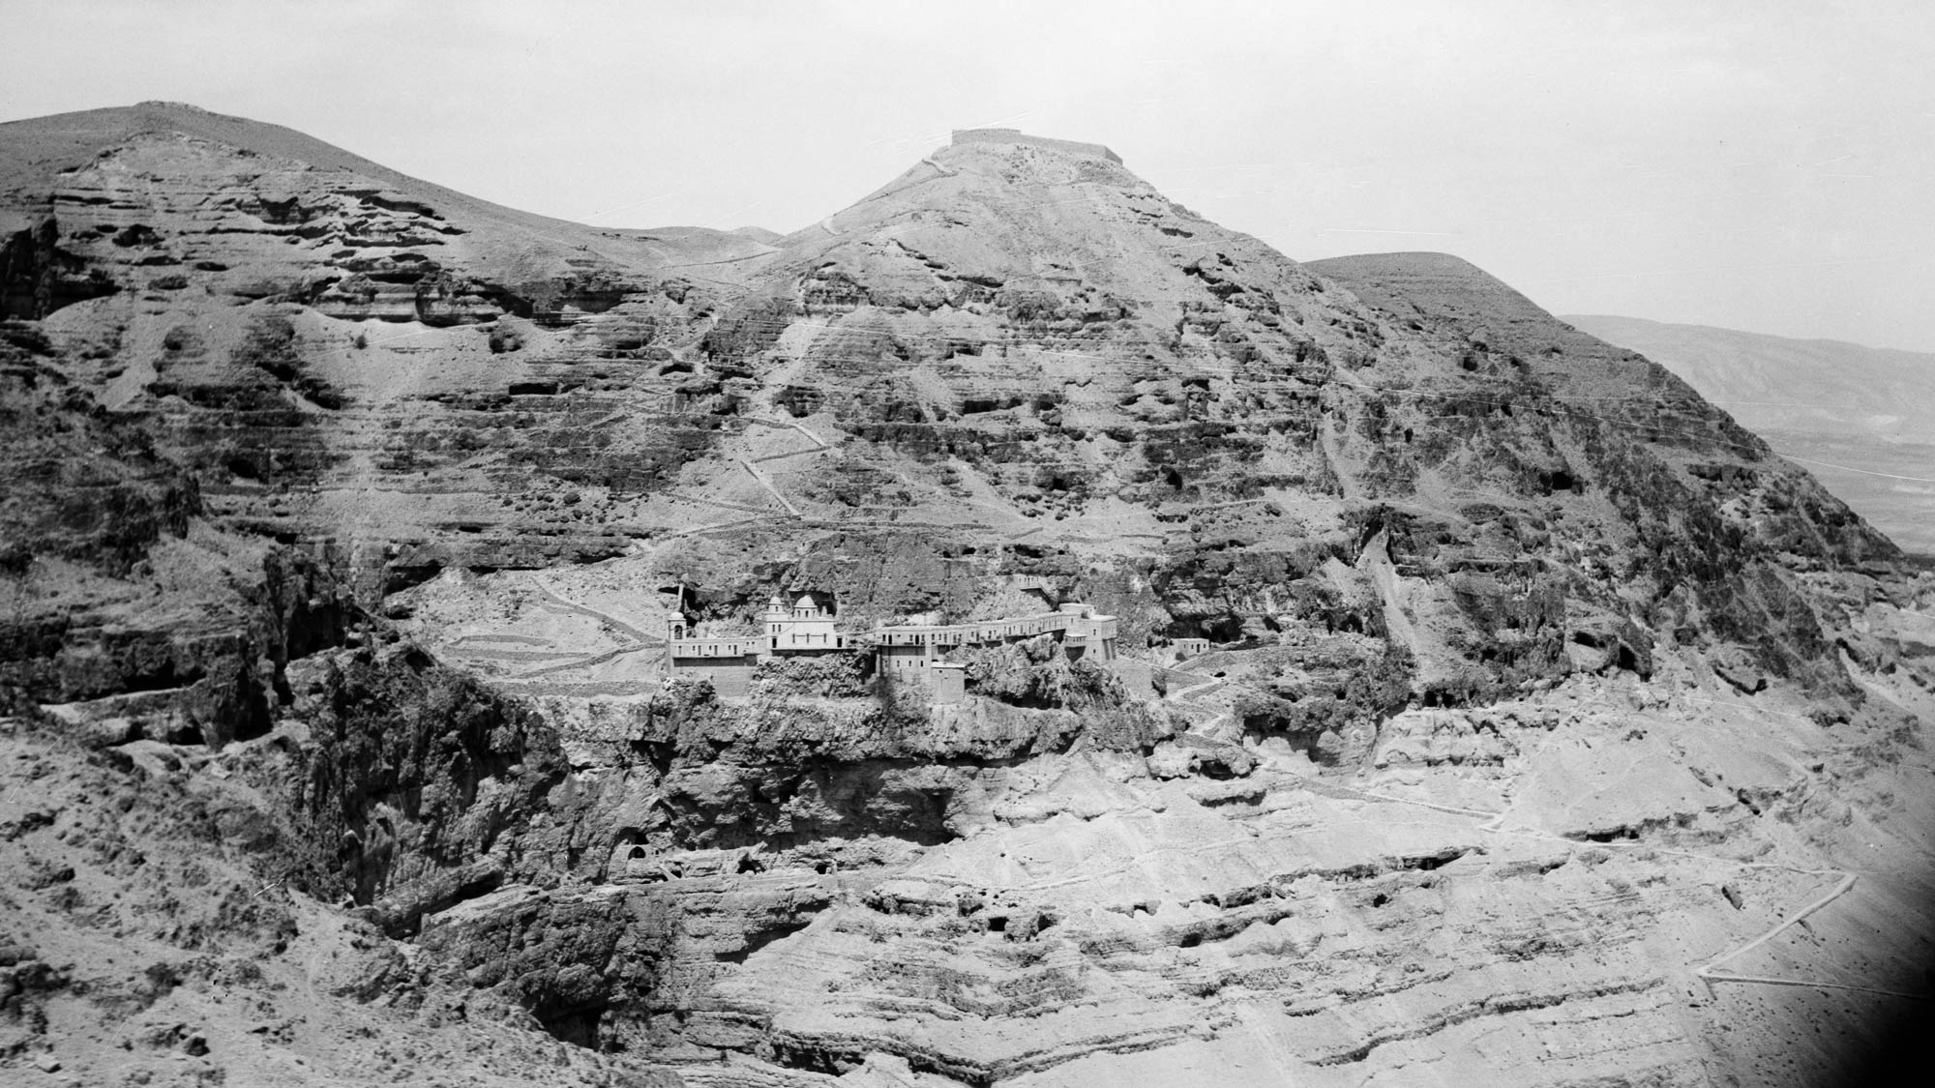
Jesus was led by the Spirit into the wilderness
Traditional Mount of Temptation near Jericho (aerial view from the southeast)
4:1
Notes:
This American Colony photograph was taken in 1931.
mat22119h

Slide 14
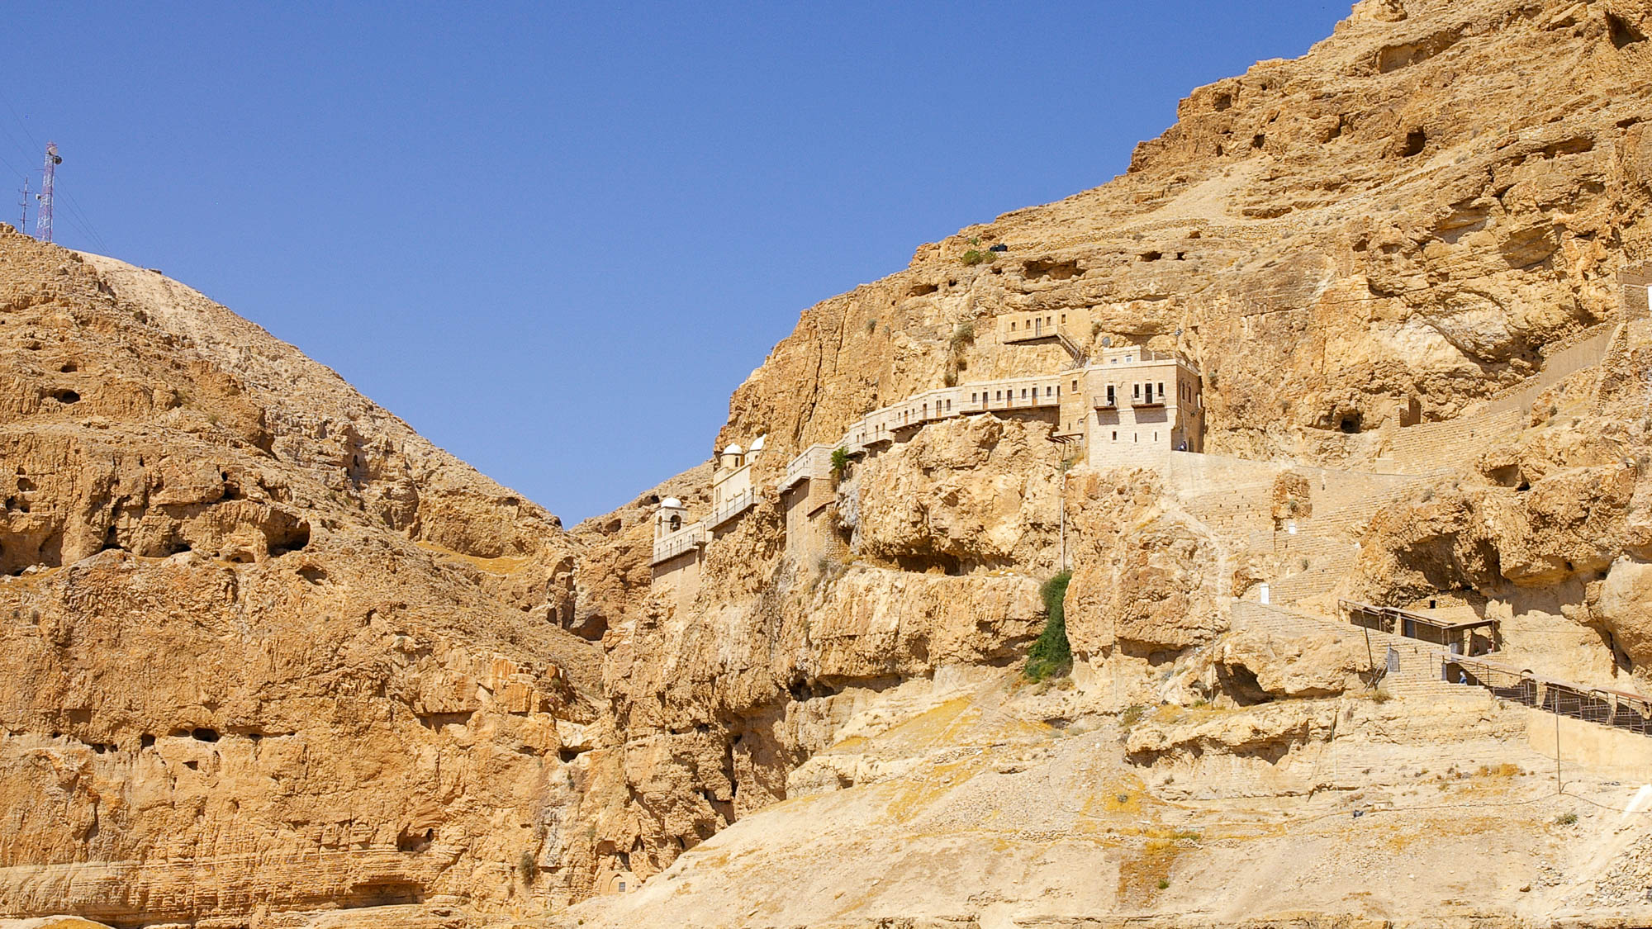
Jesus was led . . . into the wilderness to be tempted by the devil
Monastery of the Temptation near Jericho
4:1
Notes:
adr0807116431h

Slide 15
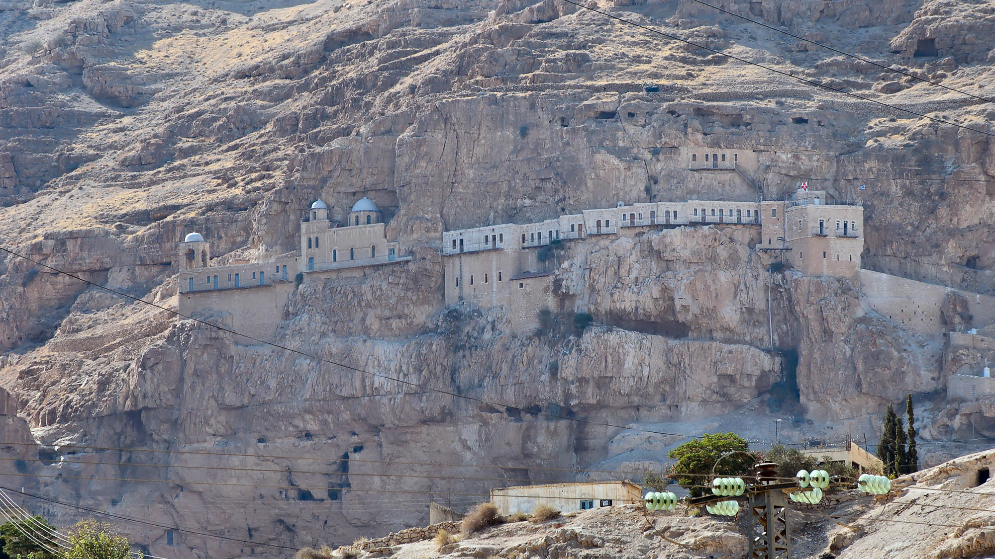
Jesus was led . . . into the wilderness to be tempted by the devil
Monastery of the Temptation near Jericho (from the east)
4:1
Notes:
The Byzantines located the temptation of Jesus on the cliff west of Jericho at Jebel Quarental (“Mount of the Forty,” named for the forty days of temptation).
tb091504796

Slide 16
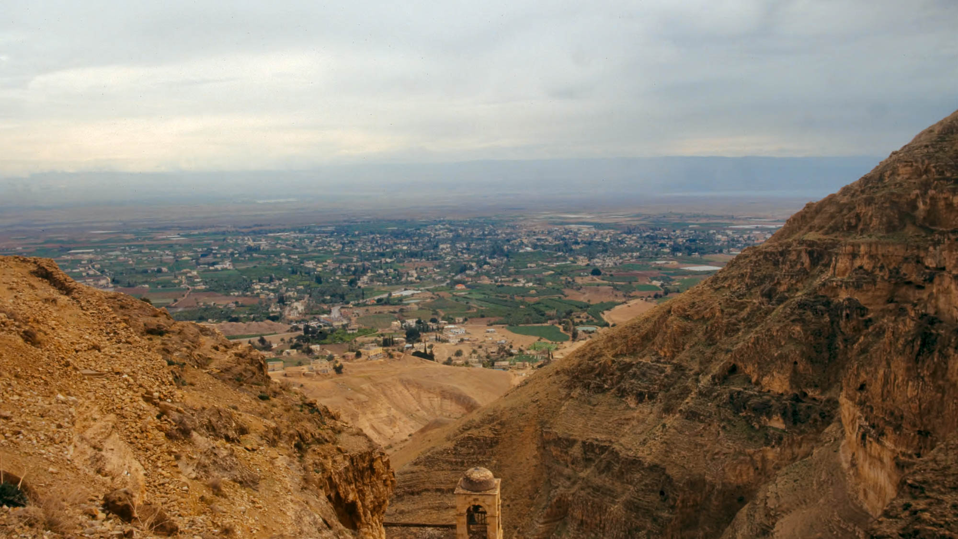
Jesus was led . . . into the wilderness to be tempted by the devil
View from the traditional Mount of Temptation looking towards Jericho
4:1
Notes:
The green fields of Jericho are visible below the Monastery of the Temptation. This photo was taken above the southern bell tower of the monastery (compare with the previous slide).
tbs80069402h

Slide 17
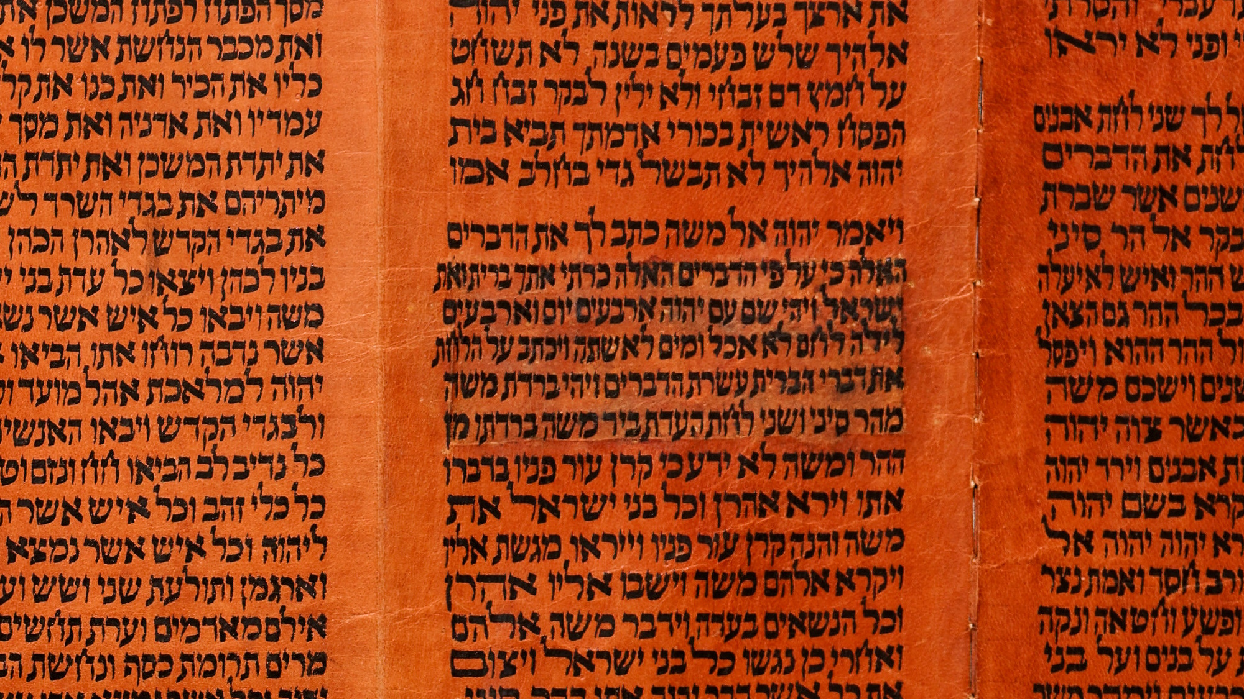
And when He had fasted forty days and forty nights
Torah scroll with Exodus 34:28 describing the fast of Moses in the wilderness
4:2
Notes:
“And he was there with Jehovah forty days and forty nights; he did neither eat bread, nor drink water. And he wrote upon the tables the words of the covenant, the ten commandments” (Exod 34:28, ASV).
This Yemenite Torah scroll was photographed at The Master’s Seminary in California.
tb031416404

Slide 18
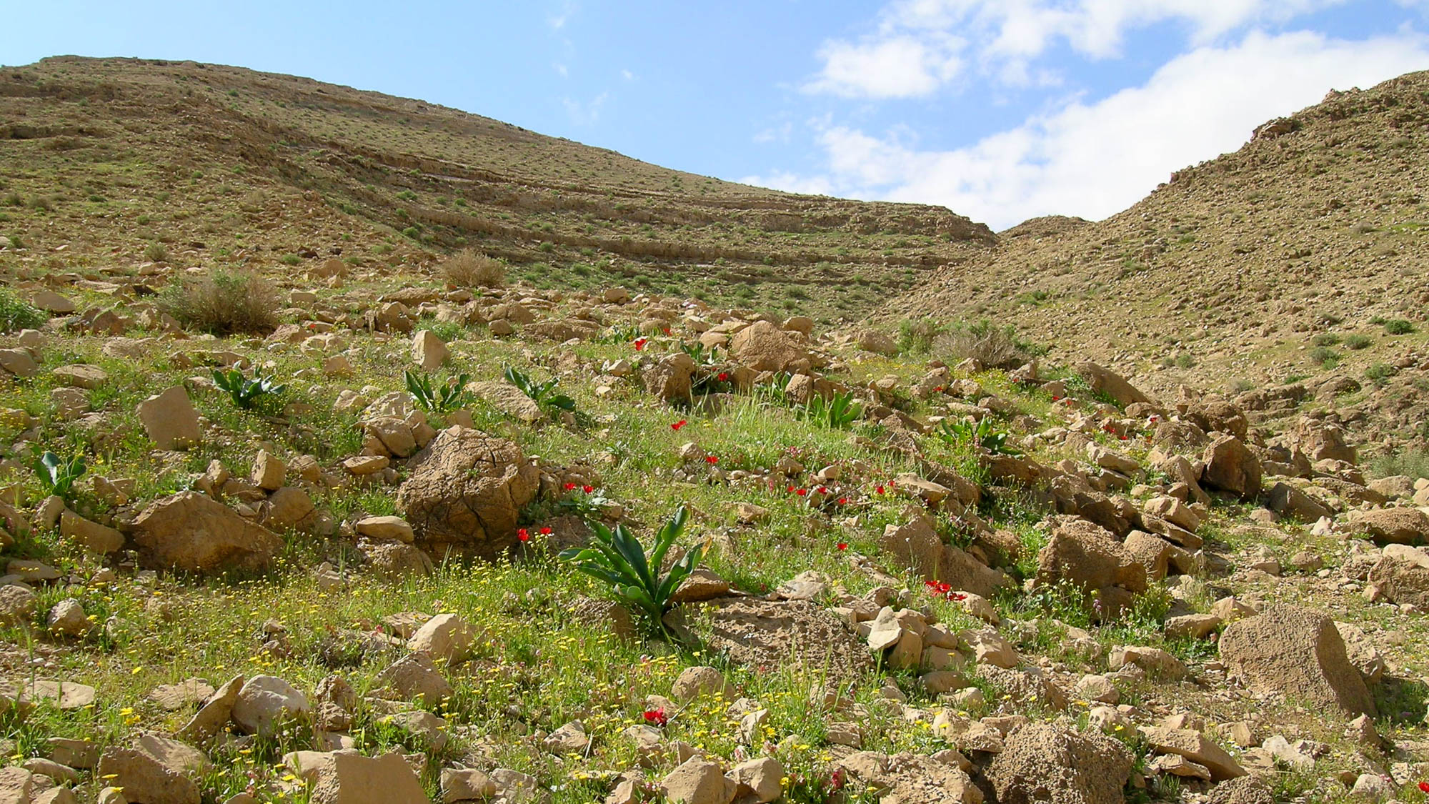
Command that these stones become bread
Stones in Nahal Tseelim in the Judean wilderness
4:3
Notes:
tb031504973h

Slide 19
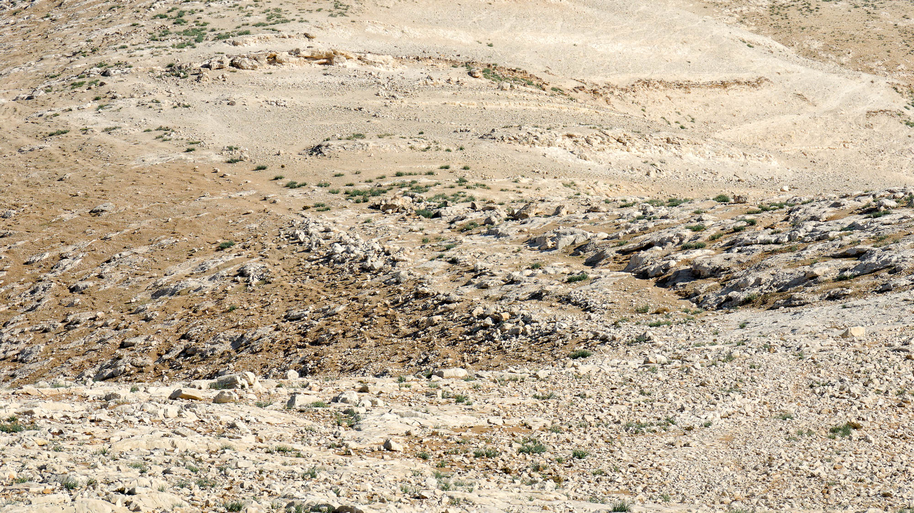
Command that these stones become bread
Stones in the Judean wilderness
4:3
Notes:
This photograph was taken along the Ascent of Adummim, between Jericho and Jerusalem.
tb113006722h

Slide 20
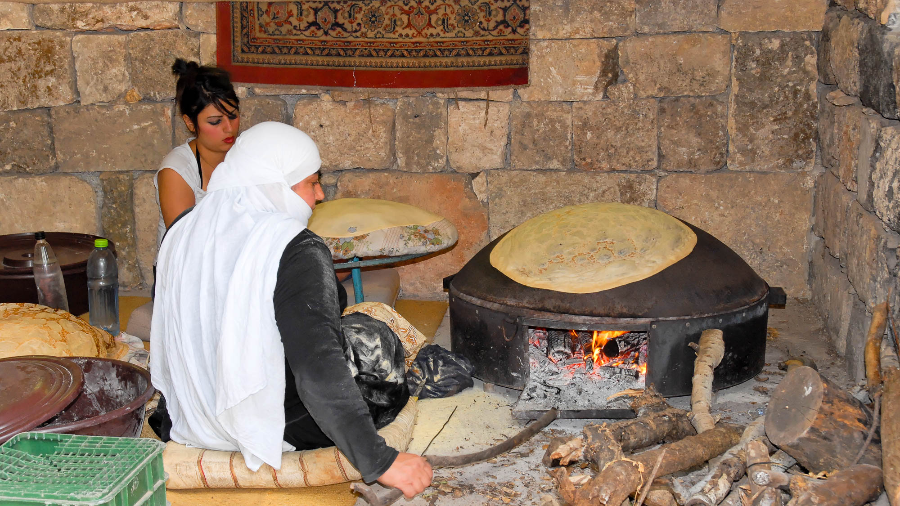
Command that these stones become bread
Druze baking bread in Banias
4:3
Notes:
Banias was known in New Testament times as Caesarea Philippi. Many Druze live in the nearby Golan Heights today.
cd100519101h

Slide 21
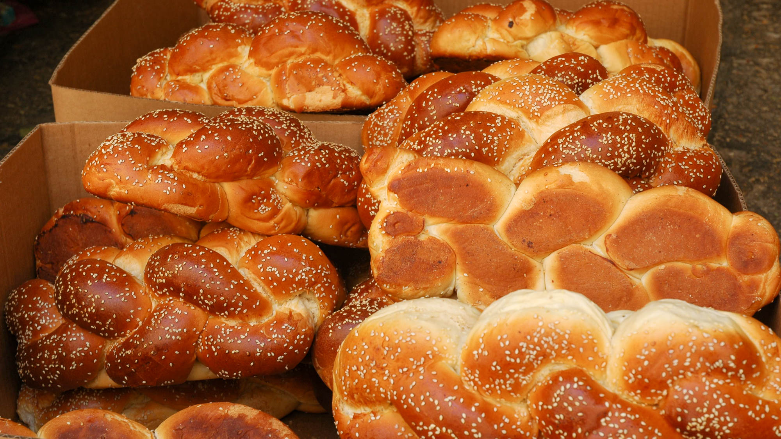
Command that these stones become bread
Challah, bread for Shabbat
4:3
Notes:
This special braided bread is eaten by Jews on the Sabbath and holidays.
tb051906361h

Slide 22
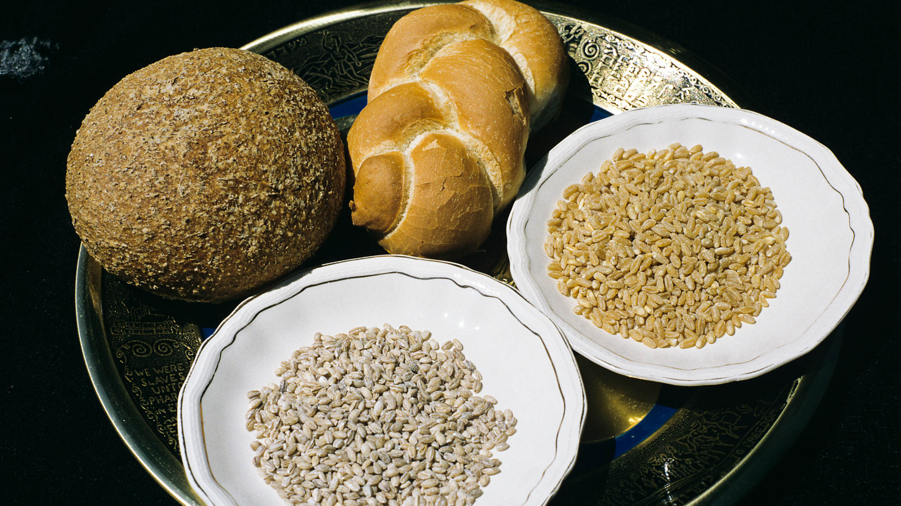
Command that these stones become bread
Barley grain and bread with wheat grain and bread
4:3
Notes:
This breads display was photographed by Gloria Suess in Moza Illit.
gs090094c08

Slide 23
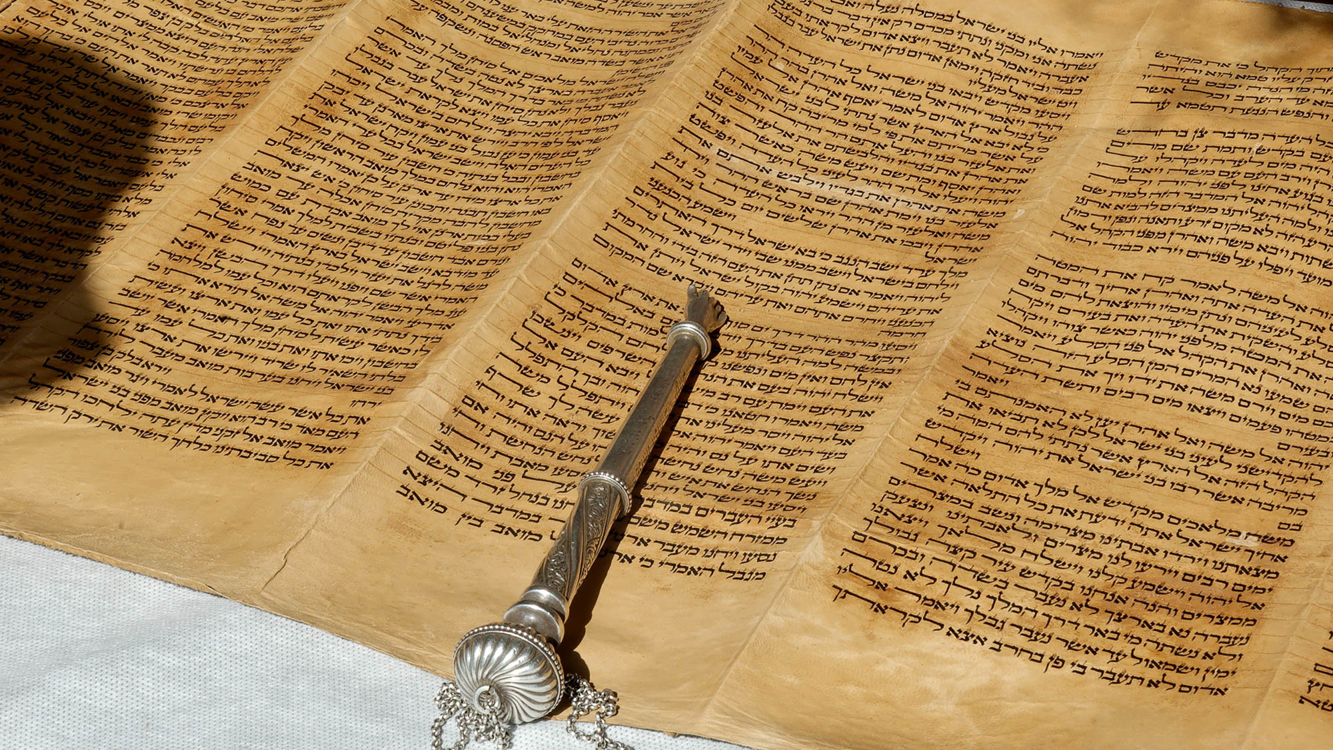
But He answered and said, “It is written . . . .”
Torah scroll with pointer
4:4
Notes:
Torah scrolls contain the five books of Moses (Genesis to Deuteronomy). Jesus refuted the devil by quoting from Deuteronomy.
tb102605486h

Slide 24
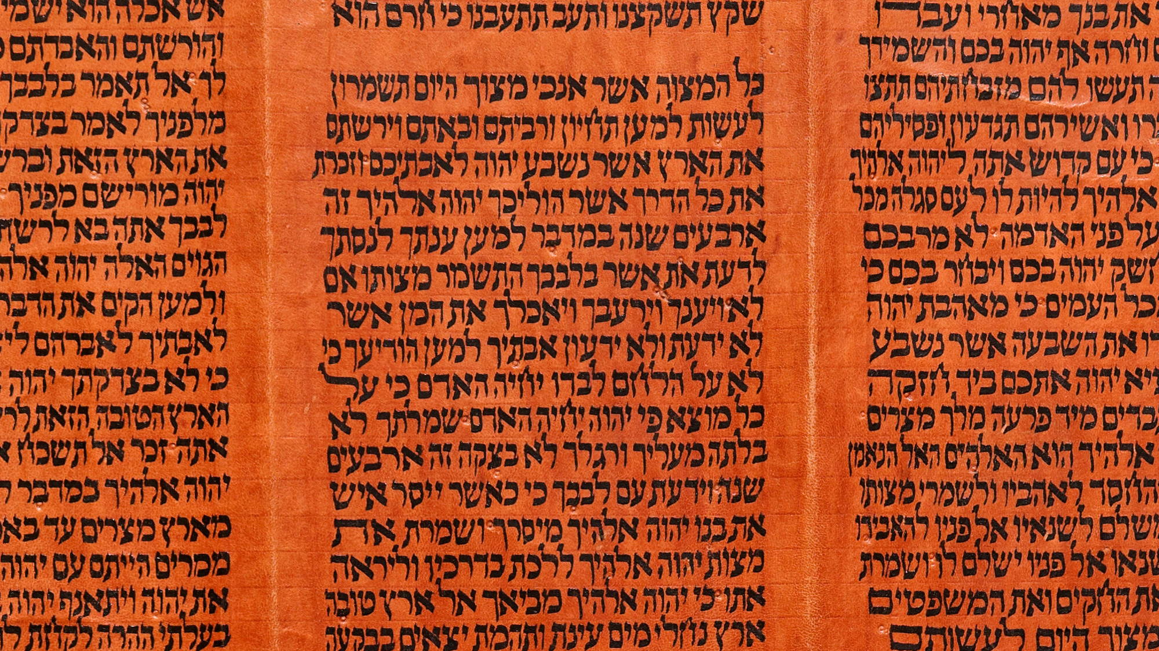
It is written, “Man shall not live by bread alone, but by every word . . . out of the mouth of God”
Torah scroll showing Deuteronomy 8:3, the source of Jesus’s quotation
4:4
Notes:
“And he humbled thee, and suffered thee to hunger, and fed thee with manna, which thou knewest not, neither did thy fathers know; that he might make thee know that man doth not live by bread only, but by everything that proceedeth out of the mouth of Jehovah doth man live” (Deut 8:3, ASV).
This Yemenite Torah scroll was photographed at The Master’s Seminary in California.
tb031416451

Slide 25
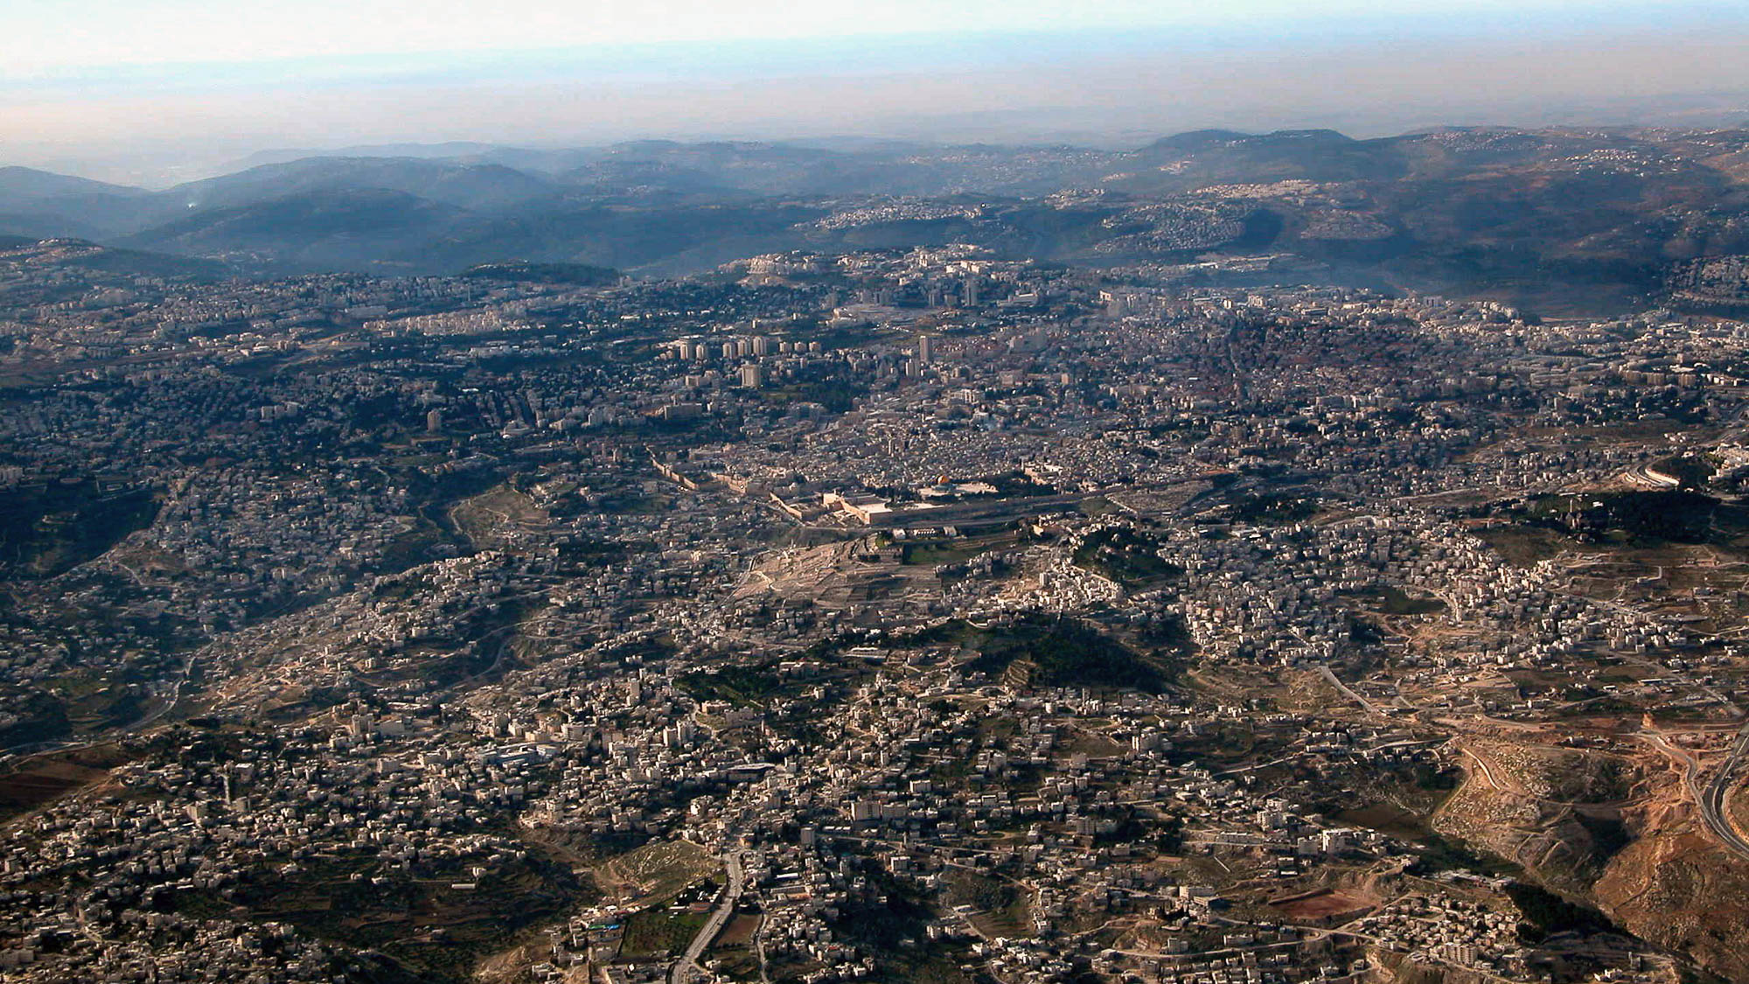
Then the devil took Him to the holy city
The holy city today (aerial view from the east)
4:5
Notes:
See the next slide for a circle around the temple area in Jerusalem.
tb010703211h

Slide 26
Then the devil took Him to the holy city
The holy city today (aerial view from the east)
4:5
Notes:
The Temple Mount is circled.
tb010703211h

Slide 27
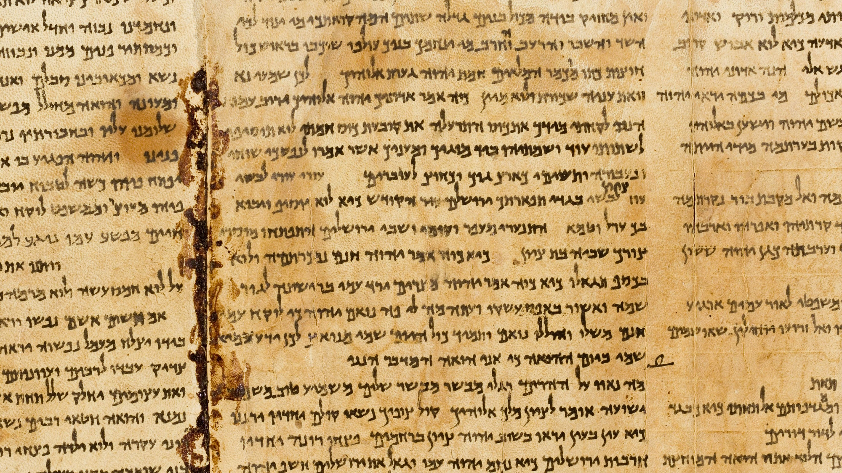
Then the devil took Him to the holy city
Mention of Jerusalem as the “holy city” on the Great Isaiah Scroll (52:1)
4:5
Notes:
“Awake, awake, put on thy strength, O Zion; put on thy beautiful garments, O Jerusalem, the holy city: for henceforth there shall no more come into thee the uncircumcised and the unclean” (Isa 52:1, ASV). The inner box marks “Jerusalem the holy city.”
The Great Isaiah Scroll is owned by the Israel Museum in Jerusalem. This image is public domain, from Wikimedia: https://commons.wikimedia.org/wiki/File:The_Great_Isaiah_Scroll_MS_A_(1QIsa)_-_Google_Art_Project-x0-y0.jpg
isax0y0

Slide 28
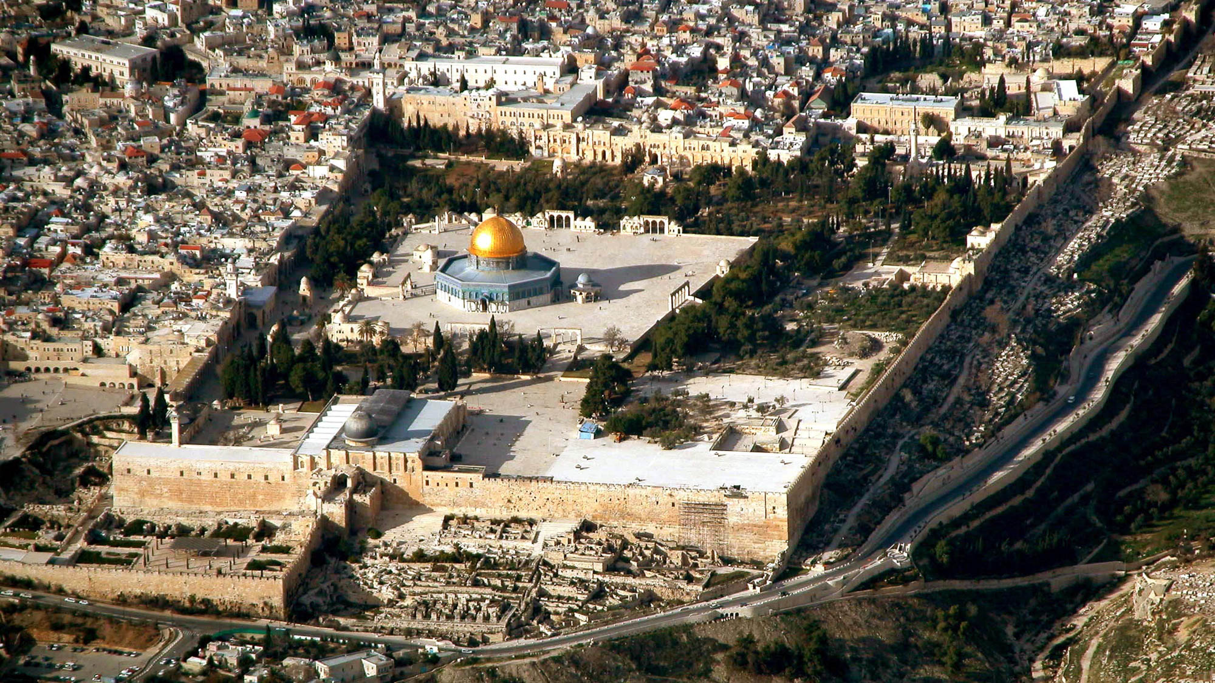
Then the devil took Him to the holy city, and set Him on the pinnacle of the temple
Temple Mount (aerial view from the south)
4:5
Notes:
There are two suggested locations for the “pinnacle of the temple.” The first is the highest point of the temple proper; this seems to be the most likely option. The second possibility is the southeastern corner of the Temple Mount, where Josephus said that one could not see the bottom of the Kidron Valley below. This view may be suggested by the word used by Luke, which more generally refers to the temple complex (ἱερόν) than to the sanctuary proper (ναός). See the next slide for labels that mark out the two options, as best as possible, on a photograph of the Temple Mount today.
tb010703231h

Slide 29
Then the devil took Him to the holy city, and set Him on the pinnacle of the temple
Temple Mount (aerial view from the south)
4:5
Notes:
There are two suggested locations for the “pinnacle of the temple.” The first is the highest point of the temple proper; this seems to be the most likely option. The second possibility is the southeastern corner of the Temple Mount, where Josephus said that one could not see the bottom of the Kidron Valley below. This view may be suggested by the word used by Luke, which more generally refers to the temple complex (ἱερόν) than to the sanctuary proper (ναός). The two options are marked out, as best as possible, on a photograph of the Temple Mount today.
tb010703231h

Slide 30
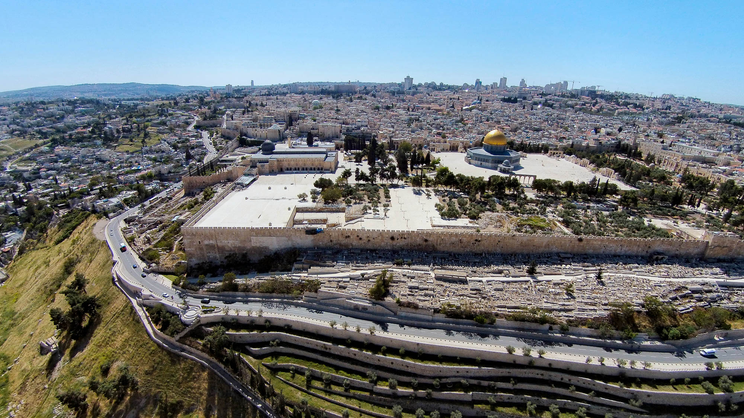
Then the devil took Him to the holy city, and set Him on the pinnacle of the temple
Temple Mount (aerial view from the east)
4:5
Notes:
See the next slide for labels for the two options.
ws042515228h

Slide 31
Then the devil took Him to the holy city, and set Him on the pinnacle of the temple
Temple Mount (aerial view from the east)
4:5
Notes:
ws042515228h

Slide 32
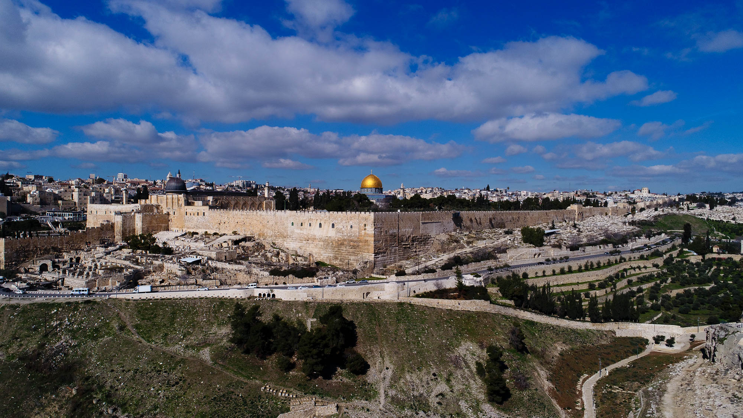
Then the devil took Him to the holy city, and set Him on the pinnacle of the temple
Temple Mount (aerial view from the southeast)
4:5
Notes:
See the next slide for a labeling of the options for the pinnacle of the temple.
ws012917290

Slide 33
Then the devil took Him to the holy city, and set Him on the pinnacle of the temple
Temple Mount (aerial view from the southeast)
4:5
Notes:
The two options for the pinnacle of the temple are marked.
ws012917290

Slide 34
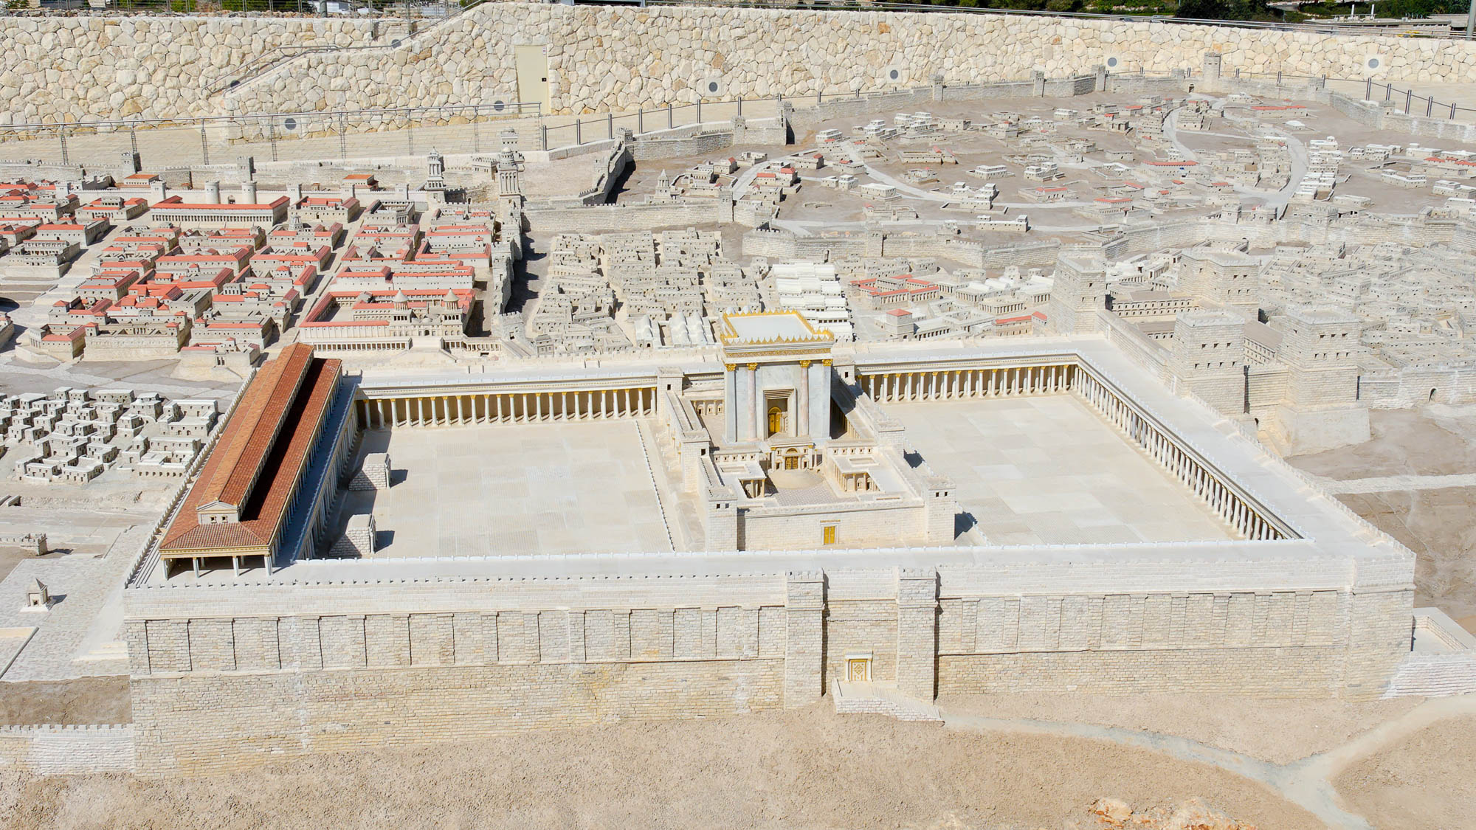
Then the devil took Him to the holy city, and set Him on the pinnacle of the temple
Temple Mount (from the east)
4:5
Notes:
This photograph is of the Jerusalem model at the Israel Museum in Jerusalem. See the next slide for labels.
tb091506432h

Slide 35
Then the devil took Him to the holy city, and set Him on the pinnacle of the temple
Temple Mount (from the east)
4:5
Notes:
This photograph is of the Jerusalem model at the Israel Museum in Jerusalem. The two options for the pinnacle of the temple are marked.
tb091506432h

Slide 36
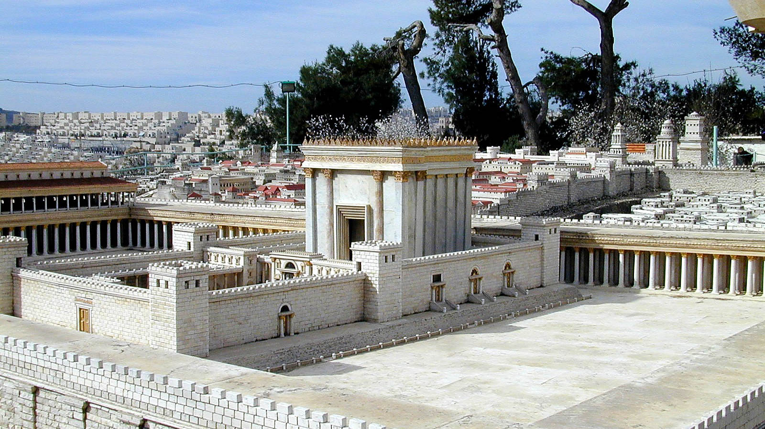
Then the devil took Him to the holy city, and set Him on the pinnacle of the temple
The Temple of Herod
4:5
Notes:
Since the temptation was to be a demonstration of God’s power to save Jesus, it seems more likely that Jesus was tempted to throw Himself down before the worshippers offering sacrifices at the temple. Fewer people would have witnessed the event if the corner of the Temple Mount was the location of the temptation. This Jerusalem model was originally at the Holyland Hotel and is now on display at the Israel Museum.
tb020101209h

Slide 37
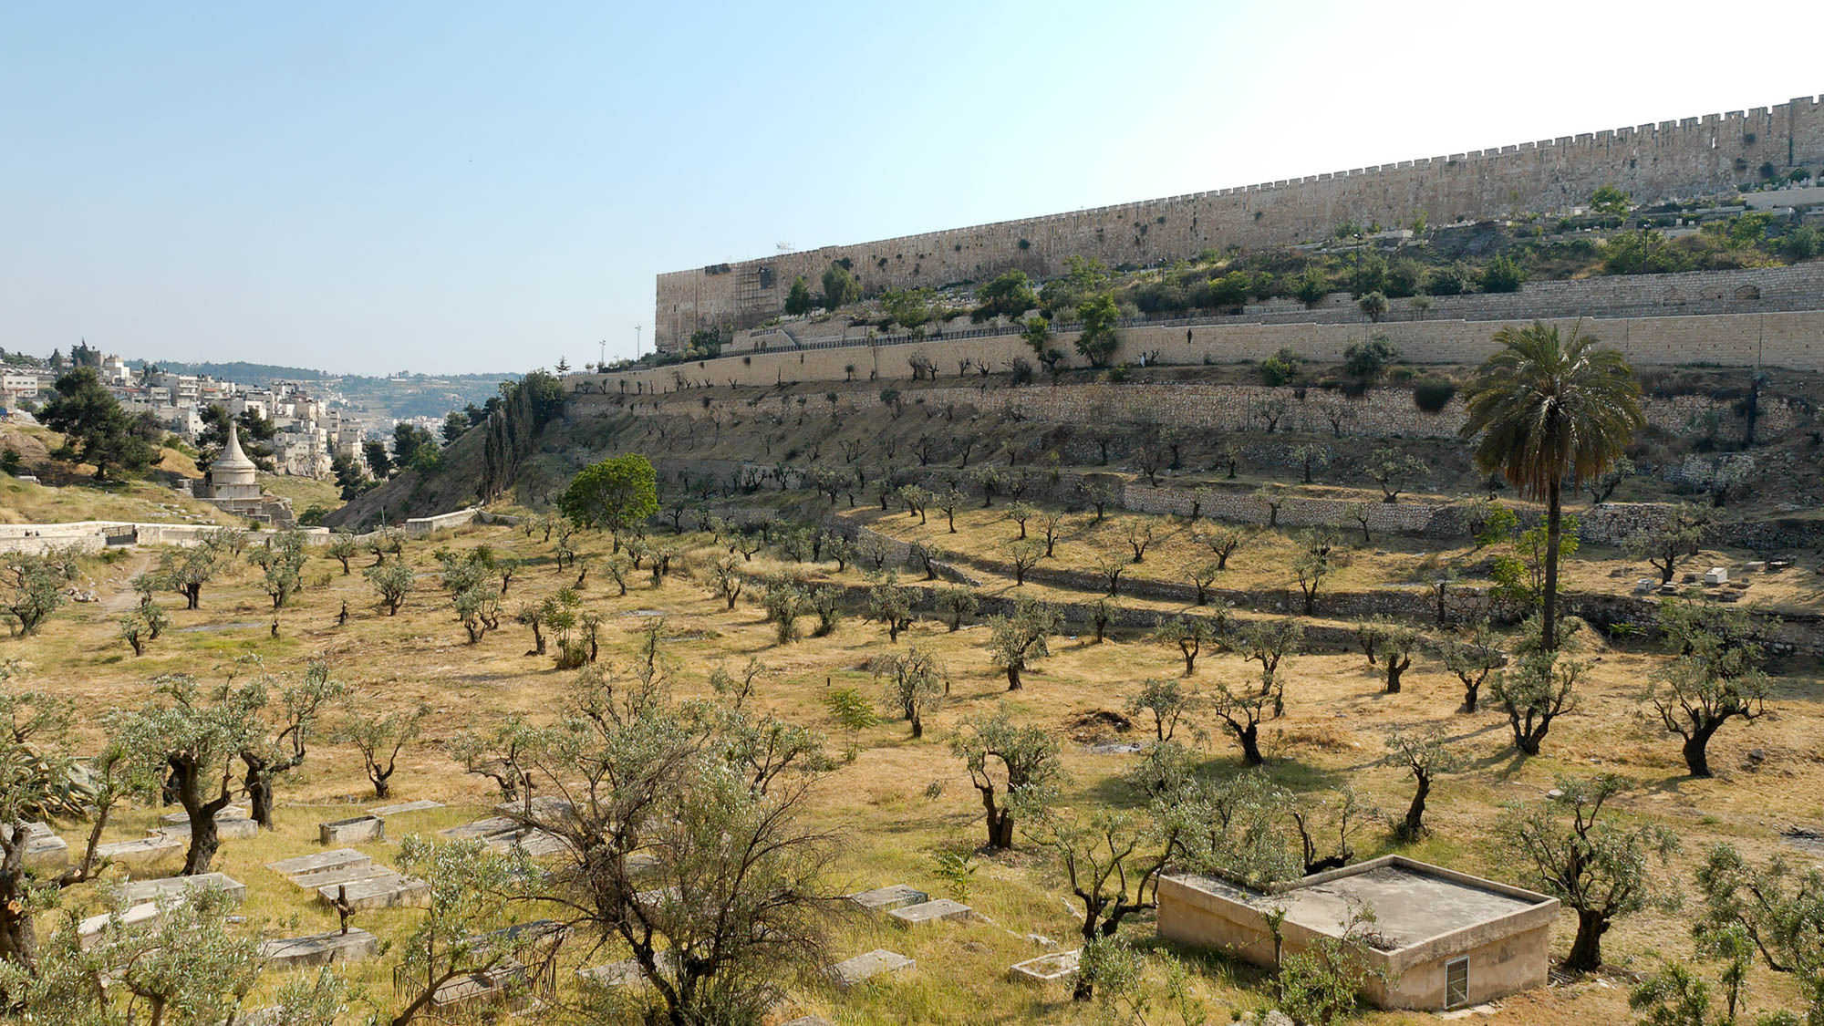
Then the devil took Him to the holy city, and set Him on the pinnacle of the temple
The eastern wall of the Temple Mount from the Kidron Valley
4:5
Notes:
The following photographs show the location of the southeastern corner of the Temple Mount, one of the options for the location of the pinnacle of the temple. If this is the case, the word “temple” here refers not to the sanctuary itself but to the temple complex.
tb051906428h

Slide 38
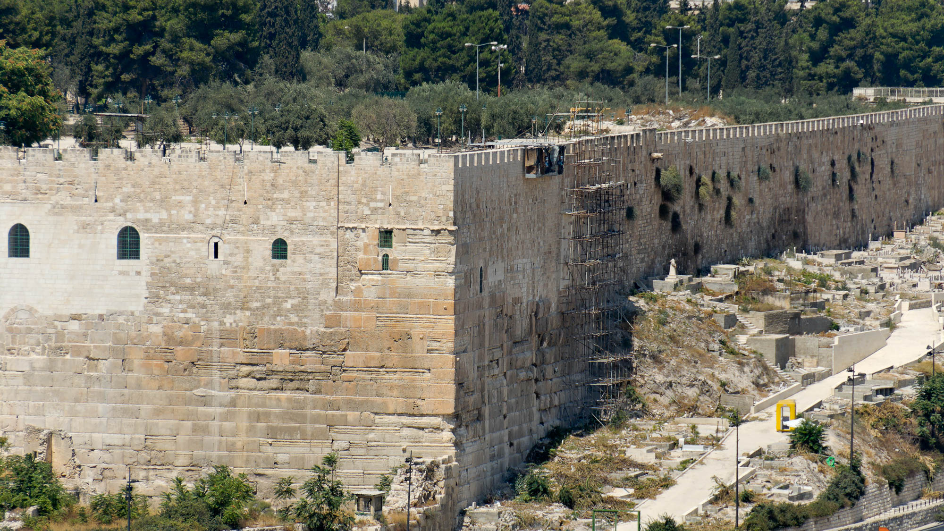
Then the devil took Him to the holy city, and set Him on the pinnacle of the temple
The southeastern corner of the Temple Mount
4:5
Notes:
The southeastern corner of the Temple Mount was part of the expansion made by King Herod. New walls were constructed on the north, west, and south, while the eastern wall remained in place but was extended.
tb091306324h

Slide 39
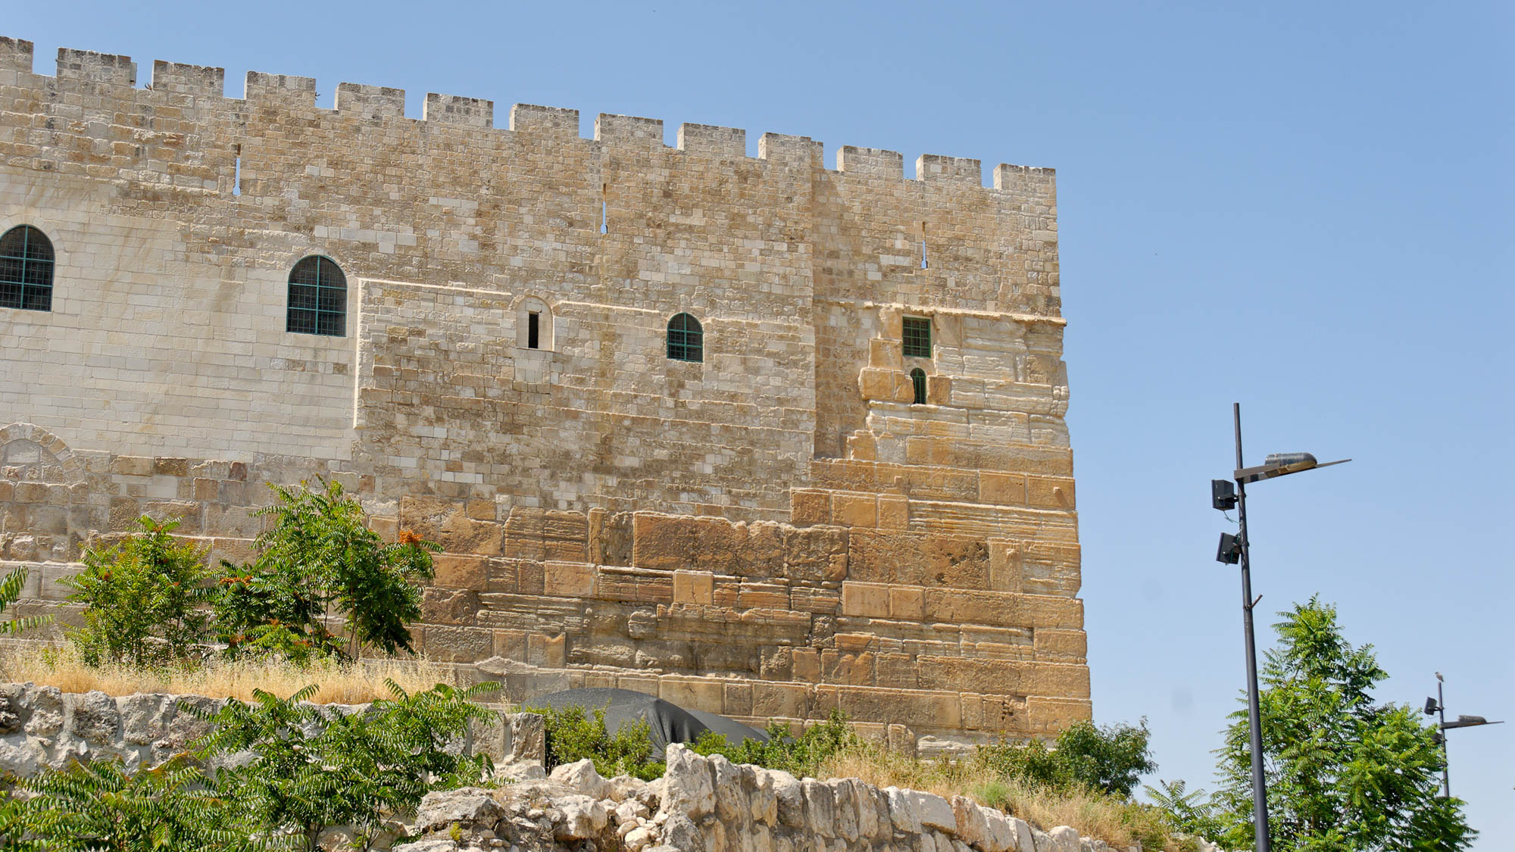
Then the devil took Him to the holy city, and set Him on the pinnacle of the temple
The southeastern corner of the Temple Mount
4:5
Notes:
Herodian stones are preserved to a great height on this corner. These large stones are distinguished from the smaller stones above (beginning at the height of the windows). The original Herodian walls were higher than today’s walls.
tb051908129h

Slide 40
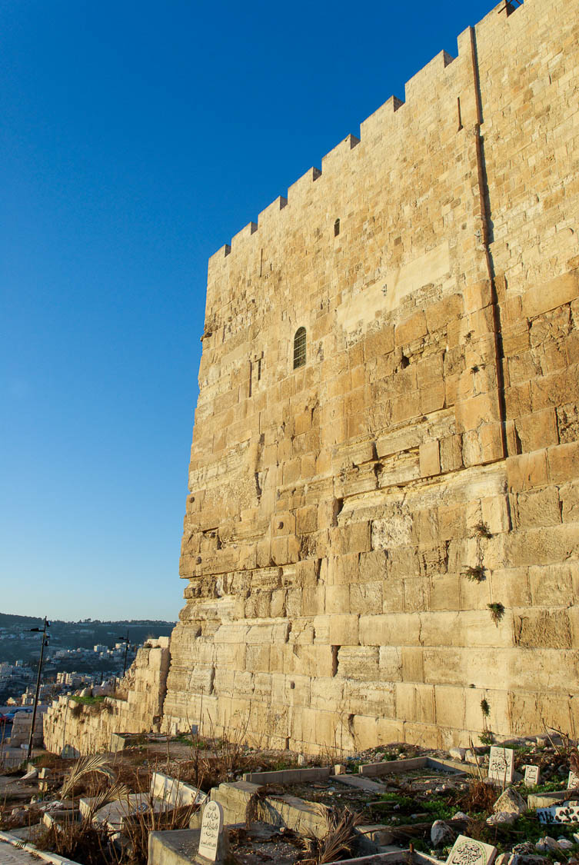
Then the devil took Him to the holy city, and set Him on the pinnacle of the temple
The southeastern corner of the Temple Mount
4:5
Notes:
This perspective makes clear the need for angels to rescue a person who jumps from the top.
tb010310617

Slide 41
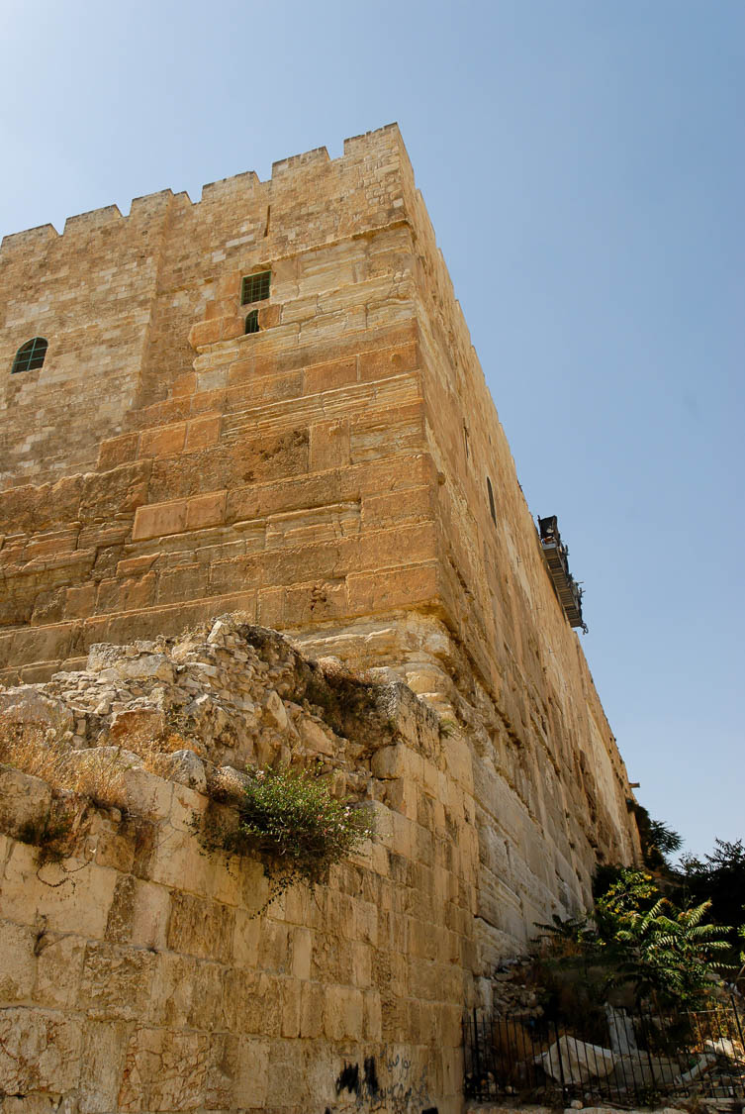
Then the devil took Him to the holy city, and set Him on the pinnacle of the temple
The southeastern corner of the Temple Mount
4:5
Notes:
tb051908162

Slide 42
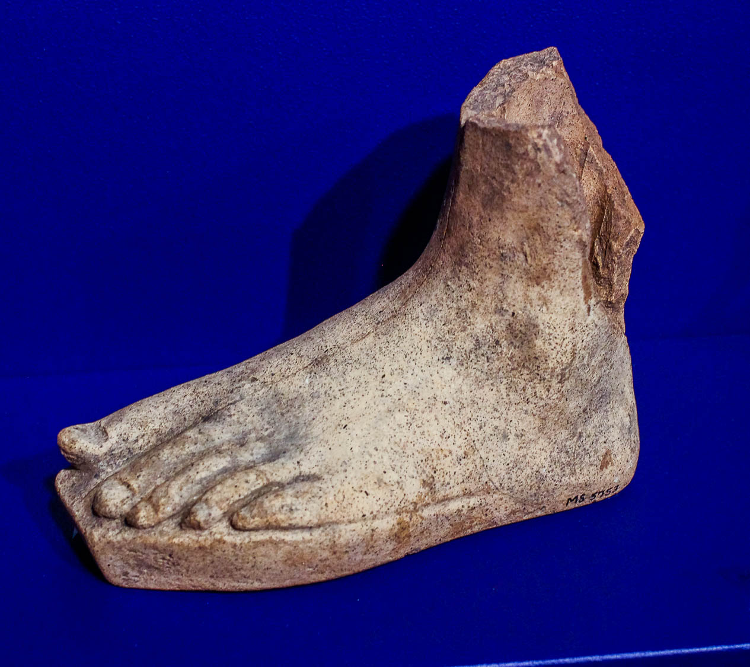
Lest you strike your foot against a stone
Etruscan votive terracotta foot, 300–100 BC, from Caere
4:6
Notes:
This artifact was photographed in the University of Pennsylvania Museum of Archaeology and Anthropology.
adr1605279919

Slide 43
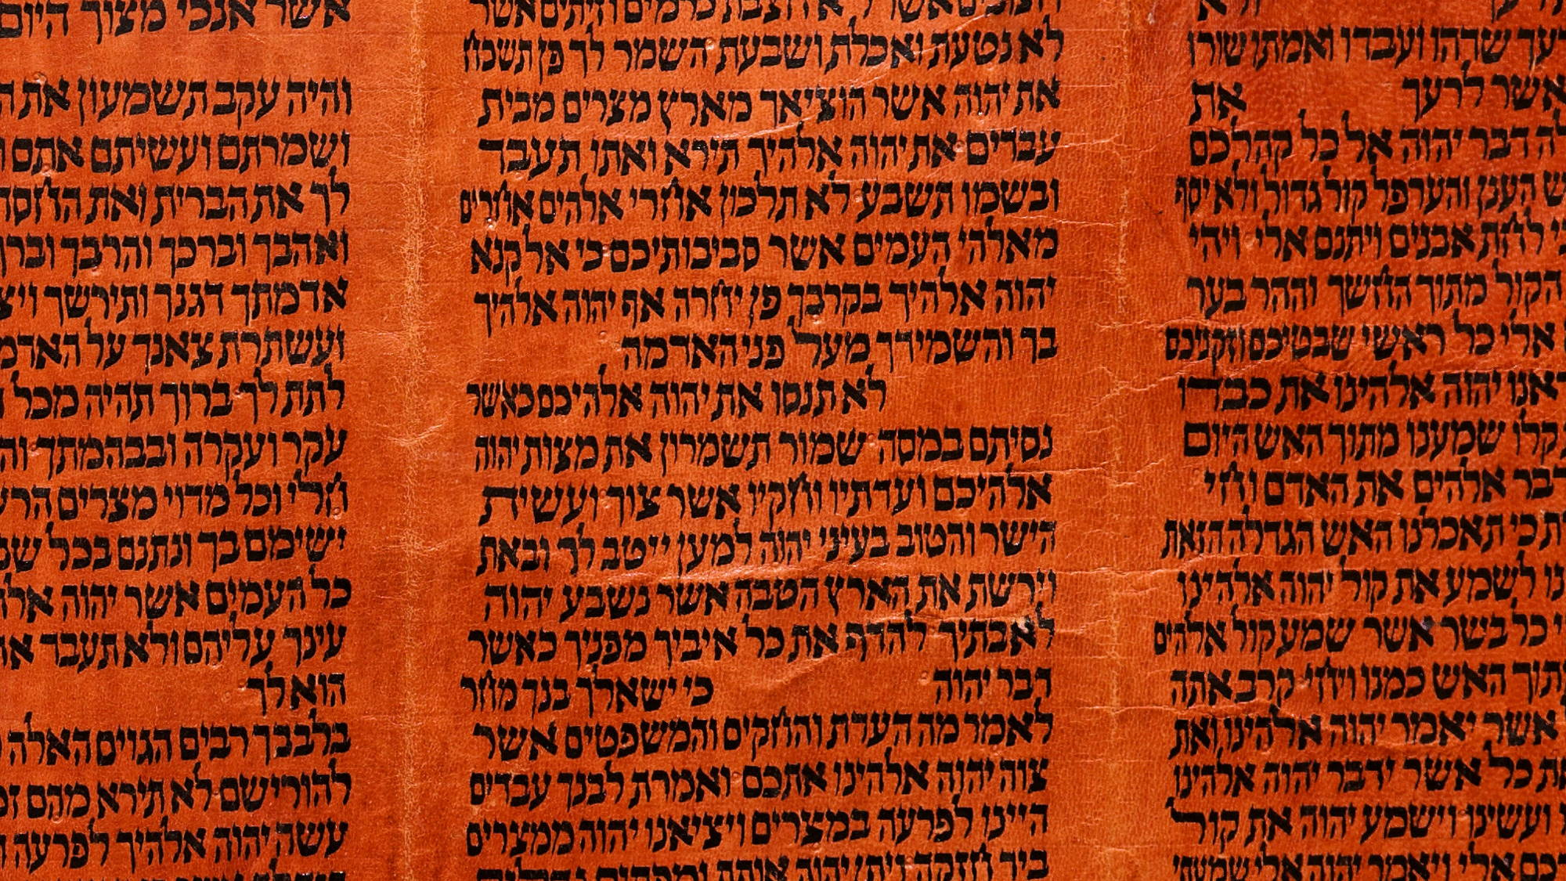
Again it is written, “Thou shalt not test the Lord thy God”
Torah scroll with Deuteronomy 6:16
4:7
Notes:
“Ye shall not tempt Jehovah your God, as ye tempted him in Massah” (Deut 6:16, ASV).
This Yemenite Torah scroll was photographed at The Master’s Seminary in California.
tb031416451

Slide 44
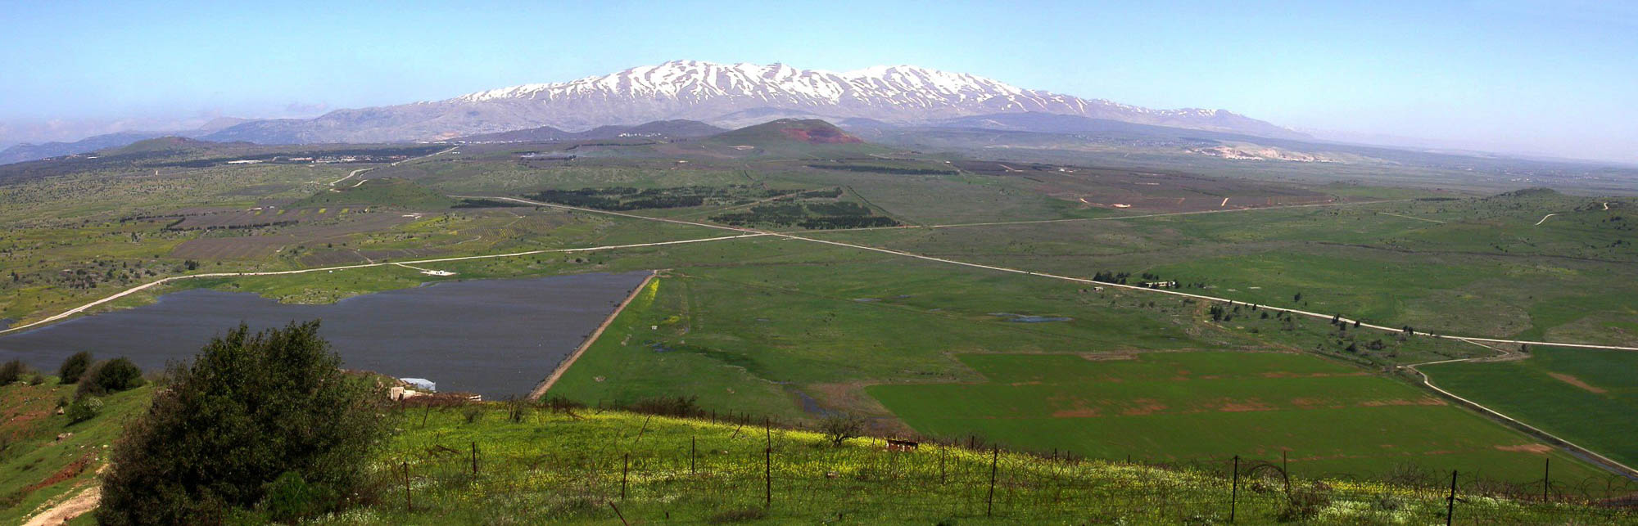
The devil took Him to a very high mountain
Golan Heights and Mount Hermon panorama
4:8
Notes:
It is unknown what mountain is in view here. Mount Hermon has been selected to illustrate the passage because it is the highest mountain in the land of Israel.
tb040903209

Slide 45
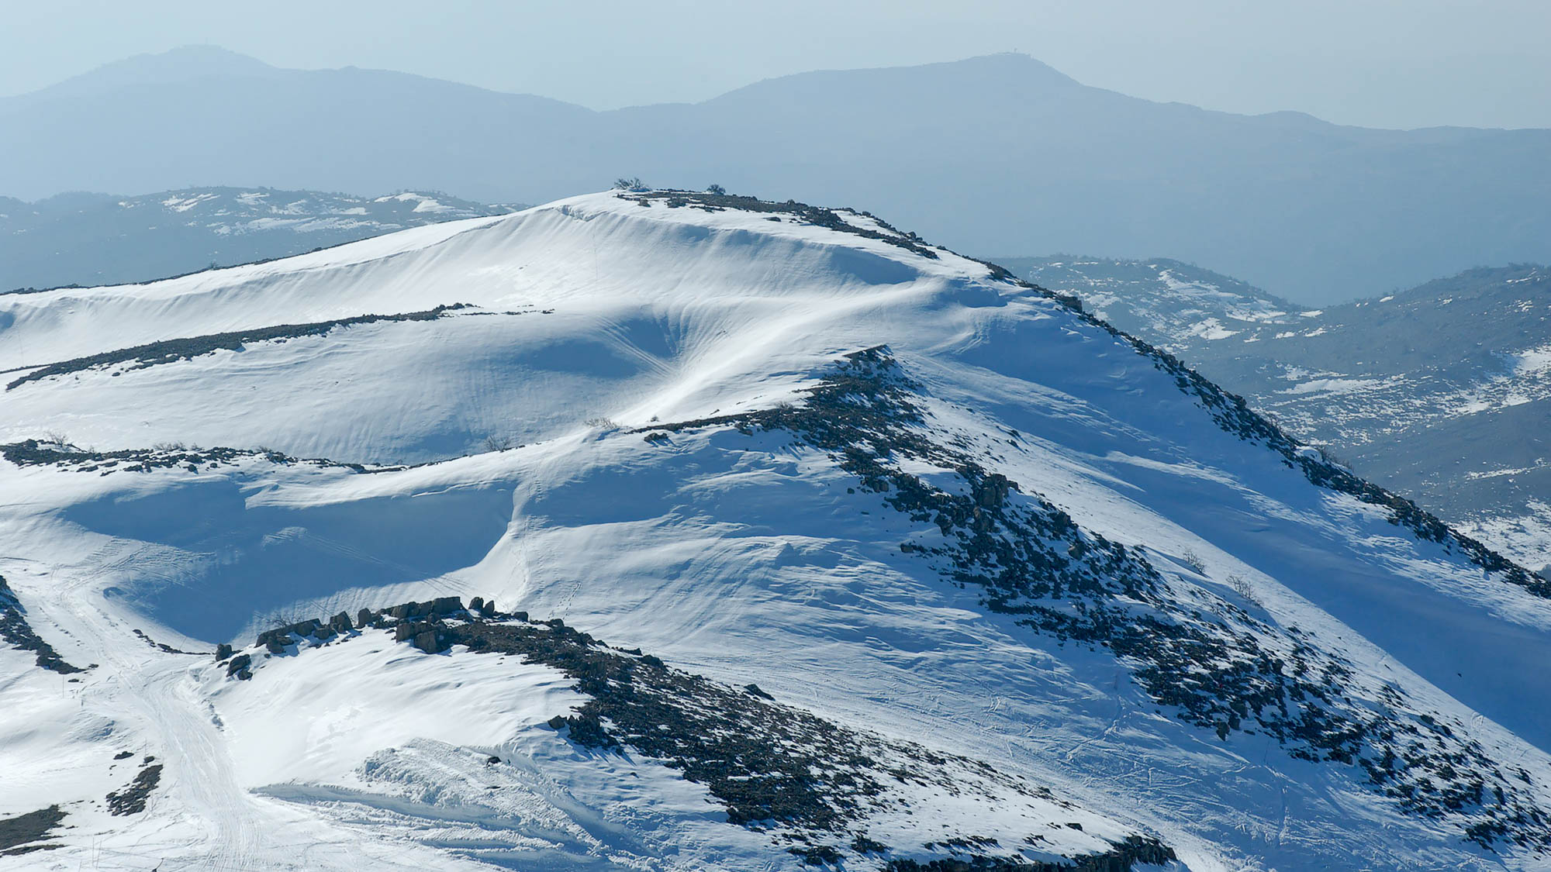
The devil took Him to a very high mountain
Mount Hermon with snow
4:8
Notes:
tb020506116

Slide 46
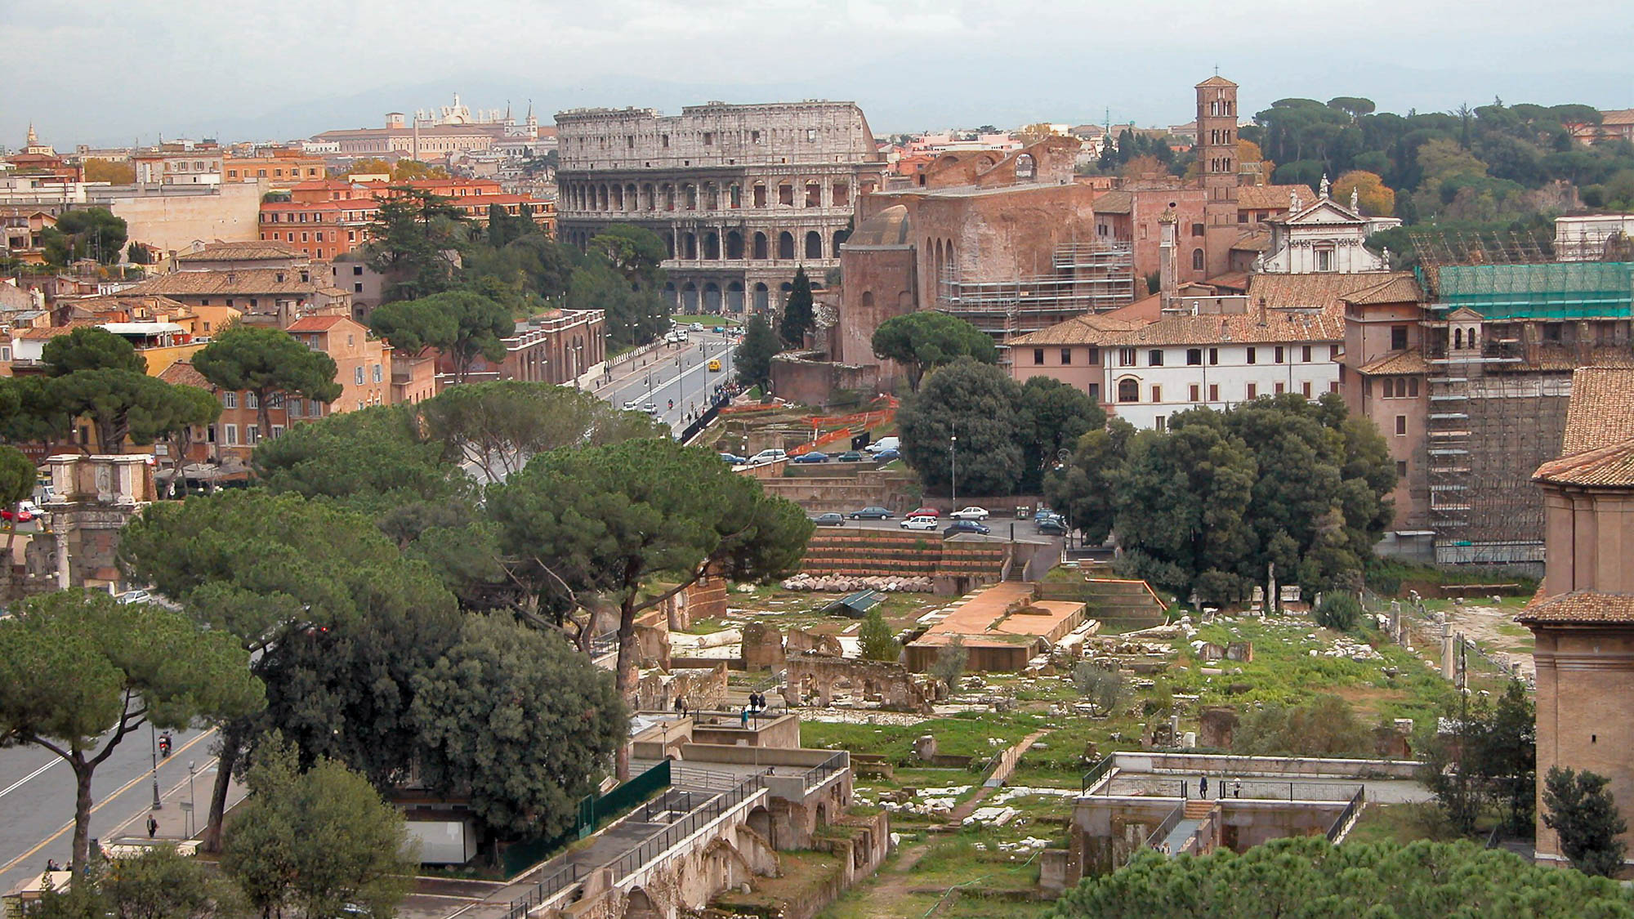
The devil . . . showed Him all the kingdoms of the world, and the glory of them
Forum and Colosseum (from the north)
4:8
Notes:
The greatest empire at the time of the temptation was the Roman Empire. The city of Rome is estimated to have had a population of one million people.
tb111902298h

Slide 47
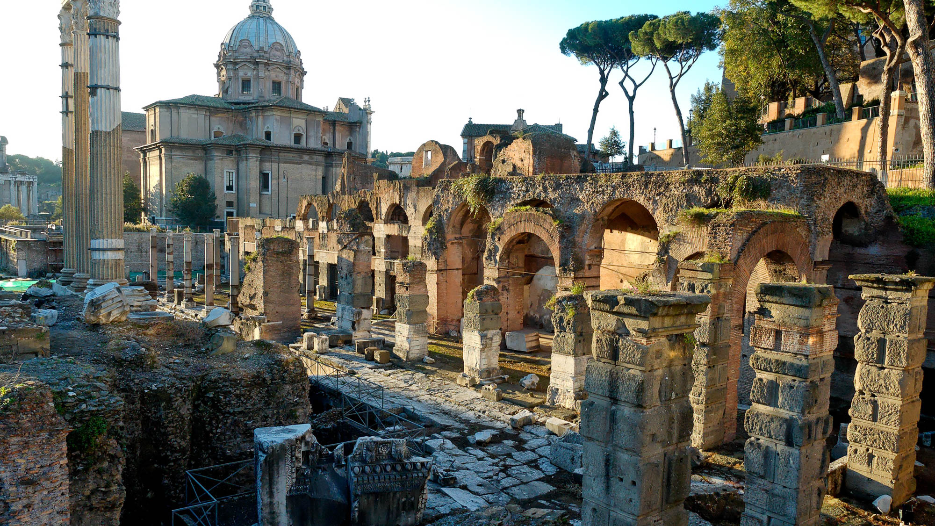
The devil . . . showed Him all the kingdoms of the world, and the glory of them
Forum of Caesar
4:8
Notes:
tb111905241h

Slide 48
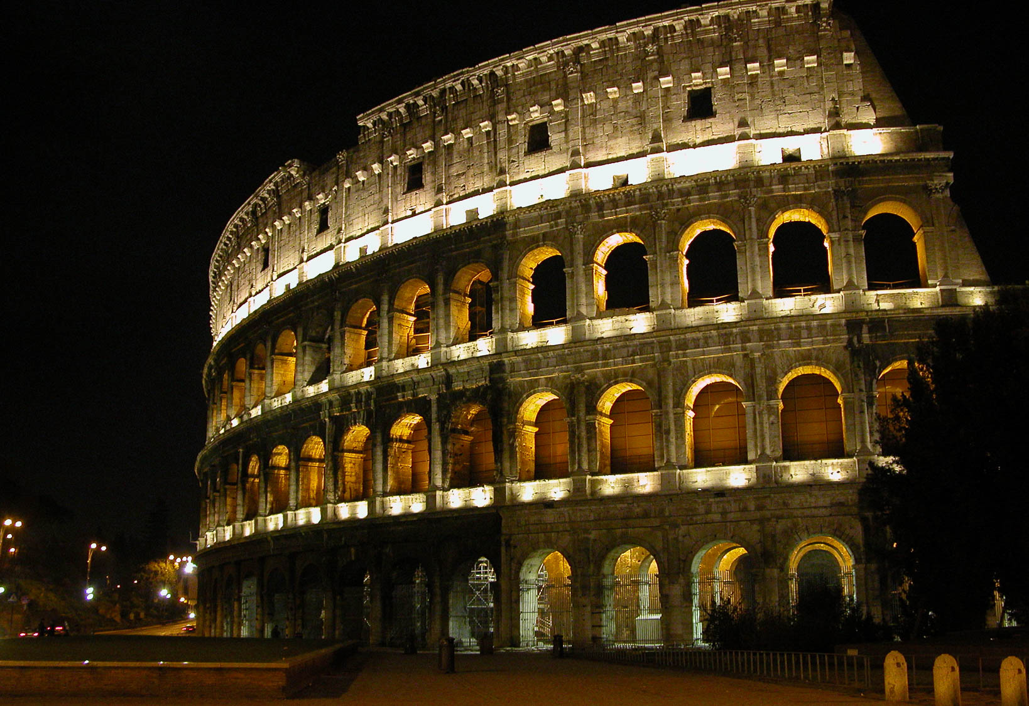
The devil . . . showed Him all the kingdoms of the world, and the glory of them
The Colosseum of Rome
4:8
Notes:
The Colosseum was not built until after the fall of Jerusalem in AD 70, but it gives a classic picture of the glory of Rome.
tb112002262

Slide 49
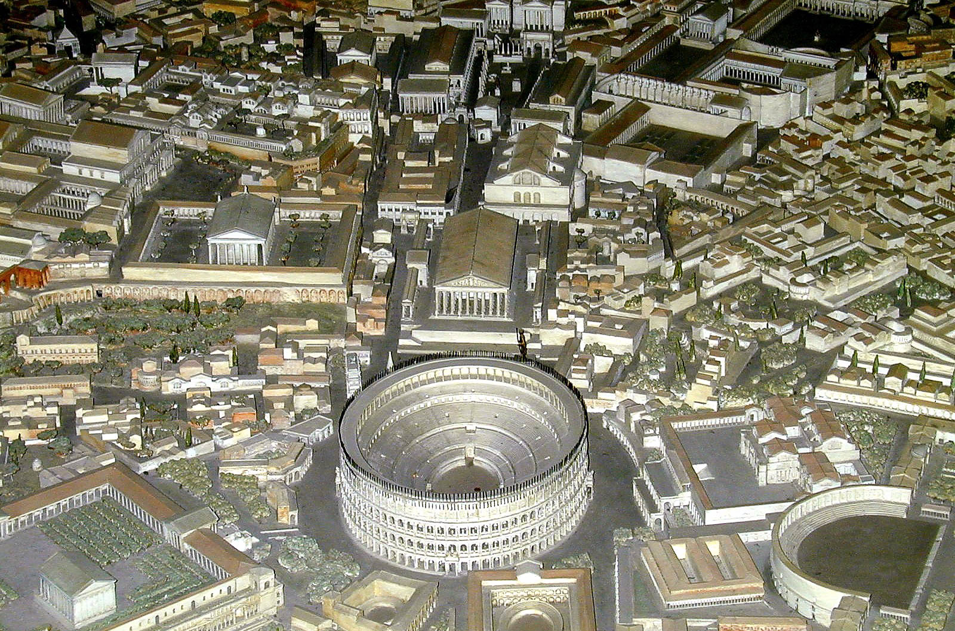
The devil . . . showed Him all the kingdoms of the world, and the glory of them
Model of Rome showing the Colosseum and forums
4:8
Notes:
This model depicts the city of Rome in the fourth century AD. It is on display in the Museum of Roman Civilization in Rome.
tb011901721h

Slide 50
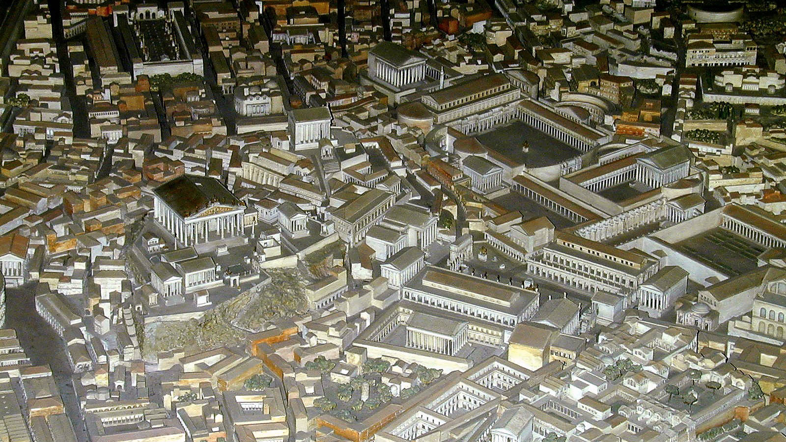
The devil . . . showed Him all the kingdoms of the world, and the glory of them
Model of Rome showing its temples and forums
4:8
Notes:
This model depicts the city of Rome in the fourth century AD. It is on display in the Museum of Roman Civilization in Rome.
tb011901722h

Slide 51
It is written, “You shall worship the Lord your God, and serve Him only”
Torah scroll with Deuteronomy 6:13-14, the source of Jesus’s quotation
4:10
Notes:
“Thou shalt fear Jehovah thy God; and him shalt thou serve, and shalt swear by his name. Ye shall not go after other gods, of the gods of the peoples that are round about you” (Deut 6:13–14, ASV).
This Yemenite Torah scroll was photographed at The Master’s Seminary in California.
tb031416448

Slide 52
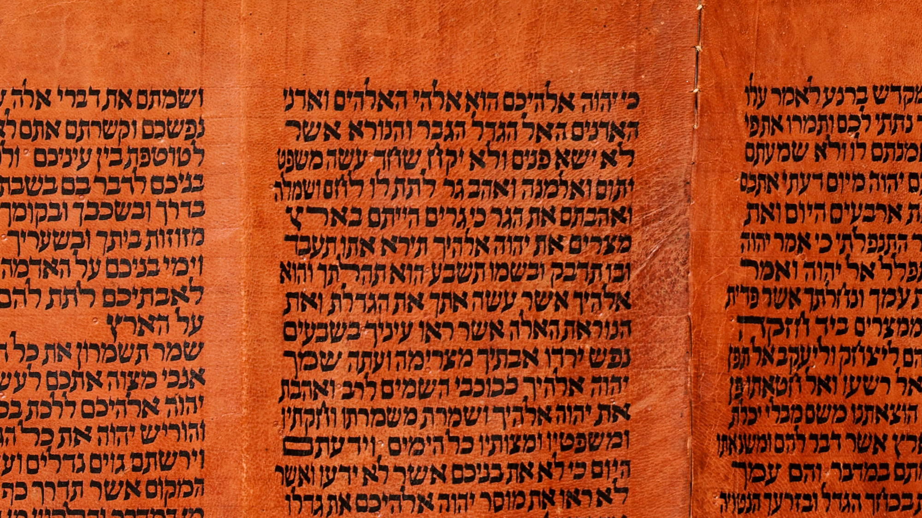
It is written, “You shall worship the Lord your God, and serve Him only”
Torah scroll with Deuteronomy 10:20, the source of Jesus’s quotation
4:10
Notes:
“Thou shalt fear Jehovah thy God; him shalt thou serve; and to him shalt thou cleave, and by his name shalt thou swear” (Deut 10:20, ASV).
This Yemenite Torah scroll was photographed at The Master’s Seminary in California.
tb031416452

Slide 53
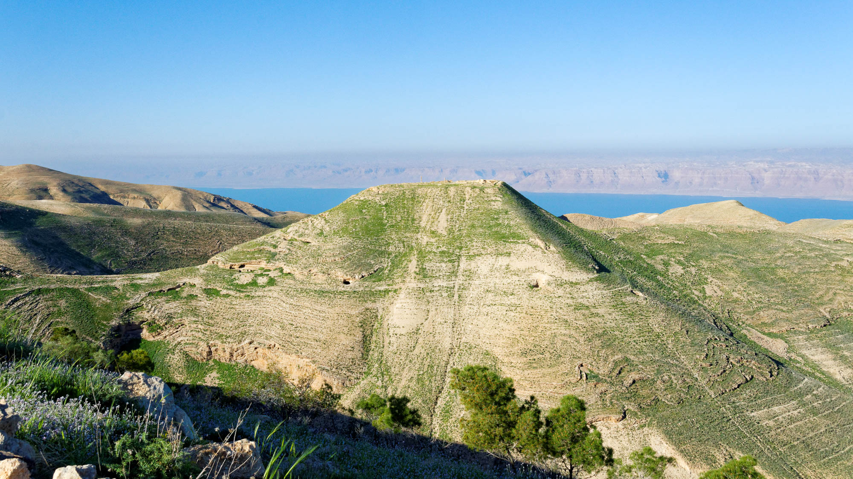
Now when He heard that John had been arrested
Macherus, place of John’s imprisonment (from the east)
4:12
Notes:
According to the first-century historian Josephus, John was imprisoned and beheaded at the palace of Herod Antipas in Macherus, east of the Dead Sea.
tb031415715h

Slide 54
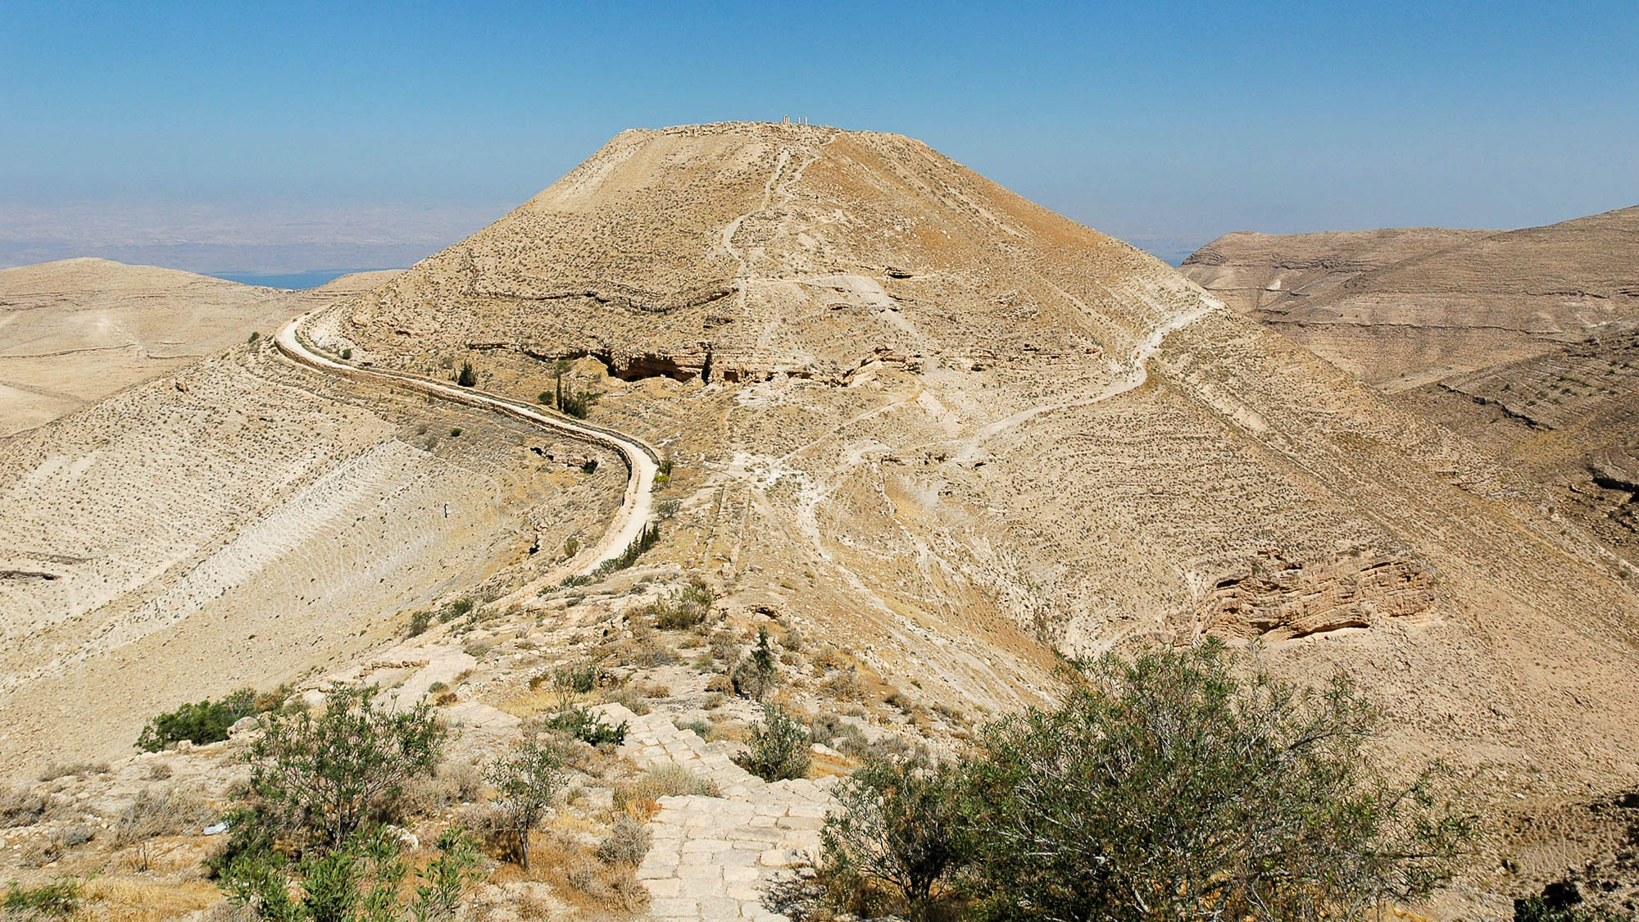
Now when He heard that John had been arrested
Macherus, place of John’s imprisonment (from the southeast)
4:12
Notes:
The fortress of Macherus was built by Herod the Great and inherited by his son Antipas, who ruled over Galilee and Perea.
tb061204083h

Slide 55
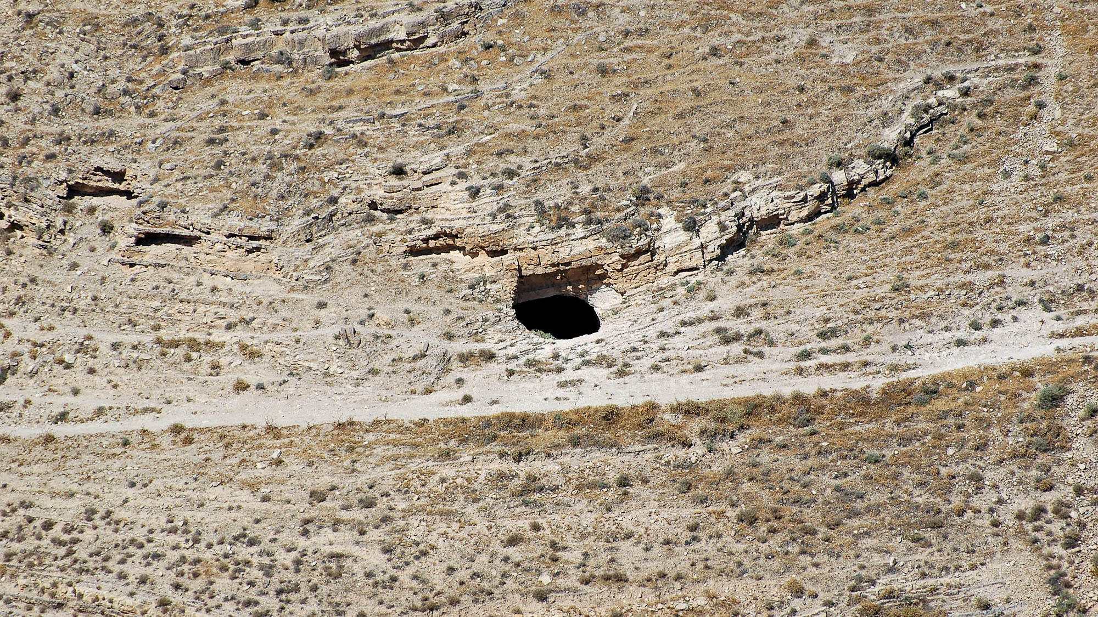
Now when He heard that John had been arrested
Macherus cave, traditional prison of John the Baptist
4:12
Notes:
According to one tradition, John was held in this prison prior to his beheading.
tb061204077h

Slide 56
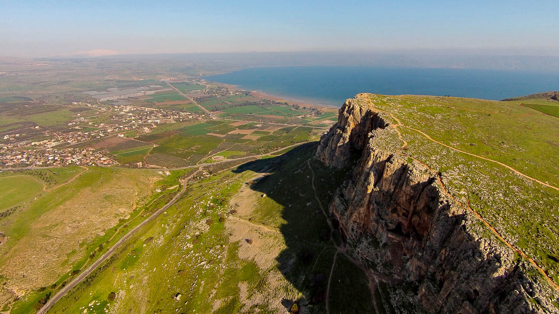
Now when He heard that John had been arrested, He withdrew into Galilee
Arbel cliffs and Sea of Galilee (aerial view from the southwest)
4:12
Notes:
ws011315157h

Slide 57
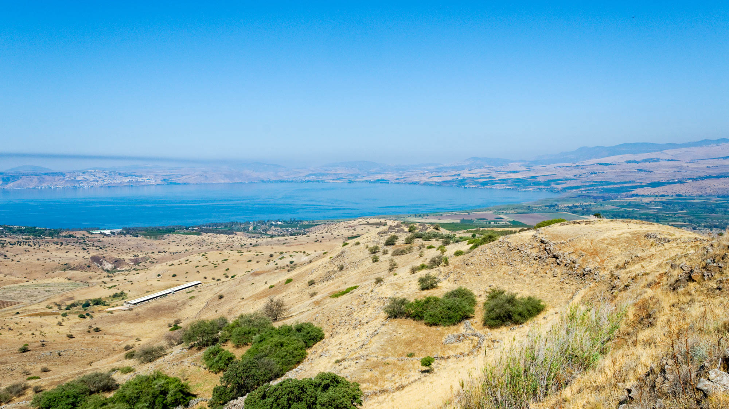
Now when He heard that John had been arrested, He withdrew into Galilee
Sea of Galilee view from Kanaf overview (from the east)
4:12
Notes:
tb053016692h

Slide 58
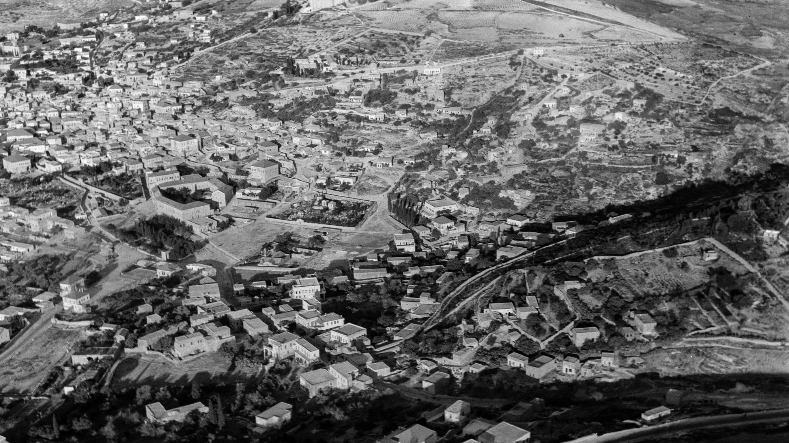
Leaving Nazareth . . .
Nazareth (aerial view from the northeast)
4:13
Notes:
This American Colony photograph was taken in 1932.
mat15869h

Slide 59
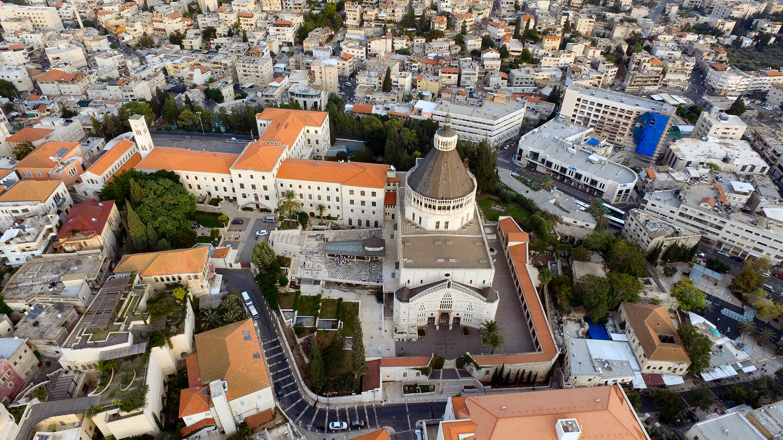
Leaving Nazareth . . .
Nazareth Church of the Annunciation (aerial view from the west)
4:13
Notes:
ws101815177

Slide 60

Leaving Nazareth . . .
Nazareth (from the south)
4:13
Notes:
This photograph was taken from the place known today as the “Mount of Precipitation,” where tradition claims that Jesus was nearly thrown to His death (Luke 4).
tb032507547

Slide 61

Leaving Nazareth . . .
Street in Nazareth
4:13
Notes:
This American Colony photograph shows Nazareth in the early 1900s.
mat00722

Slide 62

He came and settled in Capernaum, which is by the sea
Capernaum on the shore of the Sea of Galilee (aerial view from the north)
4:13
Notes:
Capernaum is located at an ideal place, close both to the road with its trade and travelers and to the lake with its fishing industry.
ws040416980

Slide 63

He came and settled in Capernaum, which is by the sea
Capernaum (aerial view from the southeast)
4:13
Notes:
Jesus may have chosen to live in Capernaum because it was close to routes with many travelers. Also, several of His disciples lived there.
tbs115200011

Slide 64

He came and settled in Capernaum, which is by the sea
Capernaum (aerial view from the south)
4:13
Notes:
This American Colony photograph was taken in October 1931.
mat15818h

Slide 65

He came and settled in Capernaum, which is by the sea
Entrance to Capernaum
4:13
Notes:
tb061516511h

Slide 66

He came and settled in Capernaum, which is by the sea
Capernaum Greek Orthodox chapel and Sea of Galilee (from the northwest)
4:13
Notes:
tb053016385h

Slide 67

He came and settled in Capernaum, which is by the sea
Capernaum synagogue interior
4:13
Notes:
The white limestone synagogue depicted above dates approximately to AD 300, but is built above an earlier synagogue from the time of Jesus. Jesus’s visits to this synagogue are recorded in Mark 1, Luke 4, and John 6.
tb102702014h

Slide 68

He came and settled in Capernaum, which is by the sea
Peter’s house in Capernaum
4:13
Notes:
The traditional home of Peter become the location of an early church. Today a Catholic church building sits over the ruins.
tb102702010h

Slide 69

That what was spoken through Isaiah the prophet might be fulfilled: “The land of Zebulun . . . ”
Isaiah 9:1-2 on the Great Isaiah Scroll
4:14-16
Notes:
“But there shall be no gloom to her that was in anguish. In the former time he brought into contempt the land of Zebulun and the land of Naphtali; but in the latter time hath he made it glorious, by the way of the sea, beyond the Jordan, Galilee of the nations. The people that walked in darkness have seen a great light: they that dwelt in the land of the shadow of death, upon them hath the light shined” (Isa 9:1–2, ASV). Matthew quotes Isaiah 9:1-2 to show how Jesus’s ministry in Galilee fulfilled the prophecy of Isaiah.
The Great Isaiah Scroll is owned by the Israel Museum in Jerusalem. This image is public domain, from Wikimedia: https://commons.wikimedia.org/wiki/File:The_Great_Isaiah_Scroll_MS_A_(1QIsa)_-_Google_Art_Project-x3-y0.jpg
isax3y0

Slide 70

The land of Zebulun
Shimron (from the north)
4:15
Notes:
Shimron was one of the more important cities of Zebulun in the OT period. It is named in the city list for Zebulun in Joshua 19:15.
tb110106537h

Slide 71

The land of Zebulun
Bethlehem of Galilee
4:15
Notes:
One of the cities allotted to Zebulun in the book of Joshua was Bethlehem (19:15). This site is not to be confused with the Bethlehem of Judah.
tb110106529h

Slide 72

And the land of Naphtali
Hazor and the land of Naphtali (aerial view from the south)
4:15
Notes:
The large city of Hazor was allotted to the tribe of Naphtali. The mountains in the left distance were also part of Naphtali’s territory.
ws012317024

Slide 73

And the land of Naphtali
Tel Chinnereth (from the north)
4:15
Notes:
Kinnereth was one of the cities of Naphtali listed in Joshua 19:35. It is likely to be identified with Tel Chinnereth on the northern shore of the Sea of Galilee. It is located about 2 miles (3 km) southwest of Capernaum.
tb102702025

Slide 74

The way to the sea
Huleh Basin (from the northeast)
4:15
Notes:
While the popular view identifies the “way of the sea” (Via Maris) as the international route along Israel’s coast, Steven Notley argues that the route should be identified with that running from Tyre to Dan to Caesarea Philippi. See page 29 in R. Steven Notley, In the Master’s Steps: The Gospels in the Land. Jerusalem: Carta Jerusalem, 2014. See the next slide for labels.
tb040903222h

Slide 75
The way to the sea
Dan
Caesarea Philippi
Huleh Basin (from the northeast)
4:15
Notes:
While the popular view identifies the “way of the sea” (Via Maris) as the international route along Israel’s coast, Steven Notley argues that the route should be identified with that running from Tyre to Dan to Caesarea Philippi. See page 29 in R. Steven Notley, In the Master’s Steps: The Gospels in the Land. Jerusalem: Carta Jerusalem, 2014.
tb040903222h

Slide 76


Galilee of the Gentiles
Panorama of Galilee hill country from the Horns of Hattin
Panorama of Galilee hill country from Sepphoris, showing Bet Netofa Valley with Cana
4:15
Notes:
The lands of the northern tribes, including Zebulun and Naphtali, were the first to be conquered by the invading Assyrians in the eighth century BC. This may explain the term “Galilee of the Gentiles.”
top: tb041003208; bottom: tb03250766p

Slide 77

Galilee of the Gentiles
Sea of Galilee (aerial view from the west)
4:15
Notes:
This view looks from above Mount Arbel and the Plain of Gennesaret to the eastern side of the lake and the Golan Heights.
ws092616415

Slide 78

The people who sit in darkness have seen a great light
Relief of Tiglath-pileser III, conqueror of Galilee in the time of Isaiah
4:16
Notes:
Isaiah’s prophecy spoke of the hope that was to come to the land that had recently been destroyed in an invasion by Tiglath-pileser in 733 BC. This relief of the Assyrian king comes from the central palace of Nimrud and dates to 728 BC, a few years after Tiglath-pileser III laid waste to Galilee, as recorded in 2 Kings 15:29. This relief was photographed in the British Museum.
tb112004892

Slide 79

The people who sit in darkness have seen a great light
Relief from central palace of Tiglath-pileser III, 730 BC
4:16
Notes:
This relief depicts the capture of Astartu and dates to only a few years after Tiglath-pileser III made Galilee a very dark place. This relief was photographed in the British Museum.
tb112004840w

Slide 80

The people who sit in darkness have seen a great light
Basalt relief of royal chariot and guards, reign of Tiglath-pileser III, from Aslantas
4:16
Notes:
The darkness of Galilee was caused by the Assyrian king and his army. This photograph was taken in the Istanbul Museum of the Ancient Orient.
adr1006054583h

Slide 81

The people who sit in darkness have seen a great light
Gate, plaza, and marketplace of the Israelite city of Dan
4:16
Notes:
The impressive Israelite city of Dan came to an end with the invasion of Tiglath-pileser III in 733 BC. Archaeologists have found significant evidence all over the tell of this destruction.
tb052907116h

Slide 82

The people who sit in darkness have seen a great light
Remains of house and stable from the Israelite period at Hazor
4:16
Notes:
Another city that shows extensive destruction by the Assyrian army in 733 BC is Hazor. The Assyrian army almost certainly marched from Dan in the center distance of the photo south through the Huleh Valley to Hazor.
tb061416488h

Slide 83

While walking by the Sea of Galilee . . .
Sea of Galilee northern shoreline
4:18
Notes:
Most of Jesus’s recorded ministry took place along the northern shore of the Sea of Galilee (shown above). See the next slide for labels.
tb053005508h

Slide 84
While walking by the Sea of Galilee . . .
Capernaum
Bethsaida
Golan Heights
Mt. of Beatitudes
Plain of Gennesaret
Magdala
Sea of Galilee northern shoreline
4:18
Notes:
Most of Jesus’s recorded ministry took place along the northern shore of the Sea of Galilee (shown above).
tb053005508

Slide 85

While walking by the Sea of Galilee . . .
Northern shoreline of the Sea of Galilee
4:18
Notes:
See the next slide for labels.
tb052000202h

Slide 86
While walking by the Sea of Galilee . . .
Golan Heights
Bethsaida
Mt. of Beatitudes
Capernaum
Heptapegon
Nof Ginosaur
Plain of Gennesaret
Northern shoreline of the Sea of Galilee
4:18
Notes:
tb052000202h

Slide 87

While walking by the Sea of Galilee . . .
Shoreline of the Sea of Galilee near the harbor of Tabgha
4:18
Notes:
One of the warm springs of Tabgha can be seen on the right side of this photo. The warm springs in the area encourage the production of algae which attracts fish. Because of this, the area has been considered a “fisherman’s hole” for thousands of years.
tbs115060011h

Slide 88

While walking by the Sea of Galilee . . .
En Ayub, one of the springs of Heptapegon
4:18
Notes:
The name “Heptapegon” means “seven springs.”
tb061516567

Slide 89

While walking by the Sea of Galilee . . .
Sea of Galilee shoreline near Tabgha harbor
4:18
Notes:
These black and white photos taken in the early 1900s show local fishermen on the Sea of Galilee. This American Colony photograph was taken between 1920 and 1933.
mat02796h

Slide 90

He saw two brothers, Simon called Peter, and Andrew his brother, casting a net into the sea
Fisherman casting net in the Sea of Galilee
4:18
Notes:
This American Colony photograph was taken between 1934 and 1939.
mat04201h

Slide 91

He saw two brothers, Simon called Peter, and Andrew his brother, casting a net into the sea
Fisherman casting net in the Sea of Galilee
4:18
Notes:
“The casting-net.—When using this, the fisherman stands on the bank or wades breast-deep into the water, and skilfully throws the net which he had arranged on his arm into the water in front of him. It falls in the shape of a ring, and as the lead weights around the fringe drag it down, the net takes the shape of a dome or cone in sinking, and finally falls upon the fishes it encloses. The fisherman then dives down and draws the leads securely together, and carries net and fish to the bank. Favourite spots are the warm springs above Magdala, where the fish congregate in vast swarms, and the fisherman frequently flings in some bait to bring them to one spot, and near enough to the shore for his purpose” (G. M. Mackie, Bible Manners and Customs [New York: Fleming H. Revell, 1898], 75).
mat00691h

Slide 92

He saw two brothers, Simon called Peter, and Andrew his brother, casting a net into the sea
Fisherman casting net in the Sea of Galilee
4:18
Notes:
This photo shows a modern demonstration of the cast-net. The modern harbor of Capernaum is visible on the shoreline.
tb052604057h

Slide 93

He saw two brothers, Simon called Peter, and Andrew his brother, casting a net into the sea
Galilee fishermen with large numbers of fish
4:18
Notes:
This American Colony photograph was taken between 1900 and 1920.
mat05689h

Slide 94

He saw two brothers, Simon called Peter, and Andrew his brother, casting a net into the sea
Peter and Andrew in mosaic in St. Paul’s Outside the Walls
4:18
Notes:
The Papal Basilica of St. Paul Outside the Walls is the traditional location in Rome where the apostle Paul was buried.
tb0517173156

Slide 95

For they were fishermen
African fisherman from Posillipo, AD 130–160
4:18
Notes:
This statue was photographed at the Spartacus Exhibit in Rome.
tb0518174016

Slide 96

And He said to them, “Follow me, and I will make you fishers of men”
Painting of Jesus calling the disciples to be fishers of men, in Duc In Altum chapel in Magdala
4:19
Notes:
The Duc In Altum Church was dedicated in May 2014. Duc In Altum is Latin for “put out into the deep water,” recalling Jesus’s words in Luke 5:4.
tb053116490

Slide 97

And He said to them, “Follow me, and I will make you fishers of men”
The Calling of Saint Peter and Saint Andrew, by James Tissot, circa 1890
4:19
Notes:
Peter himself was personally called by Jesus while he was fishing in the Sea of Galilee with his brother Andrew (Matt 4:18-20). This painting was made using opaque watercolor over graphite on gray wove paper. This image comes from the Brooklyn Museum, Purchased by public subscription, 00.159.56, public domain. Source: https://www.brooklynmuseum.org/opencollection/objects/4458
bmny4458

Slide 98

Immediately they left their nets
Fishing net fragment, 19th–20th dynasties, from Lisht
4:20
Notes:
Linen artifacts from the ancient times are rarely preserved, so this is a helpful image even if it is about 1,000 years earlier than the time of Christ and comes from Egypt. This artifact was photographed in the Metropolitan Museum of Art in New York City. This image comes from The Metropolitan Museum of Art, public domain, Rogers Fund and Edward S. Harkness Gift, 1922, accession number 22.1.1212, http://metmuseum.org/art/collection/search/555229.
met555229h

Slide 99

He saw two other brothers . . . in the boat with Zebedee their father
First-century boat discovered in the Sea of Galilee
4:21
Notes:
The remains of this first-century AD boat were discovered along the northwestern shore of the Sea of Galilee. The boat is now on display in the Yigal Alon Museum at Nof Ginosar.
tb061516581h

Slide 100

He saw two other brothers . . . in the boat with Zebedee their father
Reconstruction of first-century boat at the Sea of Galilee
4:21
Notes:
This reconstruction was based upon an ancient boat discovered along the shore of the Sea of Galilee (see previous slide). It was photographed when on display at Kibbutz En Gev.
tb112000204

Slide 101

He saw two other brothers . . . in the boat with Zebedee their father
Fishing boats in the Sea of Galilee
4:21
Notes:
This photograph was taken near the northern shore of the Sea of Galilee by David Bivin in 1968.
db6808215511

Slide 102

He saw two other brothers . . . in the boat with Zebedee their father
Boats along shore of Tiberias
4:21
Notes:
This photograph was taken by photographers from the American Colony in the early 1900s.
mat12142

Slide 103

He saw two other brothers . . . in the boat with Zebedee their father
Fishermen with nets on the Sea of Galilee
4:21
Notes:
This hand-colored American Colony photograph was taken in October 1945.
mat22959h

Slide 104

He saw two other brothers . . . in the boat . . . mending their nets
Fisherman mending net in Mitylene
4:21
Notes:
Mitylene is the port city of the Greek island of Lesbos.
tb061206268h

Slide 105

He saw two other brothers . . . in the boat with Zebedee their father, mending their nets
Fisherman’s boat on the Sea of Galilee
4:21
Notes:
This photochrom image was taken in the 1890s. The village of Tiberias is visible in the distance.
pcm02740h

Slide 106

He saw two other brothers . . . mending their nets
Galilean fishermen mending their nets at dawn
4:21
Notes:
This photograph was taken by photographers from the American Colony in the early 1900s.
mat05685h

Slide 107

He saw two other brothers . . . mending their nets
Galilean fishermen mending their nets at dawn
4:21
Notes:
This is a colorized version of the previous photograph, taken by photographers from the American Colony in the early 1900s.
mat14944

Slide 108

He saw two other brothers . . . mending their nets
Fishermen mending their nets along the Sea of Galilee
4:21
Notes:
mat04162

Slide 109

He saw two other brothers . . . mending their nets
Fishermen mending their nets along the Sea of Galilee
4:21
Notes:
This photograph was taken by photographers from the American Colony before World War I.
mat07019

Slide 110

He saw two other brothers . . . mending their nets
Needle for mending fishing net, 1st century AD
4:21
Notes:
This artifact is in the Jared James Clark Collection.
tb0713158498

Slide 111

He saw two other brothers . . . mending their nets
Needle for mending fishing net, 1st century AD
4:21
Notes:
This artifact is in the Jared James Clark Collection.
tb0713158500h

Slide 112

And Jesus went throughout all Galilee, teaching in their synagogues
Synagogue of Chorazin
4:23
Notes:
Scripture never records Jesus’s visit to Chorazin, but references like this one must include a visit to Chorazin, especially in light of Jesus’s later condemnation of the city “despite the mighty works done in you” (Matt 11:21).
tb102502012h

Slide 113

And Jesus went throughout all Galilee, teaching in their synagogues
Interior of Chorazin synagogue (from the southwest)
4:23
Notes:
According to archaeologists, this synagogue post-dates Jesus’s ministry by at least one century. An earlier synagogue has not yet been identified.
tb102502011

Slide 114

And Jesus went throughout all Galilee, teaching in their synagogues
Synagogue of Magdala (from the northwest)
4:23
Notes:
This synagogue at Magdala was recently excavated and identified. Though Scripture never records Jesus visiting Magdala, one of his famous followers came from this town. In light of this verse, it is likely that Jesus taught here.
tb053116429h

Slide 115

And Jesus went throughout all Galilee, teaching in their synagogues
Synagogue of Gamla
4:23
Notes:
This synagogue was in use in the first century AD. Though there is no specific record of Jesus visiting Gamla, it is possible that He did on one of His preaching tours. This synagogue was destroyed in the Jewish Revolt in the late 60s.
tbs76309304h

Slide 116

And Jesus went throughout all Galilee, teaching in their synagogues
Synagogue façade at Baram
4:23
Notes:
Baram is another location of a Galilean synagogue that is not mentioned in the New Testament. Though this and most synagogues discovered in Galilee so far date from several centuries after Jesus’s ministry, it is likely that villages and synagogues existed in these same places and were visited by Jesus on His preaching tours.
tb032807940h

Slide 117

And Jesus went throughout all Galilee, teaching in their synagogues
Interior of Baram synagogue
4:23
Notes:
The preservation of the Baram synagogue provides a good model for what Galilean synagogues looked like.
tb032807944h

Slide 118

And Jesus went throughout all Galilee, teaching in their synagogues
Entrance to synagogue of Khirbet Shema
4:23
Notes:
Khirbet Shema gets its name from Rabbi Shammai (50 BC – AD 30), the Jewish sage known for his differences with contemporary Hillel. Jewish pilgrims have venerated this site as the place of his tomb.
tb033104384h

Slide 119

And Jesus went throughout all Galilee, teaching in their synagogues
Interior of Khirbet Shema synagogue with bema
4:23
Notes:
The synagogue was excavated from 1970 to 1972 by Eric M. Meyers, who determined that the site was occupied from the Late Hellenistic period through the Early Arab period and again in the Crusader era. The synagogue belongs to Stratum III, which dates to ca. AD 284–306.
tb033104391h

Slide 120

And Jesus went throughout all Galilee, teaching in their synagogues
Gischala synagogue (from the north)
4:23
Notes:
The Gischala synagogue was surveyed by Germans in 1905 and later excavated by an American team in 1977-78, under the direction of Eric M. Meyers, Carol L. Meyers, and James F. Strange. The excavators determined that the synagogue consisted of four phases from AD 250 to 550. The building is nearly an exact square, measuring 56 feet (16.8 m) on each side. Though Jesus did not preach in this same building, He may have been in its predecessor.
tb033104363

Slide 121

And Jesus went throughout all Galilee, teaching in their synagogues
Arbel synagogue entrance on east side
4:23
Notes:
The Arbel synagogue is located on the western side of the Sea of Galilee, on the slope of Mount Arbel.
tb102802002h

Slide 122

And Jesus went throughout all Galilee, teaching in their synagogues
Arbel synagogue (from the south)
4:23
Notes:
Like the ruins of most ancient synagogues in Galilee today, the Arbel synagogue is not protected from the elements or visitors.
tb102802003h

Slide 123

And Jesus went throughout all Galilee, teaching in their synagogues
Ein Nashut synagogue (aerial view from the southwest)
4:23
Notes:
The Ein Nashut synagogue is located in the Golan Heights and was one of dozens of synagogues in use in this area during the Byzantine period.
ws053016409

Slide 124

And Jesus went throughout all Galilee, teaching in their synagogues
Ein Nashut synagogue (aerial view from the south)
4:23
Notes:
ws053016406

Slide 125

And Jesus went throughout all Galilee, teaching in their synagogues
Qatzrin synagogue model, 6th century AD
4:23
Notes:
This model was photographed in the Golan Archaeological Museum.
tb053016141

Slide 126

Healing all kinds of disease and sickness
Group of lepers
4:23
Notes:
This American Colony photograph was taken between 1900 and 1920.
mat01269

Slide 127

And the report of Him spread throughout all Syria
Al-Zabadani in Syria
4:24
Notes:
Al-Zabadani is located northwest of Damascus near the border of Lebanon. This photochrom image was taken in the 1890s.
pcm05911

Slide 128


And the report of Him spread throughout all Syria
Bronze coin from Syrian Antioch, issued by governor Silanus, AD 13–14
4:24
Notes:
Antioch was the capital of the Roman province of Syria. The obverse side of this coin (left) depicts a laureate head of Zeus. The reverse side (right) depicts a ram running, with a star above. It is inscribed with the text ΑΝΤΙΟΧΕΩΝ ΕΠΙ ΣΙΛΑΝΟΥ (“[a coin] of the Antiochenes in the time of Silanus”) and the date mark ΓΜ (year 43 of the Actian era). This coin is in the Jared James Clark Collection.
Left (obverse): tb030117501
Right (reverse): tb030117508

Slide 129

And great multitudes followed Him
Crowds at Jaffa Gate during Nebi Musa celebrations
4:25
Notes:
This American Colony photograph was taken in 1937.
mat16950h

Slide 130

And great multitudes followed Him from . . . Decapolis
Territory of Hippos, a city of the Decapolis, with the Sea of Galilee (from the east)
4:25
Notes:
The region of the Decapolis included ten or more Hellenistic cities. Though Jesus did not direct His ministry towards Gentiles, some of them were naturally curious at the stories they heard of this wonder worker. Hippos was located on the hill in the center of the photograph.
adr1305051351

Slide 131

And great multitudes followed Him from . . . Decapolis
Hippos (from the south)
4:25
Notes:
tb040903219h

Slide 132

And great multitudes followed Him from . . . Decapolis
A main street of Hippos (Decumanus Maximus, from the east)
4:25
Notes:
Hippos is located 1.2 miles (2 km) east of the Sea of Galilee. It is situated 1,150 feet (345 m) above the Sea of Galilee. The Greek city was called Antiochia Hippos. This was the city of horses, as is signified by both the Greek and Arabic names. Hippos means “horse.”
tb110406632

Slide 133

And great multitudes followed Him from . . . Decapolis
Gadara, a city of the Decapolis, and the Sea of Galilee
4:25
Notes:
The city of Gadara is located six miles (10 km) from the southeastern shoreline of the Sea of Galilee. The demon-possessed man lived in the region of Gadara (Matt 8:28).
tb060503103

Slide 134

And great multitudes followed Him from . . . Decapolis
A main street in Gadara (Decumanus Maximus)
4:25
Notes:
tb030915703h

Slide 135

And great multitudes followed Him from . . . Decapolis
The western theater of Gadara
4:25
Notes:
tb030915638

Slide 136

And great multitudes followed Him from . . . Decapolis
Territory of Gadara along the southeastern shore of the Sea of Galilee
4:25
Notes:
Word spread from the area of Jesus’s ministry around the Sea of Galilee to Gadara and other cities of the Decapolis.
tb060503128h

Slide 137

And great multitudes followed Him from . . . Decapolis
Territory of Gadara along the southeastern shore of the Sea of Galilee
4:25
Notes:
tb011312538h

Slide 138

And great multitudes followed Him from . . . Decapolis
Area of the harbor of Gadara
4:25
Notes:
The territory of Gadara included land touching the shore of the Sea of Galilee, thus posing no difficulty with the earliest and best readings of the Gospel of Matthew that place the miracle of 8:28-34 in the region of the Gadarenes.
tbs117080011h

Slide 139

And great multitudes followed Him from . . . Decapolis
Scythopolis (Beth Shean), a city of the Decapolis
4:25
Notes:
Scythopolis is the only city of the Decapolis located on the western side of the Jordan River. There is no record of Jesus ever visiting Scythopolis, but residents of the city may have been among the crowds from the Decapolis that followed Him.
tb121704047

Slide 140

And great multitudes followed Him from . . . Decapolis
Scythopolis (Beth Shean, aerial view from the northeast)
4:25
Notes:
The excavated remains visible at Scythopolis today date from the first through seventh centuries AD.
tbs118210011h

Slide 141

And great multitudes followed Him from . . . Decapolis
Pella, a city of the Decapolis (from the east)
4:25
Notes:
Pella is located 19 miles (30 km) south of the Sea of Galilee and 7 miles (12 km) southeast of Scythopolis (Beth Shean).
tb110703101

Slide 142

And great multitudes followed Him from . . . Decapolis
Pella, a city of the Decapolis (from the west)
4:25
Notes:
Pella is never mentioned by name in the Old or New Testaments.
tb030915534h

Slide 143

And great multitudes followed Him from . . . Decapolis
Theater of Capitolias, a city of the Decapolis
4:25
Notes:
The number of cities in the Decapolis fluctuated over the centuries. Capitolias was apparently founded in the second century AD.
tb030915742h

Slide 144

And great multitudes followed Him from . . . Decapolis
Abila, a city of the Decapolis (from the northeast)
4:25
Notes:
Abila was one of the cities of the Decapolis, but is not specifically mentioned in Scripture. The site is divided into two major tells: Tell Abila to the north and Umm el-Amad to the south.
tb060503088h

Slide 145

And great multitudes followed Him from . . . Decapolis
Abila, a city of the Decapolis (from the northeast)
4:25
Notes:
Abila was an important Christian city in the Byzantine period, as evidenced by the basilicas that have been excavated, along with records from church historians.
tb060503089

Slide 146

And great multitudes followed Him from . . . Decapolis
Gerasa, a city of the Decapolis (from the south)
4:25
Notes:
Gerasa was one of the largest cities of the Decapolis and is also one of the best preserved cities. During the second century AD, the city is estimated to have had a population of 20,000 to 25,000. The oval plaza shown above was a gathering area, and may have been the forum of the city.
tb052908616

Slide 147

And great multitudes followed Him from . . . Decapolis
Gerasa Cardo and south tetrapylon
4:25
Notes:
tb052908652

Slide 148

And great multitudes followed Him from . . . Decapolis
Nymphaeum in Gerasa, one of the cities of the Decapolis
4:25
Notes:
The nymphaeum was fed by aqueducts. Statues were placed in the niches.
tb052908660h

Slide 149

And great multitudes followed Him from . . . Decapolis
Temple of Artemis in Gerasa
4:25
Notes:
This Greco-Roman temple in Gerasa gives an idea of the layout of the Jerusalem temple at the time of Jesus (colonnaded esplanade, central shrine, etc.), though Herod’s Jerusalem temple was even larger.
tb060603190h

Slide 150

And great multitudes followed Him from . . . Decapolis
Roman theater and odeum in Philadelphia (Amman), one of the cities of the Decapolis
4:25
Notes:
The Old Testament city of Rabbah (or Rabbath-Ammon) was rebuilt and renamed Philadelphia in the third century BC. In 63 BC, it became part of the Decapolis established by Pompey. Most of the town’s Roman structures were built in the second century AD, including the theater, forum, and Hercules temple.
tb031115255

Slide 151

And great multitudes followed Him from . . . Decapolis
Roman odeum in Philadelphia (Amman)
4:25
Notes:
tb031115638h

Slide 152

And great multitudes followed Him from . . . Decapolis
Temple of Hercules in Philadelphia (Amman)
4:25
Notes:
The temple of Hercules was one of two temples built by the Romans on the acropolis (citadel) of Philadelphia in the second century AD.
tb031115253h

Slide 153

And great multitudes followed Him from . . . Decapolis
Temple of Hercules in Philadelphia (Amman)
4:25
Notes:
tb031115030h

Slide 154

And great multitudes followed Him from . . . Jerusalem
Rooftops of Jerusalem
4:25
Notes:
This photograph was taken from the rooftop of the Austrian Hospice in the Muslim Quarter.
tb042812922p

Slide 155

And great multitudes followed Him from . . . Judea
Judean hill country west of Bethlehem
4:25
Notes:
Though Matthew records none of Jesus’s early ministry outside of Galilee, he does note that crowds came to Jesus from as far as Judea.
adr1305155242

Slide 156

And great multitudes followed Him from . . . the region across the Jordan
Region of Perea (Plains of Moab) with possible Livias (Tell el-Hammam)
4:25
Notes:
The region of Perea was located on the eastern side of the Jordan River and was ruled by Antipas during the ministry of Jesus. One of the cities in Perea was Livias, possibly to be identified with Tell el-Hammam on the right side of the photo.
tb031315306

Slide 157

More than 3,000 slides in PowerPoint format. Available now from BiblePlaces.com.
Notes:
This is a free sample of the Matthew 4 presentation from the Photo Companion to the Bible. To purchase the full volume, visit https://www.bibleplaces.com/matthew/
The Photo Companion to the Bible is an image-rich resource for Bible students, teachers, and researchers. Just as a librarian stocks the shelves with as many relevant materials as possible, so we have tried to provide a broad selection of images. Our goal is that you will find in this “library” whatever it is you are looking for.
Credits: The primary creators of this presentation are Steven D. Anderson, A.D. Riddle, and Todd Bolen. The photographs have an individual file code which usually includes the initials of the photographer. Other images have additional credit or source information.
Updates: We plan to update this collection as we are able. We welcome your suggestions for improving this resource (photocompanion@bibleplaces.com). Purchasers of the Matthew volume are provided free, lifetime updates to the volume.
Copyright: This photo collection is protected by copyright law and may not be distributed without written permission from BiblePlaces.com. Slide notes should be treated as any other copyrighted written material, with credit given when quoting from these notes.
For more information, see our complete “Introduction to the Photo Companion to the Bible” online at http://www.BiblePlaces.com/Intro-Photo-Companion-Bible/. Here you will find more information about photo selection, explanatory notes, Bible translation, credit information, and copyright allowances.

