Slide 1
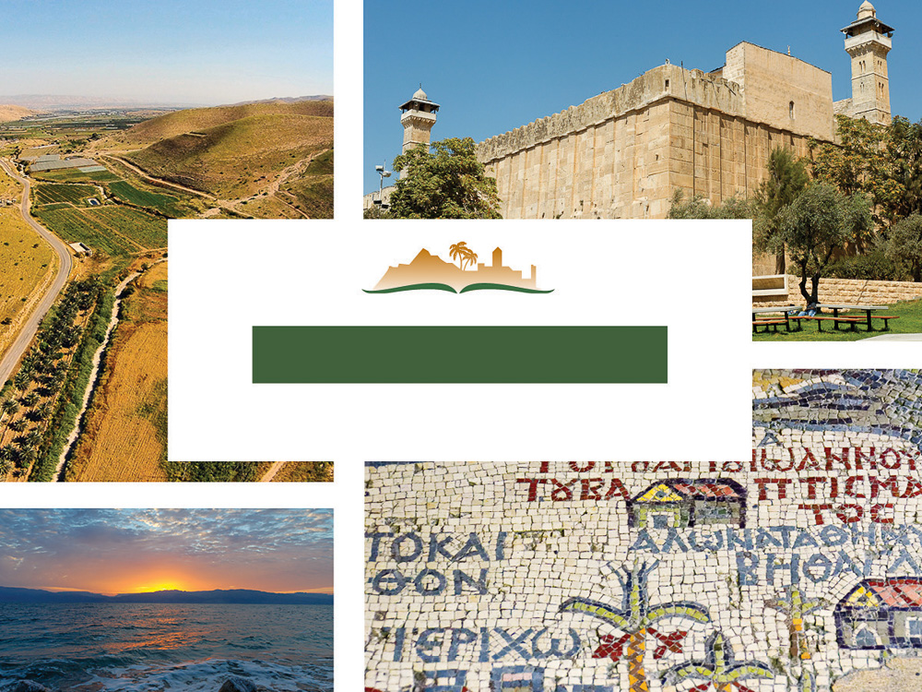
Genesis 15
Notes:
This is a free sample of the Genesis 15 presentation from the Photo Companion to the Bible. To purchase the full volume, visit https://www.bibleplaces.com/genesis/
The Photo Companion to the Bible is an image-rich resource for Bible students, teachers, and researchers. Just as a librarian stocks the shelves with as many relevant materials as possible, so we have tried to provide a broad selection of images. Our goal is that you will find in this “library” whatever it is you are looking for.
Credits: The primary creators of this presentation are Kris Udd, Chris McKinny, Steven D. Anderson, and Todd Bolen. The photographs have an individual file code which usually includes the initials of the photographer. Other images have additional credit or source information.
Updates: We plan to update this collection as we are able. We welcome your suggestions for improving this resource (photocompanion@bibleplaces.com). Purchasers of the Genesis volume are provided free, lifetime updates to the volume.
Copyright: This photo collection is protected by copyright law and may not be distributed without written permission from BiblePlaces.com. Slide notes should be treated as any other copyrighted written material, with credit given when quoting from these notes.
For more information, see our complete “Introduction to the Photo Companion to the Bible” online at https://www.BiblePlaces.com/Intro-Photo-Companion-Bible/. Here you will find more information about photo selection, explanatory notes, Bible translation, credit information, and copyright allowances.

Slide 2
Genesis 15
This is a free sample of the Genesis 15 presentation from the Photo Companion to the Bible. To purchase the full volume, visit https://www.bibleplaces.com/genesis/
The Photo Companion to the Bible is an image-rich resource for Bible students, teachers, and researchers. Just as a librarian stocks the shelves with as many relevant materials as possible, so we have tried to provide a broad selection of images. Our goal is that you will find in this “library” whatever it is you are looking for.
For more details (for this and every slide), see the Notes section below.
Notes:
This is a free sample of the Genesis 15 presentation from the Photo Companion to the Bible. To purchase the full volume, visit https://www.bibleplaces.com/genesis/
The Photo Companion to the Bible is an image-rich resource for Bible students, teachers, and researchers. Just as a librarian stocks the shelves with as many relevant materials as possible, so we have tried to provide a broad selection of images. Our goal is that you will find in this “library” whatever it is you are looking for.
Credits: The primary creators of this presentation are Kris Udd, Chris McKinny, Steven D. Anderson, and Todd Bolen. The photographs have an individual file code which usually includes the initials of the photographer. Other images have additional credit or source information.
Updates: We plan to update this collection as we are able. We welcome your suggestions for improving this resource (photocompanion@bibleplaces.com). Purchasers of the Genesis volume are provided free, lifetime updates to the volume.
Copyright: This photo collection is protected by copyright law and may not be distributed without written permission from BiblePlaces.com. Slide notes should be treated as any other copyrighted written material, with credit given when quoting from these notes.
For more information, see our complete “Introduction to the Photo Companion to the Bible” online at https://www.BiblePlaces.com/Intro-Photo-Companion-Bible/. Here you will find more information about photo selection, explanatory notes, Bible translation, credit information, and copyright allowances.

Slide 3
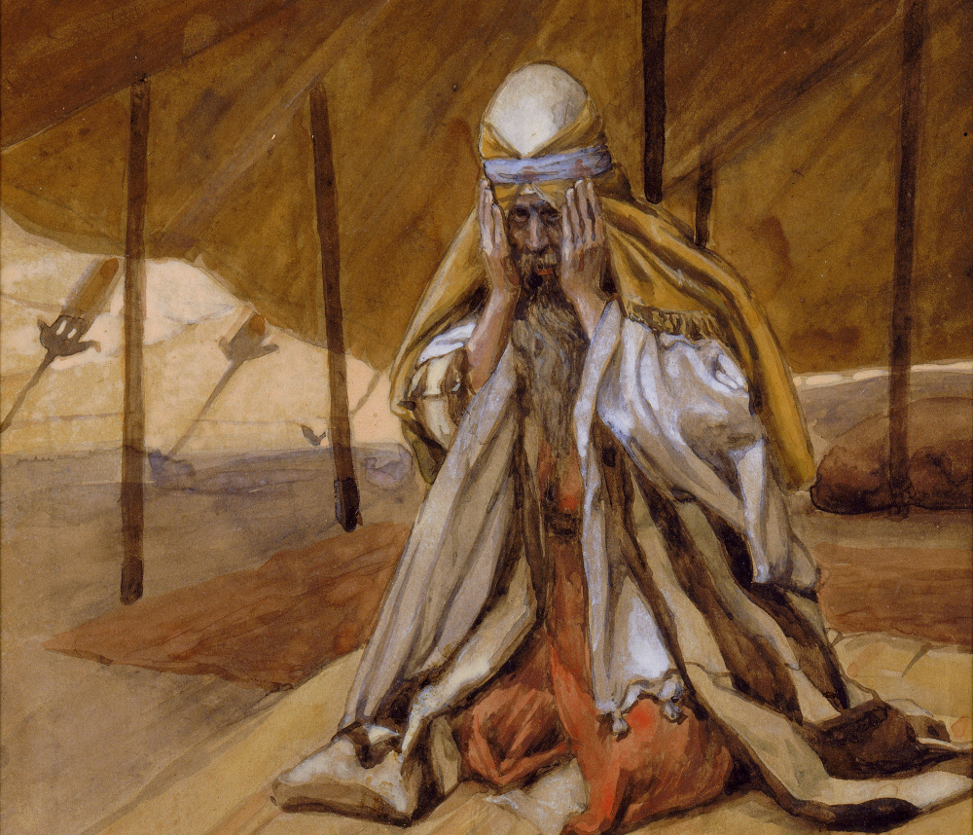
The word of Yahweh came to Abram in a vision
God Renews His Promises to Abraham, by James Tissot, circa 1898
15:1
Notes:
This is a detail of a painting by James Tissot. It portrays Abram in a posture of reverence and fear toward God. This image is in the public domain, via the Jewish Museum: https://thejewishmuseum.org/collection/26695-god-renews-his-promises-to-abraham.
tjm83855162141351836

Slide 4
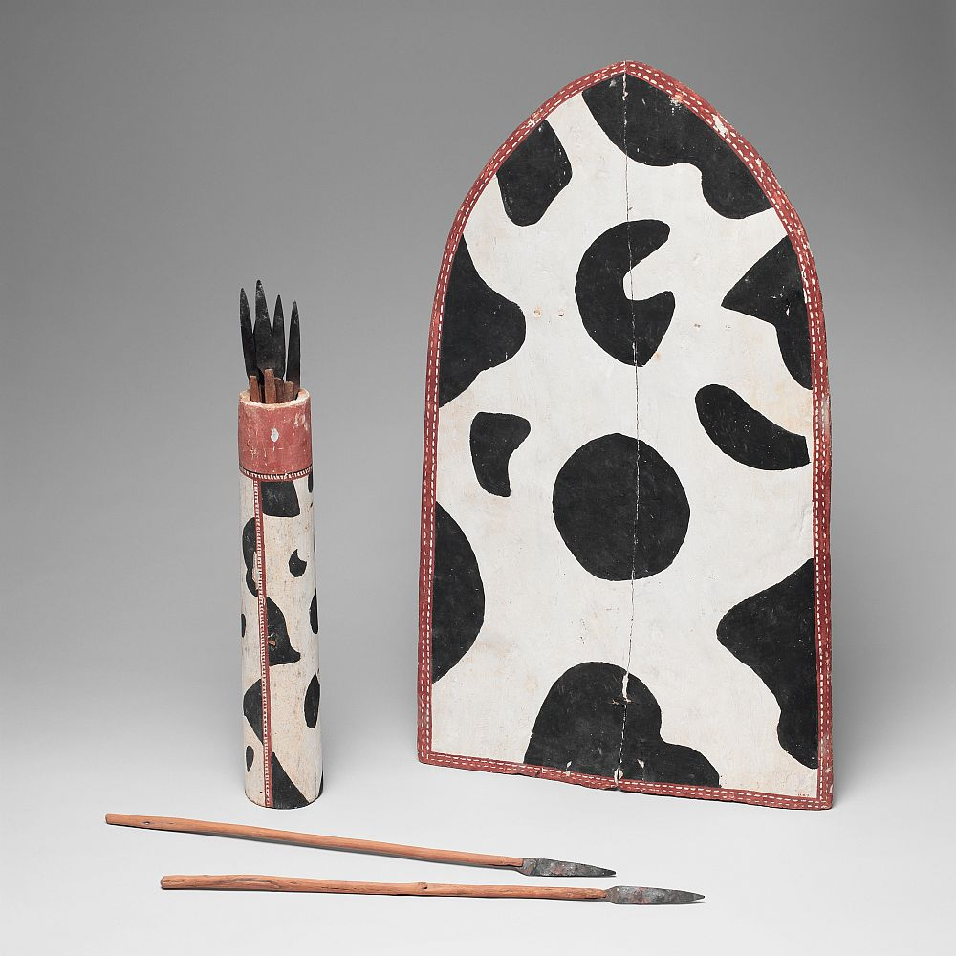
The word of Yahweh came to Abram in a vision, saying, “Fear not, Abram, for I am your shield”
Model shield, spear case, and spears, from Egypt, circa 1950 BC
15:1
Notes:
This image comes from The Metropolitan Museum of Art, public domain, Gift of Edward S. Harkness, 1917, accession number 17.9.3–.11-related, http://metmuseum.org/art/collection/search/590949.
met590949

Slide 5
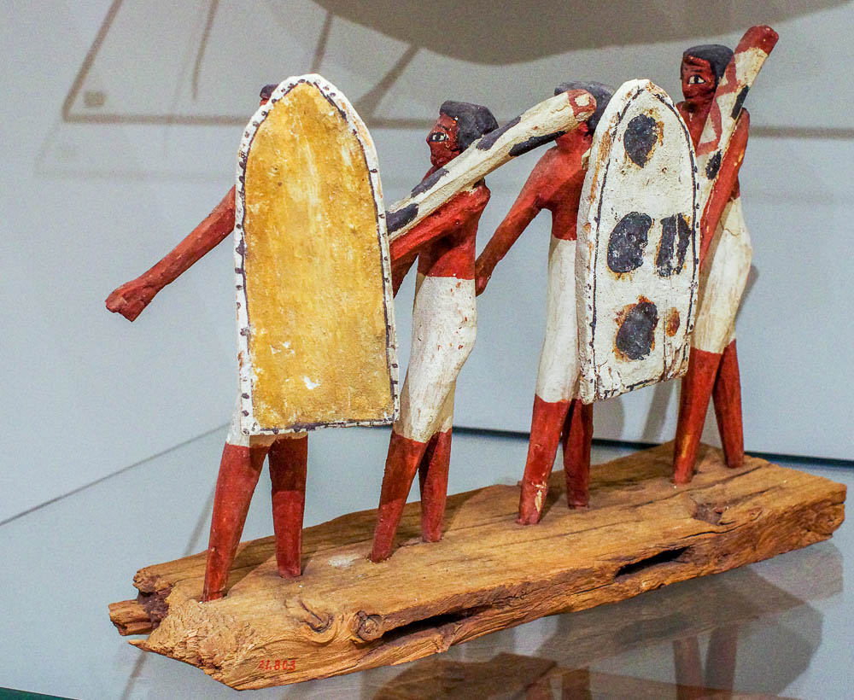
The word of Yahweh came to Abram in a vision, saying, “Fear not, Abram, for I am your shield”
Procession of soldiers, from the tomb of Djehutynakht at Deir el-Bersha, circa 2000 BC
15:1
Notes:
This model of Egyptian soldiers with battle shields was photographed at the Boston Museum of Fine Arts.
adr1711203098

Slide 6
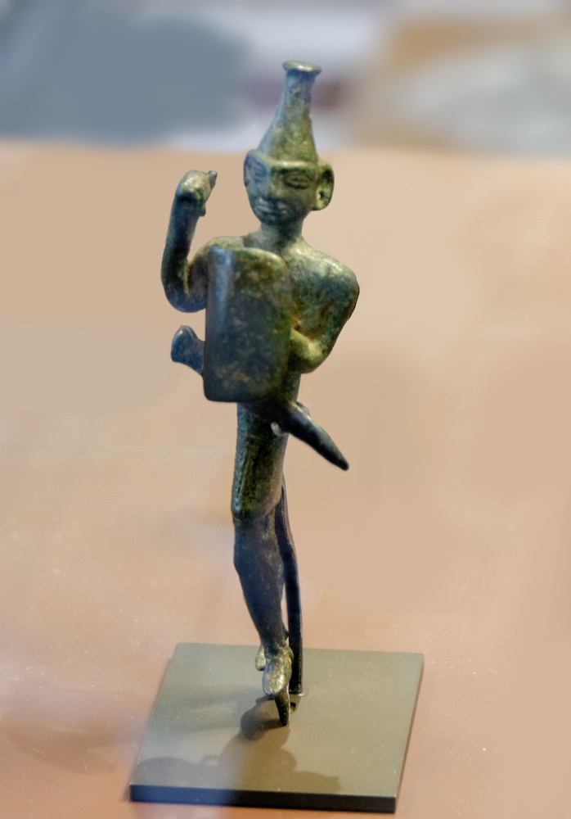
The word of Yahweh came to Abram in a vision, saying, “Fear not, Abram, for I am your shield”
Bronze statuette of a warrior god with sword and shield, from Syria, circa 1500–1250 BC
15:1
Notes:
This bronze statuette was photographed at the Louvre Museum.
tb0927195186c

Slide 7
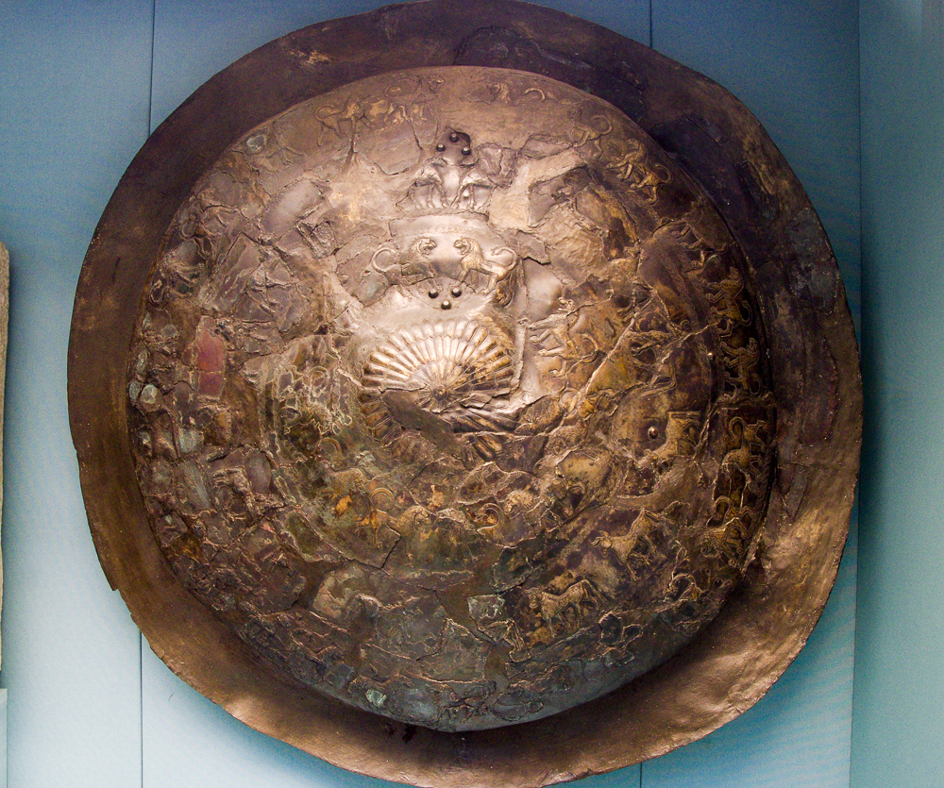
The word of Yahweh came to Abram in a vision, saying, “Fear not, Abram, for I am your shield”
Urartian bronze shield from Toprakkale, with inscription of Rusa son of Erimena, circa 650 BC
15:1
Notes:
This ancient shield was photographed at the British Museum.
adr1305251438

Slide 8
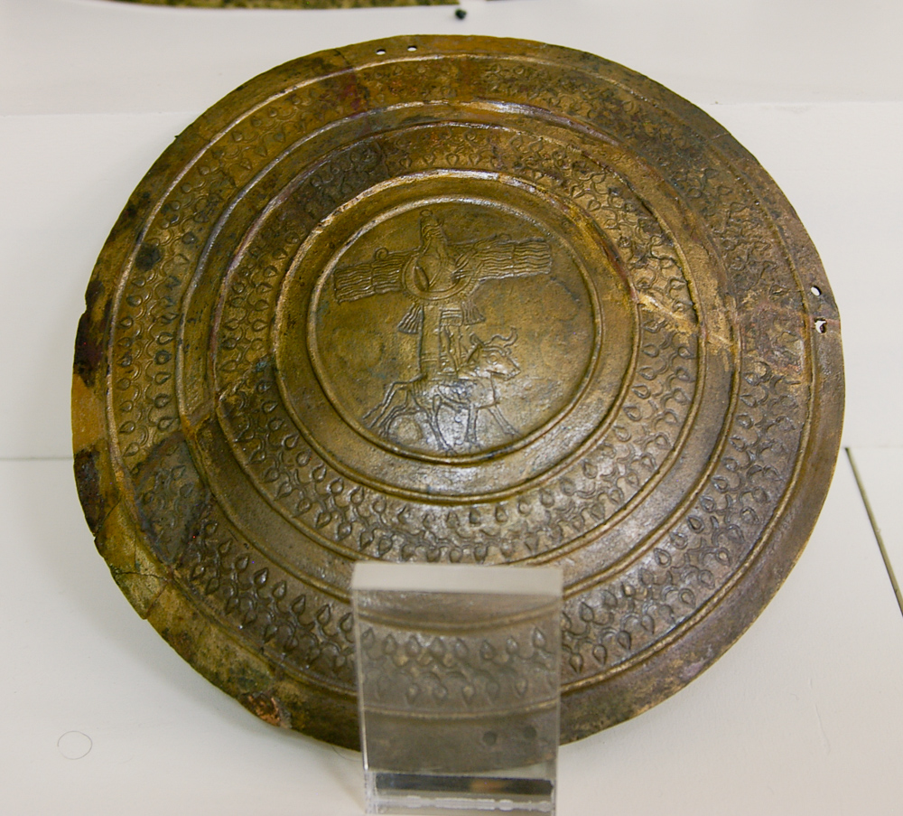
The word of Yahweh came to Abram in a vision, saying, “Fear not, Abram, for I am your shield”
Urartian bronze shield with a deity on a bull, circa 8th century BC
15:1
Notes:
This ancient shield was photographed at the Van Museum. The center boss depicts the Assyrian god Ahuramazda, standing on a bull. Of course, this is not the God whom Abraham worshiped, but the association of a deity with the shield fits with the metaphor used here by God.
adr1005232923

Slide 9
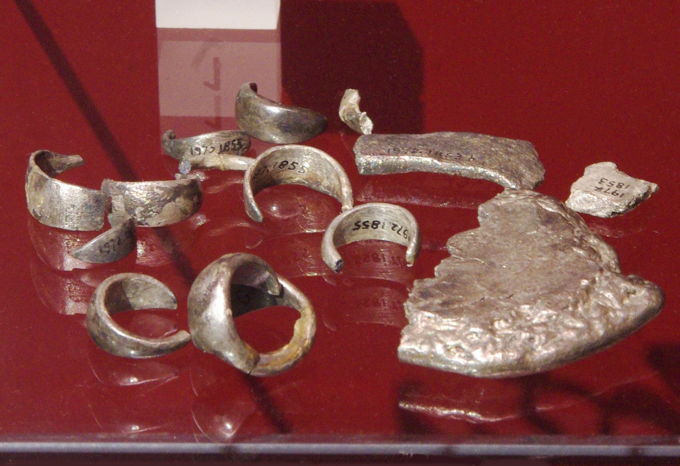
Your reward will be very great
Silver hoard from Tell Taya, circa 2200 BC
15:1
Notes:
The word “reward” (Heb. sakar, שָׂכָר) could also be translated as “wages.” There was no coined money at the time of Abram, so wages could be paid using irregular pieces of silver (hacksilver) that were weighed to produce the desired amount. The hoard of hacksilver shown here was photographed at the Ashmolean Museum at the University of Oxford.
adr1305227190

Slide 10
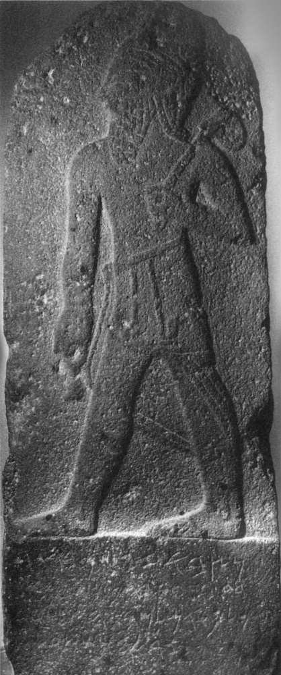
Your reward will be very great
Melqart Stele, 9th–8th centuries BC
15:1
Notes:
This brief inscription mentions a king named Bir-Hadad who was a king of “Aram” (although it is not clear which Aram). The inscription indicates that Bir-Hadad made a vow to Melqart after hearing his voice, which is somewhat similar to Abram’s experience in Genesis 15. “The stela which Bir-Hadad the son of Attar-hamek, [ . . . ] king of Aram, set up for his lord Melqart, to whom he made a vow and who heard his voice” (Pitard 2003: 152).
The stele was photographed at the Aleppo Museum. This image comes from Aleppo Museum and is in the public domain, via Wikimedia Commons: https://commons.wikimedia.org/wiki/File:Melqart_or_Bir_Hadad_stele.jpg..
Reference:
Pitard, Wayne T.
2003 The Melqart Stele. Pp. 152–53 in The Context of Scripture, vol. 2, ed. W. W. Hallo and K. Lawson Younger, Jr. Leiden: Brill.
wiki04042021341210

Slide 11
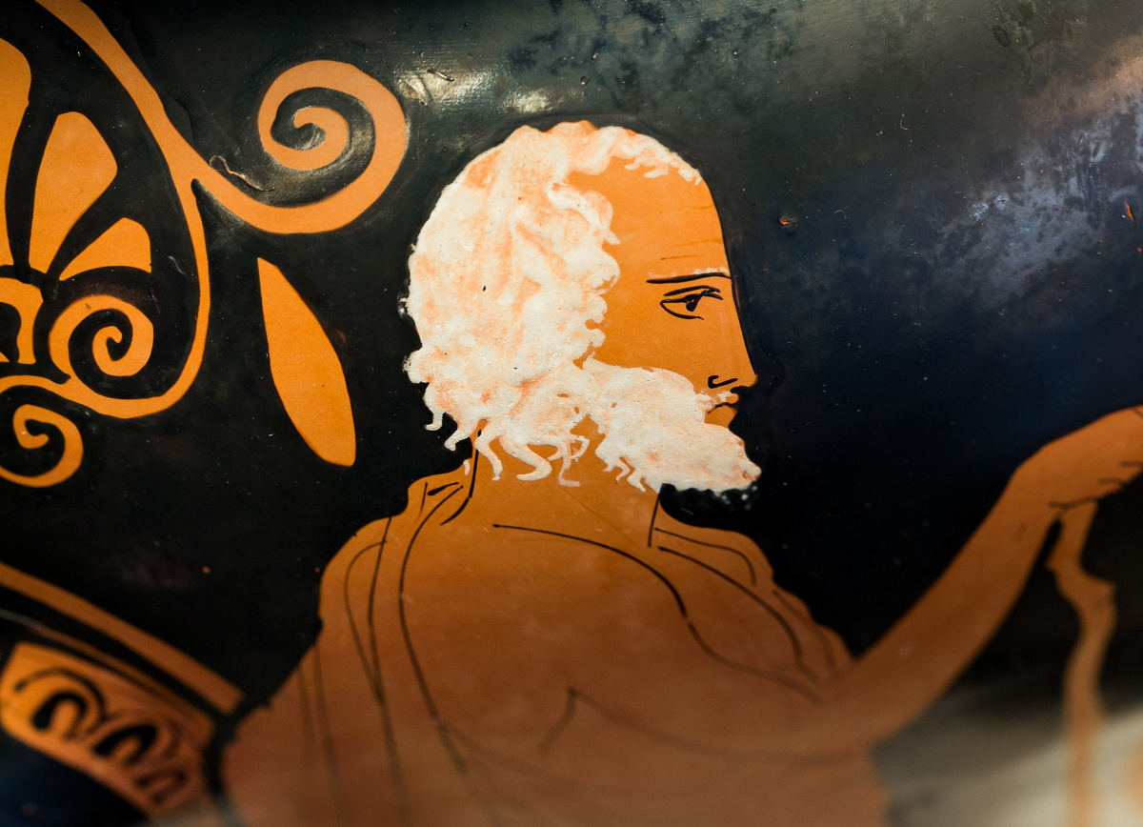
Abram said, “O Lord Yahweh, what will You give me, since I am childless”
Vase depicting an old man with a staff, from Athens, circa 430 BC
15:2
Notes:
Abram observes that he and Sarai have not had any children, and he is between 75 and 85 years old at this time (Gen 12:4; cf. Gen 16:3). The problem is that God’s promise to him cannot be fulfilled if Abram doesn’t have any seed to be multiplied in order to fill the land and bring blessing to all peoples. This beautifully rendered Greek vase depicts an old man with white hair and beard, leaning on a staff. This vase was photographed at the State Collection of Antiquities in Munich. This image comes from ArchaiOptix and is licensed under CC BY-SA 4.0, via Wikimedia Commons: https://commons.wikimedia.org/wiki/File:Kleophon_Painter_-_ARV_1143_2_-_warrior_leaving_home_-_three_draped_youths_-_M%C3%BCnchen_AS_2415_-_02.jpg.
wiki062922193944

Slide 12
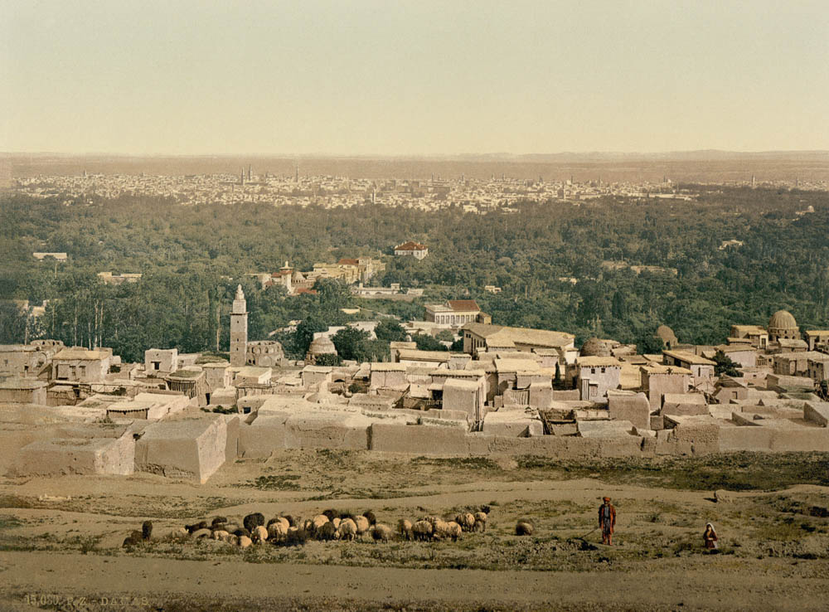
The heir of my house is Eliezer of Damascus
Damascus from Sallah, circa 1895
15:2
Notes:
This is the first reference to Eliezer, although Damascus was mentioned in the previous chapter (Gen 14:15). It seems that since Eliezer was set to be Abram’s heir, Eliezer would have been serving Abram for a lengthy period of time. This is confirmed by the subsequent statement that Eliezer had been “born in my house” (Gen 15:3). This photochrom image was taken in the 1890s.
pcm02667

Slide 13
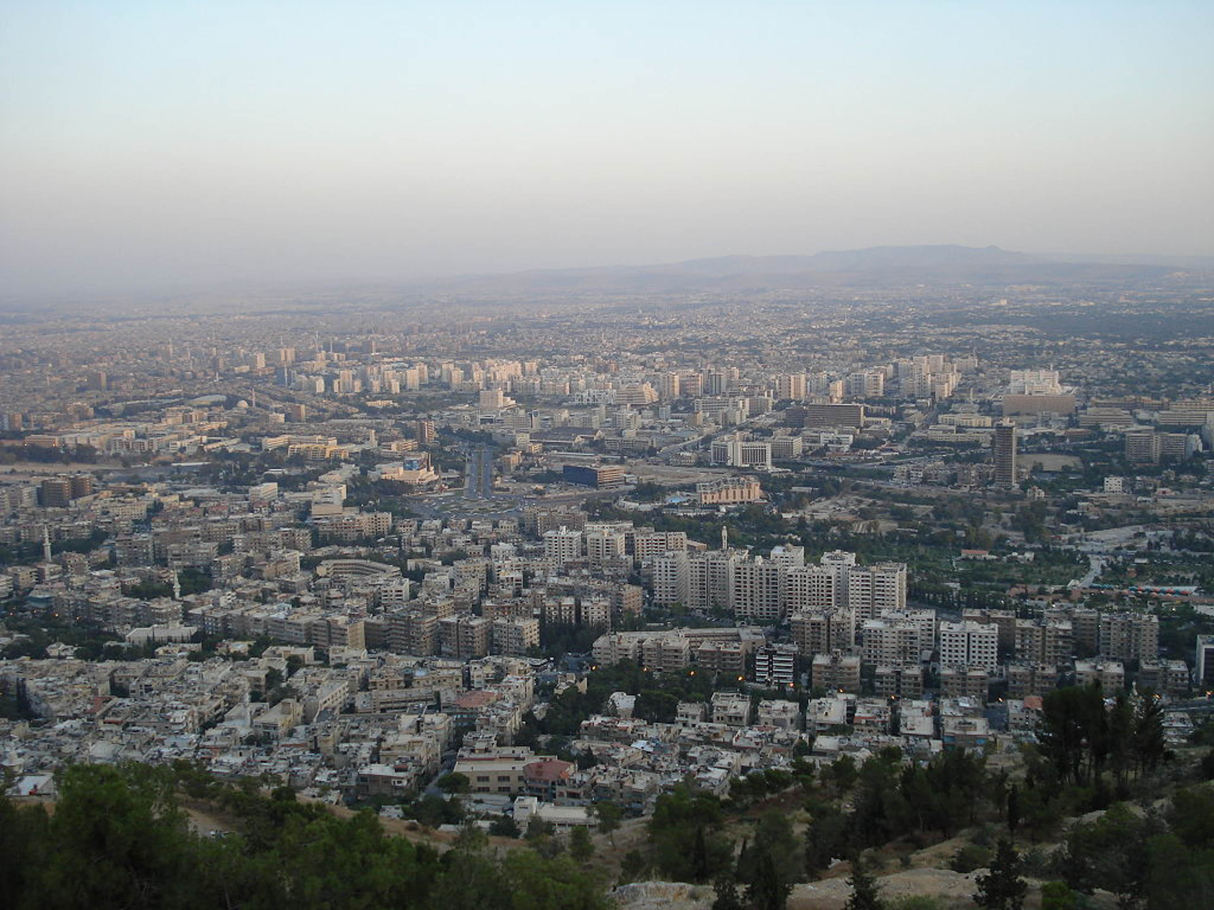
The heir of my house is Eliezer of Damascus
Modern Damascus
15:2
Notes:
The archaeology of Damascus is largely unknown, primarily because it has been continuously inhabited since antiquity. This image comes from Aziz1005 and is in the public domain, via Wikimedia Commons: https://commons.wikimedia.org/wiki/File:Damascus_from_Qasiyon.JPG.
wiki0804200723451536

Slide 14
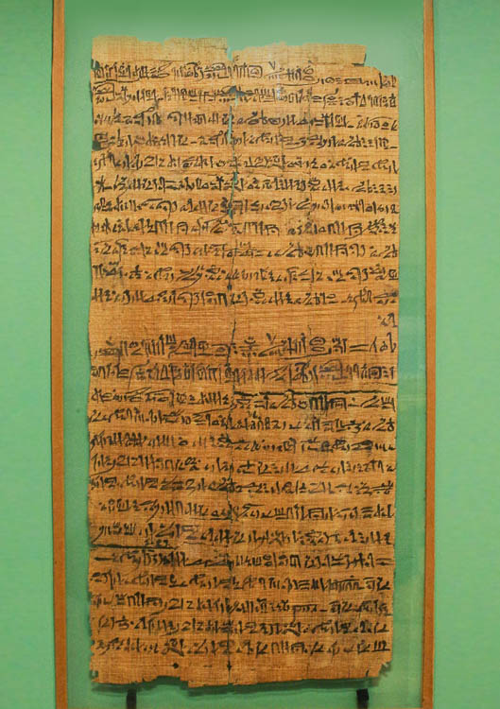
You have given me no seed, and so one born in my house will be my heir
Papyrus adoption and inheritance document, from Thebes, reign of Ramesses XI, circa 1080 BC
15:3
Notes:
Abram’s assumption seems to be that he will need to adopt Eliezer, thus making him his son and granting him the inheritance that would otherwise have gone to Abram’s natural heir. The antiquity of this practice is illustrated here by a papyrus document from Thebes, dating to the reign of Ramesses XI. The document records the adoption of a son and provides stipulations regarding his inheritance. This document was photographed at the Ashmolean Museum at the University of Oxford.
adr1805182789

Slide 15
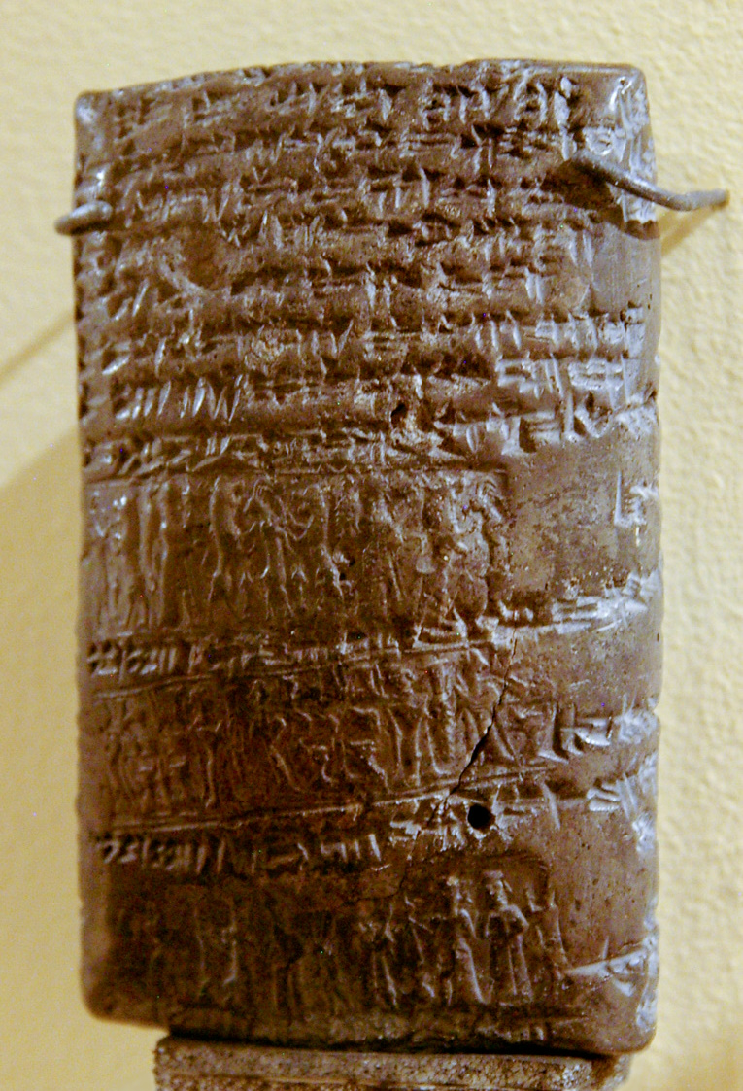
You have given me no seed, and so one born in my house will be my heir
Nuzi tablet recording an adoption through land purchase, circa 1400 BC
15:3
Notes:
It is not entirely clear whether Abram had already adopted Eliezer or whether he simply intended to do so if he had no son. Mesopotamian documents demonstrate the practice of adopting slaves/servants if a landowner did not have his own sons. This tablet was photographed at the Harvard Museum of the Ancient Near East.
adr081125079

Slide 16
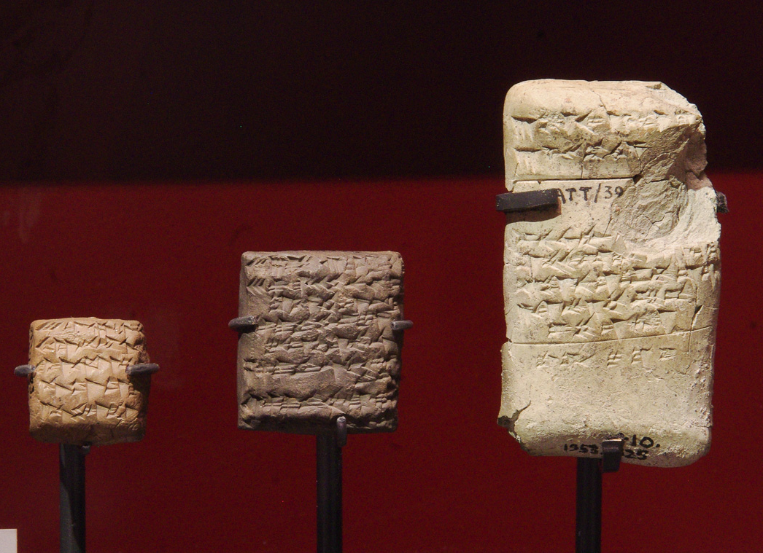
You have given me no seed, and so one born in my house will be my heir
Cuneiform tablets from Level VII of Alalakh (Tell Atchana), 1650–1550 BC
15:3
Notes:
A tablet from Late Bronze Alalakh (Alalakh Text 92; similar to the ones shown here) has been understood as a “pre-nuptial agreement” regarding several legal contexts for divorce. Hess argues that this allows for the legal transfer of the special inheritance of firstborn son rights to someone else—as seems to be the case with Eliezer of Damascus in these verses. The text mentions a number of infractions that could constitute grounds for divorce, followed by a statement regarding barrenness. “If Naidu has not given birth to an heir, then the daughter of her brother, Iwaššura, shall be given (to Iriḫalpa). If Tatadu(?) gives birth first for Iri-ḫalpa, and afterwards Naidu gives birth, then the older(?) woman shall not be given anything” (Hess 2003: 252). This display of tablets from Alalakh was photographed at the Ashmolean Museum at the University of Oxford.
Reference:
Hess, Richard S.
2003 Marriage Customs. Pp. 251–52 in The Context of Scripture, vol. 3, ed. W. W. Hallo. Leiden: Brill.
adr1305227310

Slide 17
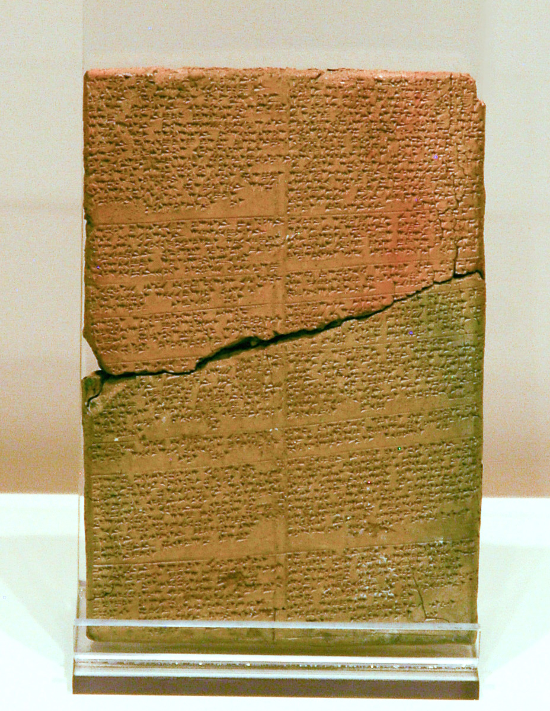
You have given me no seed, and so one born in my house will be my heir
Hittite cuneiform tablet from Hattusha (Bogazkoy)
15:3
Notes:
Abram’s lack of children is reminiscent of the Hittite text “Appu and His Two Sons,” which also has similarities to the story of Jacob and Esau. The tablet shown here is similar to the Hittite tablet that recorded “Appu and His Two Sons.”
“There was a city named Šudul. It was situated on the seacoast in the land of Lulluwa. Up there lived a man named Appu. He was the richest man in all the land. He had many cattle and sheep. He had amassed silver, gold and lapis lazuli like a huge heap of threshed grain. There was nothing which he lacked but one thing: he had neither son nor daughter” (Hoffner 2003: 153).
This tablet was photographed at the Corum Museum.
Reference:
Hoffner, Harry A., Jr.
2003 Appu and His Two Sons. Pp. 153–55 in The Context of Scripture, vol. 1, ed. W. W. Hallo. Leiden: Brill.
adr1006018027

Slide 18
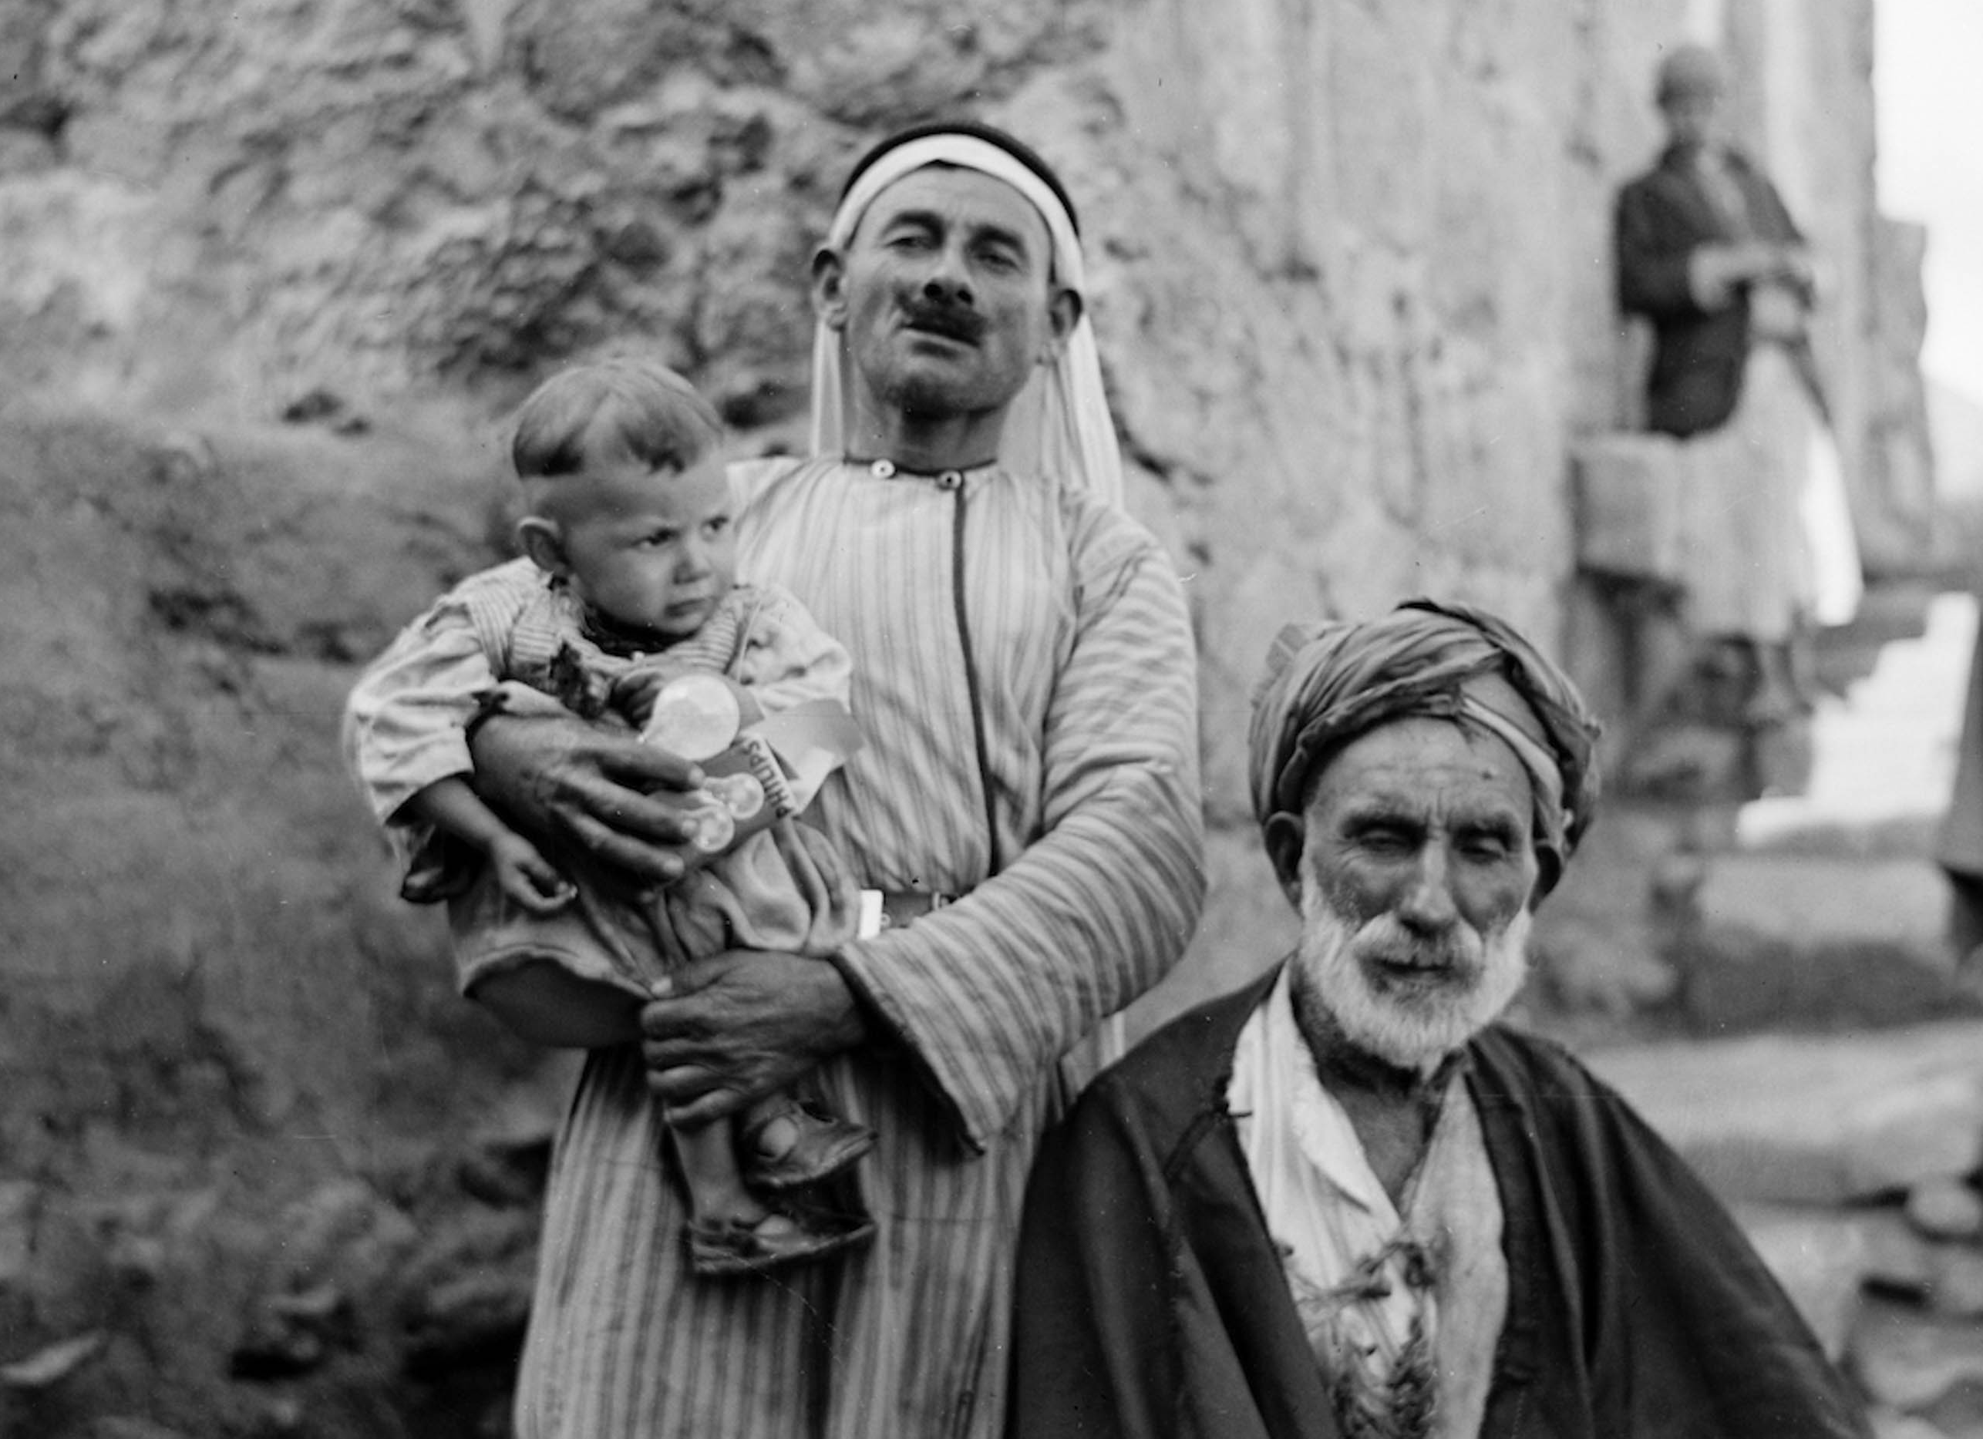
This man shall not be your heir, but your heir shall come forth out of your loins
Village elder with his son and grandson in Dahariyeh, 1940
15:4
Notes:
This American Colony photograph was taken on February 9, 1940.
mat20039

Slide 19
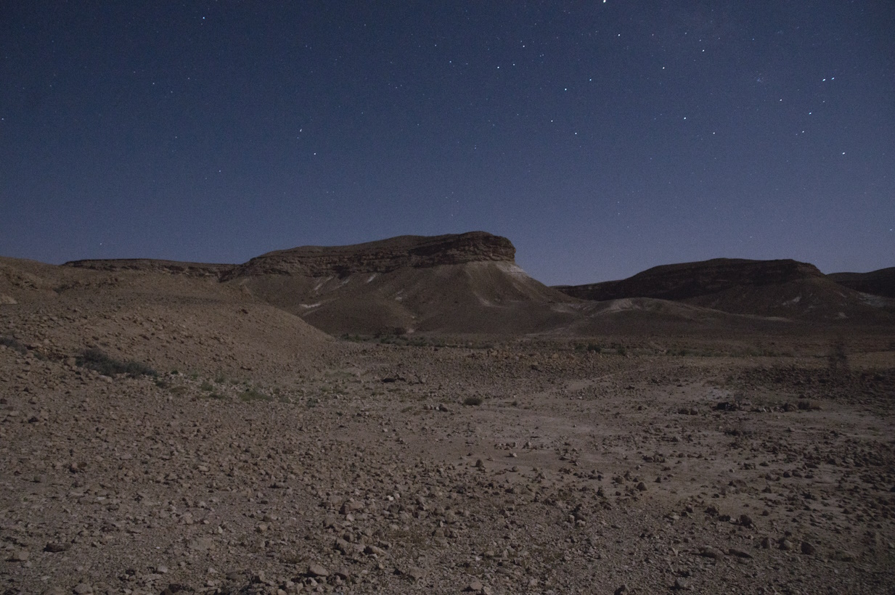
And He brought him outside
Har Karkom western precipices at night (from the northwest)
15:5
Notes:
adr1806220674c

Slide 20
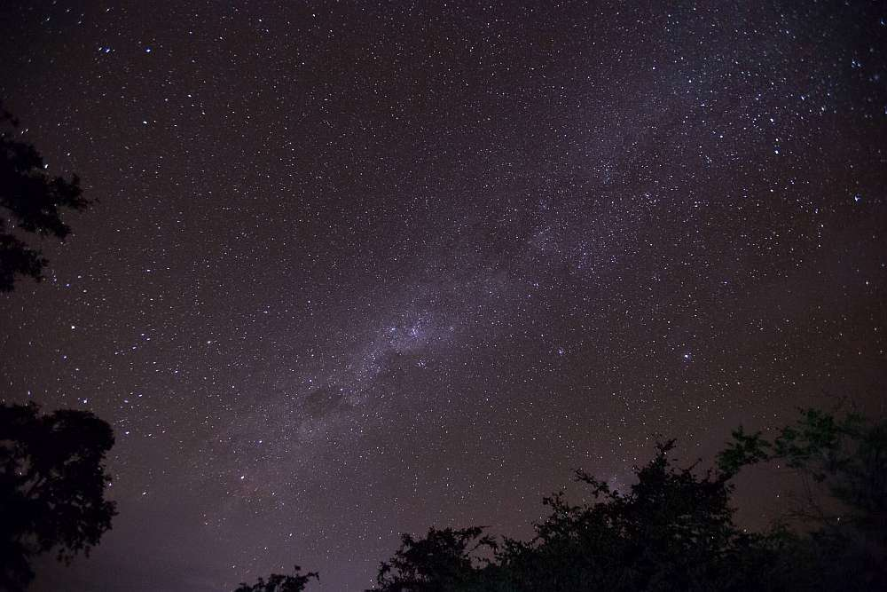
And He said, “Now look toward heaven and number the stars, if you are able to count them”
Starry sky
15:5
Notes:
The stars in this photo seem to merge with one another, with more stars lying behind the ones in the foreground.
mf140419194706

Slide 21
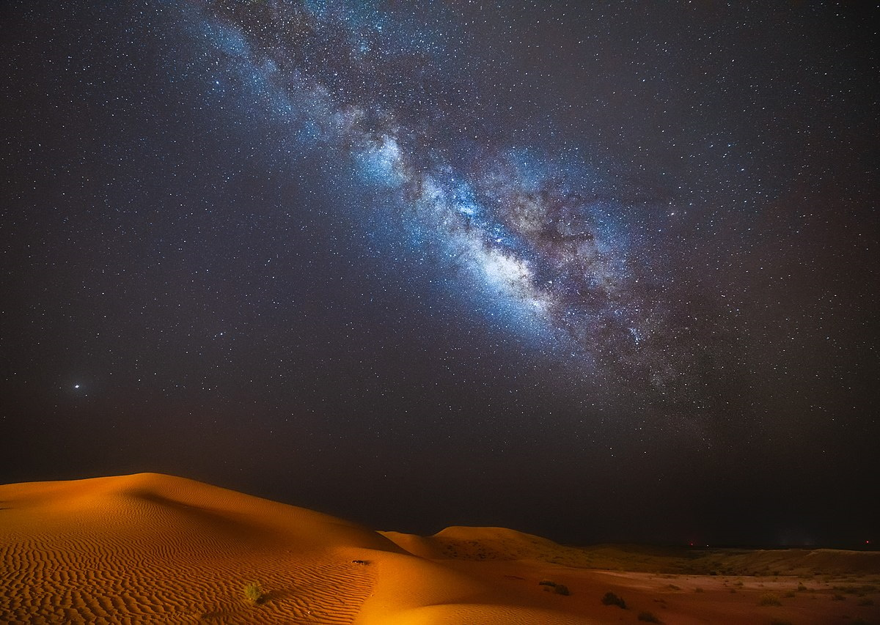
And He said, “Now look toward heaven and number the stars, if you are able to count them”
Milky Way over the desert at Al Quaa, south of Abu Dhabi
15:5
Notes:
Telescopic lenses and long exposure photographs have allowed modern man to see many more stars than would have been visible to Abram with the naked eye. Still, it would have been apparent to Abram that he could never count the visible stars. This image comes from Chrdoerr and is licensed under CC BY-SA 4.0, via Wikimedia Commons: https://commons.wikimedia.org/wiki/File:Mesmerising_natural_beauty_-_the_milky_way_and_the_desert_at_Al_Quaa.jpg.
wiki05092021004452017

Slide 22
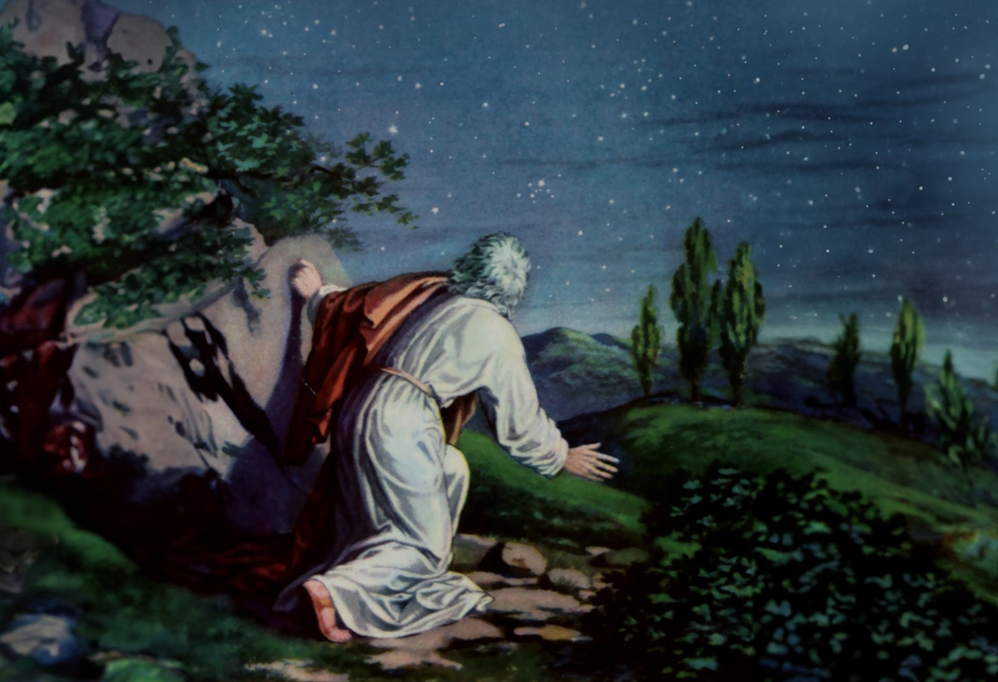
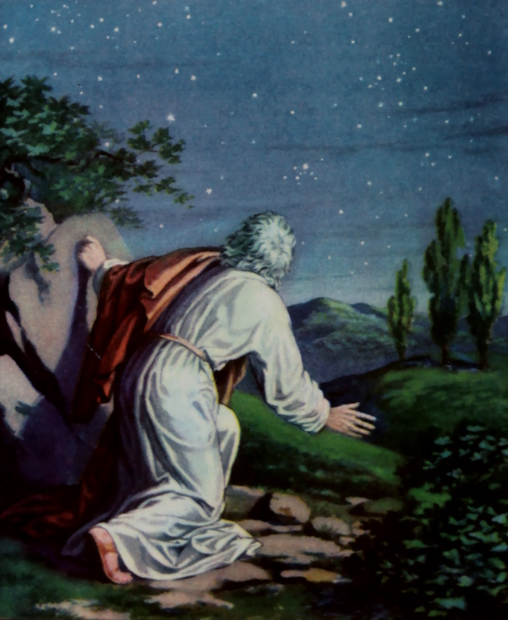
And He said, “Now look toward heaven and number the stars, if you are able to count them”
Depiction of Abram going out to look at the stars
15:5
Notes:
This illustration comes from Adolf Hult, Bible Primer, Old Testament, For Use in the Primary Department of Sunday Schools (1919). This image is in the public domain, via Wikimedia Commons: https://commons.wikimedia.org/wiki/File:Bible_primer,_Old_Testament,_for_use_in_the_primary_department_of_Sunday_schools_(1919)_(14779694194).jpg. Generative AI has been used to extend the edges of the image; the original photo is available behind this image.
wiki0730201419192834bpsai

Slide 23
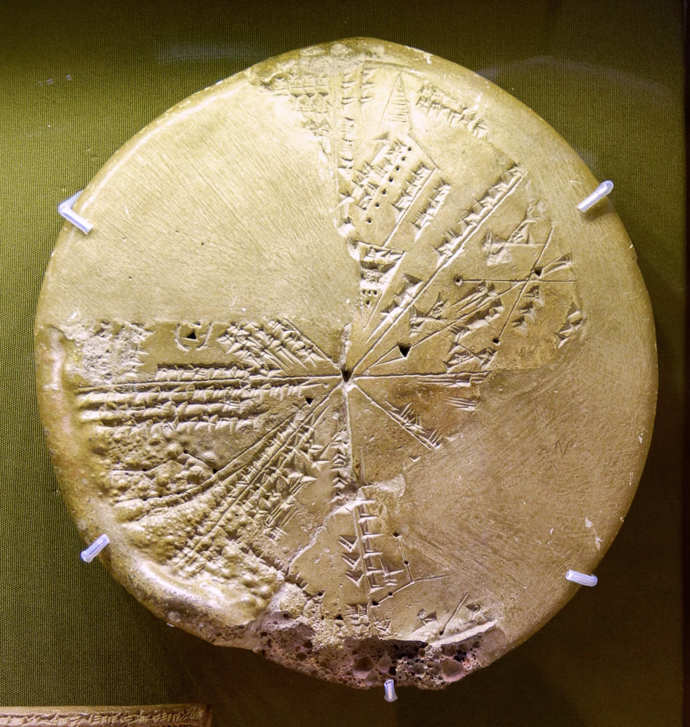
And He said, “Now look toward heaven and number the stars, if you are able to count them”
Sophisticated map of stars and their alignment, from Ashurbanipal’s library, 7th century BC
15:5
Notes:
This cuneiform sky chart was photographed at the British Museum.
tb0929197242

Slide 24
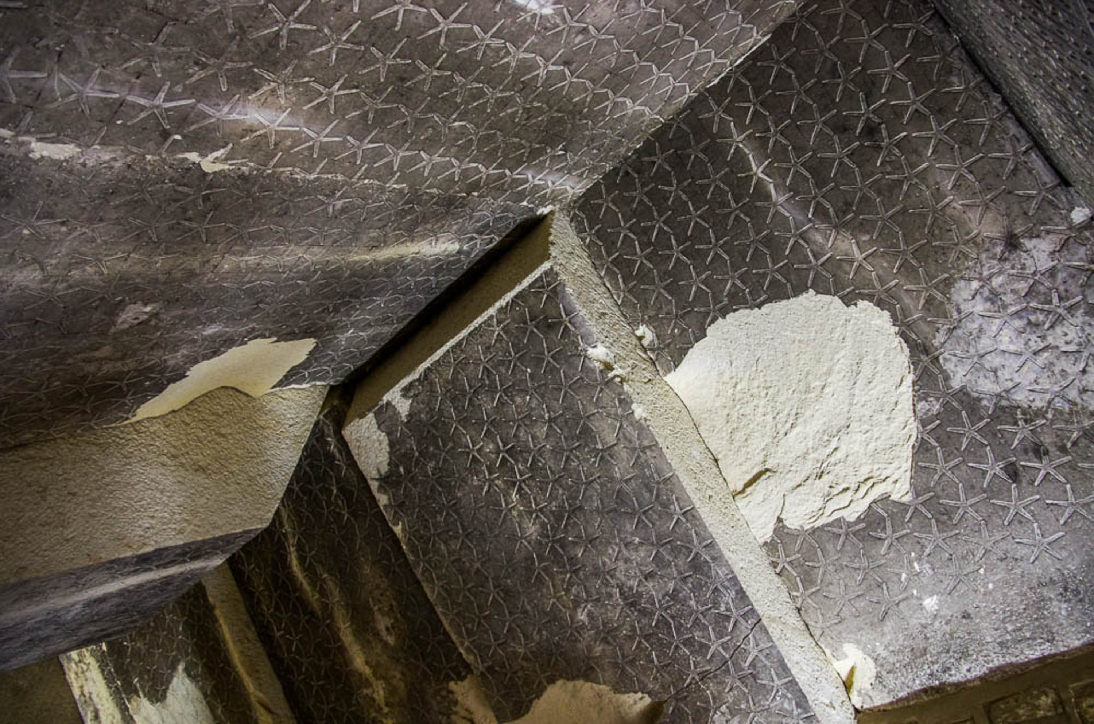
And He said, “Now look toward heaven and number the stars, if you are able to count them”
Stars on the ceiling of a burial chamber in the Pyramid of Teti at Saqqara, 3rd millennium BC
15:5
Notes:
adr1603101257

Slide 25

And He said, “Now look toward heaven and number the stars, if you are able to count them”
Air Force maneuver during Israel’s Independence Day
15:5
Notes:
In a photograph taken by David Bivin in Jerusalem in 1968, the descendants of Abraham serving in the Israeli Air Force form a star in the sky with their planes. They form the shape of a “star of David” (magen David), a symbol of the Jewish people and the primary symbol on Israel’s national flag.
db6805024411

Slide 26
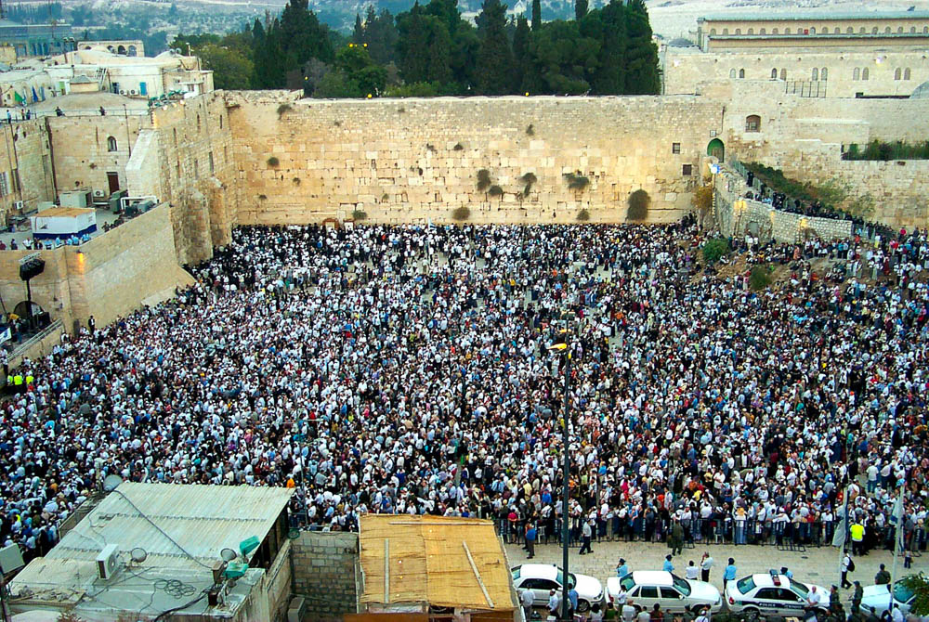
So will your seed be
Jewish people gathered at the Western Wall for the Feast of Tabernacles
15:5
Notes:
The people in this large crowd of Jews look not unlike the dots of stars in the night sky.
df100301202

Slide 27
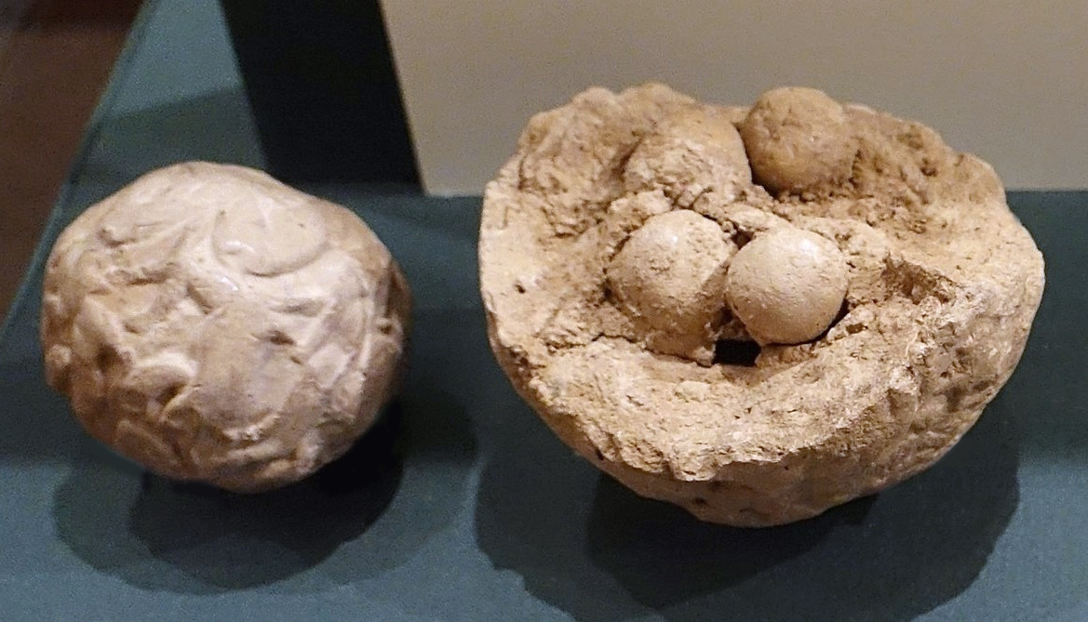
And he believed Yahweh, and He reckoned it to him for righteousness
Two clay balls with accounting tokens, Uruk period, circa 3000 BC
15:6
Notes:
The verb “to reckon” (Heb. khashab, חָשַׁב) indicates that God regarded or counted Abram as righteous. The verb can also be used (in the piel) with reference to counting or calculating in the mathematical sense (e.g., Lev 25:27; 27:18). One of the earliest forms of counting, calculating, and recording numbers is thought to be preserved in the system of tokens wrapped in clay, like the example shown here. In this system, tokens of different shapes were created to represent either different items or different numbers of items (such as livestock), and were then wrapped in a clay ball as a record. The outside of the ball was impressed with a stamp seal to indicate ownership. This display was photographed at the Oriental Institute Museum of the University of Chicago. This image comes from Daderot; Derivative work: Zunkir and is licensed under CC BY-SA 4.0, via Wikimedia Commons: https://commons.wikimedia.org/wiki/File:Clay_bullae_OIM.jpg.
wiki082214143151

Slide 28
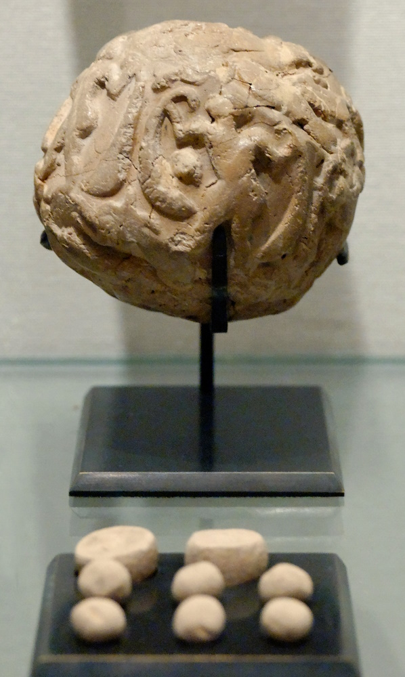
And he believed Yahweh, and He reckoned it to him for righteousness
Globular envelope with accounting tokens, from Susa, circa 3000 BC
15:6
Notes:
This clay ball and set of accounting tokens comes from the acropolis at Susa. This display was photographed at the Louvre Museum. This image comes from Marie-Lan Nguyen and is licensed under CC-BY 2.5, via Wikimedia Commons: https://commons.wikimedia.org/wiki/File:Accountancy_clay_envelope_Louvre_Sb1932.jpg.
wiki1114092119126

Slide 29
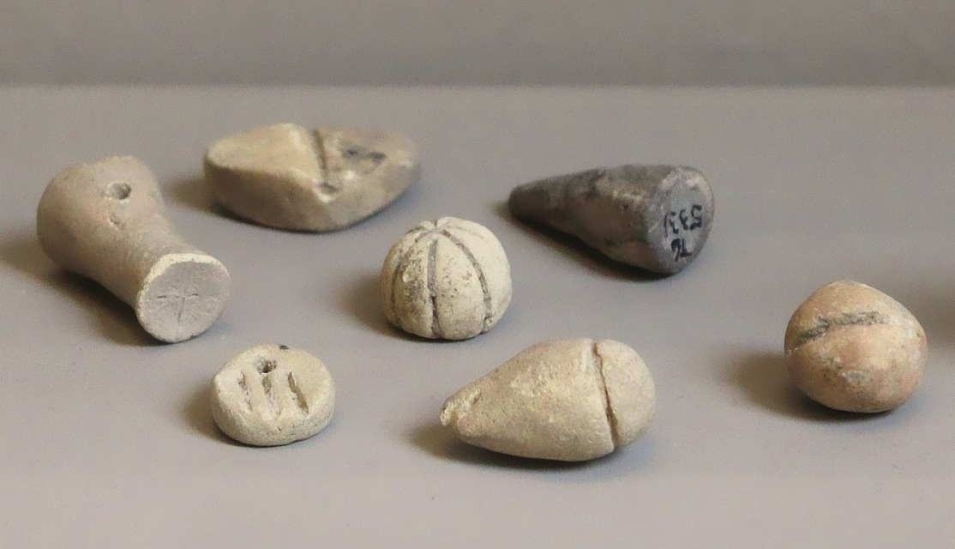
And he believed Yahweh, and He reckoned it to him for righteousness
Clay accounting tokens from Tello (ancient Girsu), circa 3100 BC
15:6
Notes:
This display shows a variety of token shapes that were used for counting, calculating, and recording in the Uruk period. This display was photographed at the Louvre Museum. This image comes from Zunkir and is licensed under CC BY-SA 4.0, via Wikimedia Commons: https://commons.wikimedia.org/wiki/File:Jetons_comptabilite_Girsu_3500_2900_Louvre.jpg.
wiki081520110432

Slide 30
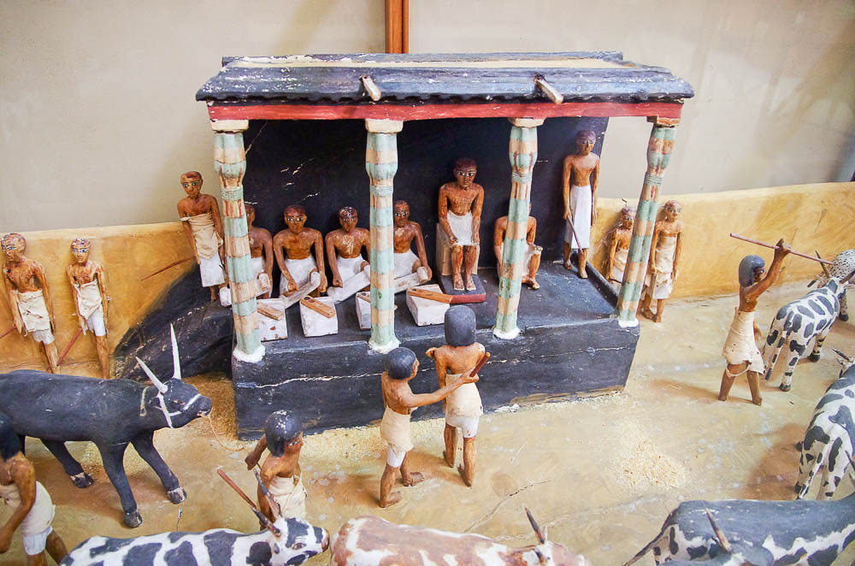
And he believed Yahweh, and He reckoned it to him for righteousness
Scribes counting cattle, from Thebes, circa 2000–1900 BC
15:6
Notes:
The reckoning of righteousness to Abram could be taken to imply that a record was being kept (or changed; cf. Exod 32:32). The model shown here depicts four scribes on a podium counting cattle as they are driven past. Each scribe has a papyrus scroll on his lap and a set of pen and ink on a small table in front of him. This model is from the late 11th or early 12th Dynasty. It was photographed at the Egyptian Museum in Cairo.
adr1603195096

Slide 31
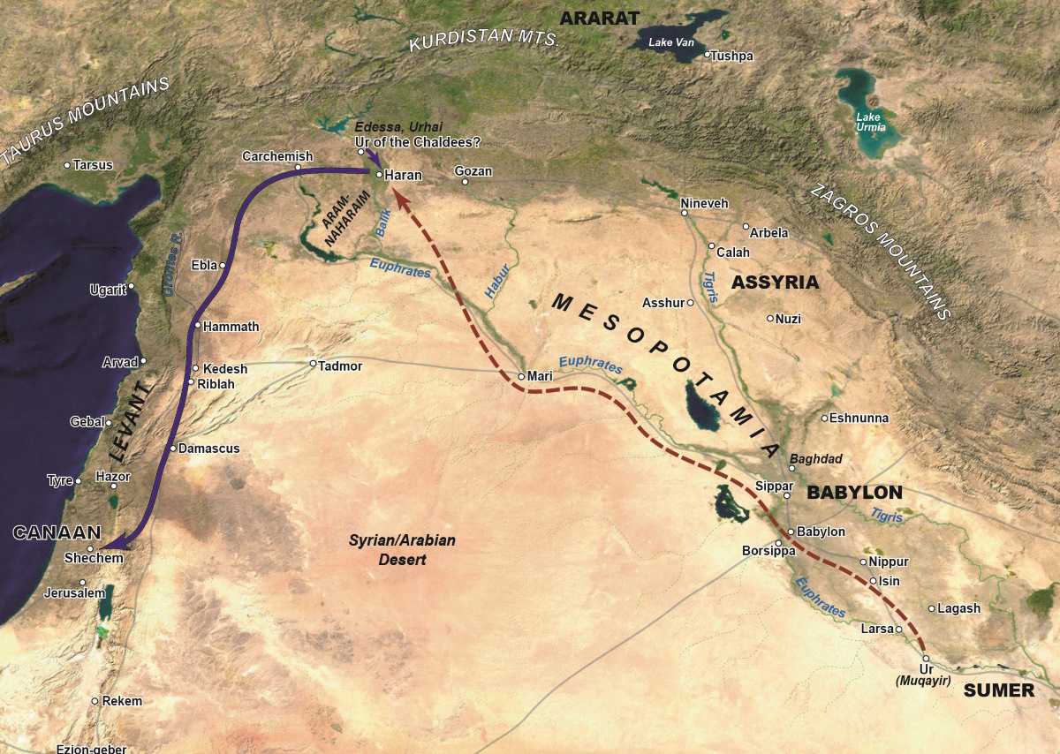
He said to him, “I am Yahweh who brought you out from Ur of the Chaldeans”
Map showing Abram’s departure from Haran and possible locations for Ur
15:7
Notes:
The location and identification of “Ur of the Chaldeans” has been the object of considerable discussion. Leonard Woolley popularized the idea that Abram’s Ur was to be identified with the great Sumerian city of the same name (Tel Muqayyar/Muqayir) in southern Mesopotamia. This view was widely accepted for much of the 20th century and is frequently encountered in works from that period.
More recent scholarship has tended to favor identifying Abram’s Ur in the region of Haran, about 1,000 miles (1,600 km) northwest of the Sumerian city. Beitzel has noted that the title “Ur of the Chaldeans” is almost certainly intended to differentiate Abram’s Ur from another Ur that would have been known at that time. Also, the southern Ur is always associated with the Sumerians, and never with the Chaldeans before the 7th century BC. In fact, there are no certain references to Chaldeans in southern Mesopotamia prior to the 9th century BC; before that, they are found only in northern Mesopotamia (Beitzel 2009: 98).
To this may be added a few other observations. Haran is not on the route from the southern Ur to the land of Canaan, which begs the question of how or why Terah and Abram would have stopped there if their destination was Canaan. Also, when Abraham sent his servant to find a wife for his son Isaac, he sent him to “my country . . . my father’s house . . . the land of my birth” (Gen 24:4-7). The servant then went to Aram-naharaim, to the city of Nahor. A generation later, Jacob fled to this same area, to the house of Laban at Haran (Gen 29:4), from which it seems logical to deduce that all of these locations were in near proximity to one another.
Reference:
Beitzel, Barry J.
2009 The New Moody Atlas of the Bible. Chicago: Moody.
This map is adapted from map 2-1 in the Satellite Bible Atlas, by William Schlegel. Used by permission.

Slide 32
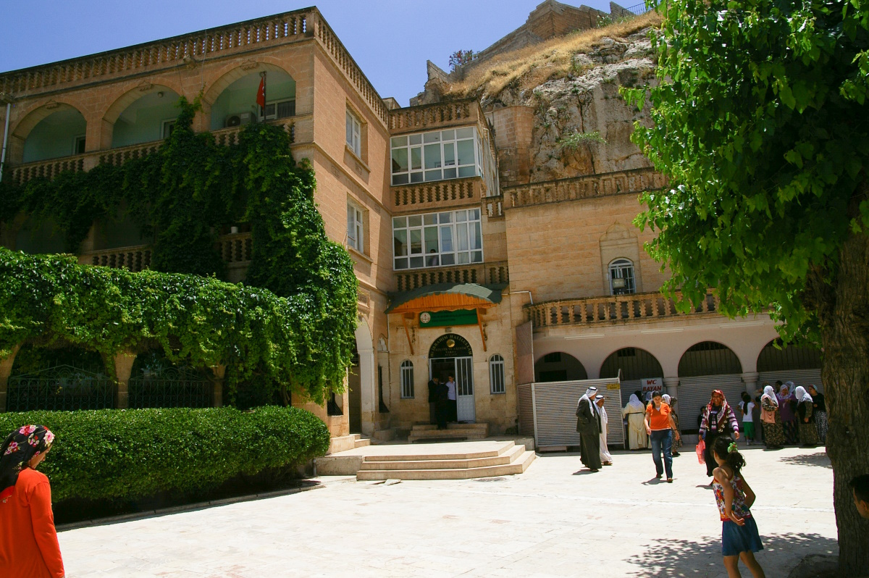
He said to him, “I am Yahweh who brought you out from Ur of the Chaldeans”
Melvid-i Halil Mosque and Abram’s traditional birthplace at Şanliurfa (Edessa), Turkey
15:7
Notes:
Jewish, Christian, and Islamic tradition identifies Urfa/Sanliurfa (Edessa) as the birthplace of Abram, and some scholars believe that this is a more suitable location for Ur of the Chaldeans than the city of Ur excavated by Leonard Woolley in southern Mesopotamia.
Sanliurfa (Edessa) sits along ancient routes midway between the crossing of the Euphrates at Zeugma and the crossing of the Tigris at Samosata. Jewish and Christian tradition identifies this as Urhai, a city founded by the biblical Nimrod. Some scholars today also believe that this is the biblical Ur of the Chaldeans from which Abram left to travel to Haran and Canaan. The city was re-founded circa 303 BC by Seleucus I Nicator and became known as Edessa. The city was home to a significant Jewish community and later became the center of Syriac Christianity.
adr1005201900c

Slide 33
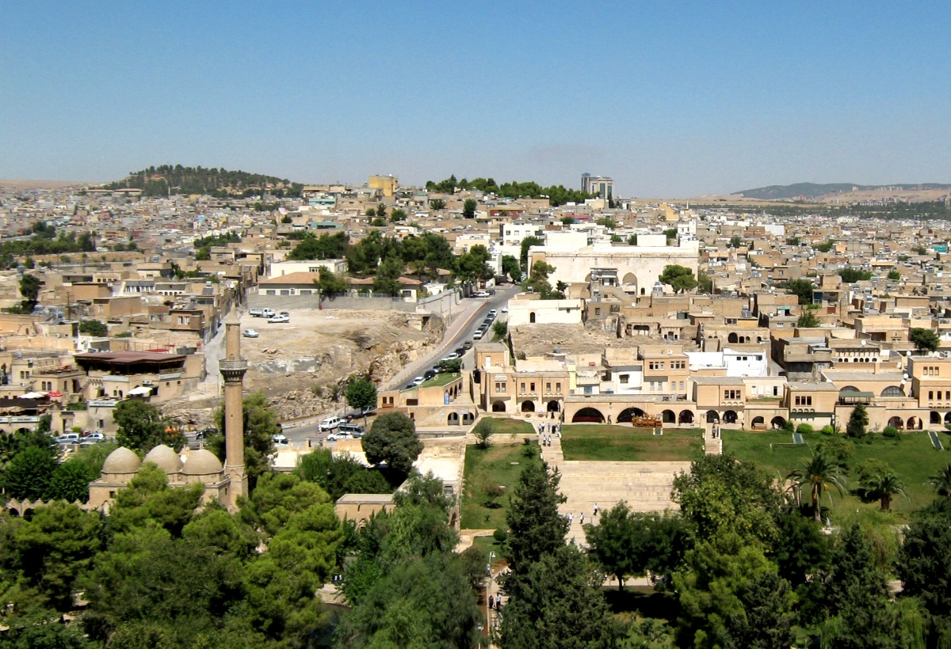
He said to him, “I am Yahweh who brought you out from Ur of the Chaldeans”
Sanliurfa, possibly Ur of the Chaldeans
15:7
Notes:
The “land of the Chaldeans” is mentioned by Isaiah (see Isa 23:13) in clear connection with northern Mesopotamia or even the northern Levant. The chapter deals with places such as Canaan, Tyre, Sidon, and even the lands of Tarshish and the island of Cyprus. This has a western, not an eastern, orientation, which fits with the way the term “Chaldean” was used in the earlier periods. This image comes from Anadolu and is in the public domain, via Wikimedia Commons: https://commons.wikimedia.org/wiki/File:Urfaskyline2.jpg.
wiki0203201312682592107

Slide 34
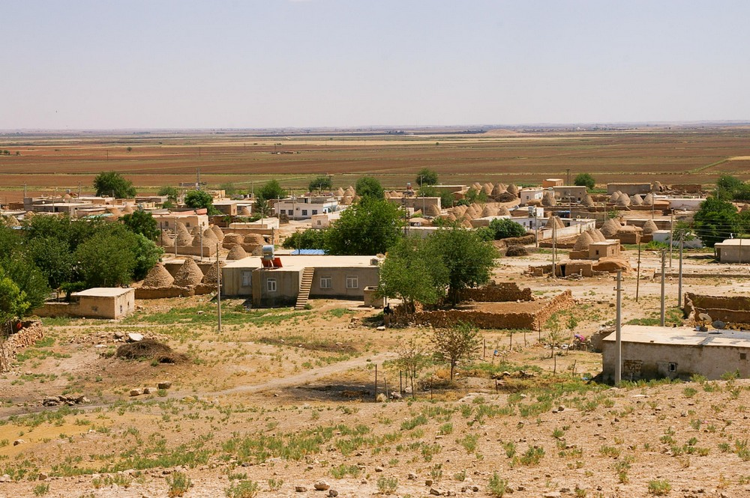
He said to him, “I am Yahweh who brought you out from Ur of the Chaldeans”
Modern village of Haran from the ancient tell
15:7
Notes:
Another point that may be considered to favor the northern Ur is the proximity of the ancient city of Haran, to which Abram and his family first journeyed. It is about 24 miles (39 km) southeast of Sanliurfa (Edessa).
adr1005201963

Slide 35
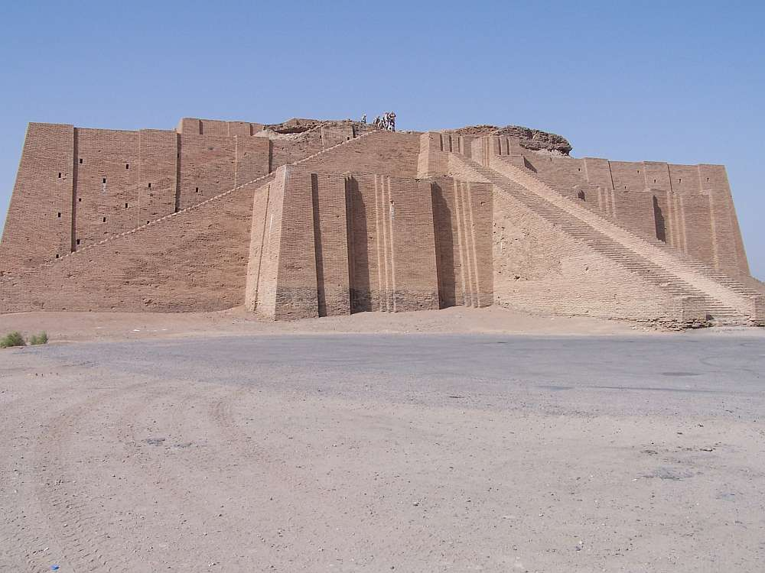
He said to him, “I am Yahweh who brought you out from Ur of the Chaldeans”
Great Ziggurat of Ur with a partially restored façade
15:7
Notes:
The southern Ur continues to have proponents, and the ancient ruins here are quite impressive. A ziggurat (temple-tower) was the dominant feature of every major city in ancient Mesopotamia. This photograph shows the ziggurat of southern Ur, which is the best-preserved ziggurat in Mesopotamia. Archaeologists estimate that it was constructed in 2100 BC. The group of soldiers standing at the top of the ziggurat in this photo gives an idea of scale. This photo was taken by a member of the United States Armed Forces in 2005 and is licensed under CC-BY-3.0., via Wikimedia Commons, https://commons.wikimedia.org/wiki/File:Ancient_ziggurat_at_Ali_Air_Base_Iraq_2005.jpg.
wiki201220081613

Slide 36
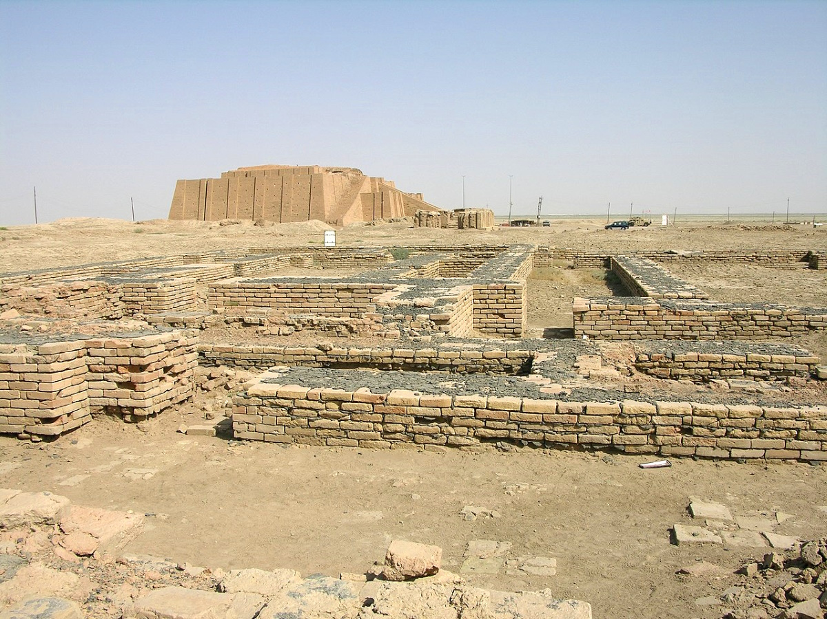
He said to him, “I am Yahweh who brought you out from Ur of the Chaldeans”
Ancient remains and the ziggurat at Sumerian Ur
15:7
Notes:
The ancient city of Sumerian Ur had hot and cold running water, a sewer system, multistory buildings, paved roads, major temples, ornate furniture, and a variety of metal instruments. The Sumerians developed a sexagesimal system that divided the hour into 60 minutes, the minute into 60 seconds, and the circle into 360 degrees—a system that we still use today. There were well-developed law codes and a standard system of weights and measures. This image comes from M.Lubinski and is licensed under CC BY-SA 2.0, via Wikimedia Commons: https://commons.wikimedia.org/wiki/File:Ur-Nassiriyah.jpg.
wiki06202006252244832

Slide 37
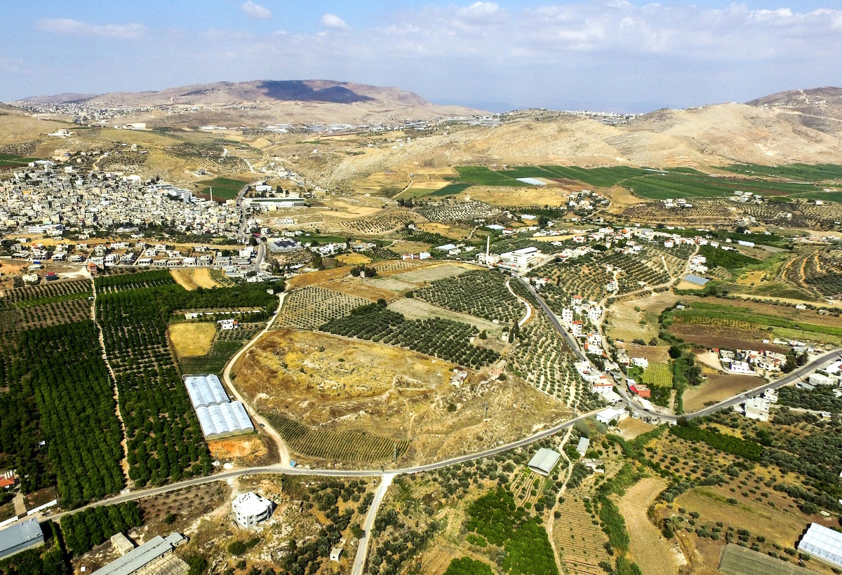
To give you this land to possess it
Tirzah (aerial view from the southwest)
15:7
Notes:
The Lord brought Abram to the land of Canaan and promised to give the land to his seed (Gen 12:7). Some photos of the promised land illustrate this divine gift, including the city of Tirzah, one of the capitals of the northern kingdom (1 Kgs 15:33). Tirzah is located in central Israel, northeast of Shechem, and was noted in the Song of Songs as being particularly beautiful (Song 6:4).
ws052916191

Slide 38
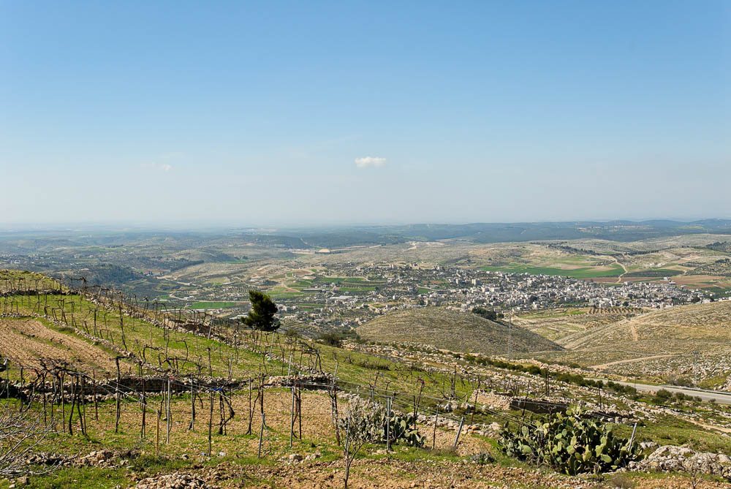
To give you this land to possess it
Shephelah from the southern Judean Hills (from the east)
15:7
Notes:
This photo shows a region in the southwestern area of the land promised to Abram.
tb030407749

Slide 39
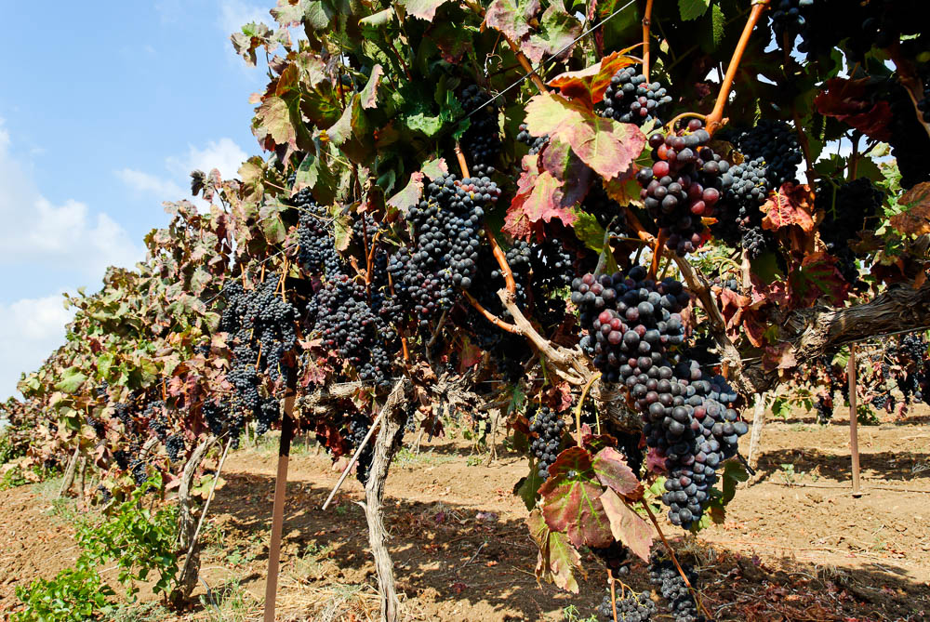
To give you this land to possess it
Vineyard near Dor
15:7
Notes:
Dor is located along the coast, south of Mount Carmel.
tb090506907

Slide 40
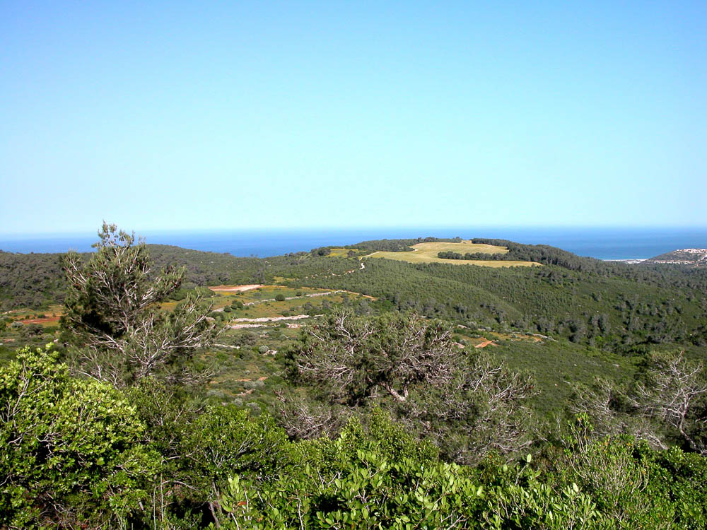
To give you this land to possess it
Mount Carmel and the Mediterranean (from the east)
15:7
Notes:
Mount Carmel was in the northeast section of the land allotted to the tribes of Israel by Joshua.
tb050403105

Slide 41
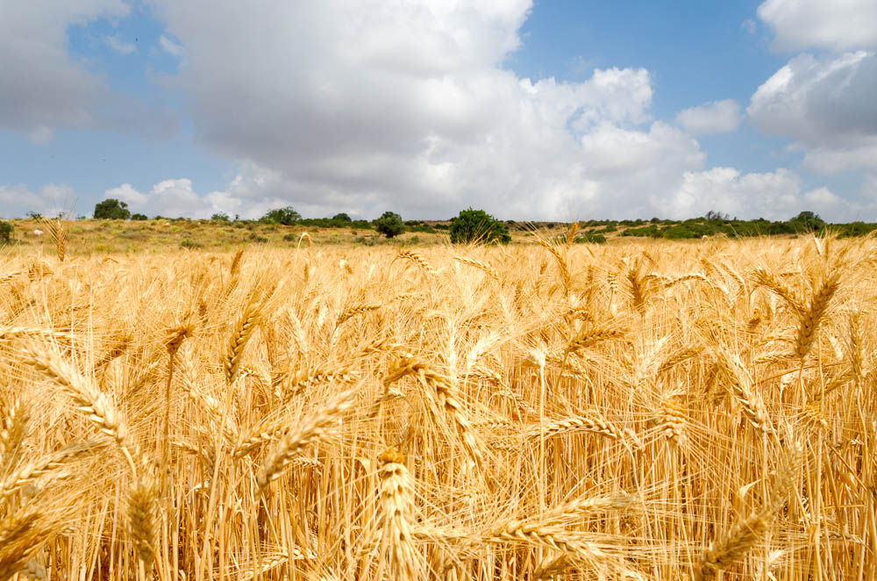
To give you this land to possess it
Wheatfield near Moresheth Gath
15:7
Notes:
The land promised to Abram by God was a productive and good land, as Moses will later describe (Deut 7:7-9).
tb052816909

Slide 42
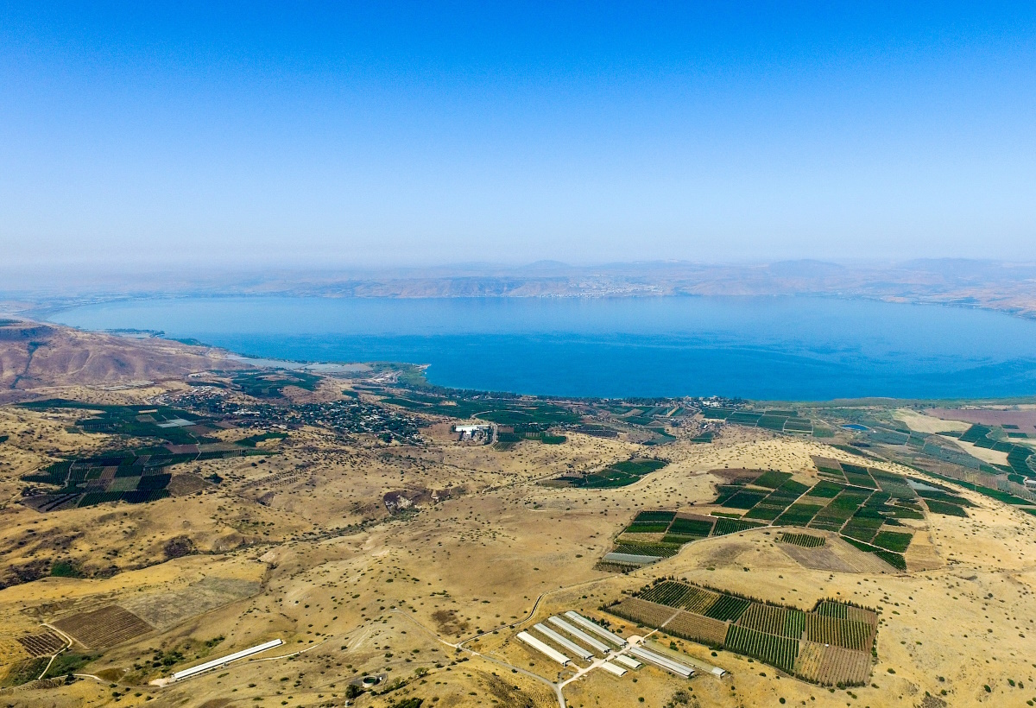
To give you this land to possess it
Sea of Galilee (aerial view from the east)
15:7
Notes:
The Sea of Galilee lies entirely within the territory promised to Abram. It is likely that Abram saw this lake at some point in his travels about the land.
ws053016342

Slide 43
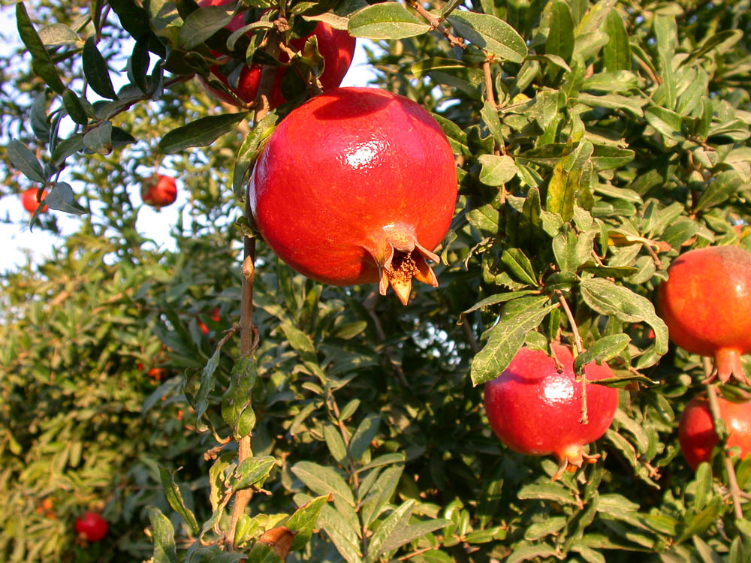
To give you this land to possess it
Pomegranates on tree near Lachish
15:7
Notes:
df100902004

Slide 44
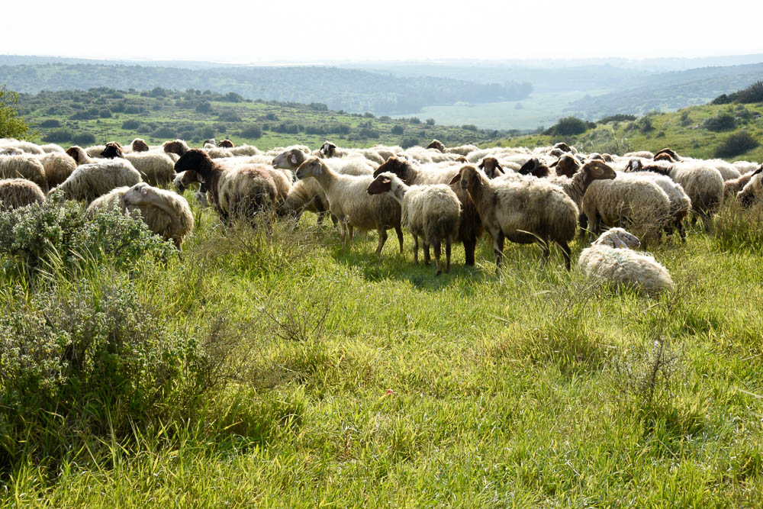
To give you this land to possess it
Flock of sheep at Maresha
15:7
Notes:
mjb1903062331

Slide 45
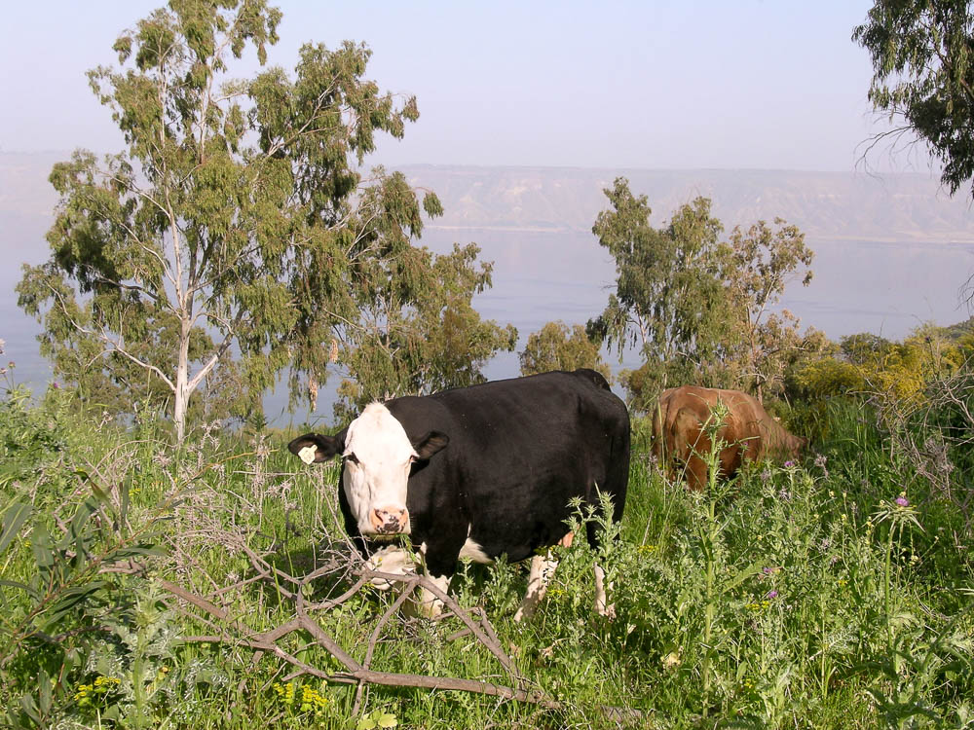
So He said to him, “Bring me a three year old heifer”
Cows near the Sea of Galilee
15:9
Notes:
tb033005864

Slide 46
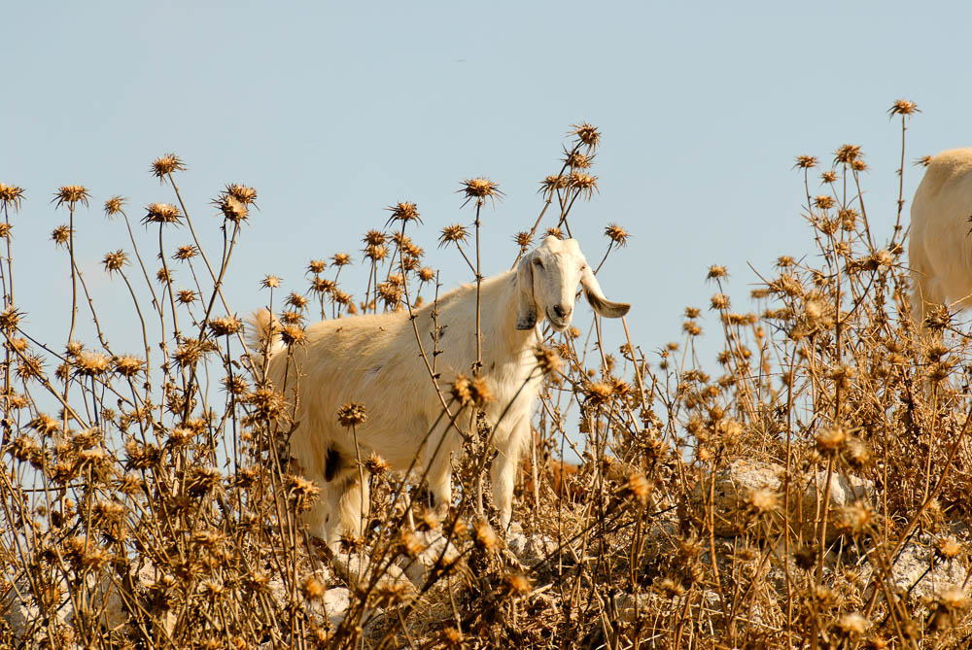
And a three year old female goat
Goat at Gath
15:9
Notes:
tb060906117

Slide 47
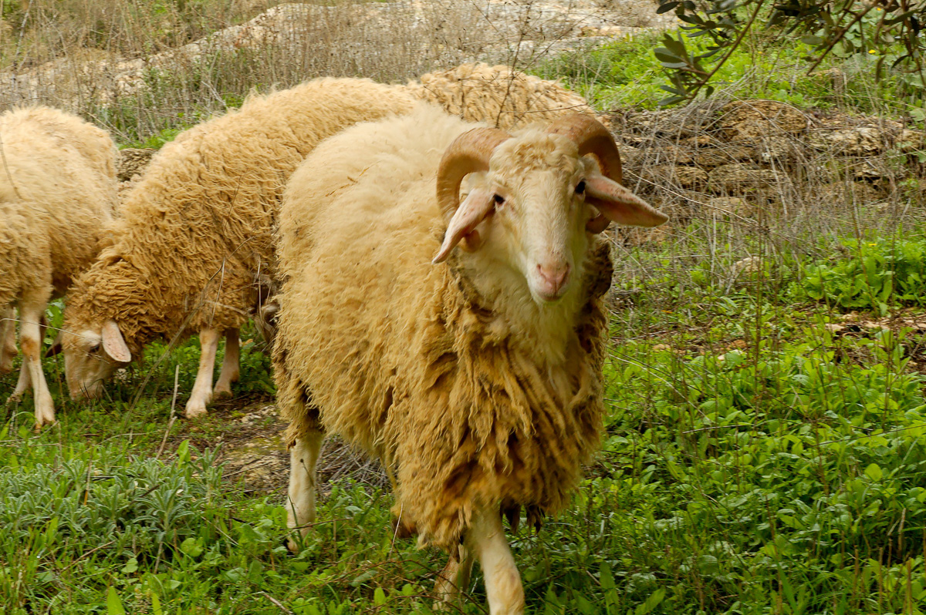
And a three year old ram
Ram at Nazareth Village
15:9
Notes:
A ram is an adult male sheep.
tb011406548

Slide 48
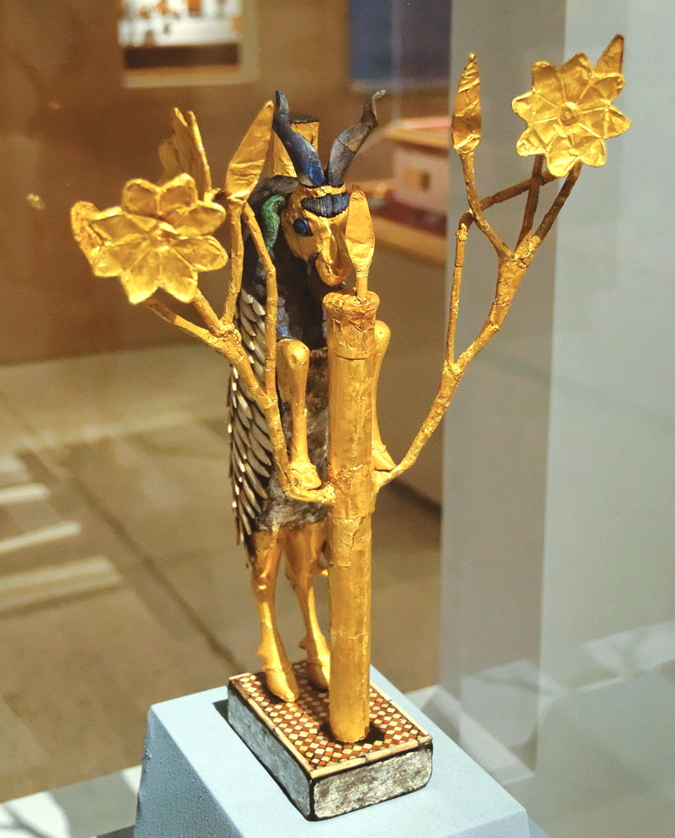
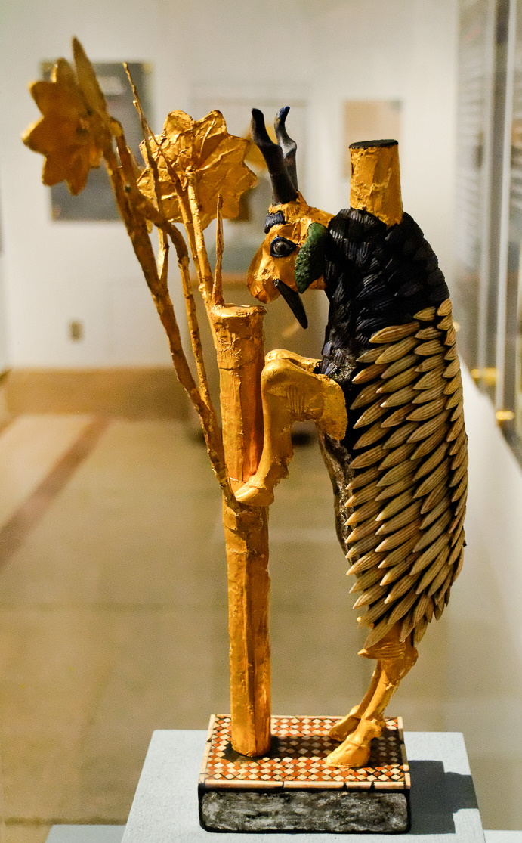
And a three year old ram
So-called “Ram caught in a thicket,” from Ur, circa 2500 BC
15:9
Notes:
This small model from ancient Ur depicts a male goat with his forelimbs in a golden tree. It seems to be a very early version of the goat/sheep/ibex and tree motif that became so common in the following centuries. The excavator of Ur, Sir Leonard Woolley, dubbed this figurine “a ram caught in a thicket” to connect it to the biblical story of Abraham (Gen 22:13). Although this ram is not depicted as caught at all, the moniker stuck. This figurine was photographed at the Museum of Archaeology and Anthropology at the University of Pennsylvania.
Left: tb072311614
Right: tb072311615

Slide 49
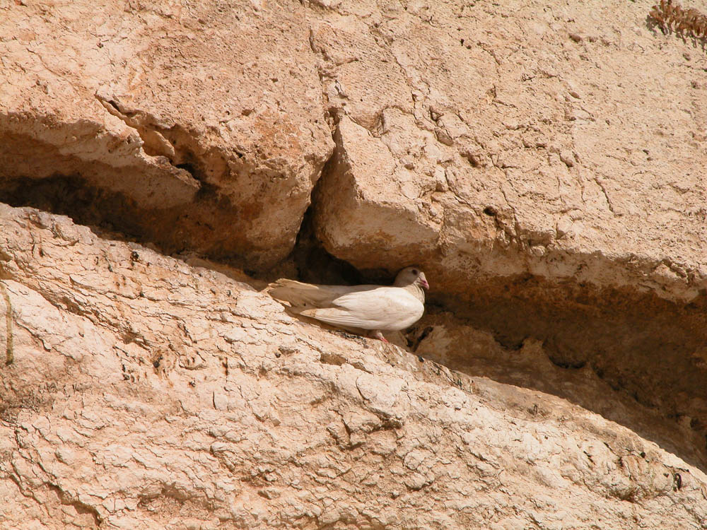
And a turtledove
Dove in the Western Wall in Jerusalem
15:9
Notes:
The turtledove (Heb. tor, תּוֹר, תֹּר) appears regularly as a sacrificial animal in the Mosaic law (e.g., Lev 1:14; 5:7; Num 6:10).
tb092603036

Slide 50
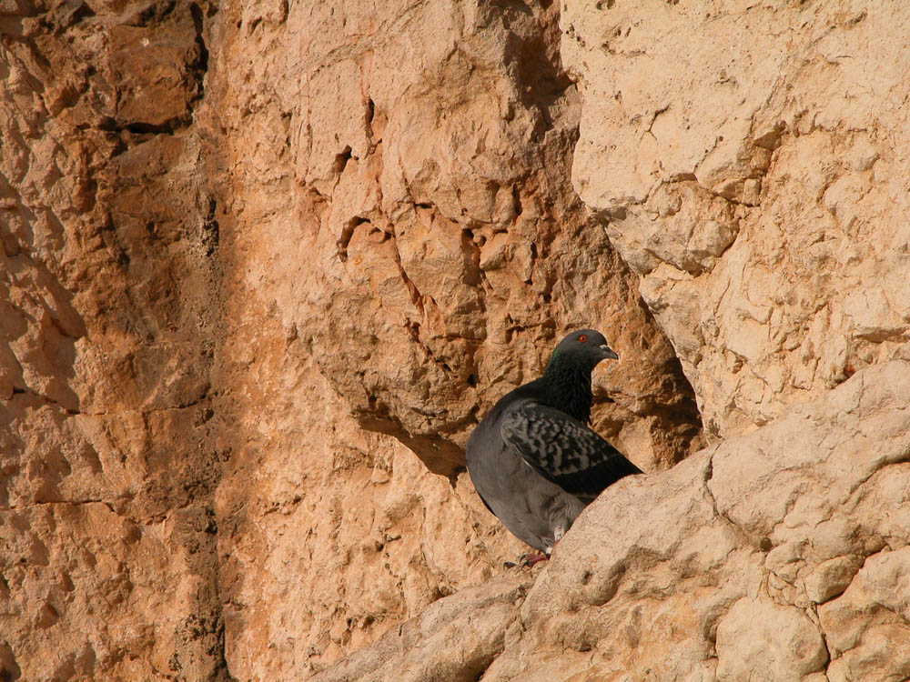
And a young pigeon
Pigeon in the Western Wall in Jerusalem
15:9
Notes:
The precise identity of the bird mentioned here as a “young pigeon” (Heb. gozal, גּוֹזָל) is uncertain. The one other time it is used in the Hebrew Bible, it appears to refer to a young eagle, although that meaning does not seem to fit the context here.
tb092603077

Slide 51

He took all these and cut them in half and laid each half opposite the other
Knife for animal sacrifice, from Ekron, 11th century BC
15:10
Notes:
This elite iron knife from Ekron is later than the time of Abram but illustrates how sacrifices were recognized as special and important events that could even require their own specialized equipment.
There is debate about possible ancient Near Eastern parallels to the ritual described in Genesis 15, but some scholars point to the Sefire treaty/loyalty oath of the 8th century BC as a possible parallel, at least in concept. Earlier in the text, Bargaʿyah king of KTK and Matiʿel king of Arpad “cut” a treaty (line 6), using the same term as in Genesis 15.
“Just as this wax is burned by fire, so may Arpad be burned and [her gr]eat [daughter-cities]! May Hadad sow in them salt and weeds(?), and may it not be mentioned (again)! This GNBʾ and [ ] (are) Matiʿel; it is his person. Just as this wax is burned by fire, so may Mati[ʿel be burned by fi]re! Just as (this) bow and these arrows are broken, so may Inurta and Hadad break [the bow of Matiʿel], and the bow of his nobles! And just as the man of wax is blinded, so may Mati[ʿel] be blinded! [Just as] this calf is cut in two, so may Matiʿel be cut in two, and may his nobles be cut in two” (Fitzmeyer 2003: 214).
Another example that includes both a loyalty oath and a land grant comes from an 18th century BC document at Alalakh. In this text, the sacrificer swears by his own life. In the Abrahamic covenant, Yahweh swears by His own life.
[I will give to Ya]rimlim.
The town of Murar, in addition to [his shar]e,
I will add to it.” Abbael
swore the oath to Yarimlim
and cut the neck of a lamb, <saying:>
“If I take back what I have given you <may I be cursed.>” (Hess 2003: 370).
This artifact was photographed at the Israel Museum.
References:
Fitzmeyer, Joseph A., S.J.
2003 The Inscriptions of Bar-Ga’yah and Mati’el from Sefire. Pp. 213–17 in The Context of Scripture, vol. 2, ed. W. W. Hallo. Leiden: Brill.
Hess, Richard S.
2003 Land Grant AT 456. Pp. 369–70 in The Context of Scripture, vol. 2, ed. W. W. Hallo. Leiden: Brill.
tb032014215

Slide 52

He took all these and cut them in half and laid each half opposite the other
Aleppo Treaty, regarding the Hittite ownership of Aleppo, from Bogazkoy, circa 1300 BC
15:10
Notes:
In the later periods, the standard idiom for making a treaty or covenant was to “cut a covenant” (Heb. karath berith, כָּרַת בְּרִית; e.g., Gen 21:27; Exod 23:32; Deut 7:2; 1 Sam 23:18; etc.), an idiom that may find its origin in ancient customs like the one described here.
Another example of a similar ritual—on a Hittite tablet similar to the one shown here—appears in connection with a military defeat.
“If the troops are defeated by the enemy, then they prepare the ‘behind the river’ ritual as follows: Behind the river they sever a human, a billy-goat, a puppy (and) a piglet. On one side they set halves and on the other side they set the (other) halves. In front (of these) they make a gate of hawthorn and stretch a cord(?) up over (it). Then, before the gate, on one side they burn a fire and on the other side they burn a fire. The troops go through, but when they come alongside the river, they sprinkle water over them(selves). They perform the ritual again in the steppe. They celebrate the ritual of the steppe in the same way” (Collins 2003: 161). This tablet was photographed at the British Museum.
Reference:
Collins, Billie Jean.
2003 The “Ritual Between the Pieces.” Pp. 160–61 in The Context of Scripture, vol. 1, ed. W. W. Hallo. Leiden: Brill.
tb0929197150

Slide 53

He took all these and cut them in half and laid each half opposite the other
Relief of cattle trussed as offerings, from Heliopolis, reign of Akhenaten, 14th century BC
15:10
Notes:
This relief shows three cattle that have been trussed in preparation for sacrifice. It also depicts a number of tables or altars that have been piled with sacrifices, including cuts of meat. This relief was photographed at the San Antonio Museum of Art.
tb111716935

Slide 54

He took all these and cut them in half and laid each half opposite the other
Flint and bronze butcher knives, 16th–11th centuries BC
15:10
Notes:
This display includes a set of butchering knives and a small model of a cow. The cow is portrayed with two legs bound and its throat cut, the first step in the butchering process. These items were photographed at the Berlin Egyptian Museum and Papyrus Collection.
adr070511480

Slide 55

He took all these and cut them in half and laid each half opposite the other
Butchering scene from the Tomb Chapel of Raemkai, circa 2400 BC
15:10
Notes:
The men in this relief are engaged in butchering a cow using knives. This image comes from the Metropolitan Museum of Art and is in the public domain. Source: https://www.metmuseum.org/art/collection/search/577369.
met577369

Slide 56

He took all these and cut them in half and laid each half opposite the other
Model slaughterhouse, from tomb of Meketre in El-Asasif, circa 2000 BC
15:10
Notes:
This funerary model shows men butchering two cows. The feet of the cows have been bound, and one man is cutting the throat of a cow as the first step in the butchering process. This model was photographed at the Metropolitan Museum of Art in New York City.
adr1605231707

Slide 57

He took all these and cut them in half and laid each half opposite the other
Man slaughtering a calf, from Giza, 25th century BC
15:10
Notes:
This artifact was recovered from the tomb of Ny-kau-Inpu at Giza. It dates to the Old Kingdom, 5th Dynasty. It was photographed at the Oriental Institute Museum of the University of Chicago.
tb072705162bl

Slide 58

He took all these and cut them in half and laid each half opposite the other
Sacrificial ceremony in front of Herod’s Gate, circa 1925
15:10
Notes:
“This photo almost certainly depicts the observance of Eid il-Adha, a four-day religious festival celebrated by Muslims worldwide to commemorate the willingness of Abraham to sacrifice his son. (In the Islamic version, however, that son is Ishmael and not Isaac as stated in the Hebrew Scriptures.) The feast falls approximately 70 days after the end of the month of Ramadan, and its traditional observance includes the ritual slaughter of a sheep or goat, as shown here. Herod’s Gate is one of two city gates giving direct access to the Old City’s Muslim Quarter, and it lies opposite the Arab neighborhoods of East Jerusalem outside the walls” (Note by Tom Powers, from the American Colony and Eric Matson Collection, volume 3: Jerusalem).
This American Colony photograph was taken between 1898 and 1946.
mat07355

Slide 59

He took all these and cut them in half and laid each half opposite the other
Weli of Budrieh with a sacrificed sheep, circa 1914
15:10
Notes:
This photo was taken at Sharafat, an Arab neighborhood in east Jerusalem. Sharafat was home to the Budrieh (Badriyya), a renowned family of weli (awliya, Muslim saints) to whom the village was dedicated as a waqf (Islamic trust) by the viceroy of Damascus in the 14th century. The sheep shown here is being sacrificed in a custom that has similarities with the Jewish Passover. This American Colony photograph was taken between 1900 and 1926.
mat01416

Slide 60

He took all these and cut them in half and laid each half opposite the other
Assyrian soldiers slaughtering sheep, circa 700 BC
15:10
Notes:
This illustration comes from Sir Austen Henry Layard, The Monuments of Nineveh, published in 1849. Public domain, from the New York Public Library, https://digitalcollections.nypl.org/items/510d47dc-4777-a3d9-e040-e00a18064a99.
nypl494869

Slide 61

But he did not cut the birds
Man carrying a captive bird, from Nineveh, reign of Ashurbanipal, 7th century BC
15:10
Notes:
This relief shows a bird caught and held by its wings. This relief was photographed at the British Museum. This image comes from Osama Shukir Muhammed Amin and is licensed under CC BY-SA 4.0, via Wikimedia Commons: https://commons.wikimedia.org/wiki/File:Detail._Ashurbanipal_II%27s_men_after_returning_from_the_royal_lion-hunt,_carrying_a_bird._From_Room_R,_North_Palace_at_Nineveh,_Iraq._645-635_BCE._Alabaster-bas_relief._British_Museum,_London.jpg.
wiki0130201414141630316028

Slide 62

The birds of prey came down on the carcasses, and Abram drove them away
Lappet-faced vultures feeding at Haibar Nature Reserve
15:11
Notes:
The lappet-faced vulture is a large, powerful scavenger that is still seen in southern Israel today.
tb010712137

Slide 63

The birds of prey came down on the carcasses, and Abram drove them away
Relief of a vulture carrying off entrails, from the Central Palace at Nimrud, circa 728 BC
15:11
Notes:
This relief depicts a vulture flying away with the entrails of a soldier killed on the battlefield. It was photographed at the British Museum.
tb0929197002

Slide 64

As the sun was going down, a deep sleep fell on Abram
Sunset from near Kibbutz Revadim
15:12
Notes:
Kibbutz Revadim is situated in Israel’s southern coastal plain.
adr0807293781

Slide 65

As the sun was going down, a deep sleep fell on Abram
Relief of men sleeping next to a campfire, reign of Akhenaten, 14th century BC
15:12
Notes:
This relief, which likely comes from Tell el-Amarna, was photographed at the Brooklyn Museum in New York City.
adr1606020771

Slide 66

Then a terror and great darkness fell on him
Tragic theater mask, from Athens, late Hellenistic copy of 4th century BC type
15:12
Notes:
The description of Abram here is somewhat obscure. Translators differ on whether both dread and darkness fell on Abram (NASB, ESV, CSB), or if the words should be taken together to indicate a great and horrible darkness (NET, NIV, CEB).
Emotions were rarely expressed in the art of the ancient world prior to the Greek period, but this later theater mask portrays a sense of fear that seems similar to what was experienced by Abram. This phrase is repeated at the end of the chapter (1 Sam 15:35). This marble mask was photographed at the National Archaeological Museum in Athens.
tb011117501

Slide 67

Your seed will be strangers in a land that is not theirs for four hundred years
Nile River near the tombs at Beni Hasan (from the southeast)
15:13
Notes:
This statement is a prophecy concerning the sojourn of the Israelites in Egypt. The reference here to “four hundred years” should probably be taken as a round number. Exodus 12:41 provides a more exact number when it states that the Israelites came out of Egypt “at the end of four hundred and thirty years, to the very day.”
A number of English versions place the “four hundred years” at the end of the verse, without punctuation, which suggests that the four hundred years apply to the length of time the Israelites were enslaved and oppressed. While such a reading is possible, it is not certain. In fact, the quick pace of the narrative of Exodus 1–2 suggests that the oppression of the Israelites applied only to the last part of the sojourn and that the four hundred years describe the entire sojourn, not only the latter period of oppression. Another way to render the verse, preserving the Hebrew word order more closely, would be, “They will be strangers in a land that is not theirs, where they will be enslaved and oppressed, for four hundred years” (cf. NIV2011, CSB).
tb010805124

Slide 68

Your seed will be strangers in a land that is not theirs for four hundred years
Three great pyramids with smaller pyramids of queens
15:13
Notes:
The pyramids at Giza shown here were built during the Egyptian 4th Dynasty (26th century BC) and were centuries old already by the time of Abram. They are one of the most recognizable symbols of Egypt, the land of which God speaks in this statement.
tbs89289701

Slide 69

Your seed will be strangers in a land that is not theirs for four hundred years
Temple Court of Ramses II at Luxor, circa 13th century BC
15:13
Notes:
tb011005758

Slide 70

Your seed will be strangers in a land that is not theirs for four hundred years
Egyptian scribe presenting Asiatic traders, from Beni Hasan, circa 1870 BC
15:13
Notes:
This tomb painting depicts an Egyptian scribe (large figure at right) presenting a line of Asiatics who have come down to Egypt from the Levant. Their distinctive hair, beards, and colorful clothes set them apart from their Egyptian counterparts. This depiction is quite close in time to the actual arrival of Jacob and his clan in Egypt. This painting was photographed in the tomb of Khnumhotep II at Beni Hasan.
adr1603247508

Slide 71

They will be enslaved and oppressed there
Model farmyard and butchery with men using yokes, from Asyut, circa 1900 BC
15:13
Notes:
In the model shown here, servants or slaves are shown carrying jars and doing other menial tasks, illustrating the oppression of the Israelites in Egypt. This image comes from the Metropolitan Museum of Art and is in the public domain. Source: https://www.metmuseum.org/art/collection/search/555948.
met555948

Slide 72

They will be enslaved and oppressed there
Riverside scene with a man using a yoke to carry water, from Tell el-Amarna, 14th century BC
15:13
Notes:
This relief depicts a man using a yoke to carry two water jars back and forth from the river to an irrigated garden, shown as a series of square plots. This image comes from the Brooklyn Museum and is in the public domain. Source: https://www.brooklynmuseum.org/opencollection/objects/3738.
bmny3738

Slide 73

They will be enslaved and oppressed there
Model of brick makers, from the Tomb of Djehutynakht at Deir el-Bersha, circa 2000 BC
15:13
Notes:
This model shows men engaged in making bricks. The two men on the left are treading the clay and forming it to the right consistency. The two men in the center are carrying materials (now missing) suspended from a pole. The man at the right is using a wooden frame to form rows of bricks. This image comes from the Boston Museum of Fine Arts, Harvard University—Boston Museum of Fine Arts Expedition, accession number 21.411, public domain: https://collections.mfa.org/download/143704.
mfa143704

Slide 74

They will be enslaved and oppressed there
Foreigners paying homage, from the tomb of Horemheb at Saqqara, circa 1320 BC
15:13
Notes:
This relief depicts men who were foreigners to the Egyptians coming to pay homage to the Egyptian king Aye. It comes from the tomb of the next king, Horemheb, and was photographed at the Oriental Institute Museum at the University of Chicago.
adr1401046135

Slide 75

They will be enslaved and oppressed there
Statue of a kneeling captive, from the reign of Pepi II, Dynasty 6, 23rd century BC
15:13
Notes:
This statue depicts a kneeling captive, who has his arms bound behind his back. This image comes from the Metropolitan Museum of Art, public domain, Fletcher Fund, 1947, http://metmuseum.org/art/collection/search/543869.
met543869

Slide 76

They will be enslaved and oppressed there
Relief of Merneptah smiting his enemies, from Memphis, circa 1210 BC
15:13
Notes:
This relief was photographed at the Museum of Archaeology and Anthropology at the University of Pennsylvania.
tb072311798

Slide 77

They will be enslaved and oppressed there
Punishment of a slave by beating, from the tomb of Paheri at el-Kab, 15th century BC
15:13
Notes:
This relief shows an Egyptian slave being punished by a thrashing.
adr1603226680

Slide 78

But I will judge the nation whom they serve
Fallen colossal statue at the Ramesseum, 13th century BC
15:14
Notes:
This fallen statue of Ramses II measures 22 feet (7 m) wide and was once more than 55 feet (17 m) tall.
tbs90019701

Slide 79

But I will judge the nation whom they serve
Broken statues of a pharaoh at Tanis (Zoan)
15:14
Notes:
tb010605660

Slide 80

But I will judge the nation whom they serve
Broken statue at the temple of Ramesses II at Abydos, 13th century BC
15:14
Notes:
adr1603153382

Slide 81

And afterward they will come out with many possessions
Egyptian jewelry, New Kingdom period, circa 1500–1070 BC
15:14
Notes:
When they finally left Egypt, the Israelites asked their Egyptian neighbors for their silver, gold, and clothing (Exod 11:35-36). This display of Egyptian jewelry was photographed at the Louvre Museum.
tb060408853c

Slide 82

And afterward they will come out with many possessions
Gable-topped chest and linens, from Thebes, 15th century BC
15:14
Notes:
It seems that the materials used to build the tabernacle in the wilderness likely came from the abundance of items given to the Israelites by the Egyptians as they left. This included silver, gold, and cloth, and probably other items like bronze and wood. The garments worn by the priests were to be made of linen (Exod 39:27-28), the material shown here.
From the museum website: “This whitewashed chest was one of three found in Hatnofer's tomb. Two of the chests, including this one, were probably made especially for his burial. They were filled with linen sheets of various qualities and weaves. Shown here with the chest are a shirt of fine linen; a sheet of superfine weave, probably used as an outer garment; and a sheet of coarser weave more than seventeen yards long, which may have served as a mattress. After it was packed with linen, the chest was tied shut with a piece of linen cord that was secured with a mud seal.”
This image comes from the Metropolitan Museum of Art, public domain, Rogers Fund, 1936, accession number 36.3.56,.54,.111,.140-related, http://metmuseum.org/art/collection/search/688616.
met688616

Slide 83

And afterward they will come out with many possessions
Box for scribal tools, of gilded wood and ivory, from the Valley of the Kings, 14th century BC
15:14
Notes:
It is possible that other luxury items were sent out with the Israelites when they left Egypt. This ornate chest is about a century later than the time of the Exodus from Egypt but illustrates the materials and craftsmanship that characterized many of the luxury items from that period. This chest, which was recovered from the tomb of Tutankhamun in the Valley of the Kings, was photographed at the Egyptian Museum in Cairo.
adr1603194779

Slide 84

And afterward they will come out with many possessions
Replica of the grave chamber of Tutankhamun, 14th century BC
15:14
Notes:
This jumble of grave goods from the tomb of Tutankhamun includes several beds, stools, storage chests, and a pile of mummified objects. It illustrates luxury items that were enjoyed by upper-class Egyptians around the time of the Exodus. This replica, photographed by Alexander Schick, belongs to a traveling exhibition under the auspices of Semmel Concerts Entertainment (www.tut-ausstellung.com).
as121309801

Slide 85

As for you, you will go to your fathers in peace and be buried at a good old age
Tomb of the patriarchs at Machpelah in Hebron
15:15
Notes:
The structure in this photograph was built during the reign of King Herod in the 1st century BC. It was built over the traditional location of the tombs of the patriarchs. It has been modified since that time but the main structure that has pilasters (engaged columns) is original to the 1st century BC.
db6601060206

Slide 86

As for you, you will go to your fathers in peace and be buried at a good old age
Machpelah in Hebron (from the west)
15:15
Notes:
tb052816127

Slide 87

As for you, you will go to your fathers in peace and be buried at a good old age
Abraham’s cenotaph in the Machpelah in Hebron
15:15
Notes:
A cenotaph is an empty monument or tomb that is erected to honor the deceased, who may be buried elsewhere. In the case of Abraham, this cenotaph marks the approximate location of his tomb, according to tradition, but the location of his actual remains is unknown.
tb021900338

Slide 88

And in the fourth generation they shall return here
Four generations of a Jewish family at Kibbutz Degania, 1945
15:16
Notes:
Many readers will sense a disparity between the mention of 400 years (Gen 15:13) and four generations (Gen 15:16), apparently with reference to the same time span. Mathews observes, “Hebrew dôr (‘generation’) denotes a span of time, but not necessarily the same fixed number of years. The adult male population in Israel was counted at the age of twenty (e.g., Exod 38:26; Lev 27:3; Num 1:3; 14:29; 26:2; Ezra 3:28), yet forty years amounts to the wilderness “generation” (e.g., Num 32:13; 2 Kgs 10:30; 15:12; Ps 95:10). The reference to ‘four hundred years’ (v. 13) suggests that ‘generation’ should also equate to a hundred years. This is supported by Abram’s first generation (Isaac) who was born after a hundred years (21:5)” (Mathews 1996: 174–75).
This image comes from Zoltan Kluger and is in the public domain, via Wikimedia Commons: https://commons.wikimedia.org/wiki/File:FOUR_GENERATION_OF_THE_ROSENFELD_FAMILY_AT_KIBBUTZ_DEGANIA_B._GRANDFATHER_YA%27ACOV,_SON_MOSHE_AND_WIFE_MIRIAM,_GRANDDAUGHTER_NEOMI_AND_GREAT_GRANDSON_YD15-009.jpg.
Reference:
Mathews, Kenneth A.
1996 Genesis 1:1–11:26. New American Commentary. Nashville: Broadman and Holman.
wiki1001453072542

Slide 89

And in the fourth generation they shall return here
 |  | King over Joseph | New King | Exodus King
Long Sojourn | Early Exodus | Amenemhet II or Senwosret II | Hyksos king or Ahmose | Thutmose III or Amenhotep II
Long Sojourn | Late Exodus | Hyksos or Egyptian king | perhaps Horemheb | Ramesses II
Short Sojourn | Late Exodus | Thutmose III | Horemheb | Ramesses II
Three Views: Sojourn and Exodus
15:16
Notes:
A brief explanation is provided here for the chronological issues that lead scholars to identify different pharaohs of the Israelite Sojourn and Exodus. Important biblical texts in determining the chronology are Genesis 15:13-21, Exodus 12:40-41, Acts 7:6, and Galatians 3:17. Primarily, two specific time spans are debated: how long did the people of Israel live in Egypt (the Sojourn), and when were the Exodus and Conquest? It is possible to hold to either an Early or Late Conquest/Exodus viewpoint while holding to either a Long Sojourn (430 years) or Short Sojourn (215 years) position.
From a textual perspective, the evidence for a Long Sojourn in Egypt follows a straightforward reading of the Hebrew Bible’s “400 years” (Gen 15:13, and presumably the “4th generation” in Gen 15:16) and the Hebrew Bible’s reading of “430 years in Egypt” in Exodus 12:40-41.
The evidence for a Short Sojourn primarily comes from the LXX reading of Exodus 12:40, which adds “and in Canaan” after “430 years in Egypt,” which is then coupled with the 215 years between Abram’s call from Haran to Jacob’s arrival in Egypt to suggest that the 430 years refers to 215 years in Canaan and 215 years in Egypt (cf. Merrill 2008: 93–96). Complicating matters further, the much later writings of Josephus (Ant. 2.315; although this reference is inconsistent with another of his statements about Gen 15:13-21 where he states that it was “400 years” Ant. 2.201; cf. Ant. 1.183) and the apostle Paul (Gal 3:17) seem to interpret these texts in light of the Short Sojourn view.
There are essentially three main theories among those who affirm the historicity of these events: (1) Early Date Exodus/Conquest (1446/1406 BC) + Long Sojourn (430 yrs) = circa 1876 BC arrival of Israel in Egypt; (2) Late Exodus/Conquest (ca. 1270/1230 BC) + Long Sojourn (430 yrs) = circa 1700 BC arrival of Israel in Egypt; (3) Late Exodus/Conquest (ca. 1270/1230BC) + Short Sojourn (215 yrs) = circa 1450 BC arrival of Israel in Egypt. We have provided illustrations depicting each of these viewpoints (all dates following Kitchen 1992: 328–29), and have briefly outlined these positions below.
If one holds to an Early Exodus/Conquest (1446/1406 BC) and a Long Sojourn of 430 (or 400) years, the Israelites entered Egypt circa 1876 BC (e.g., Merrill 2008). According to this view, Joseph would have presumably arrived during the reign of Amenemhat II (the absolute dates of the kings of this period are subject to debate) and would have been active during the reigns of Senwosret II (1845–1837 BC) and Senwosret III (1837–1819 BC). The new pharaoh “who knew not Joseph” (Exod 1:8) could have been a Hyksos king (17th century BC) or Ahmose (1539–1515 BC), the first king following the expulsion of the Hyksos. The pharaoh of the Exodus would have been either Thutmose III (ca. 1479–1425 BC) or Amenhotep II (ca. 1427–1400 BC).
If one holds to a Late Exodus/Conquest (ca. 1270/1230 BC) and a Long Sojourn (430 yrs), the Israelites entered Egypt circa 1700 BC. According to this view, Joseph and the Israelites came into Egypt during the era of the Semitic Hyksos. The identity of the Pharaoh “who did not know Joseph” is unknown but could have been a king such as Horemheb (1319–1292 BC), who resumed work at Avaris/Pi-Ramses and preceded Ramesses I, the founder of the 19th dynasty (1292–1291 BC; see Kitchen 2003: 309–10). The pharaoh of the Exodus in this view would be Ramesses II (1279–1213 BC), with support from the occurrence of the name “Pi-Ramses” in Exodus 1:11 (see discussion in Hoffmeier 1997: 112–16; Merrill 2008: 93–96).
If one holds to a Late Exodus/Conquest (ca. 1270/1230) and a Short Sojourn of 215 years, the Israelites entered Egypt circa 1445 BC. According to this view, Joseph arrived during the reign of Thutmose III (1479–1425 BC). The pharaoh “who did not know Joseph” could have been Horemheb (1319–1292 BC), with Ramesses II (1279–1213 BC) as the pharaoh of the Exodus (see discussion in Hoffmeier 1997: 112–16; Merrill 2008: 93–96).
An editable version is included behind this graphic.
References:
Hoffmeier, James K.
1997 Israel in Egypt: The Evidence of the Authenticity of the Exodus Tradition. New York and Oxford: Oxford.
Kitchen, Kenneth A.
1992 Egypt, History of (Chronology). Anchor Bible Dictionary, vol. 2, ed. D. N. Freedman. New York: Doubleday.
2003 On the Reliability of the Old Testament. Grand Rapids: Eerdmans.
Merrill, Eugene H.
2008 Kingdom of Priests: A History of Old Testament Israel. 2nd edition. Grand Rapids: Baker.
Graphic created by A.D. Riddle.

Slide 90

For the iniquity of the Amorite people is not yet complete
Statuette of a storm god holding lightning, from Tortosa, circa 1500–1250 BC
15:16
Notes:
The nature of the “iniquity” (Heb. avon, עָוֹן) of the Amorites is not specified. One may compare, however, the judgment upon Ahab, who “acted very abominably in following idols, according to all that the Amorites had done, whom the Lord cast out before the sons of Israel” (1 Kgs 21:26). This bronze and silver statue was photographed at the Louvre Museum.
tb0927195188

Slide 91

For the iniquity of the Amorite people is not yet complete
Victory stele of Naram-Sin of Akkad, circa 2230 BC
15:16
Notes:
The worship of idols is often associated in the Hebrew Bible with violence and bloodshed. On this stele of the Akkadian ruler Naram-Sin, he is depicted as a larger-than-life figure who ascends steps upward even as he vanquishes his enemies. The horned helmet he wears indicates a proclamation of his own divinity since it was an artifact regularly used in art to depict the gods. This stele was brought as spoil from Sippar to Susa in the 12th century BC. It was photographed at the Louvre Museum.
tb0927194856

Slide 92

And it came about when the sun went down and it was dark
Twilight scene
15:17
Notes:
mf130806050820

Slide 93

There appeared a smoking oven and a flaming torch that passed between these pieces
Tripod incense burner with painted metopes, from Tell el-Ghassil, circa 1200–900 BC
15:17
Notes:
The scene described in this verse can be understood in more than one way. Most English versions take the oven and torch to be two different items, with either one or both passing between the pieces. An alternative is to understand the conjunction (Heb. letter vav) in the explanatory sense, “a smoking oven, that is, a flaming torch” (cf. CEB “a smoking vessel with a fiery flame”). There are numerous other places where the conjunction is used this way (HALOT entry 5; cf. 1 Sam 17:40; 28:3; etc.), and the fact that the verb “to pass” (Heb. abar, עָבַר) is singular in this case lends support to this view. This would also be the more logical view if the fiery vessel is intended to represent Yahweh, as is usually assumed to be the case. Why Yahweh would be represented by two different vessels is more difficult to explain.
The word “oven” (Heb. tannur, תָּנּוּר) refers to a container that held burning charcoal, used for cooking food or even heating a room. Such containers were sometimes portable, like the example shown here. The holes that pierce the sides of this container were intended to supply air to keep the coals burning. This ancient fire pot was photographed at the American University of Beirut Archaeology Museum.
adr1307191293

Slide 94

There appeared a smoking oven and a flaming torch that passed between these pieces
Incense burner from Ghrarah
15:17
Notes:
This ancient brazier was photographed at the Petra Cave Museum.
df072007142

Slide 95

There appeared a smoking oven and a flaming torch that passed between these pieces
Incense burner from En Gev, 9th century BC
15:17
Notes:
This ancient burner was photographed at the Israel Museum.
adr1306213123

Slide 96

There appeared a smoking oven and a flaming torch that passed between these pieces
Cooking pot over a thorn fire in a peasant home, circa 1910
15:17
Notes:
This larger clay oven is able to heat a full-sized cooking pot, while still being portable. This American Colony photograph was taken between 1900 and 1920.
mat05924

Slide 97

There appeared a smoking oven and a flaming torch that passed between these pieces
Assyrians besieging and burning an Urartian city, reign of Shalmaneser III, 9th century BC
15:17
Notes:
A “torch” (Heb. lappid, לַפִּיד) refers most often to a hand-held bundle of flammable material (cf. Judg 7:16; 7:20; 15:4). This depiction of a burning city comes from the bronze bands that once decorated the city gates of Balawat. Soldiers approach the city from either side with burning torches, and the city is depicted with flames leaping up from the walls. This relief was photographed at the British Museum.
adr1805194217

Slide 98

There appeared a smoking oven and a flaming torch that passed between these pieces
Assyrians setting fire to a city gate, from Nineveh, 7th century BC
15:17
Notes:
This relief depicts an Assyrian soldier with a long torch attempting to set fire to a city gate. It comes from the north palace of Tiglath-pileser III at Nineveh and was photographed at the British Museum.
tb0929197314

Slide 99

There appeared a smoking oven and a flaming torch that passed between these pieces
Cuneiform tablet mentioning a blue wig dedicated to the god Ninurta, from Emar, ca. 1230 BC
15:17
Notes:
A tablet from Emar (like the one shown here) records a similar ritual that also mentions animals to be sacrificed and a procession of priests that carry a torch with the high priestess to be. This tablet deals with the “Installation of the Storm God’s High Priestess”:
”Just before evening, one ox, seven sheep, three lambs, along with a torch and the singers proceed in front of her, while the divine axe follows behind” (Fleming 2003: 430).
This tablet was photographed at the Bible Lands Museum in Jerusalem.
Reference:
Fleming, Daniel.
2003 The Installation of the Storm God’s High Priestess. Pp. 427–31 in The Context of Scripture, vol. 1, ed. W. W. Hallo. Leiden: Brill.
adr1806274436

Slide 100

There appeared a smoking oven and a flaming torch that passed between these pieces
Ramesses II at the Battle of Kadesh, from the Ramesseum, 13th century BC
15:17
Notes:
The torch was sometimes equated with power and authority in the ancient world. In the “The Battle of Qadesh—the Poem, or Literary Record,” Ramesses II claimed that the ruler of Hatti (Muwatallis II) made the following proclamation concerning the greatness of Ramesses:
“Thereupon the despicable, defeated Ruler of Hatti sent (a message),
honoring my name like (that of) Re, saying:
‘You are (very) Sutekh, Baal in person,
dread of you is like a torch-brand in the land of Hatti.’
Then he despatched his envoy, bearing a letter in his hand, in the mighty name of My Majesty” (Kitchen 2003: 37).
The relief shown here was photographed at the interior of the second pylon at the Ramesseum.
Reference:
Kitchen, Kenneth A.
2003 The Battle of Qadesh. Pp. 32–40 in The Context of Scripture, vol. 2, ed. W. W. Hallo. Leiden: Brill.
adr1603132791

Slide 101

Yahweh made a covenant with Abram, saying, “To your seed I have given this land”
Kudurru known as the Sun God Tablet, from Sippar, circa 850 BC
15:18
Notes:
The content of the covenant Yahweh made with Abram was to give him a land. A kudurru was a record of a land grant made by a king to a favored individual. The original stone kudurrus were stored in temples, while the landowners were given clay copies. The text of a kudurru recorded the clauses of the contract between the king and his vassal and a divine curse on anyone who would break the contract. Kudurrus were used by the Kassites in Babylonia from the 16th to the 12th centuries BC. The carving on the kudurru pictured here shows both the king and the deity under whose auspices the contract was made. In this case, the god is Shamash, represented by a sun disc above the table. This kudurru was photographed at the British Museum. See the next slide for a close-up.
tb0929197380

Slide 102

Yahweh made a covenant with Abram, saying, “To your seed I have given this land”
Kudurru known as the Sun God Tablet, from Sippar, circa 850 BC
15:18
Notes:
The content of the covenant Yahweh made with Abram was to give him a land. A kudurru was a record of a land grant made by a king to a favored individual. The original stone kudurrus were stored in temples, while the landowners were given clay copies. The text of a kudurru recorded the clauses of the contract between the king and his vassal and a divine curse on anyone who would break the contract. Kudurrus were used by the Kassites in Babylonia from the 16th to the 12th centuries BC. The carving on the kudurru pictured here shows both the king and the deity under whose auspices the contract was made. In this case, the god is Shamash, represented by a sun disc above the table. This kudurru was photographed at the British Museum.
tb0929197380

Slide 103

Yahweh made a covenant with Abram, saying, “To your seed I have given this land”
Kudurru of Meli-Shipak donating land to his son, taken as spoils to Susa, 12th century BC
15:18
Notes:
This kudurru was photographed at the Louvre Museum.
tb0927194565

Slide 104

Yahweh made a covenant with Abram, saying, “To your seed I have given this land”
Kudurru from Babylon, circa 1100 BC
15:18
Notes:
This kudurru includes a description of the land that was granted to the recipient, a man named Gula-eresh. It was photographed at the British Museum. For more information about the iconography on this kudurru, see: http://www.mazzaroth.com/ChapterFour/Kudurru.htm, or
https://www.britishmuseum.org/research/collection_online/collection_object_details.aspx?objectId=369354&partId=1&images=true&museumno=102485&page=1.
tb112004076

Slide 105

From the river of Egypt to the great river, the river Euphrates
Euphrates River
River of Egypt
Nile
Satellite image of the Near East
15:18
Notes:
The name “river of Egypt” (Heb. nahar mitzraim, נָהָר מִצְרַיִם) appears only here in the Hebrew Bible. It is almost certainly to be understood to be the same as the “brook of Egypt” (Heb. nahal mitzraim, נָהָל מִצְרַיִם) that appears elsewhere (e.g., Num 34:5; Josh 15:4; 1 Kgs 8:65). This is the Wadi el-Arish, located about 45 miles (72 km) southwest of Gaza. Incidentally, Hebrew uses a different term for the Nile River (Heb. yeor, יְאֹר; Gen 41:1; Exod 1:22; Isa 19:7).
The “great river, the river Euphrates” (Heb. hanahar hagadol nehar perath, הַנָּהָ֥ר הַגָּדֹ֖ל נְהַר־פְּרָֽת) is located far to the north, functioning as the practical southern and western border of ancient Mesopotamia. The distance between these two rivers, as the crow flies, is about 425 miles (684 km).
This public domain image comes from NASA Visible Earth courtesy MODIS Rapid Response Team, Goddard Space Flight Center. Source: https://visibleearth.nasa.gov/images/51517/dust-over-iraq-syria-and-turkey.
nasa51517

Slide 106

From the river of Egypt to the great river, the river Euphrates
Wadi el-Arish (from the north)
15:18
Notes:
Though the Wadi el-Arish is a massive drainage system in northern Sinai, it is not easily visible today. It is broad and flat, and the wadi bed is planted with date palms in many places. The land promised to Abram extended as far as this river and did not include the land of Egypt.
tbs100169811

Slide 107

From the river of Egypt to the great river, the river Euphrates
Wadi el-Arish (from the south)
15:18
Notes:
The southern border description of Canaan in Numbers 34:5 ends on the eastern side with the “River of Egypt,” which should be identified with this same drainage system.
tbs100159811

Slide 108

From the river of Egypt to the great river, the river Euphrates
Euphrates River near Deir ez-Zor
15:18
Notes:
Deir ez-Zor is situated along the banks of the Euphrates River at about the crossing point for the road through the desert to Palmyra. At this point, the river is about 260 yards (240 m) across. This image comes from Dosseman and is licensed under CC BY-SA 4.0, via Wikimedia Commons: https://commons.wikimedia.org/wiki/File:Deir_Ez-Zor_Euphrates_9910.jpg.
wiki041220091721084256

Slide 109

From the river of Egypt to the great river, the river Euphrates
Euphrates River at Dura Europos
15:18
Notes:
This view of the Euphrates River is at Dura Europos, about 52 miles (84 km) downstream from Deir ez-Zor on the previous photo. The river is approximately the same width here, as there is very little additional water that flows into the river between the two cities. This image comes from Alen Ištoković and is licensed under CC BY 3.0, via Wikimedia Commons: https://commons.wikimedia.org/wiki/File:Euphrates_river_-_panoramio_(1).jpg.
wiki0925200929722762

Slide 110

From the river of Egypt to the great river, the river Euphrates
Euphrates River near Zalabiyeh, Syria
15:18
Notes:
This view of the Euphrates River is at Zalabiyeh, Syria, about 30 miles (48 km) upstream from Deir ez-Zor. This image comes from Bertramz and is licensed under CC BY-SA 3.0, via Wikimedia Commons: https://commons.wikimedia.org/wiki/File:Zalabiya,Euphrat.jpg.
wiki100919201241190

Slide 111

The territory of the Kenites, the Kenizzites, the Kadmonites
Girgashites?
Canaanites
Rephaim
Perizzite?
Amorites
Jebusite
Hittites
Kadmonites
Kenizzites
Kenites
Topographic map of the Levant, marked with the sons of Canaan son of Ham
15:18
Notes:
The Lord further described the land that He would give to Abram’s descendants by the names of the current occupants. Some scholars suggest that the first of the list is arranged from south to north with the Kenites, the Kenizzites, and the Kadmonites representing desert peoples of the south, the Hittites representing a southern hill-country people in the vicinity of Hebron (e.g., Gen 23), the Perizzites representing a central/northern hill-country people (Gen 13:7; 34:30—Bethel and Shechem), and the Rephaim referring to those living in northern Transjordan (cf. Gen 14:5). The Amorites and Canaanites are general terms that refer to the entire region. The Girgashites are largely unknown—but see subsequent slides. The Jebusites occupied Jerusalem.
Several of the peoples mentioned in Genesis 15:19-21 are mentioned in the Table of Nations in connection with Canaan son of Ham. For more details, see slides on Genesis 10:15.
This map comes from Sémhur and is licensed under CC BY-SA 4.0, via Wikimedia Commons: https://commons.wikimedia.org/wiki/File:Near_East_topographic_map-blank.svg.
wiki081720088439

Slide 112

The territory of the Kenites, the Kenizzites, the Kadmonites
Bedouin tents under acacia tree in the Sinai, circa 1925
15:19
Notes:
The Kenites were a nomadic group associated with the region of Sinai (Judg 1:16) and later with the Negev and wilderness areas. They had close ties to Israel (e.g., Gen 15:19; Num 24:21; Judg 4:11, 17; 5:24; 1 Sam 15:6; 27:10; 30:29; 1 Chr 2:55). Judges 1:16 indicates that they moved from the ”city of palms” (Jericho? Tamar? Zoar?) to Arad. This American Colony photo was taken between 1920 and 1933.
mat15565

Slide 113

The territory of the Kenites, the Kenizzites, the Kadmonites
“Jael Street” sign in Jerusalem
15:19
Notes:
Despite typical southern and desert dwelling of the Kenites, Heber the Kenite and his wife Jael dwelled in Galilee (Judg 4). “Jael Street” is located in the Baka neighborhood, south of the Old City.
lbd102218316

Slide 114

The territory of the Kenites, the Kenizzites, the Kadmonites
Bedouin tents near Beersheba
15:19
Notes:
The Kenizzites may be associated with Kenaz, who is later mentioned as a “son” of Eliphaz and tribe of Edom (Gen 36:15). Caleb and Othniel were also connected with the Kenizzites, if the same group is intended (Num 32:12; Josh 14:6; 15:17). The northern Negev was later connected with Caleb and Othniel (Judg 1:15; 1 Sam 30:14). This photograph was taken by David Bivin in 1969.
db6904196706

Slide 115

The territory of the Kenites, the Kenizzites, the Kadmonites
Bedouin tent in Wadi Dana
15:19
Notes:
The term Kadmonite means “easterner,” and they are likely the same group that are elsewhere referred to as the “people of the east” (Gen 29:1; Judg 6:3, 33; 7:12; 8:10; Isa 11:14; Jer 49:28; Ezek 25:4, 10; Job 1:3). They may also be related to “Kedemah”—a “son” of Ishmael (Gen 25:15). The Kadmonites were likely a nomadic group that that traveled over a wide area, including the Negev and Negev Highlands. Wadi Dana is located in southern Jordan.
tb053108946

Slide 116

And the Hittites, the Perizzites, the Rephaim
Translation | Hebrew | Greek | Description | Reference | Identification
Heth | חֵת | Χετταῖον | Table of nations - son of Canaan | Gen 10:15; 1 Chr 1:13 | Hebron vicinity
Sons of Heth | בְּנֵי־חֵת | τοῖς υἱοῖς Χετ | Sons of Heth near Hebron | Gen 23:3, 5, 7, 10 (x2), 16, 18, 20; 25:10; 49:32 | Hebron vicinity
Ephron (the son of Zohar) the Hittite | עֶפְרוֹן הַחִתִּי | Εφρων ὁ Χετταῖος | Leader of Hittites near Hebron | Gen 23:10; 25:9; 410:15-169-30; 50:13 | Hebron vicinity
Judith the daughter of Beeri the Hittite | בְּאֵרִי הַחִתִּי | Βεηρ τοῦ Χετταίου | Wife of Esau | Gen 26:34 | Hebron vicinity
Basemath (or Adah) the daughter of Elon the Hittite | אֵילֹן הַחִתִּי | Αιλων τοῦ Ευαίου | Wife of Esau | Gen 26:34; 36:2 | Hebron vicinity
Daughters of Heth | בְּנוֹת חֵת | τὰς θυγατέρας τῶν υἱῶν Χετ | Wives of Esau | Gen 27:46 (x2) | Hebron vicinity
The Hittites | הַחִתִּי | Χετταίων | One of the seven nations Israel was to drive out | Exod 3:8, 17; 13:5; 23:23, 28; 33:2; 34:11; Num 13:29; Deut 7:1; 20:17; Josh 3:10; 9:1; 11:3; 12:8; 24:11; Judg 3:5; 1 Kgs 10:15-160; 2 Chr 8:7; Ezra 9:1; Neh 9:8 | Hebron vicinity (cf. Num 13:29)
Ahimelech the Hittite | אֲחִימֶלֶךְ הַחִתִּי | Αχιμελεχ τὸν Χετταῖον | Warrior for David | 1 Sam 26:6 | Hebron vicinity
Uriah the Hittite | אוּרִיָּה הַחִתִּי | Ουριου τοῦ Χετταίου | Warrior for David; husband of Bathsheba | 2 Sam 11:3, 6, 17, 21, 24; 12:9; 23:39; 2 Kgs 15:5; 1 Chr 11:4; | Hebron vicinity
Your mother was a Hittite | וְאִמֵּךְ חִתִּית | καὶ ἡ μήτηρ σου Χετταία | Birth of Israel | Ezek 16:3, 45 | Hebron vicinity
The land of the Hittites | אֶרֶץ הַחִתִּים | missing | Regional term | Josh 1:4 | Northern Levant and eastern Anatolia
The land of the Hittites | אֶרֶץ הַחִתִּים | γῆν Χεττιιμ | Regional term | Judg 1:26; cf. 2 Sam 24:6 | Either Hebron vicinity or northern Levant and eastern Anatolia
Kings of the Hittites | מַלְכֵי הַחִתִּים | τοῖς βασιλεῦσιν Χεττιιν | Political group (cf. kings of Aram) | 1 Kgs 10:29; 2 Kgs 7:6; 2 Chr 1:17 | Northern Levant and eastern Anatolia
Hittite women | חִתִּיֹּת | Χετταίας | Foreign wives of Solomon (LXX adds “Amorite”) | 1 Kgs 11:1 | Northern Levant and eastern Anatolia
Chart of biblical Hittites
15:20
Notes:
Bryant Wood has suggested that the Hebrew Bible itself distinguishes between the local, Canaanite “Hittites” (whom he suggests calling “Hethites”) and the foreign, Indo-Europeans of Anatolia. The writers make this distinction by referring to the Canaanites using the singular forms, while the plural forms are used for the Anatolians. In the chart shown here, the singular forms are listed above (white) and the plural forms are listed below (yellow). An editable version is included behind this chart.
Reference:
Wood, Bryant G.
2011 Hittites and Hethites: A Proposed Solution to an Etymological Conundrum. Journal of the Evangelical Theological Society 54: 239–50.
This chart was created by Chris McKinny.

Slide 117

And the Hittites, the Perizzites, the Rephaim
Hebron (from the west), circa 1925
15:20
Notes:
The presence of Canaanite Hittites in the area of Hebron appears very early in the biblical tradition. Abraham interacted with them when he purchased a burial plot for Sarah. ”Now Ephron was sitting in the midst of the children of Heth: and Ephron the Hittite answered Abraham in the audience of the children of Heth” (Gen 23:10). Interestingly, these same people are referred to as “the people of the land” (Gen 23:12), which serves to distinguish them from Abraham himself, who was a foreigner.
This American Colony photograph, taken between 1898 and 1946, shows the Arab city that grew up below the ancient tell and around the Machpelah, the Herodian monument in the distant center that was built over the traditional tomb of Abraham, Isaac, Jacob, and their wives.
mat05912

Slide 118

And the Hittites, the Perizzites, the Rephaim
Hebron with Canaanite walls (aerial view from the south)
15:20
Notes:
This aerial view shows the area of the ancient city (Tell er-Rumeida), including some of the recent excavations. Much of the area excavated in the foreground of the aerial photo is a wall from the Middle Bronze Age (2000–1500 BC). See the next slide for a ground view of this wall.
ws120616749

Slide 119

And the Hittites, the Perizzites, the Rephaim
Canaanite wall in Hebron
15:20
Notes:
Hebron was fortified during the Early Bronze Age (3000–2200 BC) with a massive wall that was twenty feet (6 m) thick. In the succeeding Middle Bronze Age (2000–1500 BC), an even larger wall was built, using cyclopean stones, some of which are as much as 6 feet (2 m) across. This wall is still 14 feet (4.3 m) high in places and is estimated to have been at least twice that originally. Many Late Bronze (1500–1200 BC) cities, if fortified, continued to use the Middle Bronze fortifications. Such massive fortifications would have been visible from quite a distance and would have been quite intimidating.
This wall has sometimes been called the “Wall of the Giants” because of the huge stones used in its construction. This is interesting in light of the references to giants (Anakim) living in the city in the generations before Joshua (Josh 11:21; 14:15; 15:13).
tb052816070

Slide 120

And the Hittites, the Perizzites, the Rephaim
Hurrian stone tablet of Tish-atal, king of Urkesh, 21st century BC (replica)
15:20
Notes:
The Perizzites were one of the indigenous peoples of Canaan and were often mentioned in the various lists of these nations (e.g., Deut 7:1). Their background is unknown, but some suggest a Hurrian origin. Statements such as those found in Genesis 13:7 (Bethel and Ai), Genesis 34:30 (Shechem), Joshua 11:3; 17:5 (Ephraim and Manasseh), and Judges 1:3-5 (Bezek in the territory of Manasseh) indicate that some of the Perizzites were located in the central hill country. This tablet was photographed at the Harvard Museum of the Ancient Near East.
adr081125010

Slide 121

And the Hittites, the Perizzites, the Rephaim
Golan Heights and Mount Hermon (aerial view from the south)
15:20
Notes:
The Rephaim were encountered in the previous chapter (Gen 14:5) where they are located in the region east of the Sea of Galilee, also known as Golan. This aerial view looks north across the Golan Heights toward Mount Hermon, visible as a snow-capped mountain on the horizon.
ws040416837

Slide 122

And the Hittites, the Perizzites, the Rephaim
Synagogue mosaic depicting Samson or Goliath, from Wadi Hammam, 3rd–4th centuries AD
15:20
Notes:
The Rephaim are associated elsewhere with the Anakim (Deut 2:11, referred to by the Moabites as Emim) and one of the notable Rephaim was Og, king of Bashan, who slept in an iron bedstead that was 9 cubits (13 ft; 4 m) in length (Deut 3:11). The Anakim are also described as having been extraordinarily large (e.g., Num 13:33; Deut 9:2).
The mosaic shown here was probably intended to depict either Samson or Goliath. The Aramaic inscription at the bottom right mentions the donor: “. . . son of Shimona and . . . made this mosaic at their own expense.” Wadi Hammam, where this mosaic originates, is located west of the Sea of Galilee. This mosaic was photographed at the Israel Museum.
tb032014761

Slide 123

The Amorites, the Canaanites, the Girgashites, and the Jebusites
Generic terms:
Amorites
Canaanites
Amorites/
Rephaim
Girgashites?
Perizzites?
Canaanites
Jebusites
Amorites
Hittites
Kenites, Kenizzites, Kadmonites?
Possible locations of Canaan’s various inhabitants
15:21
Notes:
This list includes several of the of the “seven nations” that Israel was to drive out (Deut 7:1).
This map is adapted from map 1-1 from the Satellite Bible Atlas, by William Schlegel. Used by permission.

Slide 124

The Amorites, the Canaanites, the Girgashites, and the Jebusites
Tell Hesban, possible location of Heshbon, capital of Sihon (from the north)
15:21
Notes:
The Bible connects the Amorites with different regions of Canaan.
“After he had smitten Sihon the king of the Amorites, who dwelt in Heshbon, and Og the king of Bashan, who dwelt in Ashtaroth, at Edrei.” (Deut 1:4, ASV)
“And Jehovah will do unto them as he did to Sihon and to Og, the kings of the Amorites, and unto their land; whom he destroyed.” (Deut 31:4, ASV)
Heshbon was the capital of Sihon’s kingdom (Num 21:26). The identification of that ancient city with Tell Hesban remains difficult. Little has been found at the site that predates the Iron Age, except for scattered evidence of Egyptian presence during the 18th, 19th, and 22nd Dynasties. If Heshbon was located at another site, it could not have been far from here.
tb061304043

Slide 125

The Amorites, the Canaanites, the Girgashites, and the Jebusites
Golan Heights, ancient Bashan, home of Og (aerial view from the west)
15:21
Notes:
The Golan Heights are the region of ancient Bashan. It was a fertile and fairly flat land located east of the Sea of Galilee. Bashan was the area later ruled by the Amorite king Og (Deut 1:4). The account of Og’s defeat by Israel appears in Numbers 21:33-35.
tbs113300011

Slide 126


The Amorites, the Canaanites, the Girgashites, and the Jebusites
Basalt Code of Hammurabi, brought to Susa in 12th century BC, 1792–1750 BC
15:21
Notes:
During the early 2nd millennium BC, the Amorites (Amurru) had a very wide empire in the ancient Near East. There was a line of twelve Amorite kings who reigned in Babylon, of whom Hammurapi (Hammurabi) was the greatest. This basalt stele was photographed at the Louvre Museum.
Left: tb0927194288
Right: tb0927194285

Slide 127

The Amorites, the Canaanites, the Girgashites, and the Jebusites
Ruins of a Canaanite temple at Nahariya
15:21
Notes:
The name Canaanite refers to an indigenous inhabitant of Canaan, the region between the Jordan River and the Mediterranean Sea. The term is found in the Mari texts (19th century BC), at Ugarit (14th century BC), and in the Amarna letters (14th century BC), among others. It is illustrated here by a Canaanite temple that was excavated at Nahariya, on the Plain of Asher in northwestern Israel.
mm101109040

Slide 128

The Amorites, the Canaanites, the Girgashites, and the Jebusites
Faience plaque of a Canaanite, from Medinet Habu, reign of Ramesses III, 12th century BC
15:21
Notes:
This artifact was photographed at the Oriental Institute Museum at the University of Chicago.
adr1206169211b

Slide 129

The Amorites, the Canaanites, the Girgashites, and the Jebusites
Kursi slope (aerial view from the south)
15:21
Notes:
The name Girgashite appears only a handful of times in the Hebrew Bible (Gen 10:16; 15:21; Josh 3:10; 24:11; Neh 9:8). Baker notes that “reference to a similar name, grgš and bn grgš “son of Grgs,” has been found in the Ugaritic texts (UT 3:381, no. 619), showing that the name form existed in Canaanite territory early in the period of the Israelites” (Baker 1992: 1029). Some scholars connect the Girgashites with the later presumed settlement of the Gergesenes (Kursi) on the eastern shore of the Sea of Galilee. This location is sometimes identified with the place of Jesus’s miracle of the casting of the demons into the pigs (Matt 8:28; Mark 5:1; Luke 8:26, 37). See the next slide for labels.
Reference:
Baker, David W.
1992 Girgashite. Anchor Bible Dictionary, vol. 2, ed. D. N. Freedman. New York: Doubleday.
ws012217047

Slide 130
The Amorites, the Canaanites, the Girgashites, and the Jebusites
Kursi church
Ancient Gergesa
Kursi slope
Kursi slope (aerial view from the south)
15:21
Notes:
The name Girgashite appears only a handful of times in the Hebrew Bible (Gen 10:16; 15:21; Josh 3:10; 24:11; Neh 9:8). Baker notes that “reference to a similar name, grgš and bn grgš “son of Grgs,” has been found in the Ugaritic texts (UT 3:381, no. 619), showing that the name form existed in Canaanite territory early in the period of the Israelites” (Baker 1992: 1029). Some scholars connect the Girgashites with the later presumed settlement of the Gergesenes (Kursi) on the eastern shore of the Sea of Galilee. This location is sometimes identified with the place of Jesus’s miracle of the casting of the demons into the pigs (Matt 8:28; Mark 5:1; Luke 8:26, 37).
Reference:
Baker, David W.
1992 Girgashite. Anchor Bible Dictionary, vol. 2, ed. D. N. Freedman. New York: Doubleday.
ws012217047

Slide 131

The Amorites, the Canaanites, the Girgashites, and the Jebusites
Area of Kursi (aerial view from the southwest)
15:21
Notes:
Ancient Gergesa (Tel Kursi) was actually located directly on the shores of the Sea of Galilee due west of Kursi. Neither Kursi or Tel Kursi have remains that predate the Roman period (Hartal and Ben Efraim 2012b: sites 11, 14). On the other hand, the nearby tell known as “el-Khashash” is a significant site that was inhabited in the Intermediate Bronze, Late Bronze, Iron I, and Iron II (Hartal and Ben Efraim 2012b: site 15). In addition, a large tel (Shuqayyif) is located further north with continuous remains from the Middle Bronze–Iron II over 17 acres (7 ha) (Hartal and Ben Efraim 2012a: site 84).
If the Girgashites are to be connected with Gergesa, perhaps these sites represent the vicinity of the Girgashites. On the other hand, these places also overlap with the region of the Geshurites, and nearby Tel Hadar has also been connected with the Geshurites. The LXX of Deuteronomy 7:1 reads “Γεργεσαῖον”, which Eusebius connected with Gergesa (Onom. 64.1). See the next slide for labels.
References:
Hartal, M. and Ben Efraim, Y.
2012a Map of Maʿale Gamle. Online. Jerusalem: Israel Antiquities Authority.
2012b Map of ʿEin Gev. Online. Jerusalem: Israel Antiquities Authority.
ws092816461

Slide 132
The Amorites, the Canaanites, the Girgashites, and the Jebusites
Shuqayyif
El-Khashash
Tel Hadar
Nahal Samakh
Kursi church
Ancient Gergesa
Kursi slope
Area of Kursi (aerial view from the southwest)
15:21
Notes:
Ancient Gergesa (Tel Kursi) was actually located directly on the shores of the Sea of Galilee due west of Kursi. Neither Kursi or Tel Kursi have remains that predate the Roman period (Hartal and Ben Efraim 2012b: sites 11, 14). On the other hand, the nearby tell known as “el-Khashash” is a significant site that was inhabited in the Intermediate Bronze, Late Bronze, Iron I, and Iron II (Hartal and Ben Efraim 2012b: site 15). In addition, a large tel (Shuqayyif) is located further north with continuous remains from the Middle Bronze–Iron II over 17 acres (7 ha) (Hartal and Ben Efraim 2012a: site 84).
If the Girgashites are to be connected with Gergesa, perhaps these sites represent the vicinity of the Girgashites. On the other hand, these places also overlap with the region of the Geshurites, and nearby Tel Hadar has also been connected with the Geshurites. The LXX of Deuteronomy 7:1 reads “Γεργεσαῖον”, which Eusebius connected with Gergesa (Onom. 64.1).
References:
Hartal, M. and Ben Efraim, Y.
2012a Map of Maʿale Gamle. Online. Jerusalem: Israel Antiquities Authority.
2012b Map of ʿEin Gev. Online. Jerusalem: Israel Antiquities Authority.
ws092816461

Slide 133

The Amorites, the Canaanites, the Girgashites, and the Jebusites
Jerusalem (aerial view from the southwest)
15:21
Notes:
The term Jebusite refers to an inhabitant of the city of Jebus, another name for Jerusalem (Judg 19:10; 1 Chr 11:4). In the early periods, this city was located on the ridge south of the Temple Mount. In later times, it became known as the “City of David,” a term that is still used to differentiate this area from the modern city of Jerusalem. The next slide includes labels.
tb010703234

Slide 134
The Amorites, the Canaanites, the Girgashites, and the Jebusites
Jerusalem
Jerusalem (aerial view from the southwest)
15:21
Notes:
The term Jebusite refers to an inhabitant of the city of Jebus, another name for Jerusalem (Judg 19:10; 1 Chr 11:4). In the early periods, this city was located on the ridge south of the Temple Mount. In later times, it became known as the “City of David,” a term that is still used to differentiate this area from the modern city of Jerusalem.
tb010703234

Slide 135

More than 6,800 slides in PowerPoint format. Available now from BiblePlaces.com.
Notes:
This is a free sample of the Genesis 15 presentation from the Photo Companion to the Bible. To purchase the full volume, visit https://www.bibleplaces.com/genesis/
The Photo Companion to the Bible is an image-rich resource for Bible students, teachers, and researchers. Just as a librarian stocks the shelves with as many relevant materials as possible, so we have tried to provide a broad selection of images. Our goal is that you will find in this “library” whatever it is you are looking for.
Credits: The primary creators of this presentation are Kris Udd, Chris McKinny, Steven D. Anderson, and Todd Bolen. The photographs have an individual file code which usually includes the initials of the photographer. Other images have additional credit or source information.
Updates: We plan to update this collection as we are able. We welcome your suggestions for improving this resource (photocompanion@bibleplaces.com). Purchasers of the Genesis volume are provided free, lifetime updates to the volume.
Copyright: This photo collection is protected by copyright law and may not be distributed without written permission from BiblePlaces.com. Slide notes should be treated as any other copyrighted written material, with credit given when quoting from these notes.
For more information, see our complete “Introduction to the Photo Companion to the Bible” online at https://www.BiblePlaces.com/Intro-Photo-Companion-Bible/. Here you will find more information about photo selection, explanatory notes, Bible translation, credit information, and copyright allowances.

