Slide 1
EXODUS 2
Notes:
The Photo Companion to the Bible is an image-rich resource for Bible students, teachers, and researchers. Just as a librarian stocks the shelves with as many relevant materials as possible, so we have tried to provide a broad selection of images. We do not expect many situations where someone will need, desire, or even approve of every image, but our goal is that you will find in this “library” whatever it is you are looking for.
Credits: The primary creators of this presentation are Kris Udd, Steven D. Anderson, Chris McKinny, and Todd Bolen. The photographs have an individual file code which usually includes the initials of the photographer. Other images have additional credit or source information.
Updates: We plan to update this collection as we are able. We welcome your suggestions for improving this resource (photocompanion@bibleplaces.com). Purchasers of the Exodus volume are provided free, lifetime updates to the volume.
Copyright: This photo collection is protected by copyright law and may not be distributed without written permission from BiblePlaces.com. Slide notes should be treated as any other copyrighted written material, with credit given when quoting from these notes.
For more information, see our complete “Introduction to the Photo Companion to the Bible” online at http://www.BiblePlaces.com/Intro-Photo-Companion-Bible/. Here you will find more information about photo selection, explanatory notes, Bible translation, credit information, and copyright allowances.

Slide 2
EXODUS 2
This is a free sample of the Exodus 2 presentation from the Photo Companion to the Bible. To purchase the full volume, visit https://www.bibleplaces.com/exodus/ The Photo Companion to the Bible is an image-rich resource for Bible students, teachers, and researchers. Just as a librarian stocks the shelves with as many relevant materials as possible, so we have tried to provide a broad selection of images. Our goal is that you will find in this “library” whatever it is you are looking for. For more details (for this and every slide), see the Notes section below.
Notes:
The Photo Companion to the Bible is an image-rich resource for Bible students, teachers, and researchers. Just as a librarian stocks the shelves with as many relevant materials as possible, so we have tried to provide a broad selection of images. We do not expect many situations where someone will need, desire, or even approve of every image, but our goal is that you will find in this “library” whatever it is you are looking for.
Credits: The primary creators of this presentation are Kris Udd, Steven D. Anderson, Chris McKinny, and Todd Bolen. The photographs have an individual file code which usually includes the initials of the photographer. Other images have additional credit or source information.
Updates: We plan to update this collection as we are able. We welcome your suggestions for improving this resource (photocompanion@bibleplaces.com). Purchasers of the Exodus volume are provided free, lifetime updates to the volume.
Copyright: This photo collection is protected by copyright law and may not be distributed without written permission from BiblePlaces.com. Slide notes should be treated as any other copyrighted written material, with credit given when quoting from these notes.
For more information, see our complete “Introduction to the Photo Companion to the Bible” online at http://www.BiblePlaces.com/Intro-Photo-Companion-Bible/. Here you will find more information about photo selection, explanatory notes, Bible translation, credit information, and copyright allowances.

Slide 3
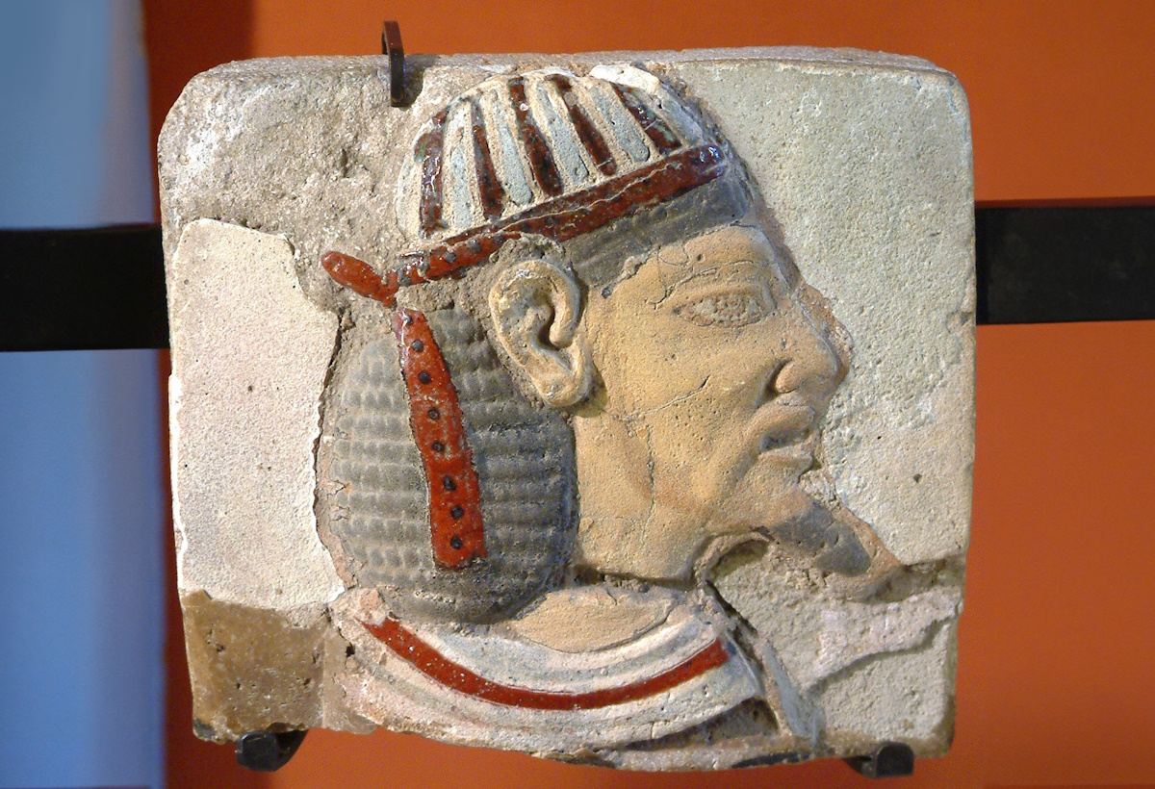
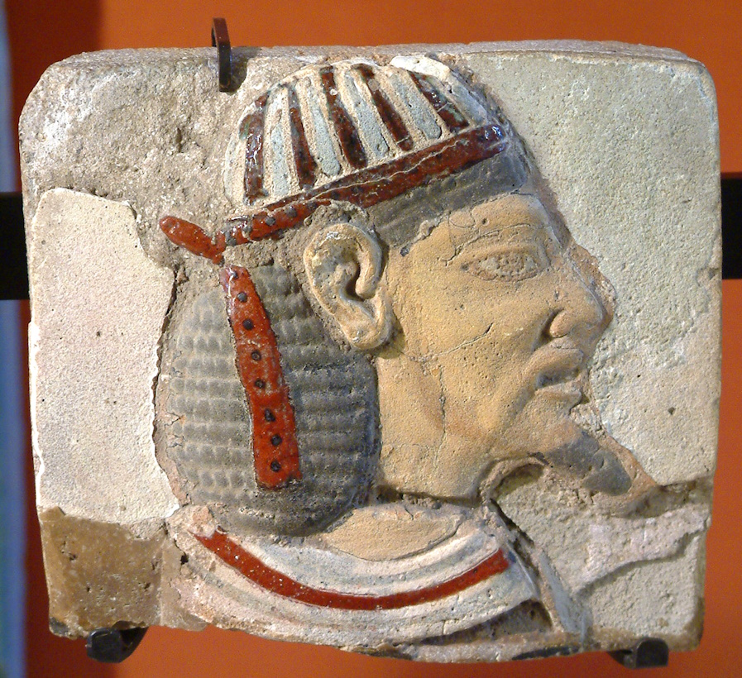
Now a man from the house of Levi went and married a Levite woman
Plaque with the head of an Asiatic man, from Tell el-Yehudiyeh, circa 1200 BC
2:1
Notes:
The term “Asiatic” is often used to describe Semitic people from the Levant (the area of ancient Canaan and Syria) who interacted with the ancient Egyptians. The Hebrews would have been considered part of this general group. This plaque illustrates how Asiatics looked from an Egyptian perspective. Some of the things that set them apart from typical Egyptians were the colorful clothing, including the cap and ribbon, the long, curly hair, the pale skin, and (on men) beards. This plaque was photographed at the Louvre Museum. This image comes from Guillaume Blanchard and is licensed under CC BY-SA 1.0, via Wikimedia Commons: https://commons.wikimedia.org/wiki/File:Egypte_louvre_120_asiatique.jpg. Generative AI has been used to extend the edges of the image; the original photo is available behind this image.
wiki0716041722331477772

Slide 4
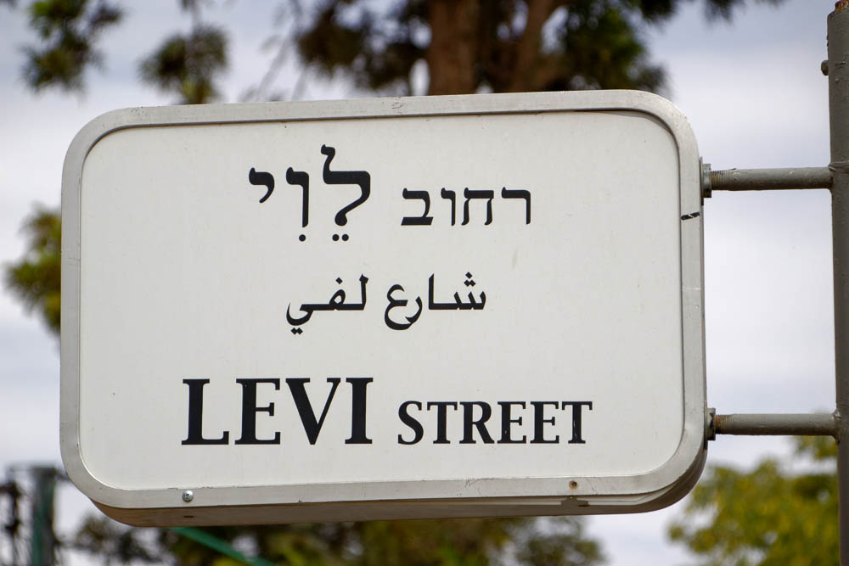
Now a man from the house of Levi went and married a Levite woman
“Levi Street” sign in Jerusalem
2:1
Notes:
“Levi Street” is located in the Baka neighborhood, south of the Old City.
lbd102218503

Slide 5
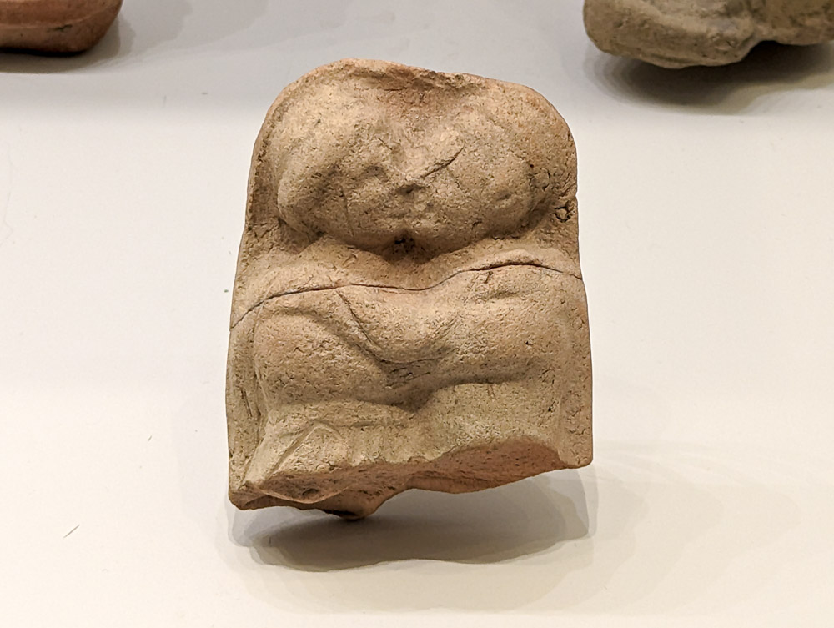
Now a man from the house of Levi went and married a Levite woman
Plaque of an embracing couple, from Mesopotamia, 2nd millennium BC
2:1
Notes:
This plaque was photographed at the Israel Museum.
ku0607230849080

Slide 6
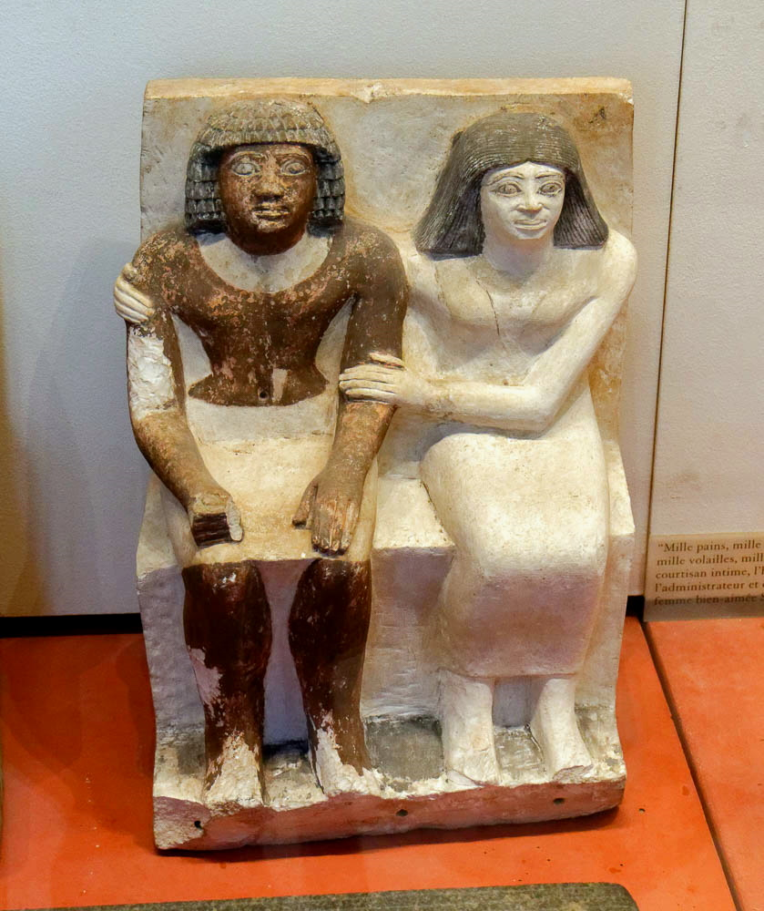
Now a man from the house of Levi went and married a Levite woman
Painted statuette of a couple, probably Isi and his wife, from Edfu, circa 2300 BC
2:1
Notes:
This statuette comes from the tomb of Isi at Edfu, Egypt. It was photographed at the Louvre Museum.
tb0928195945

Slide 7
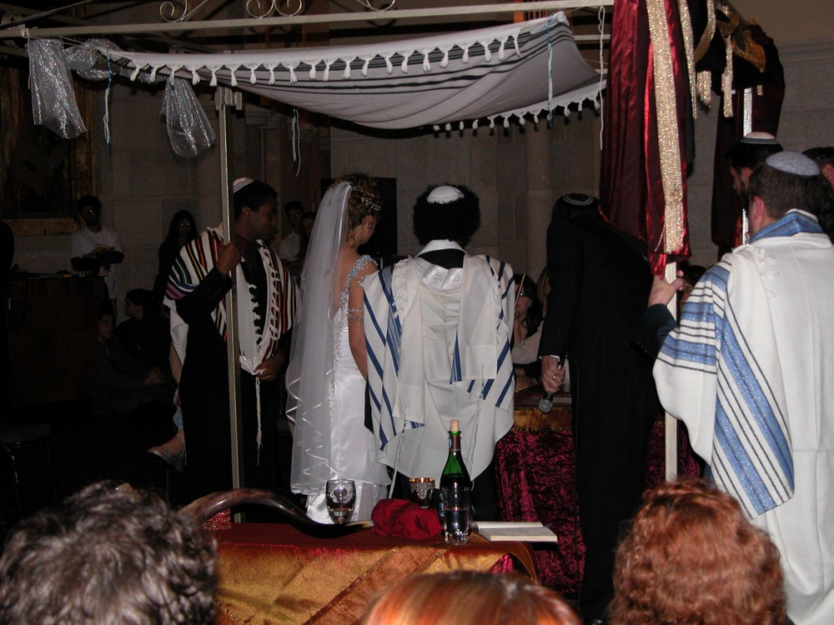
Now a man from the house of Levi went and married a Levite woman
Bride and groom sign the marriage contract (ketubah) at their wedding
2:1
Notes:
This modern illustration shows a Jewish wedding.
tb020503003

Slide 8
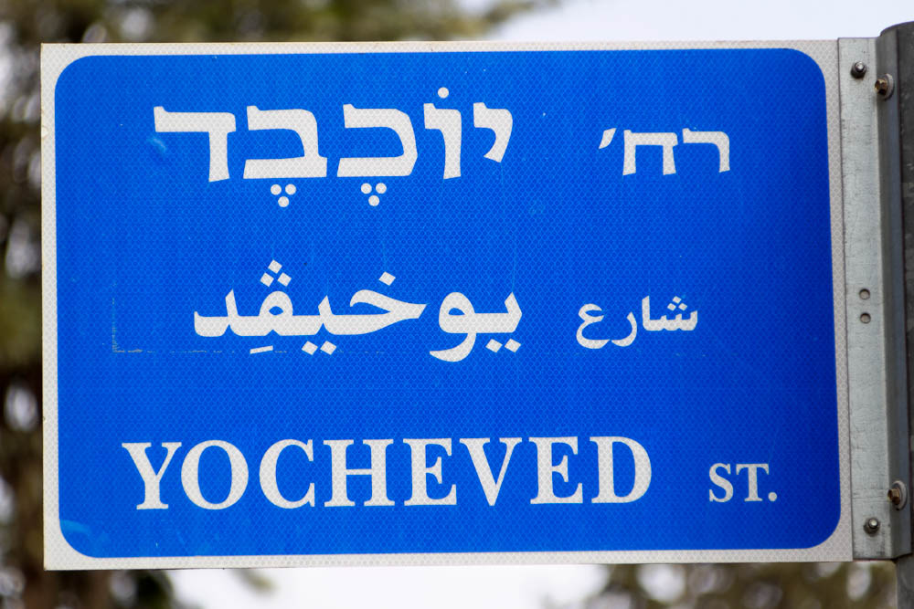
Now a man from the house of Levi went and married a Levite woman
“Jochebed Street” sign in Jerusalem
2:1
Notes:
Jochebed is named as the mother of Moses (and his siblings) and wife of Amram in Exodus 6:20 and Numbers 26:59, though comparison with other passages suggests that she and Amram were more distant ancestors of Moses (Gen 46:11; Exod 12:40). “Jochebed Street” is located in the Baka neighborhood, south of the Old City.
lbd102218497

Slide 9
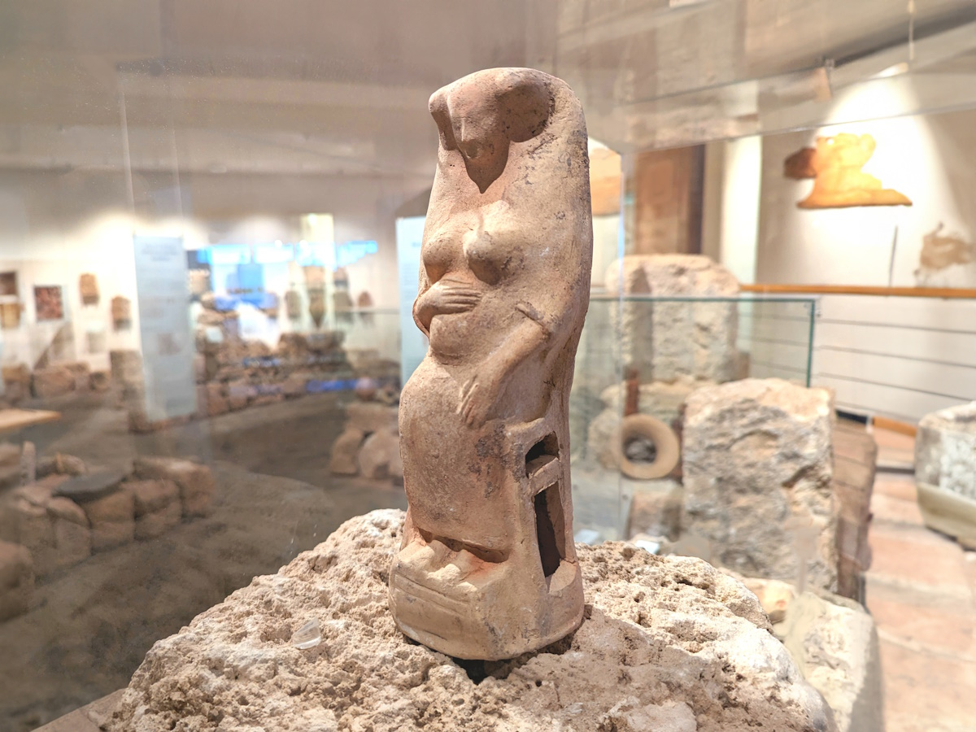
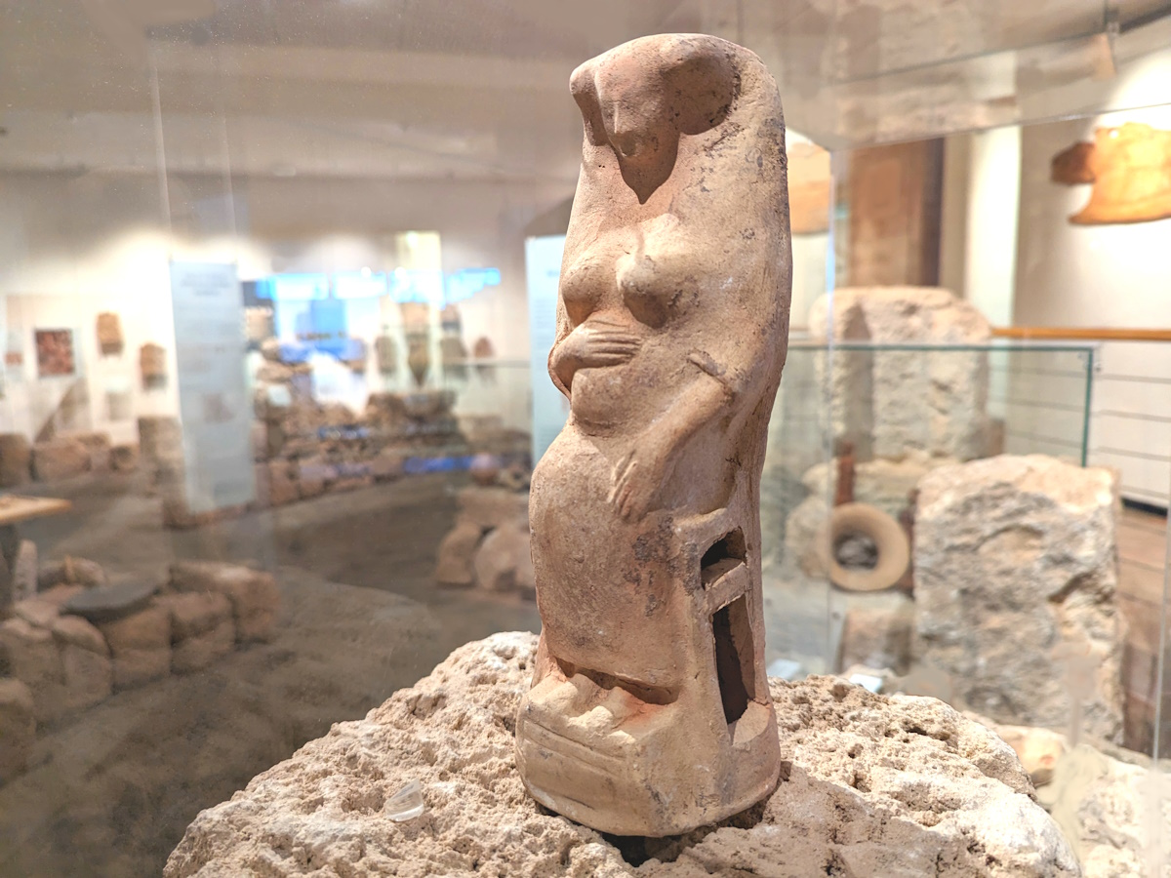
And the woman conceived and gave birth to a son
Figurine of a pregnant woman, 8th–5th centuries BC
2:2
Notes:
This clay figurine depicts a pregnant woman seated on a chair. Figurines like this were common during the Iron Age and are sometimes interpreted as fertility figurines. This figurine was photographed at the Hecht Museum at the University of Haifa. Generative AI was used to extend the edges of this photo; the original image is available behind this image.
ku0531230751233psai

Slide 10
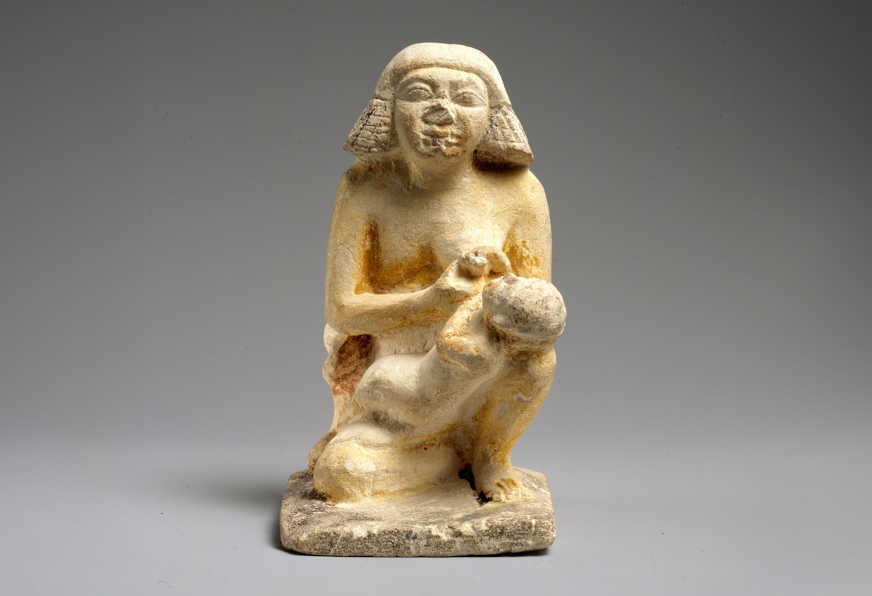
And the woman conceived and gave birth to a son
Figurine of a woman nursing a child, from Egypt, circa 2300 BC
2:2
Notes:
This image comes from The Metropolitan Museum of Art, public domain, Purchase, Edward S. Harkness Gift, 1926, accession number 26.7.1405, https://www.metmuseum.org/art/collection/search/543905.
met543905

Slide 11
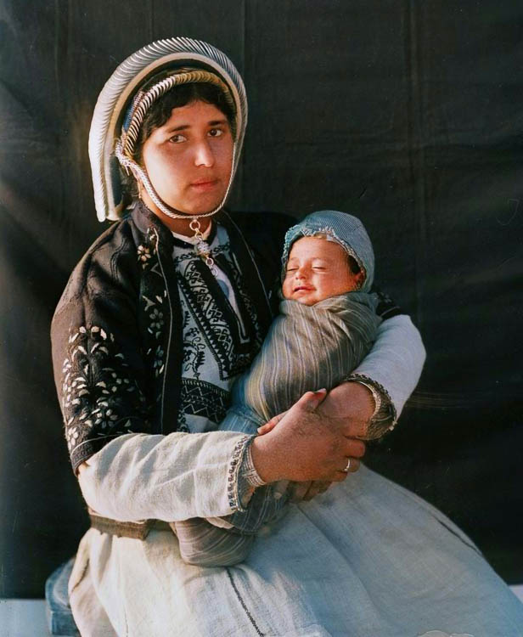
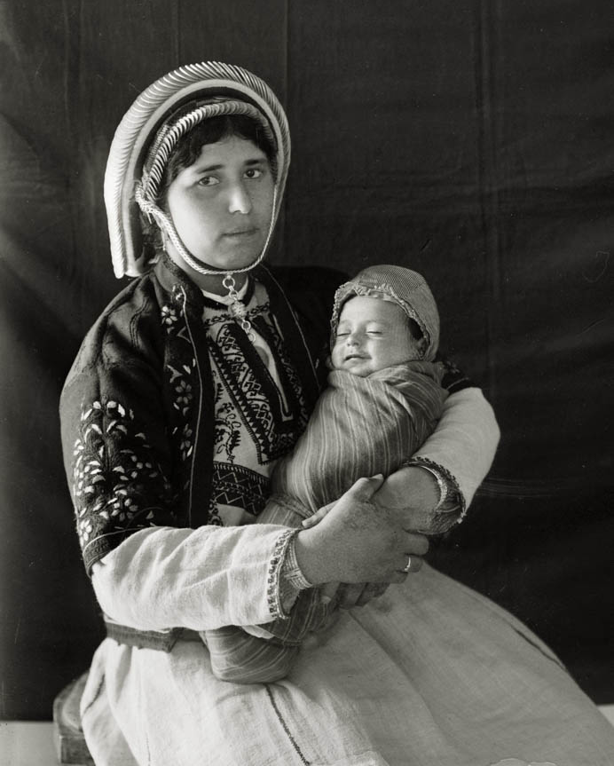
When she saw that he was a fine child, she hid him for three months
Mother and infant, circa 1936
2:2
Notes:
Photographers from the American Colony in Jerusalem took this photograph as part of a re-creation of the Christmas story between 1934 and 1939. This version has been colorized by AI; the original photo is available behind this image.
mat04165col

Slide 12
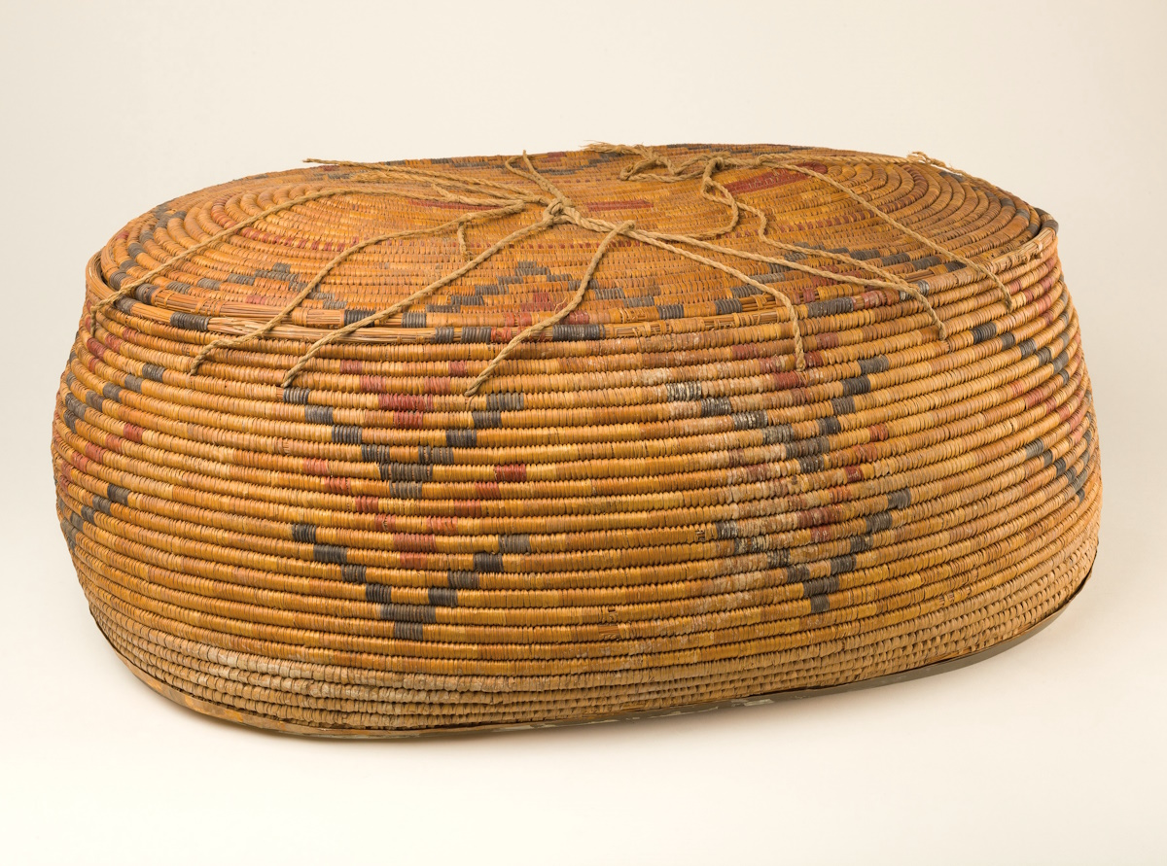
She took for him a basket made of reeds and coated it with tar and pitch
Large oval storage basket, from Thebes, circa 1480 BC
2:3
Notes:
The woven basket shown here dates to about the time of Moses and illustrates the type of basket into which he could have been placed. This early 18th-dynasty basket is made of halfa grass, palm leaf, and linen cord. The basket dimensions are as follows: length 25 inches (63 cm); greatest width 15 3/4 inches (40 cm); height 19 1/16 inches (48 cm). The lid dimensions: length 22 1/16 inches (56 cm); width 12 5/8 inches (32 cm); height 1 9/16 inches (4 cm). Both the basket and its lid “are made with coils of grass that are sewn together using the same grass. A flange of two coils has been attached to the inside of the rim using strips of palm leaf. The decoration of chevrons is created with dyed grass wrapped around the coils” (from the Met website).
The word for the basket in which the infant Moses was set afloat in the Nile River is the same as the word used for Noah’s ark (Heb. tebah, תֵּבַת; e.g., Exod 2:3). It may be noted that both events involved divine salvation through a water-trial of God’s chosen man. This image is from the Metropolitan Museum of Art, public domain, Rogers Fund, 1936, http://metmuseum.org/art/collection/search/545131.
met545131

Slide 13
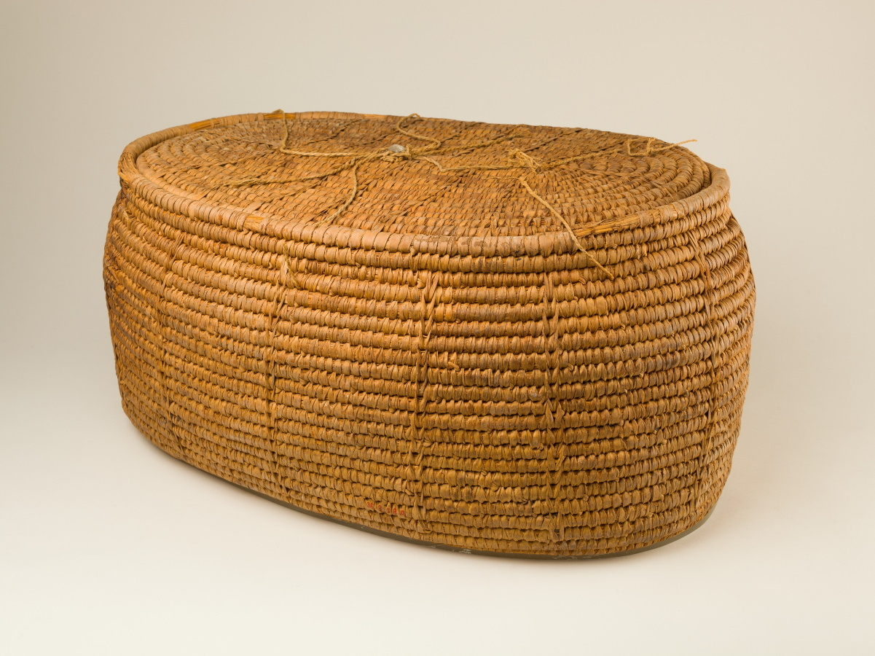
She took for him a basket made of reeds and coated it with tar and pitch
Large oval storage basket, from Thebes, circa 1492–1473 BC
2:3
Notes:
This early 18th-dynasty basket is made of halfa grass coils sewn together with strips of palm leaf. It was tied shut using pieces of linen cords attached around the top edge of the basket. Its dimensions are as follows: length 21 5/8 inches (55 cm); width 15 3/4 inches (40 cm). The lid: length 18 5/16 inches (46 cm); width 13 inches (33 cm). Overall: height 9 5/8 inches (24 cm). This image comes from The Metropolitan Museum of Art, public domain, Rogers Fund, 1936, accession number 36.3.58a, b, https://www.metmuseum.org/art/collection/search/548981.
met548981

Slide 14
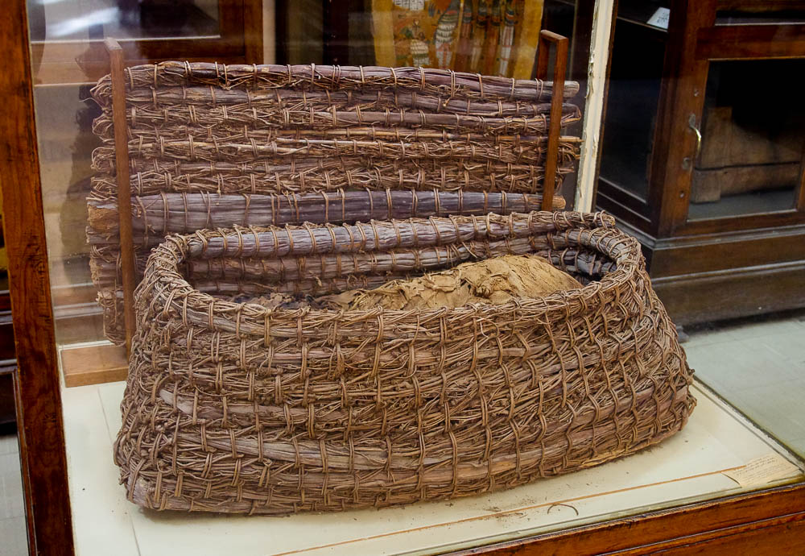
She took for him a basket made of reeds and coated it with tar and pitch
Oval basket made of palm ropes, with rectangular lid, from Tarkhan, 3rd millennium BC
2:3
Notes:
The person buried in this basket is wrapped well in linen. This basket from the 1st–3rd dynasties was photographed at the Egyptian Museum in Cairo.
adr1603195123

Slide 15
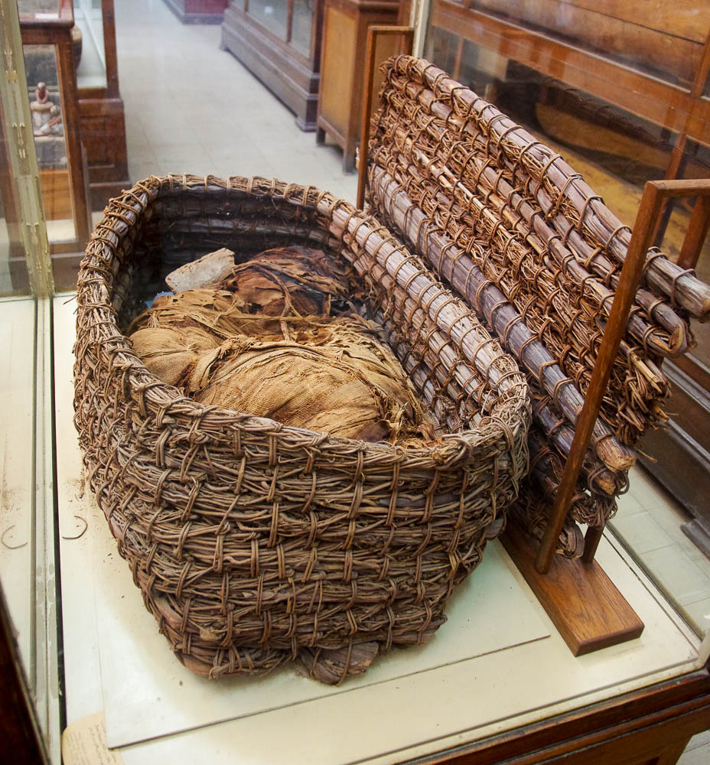
She took for him a basket made of reeds and coated it with tar and pitch
Oval basket made of palm ropes, with rectangular lid, from Tarkhan, 3rd millennium BC
2:3
Notes:
adr1603195113

Slide 16
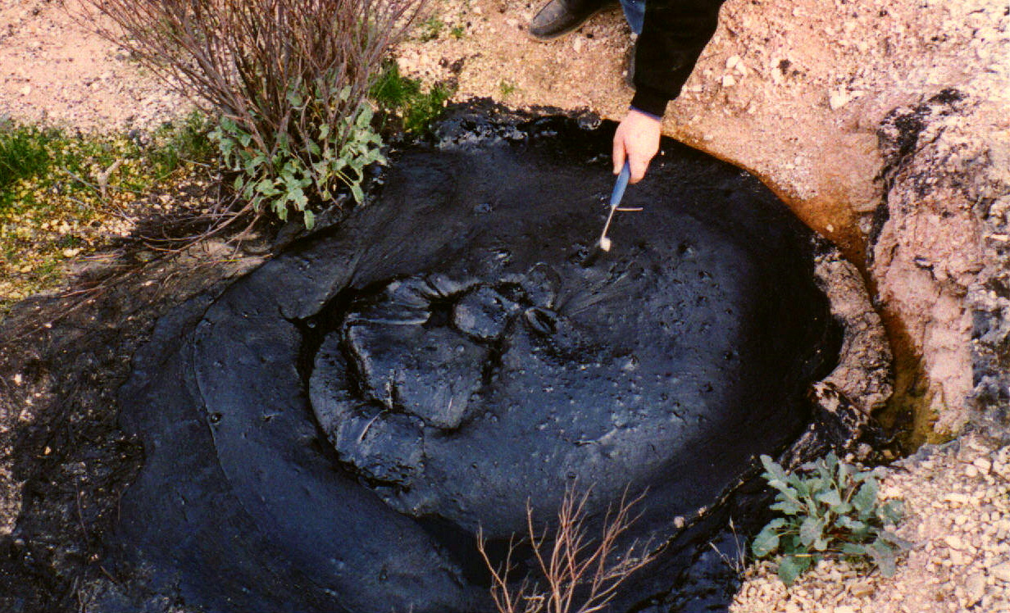
She took for him a basket made of reeds and coated it with tar and pitch
Natural tar seep in the San Joaquin Valley, California
2:3
Notes:
The word “tar” (Heb. chemar, חֵמָר) refers to bitumen or asphalt, a black, naturally occurring petroleum product that is resistant to water. The word “pitch” (Heb. zepheth, זֶפֶת) could be a synonym that refers to a very similar product, although it could also refer the resin of conifers.
The tar seep shown here is part of the McKittrick Oil Field in the San Joaquin Valley of central California. This image comes from Lldenke and is licensed under CC BY 3.0, via Wikimedia Commons: https://commons.wikimedia.org/wiki/File:McKittrick_Tar_Seep_North_of_Highway_58.jpg.
wiki050120000531752

Slide 17
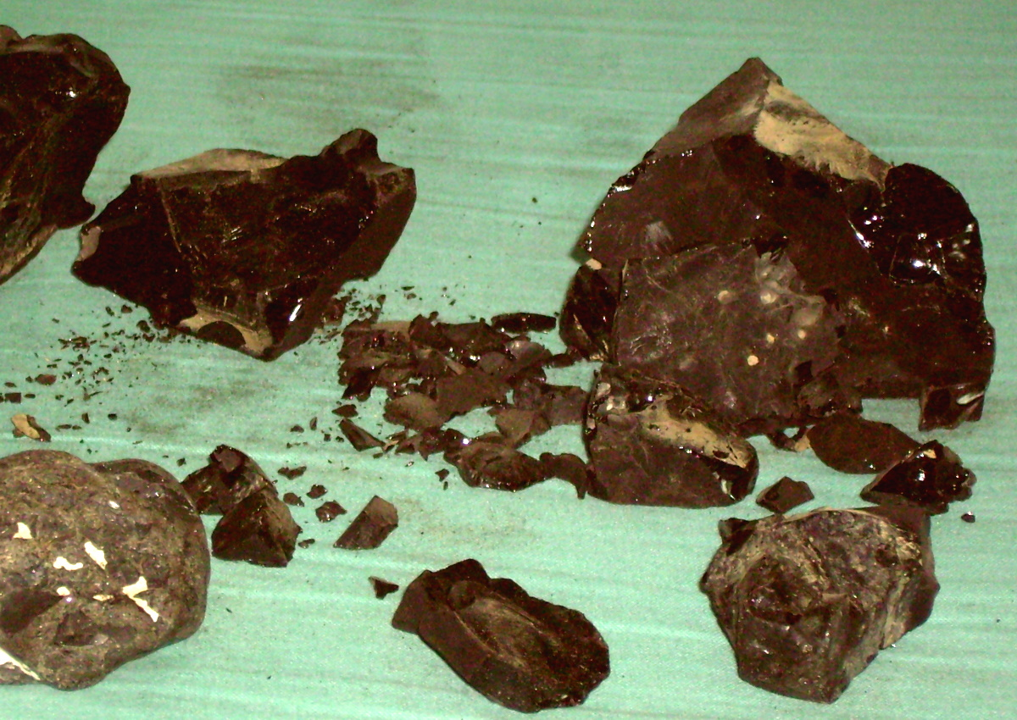
She took for him a basket made of reeds and coated it with tar and pitch
Natural bitumen collected along the shore of the Dead Sea
2:3
Notes:
The Dead Sea has been a source of tar or bitumen since ancient times. The specimens shown here were collected along the shore of the Dead Sea in modern times. This image comes from Daniel Tzvi and is in the public domain, via Wikimedia Commons: https://commons.wikimedia.org/wiki/File:Bitumen.jpg.
wiki0417200707241326

Slide 18
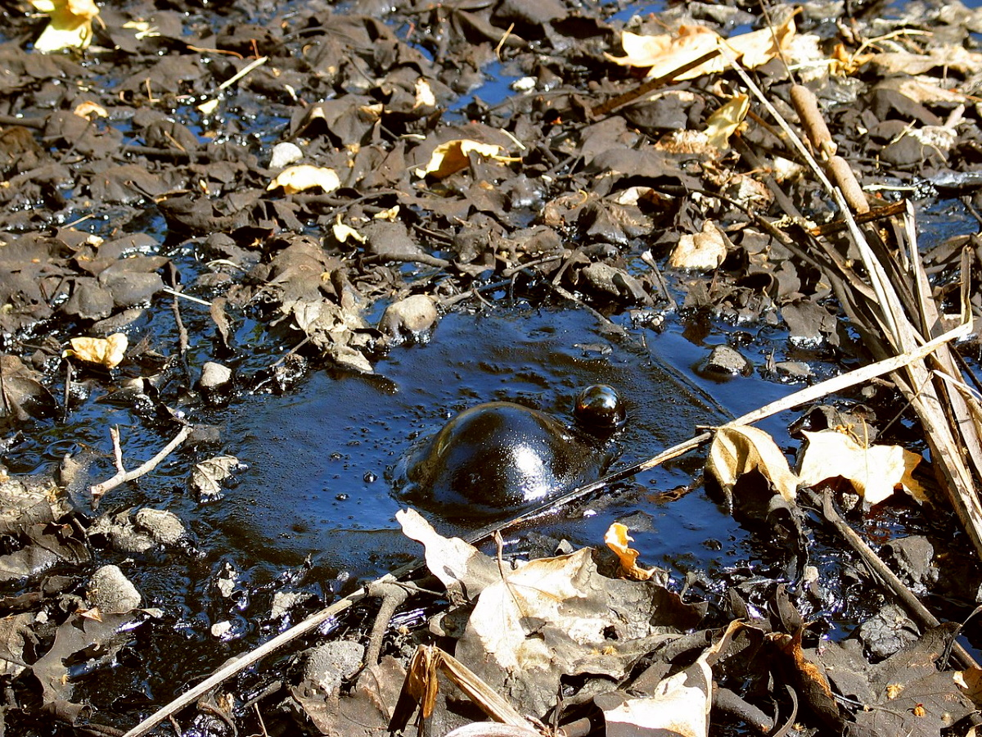
She took for him a basket made of reeds and coated it with tar and pitch
Open pool with a bubble of pitch, in the La Brea Tar Pits in Los Angeles, California
2:3
Notes:
The well-known La Brea Tar Pits in California have been seeping tar for thousands of years. This image comes from Daniel Schwen and is licensed under CC BY-SA 2.5, via Wikimedia Commons: https://commons.wikimedia.org/wiki/File:USA_tar_bubble_la_brea_CA.jpg.
wiki041520042126

Slide 19
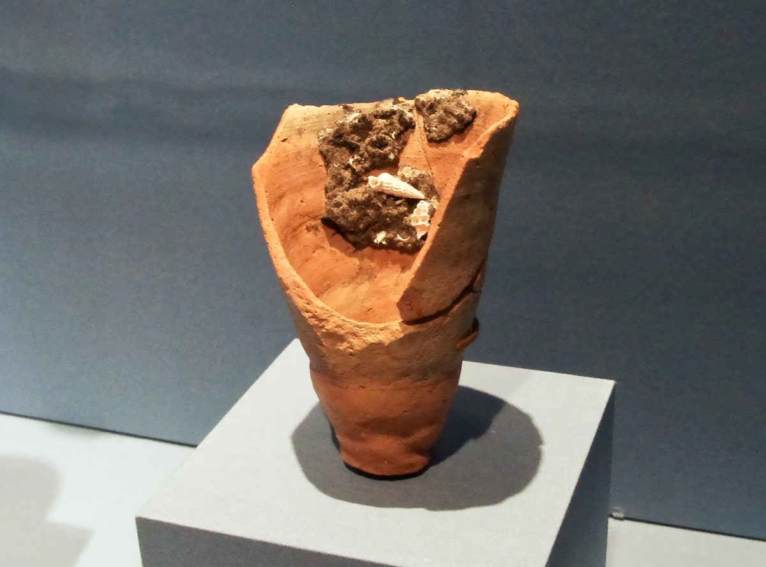
She took for him a basket made of reeds and coated it with tar and pitch
Vessel with bitumen and barnacles, from Ayn as-Sayh, 5th millennium BC
2:3
Notes:
Bitumen (i.e., tar or asphalt) was traded as a commodity in Mesopotamia as early as the 5th millennium BC. It was used in Egypt as part of the embalming process in later periods, but evidence for its use in embalming is not found prior to about 1100 BC. This display was photographed at the Nelson-Atkins Museum of Art.
adr1405297235

Slide 20
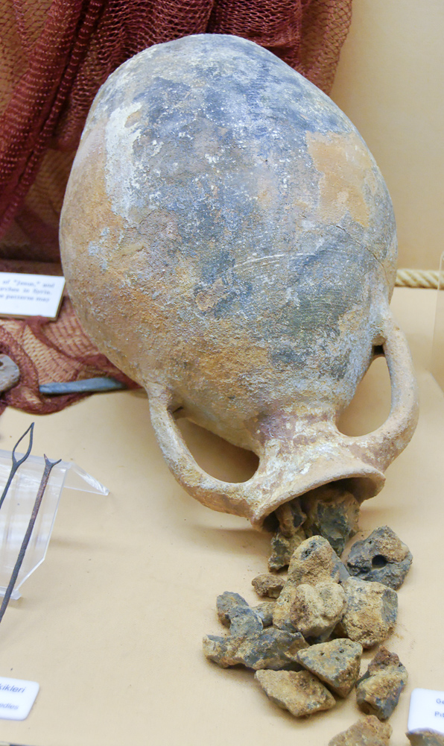
She took for him a basket made of reeds and coated it with tar and pitch
Pitch from a shipwreck off Serçe Limani, 11th century AD
2:3
Notes:
This display was photographed at the Bodrum Museum of Underwater Archaeology.
tb062106240

Slide 21
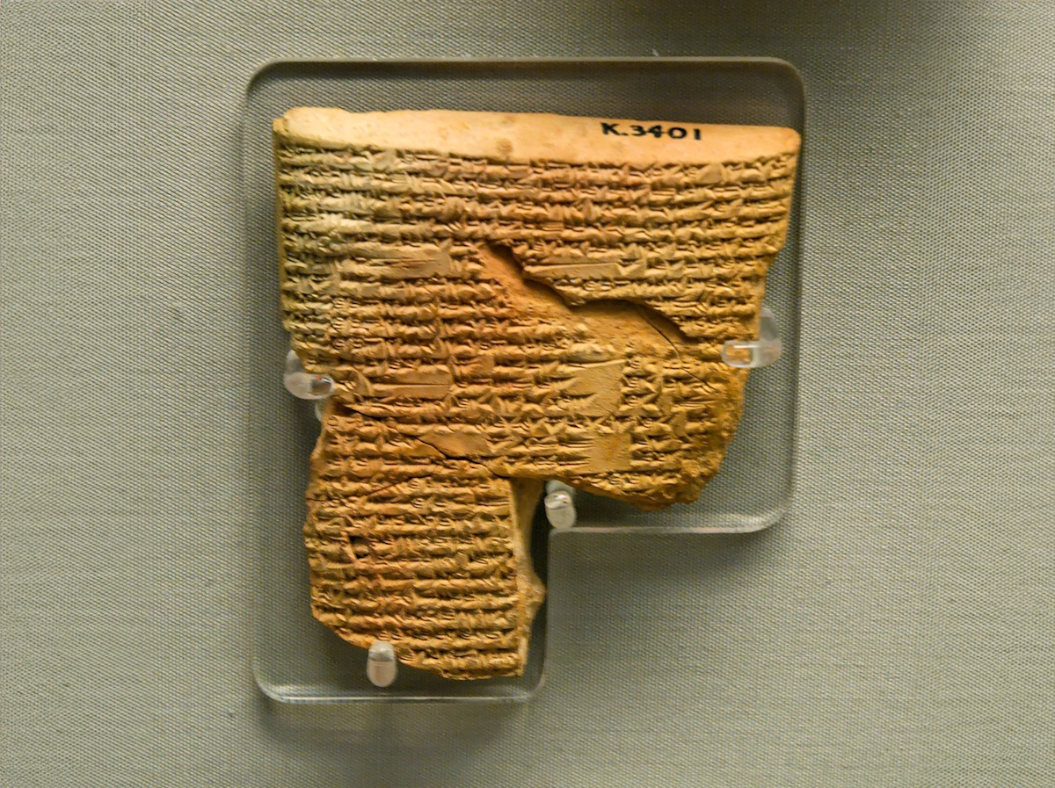
She took for him a basket made of reeds and coated it with tar and pitch
Tablet with the birth legend of Sargon of Akkad, 8th century BC
2:3
Notes:
There are some striking similarities between the story of the birth of Sargon I (ca. 1950 BC) and the story of Moses’s birth. The birth legend of Sargon (of Akkad/i.e., Sargon I) seems to have been written during the reign of Sargon II (r. 721–705 BC); however, the story/legend is probably much earlier. Scholars debate whether one of these borrows from the other or if the similarities are coincidental.
“I am Sargon the great king, king of Agade.
My mother was a high priestess, I did not know my father.
My father’s brothers dwell in the uplands.
My city is Azupiranu, which lies on Euphrates bank.
My mother, the high priestess, conceived me, she bore me in secret.
She placed me in a reed basket, she sealed my hatch with pitch.
She left me to the river, whence I could not come up.
The river carried me off, it brought me to Aqqi, drawer of water.
Aqqi, drawer of water, brought me up as he dipped his bucket.
Aqqi, drawer of water, raised me as his adopted son.
Aqqi, drawer of water, set (me) to his orchard work” (Foster 2003: 461).
This tablet was photographed at the British Museum.
Reference:
Foster, Benjamin R.
2003 The Birth Legend of Sargon of Akkad. Pg. 461 in The Context of Scripture, vol. 1, ed. W. W. Hallo. Leiden: Brill.
tb112004124c

Slide 22
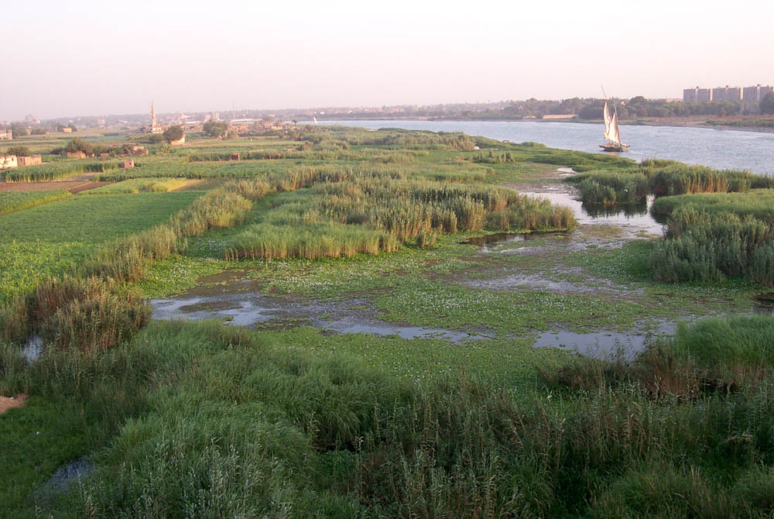
She set it among the reeds by the bank of the river
Nile River in Cairo
2:3
Notes:
The Nile Delta, where the Hebrews lived, is low-lying land. It is so flat that the Nile River divides into several branches as it slowly meanders toward the Mediterranean Sea. As a result, many of the banks of these branches are swampy, and it is not uncommon to find large beds of reeds in such places. The Egyptians used reeds for a variety of purposes, from making baskets and mats to making boats. Papyrus was used from a very early period for the production of writing material, one of the commodities that was shipped abroad for millennia.
df070102104

Slide 23
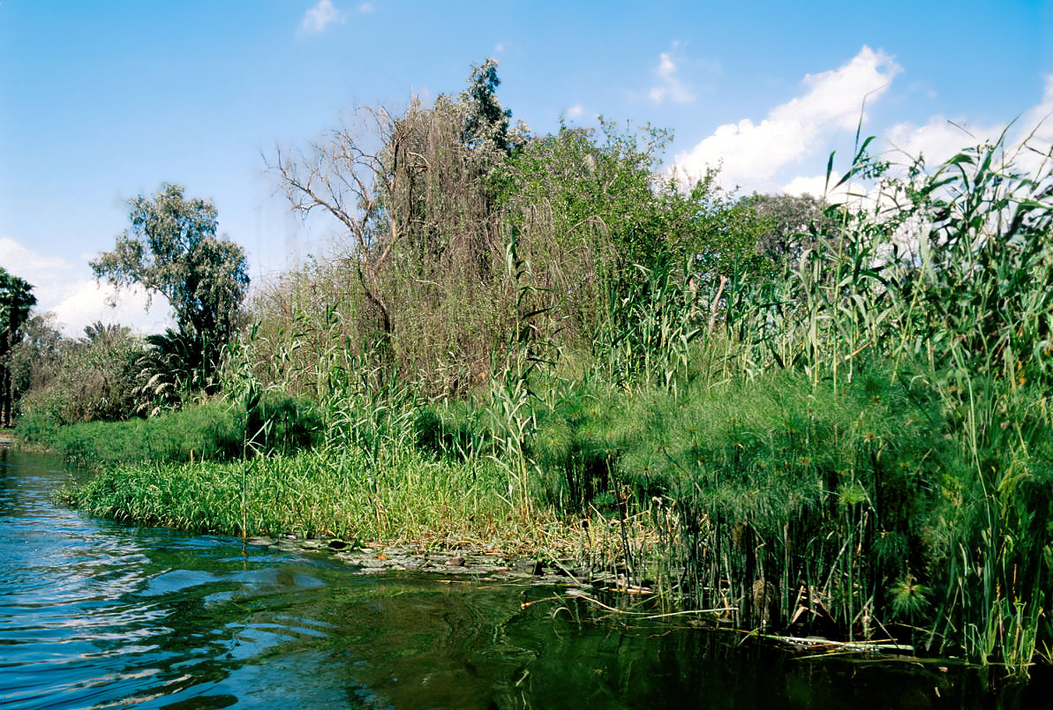
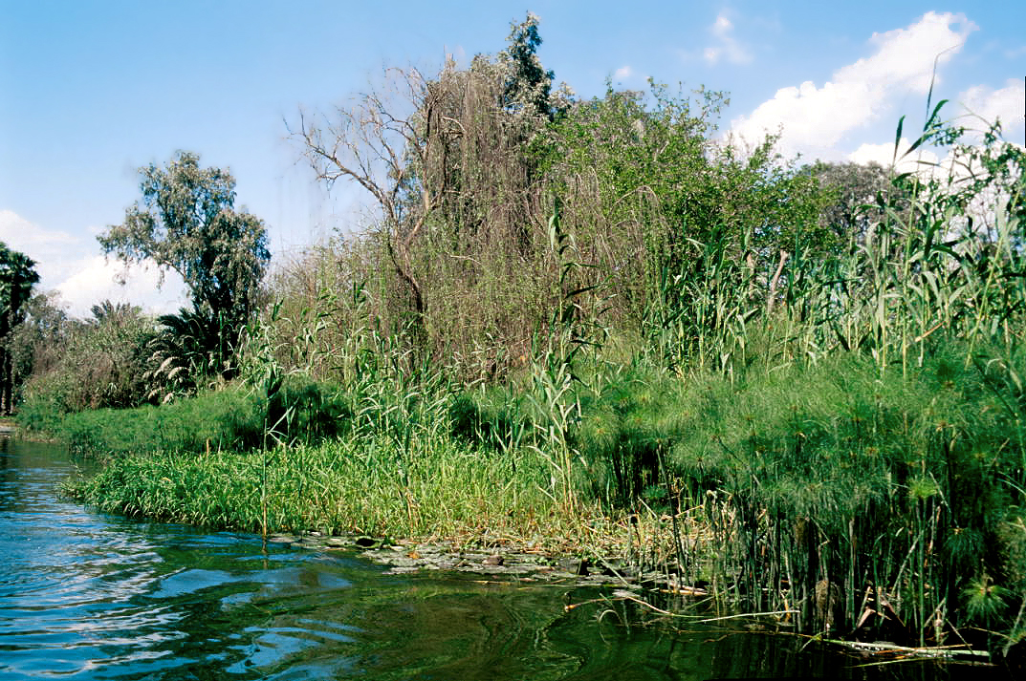
She set it among the reeds by the bank of the river
Vegetation along the Nile River near Giza
2:3
Notes:
This photo was taken along the bank of Jacob’s Island, in the Nile River near Giza. The plants in the foreground on the right are papyrus plants. This image comes from LBM1948 and is licensed under CC BY-SA 4.0, via Wikimedia Commons: https://commons.wikimedia.org/wiki/File:Guiza_1999_02.jpg. Generative AI was used to extend the edges of the image; the original photo is available behind this image.
wiki03991073713925

Slide 24
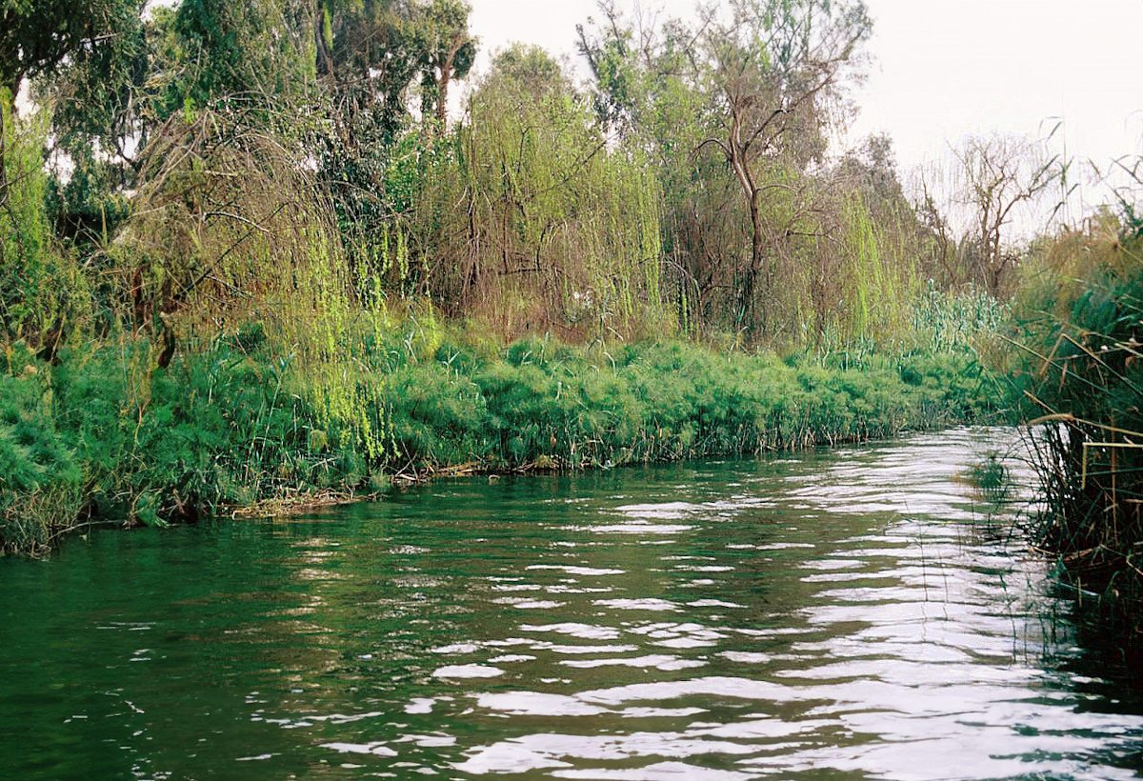
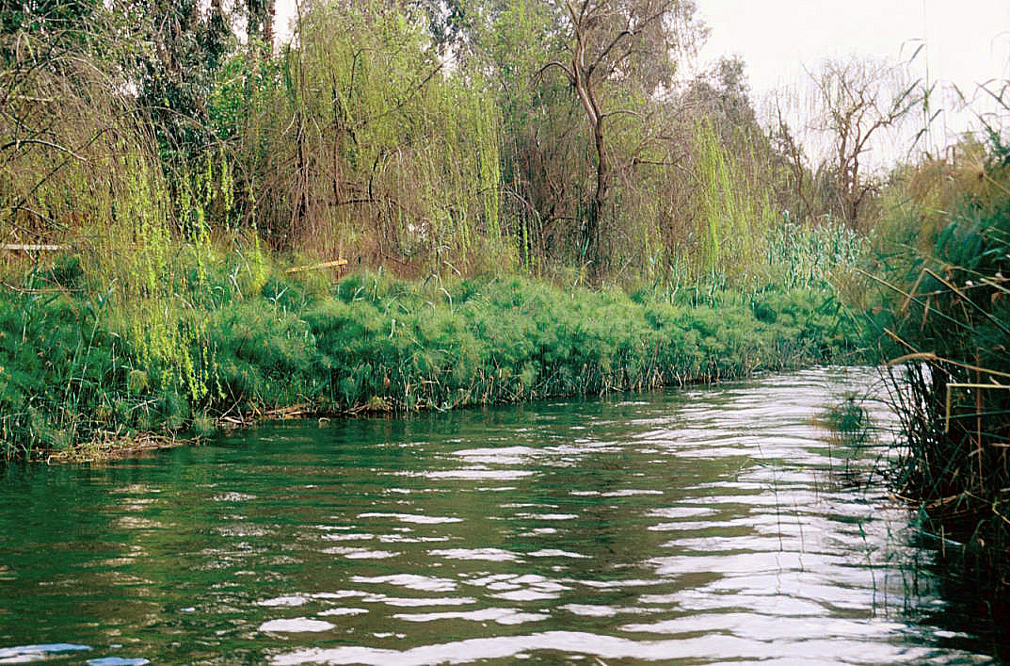
She set it among the reeds by the bank of the river
Papyrus plants and other reeds growing along the Nile River near Giza
2:3
Notes:
This photo illustrates the reeds and other lush undergrowth that thrive along the banks of the Nile. This image comes from LBM1948 and is licensed under CC BY-SA 4.0, via Wikimedia Commons: https://commons.wikimedia.org/wiki/File:Guiza_1999_03.jpg. Generative AI was used to extend the edges of the image; the original photo is available behind this image.
wiki03991073707103

Slide 25
She set it among the reeds by the bank of the river
Papyrus plants growing along the edge of the Nile River near Giza
2:3
Notes:
This image comes from LBM1948 and is licensed under CC BY-SA 4.0, via Wikimedia Commons: https://commons.wikimedia.org/wiki/File:Guiza_1999_05.jpg. Generative AI was used to extend the edges of the image; the original photo is available behind this image.
wiki03991073713137

Slide 26
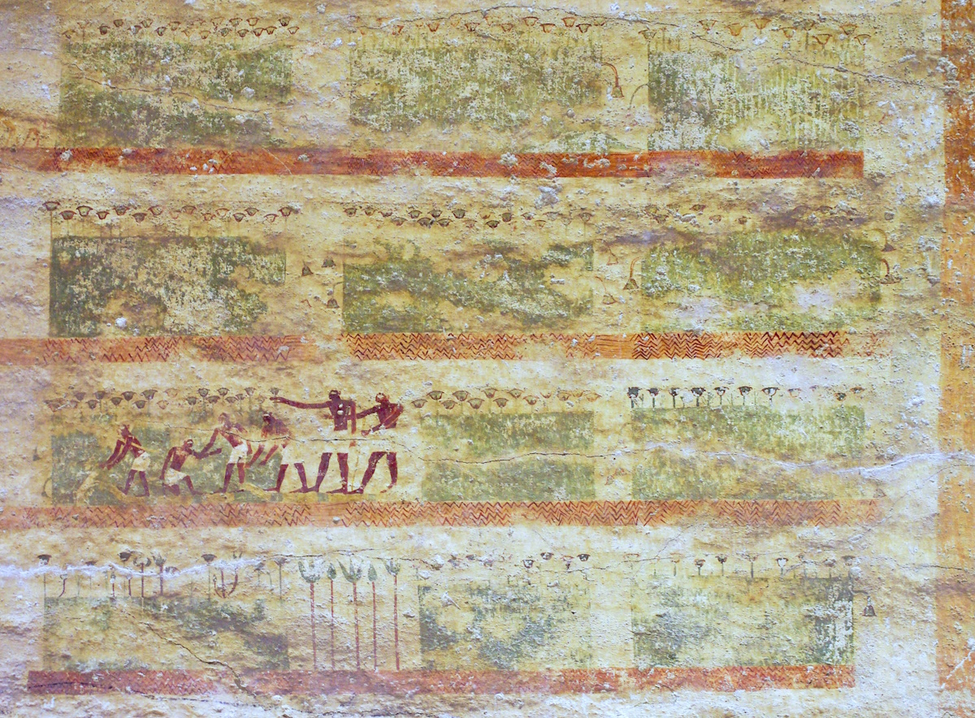
She set it among the reeds by the bank of the river
Nile marsh scenes, painting in the tomb of Khety at Beni Hasan, circa 2000 BC
2:3
Notes:
This tomb painting of men working in the marshes along the Nile River was photographed in the tomb of Khety at Beni Hasan.
adr1603247487c

Slide 27
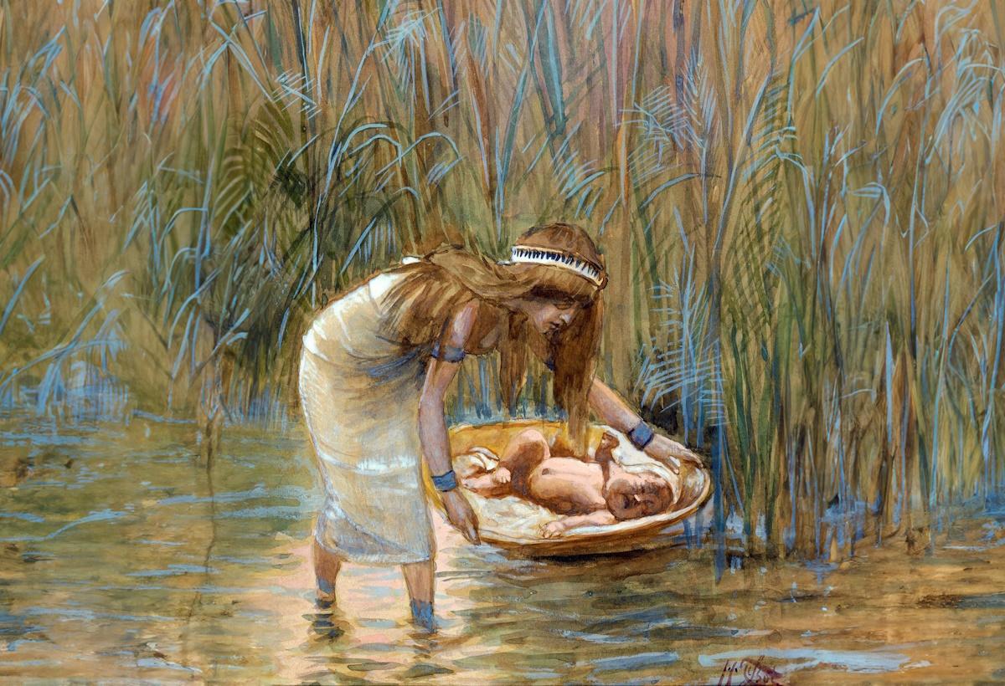
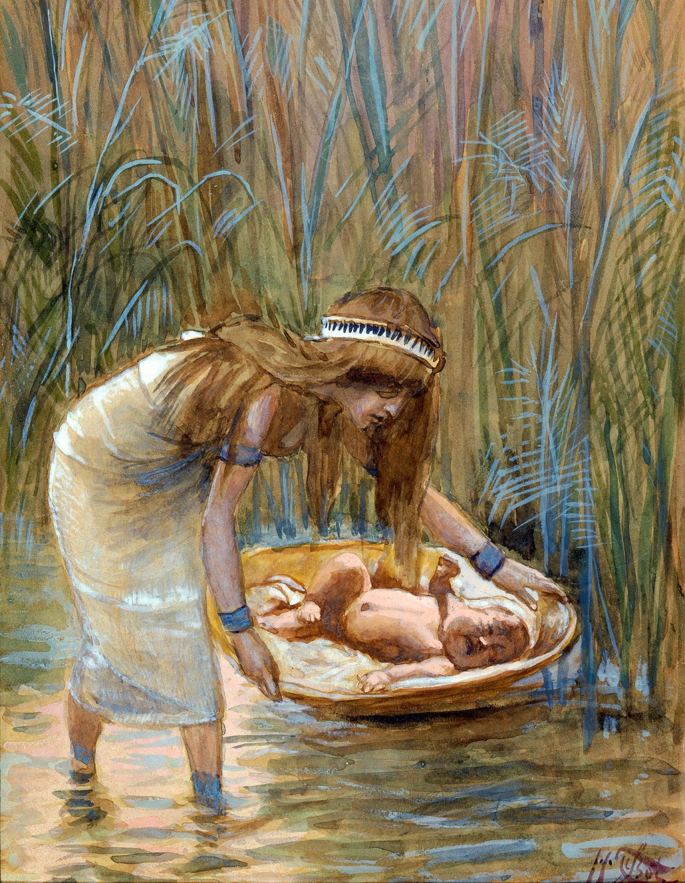
She set it among the reeds by the bank of the river
Moses Laid Among the Rushes, by James Tissot, circa 1899
2:3
Notes:
The final step in the hiding, and eventual exposure, of Moses was when he was placed in a basket and put afloat along the bank of the Nile River (Exod 2:3-10). This image of a gouache on board painting is in the public domain, via the Jewish Museum: https://thejewishmuseum.org/collection/26331-moses-laid-amid-the-flags. Generative AI was used to extend the edges of this image; the original photo is available behind this image.
tjm26331psai

Slide 28
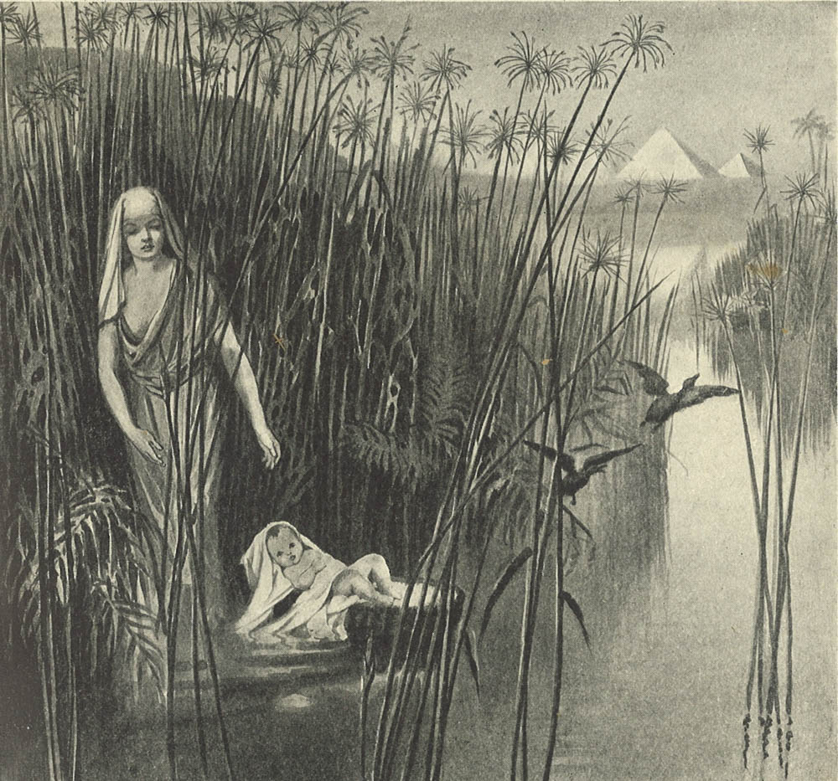
And his sister stood far off, to see what would be done
Baby Moses is watched by his sister
2:4
Notes:
This illustration comes from Charles Foster, Bible Pictures and What They Teach Us (1886, 1914).
fbp059a

Slide 29
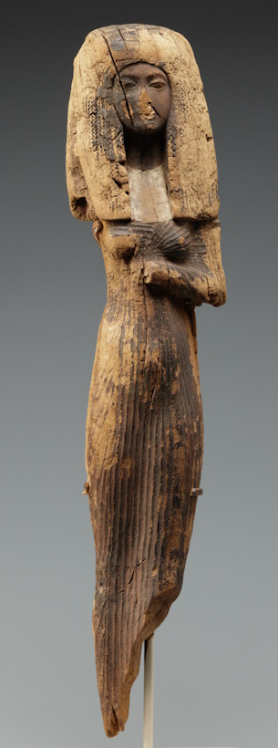
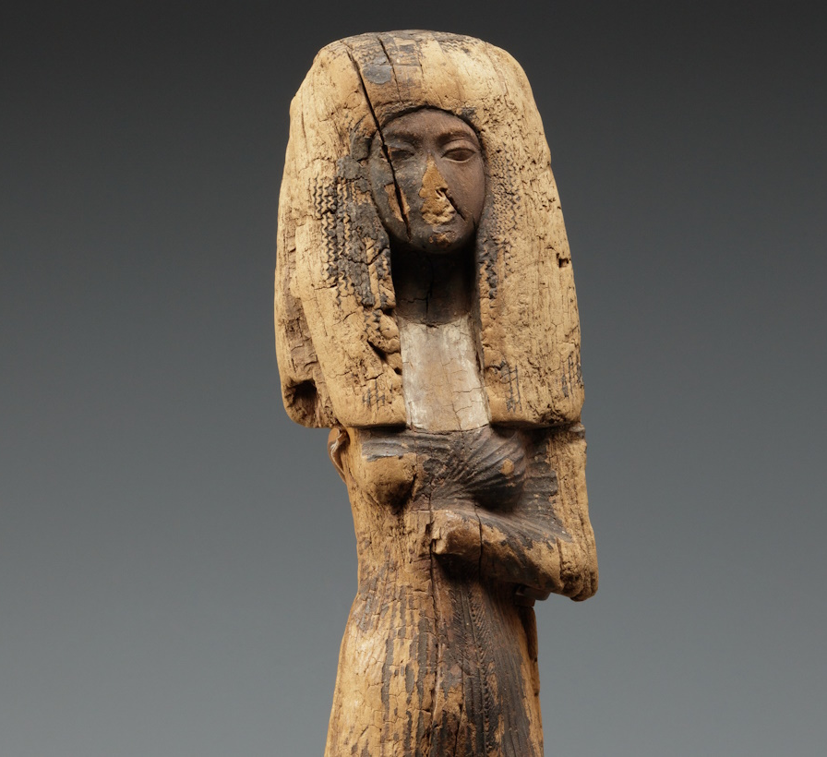
The daughter of Pharaoh came down to bathe at the river
Wooden statuette of a young woman, from Egypt, circa 1300 BC
2:5
Notes:
This image comes from The Metropolitan Museum of Art, public domain, Bequest of Walter C. Baker, 1971, accession number 1972.118.37, https://www.metmuseum.org/art/collection/search/550681.
met550681

Slide 30
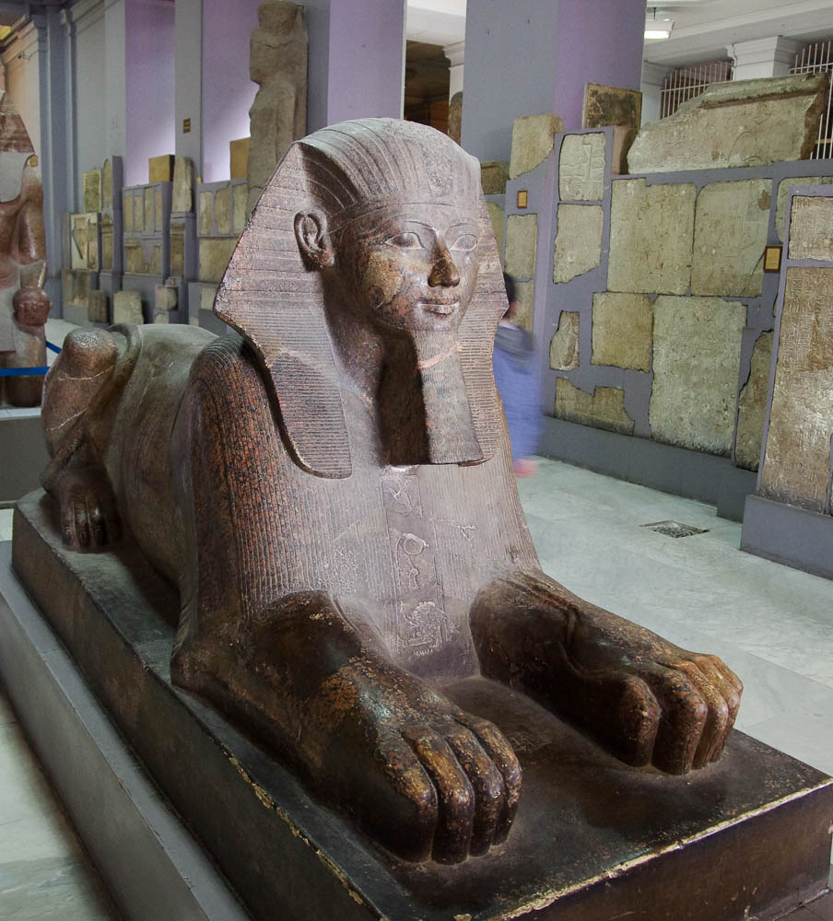
The daughter of Pharaoh came down to bathe at the river
Colossal granite sphinx of Hatshepsut, from Deir el-Bahari, 15th century BC
2:5
Notes:
Some Bible scholars have suggested that the daughter of Pharaoh who adopted Moses may have been Hatshepsut, who went on to become one of the rare female rulers of Egypt. The suggestion is only possible if one accepts the early date for the exodus and combines this with a high Egyptian chronology. There is no direct evidence of a connection between Hatshepsut and the birth story of Moses. This sphinx was photographed at the Egyptian Museum in Cairo.
adr1603111684

Slide 31
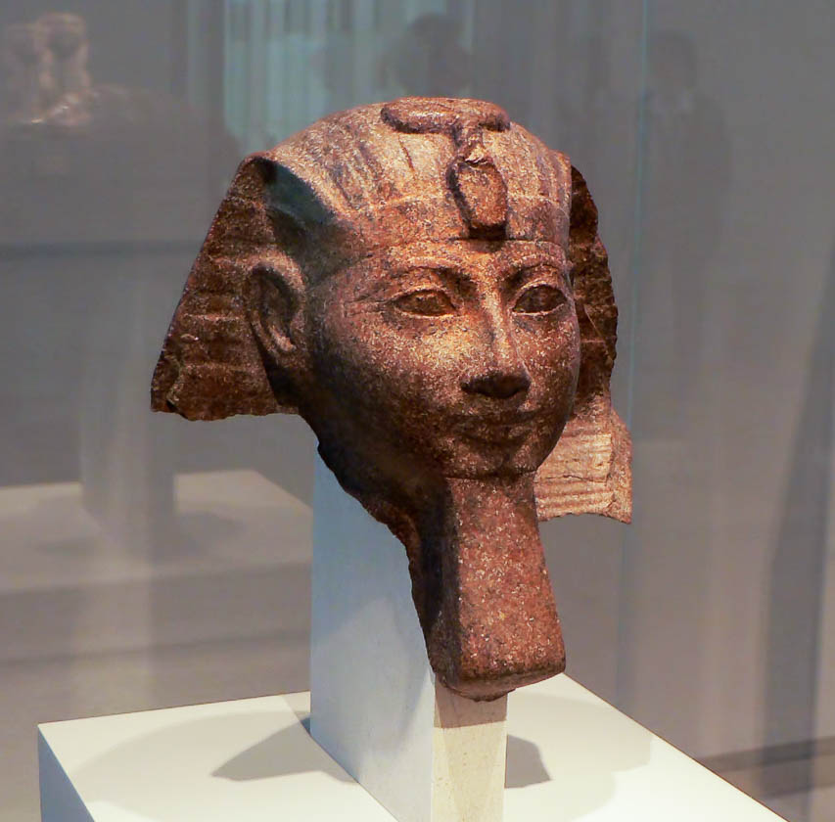
The daughter of Pharaoh came down to bathe at the river
Brown granite head of Hatshepsut, 18th dynasty, 15th century BC
2:5
Notes:
Hatshepsut was only the second known female ruler of Egypt, the first being Queen Sobkneferu (r. 1763–1760). As the ruler of Egypt, she depicted herself with the royal beard, as can be seen in this statue head. After her death, there was a concentrated effort to erase her name and images of her wherever they existed. This statue head was photographed at the Berlin Egyptian Museum and Papyrus Collection.
adr070511839

Slide 32
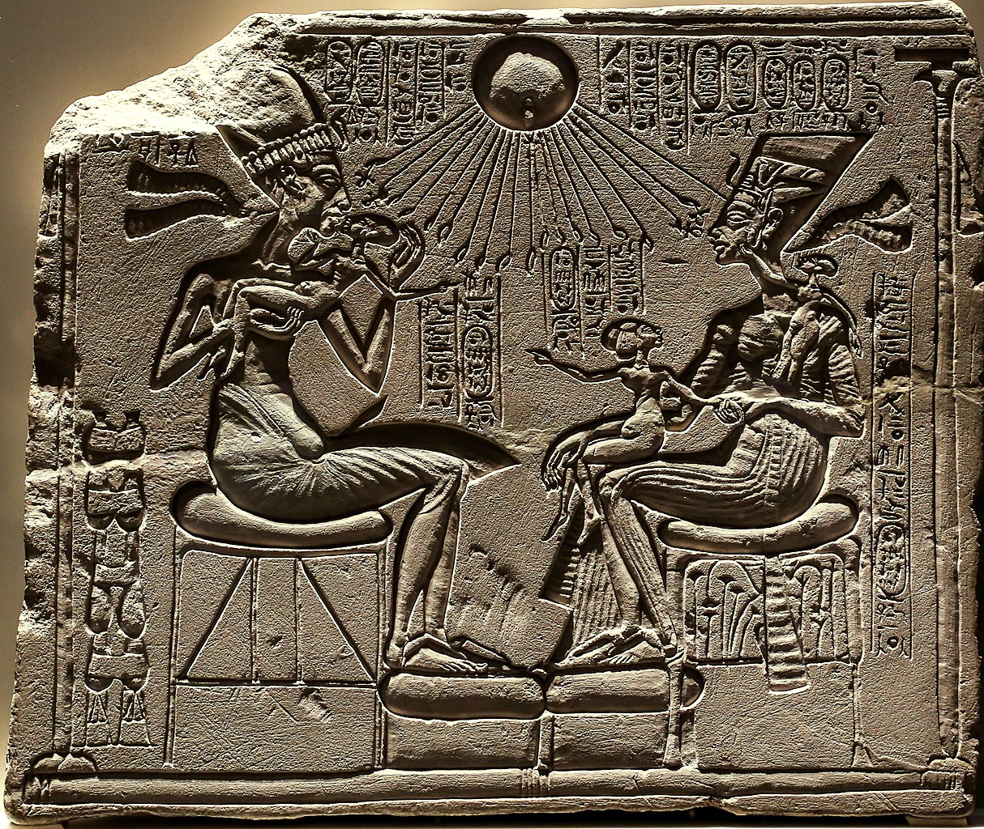
The daughter of Pharaoh came down to bathe at the river
House altar with Akhenaten, Nefertiti, and three daughters, 14th century BC
2:5
Notes:
Regardless of an identification with a specific historical person, a legitimate daughter of Pharaoh would have had a place of prominence in the Egyptian royal court. This house altar dates to the 18th dynasty and was photographed in the Berlin Egyptian Museum and Papyrus Collection. This image comes from Neoclassicism Enthusiast and is licensed under CC BY-SA 4.0, via Wikimedia Commons: https://commons.wikimedia.org/wiki/File:Relief_depicting_Akhenaton_and_Nefertiti_with_three_of_their_daughters_under_the_rays_of_Aton_01_(cropped).jpg.
wiki122020141613388239

Slide 33
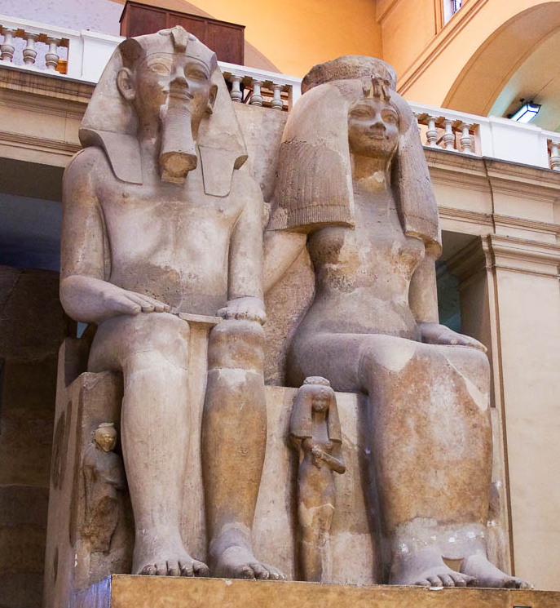
The daughter of Pharaoh came down to bathe at the river
Amenhotep III and Queen Tiye and three daughters, from Kom el-Hetan, 14th century BC
2:5
Notes:
This colossal statue depicts Amenhotep III (r. 1390–1353 BC) and Queen Tiye. Their three daughters are depicted as small figures near their feet. This statue was photographed at the Egyptian Museum at Cairo.
adr1603111572

Slide 34
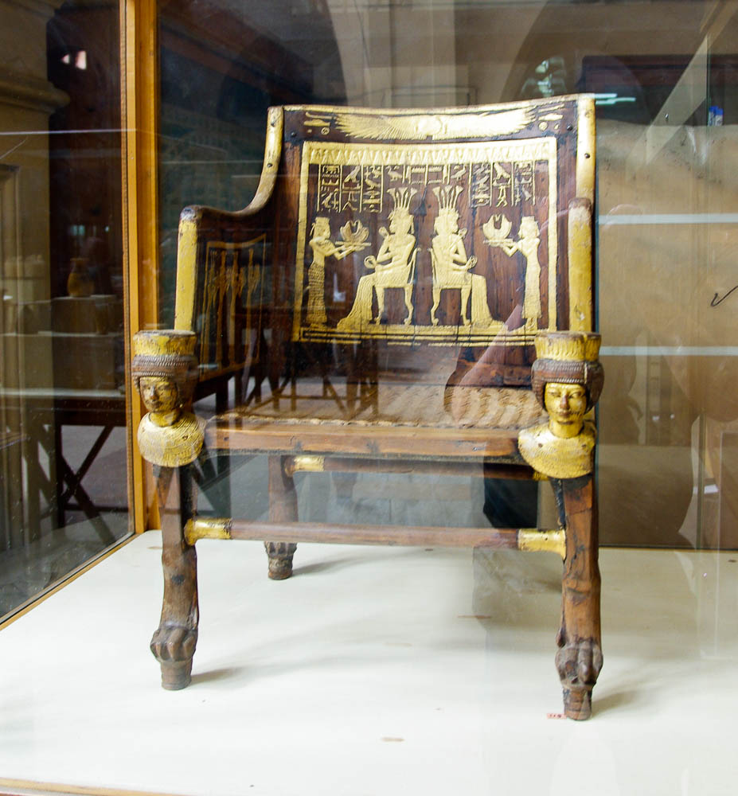
The daughter of Pharaoh came down to bathe at the river
Chair of Sitamun daughter of Amenhotep III, from Valley of the Kings KV 46, 14th century BC
2:5
Notes:
This chair belonged to one of the royal daughters of Amenhotep III. It was photographed at the Egyptian Museum in Cairo. See the next two slides for closer views of this chair.
adr1603194408

Slide 35
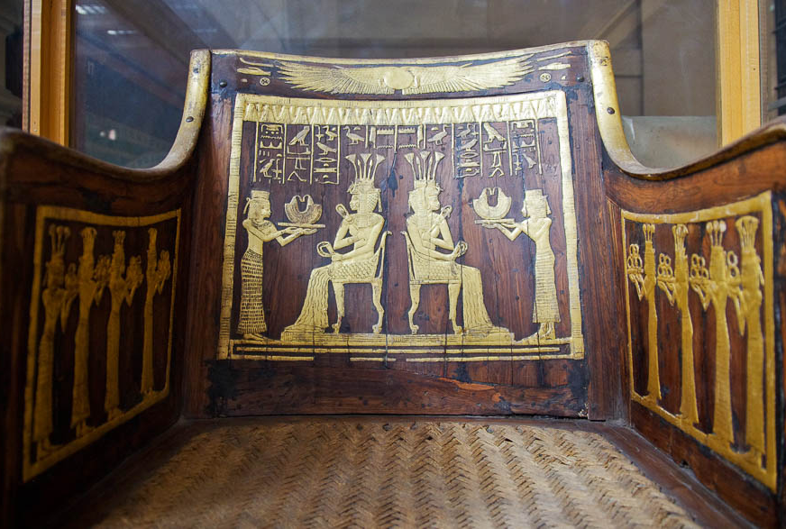
The daughter of Pharaoh came down to bathe at the river
Chair of Sitamun daughter of Amenhotep III, from Valley of the Kings KV 46, 14th century BC
2:5
Notes:
This artifact was photographed at the Egyptian Museum in Cairo.
adr1603194411

Slide 36
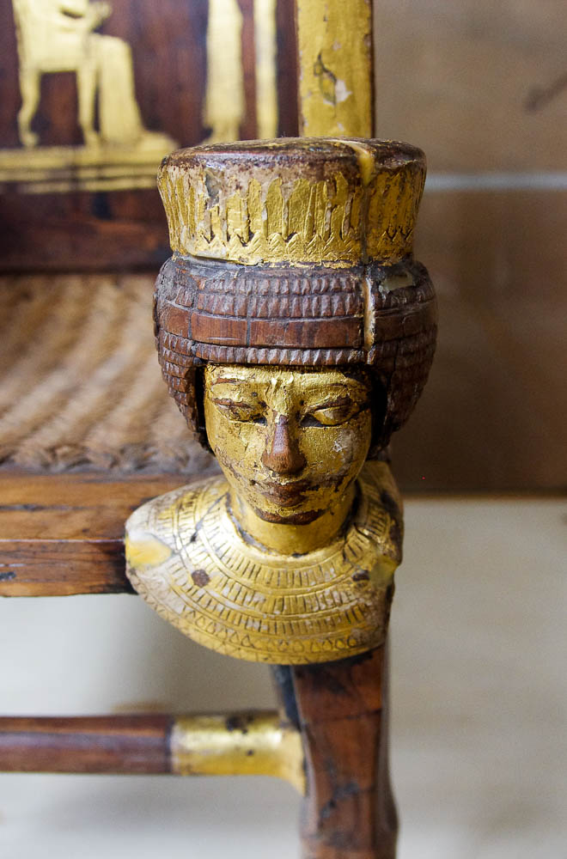
The daughter of Pharaoh came down to bathe at the river
Chair of Sitamun daughter of Amenhotep III, from Valley of the Kings KV 46, 14th century BC
2:5
Notes:
This artifact was photographed at the Egyptian Museum in Cairo.
adr1603194410

Slide 37
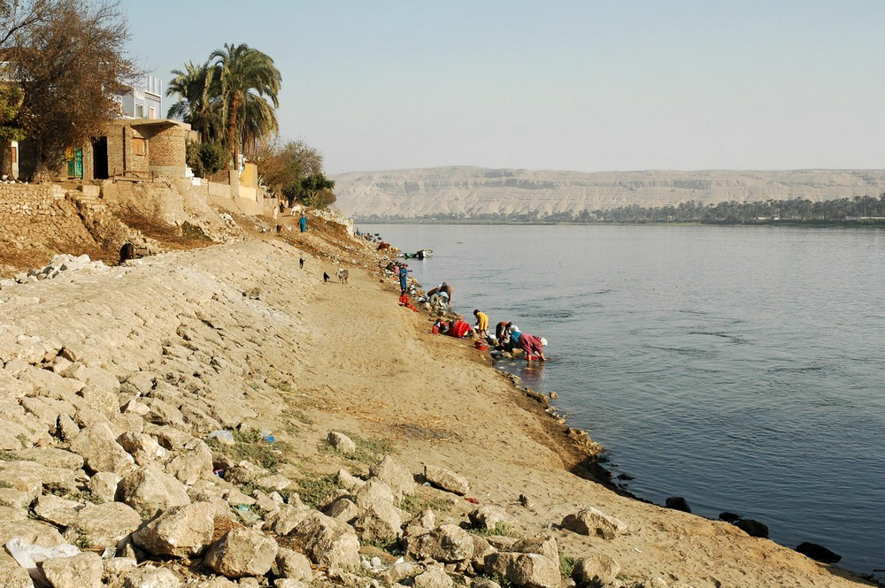
The daughter of Pharaoh came down to bathe at the river
Women washing clothing in the Nile River near Tell el-Amarna
2:5
Notes:
These women are washing various items in the Nile, rather than bathing themselves.
tb010905258

Slide 38
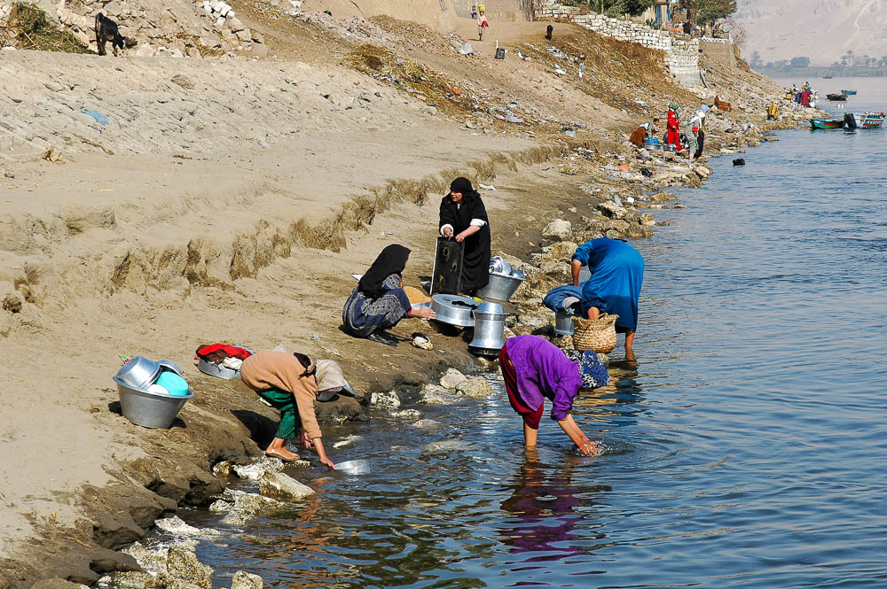
The daughter of Pharaoh came down to bathe at the river
Women washing clothing in the Nile River near Tell el-Amarna
2:5
Notes:
tb010905377

Slide 39
And she saw the basket among the reeds
Infant in a basket among the reeds of the Nile River
2:5
Notes:
This image was created using generative AI.

Slide 40
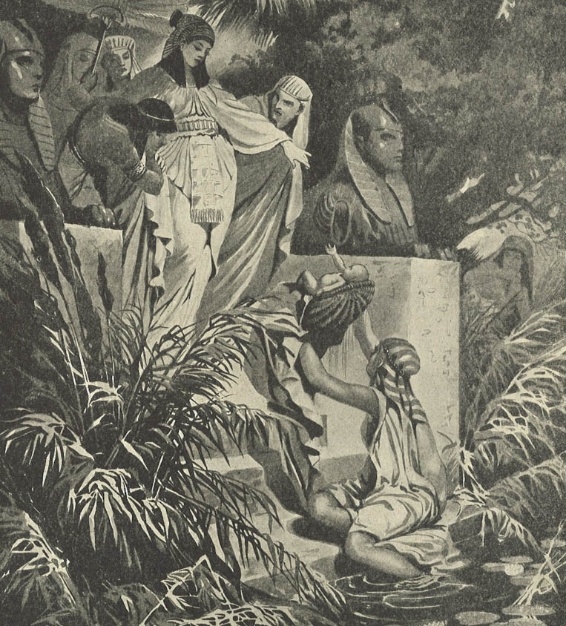
She sent her servant woman, and she brought it
Illustration of Pharaoh’s daughter finding the infant Moses
2:5
Notes:
This illustration comes from Charles Foster, Bible Pictures and What They Teach Us (1886, 1914).
fbp007a

Slide 41
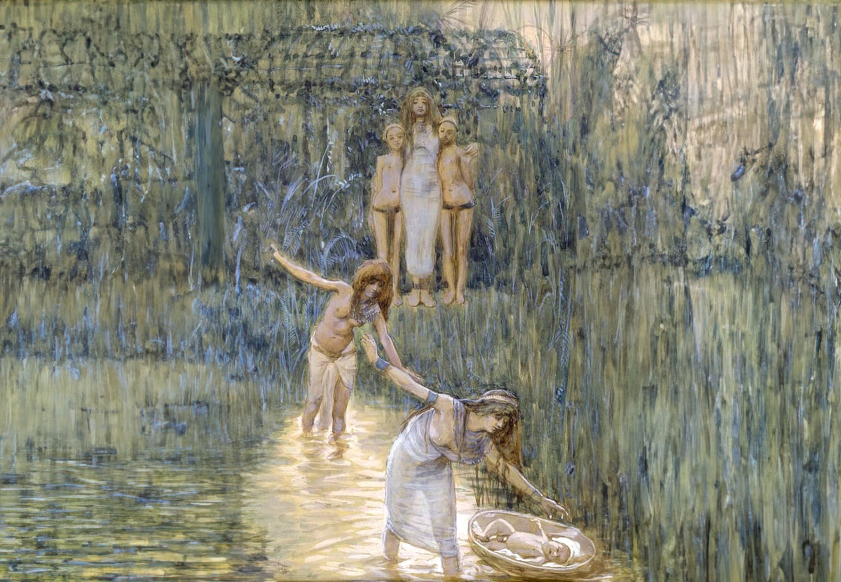
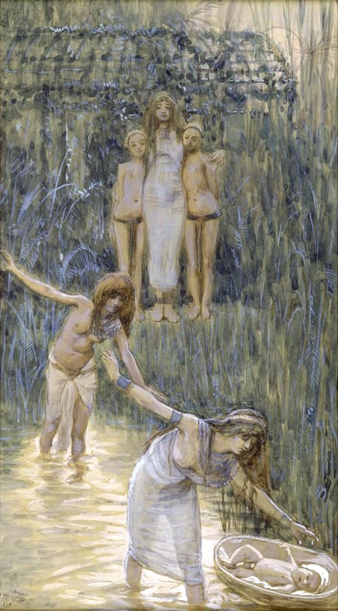
She sent her servant woman, and she brought it
Pharaoh's Daughter Has Moses Brought to Her, by James Tissot, circa 1899
2:5
Notes:
This image of a gouache on board painting is in the public domain, via The Jewish Museum: https://thejewishmuseum.org/collection/26332-pharaoh-s-daughter-has-moses-brought-to-her. Generative AI was used to extend the edges of this image; the original photo is available behind this image.
tjm26332

Slide 42
She opened it and saw the child, and the boy was crying, and she had compassion on him
Woman holding a crying infant in a basket
2:6
Notes:
This image was created using generative AI.
exod0206psai

Slide 43
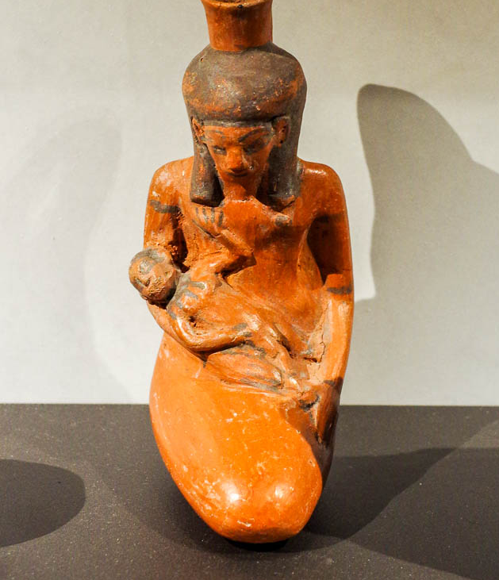
She opened it and saw the child, and the boy was crying, and she had compassion on him
Bottle in the form of a woman and infant, 18th dynasty, circa 1400 BC
2:6
Notes:
This ceramic bottle shaped like a woman with an infant was photographed at the National Museum of Antiquities (Rijksmuseum van Oudheden) in Leiden.
adr1805206348

Slide 44
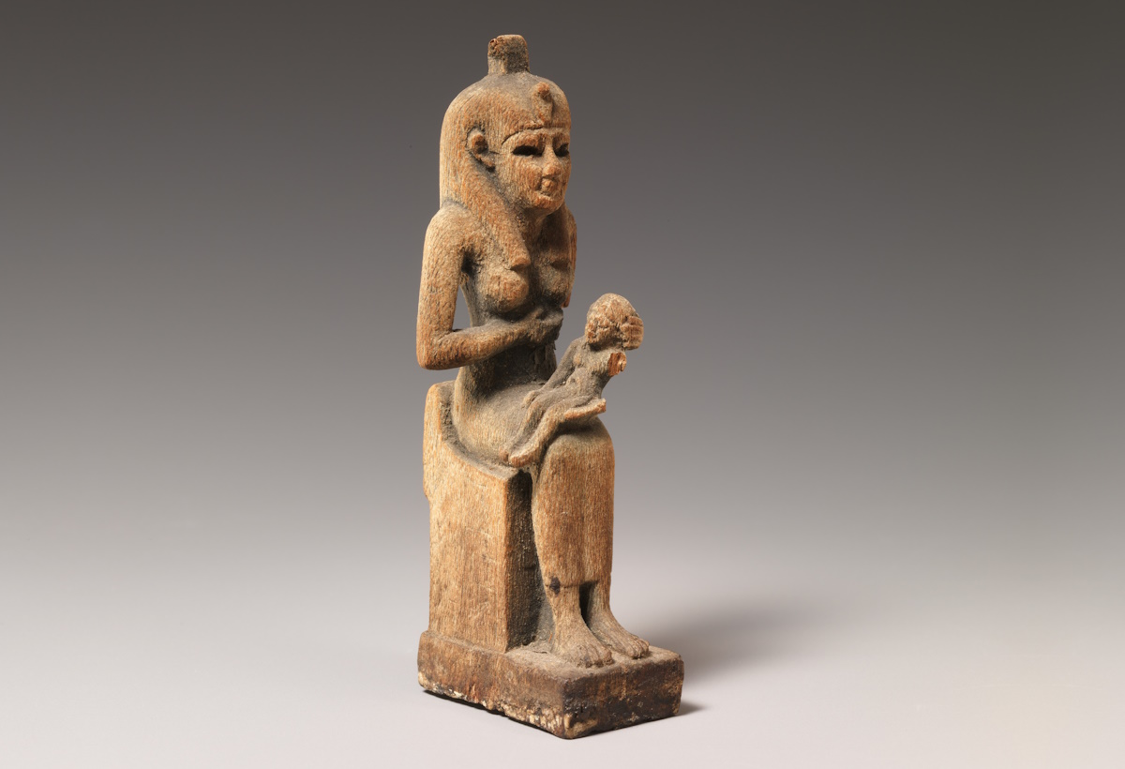
His sister then said to Pharaoh’s daughter, “Shall I . . . call a nurse of the Hebrew women”
Wooden statue of Isis nursing the infant Horus, from Egypt, 664–30 BC
2:7
Notes:
This image comes from The Metropolitan Museum of Art, public domain, Gift of James Douglas, 1890, accession number 90.6.149, www.metmuseum.org/art/collection/search/552072.
met552072

Slide 45
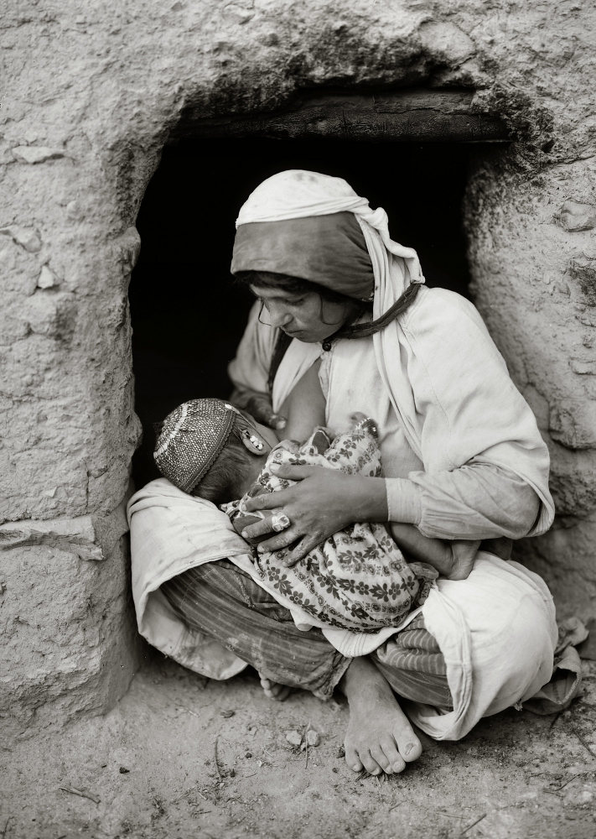
His sister then said to Pharaoh’s daughter, “Shall I . . . call a nurse of the Hebrew women”
Syrian woman nursing baby, circa 1925
2:7
Notes:
Nursing may have lasted around three years. This American Colony photograph was taken between 1898 and 1946.
mat07209

Slide 46
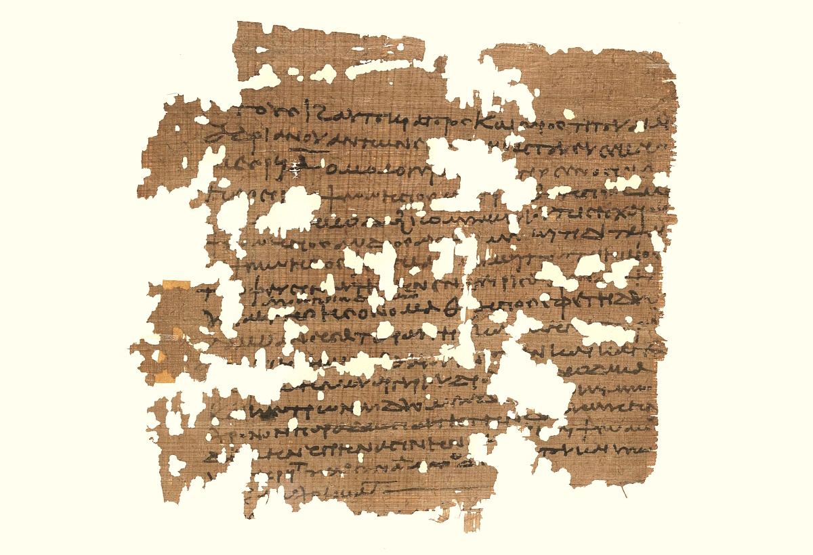
His sister then said to Pharaoh’s daughter, “Shall I . . . call a nurse of the Hebrew women”
Wet-nurse contract for a child found on a garbage dump, from Egypt, July 25, AD 154
2:7
Notes:
Although this papyrus contract is many centuries later than the time of Moses, it illustrates a similar situation in which a discarded child had been rescued by a compassionate person, who then secured the services of a woman as a wet nurse. According to the University website, the text of the papyrus reads as follows: "Year 17 of Emperor Caesar Titus Aelius Hadrian Antoninus Augustus Pius, Mesore 1. M..ter-Senosiris, a Persian, the daughter of Psennesis, her mother being Thaesis, aged 4x, with a scar on the left shoulder, with her guardian being her husband Pisechthis, the son of Psennesis, aged 45, agrees with Metis-Tapsais, the daughter of Psennesis, granddaughter of Ps..., her mother being Tbekis, to nurse the infant slave girl from the garbage dump, whose name is Thaesis, who was entrusted to her by her (Tapsais), for two years, receiving from her each month . . . twelve drachmae. . ."
This image comes from the University of Michigan, Advanced Papyrological Information System, and is in the public domain. Source: http://quod.lib.umich.edu/a/apis/x-5130/133r.tif
umapis13311924732154

Slide 47
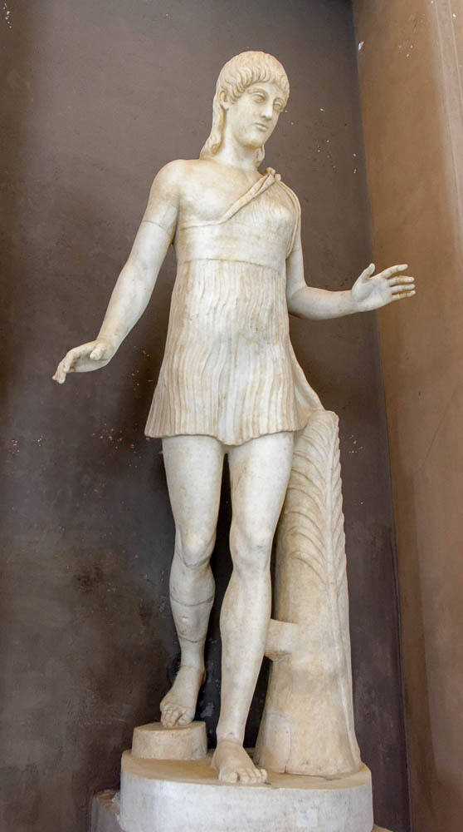
And Pharaoh’s daughter said to her, “Go”
Running girl statue, mid-1st century BC
2:8
Notes:
Although the Bible doesn’t say, we may imagine that Moses’s sister (Miriam) ran with haste to fetch her mother after being sent by Pharaoh’s daughter. This statue was created over a millennia later but shows a young woman running. It is the so-called Barberini Atalanta and was photographed at the Vatican Museums.
tb0512176992

Slide 48
And the girl went and called the child’s mother
Bedouin mother and swaddled baby, circa 1925
2:8
Notes:
This American Colony photograph was taken between 1898 and 1946.
mat05982

Slide 49
And Pharaoh’s daughter said unto her, “Take this child away and nurse it for me”
Pharaoh’s Daughter Receives the Mother of Moses, by James Tissot, circa 1899
2:9
Notes:
This image of a gouache on board painting is in the public domain, via the Jewish Museum: https://thejewishmuseum.org/collection/26333-pharaoh-s-daughter-receives-the-mother-of-moses.
tjm26333

Slide 50
So the woman took the child and nursed it
Limestone statuette of a woman nursing child, from Egypt, circa 1938–1756 BC
2:9
Notes:
This statue from the 12th–early 13th dynasty was photographed at the Brooklyn Museum.
adr1606023082

Slide 51
The child grew, and she brought him to Pharaoh’s daughter, and he became her son
Tablet from Nuzi with adoption decree, circa 1450–1350 BC
2:10
Notes:
No formal adoption ritual is noted in this text, although one might have been used. The tablet shown here records an adoption decree from Nuzi in Mesopotamia. It dates to approximately the time of Moses, although it originates in Mesopotamia, not Egypt. It was photographed at the Michael C. Carlos Museum at Emory University.
adr1511187999

Slide 52
The child grew, and she brought him to Pharaoh’s daughter, and he became her son
Nuzi tablet recording an adoption through land purchase, 14th century BC
2:10
Notes:
Adoption was a well-known practice in the ancient world. This tablet from the 2nd millennium BC records a case where a person needed to sell land in order to survive, but in order to keep the land within the “family,” a fictive father-son relationship was created through adoption. The adopted son (the buyer) “inherited” the land and gave a “gift” (payment for the land) to the father (the seller). This tablet was photographed at the Harvard Museum of the Ancient Near East.
tb072811221

Slide 53
The child grew, and she brought him to Pharaoh’s daughter, and he became her son
Amenhotep II sitting on his mother’s lap with feet on footstool of enemies, from Thebes
2:10
Notes:
This image comes from Émile Prisse d'Avennes, Histoire de l’Art Égyptien d’Après les Monuments, published in 1878. Public domain, from the New York Public Library, http://digitalcollections.nypl.org/items/510d47d9-68e1-a3d9-e040-e00a18064a99.
nypl87296

Slide 54
She called his name Moses, and said, “Because I drew him out of the water”
“Yoel Moshe Salomon Street” sign in Jerusalem
2:10
Notes:
Kitchen notes the common misinterpretation of the name Moses (Heb. Mosheh, משֶׁה) as coming from the Egyptian word ms (Mose), meaning “child of” or “son of” (cf. Amen-mose, Ptah-mose, Hor-mose, etc.). However, “The name of Moses is most likely not Egyptian in the first place! The sibilants do not match as they should . . . It is better to admit that the child was named (Exod. 2:10b) by his own mother, in a form originally vocalized Mashu, ‘one drawn out’ (which became Moshe, ‘he who draws out,’ i.e., his people from slavery, when he led them forth). In fourteenth/thirteenth century Egypt, ‘Mose’ was actually pronounced Masu, and so it is perfectly possible that a young Hebrew Mashu was nicknamed Masu by his Egyptian companions; but this is a verbal pun, not a borrowing either way” (Kitchen 2003: 297).
“Moshe” on the street sign shown here is the modern Hebrew pronunciation of “Moses.”
Reference:
Kitchen, Kenneth A.
2003 On the Reliability of the Old Testament. Grand Rapids: Eerdmans.
tb100102025

Slide 55
She called his name Moses, and said, “Because I drew him out of the water”
Stele of Thutmosis III wearing warrior crown and uraeus, 15th century BC
2:10
Notes:
As noted in the previous slide, it has been common for Moses’s name to be characterized as Egyptian, notwithstanding the explanation given for its meaning, which is not the Egyptian meaning of the word. Beegle goes so far as to suggest that this was due to the ignorance of the author himself. “The biblical writer apparently did not know that it was a shortened Egyptian name, but assuming that Pharaoh’s daughter knew Hebrew, he had her use popular etymology to base the name on the verb māšâ (‘to draw out’): ‘Because I drew him out of the water’ (Exod 2:10). The name actually stems from the Egyptian verb msy ‘to give birth’ and appears as ‘Mose’ with the name of a god: e.g., Tuthmosis ‘Toth is born’ and Rameses ‘Re is born.’ Since the Egyptians often shortened such names to “Mose,” it is implicit that “Moses” was longer at first, but there is no indication as to the deity involved” (Beegle 1992: 911).
Such a view is particularly problematic for those who accept Mosaic authorship of Exodus. In contrast to the “shortened name” view, Kitchen notes that “we have also very many Egyptians who were actually just called ‘Mose,” without omission of any particular deity. Most famous because of his family’s long lawsuit is the middle-class scribe Mose (of the temple of Ptah at Memphis), under Rameses II; but he had many homonyms. So, the omission-of-deity explanation is to be dismissed as wrong” (Kitchen 2003: 296–97).
References:
Beegle, Dewey M.
1992 Moses. Anchor Bible Dictionary, vol. 4, ed. D. N. Freedman. New York: Doubleday.
Kitchen, Kenneth A.
2003 On the Reliability of the Old Testament. Grand Rapids: Eerdmans.
tb061616777

Slide 56
When Moses had grown up, he went out to his people and looked on their burdens
Carpenters making furniture and a wooden statue, from Thebes, 15th century BC
2:11
Notes:
This painting comes from the tomb of Rekhmire at Thebes.
adr1603142971c

Slide 57
When Moses had grown up, he went out to his people and looked on their burdens
Painting of men making mudbricks, in the tomb of Rekhmire at Thebes, circa 1400 BC
2:11
Notes:
This Egyptian tomb painting depicts the main activities associated with making bricks. In the lower center, men use hoes to dig up the dry clay soil that will be the base for the bricks. On the far left, two men draw water from a pond, which will be mixed with the soil to create clay. At the upper right, two men mix water and soil in a pit to create a clay that is the right consistency for the bricks. At the upper center, to the right of the pond, a man lays out row after row of bricks using a wooden brick mold. This scene was photographed at the tomb of Rekhmire, who served as "Governor of the Town" and Vizier during the reigns of Thutmose III and Amenhotep II, circa 1400 BC. See the next slide for labels.
adr1603142961

Slide 58
When Moses had grown up, he went out to his people and looked on their burdens
mixing clay and water
forming bricks with a mold
drawing water
digging up dry clay
Painting of men making mudbricks, in the tomb of Rekhmire at Thebes, circa 1400 BC
2:11
Notes:
This Egyptian tomb painting depicts the main activities associated with making bricks. In the lower center, men use hoes to dig up the dry clay soil that will be the base for the bricks. On the far left, two men draw water from a pond, which will be mixed with the soil to create clay. At the upper right, two men mix water and soil in a pit to create a clay that is the right consistency for the bricks. At the upper center, to the right of the pond, a man lays out row after row of bricks using a wooden brick mold. This scene was photographed at the tomb of Rekhmire, who served as "Governor of the Town" and Vizier during the reigns of Thutmose III and Amenhotep II, circa 1400 BC. See the next slide for the continuation of this scene.
adr1603142961

Slide 59
When Moses had grown up, he went out to his people and looked on their burdens
Painting of men making mudbricks, in the tomb of Rekhmire at Thebes, circa 1400 BC
2:11
Notes:
This scene is the continuation of the scene shown on the previous slide. At the upper center, two men mix water and soil in a pit to create a clay that is the right consistency for the bricks. At the center is a stack of finished bricks, waiting for transport. Finally, at the far right, men carry off finished bricks, using shoulder yokes. Two foremen are visible; one is seated watching the men mixing clay, and the other is standing at the far right. Both foremen hold sticks. This scene was photographed at the tomb of Rekhmire, who served as "Governor of the Town" and Vizier during the reigns of Thutmose III and Amenhotep II, circa 1400 BC. See the next slide for labels.
adr1603142962

Slide 60
When Moses had grown up, he went out to his people and looked on their burdens
mixing clay and water
digging up dry clay
stack of completed bricks
transporting completed bricks
Painting of men making mudbricks, in the tomb of Rekhmire at Thebes, circa 1400 BC
2:11
Notes:
This scene is the continuation of the scene shown on the previous slide. At the upper center, two men mix water and soil in a pit to create a clay that is the right consistency for the bricks. At the center is a stack of finished bricks, waiting for transport. Finally, at the far right, men carry off finished bricks, using shoulder yokes. Two foremen are visible; one is seated watching the men mixing clay, and the other is standing at the far right. Both foremen hold sticks. This scene was photographed at the tomb of Rekhmire, who served as "Governor of the Town" and Vizier during the reigns of Thutmose III and Amenhotep II, circa 1400 BC.
adr1603142962

Slide 61
And he saw an Egyptian beating a Hebrew, one of his brothers
Tomb depiction of workers carrying wine and papyrus, from Thebes, 15th century BC
2:11
Notes:
This painting is from Thebes, from the reign of Thutmose III or early in the reign of Amenhotep II. Note the taskmaster with a rod on the right hand side.
adr1603142960c

Slide 62
And he saw an Egyptian beating a Hebrew, one of his brothers
Punishment of a slave by beating, from the tomb of Paheri at el-Kab, 15th century BC
2:11
Notes:
This relief shows an Egyptian slave being punished by thrashing.
adr1603226680

Slide 63
And he saw an Egyptian beating a Hebrew, one of his brothers
Prisoners beaten, from the mastaba of the vizier Mereruka, circa 2200 BC
2:11
Notes:
This relief from the tomb of the vizier Mereruka, second in command only to the king during the 6th Dynasty, shows one man being beaten and another being hauled away after a beating, perhaps to a prison. This image comes from Ovedc and is licensed under CC BY-SA 4.0, via Wikimedia Commons: https://commons.wikimedia.org/wiki/File:By_ovedc_-_Mastaba_of_Mereruka_-10.jpg.
wiki1005171415495312

Slide 64
And he saw an Egyptian beating a Hebrew, one of his brothers
Man being beaten, maybe for tax evasion, from the tomb of Menna, 14th century BC
2:11
Notes:
The upper register of this tomb painting depicts a man being beaten, perhaps for failure to pay his taxes. This is thought to have been a more common form of punishment in ancient Egypt than imprisonment. This tomb painting was photographed in the tomb of Menna, a scribe and “Overseer of Fields” during the reign of Amenhotep III. This image comes from Ovedc and is licensed under CC BY-SA 4.0, via Wikimedia Commons: https://commons.wikimedia.org/wiki/File:By_ovedc_-_Tomb_of_Menna_-_17.jpg.
wiki1010171206555312

Slide 65
And he saw an Egyptian beating a Hebrew, one of his brothers
Administration of Justice: court, trial, and penalty for the theft of an ox (facsimile)
2:11
Notes:
This illustration comes from Carlo Lasinio and Giuseppe Angelelli, I Monumenti dell'Egitto, published in 1832–1844. Public domain, from the New York Public Library, http://digitalcollections.nypl.org/items/510d47d9-4760-a3d9-e040-e00a18064a99. See the next slide for a box around the beating.
nypl425464

Slide 66
And he saw an Egyptian beating a Hebrew, one of his brothers
Administration of Justice: court, trial, and penalty for the theft of an ox (facsimile)
2:11
Notes:
This illustration comes from Carlo Lasinio and Giuseppe Angelelli, I Monumenti dell'Egitto, published in 1832–1844. Public domain, from the New York Public Library, http://digitalcollections.nypl.org/items/510d47d9-4760-a3d9-e040-e00a18064a99.
nypl425464

Slide 67
He struck down the Egyptian and hid him in the sand
Relief of Merneptah smiting his enemies, from Memphis, circa 1210 BC
2:12
Notes:
This relief was photographed at the Museum of Archaeology and Anthropology at the University of Pennsylvania.
tb072311798

Slide 68
He struck down the Egyptian and hid him in the sand
Spies being beaten, in the Egyptian camp at the Battle of Kadesh, 13th century BC
2:12
Notes:
This scene shows Hittite spies being beaten in the Egyptian camp. It was photographed at Abu Simbel in southern Egypt.
adr1603215722

Slide 69
He struck down the Egyptian and hid him in the sand
Moses Slays an Egyptian, by James Tissot, circa 1899
2:12
Notes:
This image of a gouache on board painting is in the public domain, via the Jewish Museum: https://thejewishmuseum.org/collection/26334-moses-slays-an-Egyptian. Generative AI was used to extend the edges of the image; the original photo is available behind this image.
tjm26334

Slide 70
He struck down the Egyptian and hid him in the sand
Excavated squares at Tell er-Retabeh
2:12
Notes:
tb010605638c

Slide 71
He went out the next day, and, behold, two Hebrew men were fighting
Wrestling and stick fighting scenes, at Medinet Habu, 12th century BC
2:13
Notes:
This scene depicts foreigners engaged in a sort of martial arts.
tb011105895

Slide 72
But he said, “Who made you a prince and a judge over us?”
Egyptian greywacke statuette of Sa-Hathor, Senior Judge of Hierakonpolis, circa 1800–1650 BC
2:14
Notes:
The role of a judge (Heb. shaphat, שָׁפַט) was well-known in Egypt at this time. The one who judged was viewed as a legitimate authority figure who could settle arguments and even execute judgments. The statue shown here illustrates the Egyptian practice of using a judge in a similar way, although at this time Moses did not occupy that office.
This image of 13th-dynasty depiction of an Egyptian judge comes from The Walters Art Museum, public domain, Acquired by Henry Walters, accession number 22.61, https://art.thewalters.org/detail/15557/standing-statuette-of-sa-hathor/.
twam15557

Slide 73
But he said, “Who made you a prince and a judge over us?”
Tomb painting of people bringing cases to a vizier for judgement, from Thebes, 15th century BC
2:14
Notes:
This painting depicts people bringing their cases to be heard by a vizier. The bottom row is of particular interest, as it depicts two men bowing to the ground as they plead their case (far left), and two others being led off for punishment (bottom row, center). This painting was photographed in the tomb of Rekhmire at Thebes.
adr1603142949c

Slide 74
But he said, “Who made you a prince and a judge over us?”
Group of princes of Rameses II, Hypostyle Hall rear wall at the Ramesseum, 13th century BC
2:14
Notes:
adr1603132830

Slide 75
Do you intend to kill me like you killed the Egyptian?
Dead companion of Odysseus, from the Odysseus-Polyphemus Group, 1st century BC
2:14
Notes:
This statue portrays a dead man who had accompanied the legendary Odysseus and was killed while trying to escape from the cyclops Polyphemus. It was photographed at the Ephesus Museum.
mjb010317518

Slide 76
Then Moses was afraid, and said, “Surely this thing has become known”
Decorative marble mask, from Pompeii, 1st century AD
2:14
Notes:
This marble mask vividly demonstrates the fear that Moses felt. It was photographed at the Pompeii Exhibit in the Nimes Museum.
tb092019572

Slide 77
When Pharaoh heard about this matter, he tried to kill Moses
Statue of an unidentified New Kingdom pharaoh, circa 1540–1200 BC
2:15
Notes:
The name of the king of Egypt at this time is not given. This statue was photographed at the Egyptian Museum in Cairo.
adr1603111721

Slide 78
When Pharaoh heard about this matter, he tried to kill Moses
Statue of Thutmose I, circa 1493–1483 BC
2:15
Notes:
Moses was 40 years old when he fled Egypt (so Acts 7:23, and inferred from his age of 80 years in Exod 7:7; so also his age of 120 years at death, Deut 34:7). According to the Early Date Exodus of 1445/1446 BC, he fled Egypt in about 1485 BC, forty years before the Exodus. If this is accepted, the pharaoh from whom Moses fled was most likely Thutmose I (1493–1483 BC; but see different chronological scheme in Merrill 2008: 78). This statue of Thutmose I was photographed at a special exhibit at the Rijksmuseum van Oudheden. This image comes from Sailko and is licensed under CC BY 3.0, via Wikimedia Commons: https://commons.wikimedia.org/wiki/File:Xviii_dinastia,_statua_seduta_di_thutmose_I,_da_karnak,_1493-1483_ac_ca._(museo_egizio)_02.jpg.
Reference:
Merrill, Eugene H.
2008 Kingdom of Priests: A History of Old Testament Israel. 2nd edition. Grand Rapids: Baker.
wiki0316171500342808688

Slide 79
When Pharaoh heard about this matter, he tried to kill Moses
Sarcophagus of Thutmose I, circa 1483 BC
2:15
Notes:
This sarcophagus was photographed at the Boston Museum of Fine Arts. This image comes from Miguel Hermoso Cuesta and is licensed under CC BY-SA 4.0, via Wikimedia Commons: https://commons.wikimedia.org/wiki/File:Boston_sarc%C3%B3fago_Tutmosis_I_01.jpg.
wiki0716161802475184705

Slide 80
When Pharaoh heard about this matter, he tried to kill Moses
Black granite statue of Seti I, from Egypt, circa 1280 BC
2:15
Notes:
According to the Late Date Theory, the Exodus took place sometime in the 13th century, although there is no consensus regarding a specific date. Hoffmeier writes, “If there is a prevailing view among historians, biblical scholars, and archaeologists, an exodus in the Ramesside era (1279–1213 B.C.) is still favored” (Hoffmeier 1997: 126). The Late Date view typically regards Rameses II as the pharaoh of the exodus, and Moses would have fled from one of his predecessors. This photograph shows Seti I, the father of Rameses. This statue of Seti I was photographed at the Dallas Museum of Art.
Reference:
Hoffmeier, James K.
1997 Israel in Egypt: The Evidence for the Authenticity of the Exodus Tradition. New York: Oxford University Press.
adr1710135598

Slide 81
When Pharaoh heard about this matter, he tried to kill Moses
Basalt stele of Seti I, from Beth Shean, 1295 BC
2:15
Notes:
This stele was photographed at the Israel Museum.
tb060316692

Slide 82
Then Moses fled from the presence of Pharaoh and lived in the land of Midian
Nile Delta
Moab
Edom
Sinai Peninsula
Midian
Gulf of Aqaba
Gulf of Suez
Satellite map of Egypt and the Sinai Peninsula, with the possible location of Midian
2:15
Notes:
The traditional homeland of the Midianites was east of the Gulf of Aqaba. However, the Midianites were present in a much broader area, and it is not certain that Moses crossed to the eastern side of the Gulf of Aqaba.
“The presence of Midianite shepherd bands in the Sinai should not be a problem since the discovery of the Mari documents. Large-scale sheepherding requires considerable travel between summer and winter pasturages, often involving tens or hundreds of kilometers. There is no plausible objection to the presence of shepherd bands in the Sinai who were identified or identified themselves as adherents of the political/cultural system of the Midianites. The same is true of populations in the Jordan valley just N of the Dead Sea. The Midianites can no longer be regarded naively as primitive nomadic barbarians; they were a complex and cosmopolitan civilization with a highly diverse economy and, in all probability, an extensive control system for a few decades that included parts of Palestine and Transjordan” (Mendenhall 1992: 817).
The distance Moses traveled when he fled Egypt would have been at least 200 miles (321 km), and depending on his exact place of departure and destination, might have been as much as 300 miles (483 km).
This image comes from Jeff Schmaltz and is in the public domain, via NASA: https://visibleearth.nasa.gov/view.php?id=64144.
Reference:
Mendenhall, George E.
1992 Midian. Anchor Bible Dictionary, vol. 4, ed. D. N. Freedman. New York: Doubleday.
nasa010620031300874

Slide 83
Then Moses fled from the presence of Pharaoh and lived in the land of Midian
Wadi Rum
2:15
Notes:
This outline of biblical events mentioning Midian and the Midianites is meant to demonstrate the wide territory (cities and regions are in bold) that is associated with the Midianites in the biblical record. In general, Midian and clans of Midianites seem to have been widely distributed throughout Transjordan, but especially in southern Transjordan and in northern Saudi Arabia (Hejaz region).
The Midianites are first mentioned in the genealogy of Abraham and Keturah (Gen 25:2-4; 1 Chr 1:31-34).
They appear in Transjordan (Moab) during the “reign” of Hadad the son of Bedad, who “smote Midian in the field of Moab” (Gen 36:35; 1 Chr 1:45-56).
They are mentioned together with the “Ishmaelites” as traders traveling from Transjordan to Egypt via the Jezreel Valley and Dothan in the Joseph narrative (Gen 37:27-28).
Moses fled to Midian “from the face of Pharaoh” following the killing of an Egyptian taskmaster (Exod 2:15). In Midian, Moses served as a shepherd for Jethro and married his daughter Zipporah (Exod 2:16-22; 3:1; 4:19; cf. Acts 7:29).
Jethro “the priest of Midian” brought Zipporah to Moses at Mount Sinai and advised him on dividing up the responsibilities of leadership (Exod 18:1).
Hobab, the son of Reuel/Jethro, desired to return to Midian from Mount Sinai, but then remained with Israel (Num 10:29-30).
During Balak’s request of Balaam to curse Israel, Moab met with the “elders of Midian” (Num 22:4).
Cozbi, the daughter of Zur (the tribal head of a father’s house in Midian), along with Zimri (of Simeon) were killed by Phinehas (priest) at Baal-peor (cf. Num 25:14).
Following this idolatry, Yahweh commanded Moses to attack Midian (Num 25:16-18; 26:1), which was carried out by sending a thousand men from each tribe resulting in the defeat of Midian and the bringing of spoil “to the camp at the plains of Moab, which are by the Jordan at Jericho” (Num 31:1-12). In the conflict, Moses killed Evi, Rekem, Zur, Hur, and Reba (as well as Balaam)—the chiefs of Midian (Num 31:8; Josh 13:21).
Midian oppressed Israel for seven years before and during the judgeship of Gideon (Judg 6:1-7). In the narrative (Judg 6–8), the Midianites (who were allied with the Amalekites and the Qedemites) are related to the central hill country (Ophrah—Judg 6:11), the Jezreel Valley (Judg 6:33; 7:1ff.; Ps 83:9; Isa 9:4) After their defeat, Gideon pursued the Midianites to the fords of the Jordan and the Ephraimites captured and killed Oreb and Zeeb, princes of Midian (Judg 7:24–8:3; Isa 10:26). Gideon continued to pursue Zebah and Zalmunna (kings of Midian) through the Jordan Valley but stopped to ask for sustenance at Succoth and then Penuel, who refused (Judg 8:4-9). Eventually, Gideon caught up to the Midianites and routed their army and captured Zeba and Zalmunna in Karkor (which has not been identified with certainty but was probably located in the northern portion of Ammon) before returning to Succoth and Penuel to punish the cities and execute Zeba and Zalmunna (Judg 8:10-21; cf. Judg 8:28; 9:17; cf. Ps 83:8-11).
Edomite Hadad fled to Egypt via Midian and Paran after the execution of the royal Edomite household by Joab (1 Kgs 11:17-18).
Among other references to the Gideon account (Isa 9:4; 10:26), Isaiah envisioned a day in which the “young camels of Midian and Ephrah” would cover Jerusalem (Isa 60:6).
Midian is mentioned alongside Cushan, Teman, and Paran in Habakkuk 3:7.
Midian is not mentioned outside of the Bible.
tb061504502

Slide 84
Then Moses fled from the presence of Pharaoh and lived in the land of Midian
Timna Valley (aerial view from the southeast)
2:15
Notes:
The Timna Valley is located just north of Eilat, the northern tip of the Gulf of Aqaba. The region was a source of copper in antiquity, and may have been exploited by the Midianites, among others.
ws031215721

Slide 85
Then Moses fled from the presence of Pharaoh and lived in the land of Midian
Timna Valley with acacia trees
2:15
Notes:
tb110902497

Slide 86
And he sat down by a well
Well of Moses at St. Catherine’s Monastery on Jebel Musa (traditional Mount Sinai)
2:15
Notes:
tb010610867

Slide 87
And he sat down by a well
Old well at Beersheba, circa 1913
2:15
Notes:
This American Colony photograph was taken between 1900 and 1926.
mat01381

Slide 88
The priest of Midian had seven daughters; and they came to draw water and filled the troughs
Women mourning and chantresses with three priests, from el-Kab, circa 1515 BC
2:16
Notes:
This painted relief is from the tomb of Renni.
adr1603226715c

Slide 89
The priest of Midian had seven daughters; and they came to draw water and filled the troughs
Women carrying water jars, circa 1910
2:16
Notes:
This American Colony photograph was taken between 1900 and 1920. Generative AI has been used to extend the edges of this image; the original photo is available behind this image.
mat00063psai

Slide 90
The priest of Midian had seven daughters; and they came to draw water and filled the troughs
Moses by the Well at Midian, by James Tissot, circa 1899
2:16
Notes:
This image of a gouache on board painting is in the public domain, via the Jewish Museum: https://thejewishmuseum.org/collection/26335-moses-by-the-well-at-midian. Generative AI was used to extend the edges of the image; the original photo is available behind this image.
tjm26335

Slide 91
The priest of Midian had seven daughters; and they came to draw water and filled the troughs
Well with pitcher and watering troughs at Tantur
2:16
Notes:
This photo of a reconstruction of a well was taken at the Biblical Gardens that were once located at Tantur, midway between Jerusalem and Bethlehem.
tbs79349402

Slide 92
The priest of Midian had seven daughters; and they came to draw water and filled the troughs
Sheep drinking from a trough in the Elah Valley
2:16
Notes:
tb050504629

Slide 93
The priest of Midian had seven daughters; and they came to draw water and filled the troughs
Horses drinking from a trough, relief in the tomb of Meryra at Tell el-Amarna, 1549–1292 BC
2:16
Notes:
This tomb dates to the 18th dynasty.
adr1603163646

Slide 94
And the shepherds came and drove them away
Bedouin shepherds of Syria, circa 1895
2:17
Notes:
This photochrom image was taken in the 1890s.
pcm02752

Slide 95
And the shepherds came and drove them away
Shepherd and flock in Wadi er-Raha, with Ras Safsafa in the background, circa 1910
2:17
Notes:
Ras Safsafa is the peak just south of Jebel Musa, the traditional Mount Sinai. This American Colony photograph was taken between 1900 and 1920.
mat02009

Slide 96
But Moses stood up and helped them and watered their flock
Moses Defends Jethro’s Daughters, by James Tissot, circa 1899
2:17
Notes:
This image of a gouache on board painting is in the public domain, via the Jewish Museum: https://thejewishmuseum.org/collection/26336-moses-defends-jethro-s-daughters.
tjm26336

Slide 97
But Moses stood up and helped them and watered their flock
Man pouring water for a camel, circa 1910
2:17
Notes:
This American Colony photograph was taken between 1900 and 1920.
mat10619

Slide 98
And when they came to Reuel, their father
Druze tomb of Nebi Shueib (in English, Jethro’s Tomb) near the Horns of Hattin (aerial view)
2:18
Notes:
Reuel seems to be an alternate name for Jethro (cf. Exod 3:1; Num 10:29). This traditional tomb of Jethro is located in the mountains of Galilee, west of Tiberias and the Sea of Galilee.
tbs123020011

Slide 99
And they said, “An Egyptian delivered us from the hand of the shepherds”
Wood statue of Per-her-nofret, from Kafr Ammar, 5th dynasty, circa 2465–2323 BC
2:19
Notes:
This figurine was photographed at the Berlin Egyptian Museum and Papyrus Collection.
adr070511993

Slide 100
He also drew water for us and watered the flock
Model of a man drawing water from a well
2:19
Notes:
This model was photographed at the Al Ain National Museum.
tb050717786

Slide 101
He also drew water for us and watered the flock
Man drawing water at a well, near Bethlehem (from the south), 1945
2:19
Notes:
This American Colony photograph was taken on March 1, 1945.
mat12606

Slide 102
He said to his daughters, “Call him, that he may have something to eat”
Making pita bread in the Sinai mountains
2:20
Notes:
tb062005831

Slide 103
So Moses was willing to live with the man, and he gave Moses Zipporah his daughter
Bedouin maiden, circa 1925
2:21
Notes:
The name Zipporah (Heb. צִפֹּרָה) means “small bird.” This American Colony photograph was taken between 1898 and 1946.
mat06065

Slide 104
So Moses was willing to live with the man, and he gave Moses Zipporah his daughter
Bridesmaids on a camel at a Bedouin wedding, circa 1910
2:21
Notes:
This American Colony photograph was taken between 1900 and 1920.
mat01336

Slide 105
So Moses was willing to live with the man, and he gave Moses Zipporah his daughter
“Zipporah Street” sign in Jerusalem
2:21
Notes:
“Zipporah Street” is located in the Baka neighborhood, south of the Old City.
lbd102318880

Slide 106
Then she gave birth to a son
Bedouin mother and baby, circa 1910
2:22
Notes:
This American Colony photograph was taken between 1900 and 1920.
mat02105

Slide 107
He called him Gershom, for he said, “I have been foreigner in a foreign land”
Wilderness south of Makhtesh Ramon
2:22
Notes:
The name Gershom (Heb. גֵּרְשֹׁם) means “a foreigner there.”
tb010403634

Slide 108
Now it came about during the course of those many days that the king of Egypt died
Tomb painting of a woman mourning as a mummy is prepared, from el-Kab, circa 1515 BC
2:23
Notes:
This painting was photographed at the tomb of Renni.
adr1603226717c

Slide 109
Now it came about during the course of those many days that the king of Egypt died
Oiling and bandaging a mummy, in an embalming workshop model, circa 1085 BC
2:23
Notes:
This 21st-dynasty model of an embalming workshop was photographed at the Field Museum in Chicago.
adr1506084729

Slide 110
Now it came about during the course of those many days that the king of Egypt died
Gold coffin of Tutankhamun, 14th century BC
2:23
Notes:
This famous coffin of a pharaoh was photographed at the Egyptian Museum in Cairo.
tb110900522

Slide 111
The sons of Israel groaned because of their slavery, and they cried out
Tomb painting of carpenters and leatherworkers, from Thebes, 15th century BC
2:23
Notes:
This painting is in the tomb of Rekhmire.
adr1603142983c

Slide 112
The sons of Israel groaned because of their slavery, and they cried out
Egyptian workers melting bronze and casting it in molds, from Luxor, 15th century BC
2:23
Notes:
Some of the Israelites were evidently trained in metalworking, as they had skills that were used later in the construction of the tabernacle and its furnishings. This relief shows various steps in the process of refining ore to metal in an Egyptian workshop. There are two sets of men who are working the bellows for furnaces, using foot-powered pumps similar to those discovered at Timna. This wall painting is located in the tomb of Rekhmire, the “Governor of the Town” at Thebes (modern Luxor).
adr1603142963c

Slide 113
The sons of Israel groaned because of their slavery, and they cried out
Israel in Egypt, by Edward Poynter, 1867
2:23
Notes:
This painting depicts Israelites as forced laborers, hauling a massive stone lion for one of the Egyptian temples. This painting was photographed at Guidhall Art Gallery in London. This image comes from Art Renewal Center and is in the public domain, via Wikimedia Commons: https://commons.wikimedia.org/wiki/File:1867_Edward_Poynter_-_Israel_in_Egypt.jpg.
wiki0514200702382767

Slide 114
And their cry for help because of their bondage came up to God
Ivory statuette of a bound Asiatic captive, from Egypt, circa 600 BC
2:23
Notes:
This ivory statuette depicts an Asiatic captive whose arms (now missing) were bound behind his back. Obviously the Hebrews were not kept bound continuously, for the whole point of their bondage was that they would work for the Egyptians. However, the threat of actual bondage, or even death, would have been continual. This image comes from the Metropolitan Museum of Art, public domain, Gift of J. Pierpont Morgan, 1917, http://metmuseum.org/art/collection/search/548237.
met548237

Slide 115
And their cry for help because of their bondage came up to God
Relief of two captives with bound arms, from the pyramid of Sahure, circa 2400 BC
2:23
Notes:
This relief depicts Asiatics who had been enslaved by the Egyptians a millennium before the time of Moses, illustrating that such activity was hardly new. This relief was photographed at the Neues Museum in Berlin. This image comes from ArchaiOptix and is licensed under CC BY-SA 4.0, via Wikimedia Commons: https://commons.wikimedia.org/wiki/File:Fragmentary_relief_from_the_pyramid_complex_of_pharaoh_Sahure_03.jpg.
wiki122014141626

Slide 116
And their cry for help because of their bondage came up to God
Marble relief of Roman collared slaves, from Smyrna, circa AD 200
2:23
Notes:
This relief was photographed at the Ashmolean Museum at the University of Oxford. This image comes from Jun and is licensed under CC BY-SA 2.0, via Wikimedia Commons: https://commons.wikimedia.org/wiki/File:Roman_collared_slaves_-_Ashmolean_Museum.jpg.
wiki02072010153136

Slide 117
So God remembered His covenant with Abraham, with Isaac, and with Jacob
Depiction of Abram going out to look at the stars
2:24
Notes:
God’s covenant with Abraham included both the promise that his descendants would be very many (Gen 15:5) and the promise that after they had been enslaved and oppressed by a foreign nation, God would bring them out with many possessions (Gen 15:13-14). This illustration comes from Adolf Hult, Bible Primer, Old Testament, For Use in the Primary Department of Sunday Schools (1919).
This image is in the public domain, via Wikimedia Commons: https://commons.wikimedia.org/wiki/File:Bible_primer,_Old_Testament,_for_use_in_the_primary_department_of_Sunday_schools_(1919)_(14779694194).jpg. Generative AI has been used to extend the edges of the image; the original photo is available behind this image.
wiki0730201419192834bpsai

Slide 118
So God remembered His covenant with Abraham, with Isaac, and with Jacob
Milky Way over the desert at Al Quaa, south of Abu Dhabi
2:24
Notes:
In Genesis 15:5, God promised Abram that his descendants would number as many as the stars. Telescopic lenses and long exposure photographs have allowed modern man to see many more stars than would have been visible to Abram with the naked eye. Still, it would have been apparent to Abram that he could never count the visible stars. This image comes from Chrdoerr and is licensed under CC BY-SA 4.0, via Wikimedia Commons: https://commons.wikimedia.org/wiki/File:Mesmerising_natural_beauty_-_the_milky_way_and_the_desert_at_Al_Quaa.jpg.
wiki05092021004452017

Slide 119
So God remembered His covenant with Abraham, with Isaac, and with Jacob
Street signs in Beersheba: “Abraham Our Father,” “Isaac Our Father,” “Jacob Our Father”
2:24
Notes:
Generative AI was used to extend the edges of this image; the original photo is available behind this image.
db7109238109psai

Slide 120
So God remembered His covenant with Abraham, with Isaac, and with Jacob
The Machpelah at Hebron (aerial view from the west)
2:24
Notes:
God initially made His covenant (commonly called the Abrahamic Covenant) with Abraham in Genesis 12:1-3. Throughout the book of Genesis, it is reiterated numerous times, including specifically to Isaac (Gen 26:24) and Jacob (Gen 28:13-15) from God Himself. According to the book of Genesis, Abraham, Isaac, Jacob, and their wives (except Rachel) were buried in the tomb of Machpelah in Hebron. This photo shows the traditional site, marked today by a structure built by King Herod in the 1st century BC. “A variety of evidence indicates the presence of several shaft tombs, dating to the Middle Bronze Age I and perhaps also the Iron Age, beneath the Haram and in its environs. . . No systematic examination of the remains under the building has ever been possible” because of Muslim worship at the site (Ofer 1993: 607).
Reference:
Ofer, Avi.
1993 Hebron. The New Encyclopedia of Archaeological Excavations in the Holy Land, vol. 2, ed. E. Stern. New York: Simon and Schuster.
ws022416036

Slide 121
And God saw the children of Israel, and He took notice of them
Inlaid glass eyes from a sculpture, from Egypt, circa 1500–1200 BC
2:25
Notes:
This display was photographed at the Hecht Museum at the University of Haifa.
ku0531231032356c

Slide 122
More than 6,200 slides in PowerPoint format. Available now from BiblePlaces.com.
Notes:
This is a free sample of the Exodus 2 presentation from the Photo Companion to the Bible. To purchase the full volume, visit https://www.bibleplaces.com/exodus/
The Photo Companion to the Bible is an image-rich resource for Bible students, teachers, and researchers. Just as a librarian stocks the shelves with as many relevant materials as possible, so we have tried to provide a broad selection of images. Our goal is that you will find in this “library” whatever it is you are looking for.
Credits: The primary creators of this presentation are Kris Udd, Steven D. Anderson, Chris McKinny, and Todd Bolen. The photographs have an individual file code which usually includes the initials of the photographer. Other images have additional credit or source information.
Updates: We plan to update this collection as we are able. We welcome your suggestions for improving this resource (photocompanion@bibleplaces.com). Purchasers of the Exodus volume are provided free, lifetime updates to the volume.
Copyright: This photo collection is protected by copyright law and may not be distributed without written permission from BiblePlaces.com. Slide notes should be treated as any other copyrighted written material, with credit given when quoting from these notes.
For more information, see our complete “Introduction to the Photo Companion to the Bible” online at https://www.BiblePlaces.com/Intro-Photo-Companion-Bible/. Here you will find more information about photo selection, explanatory notes, Bible translation, credit information, and copyright allowances.

