Slide 1
ESTHER 4
Notes:
This is a free sample of the Esther 4 presentation from the Photo Companion to the Bible. To purchase the full volume, visit https://www.bibleplaces.com/esther/
The Photo Companion to the Bible is an image-rich resource for Bible students, teachers, and researchers. Just as a librarian stocks the shelves with as many relevant materials as possible, so we have tried to provide a broad selection of images. Our goal is that you will find in this “library” whatever it is you are looking for.
Credits: The primary creators of this presentation are Steven D. Anderson, Kris Udd, and Todd Bolen. The photographs have an individual file code which usually includes the initials of the photographer. Other images have additional credit or source information.
Updates: We plan to update this collection as we are able. We welcome your suggestions for improving this resource (photocompanion@bibleplaces.com). Purchasers of the Esther volume are provided free, lifetime updates to the volume.
Copyright: This photo collection is protected by copyright law and may not be distributed without written permission from BiblePlaces.com. Slide notes should be treated as any other copyrighted written material, with credit given when quoting from these notes.
For more information, see our complete “Introduction to the Photo Companion to the Bible” online at http://www.BiblePlaces.com/Intro-Photo-Companion-Bible/. Here you will find more information about photo selection, explanatory notes, Bible translation, credit information, and copyright allowances.

Slide 2
ESTHER 4
This is a free sample of the Esther 4 presentation from the Photo Companion to the Bible. To purchase the full volume, visit https://www.bibleplaces.com/esther/ The Photo Companion to the Bible is an image-rich resource for Bible students, teachers, and researchers. Just as a librarian stocks the shelves with as many relevant materials as possible, so we have tried to provide a broad selection of images. Our goal is that you will find in this “library” whatever it is you are looking for. For more details (for this and every slide), see the Notes section below.
Notes:
This is a free sample of the Esther 4 presentation from the Photo Companion to the Bible. To purchase the full volume, visit https://www.bibleplaces.com/esther/
The Photo Companion to the Bible is an image-rich resource for Bible students, teachers, and researchers. Just as a librarian stocks the shelves with as many relevant materials as possible, so we have tried to provide a broad selection of images. Our goal is that you will find in this “library” whatever it is you are looking for.
Credits: The primary creators of this presentation are Steven D. Anderson, Kris Udd, and Todd Bolen. The photographs have an individual file code which usually includes the initials of the photographer. Other images have additional credit or source information.
Updates: We plan to update this collection as we are able. We welcome your suggestions for improving this resource (photocompanion@bibleplaces.com). Purchasers of the Esther volume are provided free, lifetime updates to the volume.
Copyright: This photo collection is protected by copyright law and may not be distributed without written permission from BiblePlaces.com. Slide notes should be treated as any other copyrighted written material, with credit given when quoting from these notes.
For more information, see our complete “Introduction to the Photo Companion to the Bible” online at http://www.BiblePlaces.com/Intro-Photo-Companion-Bible/. Here you will find more information about photo selection, explanatory notes, Bible translation, credit information, and copyright allowances.

Slide 3
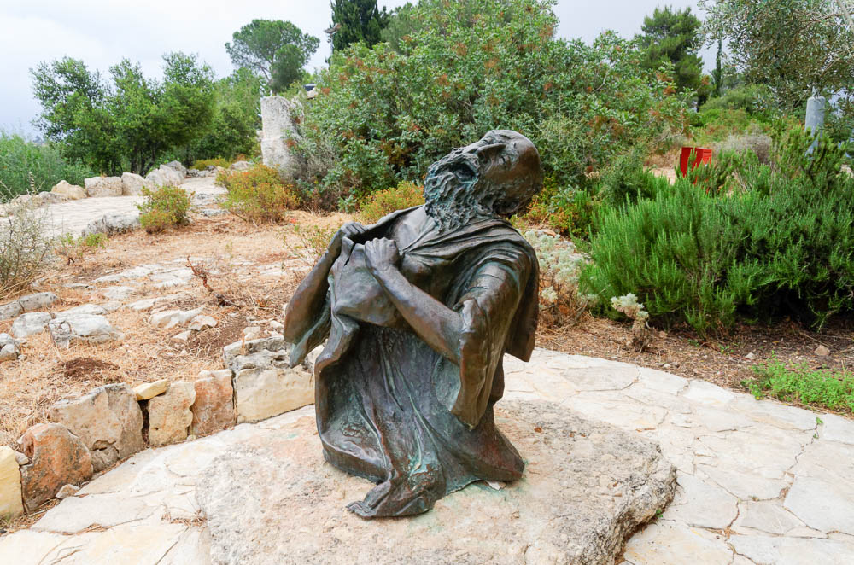
Mordecai tore his clothes and put on sackcloth with ashes
Bronze sculpture of a prophet tearing his garment
4:1
Notes:
Tearing one’s clothes was a dramatic expression of great grief. This photo of a prophet was taken at Yad HaShmonah Biblical Gardens, in the Judean hills west of Jerusalem.
tb052816710

Slide 4
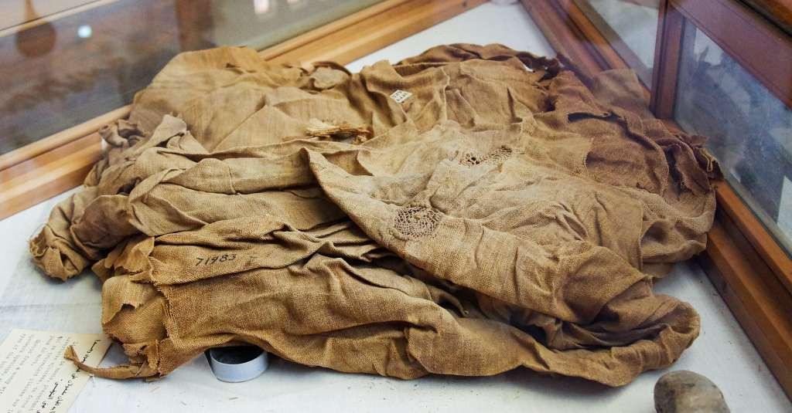
Mordecai tore his clothes and put on sackcloth with ashes
Sackcloth mummy shroud from Egypt, with eye openings
4:1
Notes:
Sackcloth was rough fabric that was usually used to make sacks, not clothing. It is somewhat similar to modern burlap. It is also interesting that the Hebrew word is saq (שַׂק), a word that has been borrowed into the English language. Ancient fabrics are rarely preserved over thousands of years. This example of ancient sackcloth was photographed at the Egyptian Museum in Cairo.
adr1603194652

Slide 5
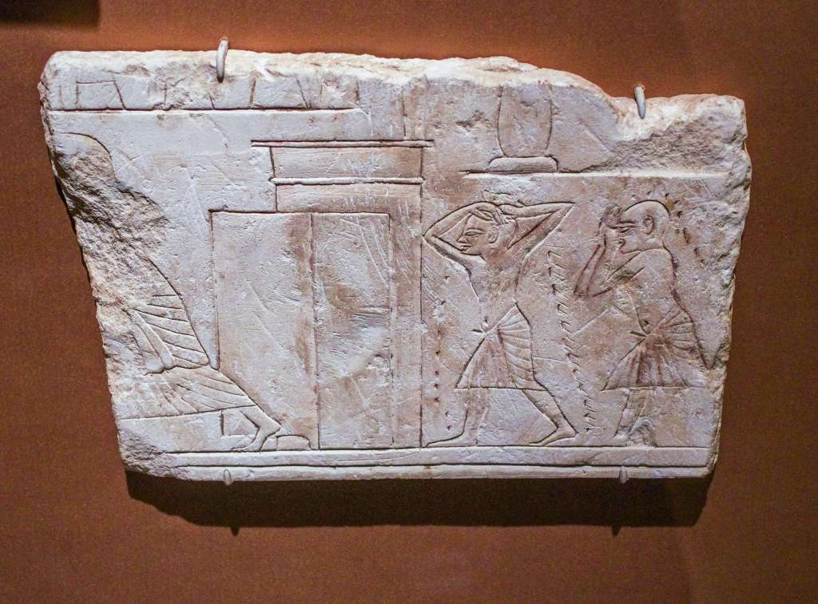
Mordecai tore his clothes and put on sackcloth with ashes
Mourners before a tomb with dust or ashes on their heads, from Saqqara, 14th century BC
4:1
Notes:
This limestone carving dates to the late 18th dynasty. It is a very rare depiction of the practice mentioned in this verse. It was photographed at the Brooklyn Museum.
adr1606023463

Slide 6
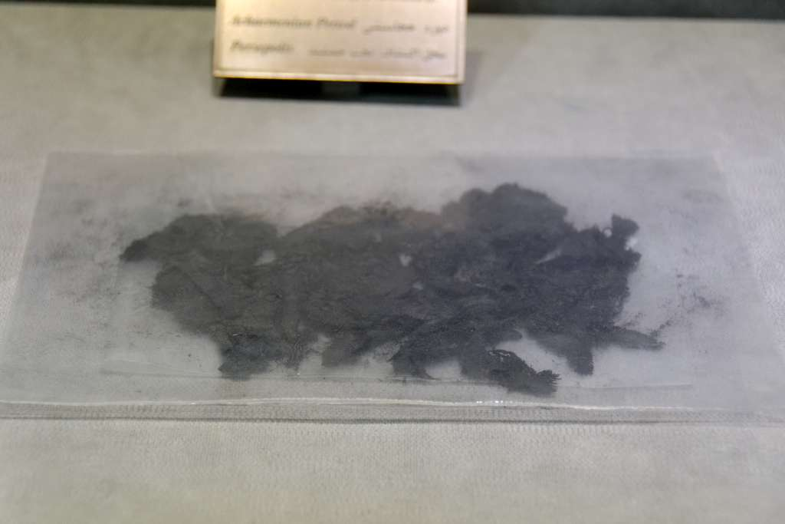
Mordecai tore his clothes and put on sackcloth with ashes
Remnants of burnt material, ash, from Persepolis, 5th–4th centuries BC
4:1
Notes:
This is not the most attractive photo, but it does show ash from the Persian empire, at close to the same time when Mordecai was putting ash on himself. This display was photographed in the Persepolis Museum.
tb0506181563

Slide 7
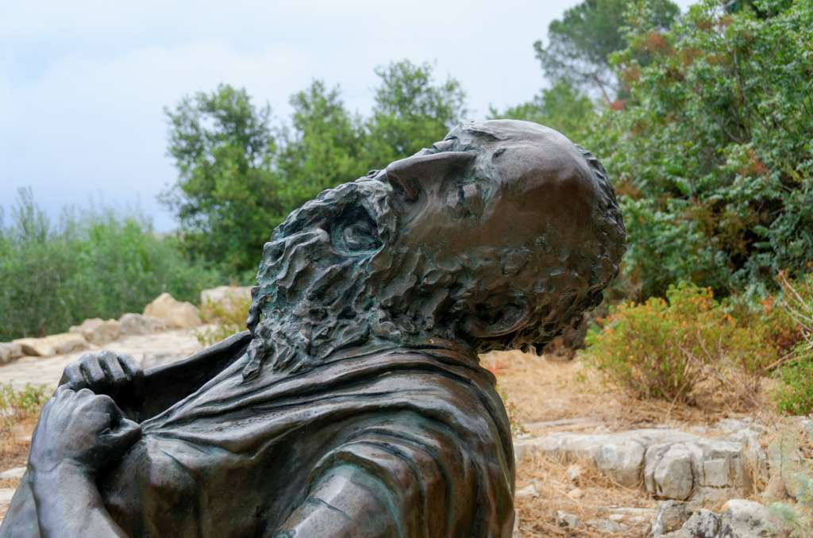
And he cried out with a loud and bitter cry
Bronze sculpture of a prophet tearing his garment
4:1
Notes:
This photo was taken at Yad HaShmonah Biblical Gardens, in the Judean hills west of Jerusalem.
tb052816713

Slide 8
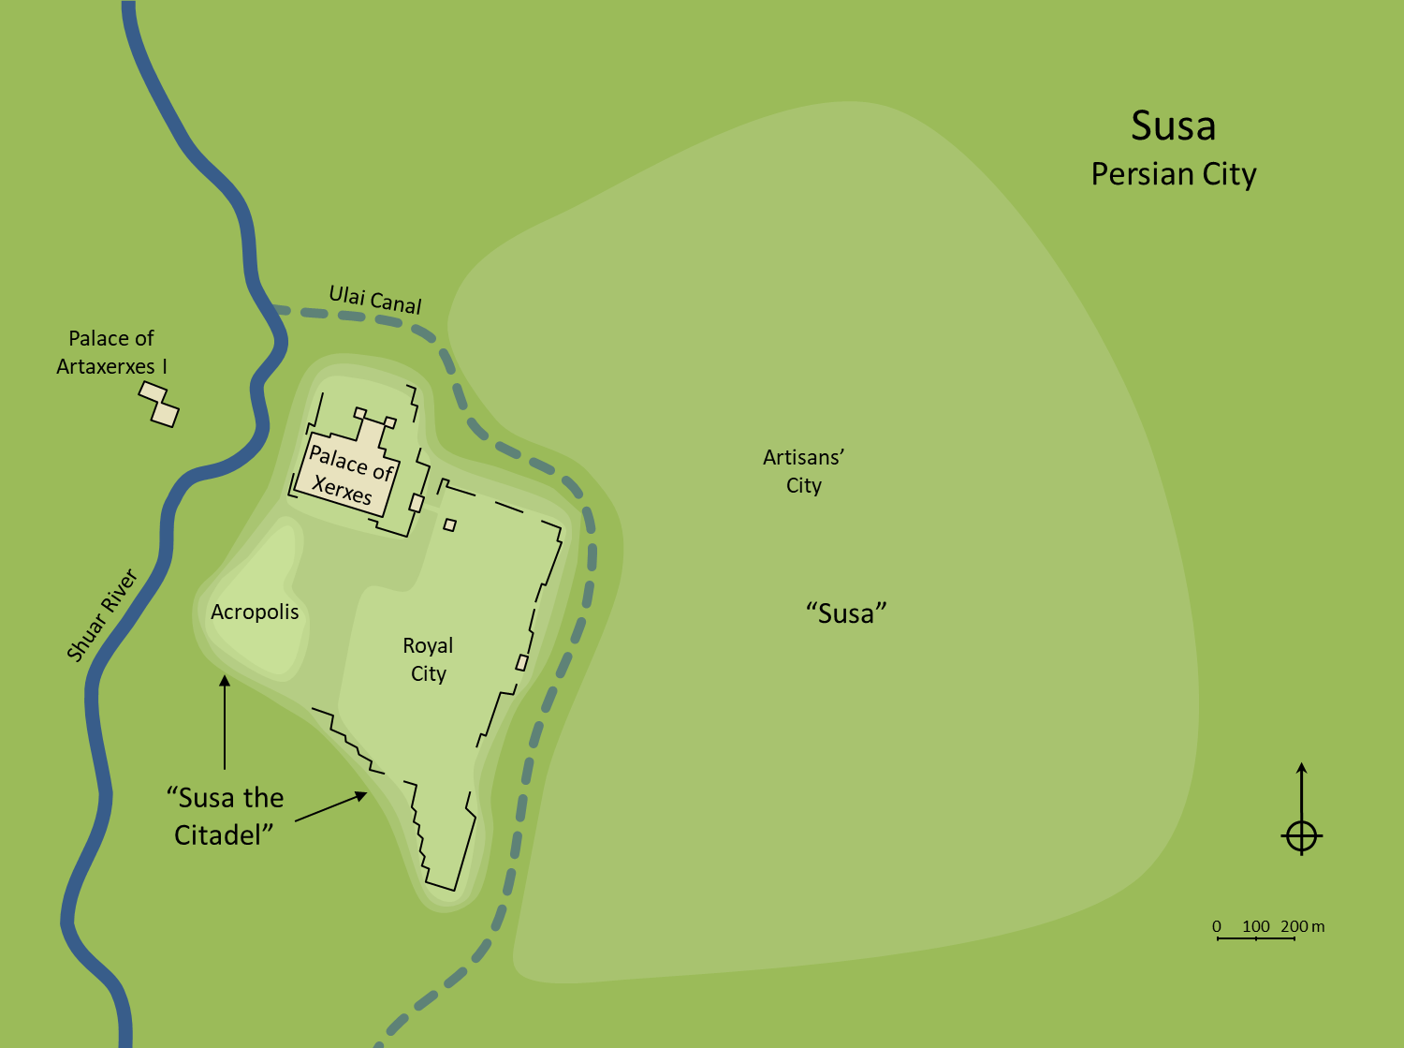
And he went out into the midst of the city
Susa
Persian City
Ulai Canal
Palace of Artaxerxes I
Palace of Xerxes
Artisans’ City
Shuar River
Acropolis
“Susa”
Royal City
“Susa the Citadel”
0
100
200 m
The royal city, Ulai Canal, and lower city of Susa (from the south)
4:2
Notes:
It is not stated explicitly whether the reference here is to the royal city next to the palace, or across the Ulai Canal in the workmen’s city. Given that Mordecai held an official position in the city gate, it seems most likely that his residence was in the royal city, and that this was where he began his mourning. An editable version is included beneath the graphic for those who wish to modify it.
Plan by Kris Udd.

Slide 9
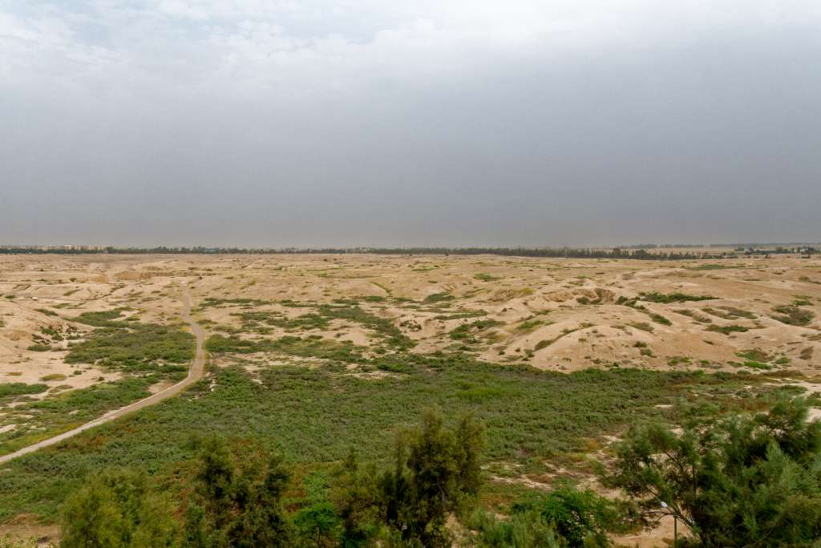
And he went out into the midst of the city
Remains of the royal city of Susa (from the west)
4:2
Notes:
This photo of the royal city was taken from the French castle on the northern end of the acropolis. The palace complex is out of view to the left (north), while the main area visible in this photo is what remains of the royal city.
tb0508182352

Slide 10
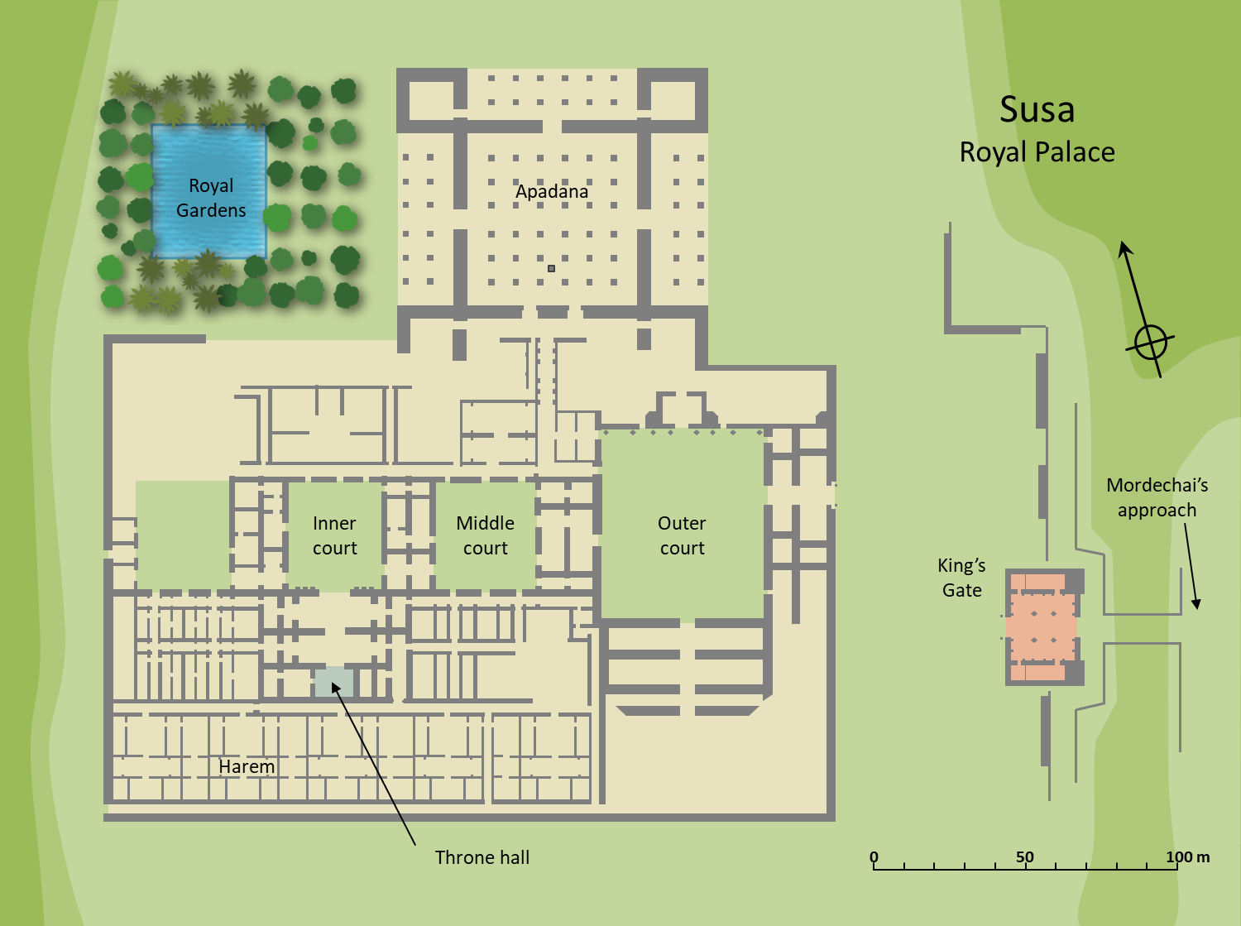
He went as far as the King’s Gate, for no one was to enter the King’s Gate clothed in sackcloth
Susa
Royal Palace
Royal Gardens
Apadana
Mordechai’s approach
Inner court
Middle court
Outer court
King’s Gate
Harem
Throne hall
0
50
100 m
Plan of the royal palace at Susa with the King’s Gate
4:2
Notes:
Mordecai was unable to enter the King’s Gate because of his state of mourning, so the nearest he was able to come was the edge of the palace compound, across the moat to the east. An editable version is included beneath the graphic for those who wish to modify it.
Plan by Kris Udd.

Slide 11
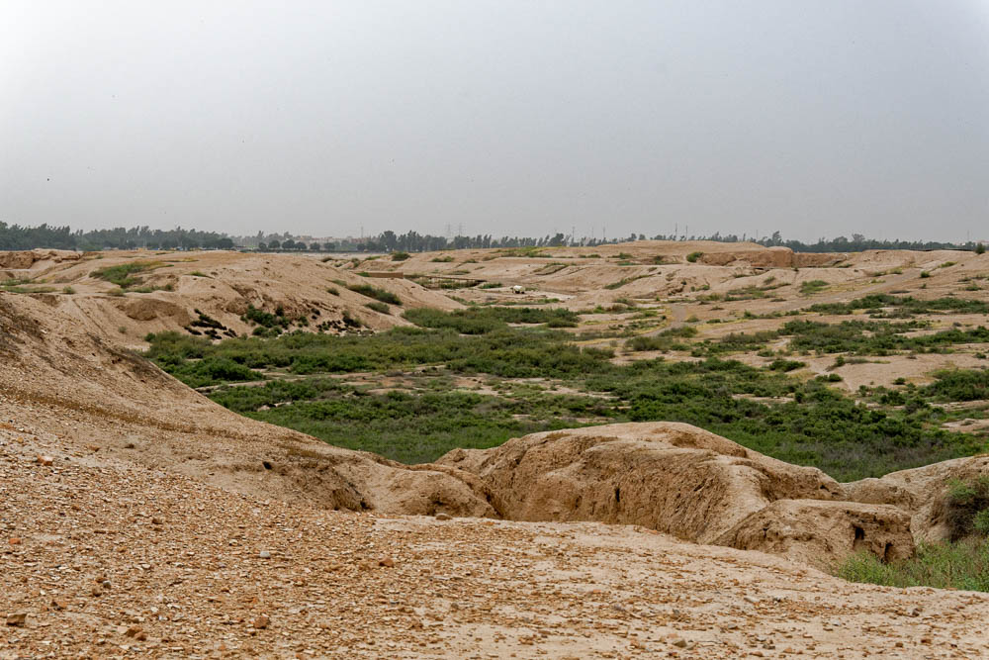
He went as far as the King’s Gate, for no one was to enter the King’s Gate clothed in sackcloth
The King’s Gate and royal city of Susa, with moat between (from the southwest)
4:2
Notes:
Mordecai’s approach to the King’s Gate would have been from the east, as far as the now-dry moat that separated the royal city from the palace complex. See the next slide for labels.
tb0508182373

Slide 12
He went as far as the King’s Gate, for no one was to enter the King’s Gate clothed in sackcloth
Royal palace
“Royal City”
King’s Gate
Dry Moat
Acropolis
The King’s Gate and royal city of Susa, with moat between (from the southwest)
4:2
Notes:
Mordecai’s approach to the King’s Gate would have been from the east, as far as the now-dry moat that separated the royal city from the palace complex.
tb0508182373

Slide 13
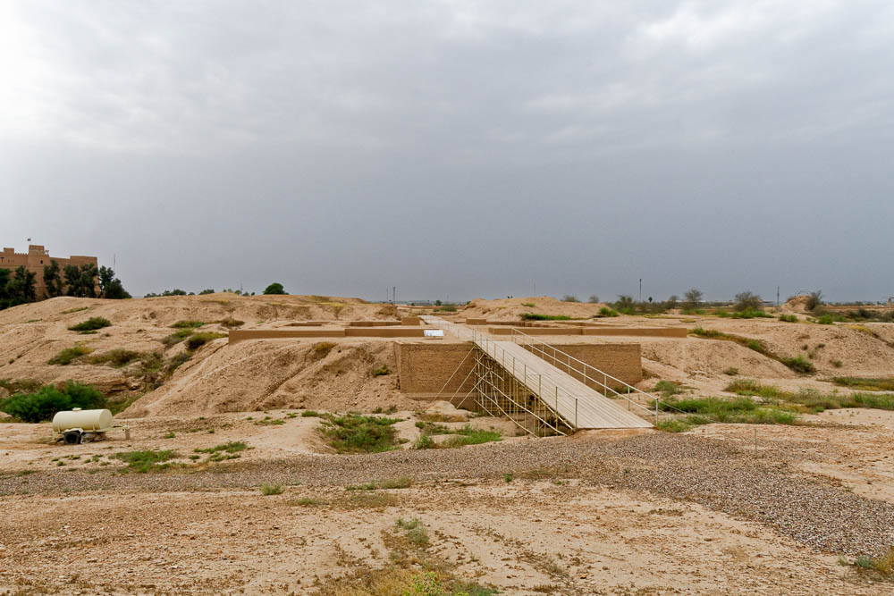
He went as far as the King’s Gate, for no one was to enter the King’s Gate clothed in sackcloth
King’s Gate at Susa (from the east)
4:2
Notes:
A moat separated the palace terrace from the rest of the city of Susa. The modern bridge replaces an ancient causeway made of mudbrick that was 96 feet (30 m) long and 54 feet (16 m) wide at the base. Mordecai approached as far as the area seen here in the foreground, but likely did not cross the bridge to the King’s Gate, since Esther’s messengers came to him in the “city square” (Esth 4:6).
tb0508182261

Slide 14
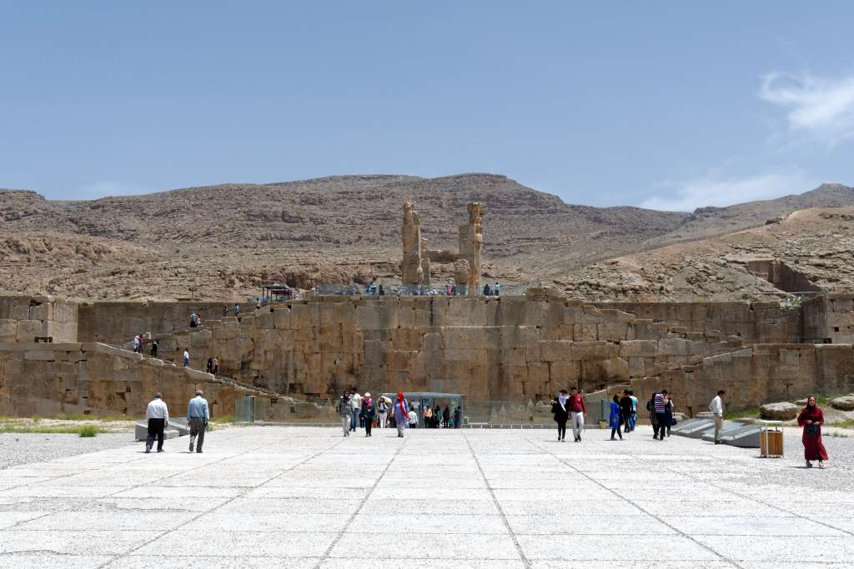
He went as far as the King’s Gate, for no one was to enter the King’s Gate clothed in sackcloth
Gate of All Lands (Gate of Xerxes) at Persepolis with staircase (from the west)
4:2
Notes:
The King’s Gate at Susa may have borne some resemblance to the Gate of All Lands at Persepolis, though without the monumental staircase.
tb0506180713

Slide 15
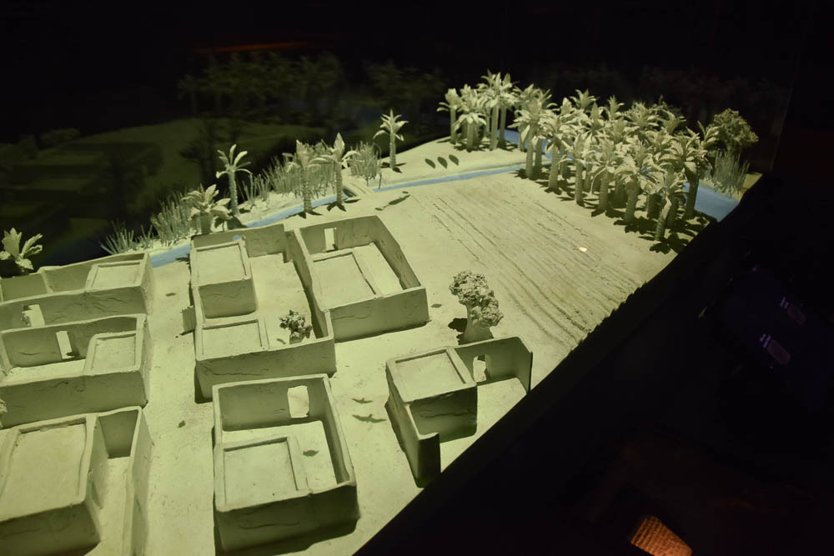
In every province, wherever the king’s commandment and decree came
Model of a Judean village occupied by exiles in Babylonia
4:3
Notes:
This model was photographed at the Bible Lands Museum in Jerusalem.
mjb1903102926

Slide 16
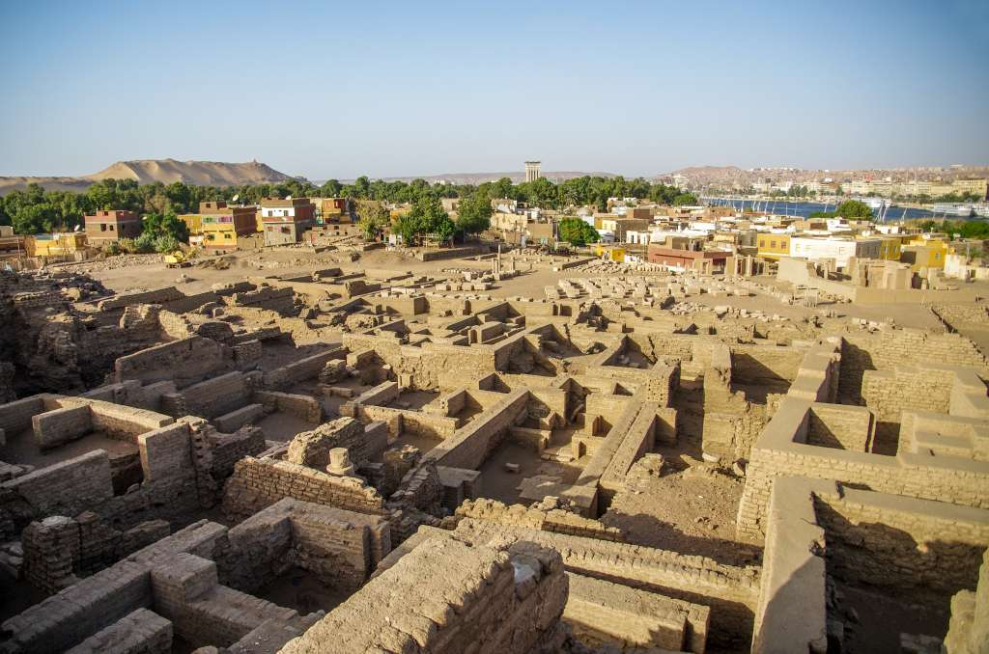
In every province, wherever the king’s commandment and decree came
Ancient residential area on Elephantine Island in southern Egypt
4:3
Notes:
Elephantine Island in southern Egypt was home to a sizable Jewish community, which presumably was a remnant population of the Jews who fled to Egypt after the destruction of Jerusalem.
adr1603205608

Slide 17
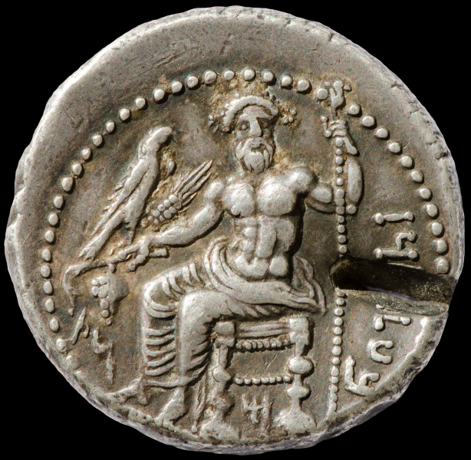
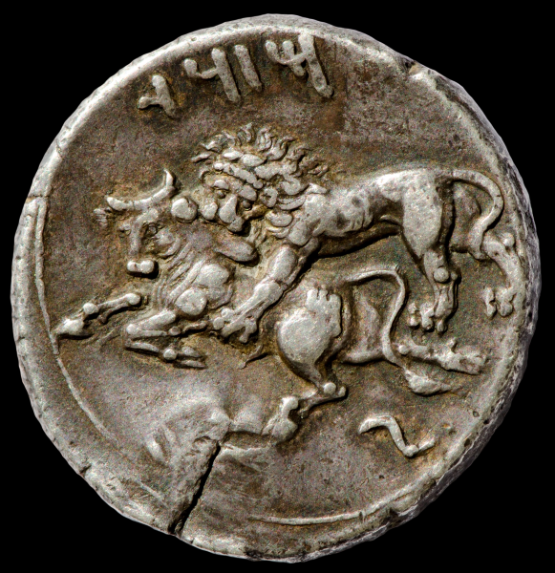
In every province, wherever the king’s commandment and decree came
Silver stater, minted in Tarsus, 361–334 BC
4:3
Notes:
Another area to which the king’s command would have come was the area of Tarsus, the future home of the Jewish apostle Paul. This coin from Tarsus dates to the period when it was under Persian rule. The obverse contains the Aramaic inscription “Baal of Tarsus” (בעל תרז) and depicts Baal holding grapes, an ear of grain, an eagle in his right hand, and a scepter in his left hand. Below the throne is the letter “M” (מ); to the left are the letters NṢ (נצ). The reverse depicts a lion attacking a bull and is inscribed “Mazaios” (מזדי), satrap of Cilicia from 361 to 334 BC. Note that the script used here is the Imperial Aramaic script. This coin is in the Jared James Clark Collection.
Obverse (left): tb0713158819b; reverse (right): tb0713158823b

Slide 18
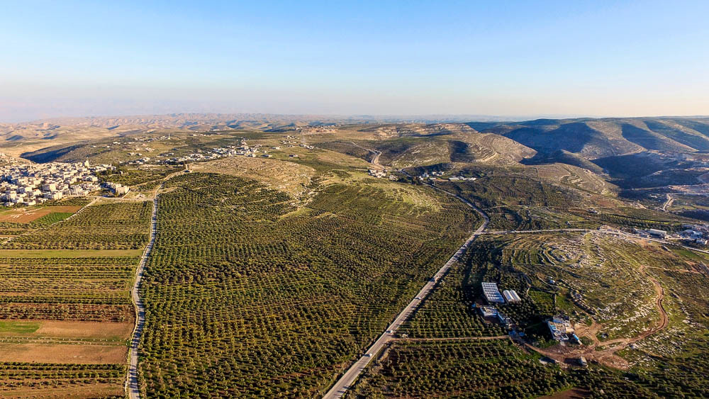
In every province, wherever the king’s commandment and decree came
Tekoa in the hill country of Judah (aerial view from the northwest)
4:3
Notes:
Tekoa, a village on the border of the Judean wilderness, was reoccupied after the exile (Neh 3:5, 27). Word of the decree would have reached this area as well.
ws022416054

Slide 19
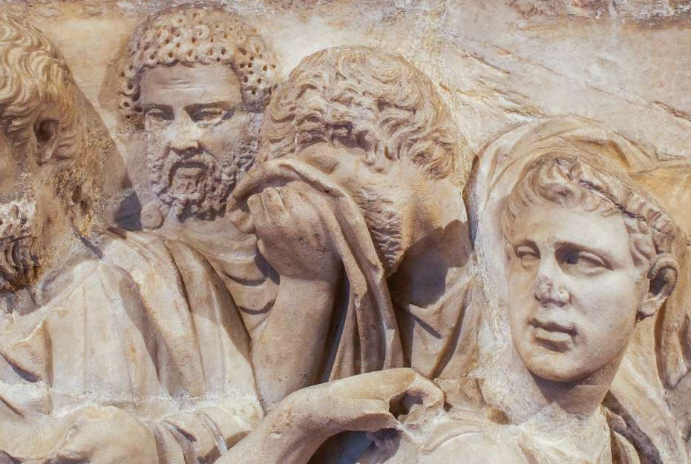
There was great mourning among the Jews, with fasting and weeping and wailing
Roman sarcophagus fragment with mourners grieving the deceased, circa AD 150
4:3
Notes:
This mourning scene from a marble sarcophagus was photographed at the Metropolitan Museum of Art.
adr1606034429

Slide 20
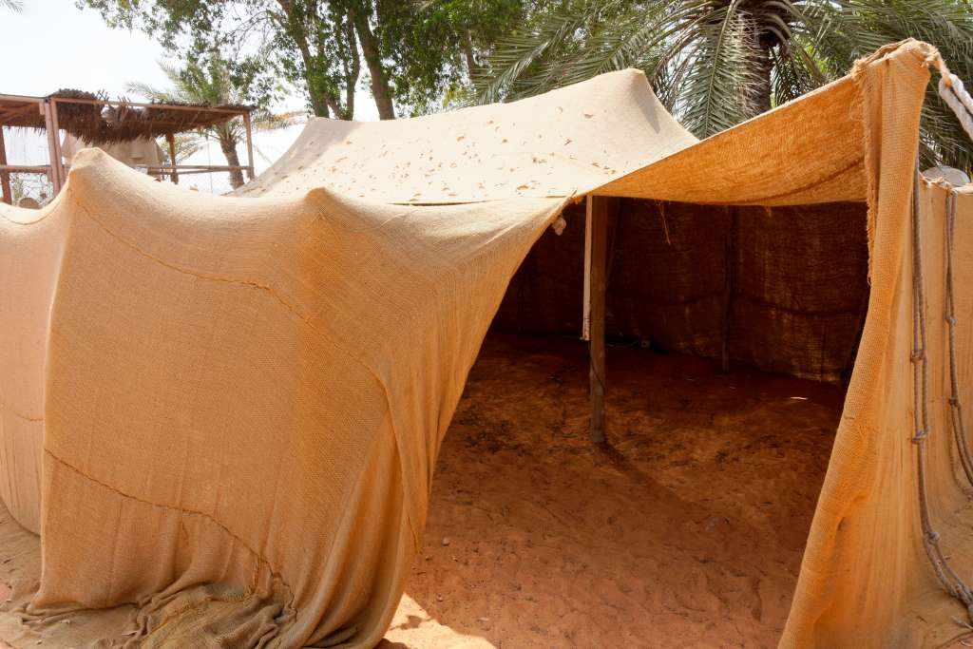
Many lay on sackcloth and ashes
Sackcloth house
4:3
Notes:
The rough material from which the tent is constructed is similar to the sackcloth that Jews of the diaspora put on. This tent was photographed at the United Arab Emirates Heritage Village in Abu Dhabi.
tb051017150

Slide 21
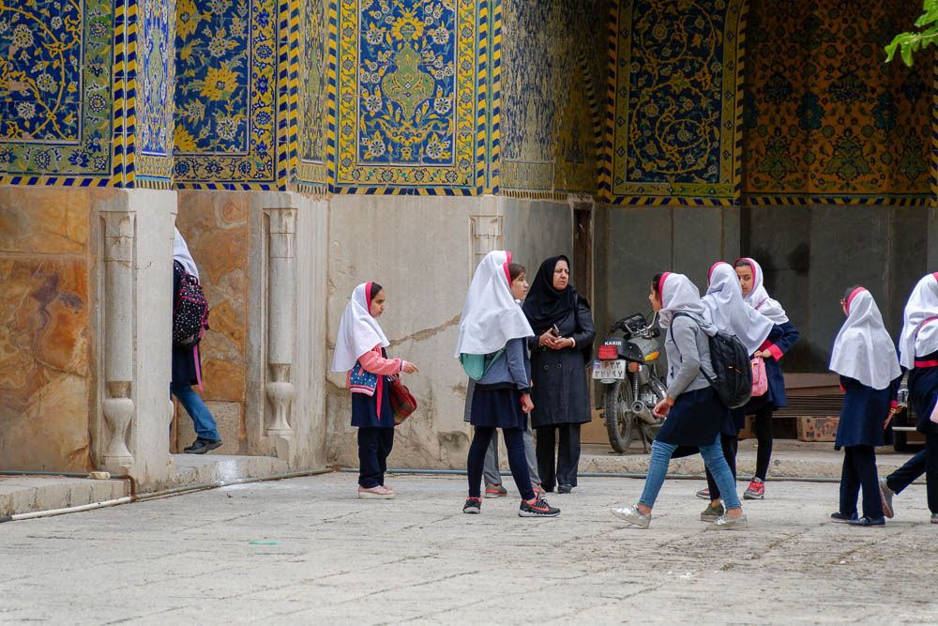
Esther’s maidens and her eunuchs came and told her
Girls in the Royal Mosque in Isfahan
4:4
Notes:
Mordecai’s arrival at the King’s Gate made his anguish very public and was probably intended also to catch Esther’s attention, which it did.
tb0512183248

Slide 22
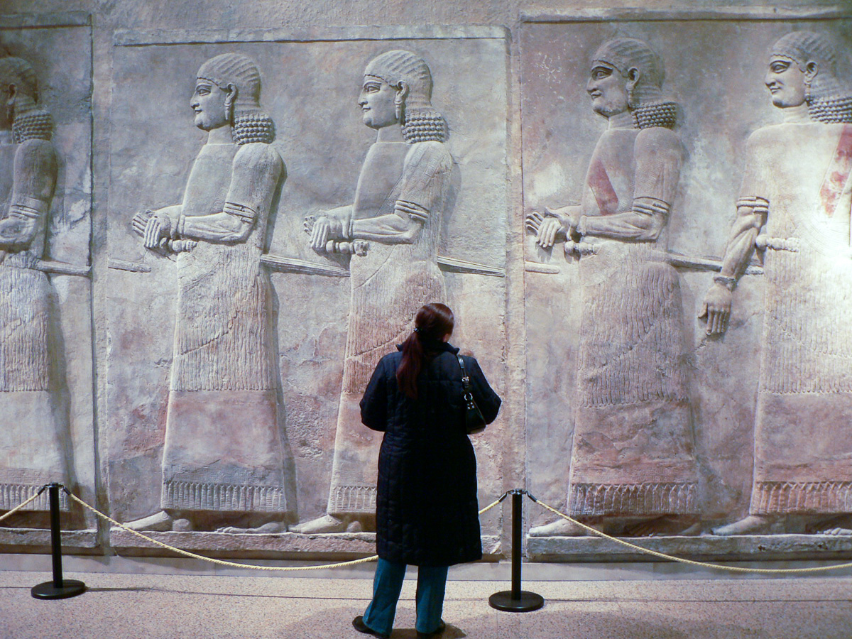
Esther’s maidens and her eunuchs came and told her
Painted relief of eunuchs, from the façade of the throne room in Khorsabad, 8th century BC
4:4
Notes:
This depiction of Assyrian court eunuchs comes from the palace of Sargon II at Khorsabad. It was photographed at the Oriental Institute Museum at the University of Chicago.
adr060218016

Slide 23
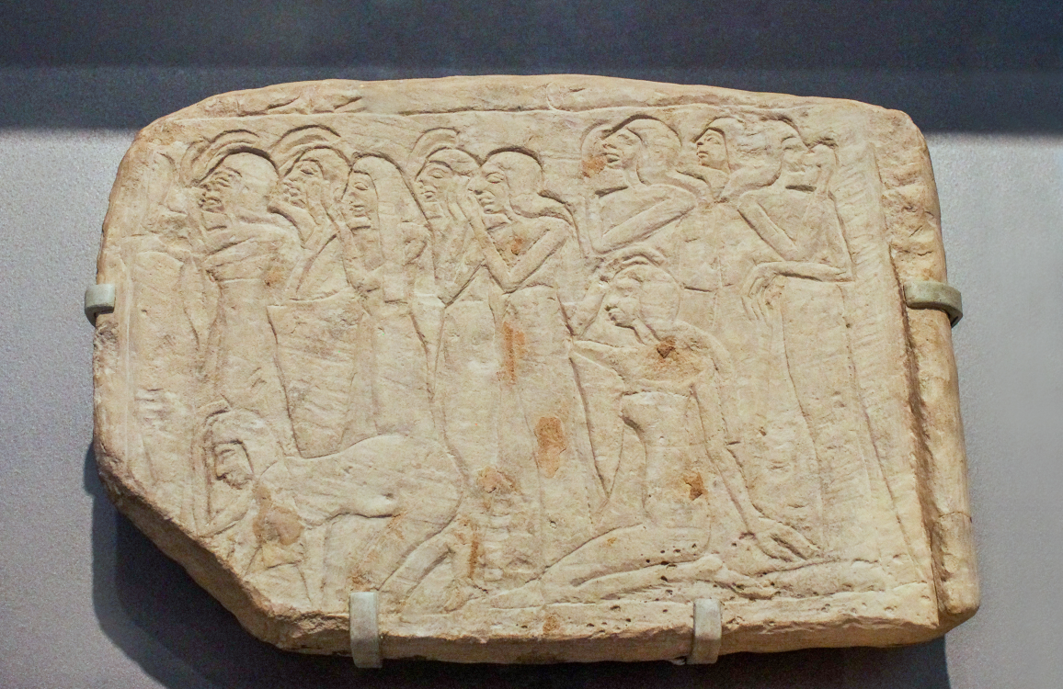
And the queen was deeply distressed
Depiction of mourning women in Egypt, 13th century BC
4:4
Notes:
The women in this relief are depicted in stances typical of mourning: faces uplifted, hands raised or on their heads, and some kneeling. They illustrate the deep distress of Esther. This relief was photographed at the Brooklyn Museum in New York.
adr1606023090

Slide 24
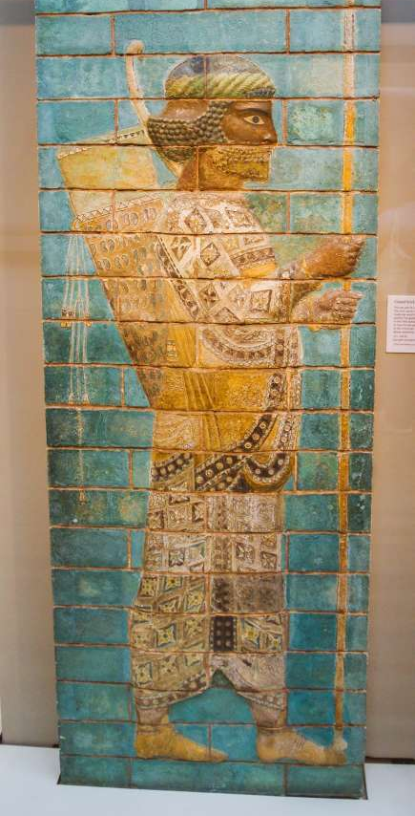
She sent garments to clothe Mordecai
Glazed brick guardsman, from Susa, 521–500 BC
4:4
Notes:
The fine and colorful clothing of this guard from Susa gives some idea of the kind of clothing that Mordecai would have worn at his post at the King’s Gate. This is probably similar to what Esther had sent out to him. Esther’s offer of clothing was may have been intended to allow Mordecai to enter the palace and inform her or her messenger about what was grieving him. This depiction of a well-dressed Persian was photographed at the British Museum.
adr1805171107

Slide 25
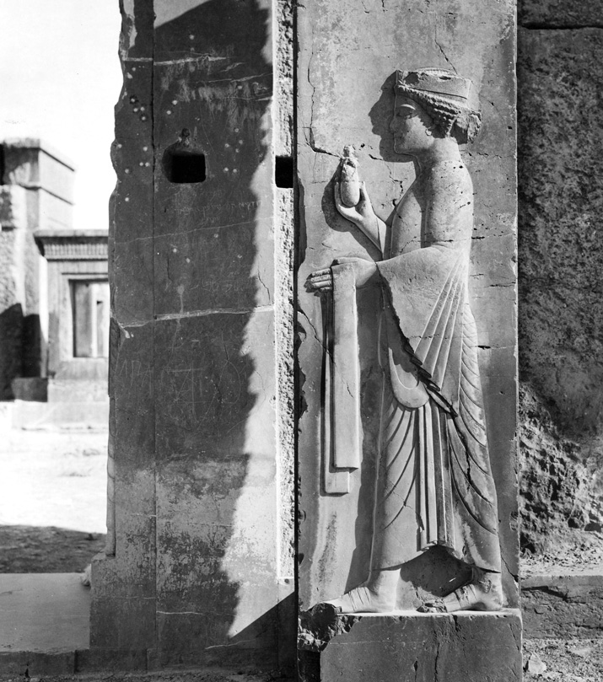
Then Esther called for Hathach, one of the king’s eunuchs
Eunuch holding a towel and perfume bottle, from Persepolis, circa 500 BC
4:5
Notes:
This carved relief depicts a eunuch that was nearly contemporary with the time of Esther. This image is used with permission of the Special Collections Research Center, University of Chicago Library. For more details, see http://photoarchive.lib.uchicago.edu/db.xqy?one=apf3-01795.xml.
chic3017952381701897

Slide 26
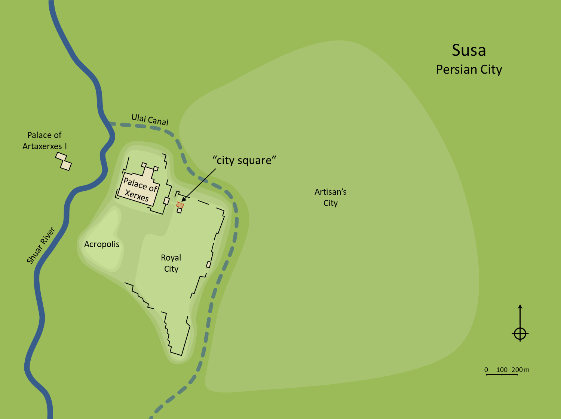
Hathach went out to Mordecai in the square of the city in front of the King’s Gate
Susa
Persian City
Ulai Canal
Palace of Artaxerxes I
“city square”
Palace of Xerxes
Artisan’s City
Shuar River
Acropolis
Royal City
0
100
200 m
Plan of the royal city, Ulai Canal, and lower city of Susa
4:6
Notes:
The “city square” (Heb. rechob, רְחֹב) was an open space or plaza. In later periods (e.g., Greco-Roman), most cities were laid out in such a way that the center of town was a market-place with large open areas for conducting business. That was not the case in Persian cities. Rather, this plaza was located directly across the moat from the King’s Gate. It seems to have been used for ceremonial activities related to the palace, but in an area that was more public and more visible to the broader populace. An editable version is included beneath the graphic for those who wish to modify it.
Plan by Kris Udd.

Slide 27
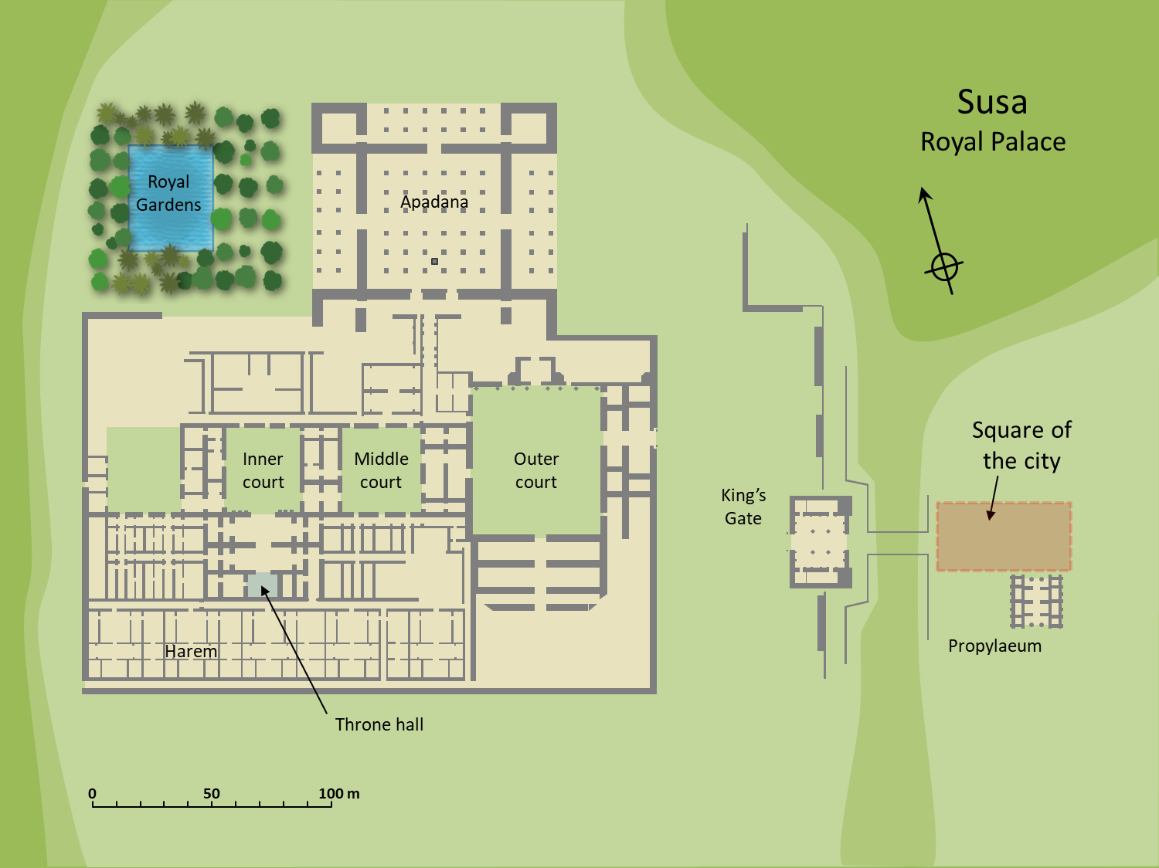
Hathach went out to Mordecai in the square of the city in front of the King’s Gate
Susa
Royal Palace
Royal Gardens
Apadana
Square of the city
Inner court
Middle court
Outer court
King’s Gate
Harem
Propylaeum
Throne hall
0
50
100 m
Plan of the royal palace at Susa with the square of the city
4:6
Notes:
Mordecai was unable to enter the King’s Gate because of his state of mourning, so the nearest he was able to approach was the edge of the royal city, across the moat to the east of the King’s Gate. The “city square” was situated between the King’s Gate and the Propylaeum, a monumental gate that provided access to the King’s Gate from across the moat. An editable version is included beneath the graphic for those who wish to modify it.
Plan by Kris Udd.

Slide 28
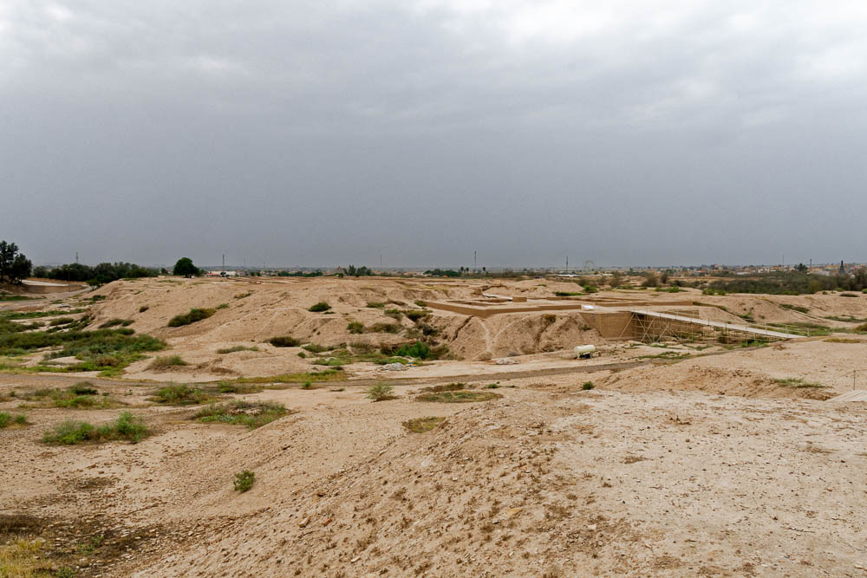
Hathach went out to Mordecai in the square of the city in front of the King’s Gate
Royal terrace, King’s Gate, and moat at Susa (from the east)
4:6
Notes:
The city square was located across the moat from the King’s Gate. See the next slide for labels.
tb0508182268

Slide 29
Hathach went out to Mordecai in the square of the city in front of the King’s Gate
Royal palace
King’s Gate
City Square
Dry moat
“Royal City”
Royal terrace, King’s Gate, and moat at Susa (from the east)
4:6
Notes:
The city square was located across the moat from the King’s Gate.
tb0508182268

Slide 30
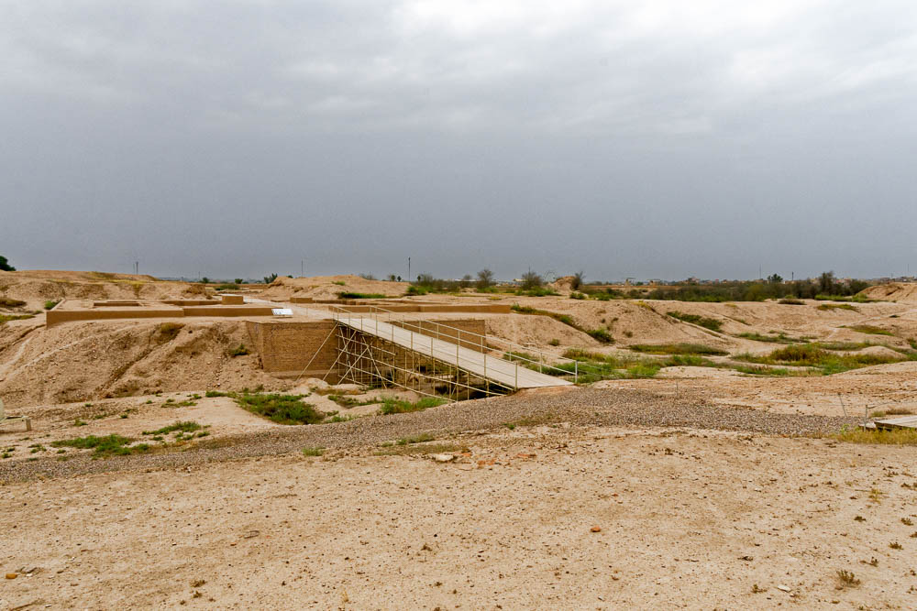
Hathach went out to Mordecai in the square of the city in front of the King’s Gate
City square, moat, and King’s Gate at Susa (from the southeast)
4:6
Notes:
See the next slide for labels.
tb0508182262

Slide 31
Hathach went out to Mordecai in the square of the city in front of the King’s Gate
Royal palace
King’s Gate
Dry moat
City Square
City square, moat, and King’s Gate at Susa (from the southeast)
4:6
Notes:
tb0508182262

Slide 32
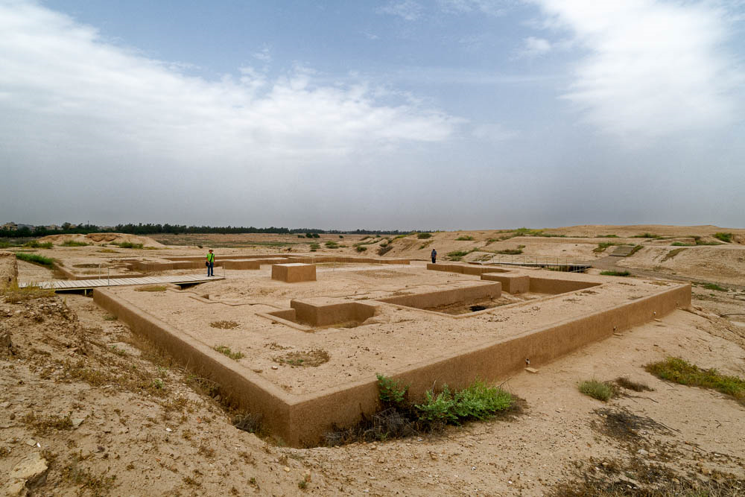
Hathach went out to Mordecai in the square of the city in front of the King’s Gate
King’s Gate, dry moat, and city square at Susa (from the east)
4:6
Notes:
The city square was located across the moat from the King’s Gate. The next slide includes labels.
tb0508182268

Slide 33
Hathach went out to Mordecai in the square of the city in front of the King’s Gate
Propylaeum
Square of the City
King’s Gate
Dry moat
King’s Gate, dry moat, and city square at Susa (from the east)
4:6
Notes:
The city square was located across the moat from the King’s Gate.
tb0508182268

Slide 34
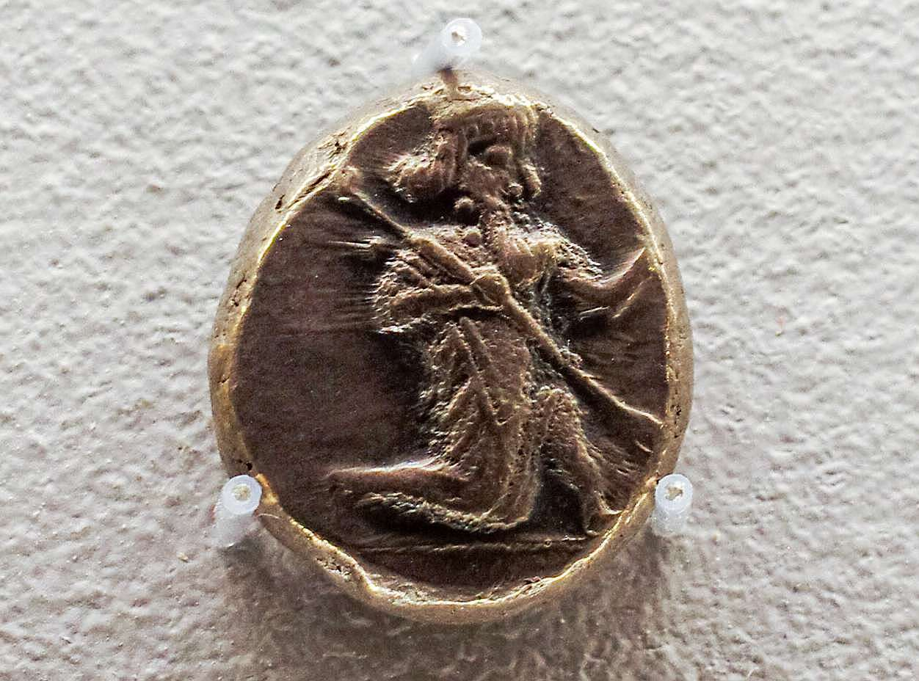
Mordecai told him . . . the exact sum of money that Haman had promised to pay
Silver siglos of Darius I, from Persia, 522–500 BC
4:7
Notes:
Mordecai’s knowledge of what had happened was quite detailed, even including the amount of money paid by Haman, indicating that he had a source inside the palace and had not just learned this from reading the edict. This silver coin is attributed to Darius I, father of Xerxes, and coins of this type could have made up part of Haman’s payment. This coin depicts the king in a kneeling/running stance, holding a spear in his right hand and a bow in his left hand (where preserved in parallel examples). This coin was photographed at the Harvard Art Museums.
adr1711203512

Slide 35
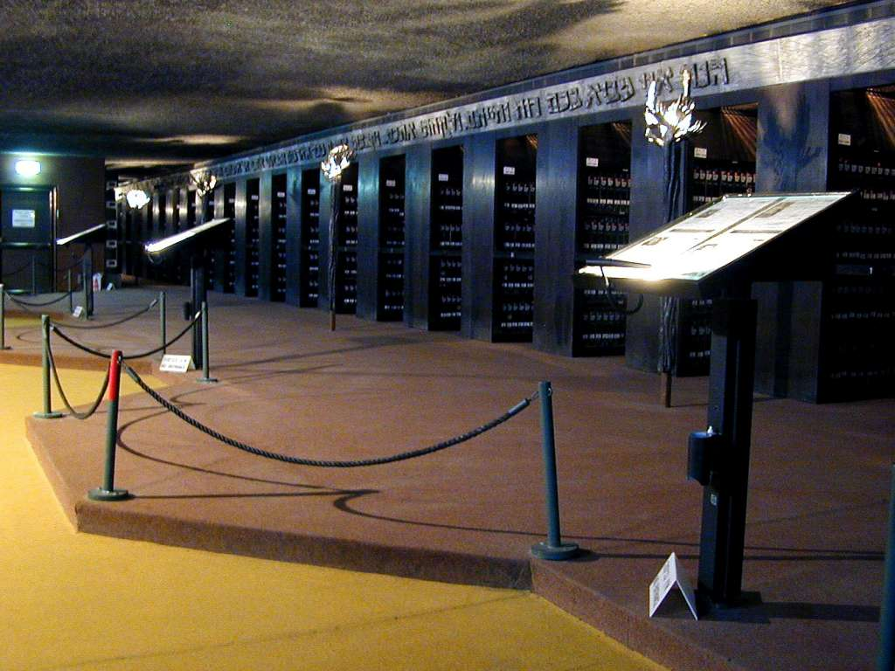
The exact sum of money that Haman had promised to pay . . . to destroy the Jews
Hall of Names at Yad VaShem
4:7
Notes:
The Hall of Names is a repository for the names of millions of Holocaust (Shoah) victims at Yad VaShem, the World Holocaust Remembrance Center in Jerusalem. No cemeteries, no headstones, no traces were left to mark the loss of the six million Holocaust victims. The Hall of Names currently houses about 2.7 million original Pages of Testimony in a temperature- and humidity-controlled environment. The names of about four and a half of the six million Jews murdered by the Nazis and their accomplices are commemorated here.
kg030801206

Slide 36
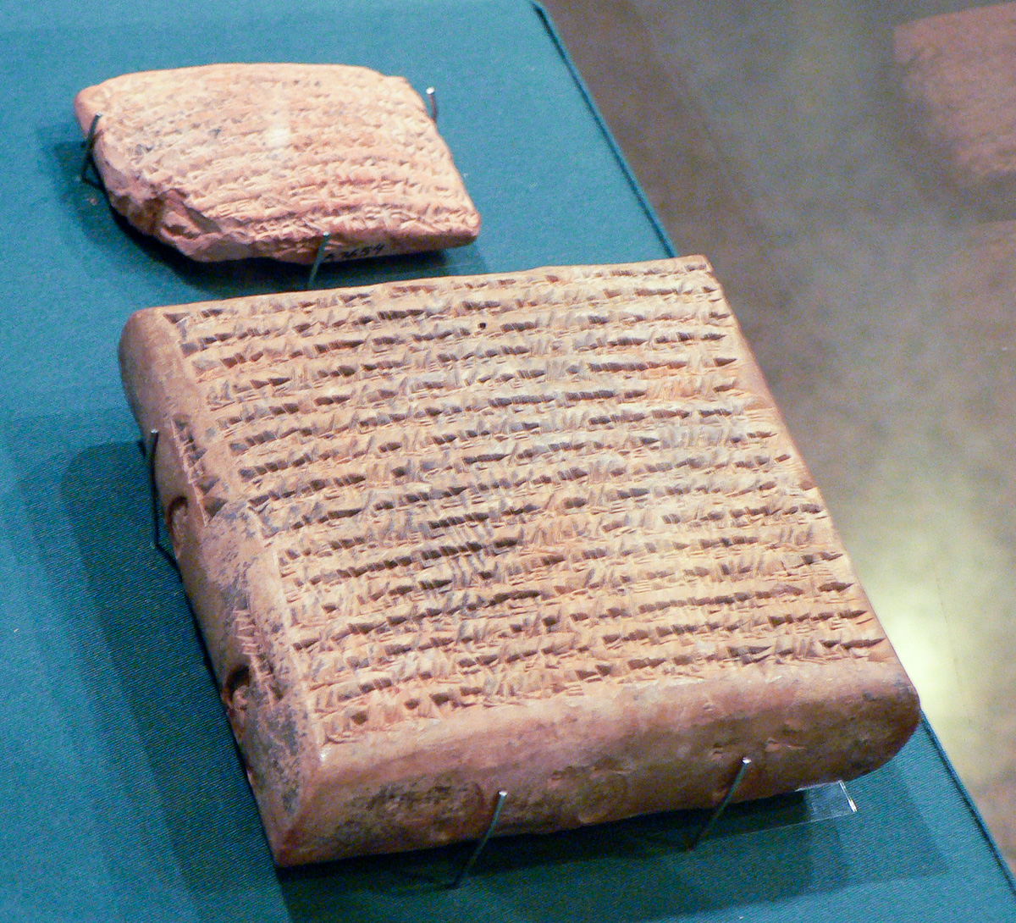
He also gave him a copy of the text of the decree
Persian and Seleucid tablets
4:8
Notes:
The decree circulating in Susa was most likely written on clay tablets, although it is also likely that a papyrus copy written in Aramaic or Hebrew was issued to the Jewish population in the capital. These tablets were photographed at the Oriental Institute Museum at the University of Chicago.
adr060815590

Slide 37
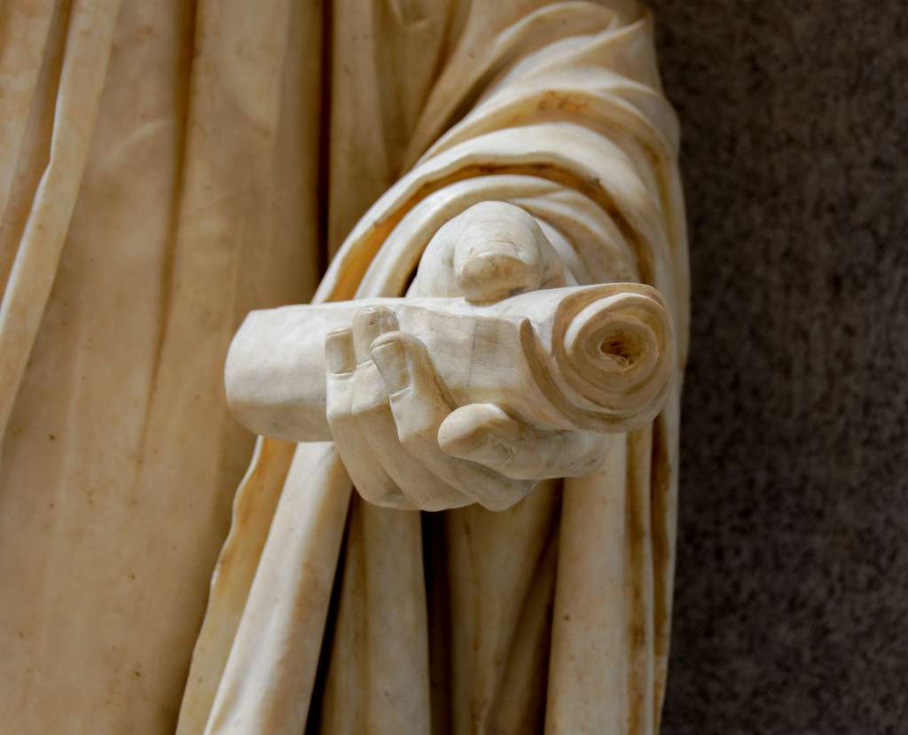
He also gave him a copy of the text of the decree
Emperor Titus with a scroll in his hand, from Rome
4:8
Notes:
This statue was found near the Lateran baptistry and was photographed at the Vatican Museums.
tb0512176644

Slide 38
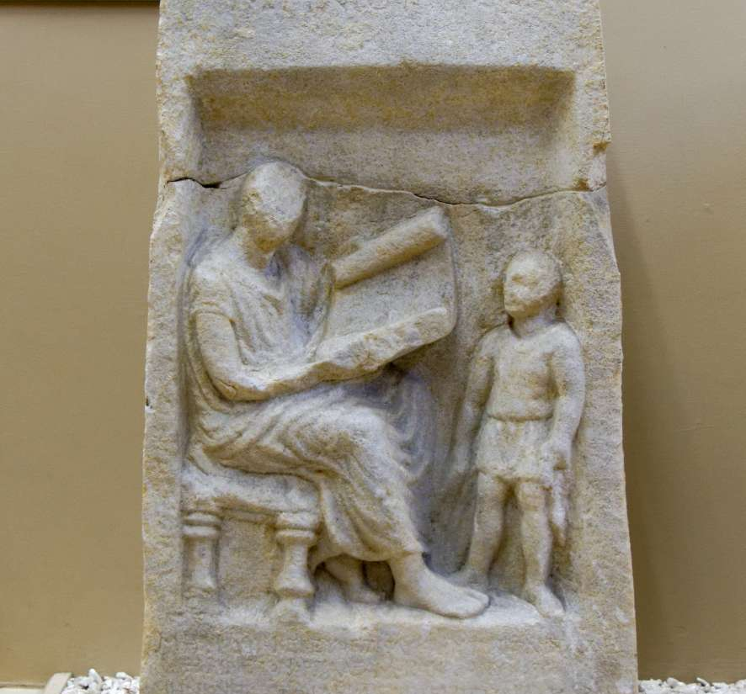
That he might show Esther and tell it to her
Marble gravestone of Menios, with reader of scroll, from Yeldegirmeni, 3rd century BC
4:8
Notes:
Whether Esther was literate or not, it was likely that Hathach read and/or translated the decree for Esther. This depiction of one person reading to another was photographed at the Istanbul Archaeological Museum.
tb122916539

Slide 39
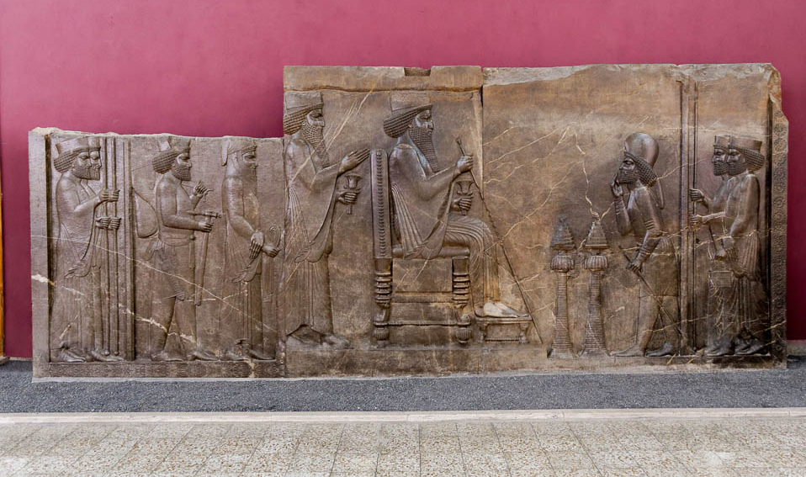
To command her to go to the king to implore his favor
Persepolis Audience Relief depicting the throne room with Darius I and Xerxes
4:8
Notes:
This depiction of the Persian throne room was photographed at the National Museum of Iran.
tb0514183887c

Slide 40
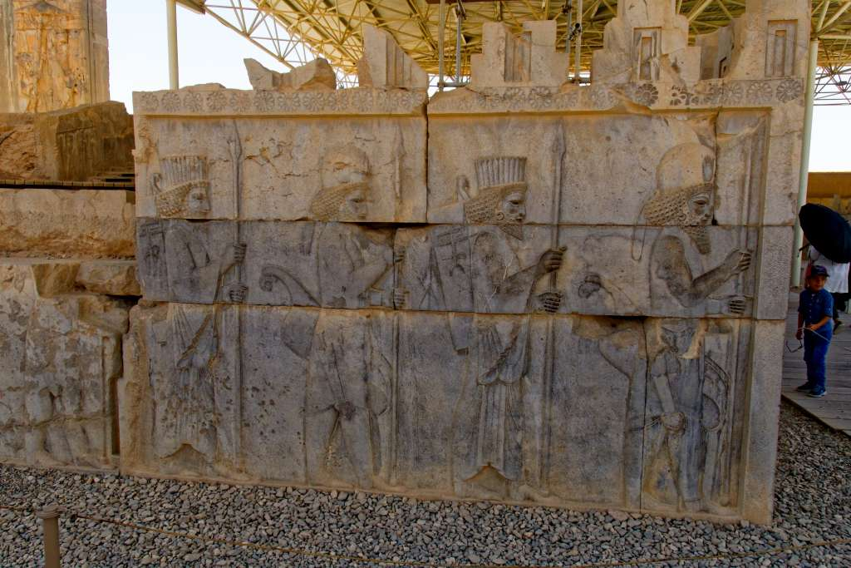
All the king’s servants
Persian and Median guards depicted on the north stairs of the Persepolis Tripylon
4:11
Notes:
The Median guards are the ones with the rounded hats, while the Persians have the tall, straight-sided hats.
tb0506181103

Slide 41
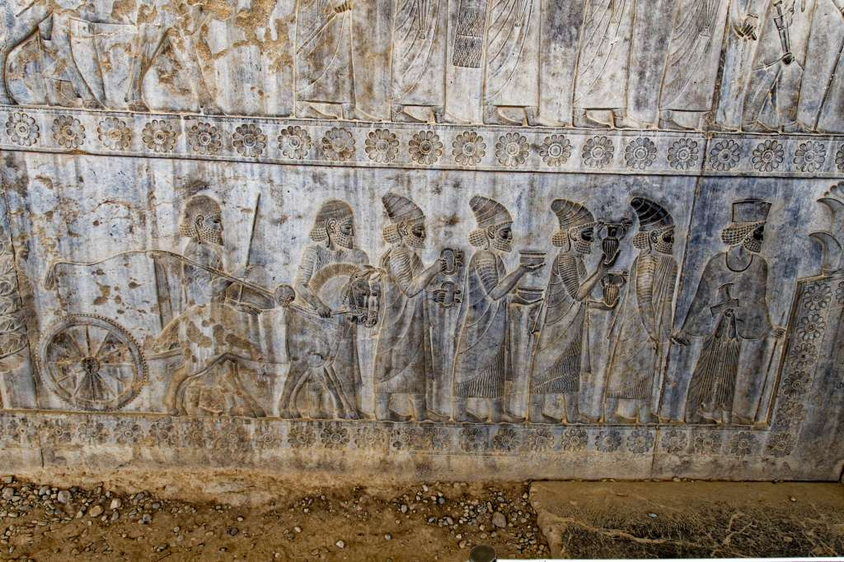
And the people of the king’s provinces
Lydian delegation depicted on the east stairs of the Persepolis apadana
4:11
Notes:
Esther characterizes the rule she is about to mention, that no one can enter the king’s presence without a summons, as something that was widely known throughout the empire.
tb0506181037

Slide 42
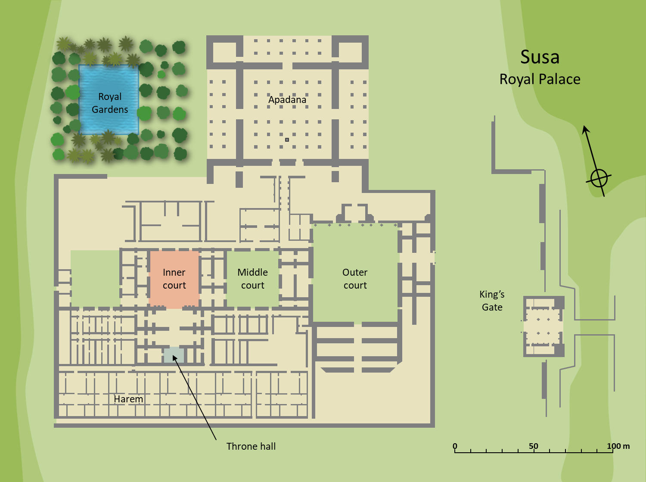
Any man or woman who comes to the king into the inner court
Susa
Royal Palace
Royal Gardens
Apadana
Inner court
Middle court
Outer court
King’s Gate
Harem
Throne hall
0
50
100 m
Plan of the royal palace at Susa showing the inner court in relation to the throne hall
4:11
Notes:
Beyond the inner courtyard are the royal apartments and the throne room itself. From the inner courtyard, one proceeds due south to stand before the king. Since the king is visible on his throne from the inner courtyard, unauthorized intruders would be considered trespassers and would be put to death. An editable version is included beneath the graphic for those who wish to modify it.
Plan by Kris Udd.

Slide 43
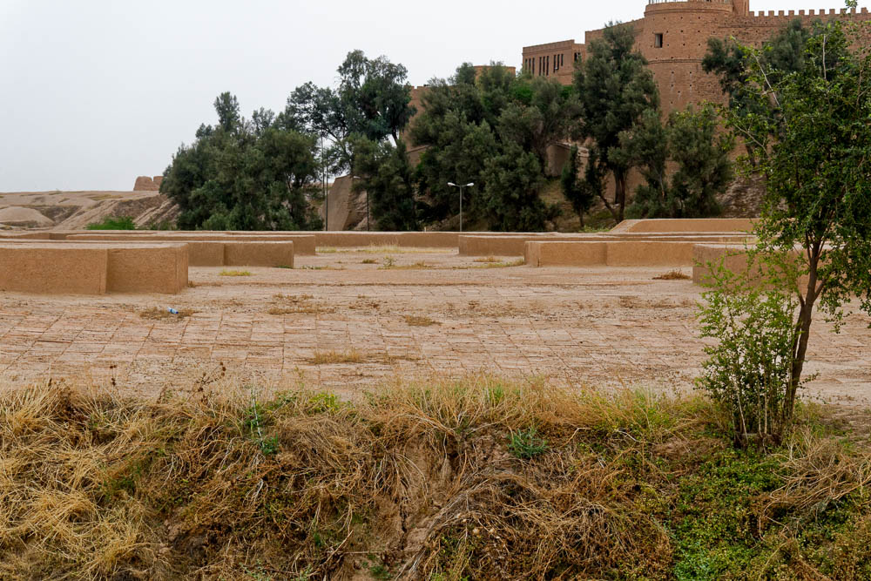
Any man or woman who comes to the king into the inner court
Inner courtyard and throne room of the royal palace at Susa (from the north)
4:11
Notes:
The view shown here is from the inner courtyard, looking directly into the throne room itself. The overgrown area in the foreground is part of the inner courtyard that was removed for further excavation by French archaeologists but not restored. See the next slide for labels.
tb0508182180

Slide 44
Any man or woman who comes to the king into the inner court
Throne room
Inner Courtyard
Inner courtyard and throne room of the royal palace at Susa (from the north)
4:11
Notes:
The view shown here is from the inner courtyard, looking directly into the throne room itself. The overgrown area in the foreground is part of the inner courtyard that was removed for further excavation by French archaeologists but not restored.
tb0508182180

Slide 45
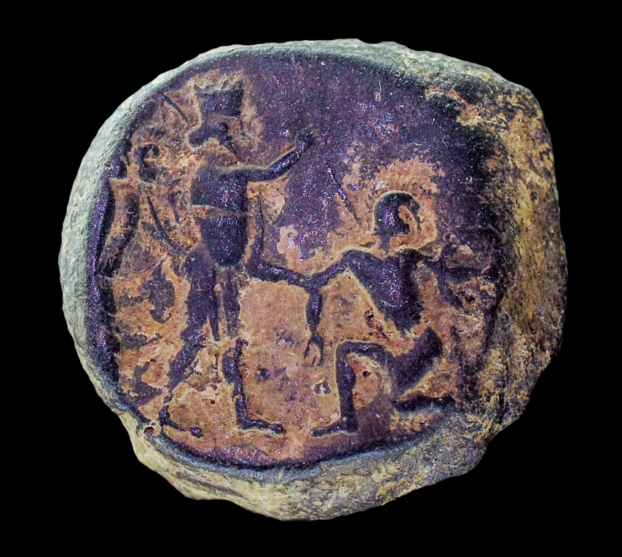
He has but one law, that he be put to death
Persian bulla depicting a Persian king slaying a Greek warrior
4:11
Notes:
This bulla (seal impression) was photographed at the Boston Museum of Fine Arts. For more information on this artifact, see https://www.mfa.org/collections/object/bulla-with-stamp-seal-impression-164620.
adr1711202594b

Slide 46
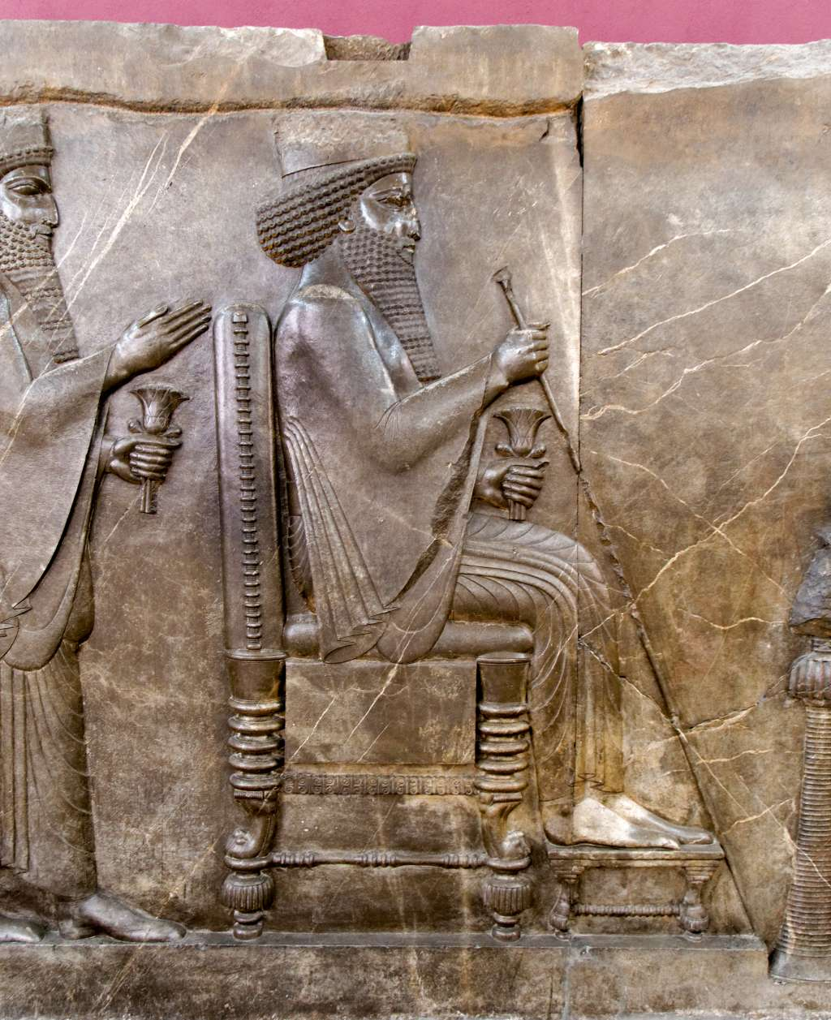
Except the one to whom the king extends the golden scepter
Darius I sitting on throne, holding scepter, depicted in the Persepolis Audience Relief
4:11
Notes:
There are several contemporary depictions of Persian kings seated on their thrones, and in each case the king holds a long, slim scepter in his right hand. Incidentally, both the king and the crown prince standing behind him hold a lotus flower in the left hand. Similar items are also often depicted in the hands of dignitaries from various places. The meaning of this item is uncertain, but it is noteworthy that this flower (Nelumbo nucifera) does not grow in Mesopotamia but is native to both Egypt and India, the two regions at the eastern and south-western extremes of the Persian empire. Perhaps this flower represents the broad geographical extent of the empire. This relief was photographed at the National Museum of Iran.
tb0514183823

Slide 47
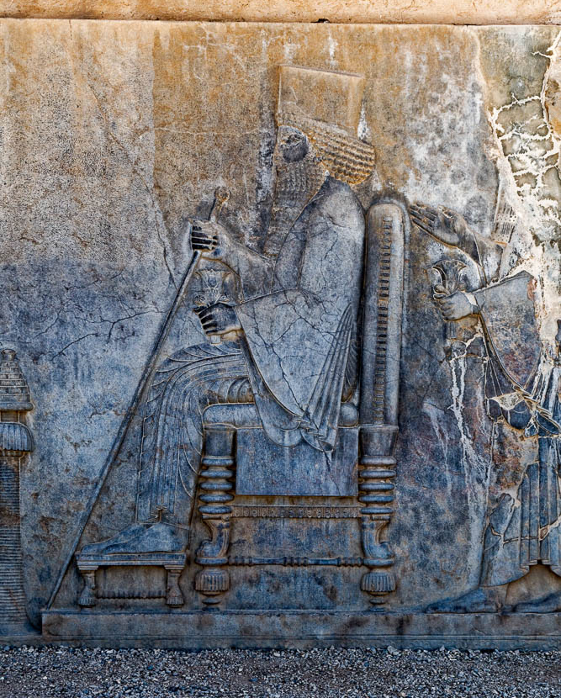
Except the one to whom the king extends the golden scepter
Darius I on his throne with a scepter, from the Persepolis Treasury, circa 500 BC
4:11
Notes:
This depiction of Darius I shows a very similar scene as the one shown on the previous slide. Again the scepter is shown as a long, slim rod, presumably fashioned of gold.
tb0506180584

Slide 48
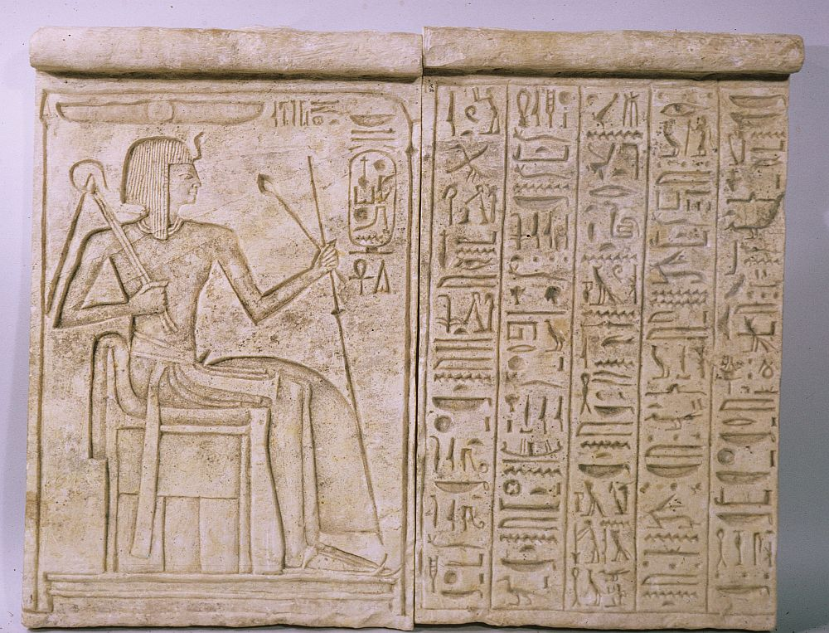
Except the one to whom the king extends the golden scepter
Relief of Ramesses IX enthroned, circa 1126–1108 BC
4:11
Notes:
The scepter is an ancient symbol of royal power. This relief depicts an Egyptian pharaoh holding a scepter and mace in his left hand, and a crook and flail in the right. Although the scepter shown here is hundreds of years older than the time of Esther and from a different culture, it is similar in size and shape to the scepters with which the Persian kings portrayed themselves. This image comes from The Metropolitan Museum of Art, public domain, Purchase, Frederick P. Huntley Bequest, 1959, http://metmuseum.org/art/collection/search/548358.
met548358

Slide 49
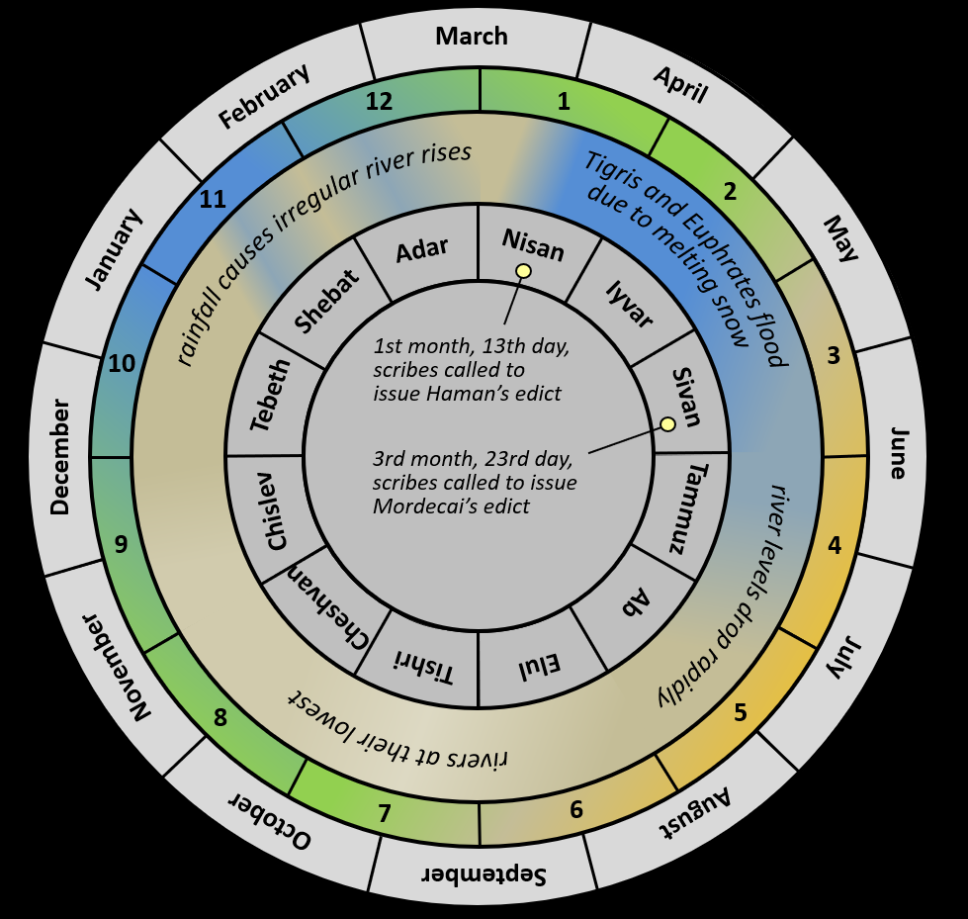
I have not been summoned to come to the king for these thirty days
March
February
April
12
1
rainfall causes irregular river rises
2
11
Tigris and Euphrates flood
due to melting snow
January
Adar
Nisan
May
Shebat
Iyvar
river levels drop rapidly
10
1st month, 13th day, scribes called to issue Haman’s edict
3
Tebeth
Sivan
rivers at their lowest
December
3rd month, 23rd day, scribes called to issue Mordecai’s edict
June
Chislev
Tammuz
9
4
Cheshvan
Ab
November
Tishri
Elul
July
8
5
October
7
6
August
September
Persian calendar and the issuing of the two decrees
4:11
Notes:
Esther’s response, "I have not been summoned to come before the king for these thirty days," is somewhat enigmatic but may point to a more sinister issue. There are two chronological anchor points in the nearby narrative. In Esther 3:13, the scribes were summoned to process the edict of Haman "on the 13th day of the 1st month." A little more than two months later, Mordecai issued the edict allowing the Jews to defend themselves, "in the 3rd month, on the 23rd day" (Esth 8:9). Where in this two-month period was Esther’s approach before the king, and how is it related to Esther's "thirty days"?
The time required to process Haman's initial edict to exterminate the Jews is not stated, but it is easy to underestimate. It could have taken several weeks from the calling of the scribes to the actual issuance of the edict. It would have been necessary to establish the exact wording of the edict and translate the edict into dozens of languages (for example, Elamite, Babylonian, Hittite, Luwian, Egyptian, Aramaic, Hebrew, Phoenician, Greek, etc.). The scribes then needed to make sufficient copies to go to hundreds of different cities. It is not unreasonable to think that they would have made several hundred copies, and perhaps in excess of a thousand. Those that were in cuneiform languages would have been written on clay tablets which would then need to be allowed to dry and then fired in order to harden them. Finally, provision must have been made for the couriers who would travel across the empire with the new edict. The Persians had the means to do these things, but it was an expensive and time consuming task nonetheless. Because of these processes, it is possible that the edict was not actually published in Susa itself before the end of the first month, and perhaps not even that quickly.
On the other end of this two-month period, some time is required between Esther's banquet with Xerxes and Haman and the proclamation of self-defense for the Jews. Not only was Haman executed (which appears to have happened fairly quickly), but Mordecai was promoted (Esth 8:1), the house of Haman was assigned to Mordecai by Esther (Esth 8:2), and a separate request was made for the self-defense edict. That this was a separate incident is indicated by the fact that Esther again went to the king un-summoned, and again the king extended the golden scepter (Esth 8:4). It is not unreasonable to imagine that these events also covered several weeks.
If these estimations are correct, then there was about a month between the official announcement of the edict in Susa and Esther's banquet. This would imply that Esther had not been called to see the king since about the same time as the decision to exterminate the Jews had been made. One can only imagine that she wondered if the king had discovered her Jewish heritage, and perhaps had not summoned her because he planned to have her killed. The bravery required to appear un-summoned before the king under such circumstances is astounding. Knowledge of this thirty-day period greatly heightens the suspense of the reader and points up the extreme gravity of the situation when Esther took her life in her hands on account of her people. An editable version is included beneath the graphic for those who wish to modify it.

Slide 50
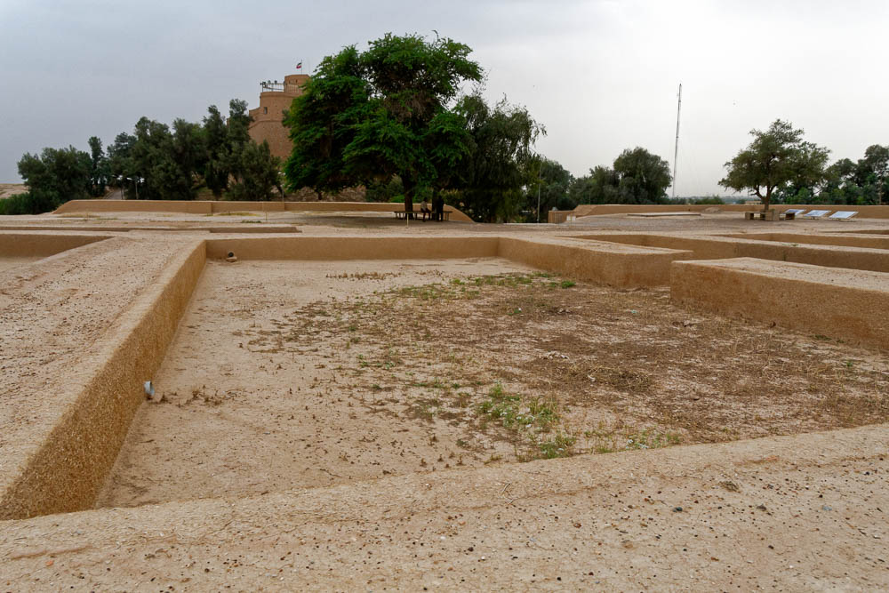
Do not think within yourself that you that you will escape in the king’s house
Area of the women’s quarters west of the throne room in the Susa royal palace (from the north)
4:13
Notes:
Archaeologists excavated a series of apartments at this location in Susa that they believe housed the women. These have not been reconstructed, but they are located just beyond the wall in the center of the photograph. The five apartments excavated each had multiple rooms and they covered an area of 10,764 square feet (1,000 sq m). They were accessed from a guarded passage that ran along the back wall of the room shown here (Perrot and Ladiray 1996: 251). The next slide includes labels.
Reference:
Perrot, Jean, and Ladiray, Daniel.
1996 The Palace of Susa. Pp. 236–54 in Royal Cities of the Biblical World, ed. Joan Goodnick Westenholz. Jerusalem: Bible Lands Museum.
tb0508182321

Slide 51
Do not think within yourself that you that you will escape in the king’s house
Area of the harem
Area of the women’s quarters west of the throne room in the Susa royal palace (from the north)
4:13
Notes:
Archaeologists excavated a series of apartments at this location in Susa that they believe housed the women. These have not been reconstructed, but they are located just beyond the wall in the center of the photograph. The five apartments excavated each had multiple rooms and they covered an area of 10,764 square feet (1,000 sq m). They were accessed from a guarded passage that ran along the back wall of the room shown here (Perrot and Ladiray 1996: 251).
Reference:
Perrot, Jean, and Ladiray, Daniel.
1996 The Palace of Susa. Pp. 236–54 in Royal Cities of the Biblical World, ed. Joan Goodnick Westenholz. Jerusalem: Bible Lands Museum.
tb0508182321

Slide 52
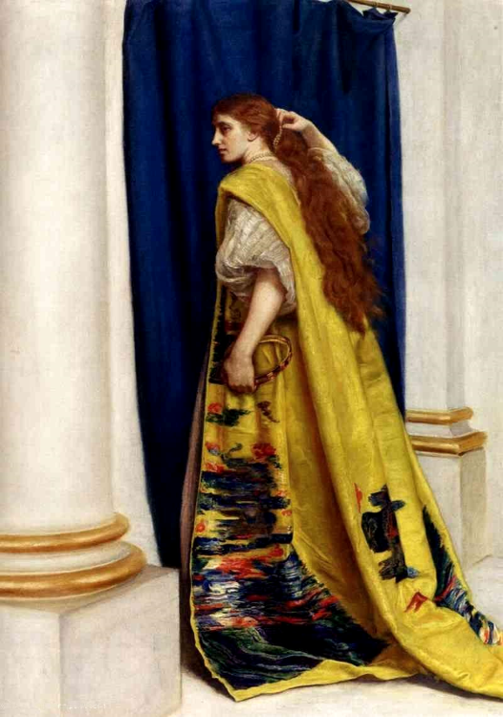
Who knows if you have not attained royalty for such a time as this?
Esther, by John Everett Millais, 1865
4:14
Notes:
This statement by Mordecai is perhaps the most famous line in the book of Esther. Although the book never mentions God directly, statements such as this hint strongly at the belief that God is working behind the scenes to preserve His people and His covenant with them. This oil painting dates to 1865 and is in a private collection. This image comes from Wikimedia Commons and is in the public domain. Source: https://commons.wikimedia.org/wiki/File:Esthermillais.jpg
wiki0904200721188001141

Slide 53
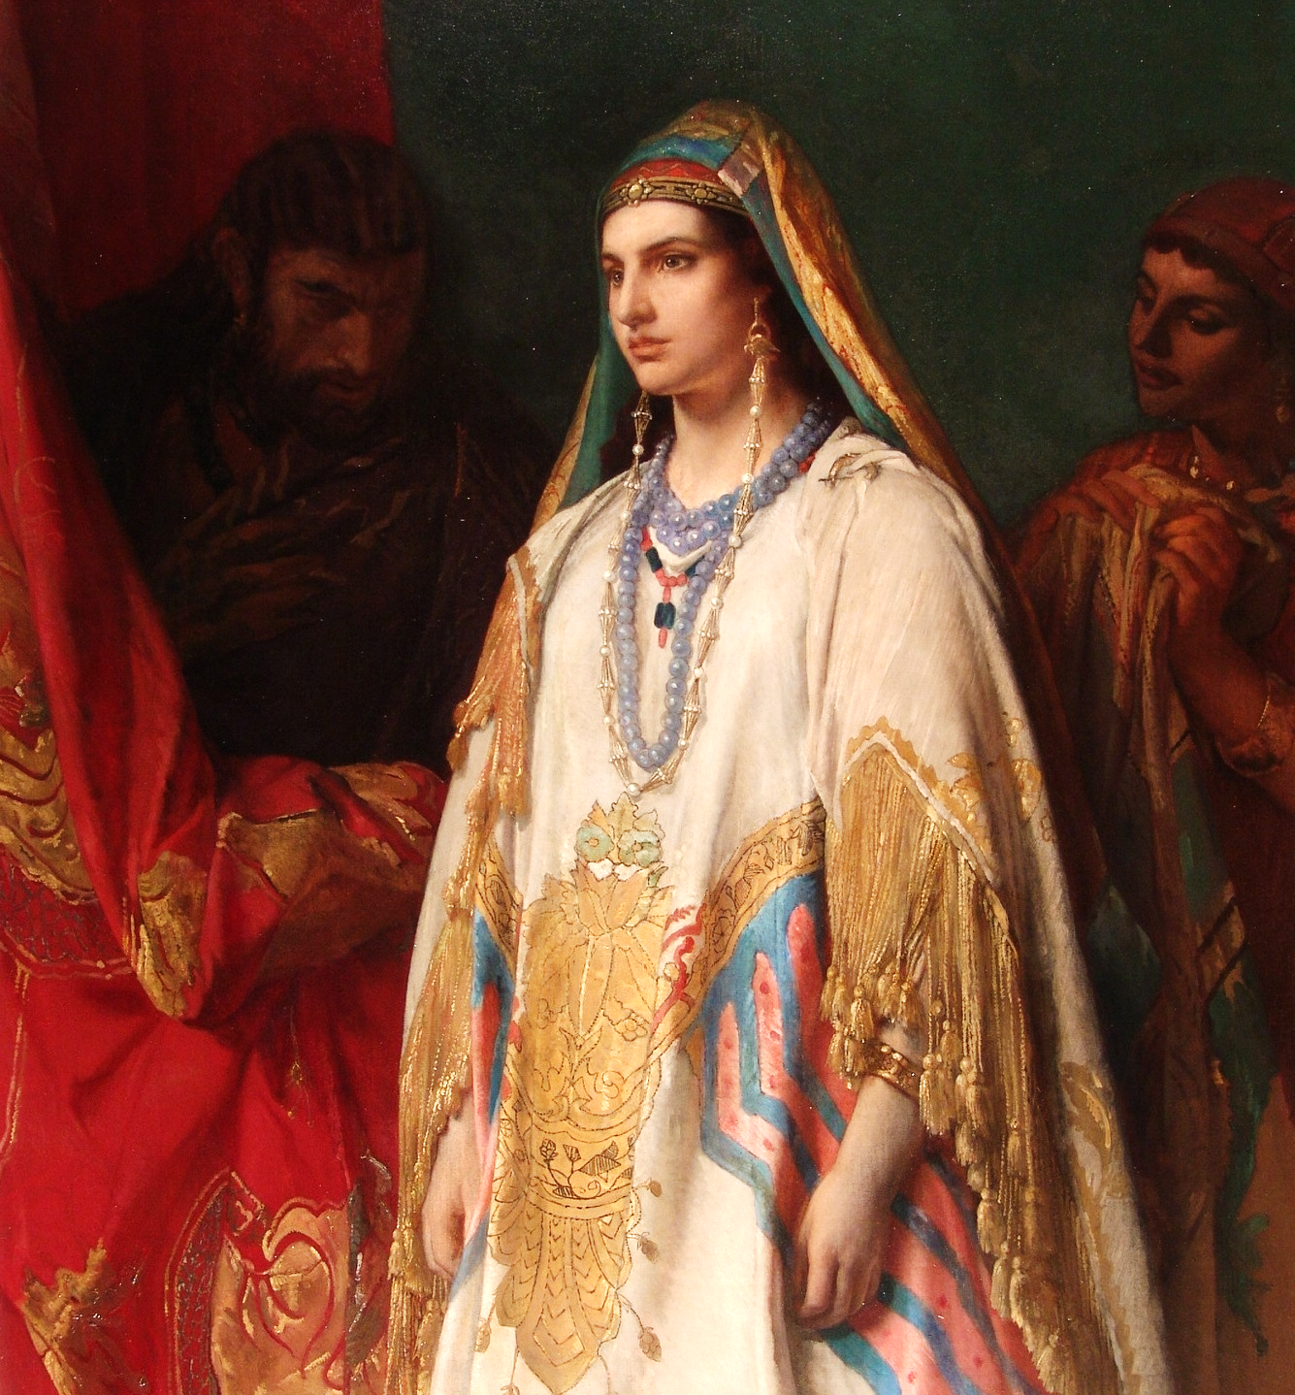
Who knows if you have not attained royalty for such a time as this?
Esther, by Jean-François Portaels, circa 1869
4:14
Notes:
Esther is pictured here in royal attire, symbolizing her special connection to the king and her unique ability to gain an audience with him as no other Jew would have been able to do. This oil painting dates to circa 1869 and is on display in the Art Gallery of New South Wales. This image comes from the Art Gallery of New South Wales and is in the public domain, via Wikimedia Commons: https://commons.wikimedia.org/wiki/File:Jean-Fran%C3%A7ois_Portaels_-_Esther.jpg.
wiki102920180137478

Slide 54
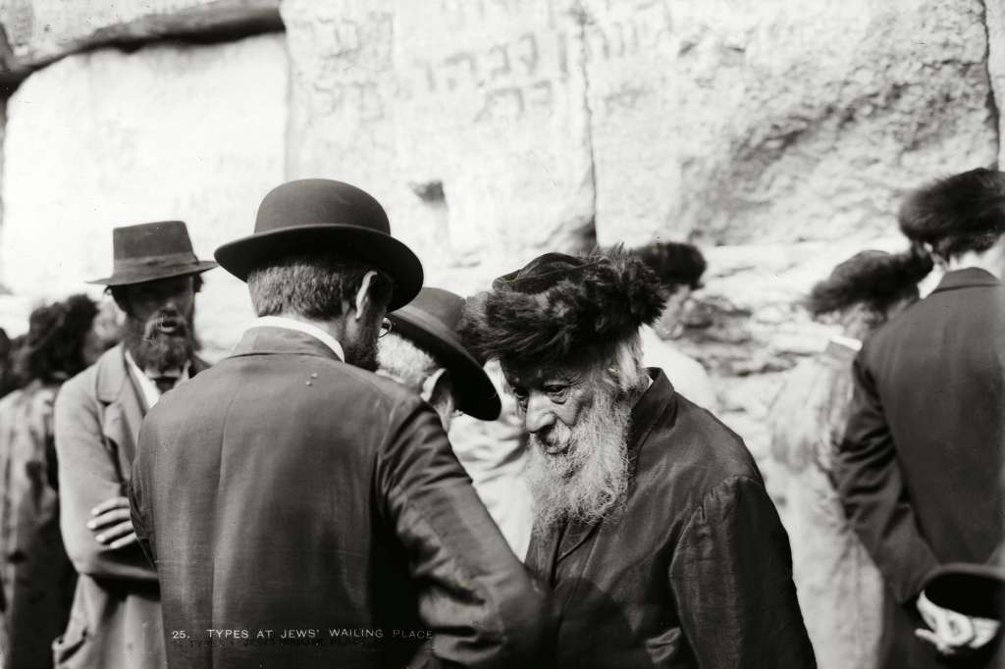
Go, gather together all the Jews who are found in Susa
Jewish people at the Western Wall in Jerusalem
4:16
Notes:
This American Colony photograph was taken between 1900 to 1920.
mat05638

Slide 55
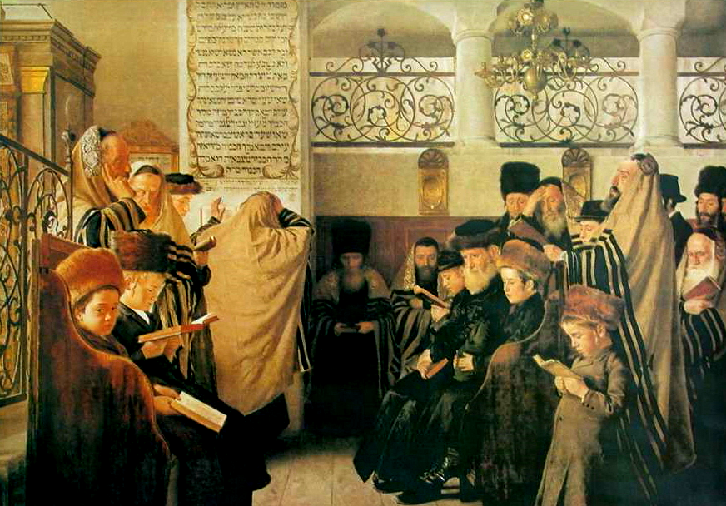
Go, gather together all the Jews who are found in Susa, and fast for me
Day of Atonement, by Isidor Kaufmann, circa 1875
4:16
Notes:
This oil painting shows Jewish worshipers gathered in a synagogue on a day of fasting and repentance. The painting was created between 1853 and 1907. This image comes from Wikimedia Commons and is in the public domain. Source: https://commons.wikimedia.org/wiki/File:Kaufmann_Day_of_Atonement.jpg
wiki091220100048872

Slide 56
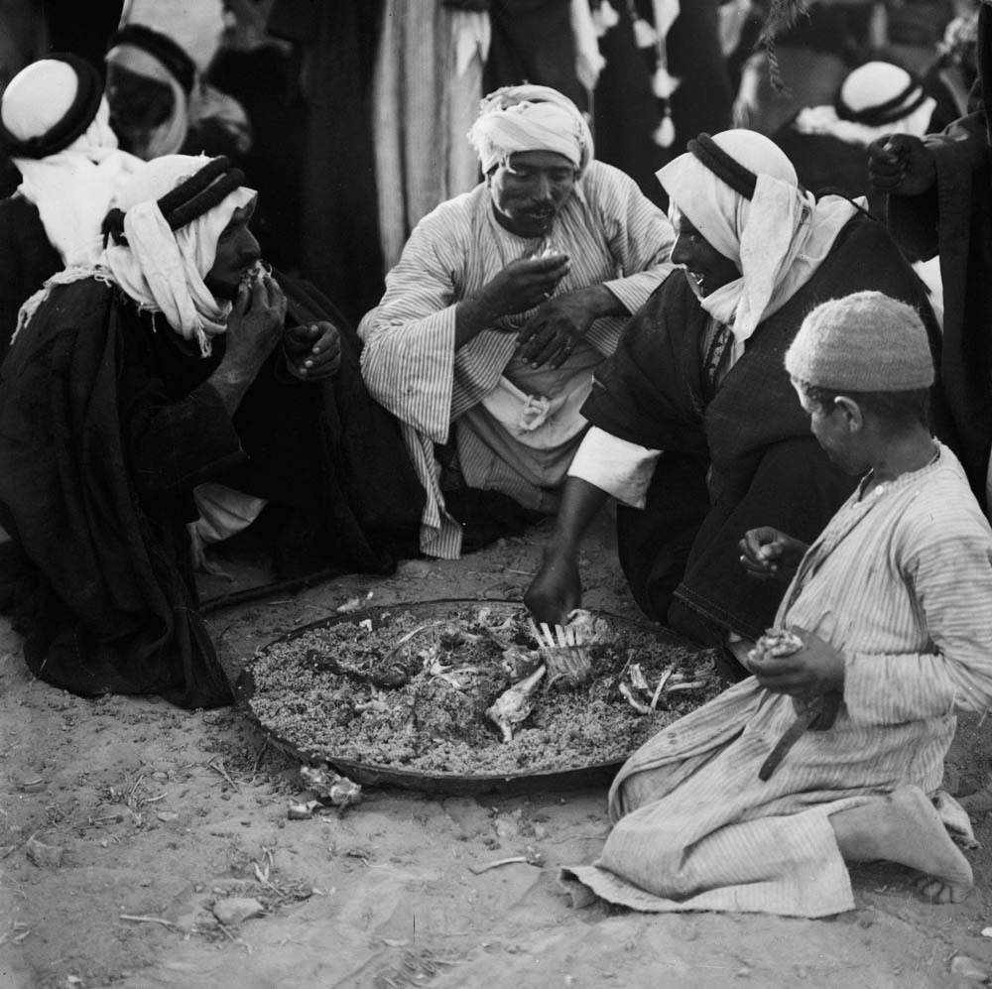
Do not eat or drink for three days, night or day
Group of Bedouins in Beersheba eating savory rice and mutton from a tray
4:16
Notes:
While others were eating their regular meals, Esther asked the Jewish population of Susa to abstain from food and drink. Fasting symbolized their sincerity in petitioning God on behalf of Esther. This American Colony photograph was taken in 1930.
mat02959

Slide 57
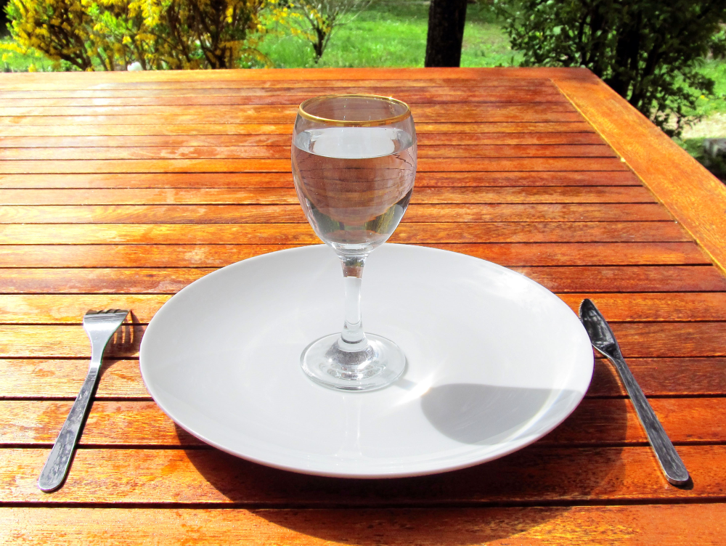
Do not eat or drink for three days, night or day
A glass of water and an empty plate
4:16
Notes:
The glass of water and empty plate shown here symbolize the fasting that Esther requested of the Jewish population of Susa. This image comes from Jean Fortunet and is licensed under CC BY 1.0, via Wikimedia Commons: https://commons.wikimedia.org/wiki/File:Fasting_4-Fasting-a-glass-of-water-on-an-empty-plate.jpg.
wiki0411201212142910

Slide 58
Do not eat or drink for three days, night or day
On the Eve of Yom Kippur, by Jakub Weinles, circa 1900
4:16
Notes:
Fasting is traditionally associated with Yom Kippur, as illustrated in the tired faces and weak postures of this painting. This oil painting dates to circa 1900 and is on display in the National Museum in Warsaw. This image comes from the National Museum in Warsaw and is in the public domain, via Wikimedia Commons: https://commons.wikimedia.org/wiki/File:Weinles_On_the_eve_of_Yom_Kippur.jpg.
wiki012820142230599445

Slide 59
More than 700 slides in PowerPoint format. Available now from BiblePlaces.com.
Notes:
This is a free sample of the Esther 4 presentation from the Photo Companion to the Bible. To purchase the full volume, visit https://www.bibleplaces.com/esther/
The Photo Companion to the Bible is an image-rich resource for Bible students, teachers, and researchers. Just as a librarian stocks the shelves with as many relevant materials as possible, so we have tried to provide a broad selection of images. Our goal is that you will find in this “library” whatever it is you are looking for.
Credits: The primary creators of this presentation are Steven D. Anderson, A.D. Riddle, Christian Locatell, Kris Udd, and Todd Bolen. The photographs have an individual file code which usually includes the initials of the photographer. Other images have additional credit or source information.
Updates: We plan to update this collection as we are able. We welcome your suggestions for improving this resource (photocompanion@bibleplaces.com). Purchasers of the Esther volume are provided free, lifetime updates to the volume.
Copyright: This photo collection is protected by copyright law and may not be distributed without written permission from BiblePlaces.com. Slide notes should be treated as any other copyrighted written material, with credit given when quoting from these notes.
For more information, see our complete “Introduction to the Photo Companion to the Bible” online at http://www.BiblePlaces.com/Intro-Photo-Companion-Bible/. Here you will find more information about photo selection, explanatory notes, Bible translation, credit information, and copyright allowances.

