Slide 1
2 Kings 8
Notes:
This is a free sample of the 2 Kings 8 presentation from the Photo Companion to the Bible. To purchase the full volume, visit www.bibleplaces.com/2kings/
The Photo Companion to the Bible is an image-rich resource for Bible students, teachers, and researchers. Just as a librarian stocks the shelves with as many relevant materials as possible, so we have tried to provide a broad selection of images. Our goal is that you will find in this “library” whatever it is you are looking for.
Credits: The primary creators of this presentation are Chris McKinny, Kris Udd, and Todd Bolen. The photographs have an individual file code which usually includes the initials of the photographer. Other images have additional credit or source information.
Updates: We plan to update this collection as we are able. We welcome your suggestions for improving this resource (photocompanion@bibleplaces.com). Purchasers of the 2 Kings volume are provided free, lifetime updates to the volume.
Copyright: This photo collection is protected by copyright law and may not be distributed without written permission from BiblePlaces.com. Slide notes should be treated as any other copyrighted written material, with credit given when quoting from these notes.
For more information, see our complete “Introduction to the Photo Companion to the Bible” online at http://www.BiblePlaces.com/Intro-Photo-Companion-Bible/. Here you will find more information about photo selection, explanatory notes, Bible translation, credit information, and copyright allowances.

Slide 2
2 Kings 8
This is a free sample of the 2 Kings 8 presentation from the Photo Companion to the Bible. To purchase the full volume, visit www.bibleplaces.com/2kings/ The Photo Companion to the Bible is an image-rich resource for Bible students, teachers, and researchers. Just as a librarian stocks the shelves with as many relevant materials as possible, so we have tried to provide a broad selection of images. Our goal is that you will find in this “library” whatever it is you are looking for. For more details (for this and every slide), see the Notes section below.
Notes:
This is a free sample of the 2 Kings 8 presentation from the Photo Companion to the Bible. To purchase the full volume, visit www.bibleplaces.com/2kings/
The Photo Companion to the Bible is an image-rich resource for Bible students, teachers, and researchers. Just as a librarian stocks the shelves with as many relevant materials as possible, so we have tried to provide a broad selection of images. Our goal is that you will find in this “library” whatever it is you are looking for.
Credits: The primary creators of this presentation are Chris McKinny, Kris Udd, and Todd Bolen. The photographs have an individual file code which usually includes the initials of the photographer. Other images have additional credit or source information.
Updates: We plan to update this collection as we are able. We welcome your suggestions for improving this resource (photocompanion@bibleplaces.com). Purchasers of the 2 Kings volume are provided free, lifetime updates to the volume.
Copyright: This photo collection is protected by copyright law and may not be distributed without written permission from BiblePlaces.com. Slide notes should be treated as any other copyrighted written material, with credit given when quoting from these notes.
For more information, see our complete “Introduction to the Photo Companion to the Bible” online at http://www.BiblePlaces.com/Intro-Photo-Companion-Bible/. Here you will find more information about photo selection, explanatory notes, Bible translation, credit information, and copyright allowances.

Slide 3
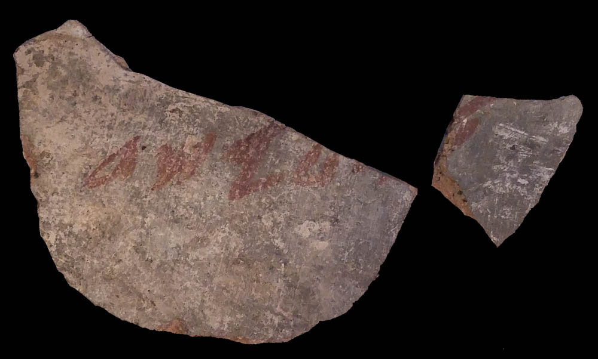
Now Elisha spoke to the woman whose son he had restored to life
Elisha ostracon from Tel Rehov, 9th century BC
8:1
Notes:
An inscribed potsherd with the name of “Elisha” (אלישע; ’lysh‘) was discovered at the site of Tel Rehov in the Jordan Rift, about 7 miles (11 km) northwest of Elisha’s hometown of Abel-meholah. The proximity in terms of both geography and chronology has led some archaeologists to suggest that this may refer to the same Elisha as mentioned in the book of Kings. The inscription was written in large letters in red ink. This photograph was taken at a special exhibit at the Eretz Israel Museum in Tel Aviv.
as0409161529

Slide 4
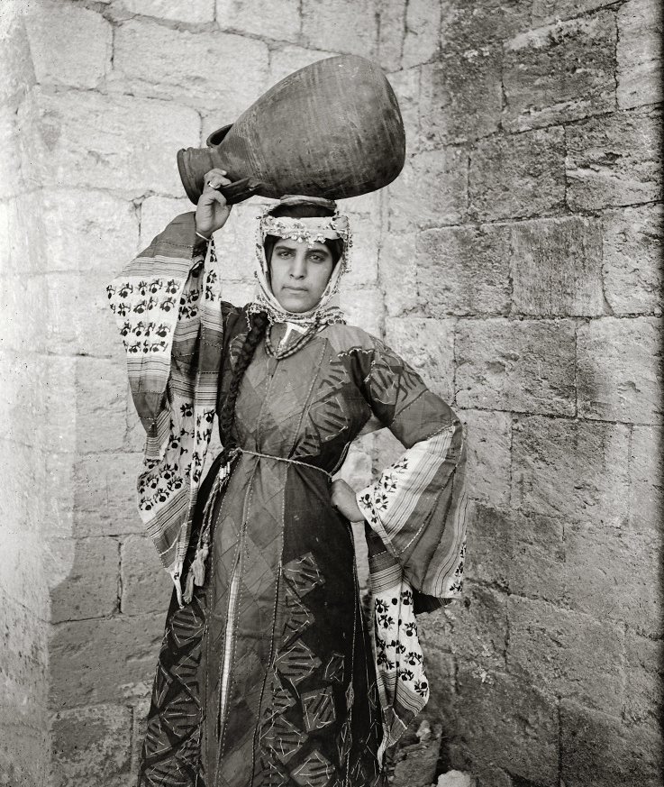
Now Elisha spoke to the woman whose son he had restored to life
Woman in Nazareth, circa 1910
8:1
Notes:
The woman mentioned here is the Shunammite woman of 2 Kings 4:1-37. This American Colony photograph was taken between 1900 and 1920.
mat01237

Slide 5
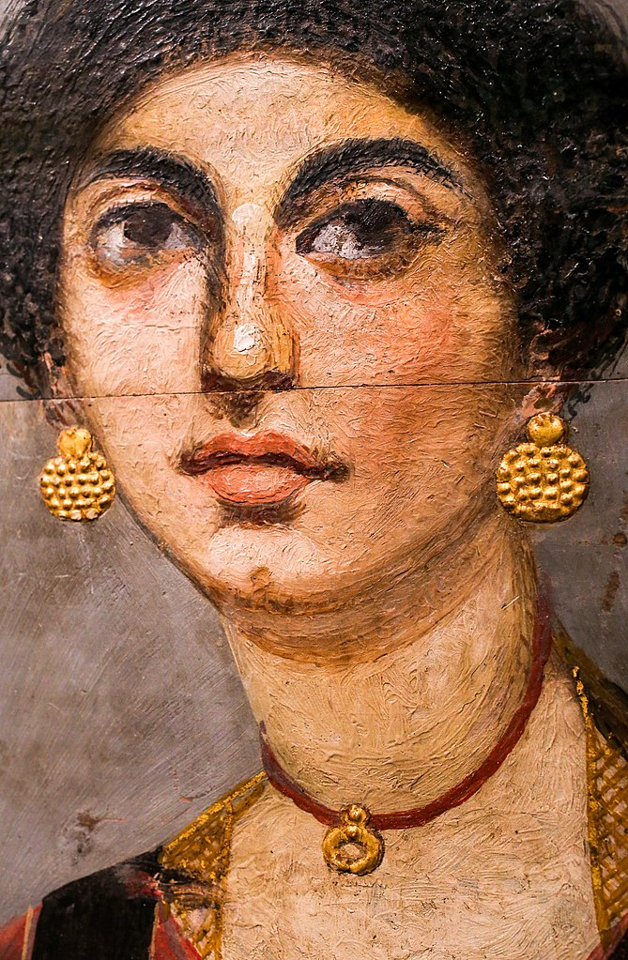
Now Elisha spoke to the woman whose son he had restored to life
Mummy portrait of a young wealthy woman, from Hawara, circa AD 70
8:1
Notes:
The Shunammite woman was “prominent” (Heb. gadol, גָּדוֹל; 2 Kgs 4:8), a term that should be understood indicate she was wealthy, and thus of high social status. This encaustic on wood mummy portrait is several centuries later than the time of Elisha, but depicts a wealthy woman bedecked with golden jewelry. Her jewelry includes a necklace with lunar-shaped pendant and large golden earrings with disk-pendants. This portrait was photographed at the Neues Museum, Berlin. This image comes from ArchaiOptix and is licensed under CC BY-SA 4.0, via Wikimedia Commons: https://commons.wikimedia.org/wiki/File:Mummy_portrait_of_a_woman_from_Hawara_-_Berlin_%C3%84M_10974_02.jpg.
wiki12202014173334196967

Slide 6
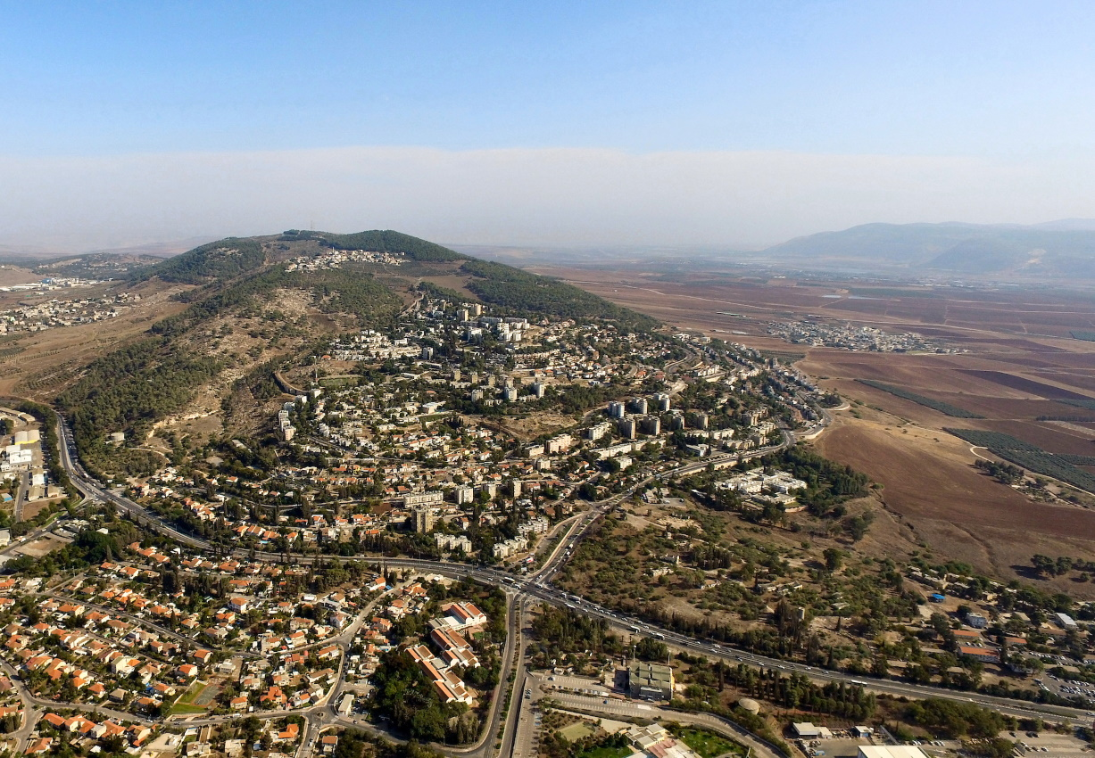
Now Elisha spoke to the woman whose son he had restored to life
Shunem and the Hill of Moreh (aerial view from the northwest)
8:1
Notes:
Shunem is a town located south of the Hill of Moreh, in the Harod Valley. The next slide includes labels.
ws102115067

Slide 7
Now Elisha spoke to the woman whose son he had restored to life
Hill of Moreh
Mt. Gilboa
Harod Valley
Nain
Shunem
Shunem and the Hill of Moreh (aerial view from the northwest)
8:1
Notes:
Shunem is a town located south of the Hill of Moreh, in the Harod Valley.
ws102115067

Slide 8
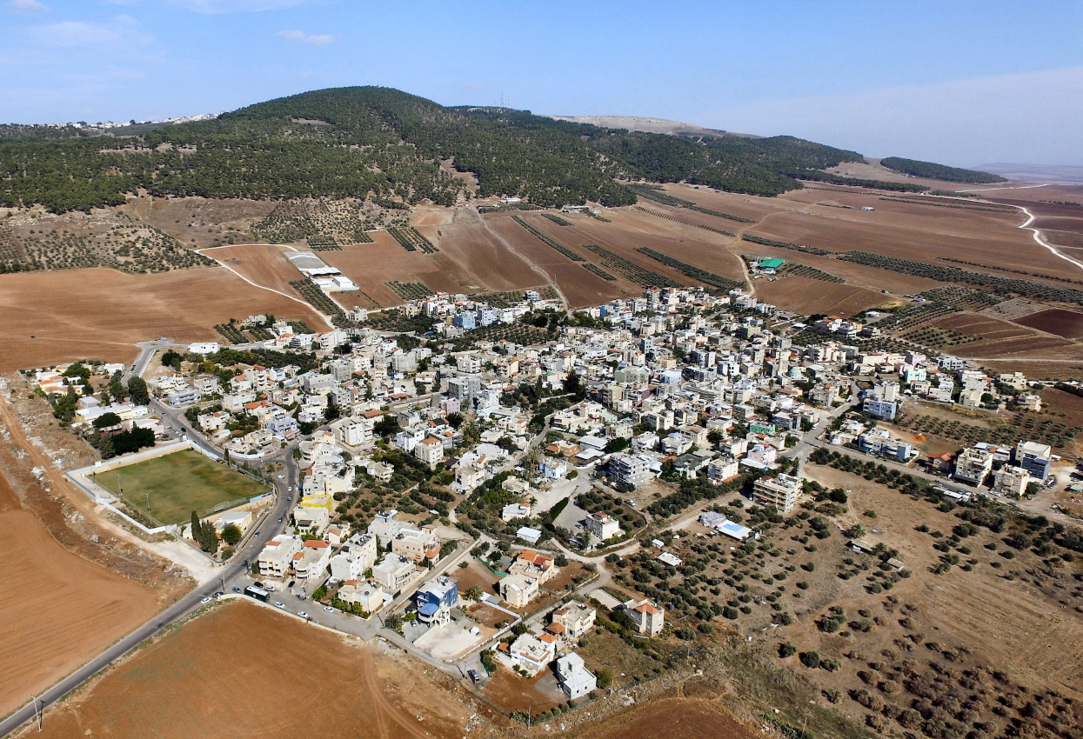
Now Elisha spoke to the woman whose son he had restored to life
Shunem and the Hill of Moreh (aerial view from the southwest)
8:1
Notes:
The ancient site of Shunem is identified with the modern Arab village of Sulam/Sulem. It is situated in the Harod Valley on the south of the Hill of Moreh. The border between Issachar to the north and Manasseh to the south appears to have passed along the Harod Valley, placing Shunem, the Hill of Moreh, and Nain in the territory of Issachar (Josh 19:18).
ws102115055

Slide 9
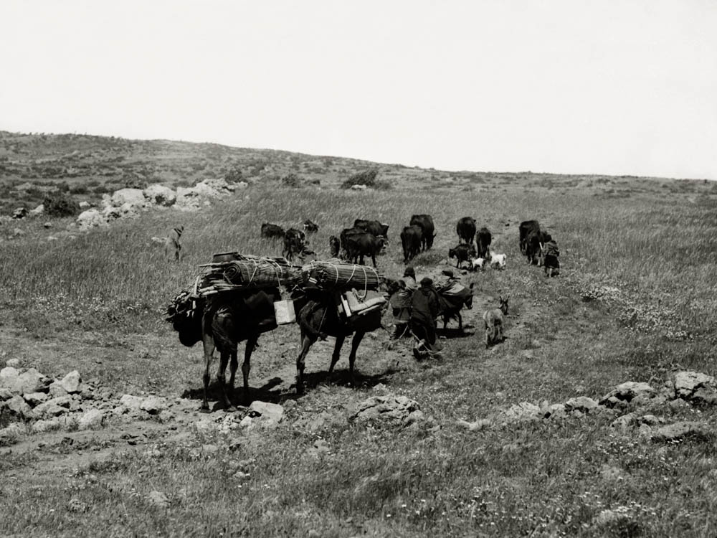
And he said, “Get up, along with your household, and go live wherever you can”
Bedouin family on the move, circa 1910
8:1
Notes:
This American Colony photo was taken between 1900 and 1920
mat01356

Slide 10
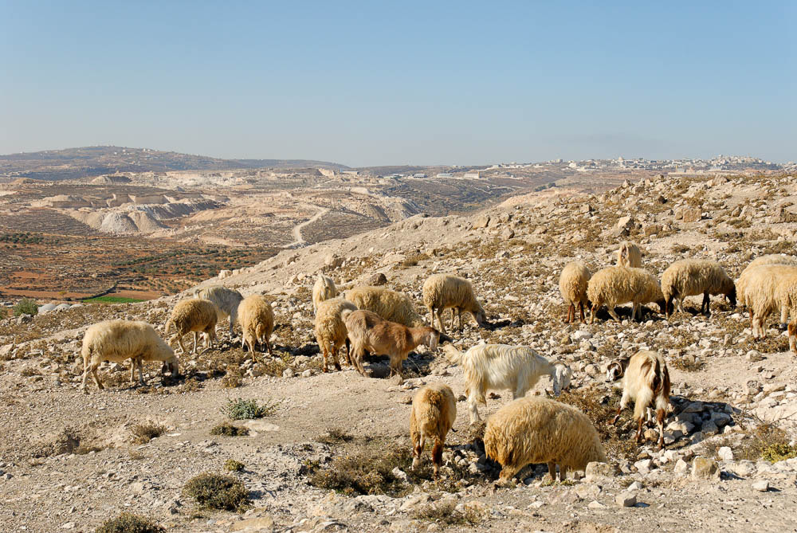
For Yahweh has called for a famine, and it will come on the land for seven years
Sheep grazing over barren ground at Tekoa
8:1
Notes:
tb111706011

Slide 11
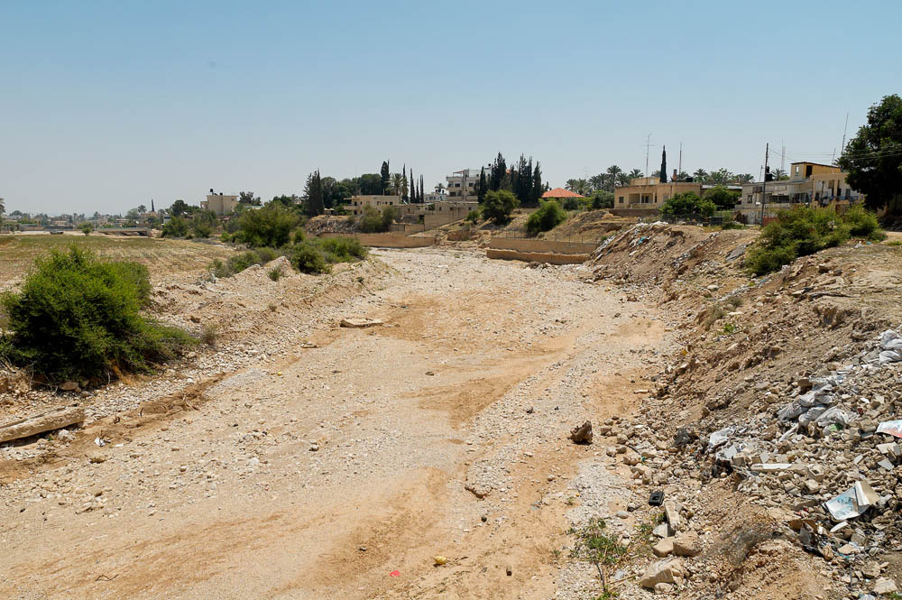
For Yahweh has called for a famine, and it will come on the land for seven years
Dry riverbed of the Wadi Qilt near Jericho
8:1
Notes:
tb051106978

Slide 12
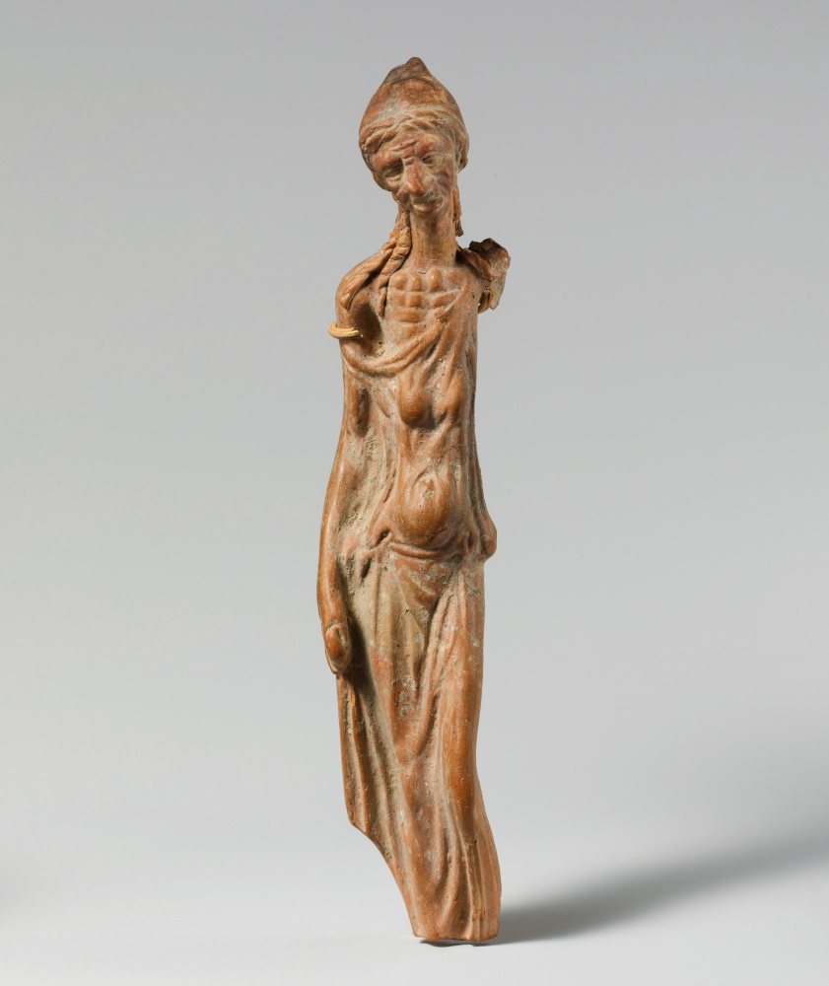
For Yahweh has called for a famine, and it will come on the land for seven years
Statuette of an emaciated woman, from Smyrna, 1st century BC
8:1
Notes:
Famine is illustrated here by a small statue of a woman that may be intended to depict someone in a state of starvation. This image comes from The Metropolitan Museum of Art and is in the public domain. Source: https://www.metmuseum.org/art/collection/search/245538
met245538

Slide 13
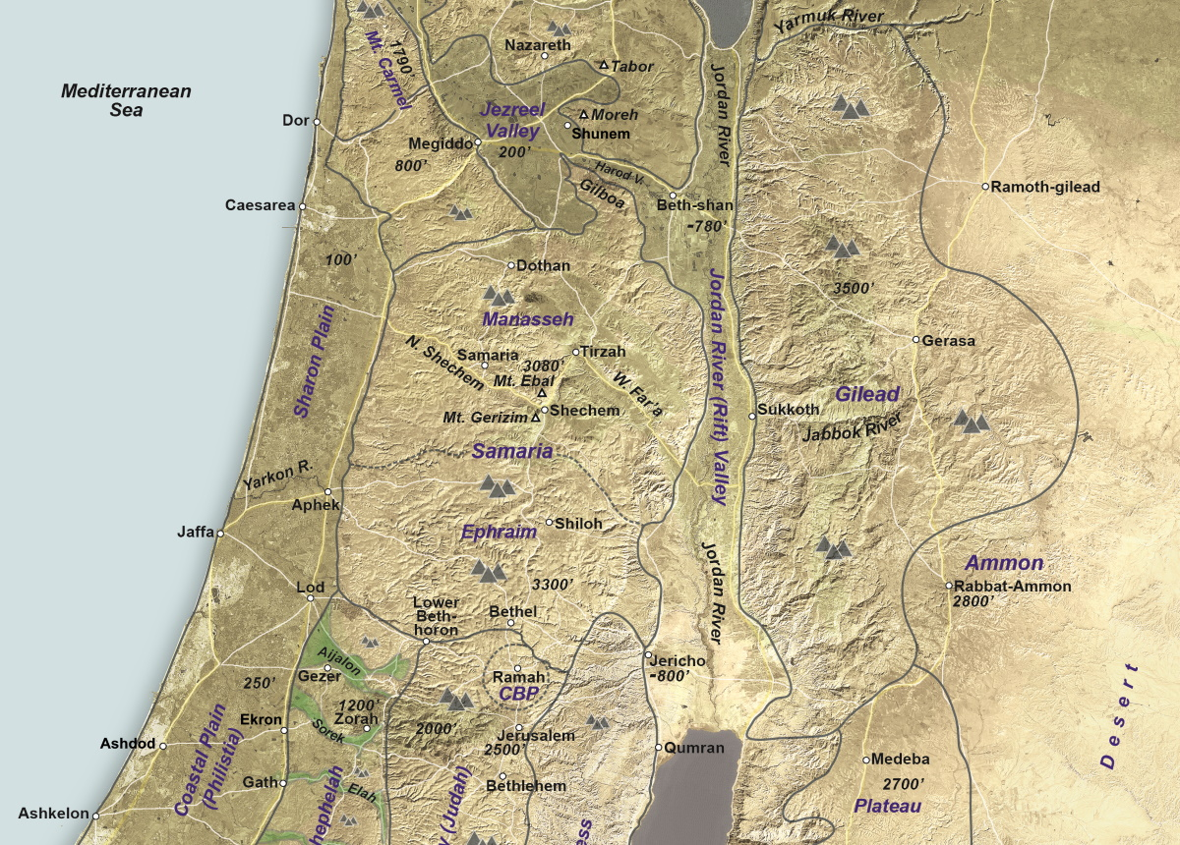
She went with her household and stayed in the land of the Philistines for seven years
Map of Israel and the land of the Philistines
8:2
Notes:
The Shunammite’s journey to the land of Philistia would have taken her south and west. The northernmost city that likely fell within the land of the Philistines at this time was Aphek, a journey of about 47 miles (75 km) from Shunem. The city of Ekron, a major Philistine city, would have been an additional 23 miles (37 km). This map is a detail adapted from map 1-2 from the Satellite Bible Atlas, by William Schlegel. Used by permission.

Slide 14
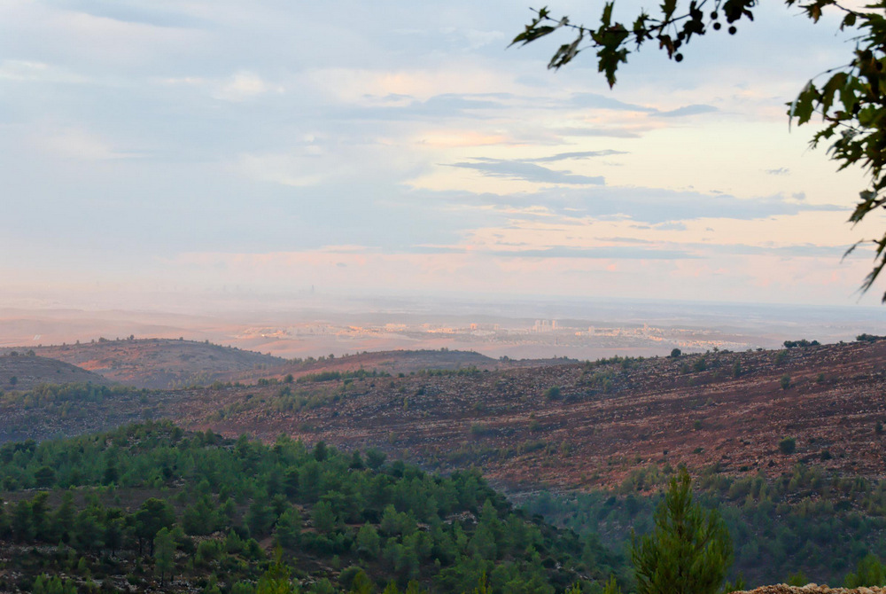
She went with her household and stayed in the land of the Philistines for seven years
Coastal plain (from Judean hill country)
8:2
Notes:
The Shunammite’s sojourn in Philistia indicates strong economic ties between Israel and Philistia in the mid-9th century BC (cf. Ahaziah sending a messenger to Ekron in 2 Kgs 2). In addition, the Lucianic Recension of 2 Kings 13:22 suggests that Israel controlled the northern part of Philistia until the reign of Jehoahaz (r. 814–798 BC) as it reads, “Hazael took from [Jehoahaz’s] hands all Philistia, from the western sea to Aphek.”
tb102806246

Slide 15
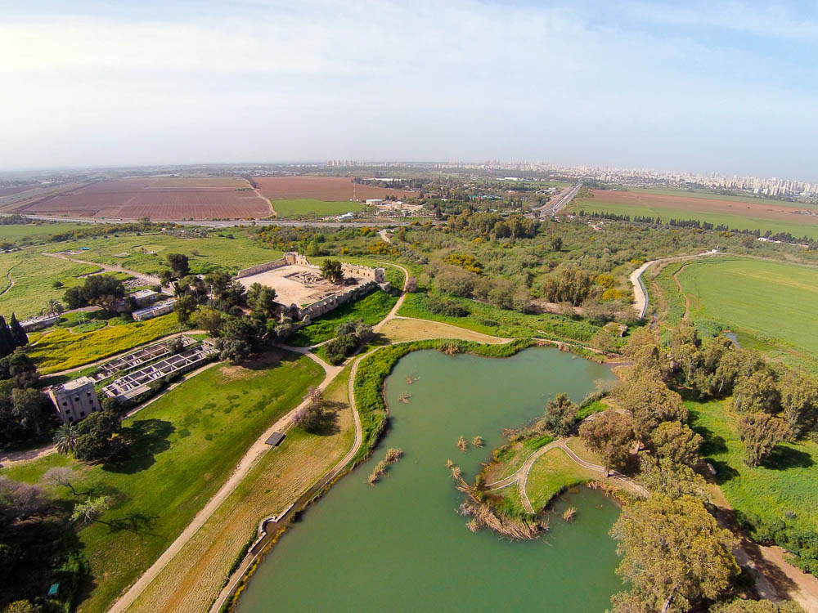
She went with her household and stayed in the land of the Philistines for seven years
Aphek (aerial view from the northeast)
8:2
Notes:
Aphek is one of the northernmost cities of the coastal plain that may have been considered part of the “land of the Philistines” (cf. 1 Sam 4:1; 1 Sam 29:1). A stay at Aphek, which was located at the large spring that was the head of the Yarkon River, would have allowed the Shunnamite to avoid the famine that she would have experienced had she stayed in Shunem.
ws032715905

Slide 16
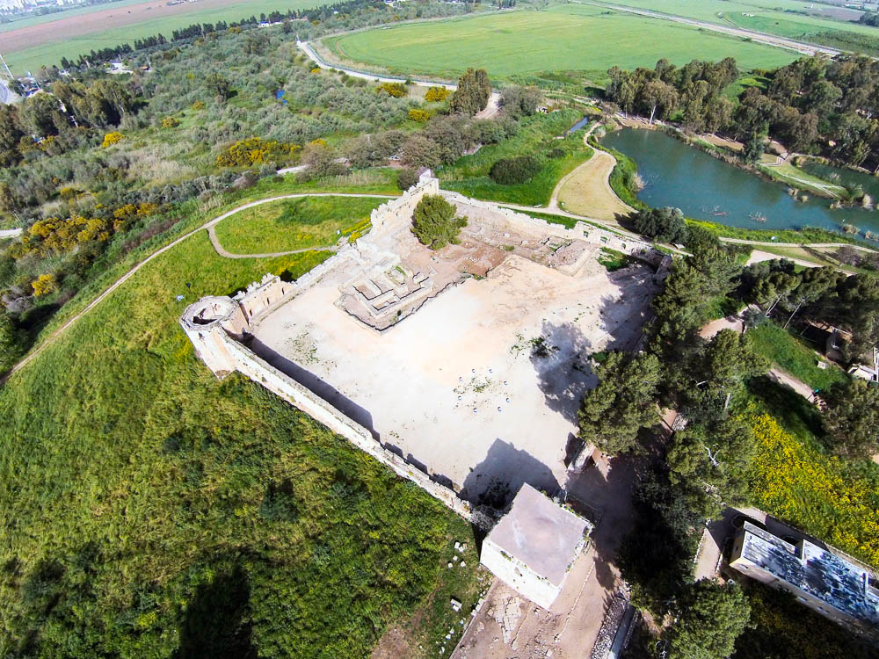
She went with her household and stayed in the land of the Philistines for seven years
Turkish fort and Late Bronze Egyptian fort at Aphek (aerial view from the southeast)
8:2
Notes:
Excavations have shown that Aphek was inhabited from the Chalcolithic period. The site has been excavated a number of times in the last century. From 1972 to 1985, a major excavation was carried out by Moshe Kochavi of Tel Aviv University. This aerial photo shows some of the excavations within the Turkish fort, which was built in the 16th century.
ws032715899

Slide 17
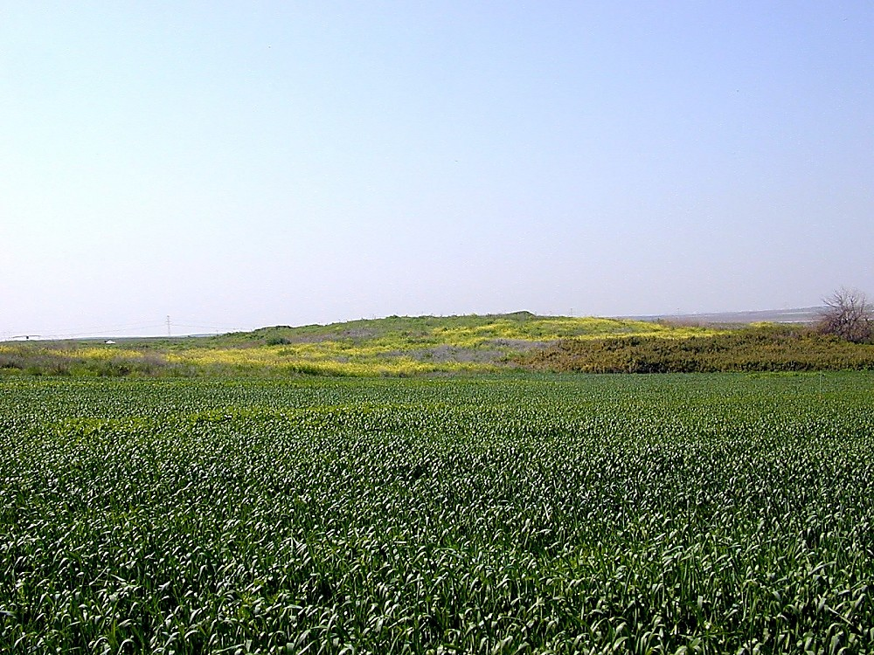
She went with her household and stayed in the land of the Philistines for seven years
Ekron
8:2
Notes:
It is possible that the Shunammite woman travelled further south, deeper into Philistia. Ekron, shown here, is the northernmost of the five largest Philistine cities (i.e., the Pentapolis: Gaza, Ashkelon, Ashdod, Gath, Ekron; cf. 1 Sam 6:17).
tb031500222

Slide 18
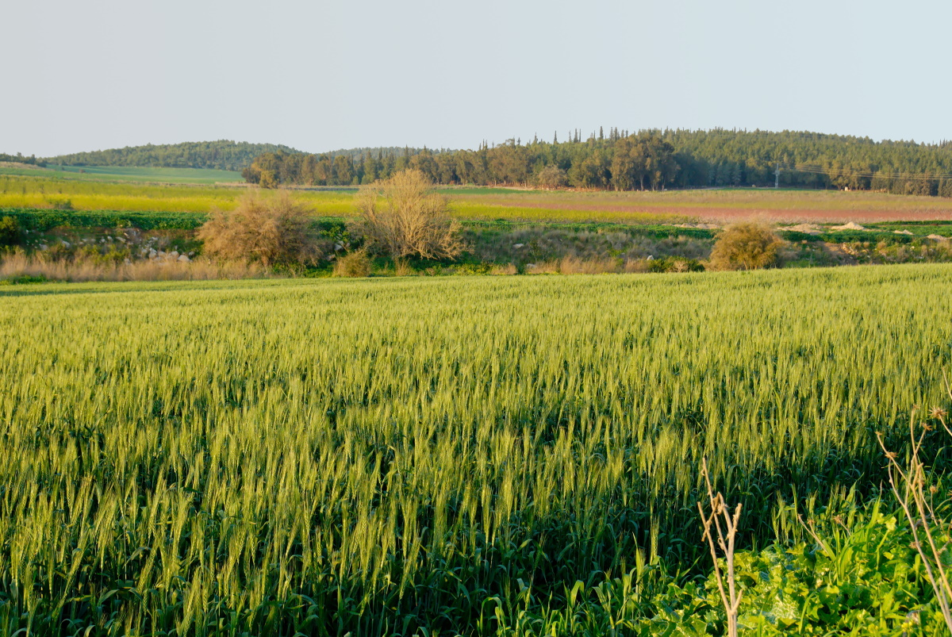
She went with her household and stayed in the land of the Philistines for seven years
Wheatfield near Gath (Tell es-Safi)
8:2
Notes:
The famine apparently did not affect Philistia, at least to the extent that it did the Israelite territories. The presence of rain is illustrated here by a green wheat field outside Gath, another Philistine city.
tb022807572c

Slide 19
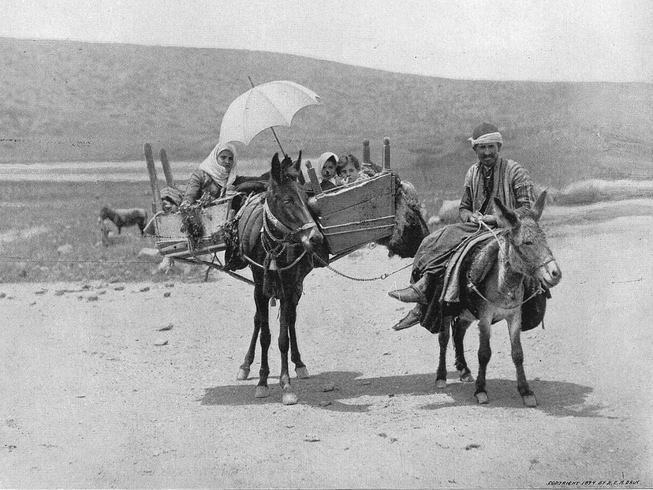
After seven years the woman returned from the land of the Philistines
Family traveling in Galilee
8:3
Notes:
This photograph was taken in the early 1890s and comes from Earthly Footsteps of the Man of Galilee, by John H. Vincent, James W. Lee, and R. E. M. Bain. A digital version of this work is available from BiblePlaces.com.
ef0134

Slide 20
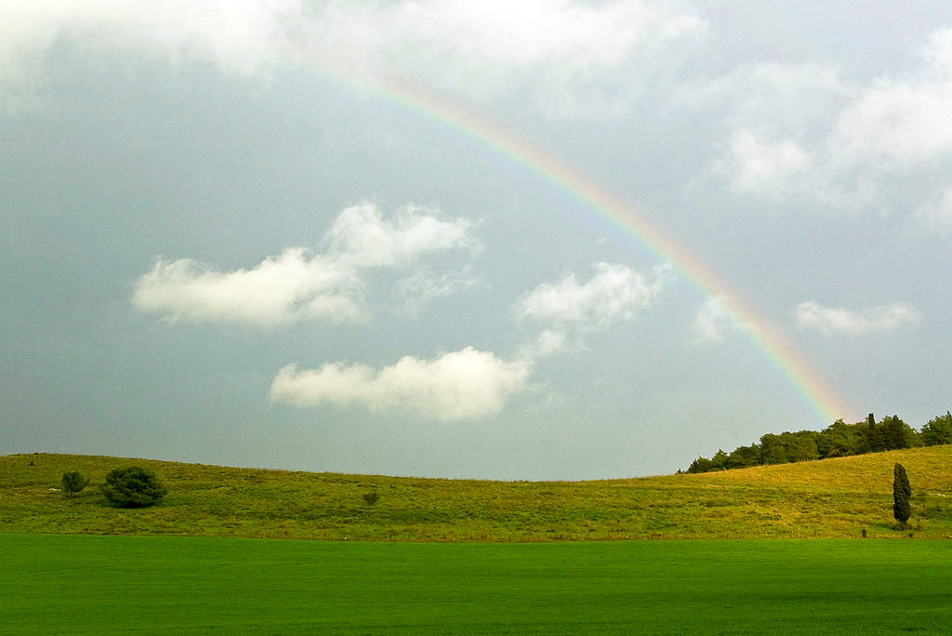
After seven years the woman returned from the land of the Philistines
Rainbow at Ramot Menashe
8:3
Notes:
Presumably the return of the Shunammite woman and her household was due to the end of the famine, represented here by a rainbow. Ramot Menashe, the location of this photo, is in the Carmel mountain range not far from the likely route of the Shunammite woman as she travelled home. This image comes from שי קסל and is licensed under CC BY 2.5, via Wikimedia Commons: https://commons.wikimedia.org/wiki/File:PikiWiki_Israel_6609_rainbow.jpg.
wiki660912302009121

Slide 21
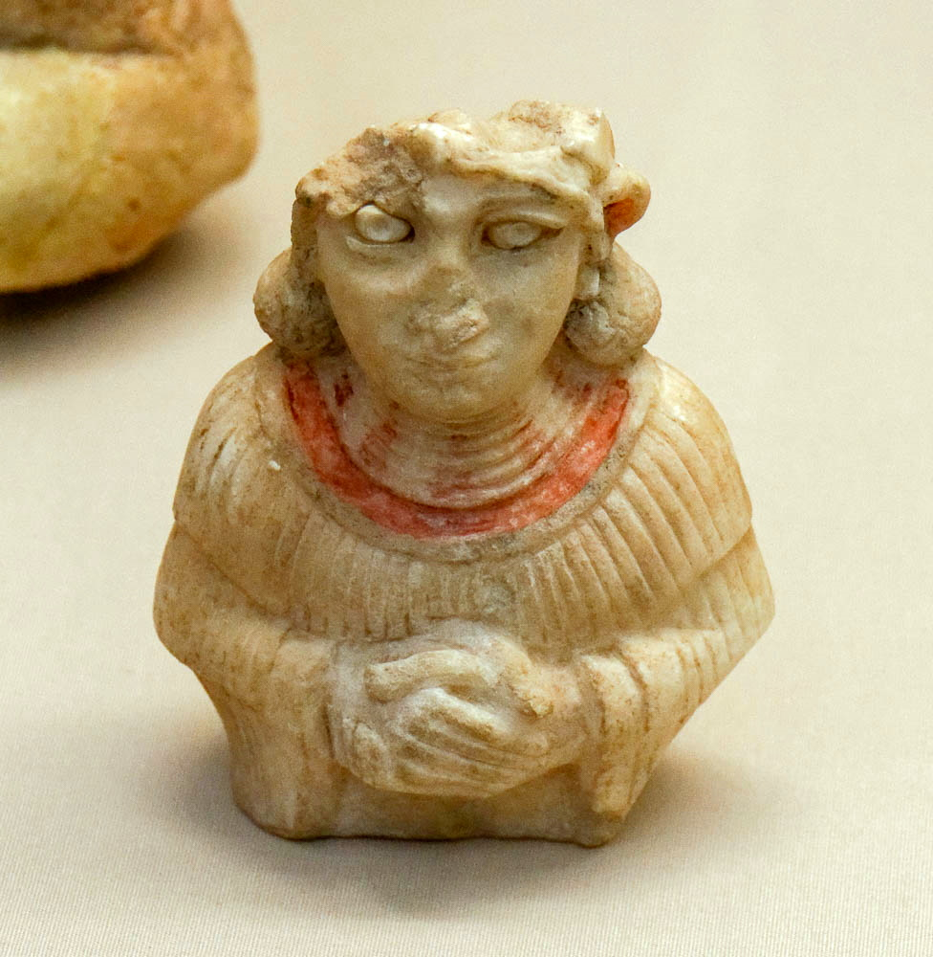
Then she went to appeal to the king for her house and her land
Painted stone statue of a woman with her hands clasped, from Ur, 2000–1600 BC
8:3
Notes:
In ancient Mesopotamia, the stance portrayed by this statue, with hand clasped in front, indicates piety and religious devotion, and is probably similar to the stance that would have been taken by a supplicant like the Shunammite woman. This statue was photographed at the British Museum.
tb0929197402

Slide 22
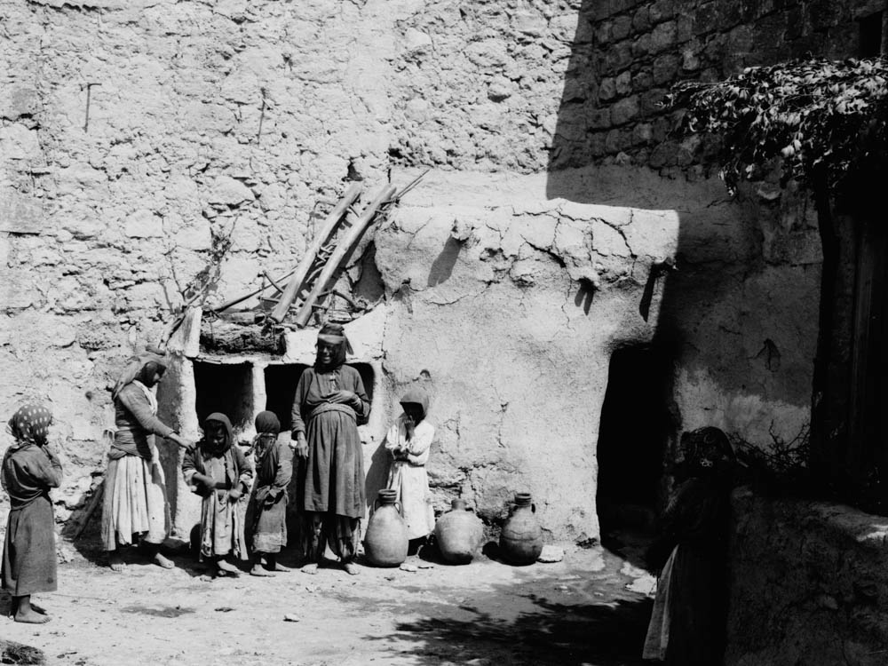
Then she went to appeal to the king for her house and her land
Woman and children in the courtyard of a house
8:3
Notes:
Apparently during her absence the woman’s house and fields had been taken over by other people, whom she now needed to evict. This American Colony photo was taken between 1898 and 1946.
mat06314

Slide 23
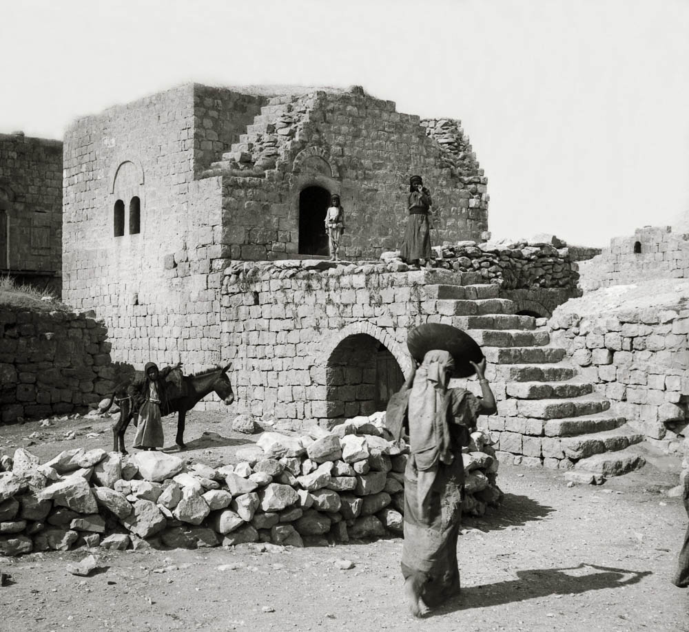
Then she went to appeal to the king for her house and her land
Village guest chamber
8:3
Notes:
According to 1 Kings 4:10, the house of the woman of Shunem had been equipped with a second-floor guestroom for Elisha. This American Colony photograph was taken between 1900 and 1920 and shows a traditional “upper room” where guests would lodge.
mat05610

Slide 24
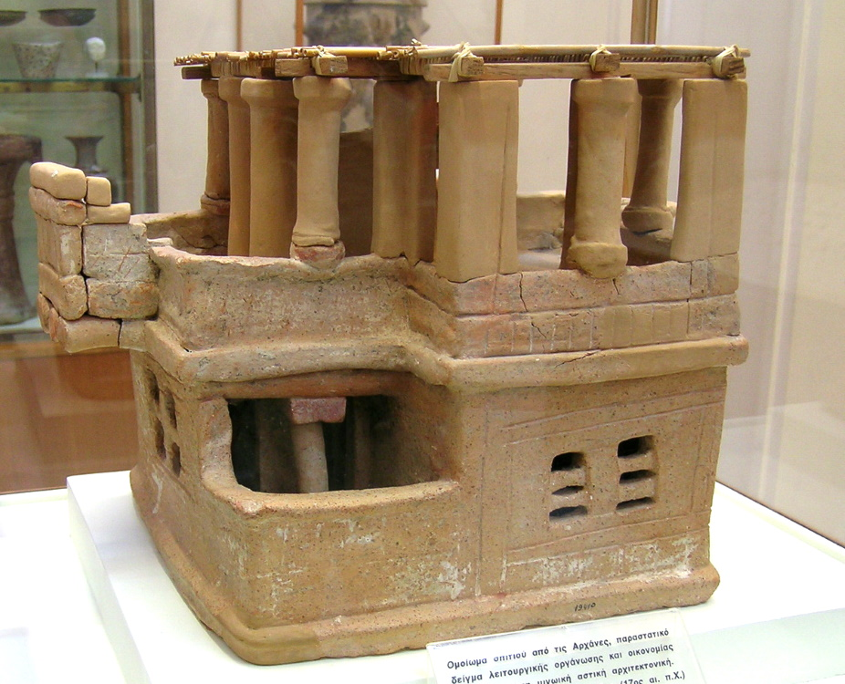
Then she went to appeal to the king for her house and her land
House model with an upper floor, from Arhanes, 17th century BC
8:3
Notes:
This model of a house with an upper room comes from Arhanes (Archanes) on the island of Crete. It was photographed at the Heraklion Museum.
tb041504168

Slide 25
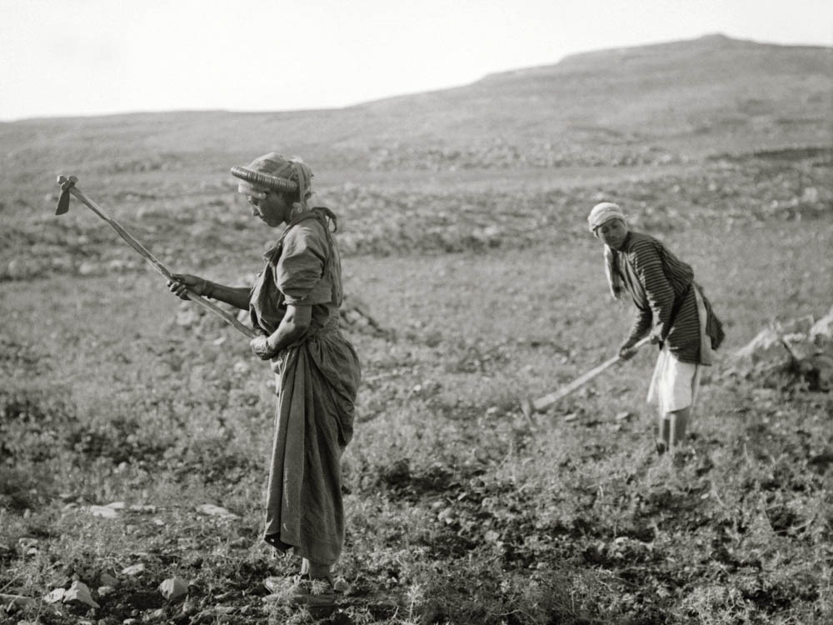
Then she went to appeal to the king for her house and her land
Working in a field with hoes, circa 1910
8:3
Notes:
The land and its produce would have been the means of support by which the Shunammite woman and her household were able to survive (cf. 2 Kgs 4:18). This American Colony photo was taken between 1900 and 1920.
mat05234

Slide 26
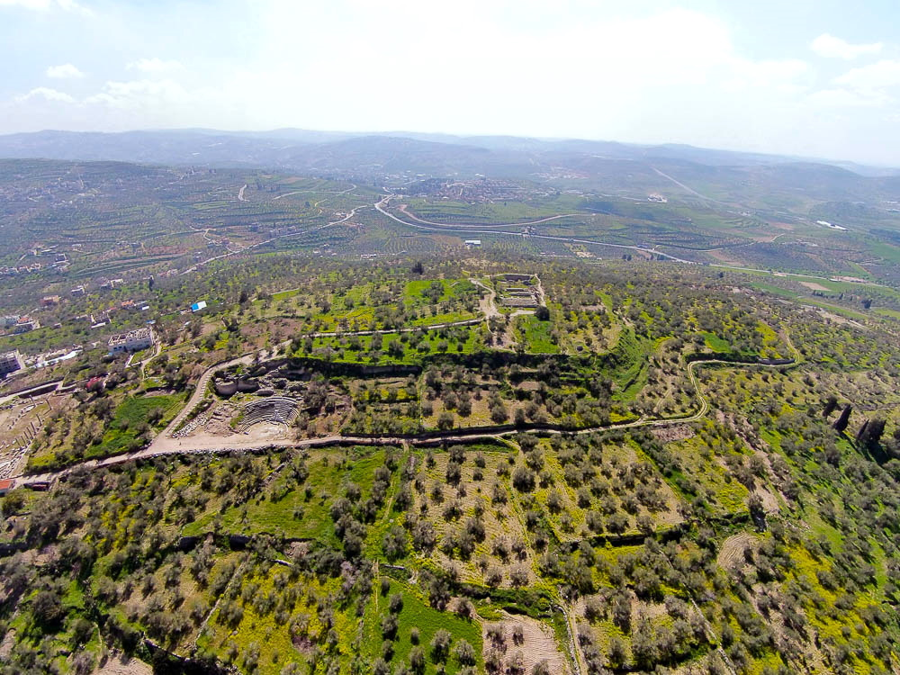
Now the king was talking with Gehazi the servant of the man of God
Samaria acropolis (aerial view from the north)
8:4
Notes:
The events of this section would almost certainly have taken place at the capital city of Samaria, the residence of the king. The palace of the Israelite kings was excavated in 1908‒10 by Harvard University, but the remains were subsequently reburied and are not visible today. The most impressive remains visible at Samaria today are from the Greco-Roman period, and include a temple to Augustus, a large theater, and a hippodrome.
ws030515602

Slide 27
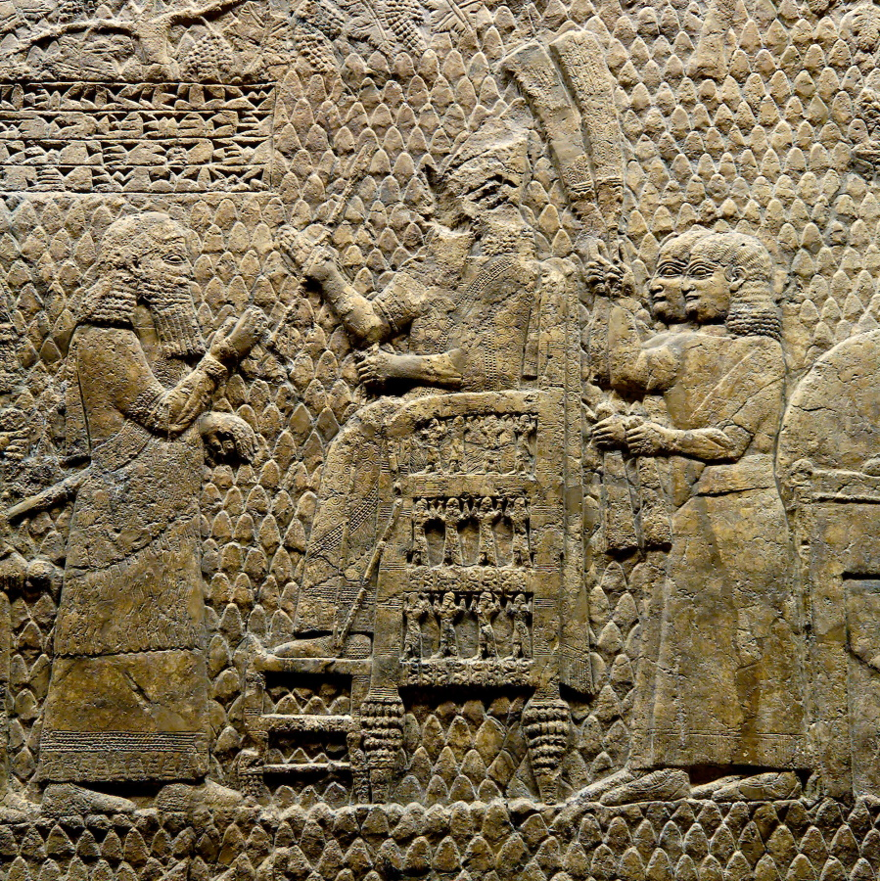
Now the king was talking with Gehazi the servant of the man of God
Assyrian king talking with an official, from Nineveh, circa 700 BC
8:4
Notes:
This relief comes from the palace of the Assyrian king Sennacherib at Nineveh. It portrays a king on his throne, attended by whisk-waving eunuchs, speaking with one of his officials. This relief was photographed at the British Museum.
tb112004329

Slide 28
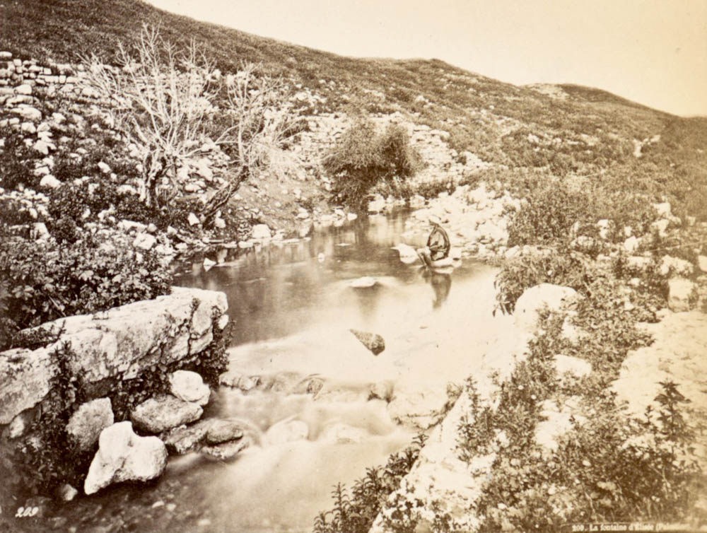
He was saying, “Please tell me all the great things that Elisha has done”
Spring of Jericho, circa 1880
8:4
Notes:
By this time Elisha had already accomplished an impressive number of miraculous feats. One was the cleansing of the spring at Jericho (2 Kgs 2:19-22). This photo was taken by Felix Bonfils between 1870 and 1889. It shows the spring of Jericho (“Elisha’s Spring”) as it flows from the foot of the tell, which is the hill that forms the backdrop. The photo is of particular interest because it shows the proximity of the spring to the city, which is difficult for the modern viewer to grasp with the roads and buildings that now cover this area.
nypl76537

Slide 29
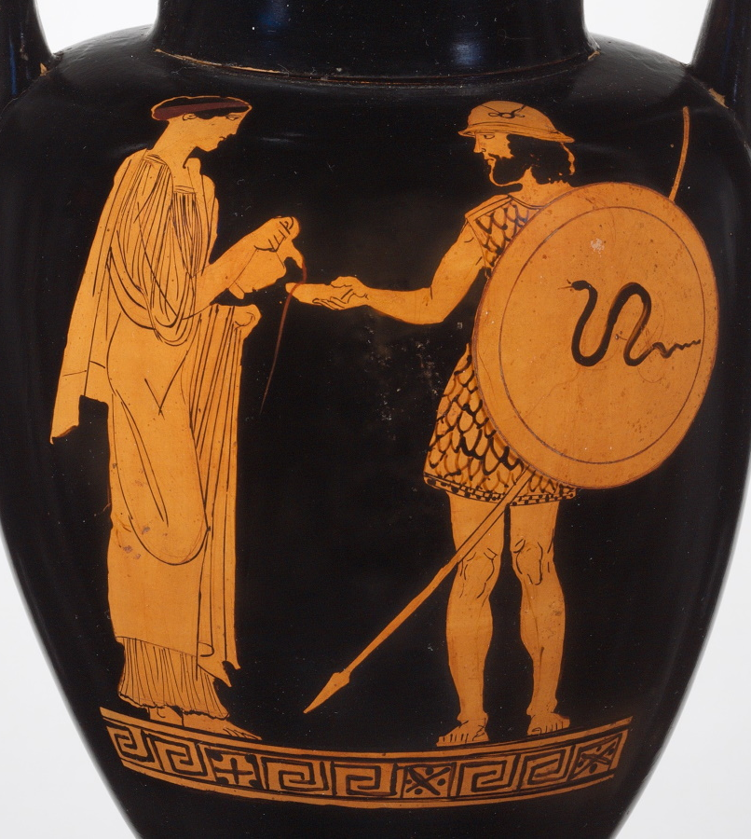
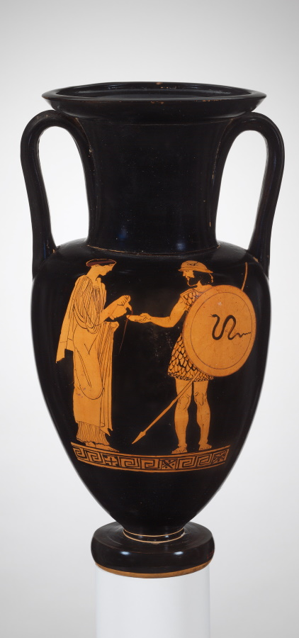
He was saying, “Please tell me all the great things that Elisha has done”
Jar depicting a woman pouring a libation for a warrior, circa 450 BC
8:4
Notes:
Another miraculous act of Elisha was the unending flask of oil that he provided for a widow (2 Kgs 4:1-7), similar to the miracle of Elijah for the widow at Zarephath (1 Kgs 17:19). The scene painted on this Greek amphora depicts a woman pouring a libation for a departing warrior. The fluid from her jar, probably wine in this case, can be seen running into the dish that he holds and even overflowing. This image comes from The Metropolitan Museum of Art and is in the public domain. Source: https://www.metmuseum.org/art/collection/search/254281.
met254281

Slide 30
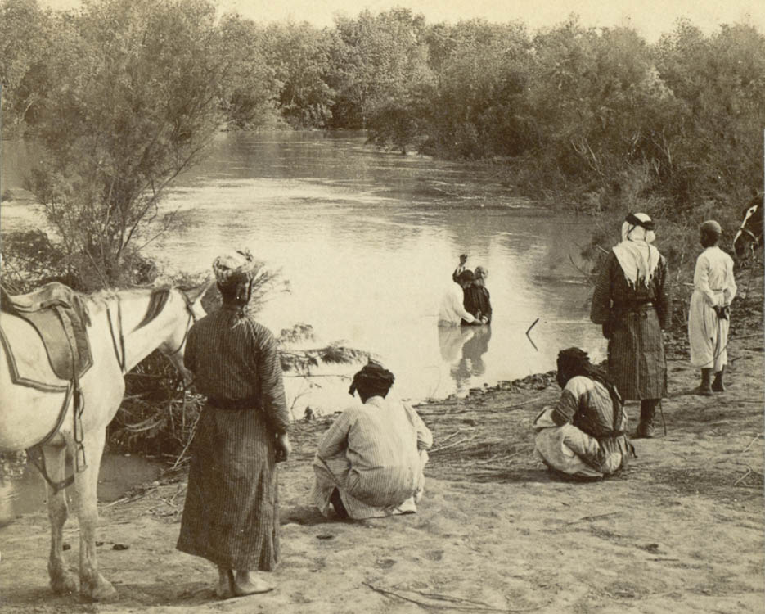
He was saying, “Please tell me all the great things that Elisha has done”
Baptism in the waters of the Jordan River, 1903
8:4
Notes:
Another miracle of Elisha was cleansing Naaman of his leprosy, which occurred when Naaman dipped himself seven times in the Jordan River (2 Kgs 5:14). This photo of a baptism in the Jordan River was taken from the western bank of the river, probably near the Qasr Al-Yahud baptism site. The view looks downstream, in the direction of the Dead Sea. This image comes from SMU Central University Libraries and is in the public domain, via Wikimedia Commons: https://commons.wikimedia.org/wiki/File:Baptizing_in_the_Jordan,_Palestine_(28903127403).jpg.
wiki28903127403

Slide 31
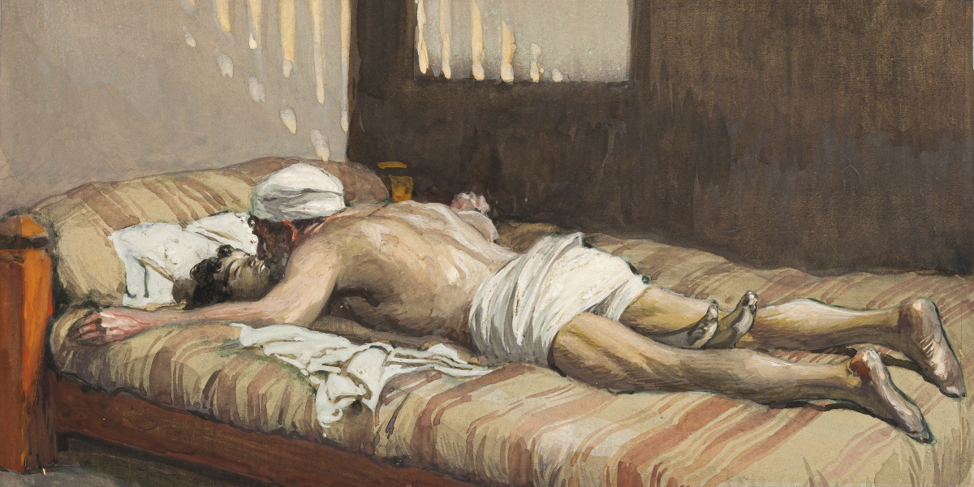
Now he was telling the king how Elisha had brought back to life the one who was dead
Elijah Raises the Widow’s Son, by James Tissot, circa 1899
8:5
Notes:
The account of Elijah raising the son of the Shunnamite woman from the dead appears in 2 Kings 4:18-37. Gehazi had been present at this event (1 Kgs 4:29-31) and was able to provide a first-hand account. Elisha’s method of laying on top of the dead child is similar to the approach taken by Elijah when he raised the son of the widow of Zarephath (1 Kgs 17:21). This image of a gouache on board painting is in the public domain, via The Jewish Museum: https://thejewishmuseum.org/collection/26556-elijah-raiseth-the-widow-s-son.
tjm26556

Slide 32
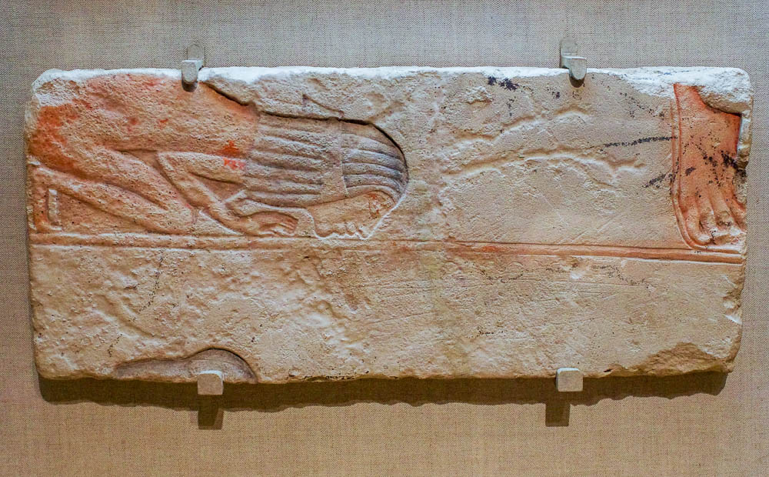
At that very moment the woman and her son appealed to the king for the return of their house
Woman bowing to the ground, from Hermopolis, reign of Akhenaten, 14th century BC
8:5
Notes:
This relief was photographed at the Boston Museum of Fine Arts.
adr1711203367

Slide 33
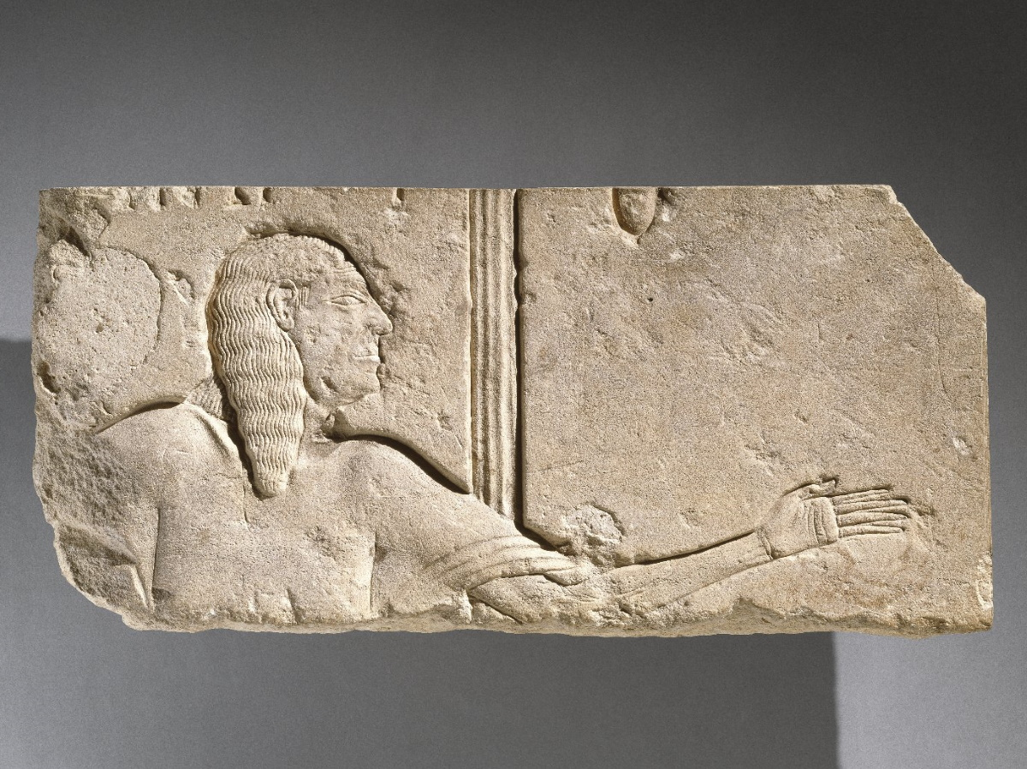
And Gehazi said, “O king, this is the woman and her son whom Elisha restored to life!”
Relief of an aged courtier, from Saqqara, circa 1300 BC
8:5
Notes:
This relief is unusual in depicting an elderly court official. He holds out his hand as though he were in conversation or perhaps presenting someone. This image comes from the Brooklyn Museum, Charles Edwin Wilbour Fund, 47.120.1, Creative Commons-BY. Source: https://www.brooklynmuseum.org/opencollection/objects/3483
bmny3483

Slide 34
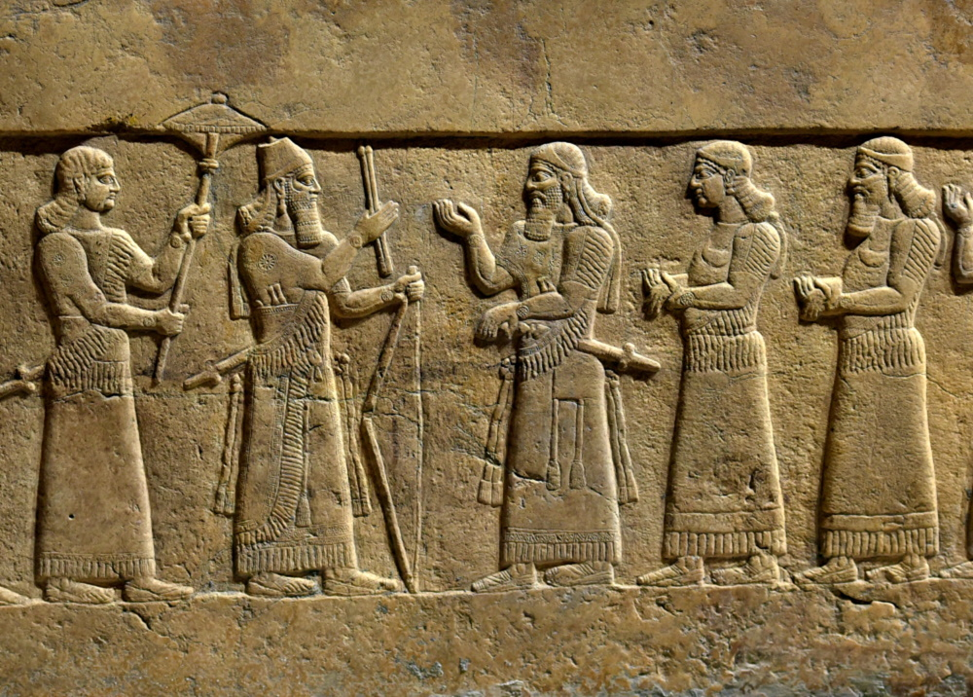
So the king appointed an officer for her, saying, “Restore all that was hers”
Assyrian king and court officials, from Nimrud, 9th century BC
8:6
Notes:
The “officer” (Heb. saris, סָרִיס) was a high-ranking official who had the authority to implement the decision of the king in matters like these. This relief illustrates a number of men (probably court officials) standing in the presence of a king. The king is Shalmaneser III (r. 858–824 BC) of Assyria, a contemporary of Joram and Elijah. This relief comes from the front panel of the throne dais of Shalmaneser III. It was photographed at the Iraq Museum. This image comes from Osama Shukir Muhammed Amin and is licensed under CC BY-SA 4.0, via Wikimedia Commons: https://commons.wikimedia.org/wiki/File:Front_Panel,_Throne_Dais_of_Shalmaneser_III_at_the_Iraq_Museum.jpg.
wiki031420191145302622

Slide 35
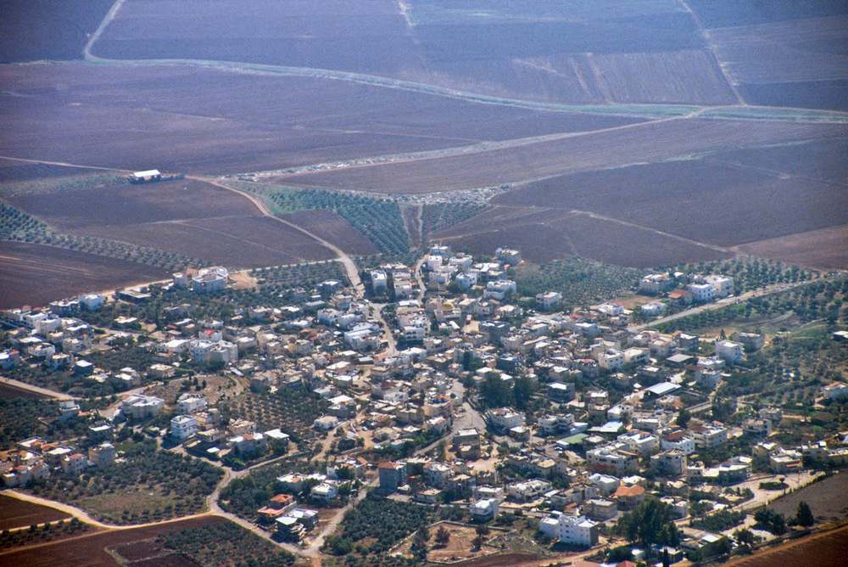
So the king appointed an officer for her, saying, “Restore all that was hers”
Shunem (aerial view from the northwest)
8:6
Notes:
Surface surveys of Shunem show occupation from the Middle Bronze to the Arabic periods. Most of the pottery, however, is from the Late Bronze and Early Iron Ages (circa 1550–1000 BC). Because the site is covered by a modern village, excavations at Shunem have not been possible.
tbs121040011

Slide 36
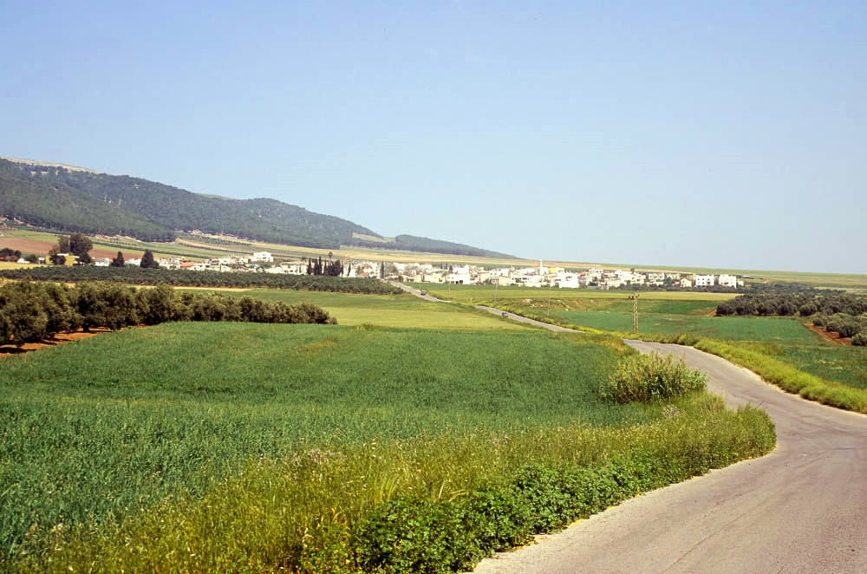
So the king appointed an officer for her, saying, “Restore all that was hers”
Shunem and the Hill of Moreh (from the west)
8:6
Notes:
This ground-level view of Shunem shows its proximity to the Hill of Moreh, located just to the north. The next slide includes labels.
tbs104109904

Slide 37
So the king appointed an officer for her, saying, “Restore all that was hers”
Hill of Moreh
Shunem
Shunem and the Hill of Moreh (from the west)
8:6
Notes:
This ground-level view of Shunem shows its proximity to the Hill of Moreh, located just to the north.
tbs104109904

Slide 38
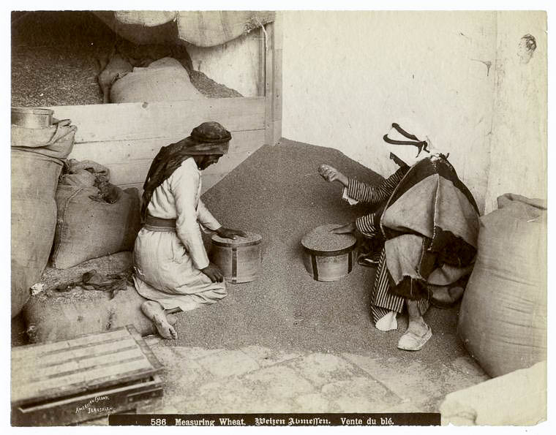
Also restore to her the produce of the land from the day that she left until now
Men measuring wheat
8:6
Notes:
The restoration of the Shunammite’s land may be in accordance with the seven-year land release (Deut 15:1; cf. Exod 21:2-3). A primary product of her land would have been grain (cf. 2 Kgs 4:18), illustrated here by men measuring wheat. This image, taken between 1900 and 1939, comes from American Colony, Assortment of Photographs of Palestine and Jerusalem, published in 1900–39. Public domain, from The New York Public Library, https://digitalcollections.nypl.org/items/510d47d9-77e0-a3d9-e040-e00a18064a99
nypl112610

Slide 39
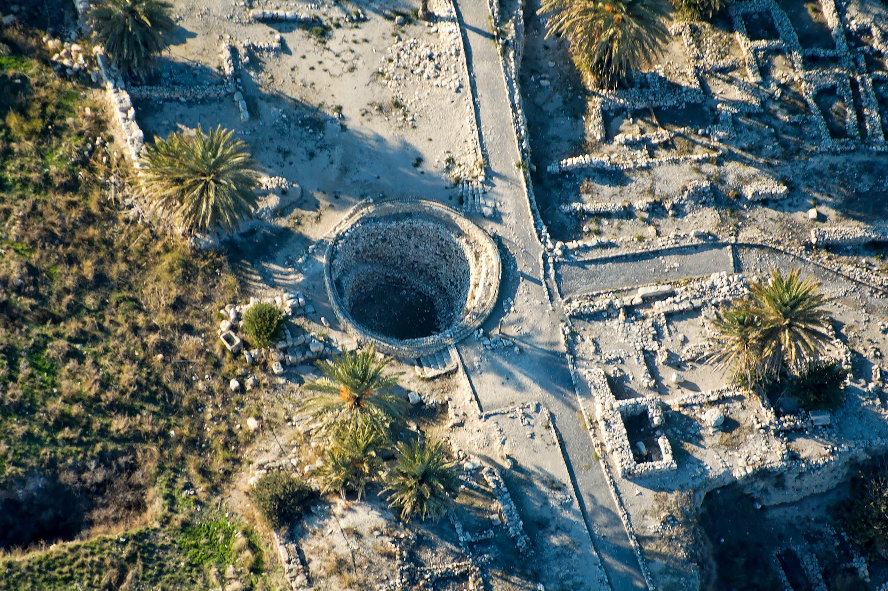
Also restore to her the produce of the land from the day that she left until now
Grain silo at Megiddo, 8th century BC (aerial view from the east)
8:6
Notes:
Grain may have been stored in silos, either at Shunem or at a nearby administrative center under the authority of the king. This 8th century BC silo from Megiddo demonstrates grain storage at an Israelite administrative center.
tb121704998

Slide 40
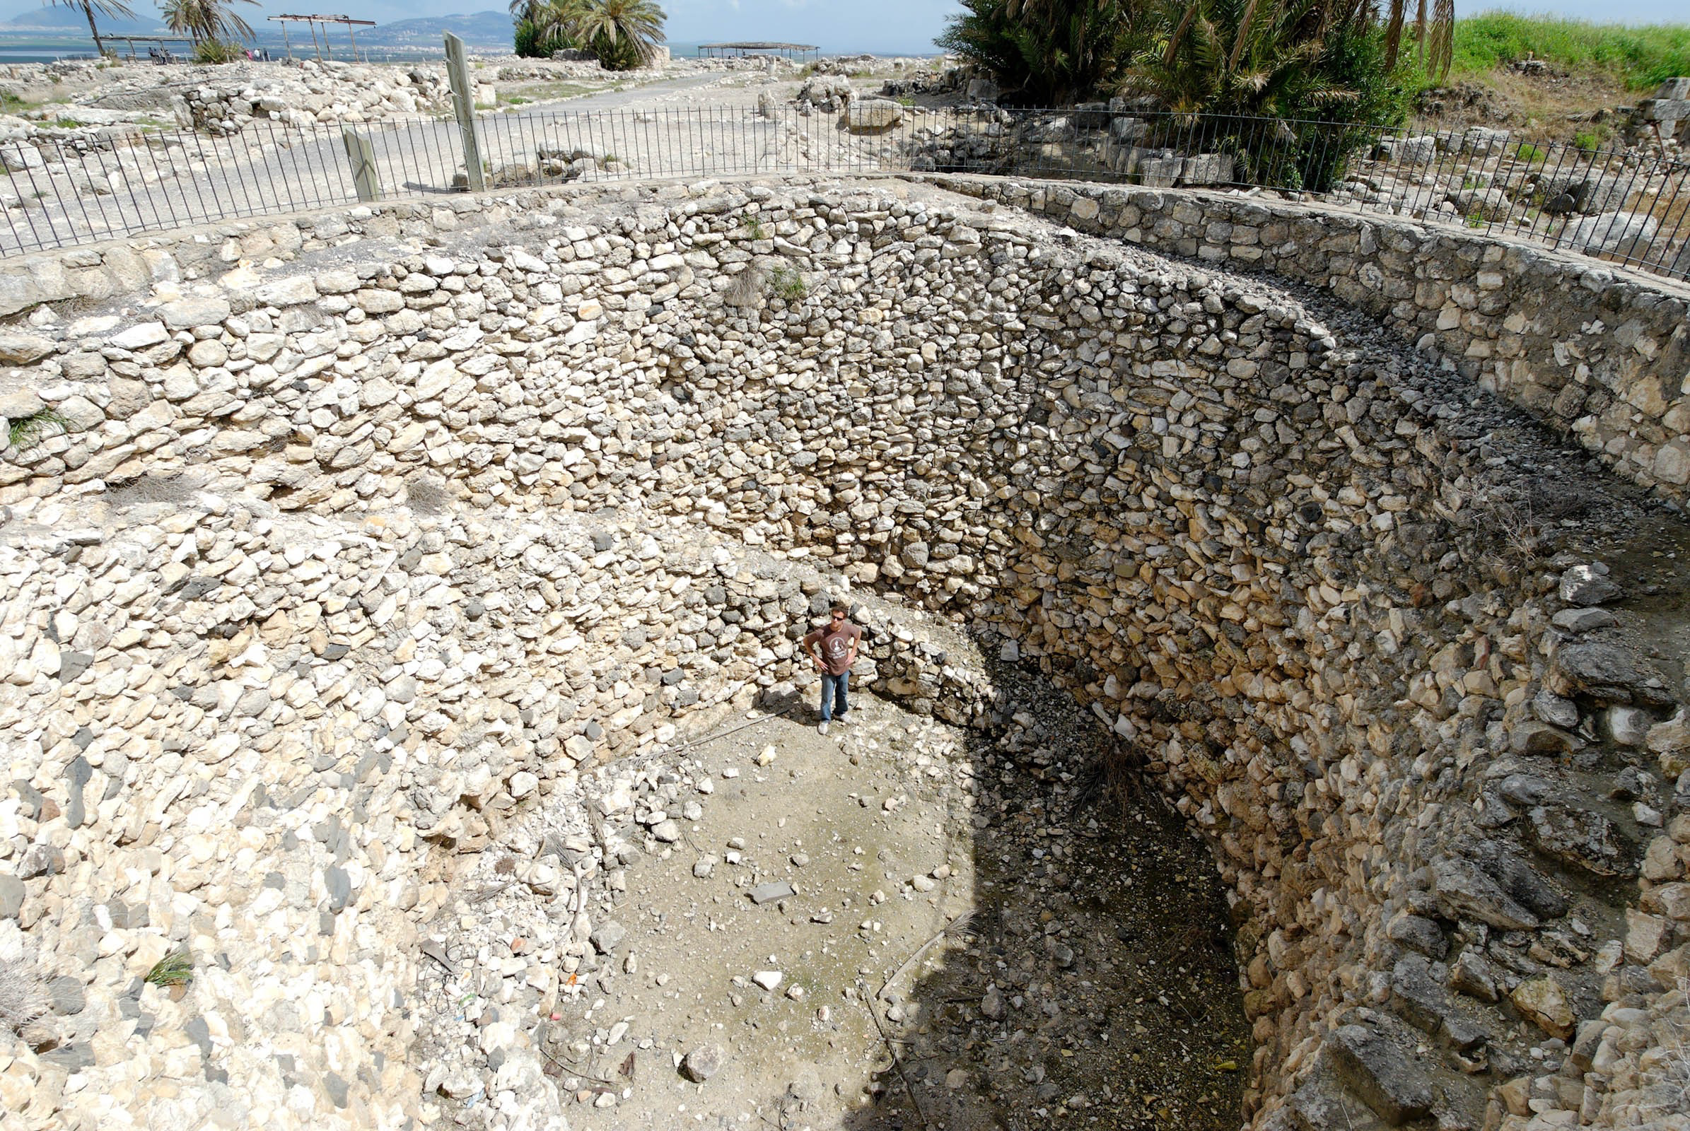
Also restore to her the produce of the land from the day that she left until now
Grain silo at Megiddo, 8th century BC
8:6
Notes:
This photo shows a ground-level view of the grain silo at Megiddo. A set of two stairways encircled the perimeter, allowing grain to be more easily accessed.
tb032507602

Slide 41
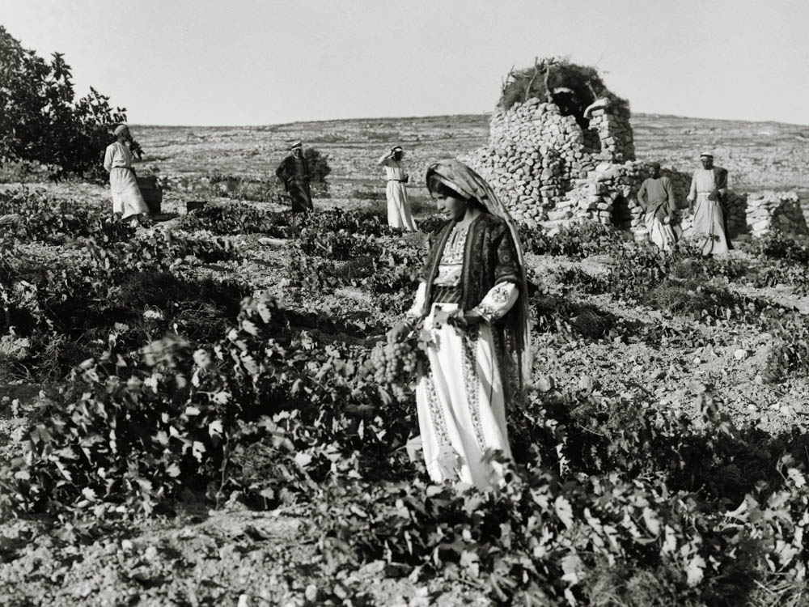
Also restore to her the produce of the land from the day that she left until now
Gathering grapes in a vineyard, circa 1935
8:6
Notes:
It is also possible that the return of produce would have included wine. The Jezreel Valley has a climate that is conducive to raising grapes, as is evident from the Naboth account (1 Kgs 21), which occurred outside Jezreel, only 3 miles (5 km) south of Shunem. This American Colony photo was taken between 1934 and 1939.
mat04200

Slide 42
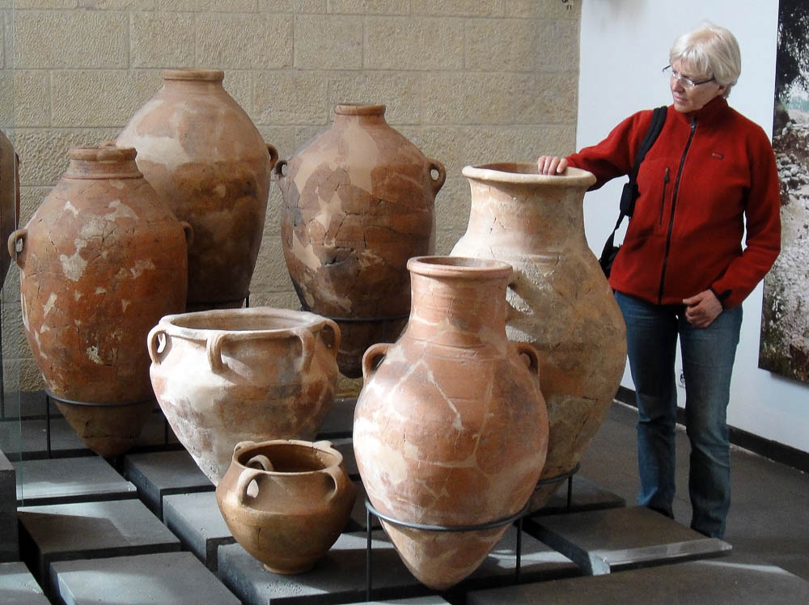
Also restore to her the produce of the land from the day that she left until now
Collared rim jars from Dan, Iron Age
8:6
Notes:
Long-term wine storage, or storage for long-haul transportation (such as to Egypt) was usually in large clay amphora. Most of the amphora shown here are too large for transportation and would have been filled and emptied in the place where they were stored. Jars of this size were also sometimes used for grain storage. This display was photographed at the Skirball Museum at Hebrew Union College in Jerusalem.
as030310500

Slide 43
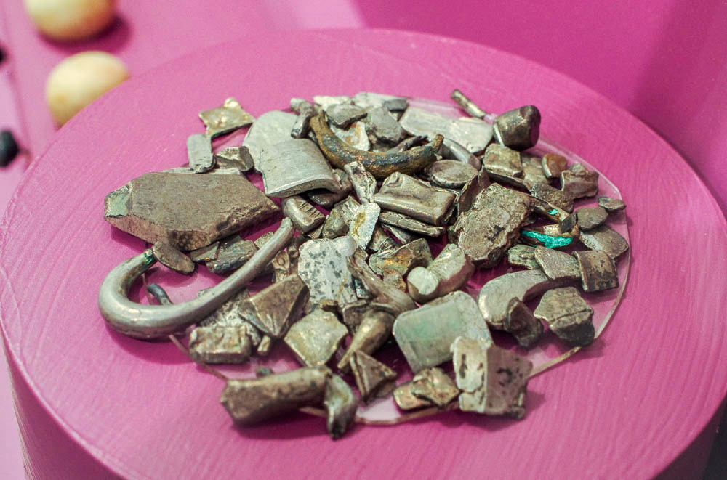
Also restore to her the produce of the land from the day that she left until now
Hacksilver (pieces of silver used as currency) from Shechem, 8th century BC
8:6
Notes:
Perhaps some restoration of goods was also made in silver, rather than in kind. This display was photographed at the Harvard Museum of the Ancient Near East.
adr1711180984

Slide 44
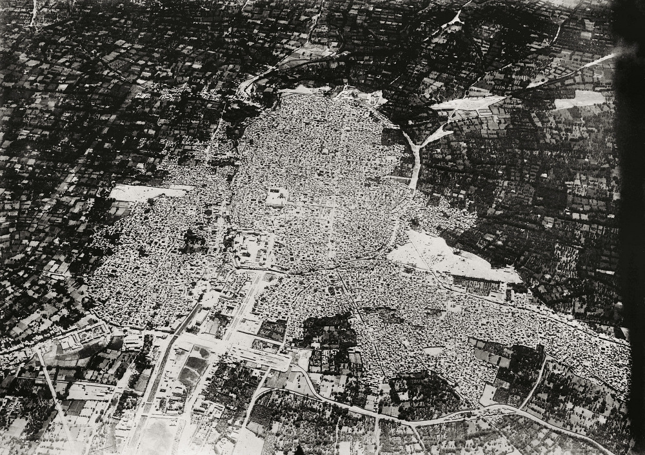
Now Elisha came to Damascus. And Ben-hadad the king of Aram was sick
Damascus, circa 1910 (aerial view from the west)
8:7
Notes:
This American Colony photograph was taken between 1900 and 1920.
mat05599

Slide 45
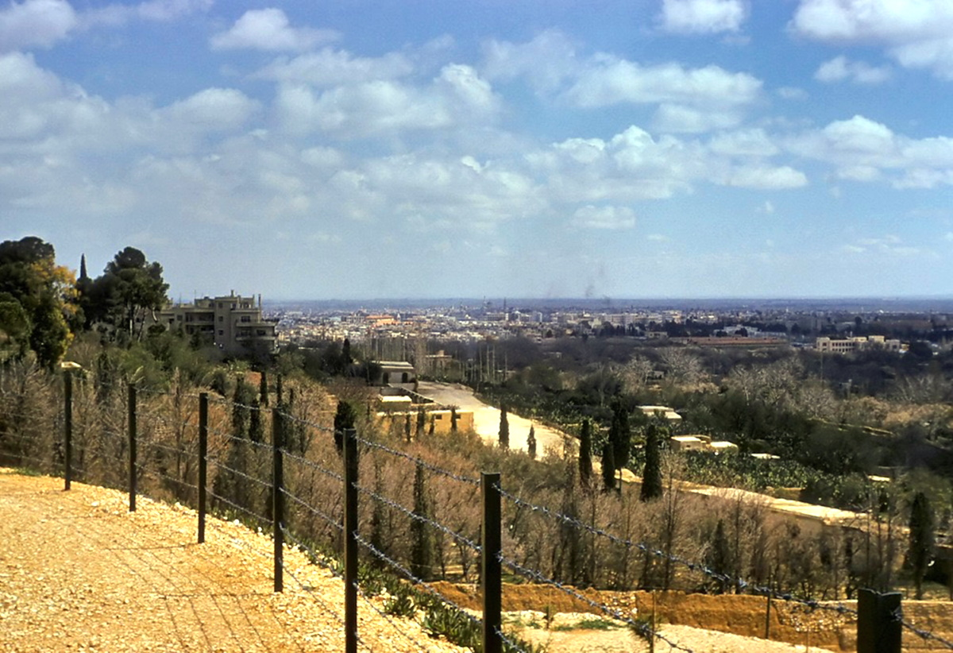
Now Elisha came to Damascus. And Ben-hadad the king of Aram was sick
View over the city of Damascus
8:7
Notes:
This photograph was taken in the 1960s and comes from The Photographs of Charles Lee Feinberg, available from www.BiblePlaces.com.
cf03-77

Slide 46
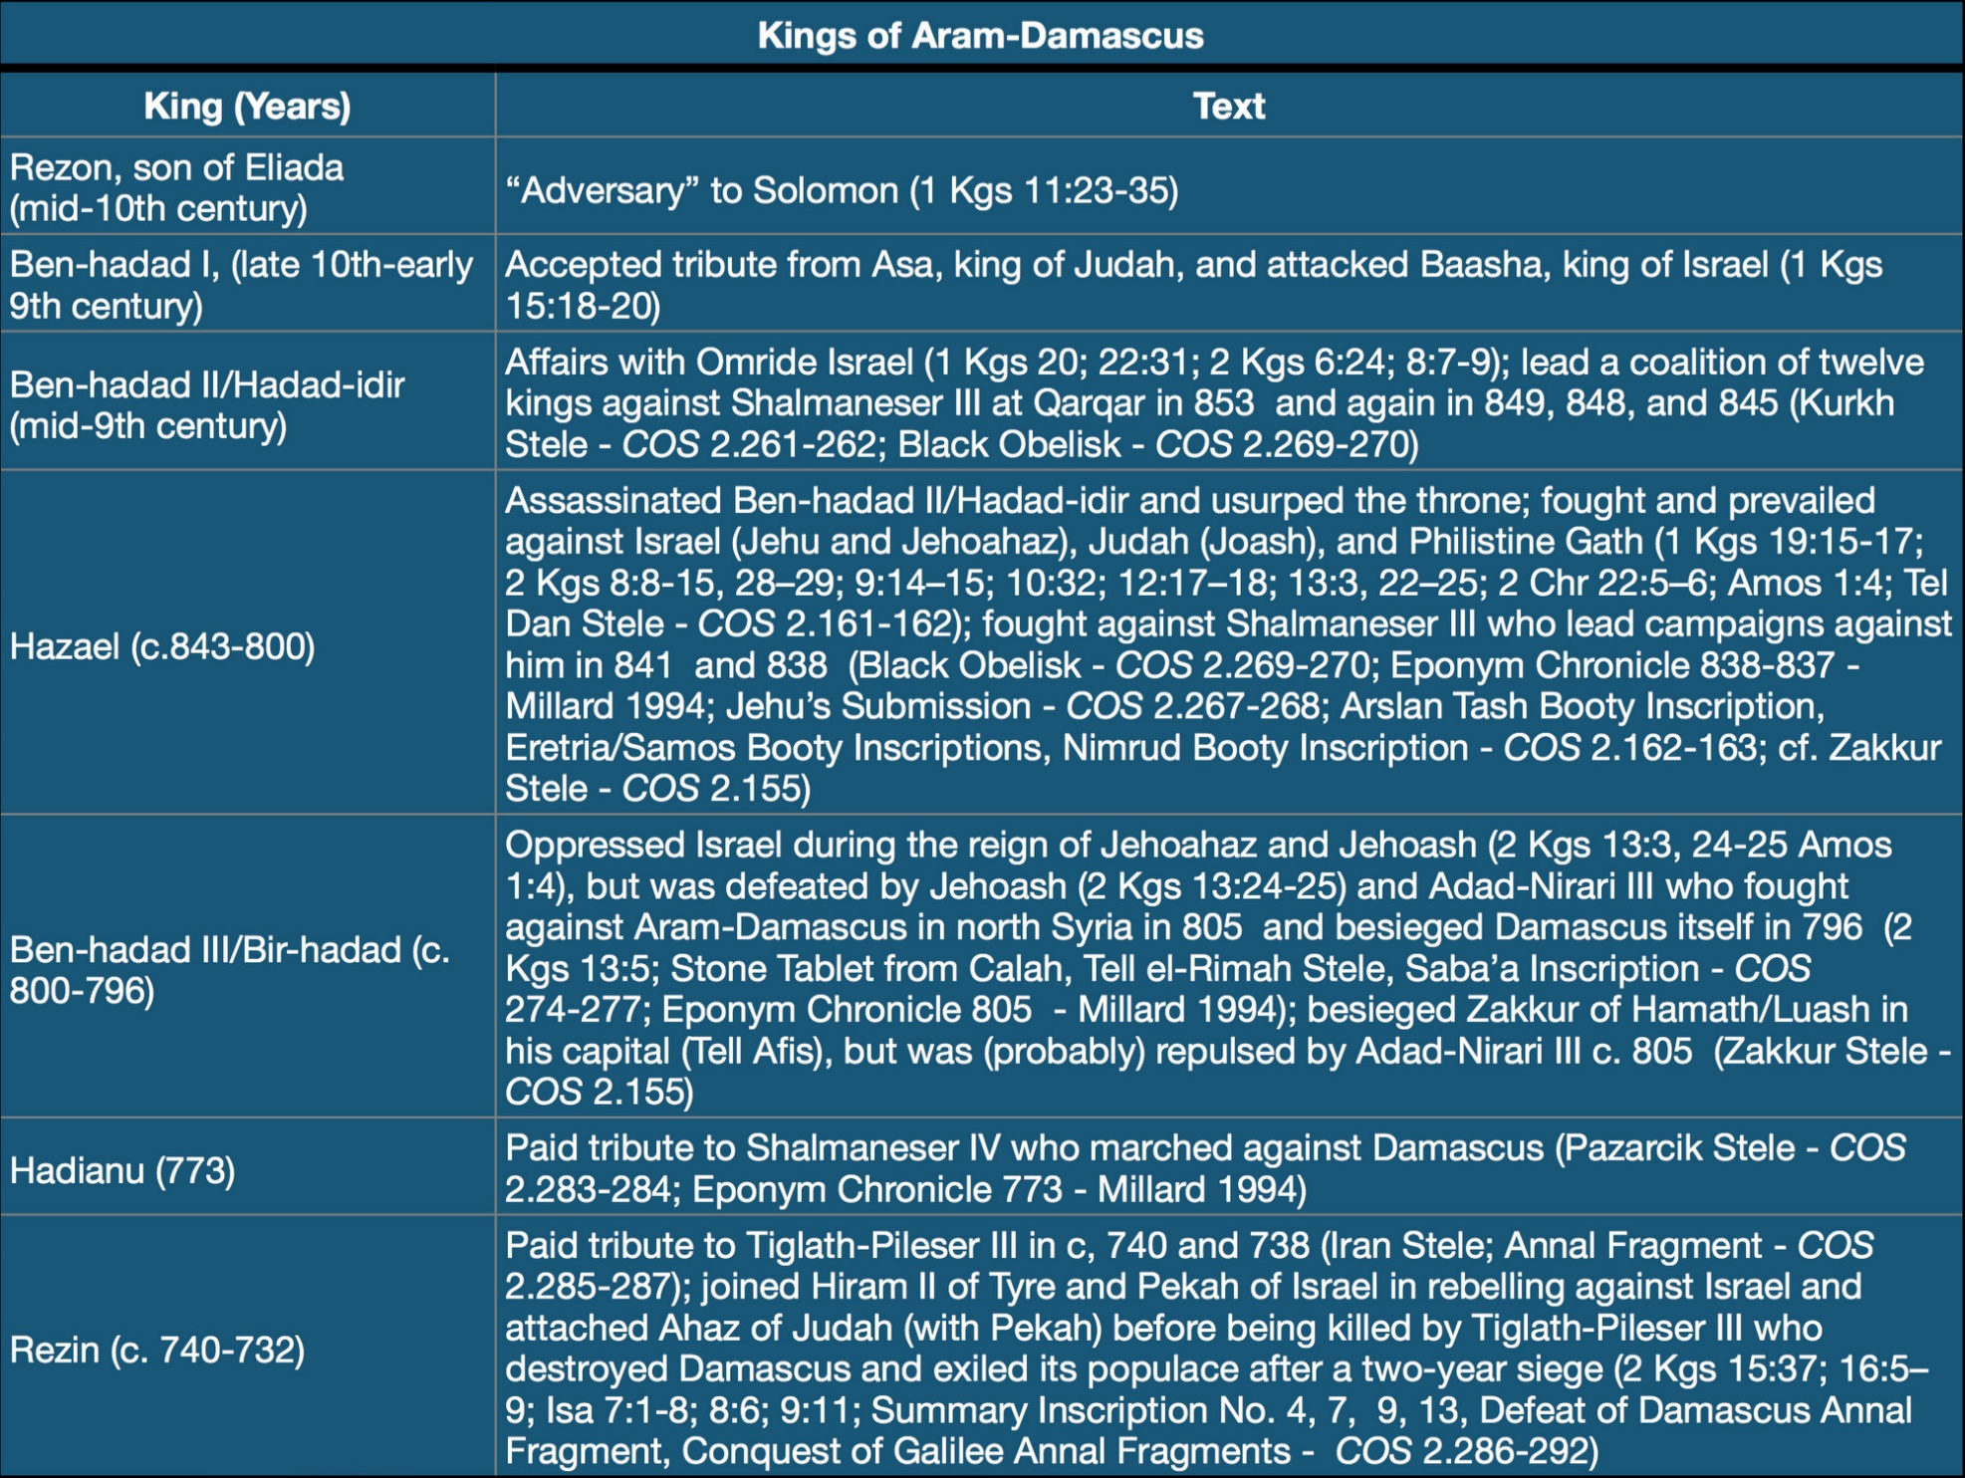
Now Elisha came to Damascus. And Ben-hadad the king of Aram was sick
Chronology chart of the known kings of Aram-Damascus
8:7
Notes:
The Aramean king mentioned here is identified as Ben-hadad. There are three kings of Aram known by this dynastic name. The king mentioned here is Ben-hadad II, since this account records his death at the hands of Hazael. Ben-hadad II reigned until at least 845 BC, since he is recorded in the twelve-king coalition against Shalmaneser III. He may have died as late as 843 BC, although a precise date is not known. This chart comes from The Regnal Chronology of the Kings of Judah and Israel: An Illustrated Guide, by Chris McKinny, available from BiblePlaces.com.

Slide 47
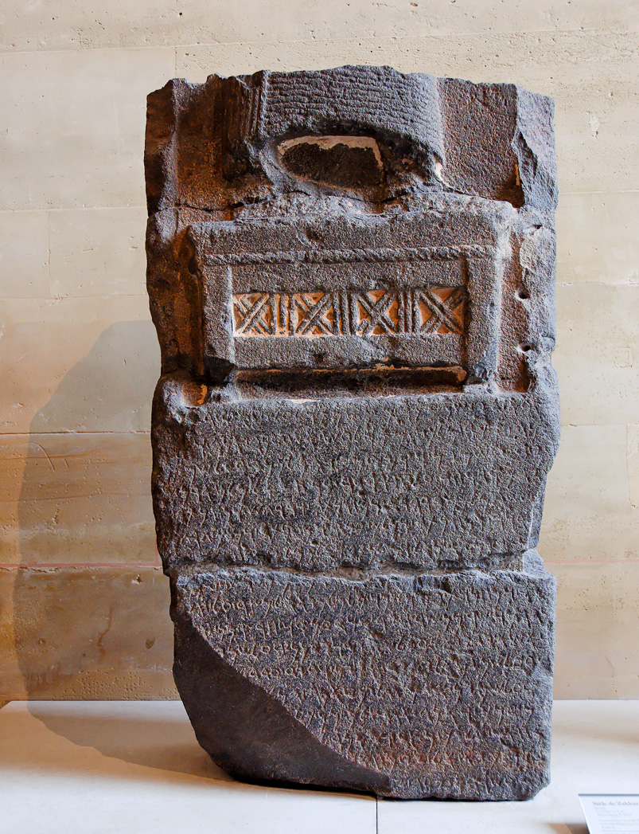
Now Elisha came to Damascus. And Ben-hadad the king of Aram was sick
Aramaic inscription on the Zakkur Stele, mentioning Ben-hadad III, from Tell Afis, circa 800 BC
8:7
Notes:
This basalt stele was set up by Zakkur, the king of Hamath, in about 800 BC. It was recovered from the ancient city of Afis, a city that is also mentioned at the end of the inscription as the place where it was installed. Afis is about 7 miles (11 km) north of Ebla. In the inscription, Zakkur refers to an enemy named “Ben-hadad, son of Hazael, king of Aram.” This is Ben-hadad III, who bore the same name as Ben-hadad II mentioned in this verse. This inscription was photographed at the Louvre Museum. The next slide includes a close-up of the name “Hazael.”
tb060408371

Slide 48
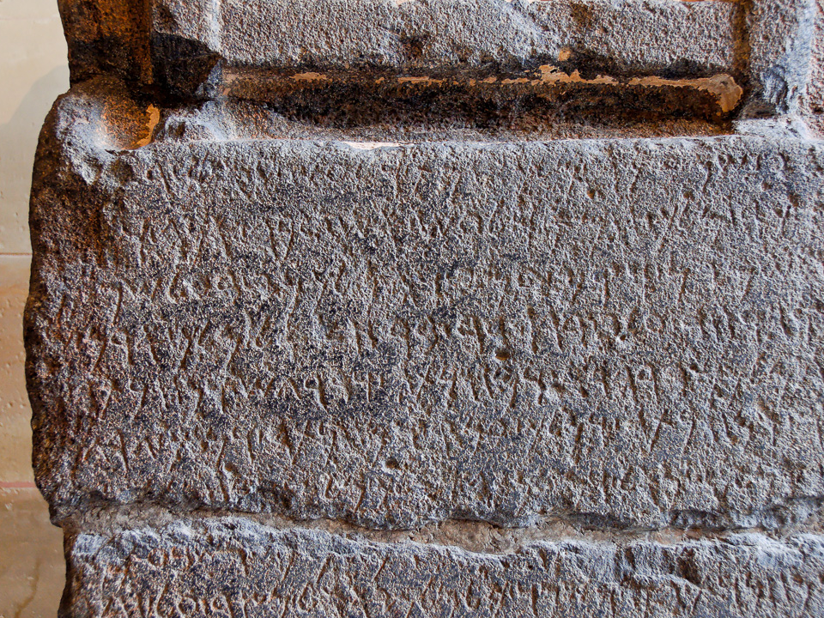
Now Elisha came to Damascus. And Ben-hadad the king of Aram was sick
Aramaic inscription on the Zakkur Stele, mentioning Ben-hadad III, from Tell Afis, circa 800 BC
8:7
Notes:
The inscription on the Zakkur Stele refers to an enemy of Zakkur, a certain “Ben-hadad, son of Hazael, king of Aram.” Because this inscription is written in Aramaic, the name is actually given as “Bar-hadad” (Arm. בר הדד); the Aramaic word “bar” is the equivalent of the Hebrew “ben,” both with the meaning “son.” This inscription was photographed at the Louvre Museum. For a full translation of this inscription, see Millard (2000: 155). The next slide includes a highlight of the name.
Reference:
Millard, Alan.
2000 The Inscription of Zakkur, King of Hamath (2.35). The Context of Scripture, vol. 2, ed. W. Hallo and K. Lawson Younger Jr. New York: Brill.
tb060408372

Slide 49
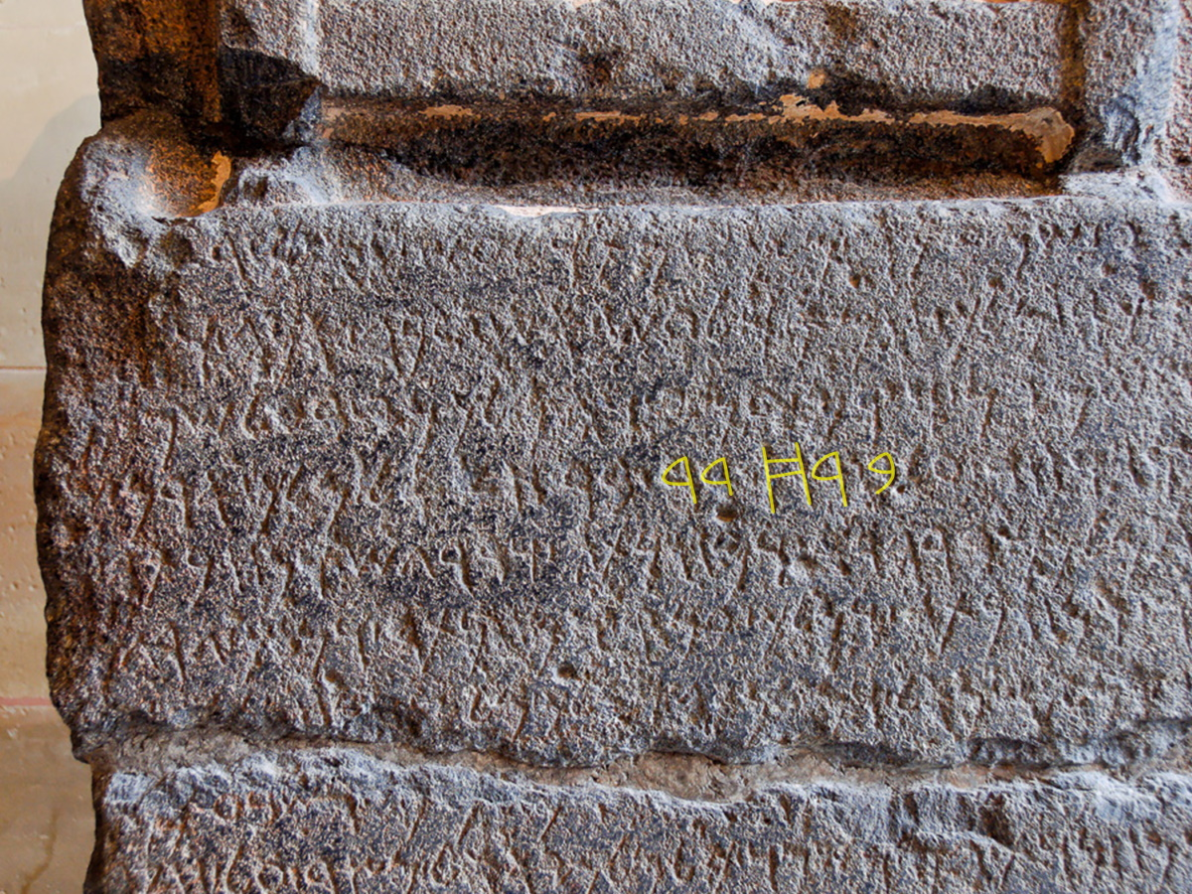
Now Elisha came to Damascus. And Ben-hadad the king of Aram was sick
Aramaic inscription on the Zakkur Stele, mentioning Ben-hadad III, from Tell Afis, circa 800 BC
8:7
Notes:
The inscription on the Zakkur Stele refers to an enemy of Zakkur, a certain “Ben-hadad, son of Hazael, king of Aram.” Because this inscription is written in Aramaic, the name is actually given as “Bar-hadad” (Arm. בר הדד); the Aramaic word “bar” is the equivalent of the Hebrew “ben,” both with the meaning “son.” This inscription was photographed at the Louvre Museum. For a full translation of this inscription, see Millard (2000: 155). An editable version is included behind the graphic for those who may wish to change it.
Reference:
Millard, Alan.
2000 The Inscription of Zakkur, King of Hamath (2.35). The Context of Scripture, vol. 2, ed. W. Hallo and K. Lawson Younger Jr. New York: Brill.
tb060408372

Slide 50
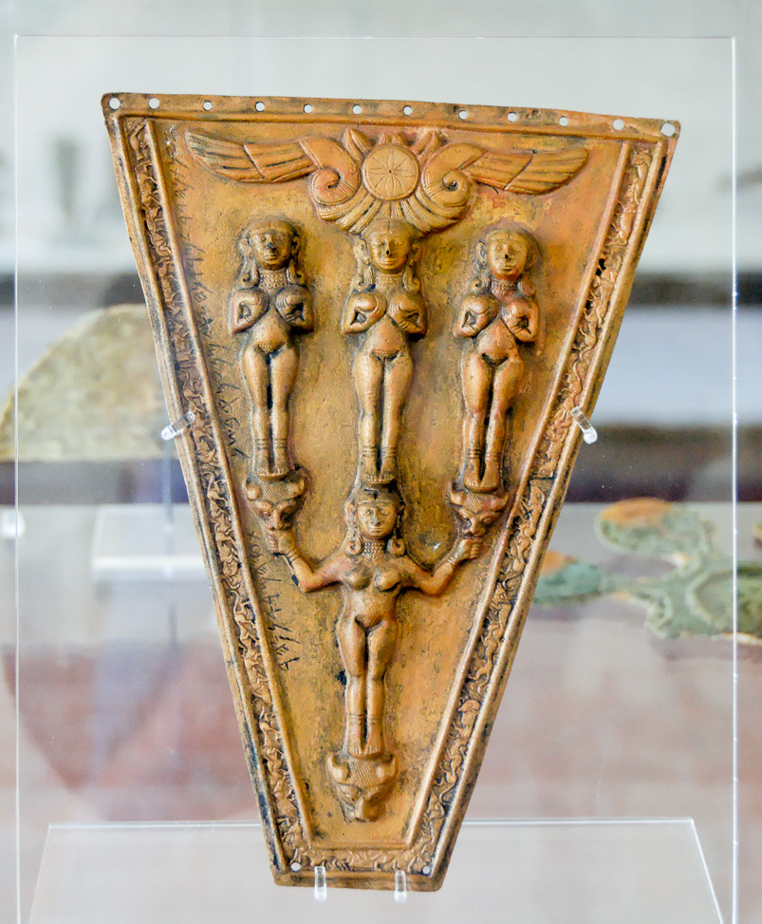
Then the king gave orders to Hazael
Horse frontlet with inscription of Hazael, from Samos, 9th century BC
8:8
Notes:
This trapezoidal cast bronze plaque was originally an ornament for a horse’s forehead. It was discovered in the Heraion of Samos in a 6th century BC context but is dated by its inscription to the 9th century BC. The way in which such an item ended up in a Greek temple on the island of Samos is not clear, although the most likely explanation may be that it was acquired through trade (so Eph’al and Naveh 1989: 200). This artifact was photographed at the Samos Museum. The next slide includes a close-up of the inscription.
Reference:
Eph'al, Israel, and Naveh, Joseph.
1989 Hazael's Booty Inscriptions. Israel Exploration Journal 39: 192–200.
tb061606107

Slide 51
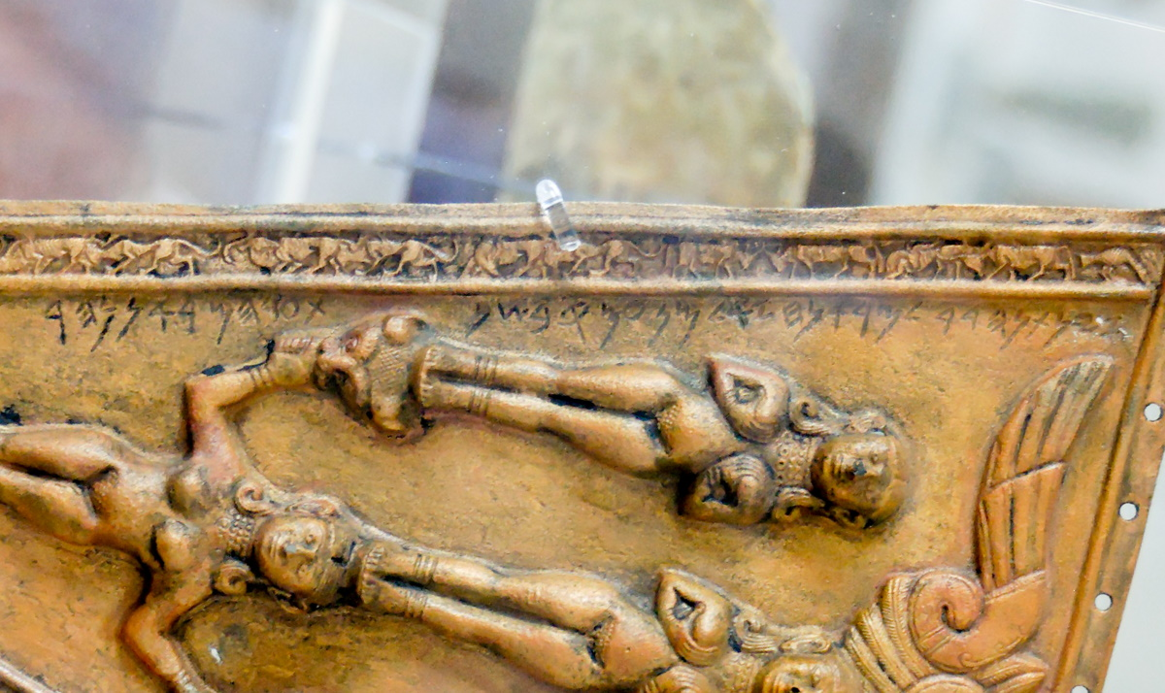
Then the king gave orders to Hazael
Horse frontlet with inscription of Hazael, 9th century BC
8:8
Notes:
This inscription reads, “That which Hadad gave our lord Hazael from ‘Umqi in the year that our lord crossed the River” (Eph’al and Naveh 1989: 193). This bronze artifact was photographed at the Samos Museum. The name “Hazael” (Heb. חזאל) is highlighted on the next slide.
Reference:
Eph'al, Israel, and Naveh, Joseph.
1989 Hazael's Booty Inscriptions. Israel Exploration Journal 39: 192–200.
tb061606107

Slide 52
Then the king gave orders to Hazael
Horse frontlet with inscription of Hazael, 9th century BC
8:8
Notes:
This inscription reads, “That which Hadad gave our lord Hazael from ‘Umqi in the year that our lord crossed the River” (Eph’al and Naveh 1989: 193). This bronze artifact was photographed at the Samos Museum. The name “Hazael” (Heb. חזאל) is highlighted.
Reference:
Eph'al, Israel, and Naveh, Joseph.
1989 Hazael's Booty Inscriptions. Israel Exploration Journal 39: 192–200.
tb061606107

Slide 53
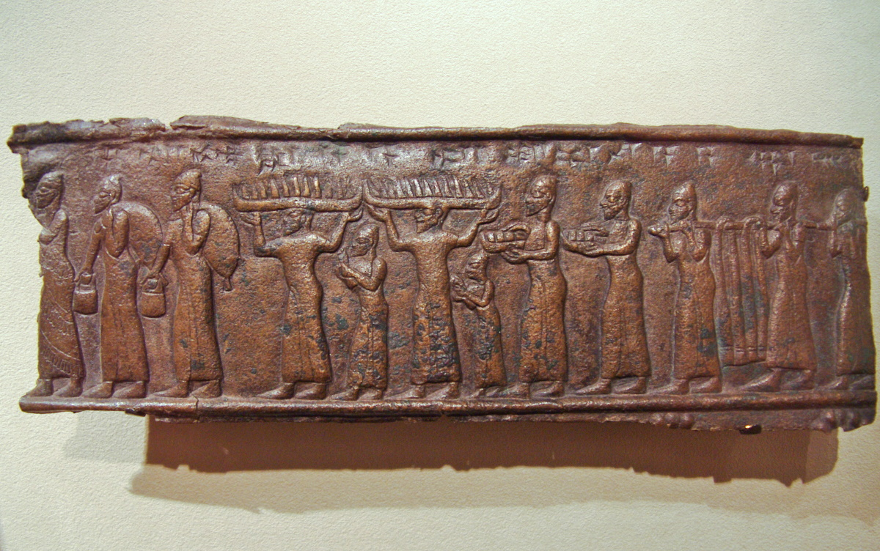
He said, “Take a present in your hand, meet the man of God, and inquire of Yahweh by him”
Depiction of men bearing tribute, from Balawat, 9th century BC
8:8
Notes:
This bronze artifact comes from the reign of the Assyrian king Shalmaneser III (r. 858–824 BC). It depicts tribute-bearers with a variety of goods, including pails or buckets, large trays, and a pole draped with cloth and hung between two porters. This object was photographed at Walters Art Museum in Baltimore.
adr1311202903

Slide 54
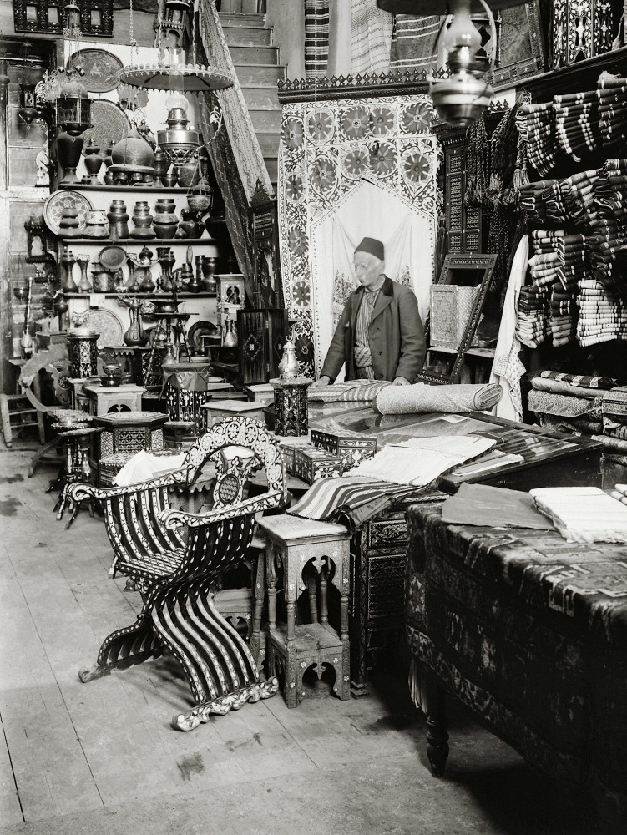
So Hazael went to meet him and took a present with him, even of every good thing of Damascus
Shop of Damascus wares in Damascus, circa 1910
8:9
Notes:
This American Colony photograph was taken between 1900 and 1920.
mat01159

Slide 55
So Hazael went to meet him and took a present with him, even of every good thing of Damascus
View of Damascus from the Umayyad Mosque (from the southeast)
8:9
Notes:
This American Colony photograph was taken between 1940 and 1946.
mat00620

Slide 56
It amounted to forty camels’ loads
Arabian camel, from Ashurbanipal’s palace at Nineveh, 7th century BC
8:9
Notes:
The most common type of camel in this region is the one-humped Arabian camel, also known as a dromedary. This type of camel appears often in reliefs of the Iron Age and is almost certainly the kind of camel in view in this account. This relief was photographed at the Vatican Museums.
tb111802018

Slide 57
It amounted to forty camels’ loads
Bactrian camels from Musri, on the Black Obelisk of Shalmaneser III, 9th century BC
8:9
Notes:
Two-humped Bactrian camels were also known in this region at this time, as depicted on this obelisk of the Assyrian king Shalmaneser III. They were likely brought to Assyria as tribute from the countries to the north. This relief was photographed at the British Museum.
tb112004818

Slide 58
It amounted to forty camels’ loads
Camels in a khan in old Damascus, circa 1910
8:9
Notes:
This American Colony photograph was taken between 1900 and 1920.
mat01158

Slide 59
It amounted to forty camels’ loads
Train of camels
8:9
Notes:
Arabian camels like the ones shown here commonly carry a load of 400 to 600 pounds (180 to 270 kg). This suggests that the gift sent out to Elisha was extraordinarily large, which in turn indicates that Elisha was greatly revered and honored by the Aramean king. This American Colony photograph was taken between 1940 and 1946.
mat00663

Slide 60
It amounted to forty camels’ loads
Line of camels
8:9
Notes:
This American Colony photograph was taken between 1898 and 1914.
mat06798

Slide 61
Elisha said to him, “Tell him he will recover”
Egyptian ivory plaque with a figure on a bed, from Cyprus, circa 1400 BC
8:10
Notes:
This ivory plaque depicts a man lying on a bed. The depiction of this man with his eyes open indicates alertness and recovery. This ivory object was photographed at the Metropolitan Museum of Art in New York City.
adr1711149811b

Slide 62
Elisha said to him, “Tell him he will recover, but Yahweh has shown me he will surely die”
Thanatos and Hypnos carrying the body of the dead Sarpedon, 5th century BC
8:10
Notes:
This amphora depicts one of the heroes of the Trojan wars, Sarpedon (a son of Zeus in Greek mythology) being carried by Thanatos (death) and Hypnos (sleep). The winged figure rising from the body may be a depiction of his spirit. The marks between the figures that resemble lettering are nonsensical. This image comes from The Metropolitan Museum of Art, public domain, Fletcher Fund, 1956, accession number 56.171.25, https://www.metmuseum.org/art/collection/search/254883.
met254883

Slide 63
He looked steadily at him until he was ashamed
Marble head of a bearded man, from Herculaneum, circa 1st century BC
8:11
Notes:
This bust may have originally represented a poet or philosopher. It was recovered from the rectangular peristyle of the Villa of Papyri at Herculaneum and was photographed at the Getty Villa in southern California.
tb100919454

Slide 64
Then the man of God wept
Roman sarcophagus fragment with men in mourning, mid-2nd century AD
8:11
Notes:
This image comes from The Metropolitan Museum of Art in New York City and is in the public domain. Source: https://www.metmuseum.org/art/collection/search/250926
met250926

Slide 65
I know the evil that you will do to the sons of Israel. You will set their strongholds on fire
Assyrians burning an Urartian city, from the bronze gate bands at Balawat, 9th century BC
8:12
Notes:
This relief in bronze depicts Assyrian soldiers setting fire to a city of Urartu. Flames can be seen rising above the city walls. This was once part of the bronze bands that held together the city gates of Balawat during the reign of Shalmaneser III. This artifact was photographed at the British Museum.
adr1805194217

Slide 66
I know the evil that you will do to the sons of Israel. You will set their strongholds on fire
Assyrians setting fire to a city gate, from Nineveh, 7th century BC
8:12
Notes:
This depiction of a burning city comes from the north palace of Tiglath-pileser III at Nineveh. This relief was photographed at the British Museum.
tb0929197314

Slide 67
I know the evil that you will do to the sons of Israel. You will set their strongholds on fire
Burning village in the Shephelah of Judah
8:12
Notes:
The smoke in this American Colony photo comes from the village of Artuf, as it burned during the 1929 riots.
mat03043

Slide 68
You will kill their young men with the sword
Bronze sword and daggers, Iron I, circa 1200‒1000 BC
8:12
Notes:
The short swords or daggers shown here are a couple of centuries older than the time of Elisha but illustrate the kind of weapons used at about this time. This display was photographed at the Louvre Museum.
tb0927195253

Slide 69
You will kill their young men with the sword
Assyrian soldier killing an enemy prisoner, from the central palace at Nimrud, 730–727 BC
8:12
Notes:
This relief was photographed at the Getty Villa in southern California while on loan from the British Museum.
tb100919408

Slide 70
You will dash their little ones to pieces
Mold-made figurine of a mother suckling a child, from Mesopotamia, circa 600 BC
8:12
Notes:
The phrase “little ones” (Heb. olel, עוֹלֵל) refers to children, likely to the youngest stages of life. This small figurine depicts a small child still young enough to be nursing. It was photographed at the Bible Lands Museum in Jerusalem.
adr1806263016

Slide 71
You will dash their little ones to pieces
Marble relief of a mother and child, from Athens, circa 430‒425 BC
8:12
Notes:
This image comes from the National Museum of Antiquities (Rijksmuseum van Oudheden) in Leiden and is in the public domain. Source: https://www.rmo.nl/imageproxy/jpg/019037
rmo019037

Slide 72
You will dash their little ones to pieces
Children exiled from Lachish as Judahite men are flayed, from Nineveh, circa 700 BC
8:12
Notes:
This relief depicts children being led off to exile, walking past men who have been staked out by Assyrian soldiers and are being flayed alive. This relief was photographed at the Israel Museum.
tb112004313

Slide 73
You will dash their little ones to pieces
Woman with child, circa 1935
8:12
Notes:
This American Colony photo was taken between 1934 and 1939.
mat04165

Slide 74
And you will rip open their pregnant women
Terracotta figurine of a pregnant woman, 600–480 BC
8:12
Notes:
This figurine depicts a pregnant woman with her hand on her belly. This image comes from The Metropolitan Museum of Art and is in the public domain. Source: https://www.metmuseum.org/art/collection/search/241267
met241267

Slide 75
And you will rip open their pregnant women
Phoenician figurine of a pregnant woman, 8th‒5th centuries BC
8:12
Notes:
This figurine was photographed at the Hecht Museum at the University of Haifa.
adr1805242499c

Slide 76
And you will rip open their pregnant women
Cypriot statuette depicting childbirth, circa 330–310 BC
8:12
Notes:
This small limestone statue depicts a woman giving birth. This image comes from The Metropolitan Museum of Art and is in the public domain. Source: https://www.metmuseum.org/art/collection/search/242249
met242249

Slide 77
Hazael said, “But what is your servant, who is but a dog, that he should do this great thing?”
Assyrian dog figurine, circa 9th‒6th centuries BC
8:13
Notes:
This figurine was photographed at the Istanbul Museum of the Ancient Orient.
adr1006054490

Slide 78
Hazael said, “But what is your servant, who is but a dog, that he should do this great thing?”
Banquet scene with a dog eating scraps under a table, circa 540 BC
8:13
Notes:
Hazael’s reply and the comparison of himself to a dog is clearly intended as a form of self-deprecation (cf. 1 Sam 17:43; 2 Sam 9:8). The idea is illustrated here by a vase painting that includes a dog eating scraps under the table of a man and woman at a banquet. This image comes from The Metropolitan Museum of Art, public domain, Fletcher Fund, 1956, accession number 56.171.1, https://www.metmuseum.org/art/collection/search/254859.
met254859

Slide 79
Hazael said, “But what is your servant, who is but a dog, that he should do this great thing?”
Sheepdogs in eastern Samaria
8:13
Notes:
tb031405356

Slide 80
Elijah answered, “Yahweh has shown me that you will be king over Aram”
Relief of the Assyrian king Tiglath-pileser III on his throne, 8th century BC
8:13
Notes:
This relief depicts the Assyrian king Tiglath-pileser III (r. 745–727) sitting on his throne. He grasps a scepter in his right hand and holds a lotus flower in his left. This relief was photographed at the National Museum of Antiquities (Rijksmuseum van Oudheden) in Leiden.
This image comes from the Dutch National Museum of Antiquities, A 1934/6.1, Creative Commons-BY. Source: https://www.rmo.nl/collectie/collectiezoeker/collectiestuk/?object=33876.
rmo33876

Slide 81
So he left Elisha and returned to his master
Man with Arabian camels, from Nimrud, 728 BC
8:14
Notes:
This relief was photographed at the British Museum.
tb112004843c

Slide 82
His master said, “What did Elisha say?” And he replied, “He said you would surely recover”
Head of a comic actor, late 1st century AD
8:14
Notes:
Hazael was dishonest and did not tell Ben-hadad the truth, although he did repeat the words of Elisha. Lying is closely related to hypocrisy, an attempt to get someone to believe something that is not true. This beautifully rendered bust portrays an actor wearing a comic mask. The mask gives the impression from a distance that the actor is continually smiling, even though closer inspection reveals that the actor himself is not. This statue was photographed at the Vatican Museums.
tb0512176536

Slide 83
The next day he took a cloth, dipped it in water, and spread it on his face, so that he died
Coarsely spun linen sheet, from the tomb of Hatnefer and Ramose at Thebes, 15th century BC
8:15
Notes:
The word translated here as “cloth” (Heb. makber, מַכְבֵּר) appears only here in the Hebrew Bible. English versions render it variously with terms like “cloth” (NET), “blanket” (NLT, NJB), “thick cloth” (NIV, KJV), or “coarse cloth” (YLT). The context indicates that it was naturally thin enough or porous enough that it was necessary to dip it in water in order to use it for suffocation. The linen sheet shown here is considered to have a coarse spin and a medium weave, and it may represent the kind of cloth used by Hazael. This image comes from The Metropolitan Museum of Art, public domain, Rogers Fund, 1936, accession number 36.3.140, https://www.metmuseum.org/art/collection/search/545139.
met545139

Slide 84
Then Hazael became king in his place
Chronology chart of the known kings of Aram-Damascus
8:15
Notes:
This chart comes from The Regnal Chronology of the Kings of Judah and Israel: An Illustrated Guide, by Chris McKinny, available from BiblePlaces.com.

Slide 85
Then Hazael became king in his place
Ivory with Aramaic inscription mentioning Hazael, from Arslan Tash, 8th century BC
8:15
Notes:
This inscription is perhaps a century later than the time of Elisha, but it preserves the name “Hazael” (Heb. חֲזָאֵל). It was photographed at the Louvre Museum. The next slide includes a label identifying the name.
tb060408576

Slide 86
Then Hazael became king in his place
Ivory with Aramaic inscription mentioning Hazael, from Arslan Tash, 8th century BC
8:15
Notes:
This inscription is perhaps a century later than the time of Elisha, but it preserves the name “Hazael” (Heb. חֲזָאֵל). It was photographed at the Louvre Museum.
tb060408576

Slide 87
Then Hazael became king in his place
Inscription on the Zakkur Stele, mentioning “Hazael, king of Aram,” from Tell Afis, circa 800 BC
8:15
Notes:
The Aramaic inscription on the Zakkur Stele refers to an enemy of Zakkur, a certain Ben-hadad, son of “Hazael, king of Aram” (Heb. חזאל מלך ארם). This inscription was photographed at the Louvre Museum. For a full translation of this inscription, see Millard (2000: 155). The next slide includes a highlight of the name and title.
Reference:
Millard, Alan.
2000 The Inscription of Zakkur, King of Hamath (2.35). The Context of Scripture, vol. 2, ed. William W. Hallo and K. Lawson Younger Jr. New York: Brill.
tb060408372

Slide 88
Then Hazael became king in his place
Inscription on the Zakkur Stele, mentioning “Hazael, king of Aram,” from Tell Afis, circa 800 BC
8:15
Notes:
The Aramaic inscription on the Zakkur Stele refers to an enemy of Zakkur, a certain Ben-hadad, son of “Hazael, king of Aram” (Heb. חזאל מלך ארם). This inscription was photographed at the Louvre Museum. For a full translation of this inscription, see Millard (2000: 155). An editable version is included behind the graphic for those who may wish to change it.
Reference:
Millard, Alan.
2000 The Inscription of Zakkur, King of Hamath (2.35). The Context of Scripture, vol. 2, ed. William W. Hallo and K. Lawson Younger Jr. New York: Brill.
tb060408372

Slide 89
He was thirty-two years old when he became king, and he reigned eight years in Jerusalem
Chronology chart of the reign of King Jehoram
8:17
Notes:
Jehoram of Judah reigned until 841 BC. The eight regnal years assigned to him here are counted from the beginning of his sole reign, thus 848‒841 BC. The details of this chart are best viewed at a higher zoom level or see the next slide for a closer view. This chart comes from The Regnal Chronology of the Kings of Judah and Israel: An Illustrated Guide, by Chris McKinny, available from BiblePlaces.com.

Slide 90
In the fifth year of Joram the son of Ahab . . . Jehoram the son of Jehoshaphat became king
Chronology chart of the reign of King Jehoram
8:16
Notes:
Jehoram of Judah (r. 853–841 BC) became sole king in the 5th year of Joram of Israel, in 848 BC. He had become co-regent together with his father Jehoshaphat in 853 BC, while Ahab was still king of Israel (cf. 2 Kgs 1:17). Jehoram of Judah reigned until 841 BC. His eight regnal years were counted from the beginning of his sole reign.
This chart comes from The Regnal Chronology of the Kings of Judah and Israel: An Illustrated Guide, by Chris McKinny, available from BiblePlaces.com.

Slide 91
He was thirty-two years old when he became king, and he reigned eight years in Jerusalem
Chronology charts of the reign of King Jehoram
8:17
Notes:
The details of this chart are best viewed at a higher zoom level. This chart comes from The Regnal Chronology of the Kings of Judah and Israel: An Illustrated Guide, by Chris McKinny, available from BiblePlaces.com.
McKinny_Jehoram

Slide 92
And he walked in the way of the kings of Israel, as did the house of Ahab
“Kings of Israel Street” sign in Jerusalem
8:18
Notes:
Jehoram’s condemnation is one of the strongest of any of the Judahite kings, with the possible exception of Manasseh. “Kings of Israel Street” is located north of the Old City of Jerusalem.
tb091902015

Slide 93
And he walked in the way of the kings of Israel, as did the house of Ahab
Bronze statuette of the Canaanite god Baal, from Ugarit, circa 13th century BC
8:18
Notes:
The prophets supported by Ahab and Jezebel were the prophets of the Canaanite god Baal and the goddess Asherah (1 Kgs 18:19). Baal was perhaps the most commonly worshiped Canaanite deity. The example shown here is cast of bronze, but at least parts of it were once covered with gold foil. This artifact was photographed at the Louvre Museum.
tb0927195213

Slide 94
And he walked in the way of the kings of Israel, as did the house of Ahab
Judahite fertility figurine, probably representing Asherah, Iron Age II, circa 800–586 BC
8:18
Notes:
Asherah was a Canaanite goddess who was considered to be the consort of El and the mother of other gods. The figurine in this photo, sometimes referred to as a “pillar figurine,” is usually considered to have been a fertility figurine representing Asherah. These figurines are often found in domestic settings, indicating that they were widely used in ancient Israel and Judah as a household idol. Some of these figurines had very simple faces that were formed by simply pinching the clay of the head, while others, like the one shown here, had detailed faces made from a mold. This figurine was photographed at the Pontifical Biblical Institute Museum in Jerusalem.
tb061116942

Slide 95
And he walked in the way of the kings of Israel, as did the house of Ahab
Asherah figurine in a house shrine, Iron Age II, circa 1000–586 BC
8:18
Notes:
This model shrine includes a figurine of Asherah; note also the two female figurines on either side of the doorway, and one of an original set of two lions crouching by the steps. Lions are another common motif associated with the worship of Asherah. This artifact belongs to the Shlomo Moussaieff collection and was photographed by Alexander Schick.
as021706501

Slide 96
And he walked in the way of the kings of Israel, as did the house of Ahab
High place of Jeroboam at Dan
8:18
Notes:
Like many of the Israelite kings before him, Ahab had “walked in the sins of Jeroboam the son of Nebat” (1 Kgs 16:31). Jeroboam, the first king of the independent kingdom of Israel, had built a high place at Bethel and another at Dan, where he installed golden calves for the Israelites to worship (1 Kgs 12:28-30). The large platform in the center of this photo is a slightly later remodeling of the high place at Dan, dating to the reign of Jeroboam II (8th century BC). The steel frame beyond and to the left of the platform provides an outline of the large sacrificial altar that once stood there.
tb011500031

Slide 97
For he married the daughter of Ahab
Omride and Davidic family tree, circa 900–800 BC
8:18
Notes:
The daughter of Ahab that Jehoram married was Athaliah (2 Kgs 8:26). Athaliah herself usurped the throne after the death of her son Ahaziah (2 Kgs 11:1-3). This chart comes from The Regnal Chronology of the Kings of Judah and Israel: An Illustrated Guide, by Chris McKinny, available from BiblePlaces.com.

Slide 98
For he married the daughter of Ahab
Marriage contract from Kultepe (Kanesh Karum), 19th century BC
8:18
Notes:
The rite of marriage is known from inscriptional evidence from a very early period, illustrated here by a 19th century BC marriage contract. It would not be surprising if a similar contract was used between the kingdoms of Israel and Judah in this situation, although none is mentioned. This tablet was photographed at the Istanbul Archaeological Museum. The museum staff mounted it upside-down; this photo has been rotated to the correct stance, which explains the odd lighting that now appears to come from below.
adr1006067262c

Slide 99
For he married the daughter of Ahab
Depiction of a wedding, from Italy, circa 50 BC – AD 50
8:18
Notes:
Although marriage is known from inscriptional evidence from a very early period (e.g., marriage scarabs of the Egyptian 18th Dynasty), depictions of the marriage ceremony generally do not predate the Greek period. The terracotta plaque shown here is thought to depict the wedding of Thetis and Peleus, the parents of Achilles in Greek mythology. It was photographed in the Louvre exhibit at the National Museum of Iran in Tehran.
tb0514184513c

Slide 100
For he married the daughter of Ahab
Red-figure loutrophoros with a groom leading his bride, circa 440 BC
8:18
Notes:
This vessel, which is now missing its long neck, handles, and foot, is a loutrophoros. The loutrophoros was used to carry water for a bride’s pre-nuptial ritual bath and featured scenes related to the wedding. This example features a depiction of the groom leading his bride to the nuptial chamber, led by a woman carrying two torches. This loutrophoros was photographed at the State Collections of Antiquities in Munich. This image comes from ArchaiOptix and is licensed under CC BY-SA 4.0, via Wikimedia Commons: https://commons.wikimedia.org/wiki/File:Naples_Painter_ARV_1099_46extra_-_wedding.jpg.
wiki071920171917373782

Slide 101
And he did what was evil in the sight of Yahweh
Bronze model of Pharaoh worshiping an Apis bull, circa 500 BC
8:18
Notes:
More specific sins of Jehoram of Judah are not enumerated, but based on the previous description he was certainly guilty of worshipping other gods. This set of a bronze bull and a bronze figure of a worshipping Egyptian king was photographed at the British Museum. This image comes from Jl FilpoC and is licensed under CC BY-SA 4.0, via Wikimedia Commons: https://commons.wikimedia.org/wiki/File:Fara%C3%B3n_ante_Apis_(British_Museum).jpg.
wiki0927201925901738

Slide 102
But Yahweh was not willing to destroy Judah, for the sake of His servant David
“King David Street” sign in Jerusalem
8:19
Notes:
King David Street is located west of the Old City of Jerusalem.
tb072404728

Slide 103
But Yahweh was not willing to destroy Judah, for the sake of His servant David
Synagogue mosaic depicting David with a harp, from Gaza, AD 508
8:19
Notes:
The mosaic shown here comes from the floor of a Byzantine-era synagogue uncovered at Gaza. David’s name (Heb. דויד) appears above the harp. The mosaic was discovered by Egyptian archaeologists in 1965 and publicized by them as a church mosaic depicting a female saint. The face and hand of the figure were gouged out shortly after. When Israel captured Gaza in the 1967 Six-Day War, the mosaic was moved to the Israel Museum for restoration. It was photographed at the Israel Museum.
tb061616894

Slide 104
For He had promised to give him a lamp always through his sons
Ceramic oil lamp, from Dothan, Iron Age II, circa 1000–586 BC
8:19
Notes:
The lamp in this photo dates to the Iron Age II and is the sort of lamp that was used in Elisha’s day. Lamps of this kind were first formed like a bowl, and then two sides were pinched together to form the spout. This lamp was actually used in antiquity, as is evident from the black soot that rings the spout. This lamp was photographed at the Benshoof Cistern Museum in Jerusalem.
adr1305123746

Slide 105
For He had promised to give him a lamp always through his sons
Oil lamps from the Iron Age, circa 1200–586 BC
8:19
Notes:
Lamps of this type could produce about 2 lumens, roughly the equivalent of a candle. Open lamps burned oil at the rate of about an ounce (28 g) per hour. Lamps varied in capacity, but some held as much as 16 ounces (450 g). This display was photographed at the Eretz Israel Museum in Tel Aviv.
tb061804660

Slide 106
For He had promised to give him a lamp always through his sons
Oil lamp, Nazareth Village
8:19
Notes:
This modern lamp is formed like a later Roman oil lamp, but illustrates the light given off by a lit lamp. It was photographed at Nazareth Village.
adr0807091941

Slide 107
For He had promised to give him a lamp always through his sons
Village elder with his son and grandson, in Dahariyeh, 1940
8:19
Notes:
As is often the case, the word “son” (Heb. ben, בֵּן) here is intended to refer not only to the first generation of direct male descendants, but to David’s descendants in general over many generations. This American Colony photo was taken February 9, 1940.
mat20039

Slide 108
In his days Edom revolted from under the hand of Judah and set up a king of their own
Chronology chart of the known kings of Edom
8:20
Notes:
The unnamed king of Edom replaced the deputy who had been a vassal to Jehoshaphat of Judah (1 Kgs 22:47). This chart comes from The Regnal Chronology of the Kings of Judah and Israel: An Illustrated Guide, by Chris McKinny, available from BiblePlaces.com.

Slide 109
In his days Edom revolted from under the hand of Judah and set up a king of their own
Map of southern Judah and Edom
8:20
Notes:
Edom is located south of Moab; the Zered River is the natural boundary between the two. This map is a detail adapted from map 1-12 from the Satellite Bible Atlas, by William Schlegel. Used by permission.

Slide 110
In his days Edom revolted from under the hand of Judah and set up a king of their own
Khirbet en-Nahas overview (from the southeast)
8:20
Notes:
Although much of Edom’s territory was extremely arid and of little use, there were also several copper mines in the region. Recent excavations have shown that these mines were active in the 10th–9th centuries BC. In light of the biblical references to Edom’s vassalhood to Judah (1 Kgs 22:47; 2 Kgs 8:20), it seems logical that this activity was carried out at the behest of the Judahite kingdom.
df080207179

Slide 111
In his days Edom revolted from under the hand of Judah and set up a king of their own
Interior of the Iron Age fortress at Khirbet en-Nahas (from the north)
8:20
Notes:
Khirbet en-Nahas was the largest mining operation during this period. According to 14C readings, copper mining at Khirbet en-Nahas ceased around the middle of the 9th century BC, which could theoretically be connected with Edom’s revolt from Jehoram of Judah.
df080207173

Slide 112
In his days Edom revolted from under the hand of Judah and set up a king of their own
Slag remains on surface at Khirbet en-Nahas
8:20
Notes:
Slag is the leftovers once the copper has been removed (smelted in a furnace).
df080207332

Slide 113
In his days Edom revolted from under the hand of Judah and set up a king of their own
Tamar, modern Ein Hatzeva (aerial view from the south)
8:20
Notes:
The Iron II fortress at Tamar (cf. 1 Kgs 9:18) may have been directed at controlling and accessing the copper trade from the Feinan and Timna regions of the Arabah. The next slide includes labels.
ws110615224

Slide 114
In his days Edom revolted from under the hand of Judah and set up a king of their own
Roman fortress
gate
Judahite fortress
Tamar, modern Ein Hatzeva (aerial view from the south)
8:20
Notes:
The Iron II fortress at Tamar (cf. 1 Kgs 9:18) may have been directed at controlling and accessing the copper trade from the Feinan and Timna regions of the Arabah.
ws110615224

Slide 115
In his days Edom revolted from under the hand of Judah and set up a king of their own
Iron Age gate at Tamar (modern Ein Hatzeva)
8:20
Notes:
The Iron Age gate at Ein Hatzeva/Tamar has four chambers, which could have incorporated three sets of gates. With walls preserved to a height of 15 feet (4.6 m) in places, the Iron Age fortress located at Ein Hatzeva (300 x 300 feet [91 x 91 m]) was much larger than the Roman fortress (150 x 150 feet [46 x 46 m]; Cohen 1993: 593–94). Six levels are identifiable at Ein Hatzeva, ranging from the 10th century BC to the 7th century AD.
Reference:
Cohen, Rudolf.
1993 Hazeva, Mezad. New Encyclopedia of Archaeological Excavations in the Holy Land, vol. 2, ed. E. Stern. Jerusalem: Carta.
tb022804727

Slide 116
In his days Edom revolted from under the hand of Judah and set up a king of their own
Ruins at Tamar (Ein Hatzeva), with a view towards Feinan and Khirbet en-Nahas
8:20
Notes:
Among the ruins of the ancient city of Tamar, many religious artifacts were discovered which could be completely restored. While all of the vessels were broken, every piece was present, having been deliberately crushed after being placed in a pit. Ashlar stones had been dropped upon them, suggesting that the destruction of these religious artifacts was part of a religious reform like that of King Josiah. Excavators, however, disagree as to whether or not these artifacts were destroyed under Josiah’s reform. Among the 75 objects found in a pit at Ein Hatzeva were 7 limestone incense altars, 15 bowls on attached pedestals, 11 chalices (vessels used for the offering of incense), and a stone sculpture with stylized human features.
tb010710939

Slide 117
Then Jehoram crossed over to Zair
Ruins at Safi, possibly Zoar (from the south)
8:21
Notes:
Zair (Heb. צָעִיר) appears only here in the Hebrew Bible and is most likely intended to refer to Zoar (Heb. צֹעַר). The place name is missing altogether from the parallel account in 2 Chronicles 21:9. The various references to Zoar (Gen 13:10; 14:2, 8; 19:22–23, 30; Deut 34:3; Is 15:5; Jer 48:34) indicate that the site was almost certainly located south of the Dead Sea in the Ghor es-Safiyeh, and probably localized at Safi (for later references that confirm this identification see Astour 1992: 1107).
The Safi region was repeatedly inhabited throughout history, and the town site existed at least as early as the Early Bronze Age. In 1924, Albright made soundings at Safi, supposing that it might be the biblical city of Zoar, but he discovered only pottery of the later periods. Nelson Glueck visited Safi in 1934 and identified Early Bronze and Middle Bronze pottery and tombs, as did Rast and Schaub in their 1973 survey.
Reference:
Astour, Michael C.
1992 Zoar. Anchor Bible Dictionary, vol. 6, ed. D. N. Freedman. New York: Doubleday.
tb061604840

Slide 118
Then Jehoram crossed over to Zair
Ruins at Safi, possibly Zoar (from the southeast)
8:21
Notes:
This photo was taken atop Safi, looking northwest toward the southern end of the Dead Sea. The hills of the southern Judean wilderness can be seen on the horizon. Excavations by the Jordanian Department of Antiquities in 1995 cataloged more than 2,000 Early Bronze Age tombs in this area. The pits visible in the foreground are Early Bronze Age tombs that have been robbed out in recent years by illegal diggers.
tb061604843

Slide 119
Then Jehoram crossed over to Zair
Deir Ain Abata, Sanctuary of Lot (from the west)
8:21
Notes:
The Byzantine site of Zoora (biblical Zoar) is located on the Medeba map on the southeastern shore of the Dead Sea, and has been identified with Tell Seh Isa, near es-Safi. Next to Zoora on the Medeba map is the Sanctuary of St. Lot, which has recently been excavated (Politis 2004). Deir Ain Abata means the “Monastery of the Abata spring.” Deir Ain Abata is about 2.5 miles (4 km) from es-Safi. The next slide includes labels.
Reference:
Politis, Konstantinos.
2004 Where Lot’s Daughters Seduced Their Father. Biblical Archaeology Review 30/1: 20–31, 64.
tb061604851

Slide 120
Then Jehoram crossed over to Zair
Sanctuary of Lot
es-Safi
Deir Ain Abata, Sanctuary of Lot (from the west)
8:21
Notes:
The Byzantine site of Zoora (biblical Zoar) is located on the Medeba map on the southeastern shore of the Dead Sea, and has been identified with Tell Seh Isa, near es-Safi. Next to Zoora on the Medeba map is the Sanctuary of St. Lot, which has recently been excavated (Politis 2004). Deir Ain Abata means the “Monastery of the Abata spring.” Deir Ain Abata is about 2.5 miles (4 km) from es-Safi.
Reference:
Politis, Konstantinos.
2004 Where Lot’s Daughters Seduced Their Father. Biblical Archaeology Review 30/1: 20–31, 64.
tb061604851

Slide 121
Then Jehoram crossed over to Zair
Deir Ain Abata, Sanctuary of Lot
8:21
Notes:
The church of the monastery at Deir Ain Abata was constructed to highlight the existence of a natural cave, visible in this photo on the left. Recent excavations in the cave have produced remains from as early as the Middle Bronze Age (Politis 2004: 30).
Reference:
Politis, Konstantinos.
2004 Where Lot’s Daughters Seduced Their Father. Biblical Archaeology Review 30/1: 20–31, 64.
tb061604856

Slide 122
Then Jehoram crossed over to Zair
Zoar and the Sanctuary of Lot, on the Medeba map, 6th century AD
8:21
Notes:
This section of the Medeba Map shows the area on the southeastern edge of the Dead Sea. The red-roofed church in the upper right is labelled “The place of Saint L[ot]” (Gk. ΤΟ ΤΟΥ ΑΓΙΟΥ Λ[ΩΤ]). The village at the middle right, surrounded by palm trees, is identified as “Balak, also S[egor], Zoar” (Gk. ΒΑΛΑΚ Η ΚΑΙ Σ[ΕΓΟΡ], ΖΟΟΡΑ). This image comes from deg777 and is licensed under CC BY-SA 4.0, via Wikimedia Commons: https://commons.wikimedia.org/wiki/File:Zoar_on_the_Madaba_map.jpg.
wiki01112007084447862

Slide 123
Then Jehoram crossed over to Zair, and all his chariots were with him
Royal Assyrian chariot at a lion hunt, from the north palace at Nineveh, 7th century BC
8:21
Notes:
This relief comes from the palace of Ashurbanipal at Nineveh and was photographed at the Getty Villa in southern California while on loan from the British Museum.
tb100919375

Slide 124
Then Jehoram crossed over to Zair, and all his chariots were with him
Model of a chariot, from the Apollo sanctuary at Pera Frangissa, circa 750–500 BC
8:21
Notes:
This model of a four-horse chariot with two riders was photographed at the British Museum.
tb0930199374

Slide 125
Then he arose by night to strike the Edomites who surrounded him and the chariot captains
Line of soldiers, from Ashurbanipal’s palace in Nineveh, 7th century BC
8:21
Notes:
This relief was photographed at the British Museum. This image comes from Johnbod and is licensed under CC BY-SA 4.0, via Wikimedia Commons: https://commons.wikimedia.org/wiki/File:Lion_Hunt_of_AshurbanipalDSCF3679_07.jpg.
wiki12012016092044

Slide 126
But his army fled to their tents
Bedouin encampment at Ghor es-Safieh, circa 1910
8:21
Notes:
This American Colony photo was taken in approximately the same location as the battle described in this text, if the identification of Zair with Safi is accepted. This photo was taken between 1900 and 1920.
mat01789

Slide 127
But his army fled to their tents
Assyrian soldiers attacking desert Arabs, from Nineveh, circa 8th century BC
8:21
Notes:
If there were Israelite casualties, they are not enumerated. However, the implication is that the battle went so badly for Judah that they had no desire to return. This relief shows men inside a tent that is being set to the torch by their enemy. This relief was photographed at the Vatican Museums.
tb0512176456r

Slide 128
So Edom has been in revolt against Judah to this day
Clay head of an Edomite goddess, from Horvat Qitmit, circa 600 BC
8:22
Notes:
The Edomite rebellion was successful, resulting in the independence of the region from Judahite control. One way in which this likely showed itself was through the worship of local Edomite gods, like the goddess shown here. This representation of a horned Edomite goddess was photographed at the Israel Museum.
adr1306213158

Slide 129
So Edom has been in revolt against Judah to this day
Edomite shrine with ritual vessels from Ein Hatzeva, circa 600 BC
8:22
Notes:
The local development of the Edomite religious system is also reflected in this set of cultic vessels, perhaps used for burning incense. These and others were recovered from an Edomite shrine at Ein Hatzeva. This display was photographed at the Israel Museum.
tb032014335

Slide 130
Then Libnah revolted at the same time
Tel Burna (aerial view from the east)
8:22
Notes:
The location of Libnah is not certain, but a good candidate is Tel Burna (Tell Bornat). Libnah was defeated during the southern campaign (Josh 10:29-31, 39; 12:15), and it was allotted to Judah (Josh 15:42) and Levi (Josh 21:13; 2 Chr 6:57) during the settlement. Libnah was defeated by Sennacherib (2 Kgs 19:8), and was the hometown of Hamutal, wife of Josiah and mother of Jehoahaz and Zedekiah (2 Kgs 23:31; 24:18). Eusebius states that “Lobna” was in the neighborhood of Eleutheropolis (120.10). The archaeological remains and geographical position of Tel Burna fit all of these textual details. The site was known as Tell Bulnab in the mid-19th century AD, which may preserve a corrupted version of the biblical name of Libnah.
ws101514573

Slide 131
Then Libnah revolted at the same time
Tel Burna (aerial view from the south)
8:22
Notes:
Excavations at Tel Burna began in 2009 under the direction of Itzhak Shai and Joe Uziel of Bar Ilan University. Archaeological investigation has revealed settlement layers from the 13th and 9th–7th centuries, as well as limited remains from the Persian period. The 8th century remains are abundant, including defensive fortifications. Additionally, remains from the Early Bronze, Middle Bronze, Late Bronze IIA, Iron I, and Early Iron IIA (10th century BC) were found during surveys of the site.
ws101514564

Slide 132
Then Libnah revolted at the same time
Wheatfield near Tel Burna, possibly Libnah
8:22
Notes:
Libnah’s close proximity to Philistine Gath (the largest city in southern Levant at the time) may have played a role in it its “revolt” from Jehoram of Judah. Tel Burna, located about 5 miles (8 km) southeast of Gath, is situated on the borderland of ancient Judah where it might have been considered possible to change allegiance. The outcome of this revolt is not given.
tb011606860

Slide 133
Are not the rest of the acts of Jehoram written in the Book of the Chronicles of the Kings?
Relief with scribes, from the central palace in Nimrud, 8th century BC
8:23
Notes:
This relief comes from the palace of Tiglath-pileser III at Nimrud. It was photographed at the British Museum.
adr090506978

Slide 134
Are not the rest of the acts of Jehoram written in the Book of the Chronicles of the Kings?
Orthodox Jewish scribe writing Torah on parchment
8:23
Notes:
This American Colony photograph was taken between 1934 and 1939.
mat14451

Slide 135
So Jehoram slept with his fathers and was buried with his fathers in the city of David
“King David’s Tomb,” sign in Jerusalem
8:24
Notes:
The parallel account in 2 Chronicles 21:20 states that Jehoram “departed with no one’s regret, and they buried him in the city of David, but not in the tombs of the kings.” Perhaps this was part of the same burial complex, but in a separate section. This sign is located on Mount Zion at the traditional tomb of David.
tb070807991

Slide 136
So Jehoram slept with his fathers and was buried with his fathers in the city of David
City of David (aerial view from the east)
8:24
Notes:
Although dead bodies were considered unclean and burials were normally kept outside the city, the biblical text is quite clear that the kings of Judah were buried within the confines of the city itself. Raymond Weill excavated the southeastern portion of the City of David in 1913–14. He uncovered large rock-hewn caverns that he identified as the royal tombs of the House of David. The next slide includes labels.
tb010703201

Slide 137
So Jehoram slept with his fathers and was buried with his fathers in the city of David
Central Valley
excavations
Siloam Pool
Area G
Tomb of David?
Jerusalem
Gihon Spring
Area E
City of David (aerial view from the east)
8:24
Notes:
Although dead bodies were considered unclean and burials were normally kept outside the city, the biblical text is quite clear that the kings of Judah were buried within the confines of the city itself. Raymond Weill excavated the southeastern portion of the City of David in 1913–14. He uncovered large rock-hewn caverns that he identified as the royal tombs of the House of David.
tb010703201

Slide 138
So Jehoram slept with his fathers and was buried with his fathers in the city of David
City of David (close-up aerial view from the southwest)
8:24
Notes:
The rock-hewn structures discovered by Weill are in the southern part of the City of David, the same area that is indicated by Nehemiah in his description (Neh 3:16). The next slide includes labels.
tb010703234

Slide 139
So Jehoram slept with his fathers and was buried with his fathers in the city of David
Dung Gate
Kidron Valley
Jerusalem
Central (Tyropean) Valley
Tomb of David?
City of David (close-up aerial view from the southwest)
8:24
Notes:
The rock-hewn structures discovered by Weill are in the southern part of the City of David, the same area that is indicated by Nehemiah in his description (Neh 3:16).
tb010703234

Slide 140
So Jehoram slept with his fathers and was buried with his fathers in the city of David
Proposed tomb of the House of David
8:24
Notes:
When Weill made the identification, most scholars accepted it as accurate. Most scholars today reject this identification. These structures do not have features typical of Iron Age tombs; there are no burial benches or repositories. This area was heavily quarried for building stone in the Hadrianic period, after the destruction of Jerusalem in the 1st century AD, making archaeological work and interpretation difficult. Because of later destruction, there is no stratigraphy, pottery, or burial gifts which would make dating the structures possible. Some scholars think that they date to the Herodian period and may have been used as wine cellars for the structures built above them. There is no other candidate for the tomb of David.
Weill discovered several underground structures in this immediate area. Two are visible behind the modern structure in this photo, and a third is around the corner to the right. If these are the tombs of the kings of Judah, perhaps the desire to separate out some members of the royal line, such as Jehoram, explains the fact that there are multiple tombs.
tb123011013

Slide 141
So Jehoram slept with his fathers and was buried with his fathers in the city of David
Proposed tomb of the House of David
8:24
Notes:
There are some scholars who continue to believe that these are the best candidates we have for the royal tombs. Jeffrey Zorn argues that Hezekiah’s tunnel was dug on the eastern edge of the City of David in order to avoid the “burial grounds of the Davidic kings” (2012: 47). Zorn also observes that there are other examples of royal tombs that were quite simple in design, such as the tomb of King Ahiram of Byblos (11th century BC; 2012: 52).
Reference:
Zorn, Jeffrey.
2012 Is T1 David's Tomb? Biblical Archaeology Review 38/6: 44–52, 78.
tb012603231

Slide 142
So Jehoram slept with his fathers and was buried with his fathers in the city of David
View from the proposed tomb of the House of David (from the north)
8:24
Notes:
tb012603232

Slide 143
So Jehoram slept with his fathers and was buried with his fathers in the city of David
Tumuli near Jerusalem (from the west)
8:24
Notes:
An interesting note is given in the parallel account, 2 Chronicles 21:19. After describing Jehoram’s gruesome death, the author states that “his people made no fire for him like the fire for his fathers.” This can be contrasted with King Asa, who was commemorated with “a very great fire” at his death (2 Chr 16:13). The lack of enthusiasm to hold this ceremony is further evidence for the disdain in which he was held by his people.
Evidence of this fire ceremony, which was also observed for other kings of Judah, may exist in a group of tumuli that have been found west of Jerusalem. About 20 tumuli have been recorded, although they are rapidly being destroyed by expanding construction from suburbs of Jerusalem. Three of them can be seen in this photo. Barkay (2003) has suggested that these were mounds raised during the mourning ceremonies for the kings of Judah. See the next slide for labels.
Reference:
Barkay, Gabriel.
2003 Mounds of Mystery: Where the Kings of Judah were Lamented. Biblical Archaeology Review 29/3: 32–39, 66, 68.
tb070807020

Slide 144
So Jehoram slept with his fathers and was buried with his fathers in the city of David
Tumulus 4
Tumulus 2
Tumulus 5
Tumuli near Jerusalem (from the west)
8:24
Notes:
An interesting note is given in the parallel account, 2 Chronicles 21:19. After describing Jehoram’s gruesome death, the author states that “his people made no fire for him like the fire for his fathers.” This can be contrasted with King Asa, who was commemorated with “a very great fire” at his death (2 Chr 16:13). The lack of enthusiasm to hold this ceremony is further evidence for the disdain in which he was held by his people.
Evidence of this fire ceremony, which was also observed for other kings of Judah, may exist in a group of tumuli that have been found west of Jerusalem. About 20 tumuli have been recorded, although they are rapidly being destroyed by expanding construction from suburbs of Jerusalem. Three of them can be seen in this photo. Barkay (2003) has suggested that these were mounds raised during the mourning ceremonies for the kings of Judah.
Reference:
Barkay, Gabriel.
2003 Mounds of Mystery: Where the Kings of Judah were Lamented. Biblical Archaeology Review 29/3: 32–39, 66, 68.
tb070807020

Slide 145
So Jehoram slept with his fathers and was buried with his fathers in the city of David
Jerusalem Tumulus 4 (from the west)
8:24
Notes:
In 1923, W. F. Albright excavated a trench in Tumulus 2 and concluded that it was man-made and dated to circa the 11th century (Albright 1923). Father Vincent visited the dig and concluded that the tumuli were tombs, perhaps Philistine. Ruth Amiran conducted a survey for the Department of Antiquities in 1953 and located 19 mounds (Amiran 1953).
In 1983, Dan Bahat and Gabriel Barkay excavated Tumulus 4. It dated to the 8th century and included two LMLK handles from the reign of Hezekiah. No human remains or other tomb materials were found, although there was evidence of a large fire at the center of the mound prior to the addition of the small stones and debris that make up the rest of the tumulus.
Barkay (2003) believes that each mound is the result of a burning from a royal funerary ceremony. If so, the pottery could give dates for each monarch. According to Barkay, the king would have first been buried in a cavern or vault in Jerusalem in a fairly private ceremony. A month or so later, there would have been a very public ceremony with singing of laments, speeches, a big fire, and all the participants would have piled up the memorial mound according to the instructions of the royal engineers. 2 Chronicles 16:13-14 mentions the fire built for King Asa, and there is a similar reference from the days of King Zedekiah (Jer 34:4-6). Another text specifically states that there was no such fire or celebration for the evil King Jehoram (2 Chr 21:16-20).
References:
Albright, W. F.
1923 Interesting Finds in Tumuli Near Jerusalem. Bulletin of the American Schools of Oriental Research 10: 1–3.
Amiran, Ruth.
1953 The Tumuli West of Jerusalem: Survey and Excavations, 1953. Israel Exploration Journal 8: 205–27.
Barkay, Gabriel.
2003 Mounds of Mystery: Where the Kings of Judah were Lamented. Biblical Archaeology Review 29/3: 32–39, 66, 68.
tb070807022

Slide 146
So Jehoram slept with his fathers and was buried with his fathers in the city of David
Jerusalem Tumulus 2
8:24
Notes:
The tumulus shown here is number 2, excavated by Albright. Albright assigned it a date around the 11th century BC, slightly earlier than David. However, if Barkay’s theory is accepted, perhaps this mound could be associated with the funeral of David.
cp113016101

Slide 147
And Ahaziah his son became king in his place
Jar handle stamped “Ahaziah, son of Tanhum,” from Judah, circa 700 BC
8:24
Notes:
The name Ahaziah (Heb. אֲחַזְיָהוּ) means “Yahweh has seized [in protection].” The short form is simply Ahaz (Heb. אָחָז), and the name is virtually identical to Jehoahaz (Heb. יְהוֹאָחָז). The stamped jar handle shown here is later than the time of Ahaziah the son of Jehoram, but it preserves the name. It was photographed at the Bible Lands Museum in Jerusalem. The next slide includes a close-up of the inscription.
adr1806262653

Slide 148
And Ahaziah his son became king in his place
Jar handle stamped “Ahaziah, son of Tanhum,” from Judah, circa 700 BC
8:24
Notes:
The inscription on this stamped jar handle reads “Ahaziah [son of] Tanḥum” (Heb. אחזיהו תנחם). The final letter of the name Ahaziah appears on the second line and is partially broken. This inscription was photographed at the Bible Lands Museum in Jerusalem. The next slide includes labels.
adr1806262653

Slide 149
And Ahaziah his son became king in his place
Jar handle stamped “Ahaziah, son of Tanhum,” from Judah, circa 700 BC
8:24
Notes:
The inscription on this stamped jar handle reads “Ahaziah [son of] Tanḥum” (Heb. אחזיהו תנחם). The final letter of the name Ahaziah appears on the second line and is partially broken. This inscription was photographed at the Bible Lands Museum in Jerusalem. An editable version is available behind this graphic.
adr1806262653

Slide 150
Ahaziah son of Jehoram king of Judah began to reign in the twelfth year of Joram son of Ahab
Chronology chart of the reign of King Ahaziah
8:25
Notes:
Ahaziah of Judah was the son of Jehoram and Athaliah (daughter of Ahab and Jezebel). He only ruled for one year (841 BC) before he was killed by Jehu at the age of 22. Thiele suggested that during his reign Judah switched their regnal dating practice from accession year to non-accession year dating, which is reflected in Ahaziah’s reign being synchronized to Joram of Israel’s eleventh and twelfth years (2 Kgs 8:25-26; 9:29).
The details of this chart are best viewed at a higher zoom level. This chart comes from The Regnal Chronology of the Kings of Judah and Israel: An Illustrated Guide, by Chris McKinny, available from BiblePlaces.com.

Slide 151
Ahaziah was twenty-two years old when he became king, and he reigned one year in Jerusalem
Chronology chart of the reign of King Ahaziah
8:26
Notes:
This chart comes from The Regnal Chronology of the Kings of Judah and Israel: An Illustrated Guide, by Chris McKinny, available from BiblePlaces.com.

Slide 152
His mother’s name was Athaliah the granddaughter of Omri king of Israel
Bronze head of a woman with a diadem, from Mersin, circa 150–100 BC
8:26
Notes:
It is not known, of course, what Athaliah looked like. Her royal pedigree, however, as the daughter of an Israelite king and a Sidonian princess (Jezebel) is illustrated by this bronze bust with a diadem. This bust comes from Mersin, a port city on the coast of southeastern Anatolia. It was photographed at the British Museum.
tb0930199228

Slide 153
Ahaziah walked in the way of the house of Ahab and did evil in the sight of Yahweh
Copper statue of the sun god Shamash, from Syria, circa 17th century BC
8:27
Notes:
The “way of the house of Ahab” refers to the worship of foreign gods, illustrated here by a statue of the Canaanite deity Shamash. This image comes from the Brooklyn Museum, Purchased with funds given by Shelby White, Ella C. Woodward Memorial Fund, and Charles Edwin Wilbour Fund, 1995.27, Creative Commons-BY. Source: https://www.brooklynmuseum.org/opencollection/objects/4284.
bmny4284

Slide 154
Ahaziah walked in the way of the house of Ahab and did evil in the sight of Yahweh
Glass figurine of Astarte, from northern Syria, circa 1500 BC
8:27
Notes:
Astarte was another deity of the Canaanite pantheon, and particularly associated with the Sidonians (cf. 1 Kgs 11:5, where she is named as Ashtoreth). This figure was photographed at the J. Paul Getty Museum. Digital image courtesy of the Getty’s Open Content Program. http://www.getty.edu/art/collection/objects/221580/unknown-maker-figure-of-astarte-near-eastern-mesopotamian-syrian-mid-2nd-millennium-bc/.
get221580

Slide 155
For he was the son-in-law of the house of Ahab
Omride and Davidic family tree, circa 900–800 BC
8:27
Notes:
Ahaziah’s connection to the house of Ahab was through his mother, Athaliah, who was the daughter of Ahab and Jezebel. This chart comes from The Regnal Chronology of the Kings of Judah and Israel: An Illustrated Guide, by Chris McKinny, available from BiblePlaces.com.

Slide 156
He and Joram the son of Ahab went to war against Hazael king of Aram at Ramoth-gilead
Tell er-Rumeith, possibly Ramoth-gilead (from the west)
8:28
Notes:
The exact location of Ramoth-gilead is somewhat uncertain. The city has been identified with three sites in close proximity to each other. Tell er-Rumeith, shown here, was excavated by Paul Lapp in the 1960s and has Iron Age remains, but some scholars believe that the site is too small to fit the biblical description.
tb060503002

Slide 157
He and Joram the son of Ahab went to war against Hazael king of Aram at Ramoth-gilead
Tell er-Rumeith, possibly Ramoth Gilead (from the west)
8:28
Notes:
The name of this site could preserve the ancient name, although the names sometimes shift location over the centuries. The excavations of the site have only recently been published (Barako et al. 2015) and indicate that the city was founded in the late 10th century BC, and although surrounded by a mud-brick wall, only covered about a quarter acre (0.1 ha).
Reference:
Barako, Tristan J.; Lapp, Nancy L.; Binkoshi, Charlotte; Boertien, Jeanette H.; Borojevic, Ksenija; Bowden Cooper, Karen; Greenfield, Haskel; Judd, Margaret A.; Reese, David S.; Seltzer, Donna; and Sgouros, Rebecca.
2015 Tell er-Rumeith: The Excavations of Paul W. Lapp, 1962 and 1967. American Schools of Oriental Research Archaeological Reports, vol. 22, ed. Nancy L. Lapp. Boston: The American Schools of Oriental Research.
tb060503012

Slide 158
He and Joram the son of Ahab went to war against Hazael king of Aram at Ramoth-gilead
Tell er-Rumeith, possibly Ramoth Gilead (from the west)
8:28
Notes:
After a destruction in the 9th century BC, the city of Tell er-Rumeith was expanded to nearly 7 acres (3 ha) and incorporated a dry moat as part of its defenses. It does not appear to have been re-inhabited after it was destroyed by Tiglath-pileser III in 733 BC.
tb060503006

Slide 159
He and Joram the son of Ahab went to war against Hazael king of Aram at Ramoth-gilead
Tell el-Husn, possibly Ramoth-gilead (from the northeast)
8:28
Notes:
A second possible location for Ramoth-gilead is Tell el-Husn, located about 8 miles (13 km) to the west of Tell er-Rumeith. Unfortunately, a Muslim cemetery on top of the tell has hindered excavation. Yarmouk University has been excavating at the site since 2008, and they have reportedly found remains from the Late Bronze to the Umayyad periods.
tb060503031

Slide 160
He and Joram the son of Ahab went to war against Hazael king of Aram at Ramoth-gilead
Ramtha, a possible location of Ramoth-gilead, from Tell er-Rumeith (from the south)
8:28
Notes:
A third candidate for Ramoth-gilead is at er-Ramtha, a modern city that preserves the name of Ramoth. The site is located about 4 miles (6.4 km) due north of Tell er-Rumeith. The presence of the modern city on top of this site has prevented any significant excavation.
tb060503025

Slide 161
He and Joram the son of Ahab went to war against Hazael king of Aram at Ramoth-gilead
Ramtha
Tell el-Husn
Tell er-Rumeith
Map with possible locations of Ramoth-gilead
8:28
Notes:
This map shows the location of the three sites mentioned in the last slides as possible candidates for Ramoth-gilead. Ramtha is about 4 miles (6 km) north of Tell er-Rumeith, and Tell el-Husn is about 8 miles (13 km) to the west. The distance from Samaria to Tell er-Rumeith is about 50 miles (80 km) as the crow flies. This map is a detail adapted from map 1-3 in the Satellite Bible Atlas, by William Schlegel. Used by permission. An editable version is included behind this graphic.

Slide 162
He and Joram the son of Ahab went to war against Hazael king of Aram at Ramoth-gilead
Plain of Ramoth-gilead
8:28
Notes:
Ramoth-gilead was situated in the tableland of Gilead. A crucial section of the Transjordanian International Highway that connected Damascus with the southern kingdoms of Transjordan and the Arabian trade routes passed through this region. During the 9th century BC, Aram-Damascus and Israel fought over Ramoth-gilead on several occasions. The first of these battles is alluded to in Ahab’s plea to have Jehoshaphat join him in battle (1 Kgs 22:3). The second battle, which included the combined forces of Judah and Israel (Jehoshaphat and Ahab), resulted in Israel being defeated at the hand of Ben-hadad II, and resulted in Ahab’s death (1 Kgs 22:29-36).
The third battle is not mentioned explicitly in the text, but may be assumed since Israel was in possession of Ramoth-gilead during Jehu’s coup (2 Kgs 9:14-15). The allied (Joram of Israel and Ahaziah of Judah) defense of the town against Hazael in 2 Kings 8:28-29 and 9:1-15 is the fourth and final battle at Ramoth-gilead against Aram-Damascus. After Jehu left Ramoth-gilead to usurp the throne from Joram (2 Kgs 9:17-31), Hazael conquered Ramoth-gilead (probably commemorated on the Tel Dan Inscription—although this victory is not explicitly mentioned in the portion that survives) and eventually all of Transjordan. This situation held until the reign of Jehoash or Jeroboam II of Israel.
tb031701151

Slide 163
The Arameans wounded Joram
Asiatic pierced by an arrow, from Egypt, reign of Amenhotep II, circa 1425 BC
8:28
Notes:
The manner in which Joram was wounded is not stated. An arrow wound seems likely, as illustrated here. This relief depicts Asiatic soldiers in battle against Egyptians; the one dressed in white has been pierced by an arrow. This block was excavated at a temple of Ramesses IV at El-Asasif; it had been re-used and is considered to have originally been created during the reign of Amenhotep II. This image comes from The Metropolitan Museum of Art and is in the public domain. Source: https://www.metmuseum.org/art/collection/search/544720
met544720

Slide 164
The Arameans wounded Joram
Relief of melee at the Battle of Ulai, reign of Ashurbanipal, 7th century BC (sketch)
8:28
Notes:
This illustration comes from Sir Austen Henry Layard, Second Series of the Monuments of Nineveh, published in 1853. Public domain, from The New York Public Library, http://digitalcollections.nypl.org/items/510d47dc-474e-a3d9-e040-e00a18064a99
nypl494764

Slide 165
The Arameans wounded Joram
Capitoline Galatian, known as the “Dying Gaul,” 1st century BC
8:28
Notes:
The sculpture shown here depicts a soldier who has been wounded in the chest, probably by a sword or spear. A chest wound that punctured a lung was a very dangerous wound. This sculpture is considered to be a 1st century BC copy of a 3rd century BC original. It was photographed at the Capitoline Museums in Rome.
tb0514179919

Slide 166
Then King Joram returned to Jezreel
Tel Jezreel (aerial view from the west)
8:29
Notes:
Jezreel is located at the eastern end of the Jezreel Valley, where it meets the Harod Valley. The location is strategic, as it guards traffic moving along the Harod Valley, between the Jordan Valley and the Mediterranean coast. Jezreel is also located at the western end of Mount Gilboa, where Saul was killed by the Philistines (1 Sam 31). The place where Gideon had his men drink water, Ein Harod, is also nearby. The Arabic name of the site is Zir’in, which preserves the name Jezreel as “l” and “n” often replace one another. The next slide includes labels.
tb121704015

Slide 167
Then King Joram returned to Jezreel
Mt. Gilboa
Ein Harod
Tel Ein Jezreel
Tel Jezreel
Ein Jezreel
Tel Jezreel (aerial view from the west)
8:29
Notes:
Jezreel is located at the eastern end of the Jezreel Valley, where it meets the Harod Valley. The location is strategic, as it guards traffic moving along the Harod Valley, between the Jordan Valley and the Mediterranean coast. Jezreel is also located at the western end of Mount Gilboa, where Saul was killed by the Philistines (1 Sam 31). The place where Gideon had his men drink water, Ein Harod, is also nearby. The Arabic name of the site is Zir’in, which preserves the name Jezreel as “l” and “n” often replace one another.
tb121704015

Slide 168
Then King Joram returned to Jezreel
Tel Jezreel (aerial view from the east)
8:29
Notes:
Jezreel was in the territory of Issachar (Josh 19:18). Part of the mound of Jezreel was encompassed by a square fortification wall during the later reign of Ahab (874–853 BC). The eastern end of the tell, visible at the forefront in this aerial photo, was once the location of a Crusader church.
tbs119230011

Slide 169
Then King Joram returned to Jezreel
Jezreel, the Harod Valley, and the Hill of Moreh (aerial view from the southeast)
8:29
Notes:
Excavations of Tel Jezreel were conducted by John Woodhead of the British School of Archaeology and David Ussishkin of Tel Aviv University in 1990–95. There were high expectations for this site because it was the last royal site to be excavated, but the results were disappointing because the ancient building stones had been robbed out in subsequent periods.
In the 9th century BC, the site was developed under a new plan. The headers and stretchers found here are like those at Samaria. This type of masonry was typical of Ahab’s construction projects. A moat protected the site on the south side, where the elevation was the lowest. Excavations revealed that the site was deserted shortly after its reconstruction by Ahab, and not because of a military destruction. There are remains of later, poor Iron Age habitation. The next slide includes labels.
ws011215039

Slide 170
Then King Joram returned to Jezreel
Hill of Moreh
Area A gate
excavations
Jezreel
Area B southeast
corner tower
moat
Jezreel, the Harod Valley, and the Hill of Moreh (aerial view from the southeast)
8:29
Notes:
Excavations of Tel Jezreel were conducted by John Woodhead of the British School of Archaeology and David Ussishkin of Tel Aviv University in 1990–95. There were high expectations for this site because it was the last royal site to be excavated, but the results were disappointing because the ancient building stones had been robbed out in subsequent periods.
In the 9th century BC, the site was developed under a new plan. The headers and stretchers found here are like those at Samaria. This type of masonry was typical of Ahab’s construction projects. A moat protected the site on the south side, where the elevation was the lowest. Excavations revealed that the site was deserted shortly after its reconstruction by Ahab, and not because of a military destruction. There are remains of later, poor Iron Age habitation.
ws011215039

Slide 171
Then King Joram returned to Jezreel
Casemate walls and tower at the northeast corner of Jezreel, 9th century BC (aerial view)
8:29
Notes:
Excavators suggest Jezreel served as a central military base for the Israelite army during the Omride dynasty. Although Samaria was the royal headquarters, Jezreel may have been the station for chariotry and cavalry (Ussishkin and Woodhead 2008: 1839). A feature that Jezreel shares with Samaria is the use of casemate city walls, in contrast to the thick, solid walls of Dan, Hazor, and Megiddo (Williamson 1996: 46). Jezreel is unique from other sites because it went out of use before the Assyrian destruction took place. This aerial photo shows a portion of the casemate city wall and a projecting tower from the time of the Omride dynasty, uncovered at the northeast corner of the site. The next slide includes labels.
References:
Ussishkin, David, and Woodhead, John.
2008 Jezreel (Yizre’el), Tel. New Encyclopedia of Archaeological Excavations in the Holy Land, vol. 5, ed. E. Stern. Jerusalem: Israel Exploration Society.
Williamson, H. G. M.
1996 Tel Jezreel and the Dynasty of Omri. Palestine Exploration Quarterly 128: 41–51.
ws011215046

Slide 172
Then King Joram returned to Jezreel
tower
casemate wall
casemate wall
Casemate walls and tower at the northeast corner of Jezreel, 9th century BC (aerial view)
8:29
Notes:
Excavators suggest Jezreel served as a central military base for the Israelite army during the Omride dynasty. Although Samaria was the royal headquarters, Jezreel may have been the station for chariotry and cavalry (Ussishkin and Woodhead 2008: 1839). A feature that Jezreel shares with Samaria is the use of casemate city walls, in contrast to the thick, solid walls of Dan, Hazor, and Megiddo (Williamson 1996: 46). Jezreel is unique from other sites because it went out of use before the Assyrian destruction took place. This aerial photo shows a portion of the casemate city wall and a projecting tower from the time of the Omride dynasty, uncovered at the northeast corner of the site.
References:
Ussishkin, David, and Woodhead, John.
2008 Jezreel (Yizre’el), Tel. New Encyclopedia of Archaeological Excavations in the Holy Land, vol. 5, ed. E. Stern. Jerusalem: Israel Exploration Society.
Williamson, H. G. M.
1996 Tel Jezreel and the Dynasty of Omri. Palestine Exploration Quarterly 128: 41–51.
ws011215046

Slide 173
Then King Joram returned to Jezreel to be healed of his wounds
Red-figure kylix with Achilles tending to his wounded friend, from Vulci, circa 500 BC
8:29
Notes:
This kylix depicts Achilles tending to the wounded Patroklos after he was wounded by an enemy arrow, illustrating the effort to restore a wounded person to health This kylix was photographed at the Altes Museum in Berlin. This image comes from ArchaiOptix and is licensed under CC BY-SA 4.0, via Wikimedia Commons: https://commons.wikimedia.org/wiki/File:Sosias_Painter_ARV_21_1_Achilles_tending_Patroklos_-_Herakles_entering_Olympus_(03).jpg. A removable graphic has been added to avoid causing offense or surprise.
wiki0402201512072159

Slide 174
Which the Arameans had given him at Ramah when he fought against Hazael king of Aram
View from Tell er-Rumeith to Ramtha, possible locations of Ramoth-gilead (from the southeast)
8:29
Notes:
Ramah is probably a short form for Ramoth-gilead. As noted above, the most likely candidates for Ramoth-gilead are Tell er-Rumeith, Tell el-Husn, or Ramtha.
tb030915793

Slide 175
Then Ahaziah the son of Jehoram . . . went down to see Joram the son of Ahab
Tel Dan Inscription, recording the names of Ahaziah and Joram, 9th century BC
8:29
Notes:
The Tel Dan Inscription mentions an Aramean king (most probably Hazael) who seems to claim to have killed the two kings mentioned in this verse, Joram son of Ahab and Ahaziah son of Jehoram. The references to both kings are fragmentary, and neither name is completely preserved. However, it is commonly reconstructed as “[Jeho]ram son of [Ahab]” and “[Ahaz]iah son of [Jehoram]” (Heb. [יהורם] יהו בר[אחז] ,[אחאב] רם בר[יהו]; Ahituv 2008: 468). This inscription was photographed at the Israel Museum. The next slide includes a close-up of the section with these two names.
Reference:
Aḥituv, Shmuel.
2008 Echoes from the Past: Hebrew and Cognate Inscriptions from the Biblical Period. Jerusalem: Carta.
mjb1904166302

Slide 176
Then Ahaziah the son of Jehoram . . . went down to see Joram the son of Ahab
Tel Dan Inscription, recording the names of Ahaziah and Joram, 9th century BC
8:29
Notes:
The date of this inscription and the preserved endings of both names are strong evidence for the reconstruction of these two names. This inscription was photographed at the Israel Museum. The next slide includes labels.
mjb1904166302

Slide 177
Then Ahaziah the son of Jehoram . . . went down to see Joram the son of Ahab
Tel Dan Inscription, recording the names of Ahaziah and Joram, 9th century BC
8:29
Notes:
The date of this inscription and the preserved endings of both names are strong evidence for the reconstruction of these two names. The upper line as reconstructed here reads “Jehoram son of Ahab” (Heb. יהורם בר אחאב), and the lower line reads “Ahaziah son of Jehoram” (Heb. אחזיהו בר יהורם). This inscription was photographed at the Israel Museum. An editable version is included behind the graphic.
mjb1904166302

Slide 178
More than 3,900 slides in PowerPoint format. Available now from BiblePlaces.com.
Notes:
This is a free sample of the 2 Kings 8 presentation from the Photo Companion to the Bible. To purchase the full volume, visit www.bibleplaces.com/2kings/
The Photo Companion to the Bible is an image-rich resource for Bible students, teachers, and researchers. Just as a librarian stocks the shelves with as many relevant materials as possible, so we have tried to provide a broad selection of images. Our goal is that you will find in this “library” whatever it is you are looking for.
Credits: The primary creators of this presentation are Chris McKinny, Kris Udd, and Todd Bolen. The photographs have an individual file code which usually includes the initials of the photographer. Other images have additional credit or source information.
Updates: We plan to update this collection as we are able. We welcome your suggestions for improving this resource (photocompanion@bibleplaces.com). Purchasers of the 2 Kings volume are provided free, lifetime updates to the volume.
Copyright: This photo collection is protected by copyright law and may not be distributed without written permission from BiblePlaces.com. Slide notes should be treated as any other copyrighted written material, with credit given when quoting from these notes.
For more information, see our complete “Introduction to the Photo Companion to the Bible” online at http://www.BiblePlaces.com/Intro-Photo-Companion-Bible/. Here you will find more information about photo selection, explanatory notes, Bible translation, credit information, and copyright allowances.

